Slide 1



Enhancing the Visibility and Impact of Your Research
Karen Gutzman
Impact and Evaluation Librarian
Galter Health Sciences Library
October 20, 2015

Slide 2

Overview
What is research impact?
What are some strategies for enhancing research impact?
    Establish Presence
    Enhance Discovery
    Increase Dissemination
    Tell your story
Tell your story: documenting and reporting research impact?

Slide 3
What is research impact?

Slide 4
What is research impact?
A Definition of Research Impact
Research impact is the demonstrable contribution that research makes to the economy, society, culture, national security, public policy or services, health, the environment, or quality of life, beyond contributions to academia.
Research Impact Principles and Framework, Australian Research Council
http://www.arc.gov.au/general/impact.htm
Academic impact
The demonstrable contribution that excellent research makes to academic advances, across and within disciplines, including significant advances in understanding, methods, theory and application.
Economic and societal impacts
The demonstrable contribution that excellent research makes to society and the economy. Economic and societal impacts embrace all the extremely diverse ways in which research-related knowledge and skills benefit individuals, organizations and nations
Pathways to Impacts, Research Councils UK
http://www.rcuk.ac.uk/ke/impacts/

Slide 5
Why do we need to think about research impact?
Quantify and document research impact
Justify future requests for funding
Quantify return on research investment
Discover how research findings are being used
Identify similar research projects
Identify possible collaborators
Determine if research findings are duplicated, confirmed, corrected, improved or repudiated
Determine if research findings were extended (different human populations, different animal models/species, etc.)
Confirm that research findings were properly attributed/credited
Demonstrate that research findings are resulting in meaningful health outcomes
Discover community benefit as a result of research findings
Progress reports
Tenure
Promotion dossiers
https://becker.wustl.edu/impact-assessment/model

Slide 6
Why do we need to think about research impact?
Quantify and document research impact
Justify future requests for funding
Quantify return on research investment
Discover how research findings are being used
Identify similar research projects
Identify possible collaborators
Determine if research findings are duplicated, confirmed, corrected, improved or repudiated
Determine if research findings were extended (different human populations, different animal models/species, etc.)
Confirm that research findings were properly attributed/credited
Demonstrate that research findings are resulting in meaningful health outcomes
Discover community benefit as a result of research findings
Progress reports
Tenure
Promotion dossiers
https://becker.wustl.edu/impact-assessment/model

Slide 7

Going beyond the counts to find evidence of meaningful impact
Diverse outputs
Diverse impacts
Diverse roles
Each a critical component of the research process
New experimental methods, data models, databases, or software tools
New diagnostic criteria
New standards of care
Biological materials or animal models
Consent documents
Clinical/practice guidelines
Quality measure guidelines
Measurement instruments
Continuing education materials
Quality measure guidelines
Cost-effective intervention
Consensus development conferences
American Medical Association Current Procedural Terminology (CPT) codes
Change in delivery of healthcare services
Gray literature
https://becker.wustl.edu/impact-assessment
http://nucats.northwestern.edu/

Slide 8
Strategies for enhancing research impact
Establish presence
Enhance discovery
Increase dissemination
Tell your story
Notes:
Improving access and retrieval of your research study is the surest way to enhance its impact.
Repetition, consistency, and an awareness of the intended audience form the basis of most the strategies.

Slide 9
Strategies for enhancing research impact
Establishing your presence as an author

Slide 10

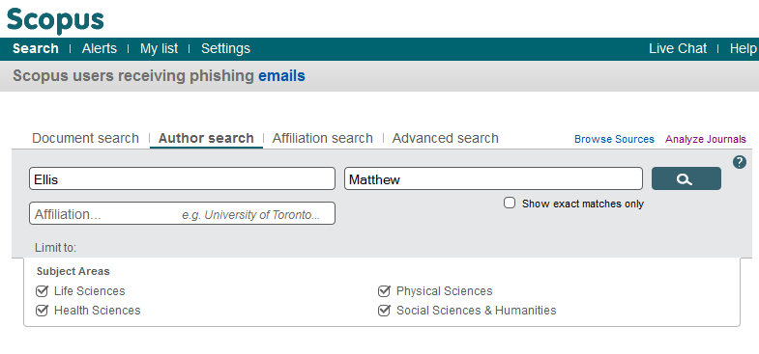
Author name variants
Establish presence
Use one name
  Use the same name variant consistently
  Check your name in Scopus or PubMed
Consistency enhances retrieval.
Notes:
If the name is a common name, consider adding your full middle name to distinguish it from other authors.

Slide 11
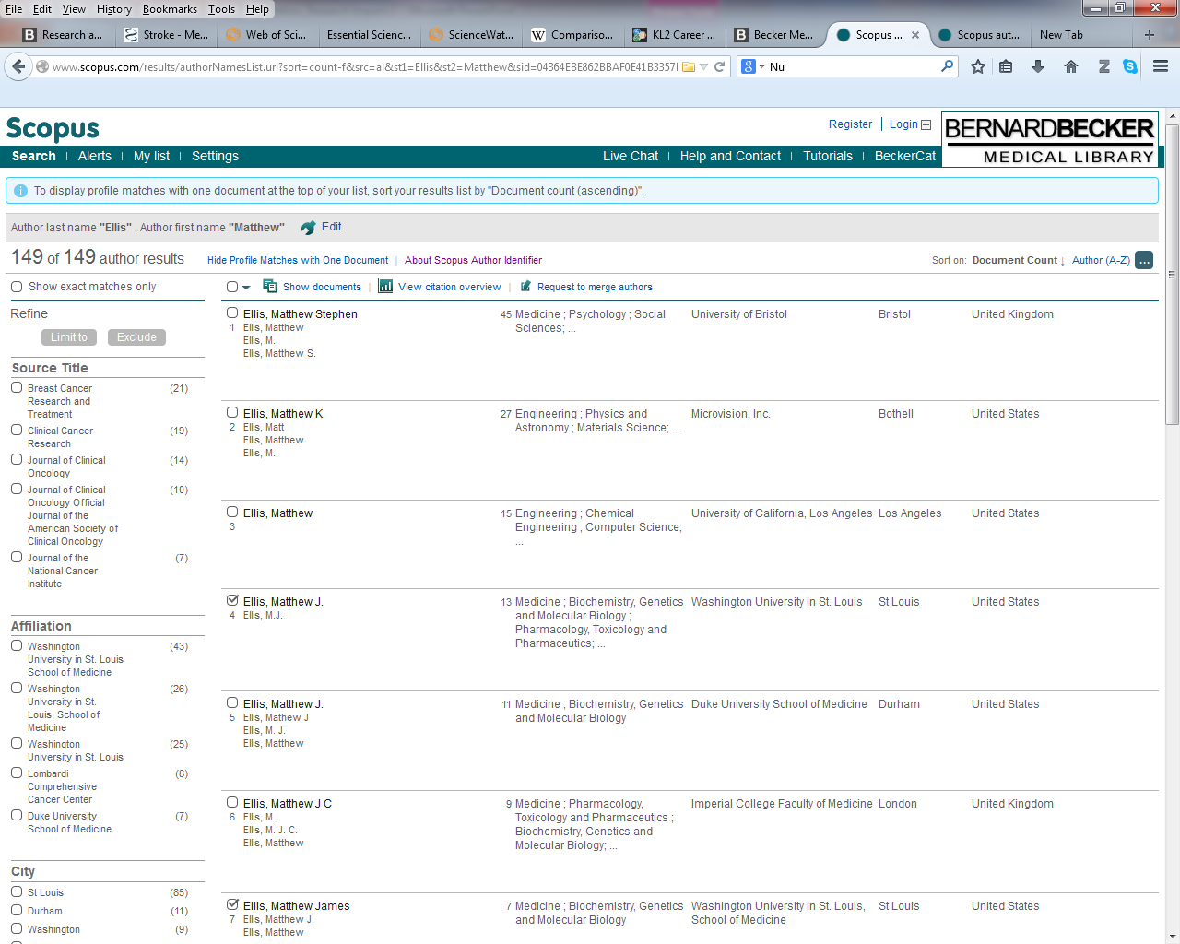
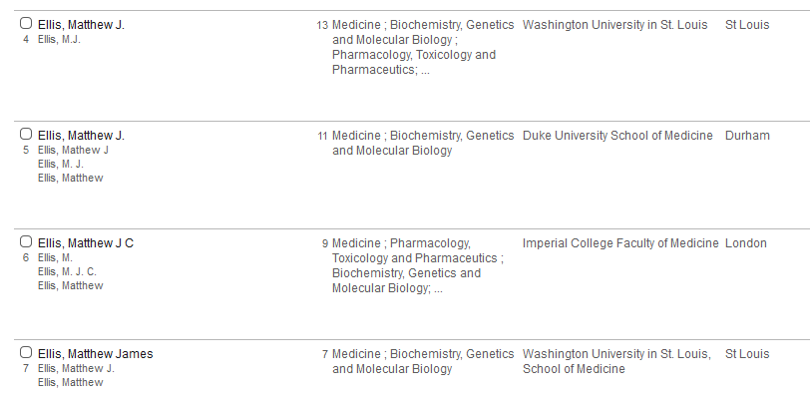
Author name variants
Establish presence
Use one name
  Use the same name variant consistently
  Check your name in Scopus or PubMed
Consistency enhances retrieval.
Notes:
If the name is a common name, consider adding your full middle name to distinguish it from other authors.

Slide 12
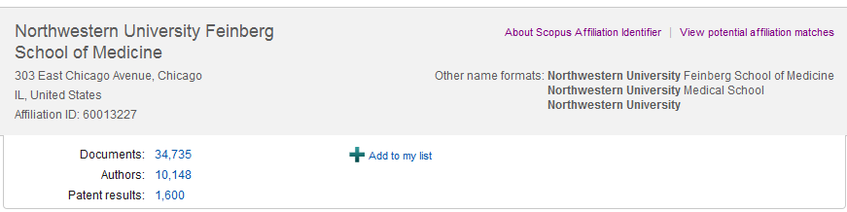
Confirm your affiliation
Establish presence
Use one name
  Official name: Northwestern University Feinberg School of Medicine
  Variant names:
      Northwestern University Medical School
      Northwestern University
Confirm affiliation
(above) screenshot of search for
AFFIL(Northwestern University )
in Elsevier’s Scopus database
Consistency enhances retrieval.
Notes:
If the name is a common name, consider adding your full middle name to distinguish it from other authors.

Slide 13
Example
Donald M Lloyd-Jones
Department of Preventive Medicine
Northwestern University Feinberg School of Medicine
680 North Lake Shore Drive, Suite 1400
Chicago, Illinois 60611
United States of America
D. Lloyd-Jones
Dept. of Prev. Med.
NU FSM
680 N. Lake Shore Dr.
Chicago, IL
USE THIS
NOT THIS
Notes:
If the name is a common name, consider adding your full middle name to distinguish it from other authors.

Slide 14

Corporate Authorship
Establish presence
Use one name
  To help in tracking, consider adding as a corporate author the name of the:
      research study
      center or institute
      division or program
Confirm affiliation
Corporate Author
  Authorship in Medline includes:
    Personal Author Names, search [au]
    Group (Corporate) Authorship, search [cn]
    Collaborator Names, search [ir]
    See here for more information.
  Clinical trials and scientific research teams are already using the corporate author concept
    The Ocular Hypertension Treatment Study Group
    See corporate author in PubMed
Consistency enhances retrieval.
Notes:
"Corporate body credited with authorship of a published work. A Corporate Body is a group of persons identified by name which acts as a single entity. Corporate bodies include associations, conferences, institutions, business firms, and government agencies." (http://www.ben.edu/library/help/glossary.htm)

Slide 15

Register for ORCiD ID
Establish presence
Use one name
  The Open Researcher and Contributor ID (ORCiD) is an open source, non-profit, community-based effort to maintain a registry of unique identifiers numbers for authors/investigators.
  ORCiD provides a persistent digital identifier and a unique identifier number for authors/investigators.
Confirm affiliation
Corporate Author
Register for ORCiD
Used by:
  Databases
  (Scopus, PubMed, Web of Science, etc.)
  Publishing Platforms
  (ScholarONE)
  Funding Agencies
  (NIH, CERN, etc. )
  and more…
Two easy steps
  Register for an ID: https://orcid.org/register
  Automatically add publications to ORCiD profile using Scopus or Web of Science
Notes:
Register for an ORCID iD and curate your ORCID record with your scholarly contributions. ORCID identifiers provide you a way to differentiate yourself and highlight your professional activities.
What is ORCID?
ORCID provides a persistent digital identifier that distinguishes you from every other researcher and, through integration in key research workflows such as manuscript and grant submission, supports automated linkages between you and your professional activities ensuring that your work is recognized.
Why do you want an ORCID iD?
Include your ORCID identifier on your Webpage, when you submit publications, apply for grants, and in any research workflow to ensure you get credit for your work.
View the ORCID integration information to see how you can use your ORCID iD
Current integrations http://orcid.org/organizations/integrators/current
Planned/in-progress work
http://orcid.org/organizations/integrators/integration-chart

Slide 16




Complete Author Profiles
Establish presence
Use one name
  Researcher ID ( from Thomson Reuters)
  Scopus author ID
  ORCID
  Google Scholar
  Linked In
Confirm affiliation
Corporate Author
Register for ORCiD
Complete author profiles
Notes:
If the name is a common name, consider adding your full middle name to distinguish it from other authors.

Slide 17
Strategies for enhancing research impact
Enhancing the discovery of your work

Slide 18
Search Engine Optimization
Enhance discovery
Optimize for searching
  Search Engine Optimization is the process of identifying factors which impact search engine accessibility
  Consider publishing your works in journals index by PubMed
    Indexing increases discoverability
    PubMed is crawled by Google and Google Scholar
  Consider the text of your title and abstract
Notes:
Academic Search Engine Optimization (ASEO): Optimizing Scholarly Literature for Google Scholar and CO.
http://www.sciplore.org/publications/2010-ASEO--preprint.pdf
In Google Scholar, the most important factors are relevance, citation count, author name(s), and name of publication.
Once the keywords are chosen, they need to be mentioned in the right places: in the title, and as often as possible in the abstract and the body of the text (but, of course, not so often as to annoy readers). Although in general titles should be fairly short, we suggest choosing a longer title if there are many relevant keywords.
[ASEO] is about helping academic search engines to understand the content of research papers and, thus, about how to make this content more widely and easily available.
Search Engine Optimization and Your Journal Article: Do you want the bad news first?
So what do you need to do? We’ve created an SEO for Authors tips sheet to give authors an at-a-glance guide to optimizing their papers. Here are some highlights:
Carefully select relevant keywords
Lead with keywords in the article title
Repeat keywords 3-4 times throughout the abstract
Use headings throughout the article
Include at least 5 keywords and synonyms in the keyword field
Link to the published article on social media, blogs and academic websites
from : http://exchanges.wiley.com/blog/2013/07/23/search-engine-optimization-and-your-journal-article-do-you-want-the-bad-news-first/

Slide 19
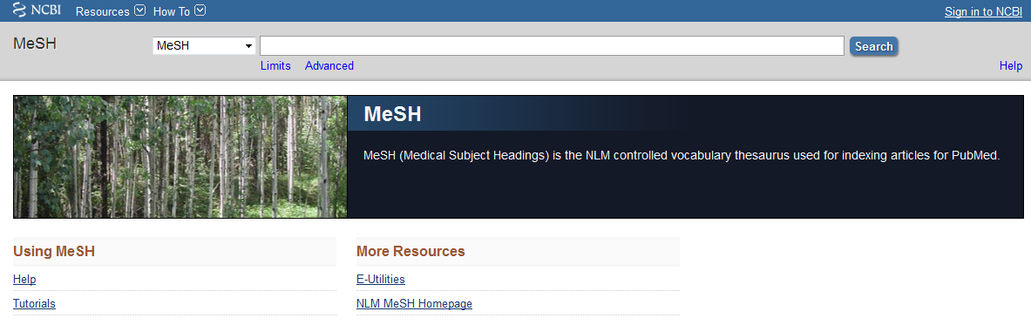
Well-constructed titles
Enhance discovery
Optimize for searching through:
  Avoid punctuation marks : ; & / ?
  Use a clear, descriptive title
  Avoid humorous titles
  Reiterate phrases or words from abstract
  Use subject-specific acronyms
  Search for words of your title in “controlled vocabularies” such as PubMed’s Medical Subject Headings (MeSH)
Well-constructed titles
Notes:
8 tips for journal article titles
Write a title using keywords that will echo throughout the manuscript—its primary concepts and variables, its headings and subheadings, and its tables and figures.
Write a title that triages the manuscript for readers wanting research or clinical focus or a highly relevant methodology.
Follow the specific instructions of the appropriate style manual.
Search for the words of your title in the “controlled vocabularies” of the major indexes, i.e., the Subject Headings in CINAHL and Keywords in MeSH, to confirm whether a reader's search will likely retrieve your title as relevant.
Write a series of possible titles based on the taxonomy of title types listed above, analyzing how each may function in the community of discourse.
If tempted by a colon or gerund, re-write the title without these elements to see whether some crucial information is lost.
Identify the population and place in the title.
Make every word in the title work hard.
From: Hays JC. Eight Recommendations for Writing Titles of Scientific Manuscripts. Public Health Nursing. 2010;27(2):101-103. doi:10.1111/j.1525-1446.2010.00832.x. (http://onlinelibrary.wiley.com/doi/10.1111/j.1525-1446.2010.00832.x/full)
Google Scholar focuses strongly on document titles. Documents containing the search term in the title are likely to be positioned near the top of the results list. Google Scholar also seems to consider the length of a title: In a search for the term 'SEO,' a document titled 'SEO: An Overview' would be ranked higher than one titled 'Search Engine Optimization (SEO): A Literature Survey of the Current State of the Art.‘
From: Beel J, Gipp B, Eilde E. Academic Search Engine Optimization (ASEO): Optimizing Scholarly Literature for Google Scholar & Co. Journal of Scholarly Publishing. 2010;41(2):176-190. doi:10.1353/scp.0.0082. (http://muse.jhu.edu/journals/journal_of_scholarly_publishing/v041/41.2.beel.html)
Also see:
Demner-Fushman D, Hauser S, Thoma G. The Role of Title, Metadata and Abstract in Identifying Clinically Relevant Journal Articles. AMIA Annu Symp Proc. 2005;2005:191-195. (http://www.ncbi.nlm.nih.gov/pmc/articles/PMC1560462/)
Example of unclear or humorous title: Spitz DJ, Spitz WU. Killer pop machines. J Forensic Sci. 1990;35(2):490-492.

Slide 20
Robust Abstracts
Enhance discovery
Optimize for searching through:
  Use Medical Subject Heading (MeSH) terms and natural language keywords
  Repeat significant keywords or descriptive phrases several times
  Include relevant unique identifiers or accession numbers linking to information on entities (genes, proteins, disease, etc.) or structures deposited in public databases
Well-constructed titles
Robust abstracts
Contact Galter Library for assistance with MeSH terms.
Notes:
Reiterate 4-5 keywords throughout abstract and text of article.
ICMJE International Committee of Medical Journal Editors Recommendations for Abstracts
Clinical trial abstracts should include items that the CONSORT group has identified as essential.
Funding sources should be listed separately after the Abstract to facilitate proper display and indexing for search retrieval by MEDLINE.
The ICMJE recommends that journals publish the clinical trial registration number at the end of the abstract.
(from http://www.icmje.org/recommendations/browse/manuscript-preparation/preparing-for-submission.html#b)
“Generally speaking, the more often a search term occurs in the document, and the more important the document field is in which the term occurs, the more relevant the document is considered.¹³ This means that an occurrence in the title is weighted more heavily than an occurrence in the abstract, which carries more weight than an occurrence in a (sub)heading, than in the body text, and so on.”
From: Beel J, Gipp B, Eilde E. Academic Search Engine Optimization (ASEO): Optimizing Scholarly Literature for Google Scholar & Co. Journal of Scholarly Publishing. 2010;41(2):176-190. doi:10.1353/scp.0.0082. (http://muse.jhu.edu/journals/journal_of_scholarly_publishing/v041/41.2.beel.html)
Medical Subject Headings (MeSH®)
The Thesaurus
MeSH is the National Library of Medicine's controlled vocabulary thesaurus. It consists of sets of terms naming descriptors in a hierarchical structure that permits searching at various levels of specificity.
MeSH descriptors are arranged in both an alphabetic and a hierarchical structure. At the most general level of the hierarchical structure are very broad headings such as "Anatomy" or "Mental Disorders." More specific headings are found at more narrow levels of the eleven-level hierarchy, such as "Ankle" and "Conduct Disorder." There are 25,186 descriptors in 2009 MeSH. There are also over 160,000 entry terms that assist in finding the most appropriate MeSH Heading, for example, "Vitamin C" is an entry term to "Ascorbic Acid." In addition to these headings, there are more than 180,000 headings called Supplementary Concept Records (formerly Supplementary Chemical Records) within a separate thesaurus.
MeSH Applications
The MeSH thesaurus is used by NLM for indexing articles from 5,200 of the world's leading biomedical journals for the MEDLINE/PubMED® database. It is also used for the NLM-produced database that includes cataloging of books, documents, and audiovisuals acquired by the Library. Each bibliographic reference is associated with a set of MeSH terms that describe the content of the item. Similarly, search queries use MeSH vocabulary to find items on a desired topic.
Author Keywords in Biomedical Journal Articles
Typically, authors are asked to choose a small number of keywords, without reference to a controlled vocabulary; whereas indexers are trained to select indexing terms from MeSH according to a specific protocol.
Information retrieval via a search engine relies on the representation of meaning in texts such as user queries and document content.
From: http://www.ncbi.nlm.nih.gov/pmc/articles/PMC3041277/
Search Engine Optimization and Your Journal Article: Do you want the bad news first?
So what do you need to do? We’ve created an SEO for Authors tips sheet to give authors an at-a-glance guide to optimizing their papers. Here are some highlights:
Carefully select relevant keywords
Lead with keywords in the article title
Repeat keywords 3-4 times throughout the abstract
Use headings throughout the article
Include at least 5 keywords and synonyms in the keyword field
Link to the published article on social media, blogs and academic websites
From : http://exchanges.wiley.com/blog/2013/07/23/search-engine-optimization-and-your-journal-article-do-you-want-the-bad-news-first/

Slide 21
Example
Poorly Optimized Abstract
Well-Optimized Abstract
Differential Glutamate Dehydrogenase Activity Profile in Patients with TLE
Summary: Purpose: Pathophysiologic mechanisms underlying TLE are still poorly understood. One major hypothesis links alterations in energy metabolism to glutamate excitotoxicity associated with seizures in TLE. The purpose of this study was to determine whether changes in the activities of enzymes critical in energy and neurotransmitter metabolism contributed to the alterations in metabolic status leading to the excitotoxic effects of glutamate.
Methods: Activities of four key enzymes involved in energy metabolism and glutamate cycling in the brain [aspartate aminotransferase (AAT), citrate synthase (CS), glutamate dehydrogenase (GDH), and lactate dehydrogenase (LDH)] were measured in anterolateral temporal neocortical and hippocampal tissues obtained from three different groups of medically intractable epilepsy patients having either MTLE, PTLE, or MaTLE, respectively.
Results: We found that activity was significantly decreased in the temporal cortex mainly in the MTLE group. A similar trend was recognized in the hippocampus of the MTLE. In all three patient groups, this activity was considerably lower, and AAT and LDH activities were higher in cortex of MTLE as compared with the corresponding activities in hippocampus (p < 0.05). In the MTLE cortex and hippocampus, GDH activities were negatively correlated with the duration since the first intractable seizure.
Conclusions: Our results support the hypothesis suggesting major alteration in activity mainly in the MTLE group. It is proposed that significant alterations in the enzyme activities may be contributing to decreased metabolism of glutamate, leading to its accumulation
Differential Glutamate Dehydrogenase (GDH) Activity Profile in Patients with Temporal Lobe Epilepsy
Summary: Purpose: Pathophysiologic mechanisms underlying temporal lobe epilepsy (TLE) are still poorly understood. One major hypothesis links alterations in energy metabolism to glutamate excitotoxicity associated with seizures in TLE. The purpose of this study was to determine whether changes in the activities of enzymes critical in energy and neurotransmitter metabolism contributed to the alterations in metabolic status leading to the excitotoxic effects of glutamate.
Methods: Activities of four key enzymes involved in energy metabolism and glutamate cycling in the brain [aspartate aminotransferase (AAT), citrate synthase (CS), glutamate dehydrogenase (GDH), and lactate dehydrogenase (LDH)] were measured in anterolateral temporal neocortical and hippocampal tissues obtained from three different groups of medically intractable epilepsy patients having either mesial, paradoxical, or mass lesionassociated temporal lobe epilepsy (MTLE, PTLE, MaTLE), respectively.
Results: We found that GDH activity was significantly decreased in the temporal cortex mainly in the MTLE group. A similar trend was recognized in the hippocampus of the MTLE. In all three patient groups, GDH activity was considerably lower, and AAT and LDH activities were higher in cortex of MTLE as compared with the corresponding activities in hippocampus (p < 0.05). In the MTLE cortex and hippocampus, GDH activities were negatively correlated with the duration since the first intractable seizure.
Conclusions: Our results support the hypothesis suggesting major alteration in GDH activity mainly in the MTLE group. It is proposed that significant alterations in the enzyme activities may be contributing to decreased metabolism of glutamate, leading to its accumulation.
This abstract appears on the first page of results in Google for GDH+epilepsy.
Notes:
Academic Search Engine Optimization (ASEO): Optimizing Scholarly Literature for Google Scholar and CO.
http://www.sciplore.org/publications/2010-ASEO--preprint.pdf
In Google Scholar, the most important factors are relevance, citation count, author name(s), and name of publication.
Once the keywords are chosen, they need to be mentioned in the right places: in the title, and as often as possible in the abstract and the body of the text (but, of course, not so often as to annoy readers). Although in general titles should be fairly short, we suggest choosing a longer title if there are many relevant keywords.
[ASEO] is about helping academic search engines to understand the content of research papers and, thus, about how to make this content more widely and easily available.
Search Engine Optimization and Your Journal Article: Do you want the bad news first?
So what do you need to do? We’ve created an SEO for Authors tips sheet to give authors an at-a-glance guide to optimizing their papers. Here are some highlights:
Carefully select relevant keywords
Lead with keywords in the article title
Repeat keywords 3-4 times throughout the abstract
Use headings throughout the article
Include at least 5 keywords and synonyms in the keyword field
Link to the published article on social media, blogs and academic websites
from : http://exchanges.wiley.com/blog/2013/07/23/search-engine-optimization-and-your-journal-article-do-you-want-the-bad-news-first/

Slide 22
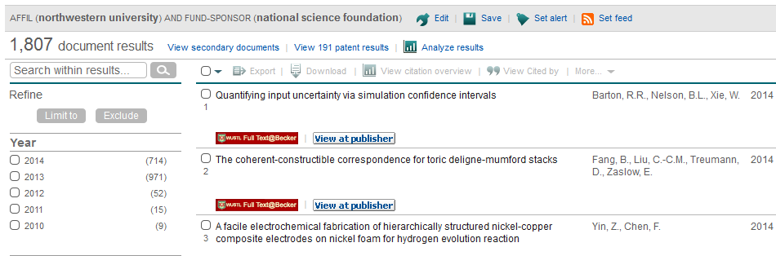
Acknowledge Grant Funding
Enhance discovery
Optimize for searching through:
  Allows for greater discoverability of works generated by grant support
  Good practice for Responsible Conduct of Research
  Required by funding agencies
Well-constructed titles
Robust abstracts
Acknowledge funding
(above) screenshot of search for
AFFIL(Northwestern University) AND FUND-SPONSOR (National Science Foundation)
from Elsevier’s Scopus database
Notes:
Reiterate 4-5 keywords throughout abstract and text of article.
ICMJE International Committee of Medical Journal Editors Recommendations for Abstracts
Clinical trial abstracts should include items that the CONSORT group has identified as essential.
Funding sources should be listed separately after the Abstract to facilitate proper display and indexing for search retrieval by MEDLINE.
The ICMJE recommends that journals publish the clinical trial registration number at the end of the abstract.
(from http://www.icmje.org/recommendations/browse/manuscript-preparation/preparing-for-submission.html#b)
“Generally speaking, the more often a search term occurs in the document, and the more important the document field is in which the term occurs, the more relevant the document is considered.¹³ This means that an occurrence in the title is weighted more heavily than an occurrence in the abstract, which carries more weight than an occurrence in a (sub)heading, than in the body text, and so on.”
From: Beel J, Gipp B, Eilde E. Academic Search Engine Optimization (ASEO): Optimizing Scholarly Literature for Google Scholar & Co. Journal of Scholarly Publishing. 2010;41(2):176-190. doi:10.1353/scp.0.0082. (http://muse.jhu.edu/journals/journal_of_scholarly_publishing/v041/41.2.beel.html)
Medical Subject Headings (MeSH®)
The Thesaurus
MeSH is the National Library of Medicine's controlled vocabulary thesaurus. It consists of sets of terms naming descriptors in a hierarchical structure that permits searching at various levels of specificity.
MeSH descriptors are arranged in both an alphabetic and a hierarchical structure. At the most general level of the hierarchical structure are very broad headings such as "Anatomy" or "Mental Disorders." More specific headings are found at more narrow levels of the eleven-level hierarchy, such as "Ankle" and "Conduct Disorder." There are 25,186 descriptors in 2009 MeSH. There are also over 160,000 entry terms that assist in finding the most appropriate MeSH Heading, for example, "Vitamin C" is an entry term to "Ascorbic Acid." In addition to these headings, there are more than 180,000 headings called Supplementary Concept Records (formerly Supplementary Chemical Records) within a separate thesaurus.
MeSH Applications
The MeSH thesaurus is used by NLM for indexing articles from 5,200 of the world's leading biomedical journals for the MEDLINE/PubMED® database. It is also used for the NLM-produced database that includes cataloging of books, documents, and audiovisuals acquired by the Library. Each bibliographic reference is associated with a set of MeSH terms that describe the content of the item. Similarly, search queries use MeSH vocabulary to find items on a desired topic.
Author Keywords in Biomedical Journal Articles
Typically, authors are asked to choose a small number of keywords, without reference to a controlled vocabulary; whereas indexers are trained to select indexing terms from MeSH according to a specific protocol.
Information retrieval via a search engine relies on the representation of meaning in texts such as user queries and document content.
From: http://www.ncbi.nlm.nih.gov/pmc/articles/PMC3041277/
Search Engine Optimization and Your Journal Article: Do you want the bad news first?
So what do you need to do? We’ve created an SEO for Authors tips sheet to give authors an at-a-glance guide to optimizing their papers. Here are some highlights:
Carefully select relevant keywords
Lead with keywords in the article title
Repeat keywords 3-4 times throughout the abstract
Use headings throughout the article
Include at least 5 keywords and synonyms in the keyword field
Link to the published article on social media, blogs and academic websites
From : http://exchanges.wiley.com/blog/2013/07/23/search-engine-optimization-and-your-journal-article-do-you-want-the-bad-news-first/

Slide 23

Follow Reporting Guidelines
Enhance discovery
Optimize for searching through:
  Equator network maintains a library for health research reporting
Well-constructed titles
Robust abstracts
Acknowledge funding
CONSORT Consolidated Standards of Reporting Trials
STROBE Strengthening the Reporting of Observational studies in Epidemiology
PRISMA Preferred Reporting Items for Systematic Reviews and Meta-Analyses
STARD Standards for Reporting Studies of Diagnostic Accuracy
COREQ Consolidated criteria for reporting Qualitative Research
ENTREQ Enhancing transparency in reporting the synthesis of qualitative research
SQUIRE Publication guidelines for quality improvement in health care
CHEERS Consolidated Health Economic Evaluation Reporting Standards
CARE Consensus-based Clinical Case Reporting Guidelines Development
SAMPL Basic Statistical Reporting for Articles Published in Biomedical Journals
Follow reporting guidelines
(above) List of reporting guidelines from http://www.equator-network.org/
Notes:
Reporting guidelines
MECIR - Methodological Expectations of Cochrane Intervention Reviews
Equator Network - Enhancing the QUAlity and Transparency Of health Research
The EQUATOR Network maintains the Library for health research reporting providing direct links to the following key reporting guidelines, also including their bibliographic references, lists of all relevant literature, and links to all available translations.
http://www.cochrane.org/about-us/evidence-based-health-care/webliography/books/reporting

Slide 24
Strategies for enhancing research impact
Increase the dissemination of your work

Slide 25

Increase Dissemination
Increase dissemination
Participate
Present
Be active: participate, present, and share
  Join professional organizations
  Participate in committees
  Volunteer for conference activities
  Teach CE courses
  Serve as a reviewer for a journal
  Serve on IRBs
  Build relationships with policy-makers and grant funding officials
  Professional conferences
  Meetings
  Department seminars
  Journal clubs
  Outreach events for the general public
http://www.icts.wustl.edu/mm/images/mainhome_posterday.jpg
Notes:
Take every opportunity to present your work at meetings, department seminars, journal clubs and events for the general public.
How to find a conference:
EurekAlert! Meeting Calendar
Web of Conferences
Conference Alerts

Slide 26



Increase Dissemination
Increase dissemination
Share
Be active: participate, present, and share
  Submit manuscript to Northwestern Medicine institutional repository:
  DigitalHub
  digitalhub.northwestern.edu
  Save your final, peer-reviewed manuscript
  Deposit research data in appropriate repository
  Other options for sharing include:
    Slideshare: http://www.slideshare.net
    Figshare: http://www.figshare.com
    Dryad: http://datadryad.org
Notes:
Share your research data
Deposit research data in appropriate repositories such as GenBank or GEO at NCBI or with publishers of journals who are willing to post the data.
Sharing of research data can lead to more rapid analysis and identification of genetic contributions to diseases and medical conditions.
Submit the manuscript to a digital subject repository such as arXiv, bioRxiv, or to the Northwestern Medicine’s institutional repository, DigitalHub.

Slide 27


Example
Notes:
Open Access publishers include BioMed Central andPLoS
For a listing of Open Access Journals, see the Directory of Open Access Journals (DOAJ)

Slide 28


Increase Dissemination
Increase dissemination
Share
Be active: participate, present, and share
  Start a blog and write about:
    Research findings
    Questions about your area of research
    Comments on publications by other authors
    Recap of conferences attended
  Partner with the library or other organization to create podcasts or videos
  Remember, research outputs are not confined to text and figures
Notes:
Research Blogging: Do you write about peer-reviewed research in your blog? Use ResearchBlogging.org to make it easy for your readers — and others from around the world — to find your serious posts about academic research. If you don't have a blog, you can still use our site to learn about fascinating developments in cutting-edge research from around the world. (http://researchblogging.org/post-list/list/date/all)

Slide 29

Example
News articles
Press releases
Citing articles
Events
Blog for announcements
“About” information
Contact information

Slide 30



Increase Dissemination
Increase dissemination
Share
Be active: participate, present, and share
  Consider writing about your research in a trade publication to reach:
    Clinicians
    Consumers
    Policy-makers
    Industry

Slide 31

Consider Open Access
Increase dissemination
  Open access (OA) publications are:
  free to readers
  do not have as many copyright restrictions on their use as traditional publications
  OA publications generally:
  receive higher visibility
  generate more citations
  allow authors to retain copyrights
Be active: participate, present, and share
Consider Open Access
  Resources:
    Northwestern Open Access Fund
    http://libguides.northwestern.edu/oafund
    Directory of Open Access Journals (DOAJ)
    http://www.joaj.org/
Notes:
“Hence the OA Advantage is real, independent and causal. It is indeed true that the size of the advantage is correlated with quality, just as citations themselves are correlated with quality (the top 20% of articles receiving about 80% of all citations); but we infer that the real cause of the higher OA advantage for the more citable articles is not a quality bias from author self-selection but the quality advantage of the more citable articles, an advantage that OA enhances by maximizing accessibility, and thereby also citability. On a playing field leveled by OA, users can selectively access, use and cite those articles that they judge to be of the highest relevance and quality, no longer constrained by their accessibility.”
Gargouri Y, Hajjem C, Larivière V, et al. Self-Selected or Mandated, Open Access Increases Citation Impact for Higher Quality Research. PLoS ONE. 2010;5(10):e13636. doi:10.1371/journal.pone.0013636. (http://www.plosone.org/article/info%3Adoi%2F10.1371%2Fjournal.pone.0013636)
Is an open access work protected by copyright?
Yes. An author can retain any or all copyrights (reproduce, distribute, publicly display and perform work) in his or her work in an open access publication, by using a Creative Commons license or negotiating rights directly with the publisher.
Are open access publications peer-reviewed?
Many, though not all, open access publications are peer reviewed. Authors should always check with the journal publisher.
How is open access publishing funded?
Open access publishing is funded in a number of ways, such as foundation grants, individual gifts, annual institutional memberships, article processing and author page charges, tax payer support, and in some cases a combination of several of these means. Faculty and students can designate amounts from research grants to cover relevant publication fees.
From Northwestern University Open Access week 2013 (http://www.library.northwestern.edu/openaccess)
Northwestern University Library is initiating and will manage this pilot open access fund during the 2013-2014 academic year to support and promote gold open access publishing of articles by Northwestern authors. The gold open access model allows for freely available access to an online article immediately upon publication. The pilot policy also stipulates that there be no embargo on any part of the content. The pilot has modest funding to pay for article processing costs so that the article may be published as gold open access. The funding is available for authors who do not have other sources of funding to cover publications costs, such as research grants. There are limits on the amount and frequency of fund support.
From Northwestern Open Access Fund (http://libguides.northwestern.edu/oafund)
DOAJ is an online directory that indexes and provides access to quality open access, peer-reviewed journals.

Slide 32


Consider Copyright – know your rights
Increase dissemination
  Academic authors have various tools to negotiate with publishers to retain the rights they may need after their work is published
  Committee on Institutional Cooperation (CIC) Provosts have approved a copyright addendum (of which NU is a member)
    http://www.cic.net/projects/library/scholarly-communication/introduction
  SPARC Copyright Addendum
    http://www.sparc.arl.org/sites/default/files/Access-Reuse_Addendum.pdf
Be active: participate, present, and share
Consider Open Access
Consider Copyright
  Creative Commons licenses allow a creator to simply identify the types of uses that are allowed and those that are prohibited.
  http://creativecommons.org/
For more information see NU Libraries Author Rights guide:
http://libguides.northwestern.edu/scholcomm/authorrights
Notes:
Retain rights to manuscripts that allow for maximum flexibility to re-use the work. Some rights include:
Post on an institutional website such as a laboratory or research study website
Post on an institutional or subject repository
Present the work at a meeting or conference
Distribute copies to colleagues
Include the work in a thesis or dissertation
Prepare derivative works
According to many standard publication agreements, all rights—including copyright—go to the journal. Signing a restrictive publication agreement can limit your scholarly universe and lessen your impact as an author.
(If the right to post a manuscript on an institutional or laboratory website cannot be obtained, create links to the manuscript from your website using the PMID from a PubMed citation or persistent URLs/DOIs that link directly to the publisher’s website. Check with the library staff of the affiliate organization for more information on how to create links to content)
SPARC®, the Scholarly Publishing and Academic Resources Coalition, is an international alliance of academic and research libraries working to create a more open system of scholarly communication. - See more at: http://www.sparc.arl.org/about#sthash.KbAkiCHT.dpuf

Slide 33


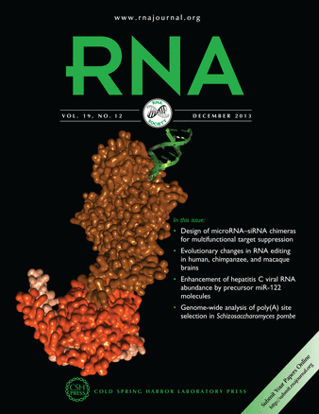
Choosing a journal
Increase dissemination
  Consider the desired audience when choosing a journal for publication.
  More specialized journals, even with a potentially smaller readership, may offer an author broader dissemination of relevant research results to their peers in their specific field of research.
  Publish your work in a journal currently indexed by PubMed.
  Citations in PubMed are crawled by Google Scholar. Google Scholar can help promote visibility and accessibility
Be active: participate, present, and share
Consider Open Access
Consider Copyright
Consider journal audience
Notes:
Topic-specific journals or journals published by a specialized society, such as RNA or Journal of Clinical Investigation, may disseminate research results more efficiently to a desired audience than general science journals, such as or Journal of the American Medical Association.

Slide 34
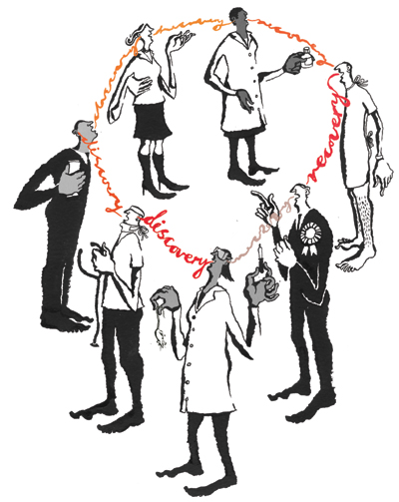
Consider description of translation
Increase dissemination
  Include a discussion of how your research could translate to clinical outcomes or technologies
  Could enhance the probability that the article will affect public policy and thus increase its impact.
Be active: participate, present, and share
Consider Open Access
Consider Copyright
Consider journal audience
Consider description of translation
Nature.com
Notes:
Publishing in the Psychological Sciences: Enhancing Journal Impact While Decreasing Author Fatigue
Emphasize translational implications, if any, of results. Impact of journal articles will be improved if they provide a direct line of reasoning for how findings might translate into useful information for real-world behaviors or technologies. This will enhance the probability that the article will affect public policy and thus increase its impact.
From: http://pps.sagepub.com/content/4/1/36.full
One study, “Translation of highly promising basic science research into clinical applications,” found that some form of industry involvement in the basic science publication was the strongest predictor of clinical experimentation, accelerating the process by about eightfold when an author had industry affiliations.
From: http://www.ncbi.nlm.nih.gov/pubmed/12731504

Slide 35
Strategies for enhancing research impact
Tell your story: documenting and reporting research impact

Slide 36
Curate your work
Tell your story
  Curate from Latin curare meaning "take care”
    Keep track of your author name and affiliation
    Keep your author profiles updated
    Use your ORCID iD
    Track your work
Curate your work
Notes:
Curator from Latin “curare” meaning “take care”. From Wikipedia, http://en.wikipedia.org/wiki/Curator
Put your best foot forward
Keep your profile data up to date and consistent across social networking sites aimed at scientists, researchers and/or physicians.
Some highly adopted institution-wide platforms include Northwestern Scholars
These institutional efforts leverage structured data about researchers to provide current and validated data which can be used to visualize your efforts and identify new collaborators.

Slide 37
Track your work
Tell your story
Why?
Curate your work
  To determine if findings are:
    properly attributed
    duplicated, improved, or repudiated
    extended
  Discover clinical applications or community benefits
  Identify similar research projects or collaborators
Track your work
Notes:
Curator from Latin “curare” meaning “take care”. From Wikipedia, http://en.wikipedia.org/wiki/Curator

Slide 38
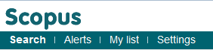
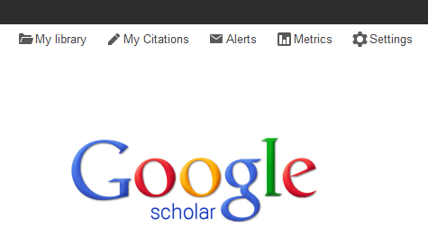
Track your work
Tell your story
Why?
Curate your work
  Set up alerts in:
    Scopus
    Google Scholar
    Web of Science
Track your work
Set up alerts
Notes:
Curator from Latin “curare” meaning “take care”. From Wikipedia, http://en.wikipedia.org/wiki/Curator

Slide 39
Track your work
Tell your story
Scholarly use
Curate your work
  Track the scholarly use of your work through:
    Number of citations (see Scopus example)
    Views online
    Downloads
Track your work
Set up alerts
Scholarly use
Notes:
Curator from Latin “curare” meaning “take care”. From Wikipedia, http://en.wikipedia.org/wiki/Curator

Slide 40
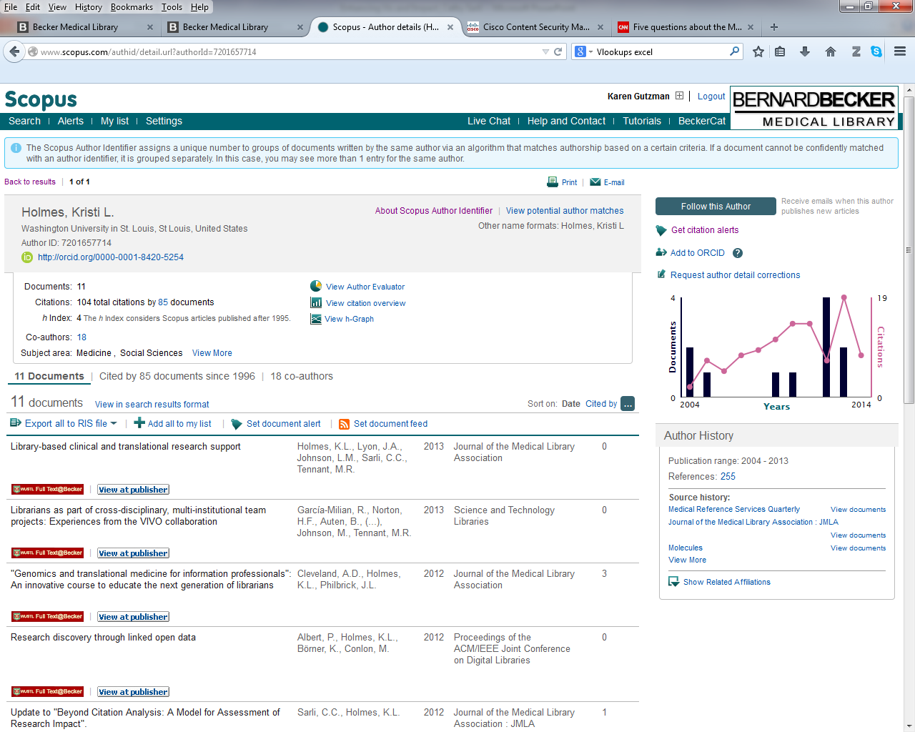
Track your work
Tell your story
Number of citations
Curate your work
Track your work
Set up alerts
Scholarly use
Notes:
Curator from Latin “curare” meaning “take care”. From Wikipedia, http://en.wikipedia.org/wiki/Curator

Slide 41
Track your work
Tell your story
Number of citations
Curate your work
Track your work
Set up alerts
Scholarly use
Notes:
Curator from Latin “curare” meaning “take care”. From Wikipedia, http://en.wikipedia.org/wiki/Curator

Slide 42
Track your work
Tell your story
Number of citations
Curate your work
Track your work
Set up alerts
Scholarly use
Notes:
Curator from Latin “curare” meaning “take care”. From Wikipedia, http://en.wikipedia.org/wiki/Curator

Slide 43




Track your work
Tell your story
Social engagement
Curate your work
  Track the social engagement of your work through:
    (also known as “altmetrics”)
    Bookmarks or Saves to online reference management systems such as Mendeley
    Mentions in social networking sites
    such as Twitter or Facebook
    Favorites in Slideshare,
    YouTube, or Figshare
Track your work
Set up alerts
Scholarly use
Social engagement
Notes:
Curator from Latin “curare” meaning “take care”. From Wikipedia, http://en.wikipedia.org/wiki/Curator

Slide 44

Track your work
Tell your story
Social engagement
Curate your work
  Track the social engagement of your work through:
    Recommendations in Figshare
    Discussions in blogs and media
    Comments or Annotations from
    readers on platforms such as
    PubMed Commons
Track your work
Set up alerts
Scholarly use
Social engagement
Notes:
Curator from Latin “curare” meaning “take care”. From Wikipedia, http://en.wikipedia.org/wiki/Curator

Slide 45



Track your work
Tell your story
Social engagement
Curate your work
  Platforms that help with this:
    Altmetric
      Consider the Altmetric Bookmarklet http://www.altmetric.com/bookmarklet.php
    Plum Analytics
      http://www.plumanalytics.com/
    Impact Story
      https://impactstory.org/
    among others…
Track your work
Set up alerts
Scholarly use
Social engagement
Notes:
Curator from Latin “curare” meaning “take care”. From Wikipedia, http://en.wikipedia.org/wiki/Curator

Slide 46
Use the numbers
Tell your story
One researcher, Dr. ABC
Curate your work
  Dr. ABC has published 210 works since 1993.
  Since 1993, Dr. ABC has co-authored 210 works with over 500 unique co-authors from over 100 institutions representing industry, academic and private affiliations including two group/corporate authors from eight countries.
  Dr. ABC is first author on 53 works; last author on 100 works and sole author on ten works. The articles have been published in nearly 60 unique journals representing 26 research areas such as hematology, pathology, toxicology, etc.
  As of 2008, over 40 unique funding agencies are noted in the acknowledgement sections of Dr. ABC’s publications
Track your work
Set up alerts
Scholarly use
Social engagement
Use the numbers
Data from Elsevier’s Scopus 7/2/2014
Notes:
Curator from Latin “curare” meaning “take care”. From Wikipedia, http://en.wikipedia.org/wiki/Curator

Slide 47
Use the numbers
Tell your story
One researcher, Dr. ABC
Curate your work
  Dr. ABC’s works have been cited 4,196 times.
  Dr. ABC’s 210 works have been cited 4,195 times by 2,620 works (1,618 articles; 666 reviews; 104 editorials; 87 letters; 66 conference papers; 53 notes, and 26 short surveys), and published in 21 different languages by authors from 72 countries.
  Dr. ABC’s most highly cited work (Medicine, 2010) has been cited 344 times, viewed 8,000 times by online readers with 6,200 full text downloads. In addition, the work has been referred to by the news media outlets 24 times; tweeted by 13 tweeters, world-wide; saved in 28 Mendeley accounts; and commented upon in eight different blogs and in PubMed Commons.
Track your work
Set up alerts
Scholarly use
Social engagement
Use the numbers
Data from Elsevier’s Scopus and Altmetrics bookmarklet 2014
Notes:
Curator from Latin “curare” meaning “take care”. From Wikipedia, http://en.wikipedia.org/wiki/Curator

Slide 48
Go beyond the numbers
Tell your story
  What is the real story?
    Contributions to the knowledge base
    Change in understanding of disease, disorder or condition
    Change in clinical practice
    Change in community health
    Change in public law or policy
  Why should we go beyond the numbers?
    Reporting of tangible and meaningful outcomes
    Demonstration of judicious use of taxpayer monies
    Allows funding bodies to reallocate resources for directions that are showing progress
    Inform the community of potential new health interventions
Curate your work
Track your work
Set up alerts
Scholarly use
Social engagement
Use the numbers
Go beyond the numbers
Notes:
Curator from Latin “curare” meaning “take care”. From Wikipedia, http://en.wikipedia.org/wiki/Curator

Slide 49
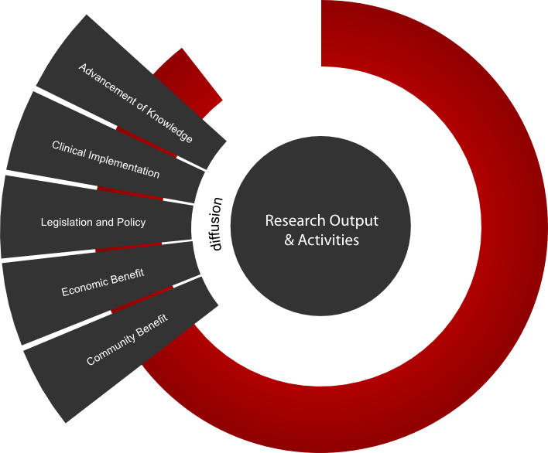
Measure what matters
Tell your story
  Becker Library Model for the Assessment of Research Impact
    Resources for finding a meaningful narrative of impact
    Assist you in locating indicators that demonstrate evidence of biomedical research impact
  Organized into the following pathways :
    Advancement of Knowledge
    Clinical Implementation
    Community Benefit
    Legislation and Policy
    Economic Benefit
Curate your work
Track your work
Set up alerts
Scholarly use
Social engagement
Use the numbers
Go beyond the numbers
Measure what matters
https://becker.wustl.edu/impact-assessment
Notes:
Becker Model
Provides a supplement to publication analysis to provide a more robust and comprehensive perspective of biomedical research impact.
reporting templates, glossary of resources and terms, examples of relevant indicators of impact across the research process, and readings
Straightforward framework for tracking diffusion of research outputs and activities to locate indicators that demonstrate evidence of biomedical research impact
individual, core, and institutional-level
Guidance for quantifying and documenting research impact as well as resources for locating evidence of impact.
Even more strategies for enhancing the impact of research.

Slide 50

Absurdum14. “Pathway." 23 Apr 2009. Online image.
Flickr. 20 Nov 2013. Available at http://goo.gl/PslmLh

Slide 51
Thank you!
Karen Gutzman
312-503-8121
karen.gutzman@northwestern.edu
Acknowledgements:
Content development assisted by Kristi Holmes and Cathy Sarli.

