Slide 1
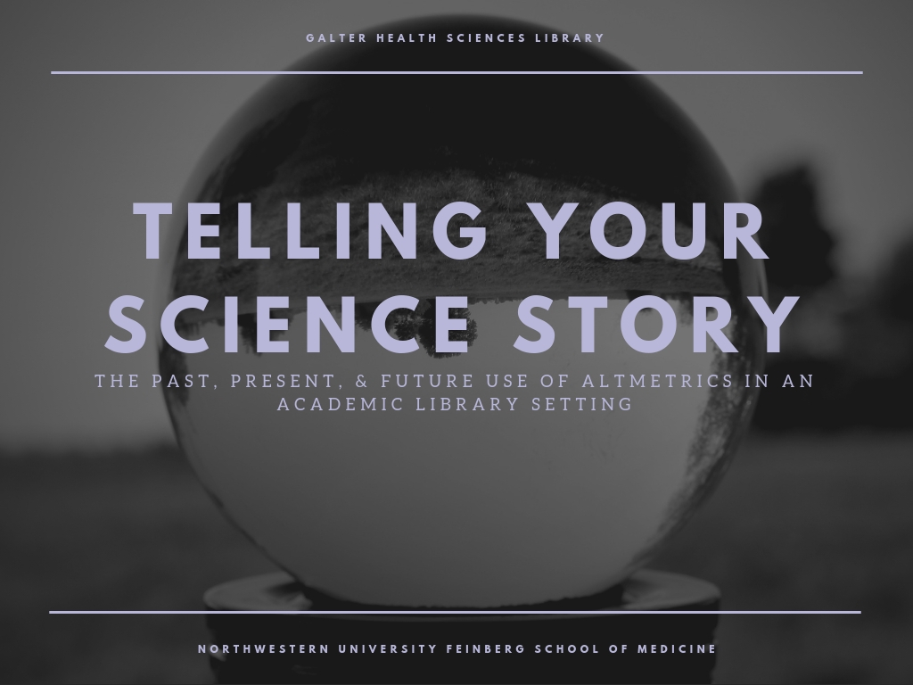
Patty Smith, MLIS
Research Impact Librarian
@psthelibrarian
Slides: http://bit.ly/5amSmith

Slide 2
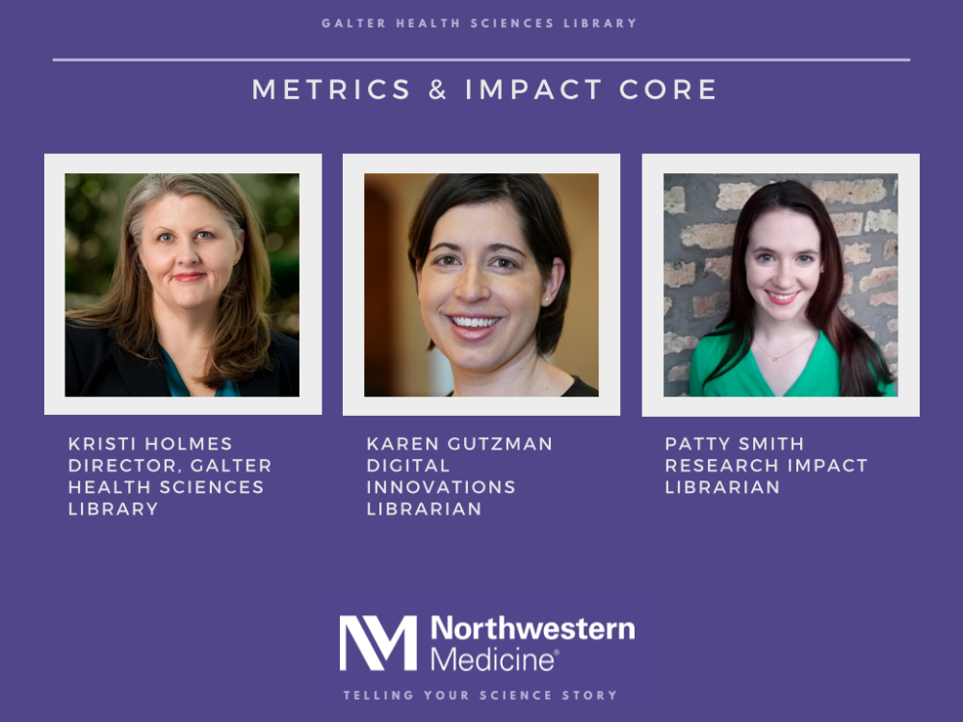

Slide 3
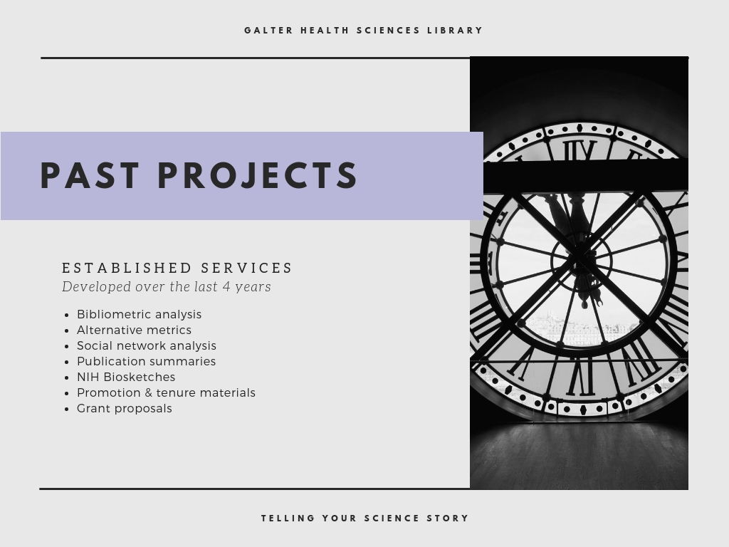

Slide 4
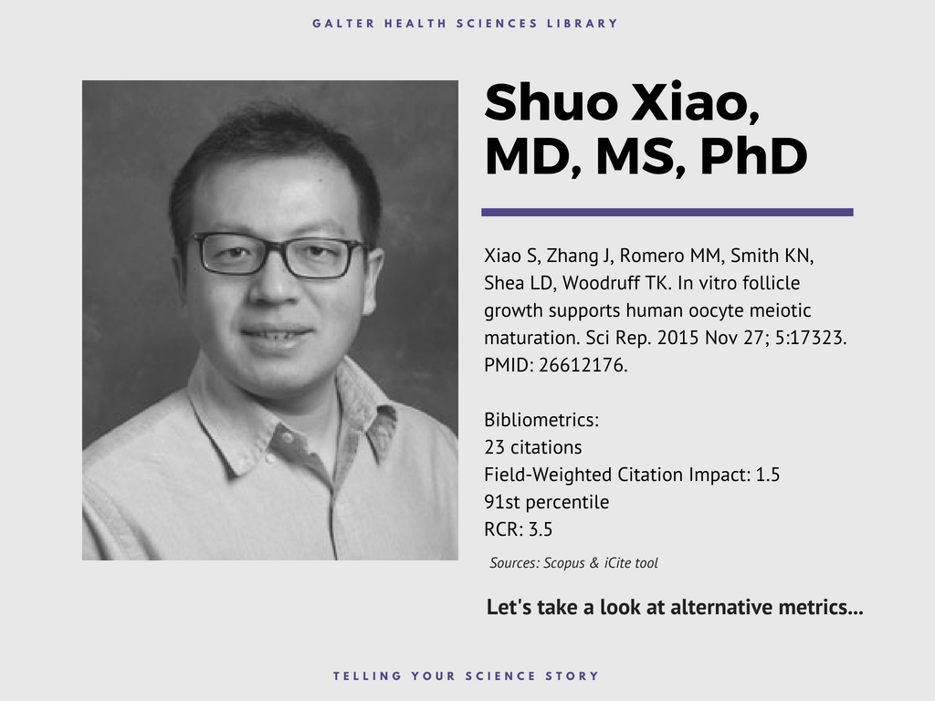

Slide 5


Slide 6
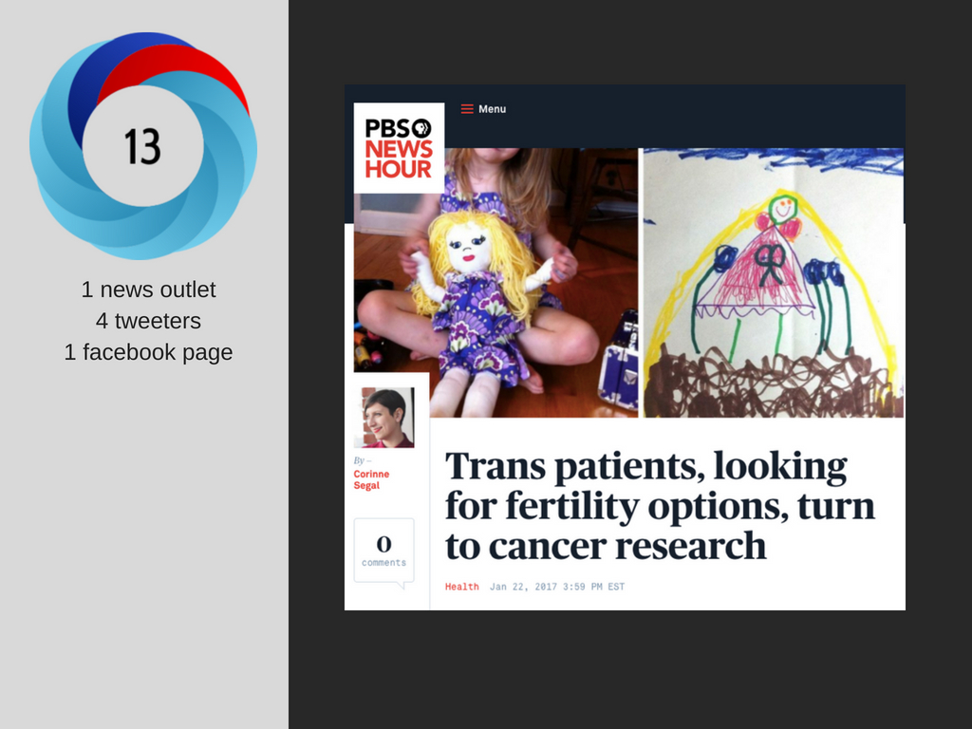

Slide 7
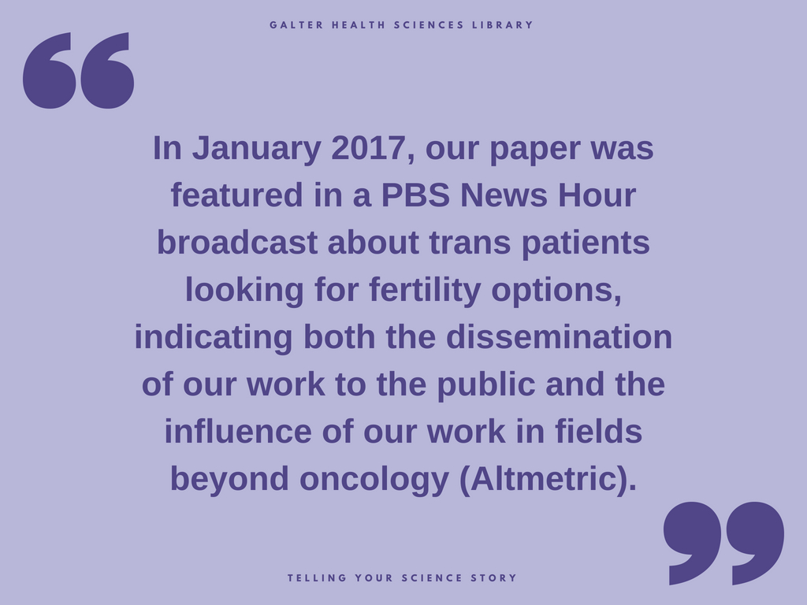

Slide 8
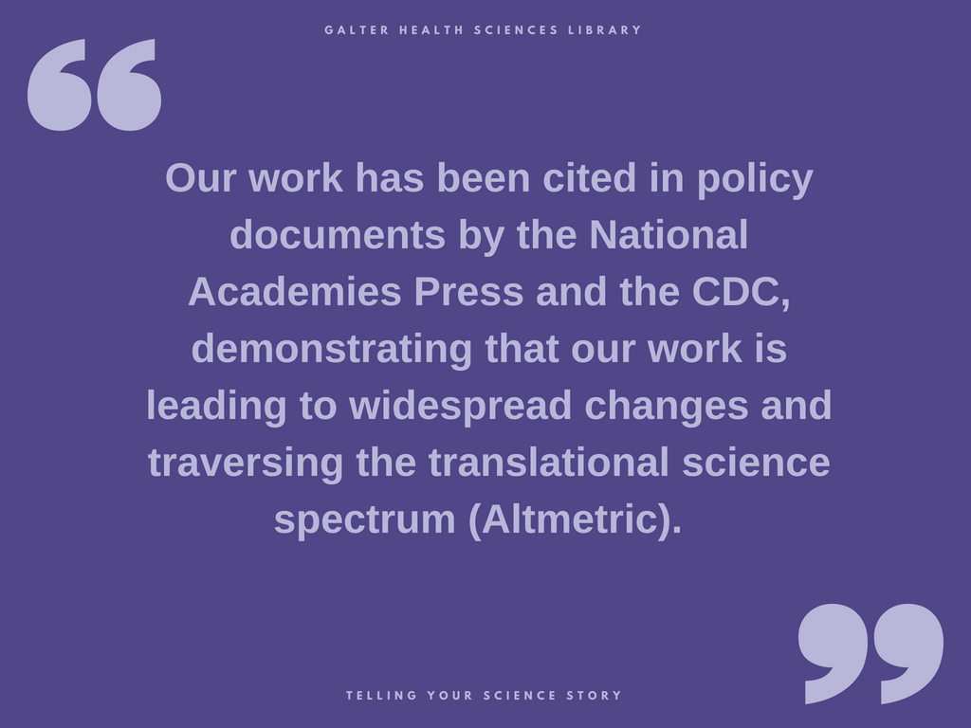

Slide 9
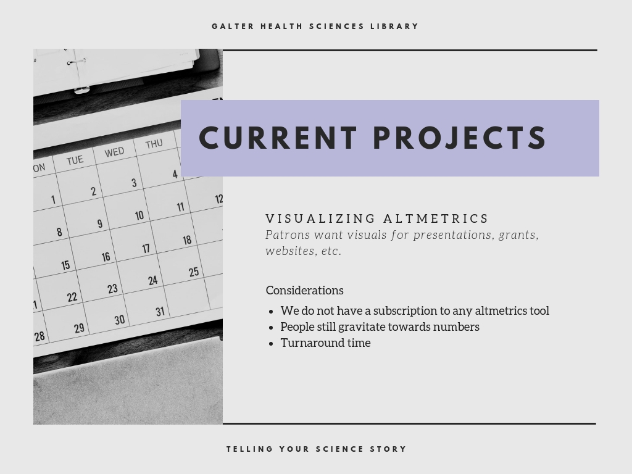

Slide 10
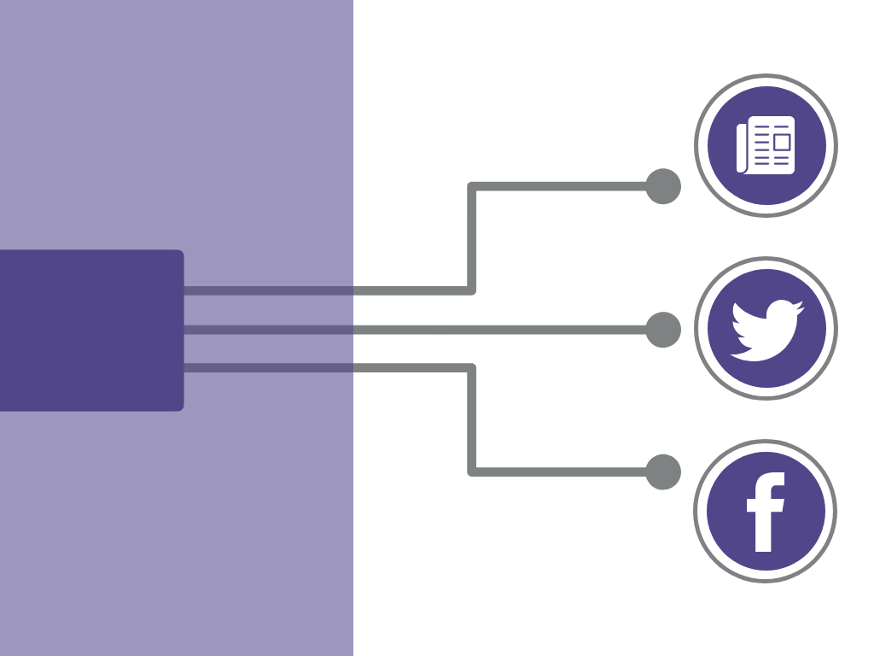
1080 news stories
137 papers
received Altmetric attention
4306 tweets
178 facebook posts

Slide 11
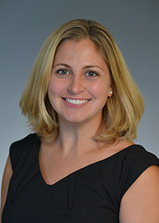


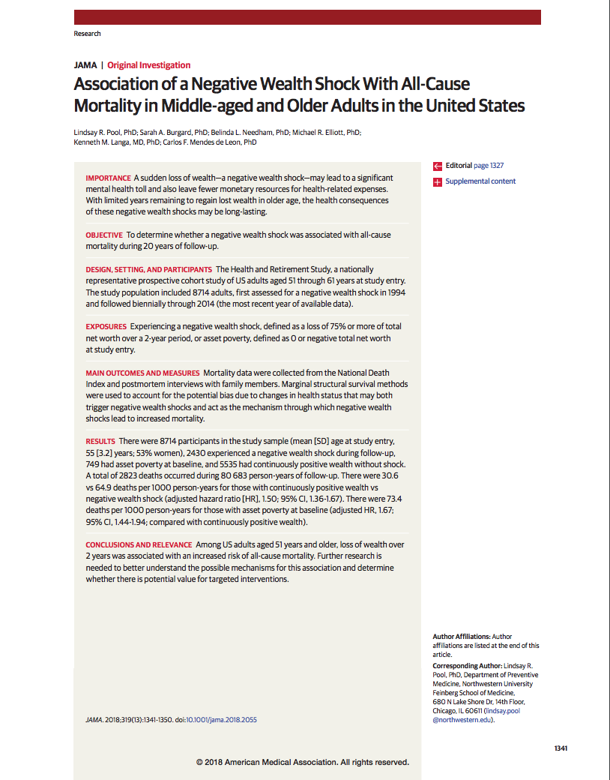




Association of a Negative Wealth Shock With All-Cause Mortality in Middle-aged and Older Adults in the United States
NU Author: Lindsay Pool
Published in JAMA in April 2018
Tweeted by 343 people, reaching over 1.8 million twitter followers
Featured in over 200 new stories around the world
Paper is in the top 1% of JAMA papers tracked by Altmetric.com
TIMELINE

Slide 12
TIMELINE
Paper cited in the policy document “Improving the physical health of people with mental health problems: Actions for mental health nurses” published by United Kingdom government
May 2016
Kathryn Reid, PhD
January 2015 & 2016
Paper cited in 2 policy documents by the National Academies Press: “Cognitive Aging: Progress in Understanding and Opportunities for Action” (2015) and “Enhancing Sleep Efficiency on Vessels in the Tug/Towboat/Barge Industry” (2016)
Lisa Wolfe, MD
Paper cited in the policy document “Sleep Matters: The Impact Of Sleep On Health And Wellbeing” published by the Mental Health Foundation.
January 2011
October 2010
Paper published in Sleep Medicine: Aerobic exercise improves self-reported sleep and quality of life in older adults with insomnia
Shirley Baron, PhD
Translation in Action
Phyllis Zee, MD, PhD

Slide 13
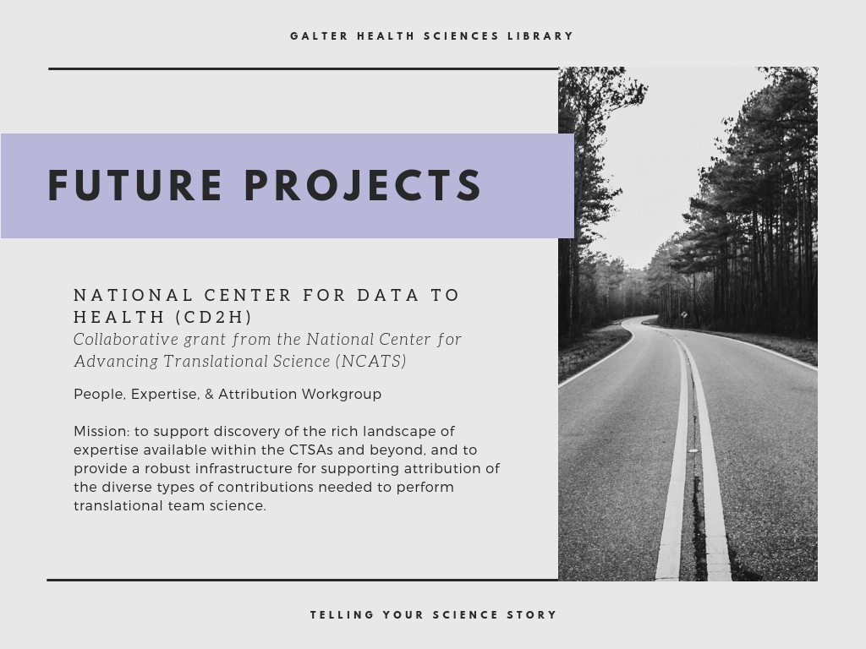
Notes:
Northwestern University, in partnership with Oregon Health & Science University, University of Washington, Johns Hopkins University School of Medicine, and Sage Bionetworks have collaboratively been awarded a $25 million grant.
The award will coalesce and coordinate informatics activities across the Clinical and Translational Science Award (CTSA) Program, a network of more than 50 medical research institutions, to provide collaborative clinical and translational research infrastructure.
promote data reuse and interoperability, tool sharing, informatics fluency, and collaboration. We are here to help by creating additional resources, building impactful infrastructure, and further coalescing the community to develop and implement innovative solutions

Slide 14
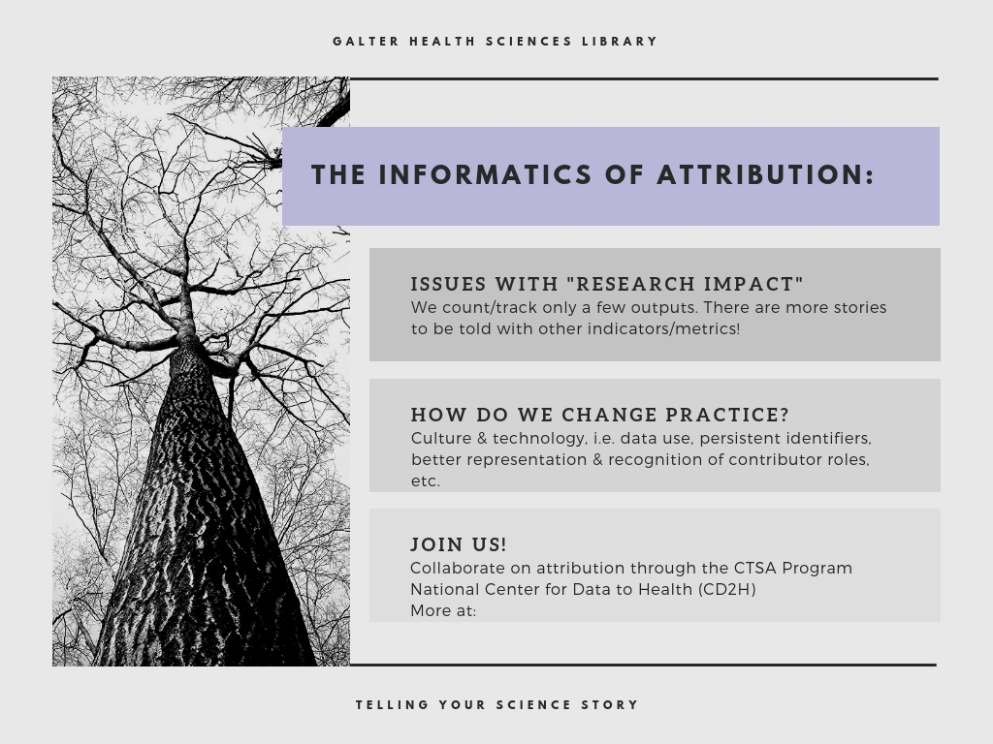
https://ctsa.ncats.nih.gov/cd2h/

Slide 15
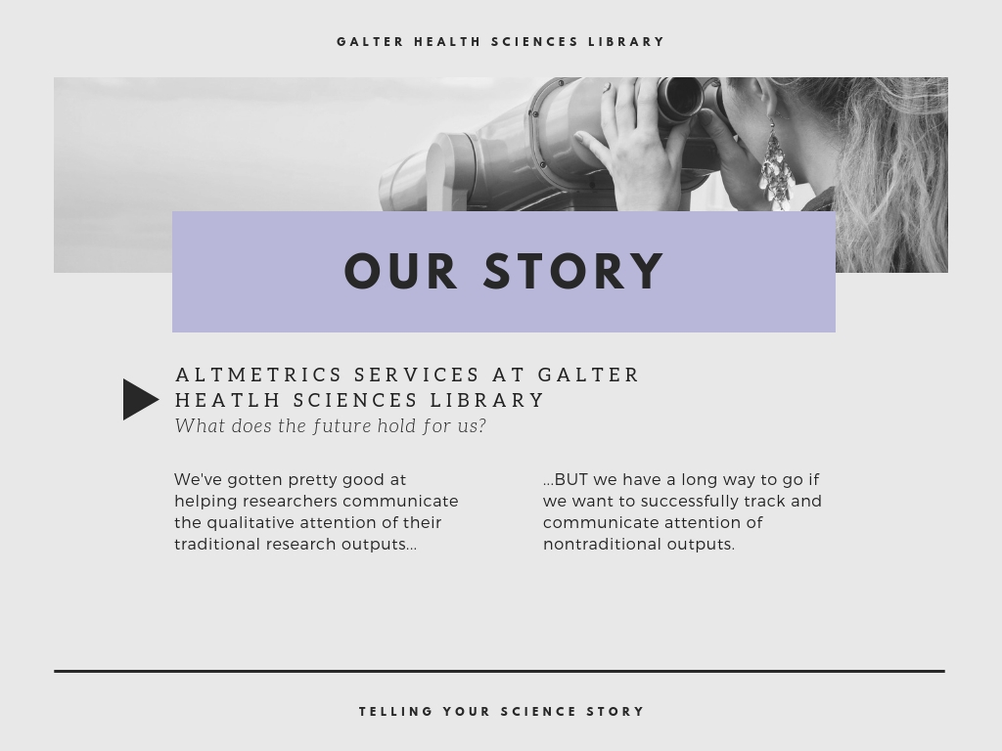

Slide 16

Acknowledgements:
Kristi Holmes and the team at Galter Health Sciences Library, Northwestern University
Cathy Sarli and the team at Becker Medical Library,
Washington University in St. Louis
Slides: http://bit.ly/5amSmith

