Slide 1
Agenda
Introductions/Workshop Background
Learning Objectives
Defining Mentoring
Mentoring for What? Articulating your Mentoring Needs and Goals
Skills to be an Effective Mentee
Wrap up and Next Steps

Slide 2
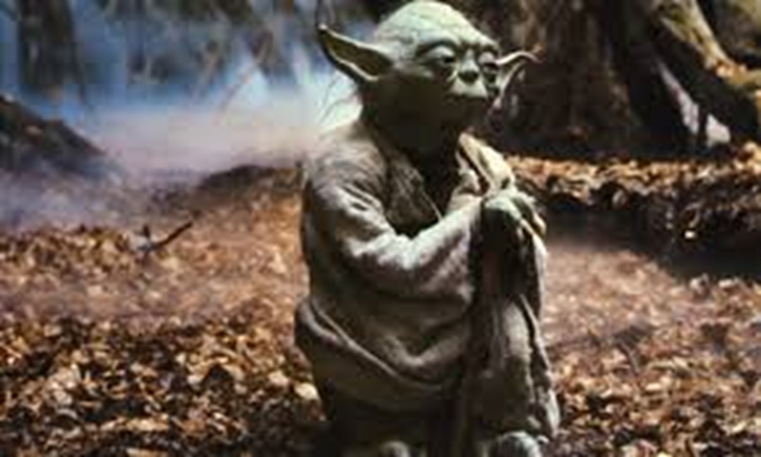
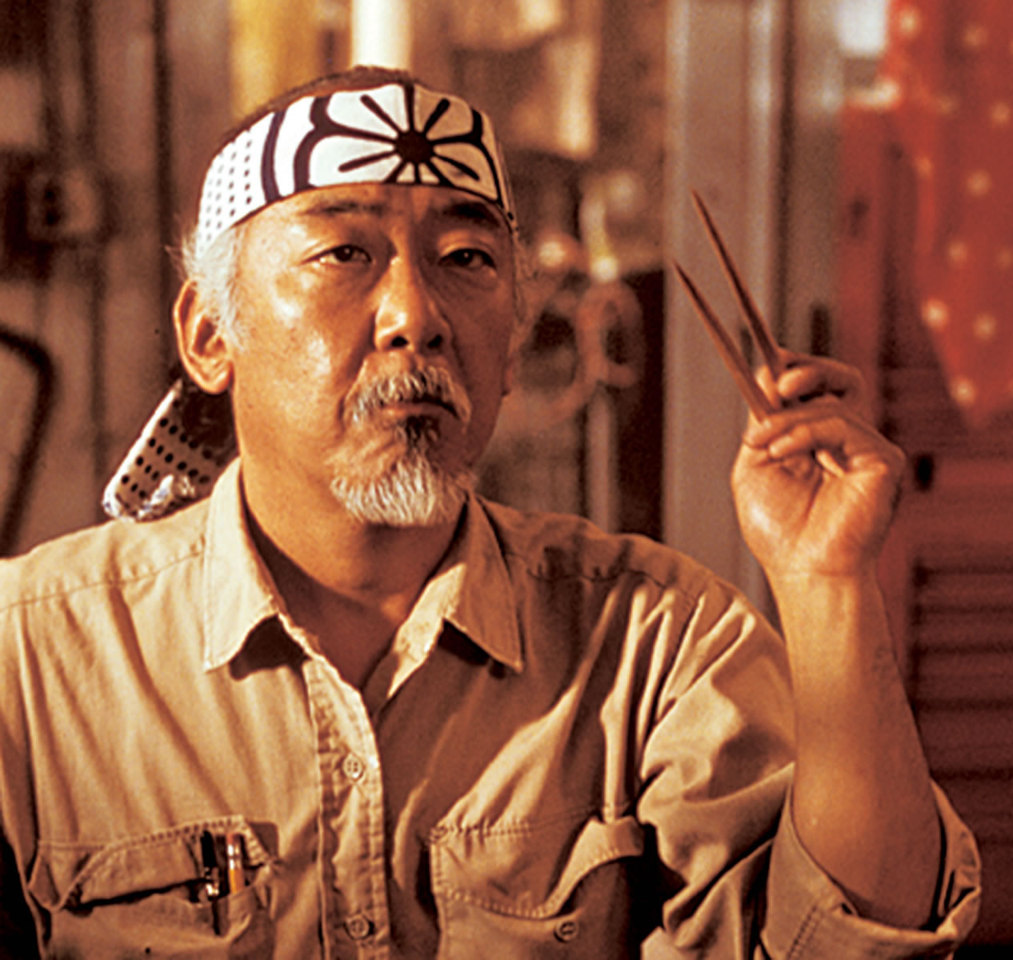
Mentor: “A wise and trusted counselor or teacher”
What do I need from my mentor(s)?
What do I need to succeed?

Slide 3
NUCATS Mentoring Workshop Background
Entering Mentoring/Mentor Training for Clinical and Translational Researchers
National CTSA mentor working group led by Fleming from 2009-2013
  26 members from 16 level 1 universities
  Met for 4 years, wrote 13 papers, developed and tested a mentor training curriculum
  Came to a consensus on “best mentoring practices”
Delivered training to over 700 faculty at NU
Evolution to enhance efficiency of delivery and respond to requests for specific content
Broaden the focus: Mentoring for What?

Slide 4
NUCATS Series on Developing and Enhancing Mentoring Relationships (reimagined Mentor Development Workshop)
All scheduled for 7:30 – 9:00 AM on Thursdays via Zoom until further notice Beginning Jan, is always 1st Thurs of the month
10/29/2020 | Articulating your Mentoring Needs
12/10/2020 | Establishing and Aligning Expectations in Mentoring
01/07/2021 | Maintaining Effective Communication/Difficult Conversations
02/04/2021 | Cultural Awareness in Mentoring across Differences
03/04/2021 | Creating SMART Goals for Your Feinberg Faculty Portal and Your Career Development Plan
04/01/2021 | Mentor Mapping and Mentor Networks
05/06/2021 | Evaluating Your Goals/Evaluating Your Mentee’s Goals
06/03/2021 | Articulating Your Mentoring Philosophy and Plan

Slide 5
Articulating your Mentoring Needs
Learning Objectives
By the conclusion of this workshop, attendees will:
  Identify 2-3 specific areas in which they are individually seeking mentoring
  Describe at least 3 qualities of being an effective mentee
  List 2-3 individual behavior changes that, if integrated into their mentoring relationships, could enhance mutual satisfaction with the relationship

Slide 6
Mentoring Defined
“Within this framework, we consider mentoring to be a dynamic, reciprocal relationship in a work environment between an advanced career incumbent (mentor) and a beginner (protege) aimed at promoting the career development of both.”
Healy CC, Welchert AJ. Mentoring relationships: a definition to advance research and practice. Educational Researcher 1999; 19(9): 17–21.
“…a relationship between a more experienced person, the mentor, and a less experienced person, the mentee or trainee, within which important career skills are transferred from one to the other. The mentoring relationship is an agreement between two people that the mentor will take a long-term interest in the career development and aspirations of the mentee. This is a serious responsibility for the mentor, who must accept that he or she has taken on an important, perhaps life-long, role in another's career."
National Institute of General Medical Sciences
https://www.nigms.nih.gov/training/strategicplanimplementationblueprint/pages/EvidenceBasedMentoring.aspx
“Mentorship is a professional, working alliance in which individuals work together over time to support the personal and professional growth, development, and success of the relational partners through the provision of career and psychosocial support.”
National Academies of Sciences Engineering Medicine https://www.nap.edu/resource/25568/interactive/

Slide 7
What makes a great mentor?

Slide 8
What the Best Mentors Do
Put the relationship before the mentorship
Focus on character rather than competency.
Shout loudly with your optimism, and keep quiet with your cynicism.
Be more loyal to your mentee than you are to your company.

Slide 9

(what is she thinking?)
Will you be my mentor?
Write responses in chat

Slide 10
“Effective Mentorship cannot exist without menteeship”
Chopra, Woods, Saint, BMK, 2016

Slide 11
Mentoring for What?

Slide 12
BREAKOUT GROUPS
Articulating Your Mentoring Needs and Goals
10 minutes total
Introduce yourself (BRIEFLY: Name, Division, Primary Role – e.g., research, teaching, clinical, administrative)
Each member to present their responses, others ask questions/offer feedback to help clarify and specify areas/skills
REMEMBER YOUR GROUP NUMBER/ Identify spokesperson
    Identify 2 – 3 areas in which you are looking for mentoring, i.e., what is the ultimate goal of your mentoring needs?
    Identify 2 - 3 skills* you are seeking to develop/improve through mentoring
    *Specify the time frame for developing and implementing each skill you identified

Slide 13
BREAKOUT GROUPS
60-seconds to think
Take 1 minute to think and write down your needs before sharing with group
    Identify 2 – 3 areas in which you are looking for mentoring, i.e., what is the ultimate goal of your mentoring needs?
    Identify 2 - 3 skills you are seeking to develop/improve through mentoring
    *Specify the time frame for developing and implementing each skill you identified

Slide 14
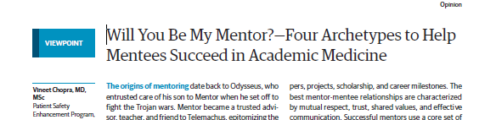
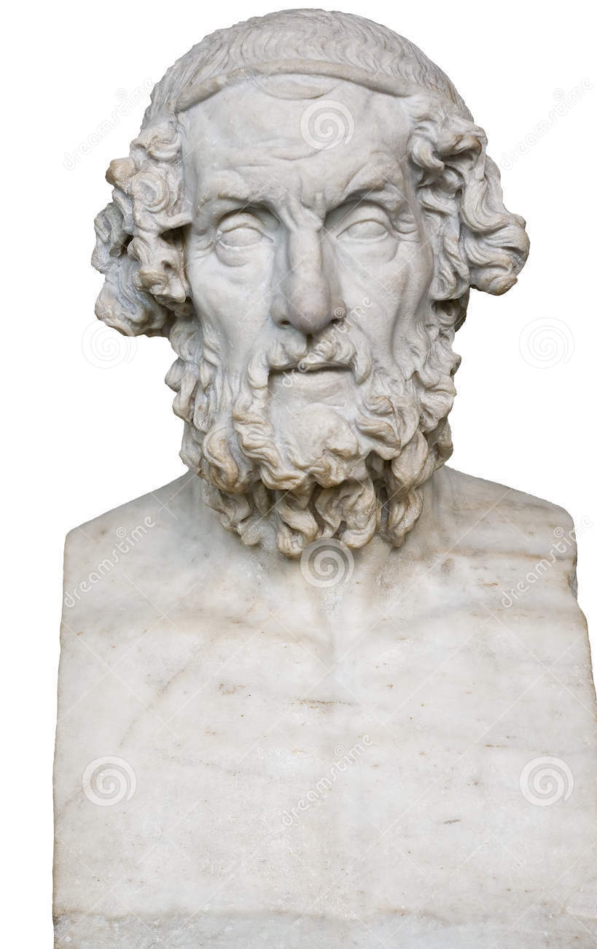
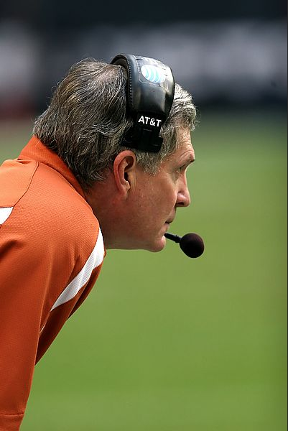
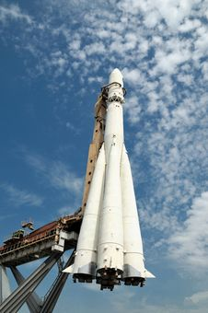
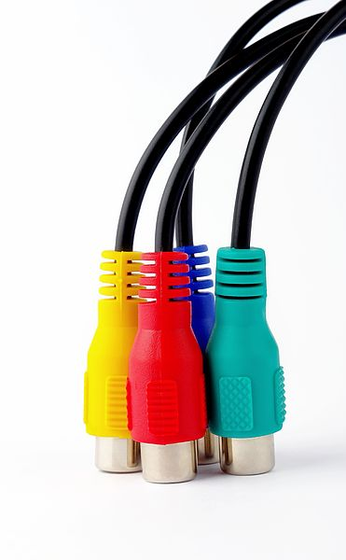
Traditional Mentor
Formal, Career-focused
Long-term
Reciprocal
Coach
Issue-focused
Short-term
Sponsor
Influential
Visibility-focused
Connector
Link mentees with others
Create networks
Focused on their field
Chopra V, Arora VM, Saint S. Will You Be My Mentor?—Four Archetypes to Help Mentees Succeed in Academic Medicine. JAMA Intern Med. 2018;178(2):175–176. doi:10.1001/jamainternmed.2017.6537

Slide 15
Mentee Missteps
Share in Chat
Mentee gaffes or missteps that you know of/have heard of/have experienced?

Slide 16
BREAKOUT GROUPS
Mentee Skills (5 minutes)
  What skills do you need to be an effective mentee?
      what skills do you already have and which might you need to work on?
  How would you define a “great mentee”? What are the qualities of a “great mentee”?
REMEMBER YOUR GROUP NUMBER/ Identify spokesperson

Slide 17
BREAKOUT GROUPS (5 minutes)
60-second timer
Take 1 minute to think and write down your needs before sharing with group
  What skills do you need to be an effective mentee?
      What skills do you already have and which might you need to work on?
  How would you define a “great mentee”? What are the qualities of a “great mentee”?

Slide 18
Mentoring Best Practices for Mentees
Communicate openly and honestly
Develop realistic goals and set expectations
Communicate agenda and goals with mentor prior to meeting; Arrive at each meeting with clear goals/objectives for discussion
Be respectful of mentor’s time
Set small milestones in order to achieve larger goal over time
Follow through on commitments
Practice Self-reflection
Support your peers
Ask questions and solicit constructive feedback
Have multiple mentors
Be Proactive / Take initiative
Recognize Mentoring Relationships do not need to be forever

Slide 19
Choosing a Mentor Aligned with your Needs
Chose a mentor with the following qualities:
Interested in developing your career
Commitment to mentoring
Match your emotional needs
  Do you need more support and praise or more challenge?
Match with your professional needs
  Help with writing?
  Methodological skills?
  Research/scholarly interests
A successful track record
Good communication skills
Will provide networking opportunities
Is institutionally savvy
Expresses interest in you as a person
There is potential for reciprocity
Copyright © 2010 The Regents of the University of California
Created by Mitchell D. Feldman, MD, MPhil UCSF Faculty Mentoring Program

Slide 20
Remember….
Mentoring is an evolving experience (you are a mentee and mentor)
Think of type of mentee you would like to have and pattern yourself accordingly
Consider how can you better articulate your own goals
Look at upcoming Sessions – choose which will best fit your needs
  December 10, 2020: Establishing and Aligning Expectations in Mentoring

Slide 21
What is your own Take Away?
What aspect of how you have approached your mentoring relationship do you plan to change moving forward?
  That is, what individual behavior change could you integrate into your mentoring relationship that could enhance mutual satisfaction with the relationship?
    Share in chat if willing
  What is the time frame in which you intend to make that change?

Slide 22
Thank You for Attending
Please Complete Brief Evaluation via REDCap (will be emailed to you)
Questions:
Kenzie A. Cameron k-cameron@northwestern.edu
Mercedes Carnethon carnethon@northwestern.edu
Resources and Opportunities on Website:
https://www.nucats.northwestern.edu/education-and-career-development/investigator-development/index.html

