Slide 1
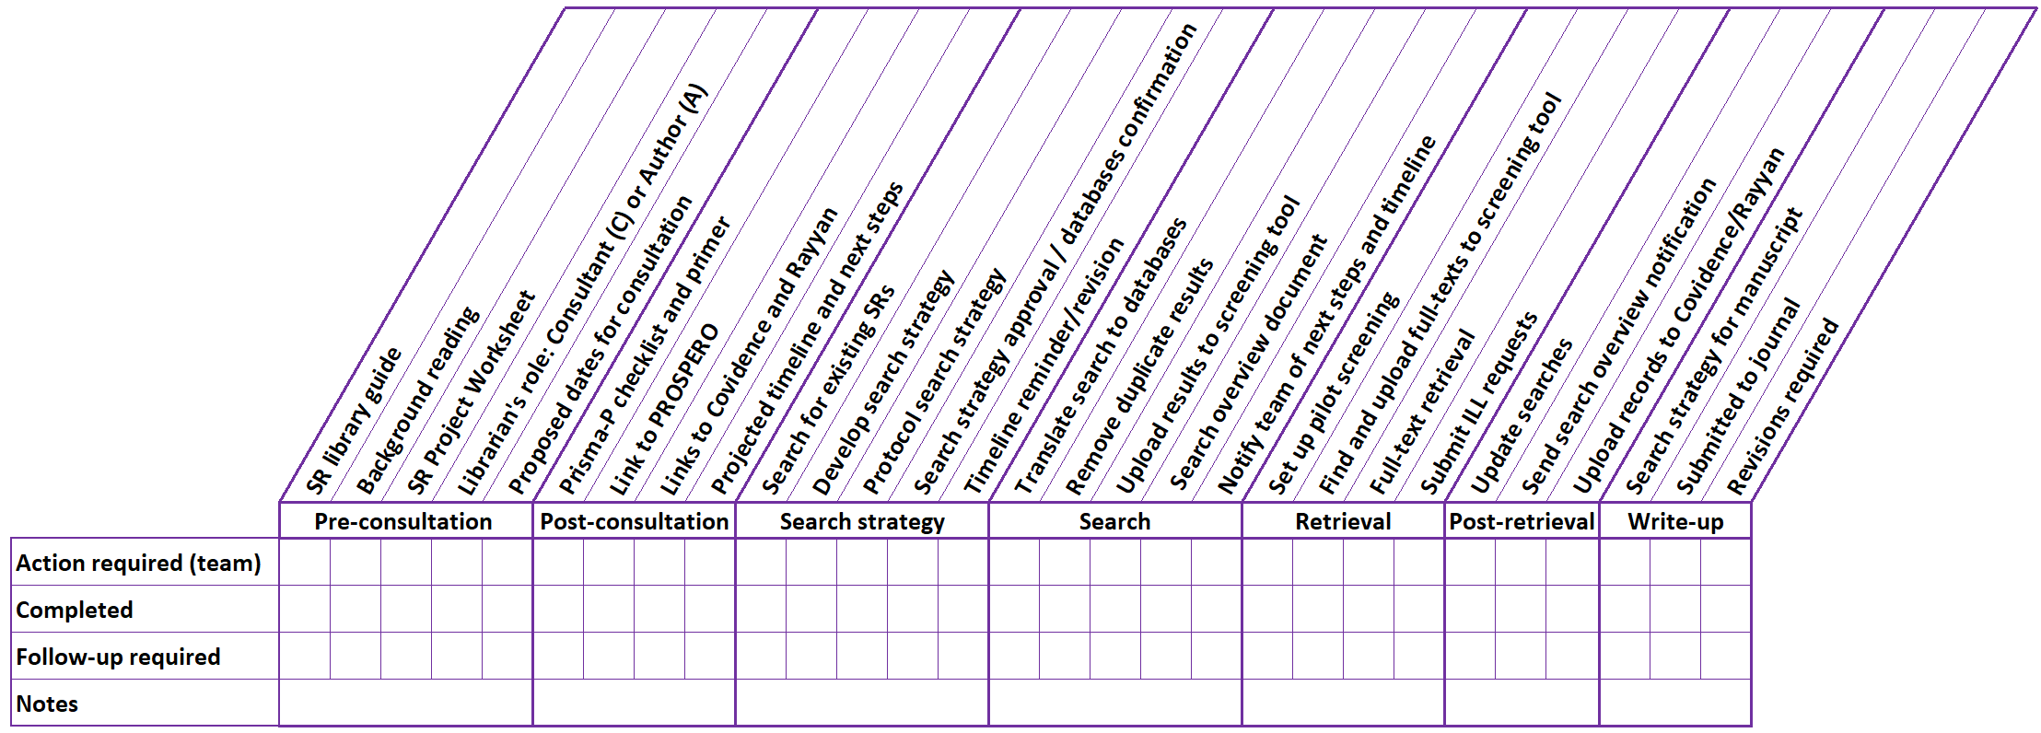

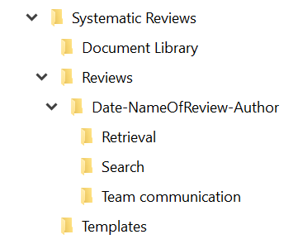






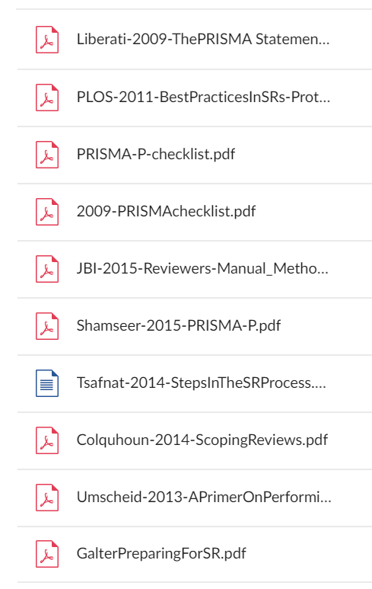
Managing Multiple Systematic Reviews:
Recommended Practices & the Systematic Review Tracking Checklist
Q. Eileen Wafford¹, MSt, MLIS
Peggy Murphy², MILS
Jonna Peterson¹, MLIS
Pamela L. Shaw¹, MSLIS, MS
Background
Managing demands
Librarians in the systematic review process
The challenges of managing multiple systematic reviews have led to development of the Systematic Review Tracking Checklist and a system that incorporates additional recommendations including data management practices
The Process
Developing the system
The iterative process for practical application
Finding Resources
Seek additional tools and training
Existing guides and training will aid you in the process
Information Management
Recommended practices
Use your workflow to organize information
Naming convention tips:
Avoid the use of words like "final", "final-final", "new"
Avoid spaces in filenames: Use underscores or dashes
Use versioning to track version changes
For publications, use Author-Year-Title
For files and folders, use Date-ReviewName-Author-…
For files that are frequently updated, begin filename with YYYYMMDD
Systematic Review
Tracking Checklist
Stay more organized
Monitor your progress
Use the checklist
to keep track of
various tasks
and ensure
completeness
LEVEL 1
Systematic review folder
Place all content in a master Systematic Review folder
Commonly shared content
  Tracking Checklist
  Document Library
  Templates
  Reviews
Project folder for each review
The completed worksheet or protocol acts as the “Readme” document
Aim
Test, assess, and refine recommended practices and Systematic Review Tracking Checklist
LEVEL 2
Consultation
SR library guide
Background reading
SR Project Worksheet
Proposed dates for consultation
Librarian's role: Consultant or Author
Prisma-P checklist and primer
Link to PROSPERO
Link to Covidence or Rayyan
Search for existing SRs
Projected timeline and next steps
CUSTOMIZATIONS
LEVEL 3
Search
Action Required
(Team/Librarian)
Develop search strategy
Protocol search strategy write up
Search strategy approval confirmation
Translate search to databases
Remove duplicate results
Upload records for pilot screening
Upload records for screening
Send search overview document
Notify team of next steps and timeline
Files | Folders
Log | Communications
Worksheet | Search
Protocol | Retrieval
Customize for your situation
Adapt the checklist
Review and testing the showed we can group the pre- and post-consultation tasks under "consultation"
Develop
Evaluate workflows, establish templates,
and define recommendations
Test
Recruit librarians and apply tools and recommendations
Templates
Refine
Survey librarians and make refinements as needed
Document
Library
First email
Describe the librarian’s roles, share worksheet and provide information
Protocol
Literature about the protocol for teams with questions or concerns
Search strategy
Describe the search strategy and submit candidate terms
Search overview
Provide results and final search strategies for each database searched
Retest
Re-employ checklist, templates, and data management practices
For commonly shared articles
Place these articles in the Document Library folder for easy retrieval
Employ
Employ the Systematic Review Tracking Checklist and recommended practices
Results
Testing the system
Revisiting the development phase
Testing the recommended practices and Systematic Review Tracking Checklist led us to identify resources and ways to improve our workflow, the checklist and data management practices
Moving forward
By incorporating our recommended practices and the Systematic Review Tracking Checklist, we anticipate that users will be able to plan as well as control the workload from systematic reviews
¹ Galter Health Sciences Library and Learning Center, Feinberg School of Medicine Northwestern University
² Pritzker Research Library, Ann & Robert H. Lurie Children's Hospital of Chicago

