Slide 1
Beyond an
Apple A Day
Finding Reliable Health Information Online
Karen Gutzman, Librarian, Northwestern University
Diana Almader-Douglas, Librarian, Central Arizona College
Notes:
Karen: Provide welcome and our names. Glad you could join us today. Welcome to presentation….

Slide 2
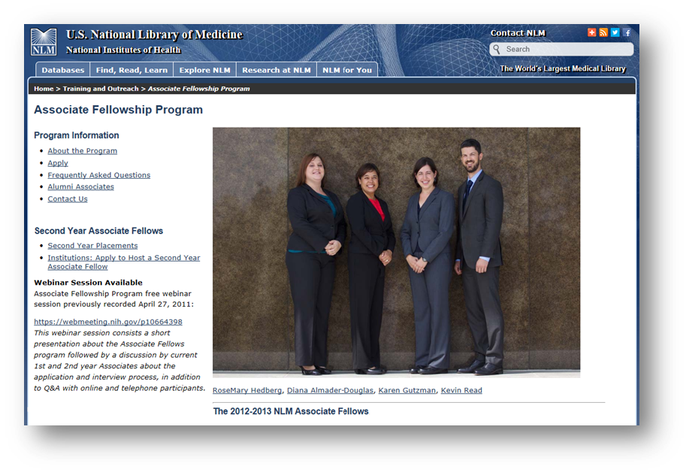
About Us
Notes:
Karen to start. How we met, brief info, info about what we did there. Fun fact(s).
Founded in 1836. The world’s largest biomedical library.
The National Library of Medicine Associate Fellowship is:
A one-year residency program (with an optional second year) for recent library science graduates interested in a career in health sciences librarianship
A program combining curriculum and project work
The Associate Fellowship provides knowledge and skills in project work ranging from:
Data analysis of programs and services such as extramural grants, indexed journal articles, controlled vocabularies, datasets, and customer inquiries
Creation of online tutorials and educational awareness videos
Social media outreach
And more, including legislative tracking, web site enhancement, disaster information outreach studies, and review of next generation discovery interfaces
The Associate Fellowship offers opportunities for professional development through:
Participation in lectures, exercises, conferences, short and extended visits to other health sciences libraries
Workshops on work style, resume review, negotiation, and presentation skills
Mentorship from a program coordinator and NLM staff who serve as preceptors

Slide 3
Agenda
Pre-session questionnaire
Demonstration of MedlinePlus
Review of other resources
Post-session questionnaire
Notes:
Diana. Give a few min; we passed out questionnaire at beginning but if you haven’t had a chance to fill one out, please take time to do it now.

Slide 4


Health Information online...
72% of internet users searched for health information within the past year
35% of American adults have gone online to figure out a possible diagnosis
Health Online 2013. Pew Research Center. http://www.pewinternet.org/2013/01/15/health-online-2013/
Notes:
Karen. We know that people use the internet for finding health information. Millions of consumers get health information from magazines, TV or the Internet.
Pew Research Study. http://www.pewinternet.org/2013/01/15/health-online-2013/

Slide 5

Is it reliable?
Is it overwhelming?
Ask yourself:
Who is responsible for the content of this website?
How current is this information?
Searching for health information online can be like trying to drink from a fire hydrant.
Notes:
Karen. Some of the information is reliable and up to date; some is not. How can you tell the good from the bad?
First, consider the source. If you use the Web, look for an "about us" page. Check to see who runs the site: Is it a branch of the government, a university, a health organization, a hospital or a business? Focus on quality. Does the site have an editorial board? Is the information reviewed before it is posted? Be skeptical. Things that sound too good to be true often are. You want current, unbiased information based on research.
NIH: National Library of Medicine
If it is overwhelming then be sure to Consult with your health professional--Patient/provider partnerships lead to the best medical decisions.
We are going to walk you through a few good places to start when looking for health information online.

Slide 6

MedlinePlus: Let’s Take a Virtual Tour
A service of the
U.S. National Library of Medicine
NIH National Institutes of Health
Notes:
Diana

Slide 7
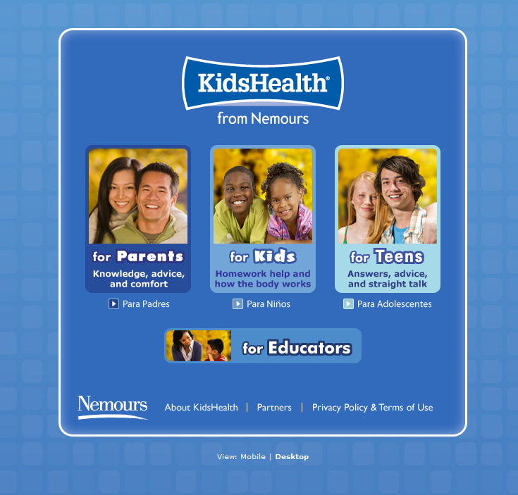
KidsHealth from Nemours
Notes:
If you're looking for information you can trust about kids and teens that's free of "doctor speak," you've come to the right place. KidsHealth is the most-visited site on the Web for information about health, behavior, and development from before birth through the teen years.
On a typical weekday, KidsHealth gets as many as a million visits. One of the things that make KidsHealth special is that it's really four sites in one: with sections for parents, for kids, for teens, and for educators.
KidsHealth is more than just the facts about health. As part of The Nemours Foundation's Center for Children's Health Media, KidsHealth also provides families with perspective, advice, and comfort about a wide range of physical, emotional, and behavioral issues that affect children and teens.
And all KidsHealth articles, animations, games, and other content go through a rigorous medical review by pediatricians and other medical experts.
The Nemours Center for Children's Health Media is a part of The Nemours Foundation, a nonprofit organization created by philanthropist Alfred I. duPont in 1936 and devoted to improving the health of children.

Slide 8
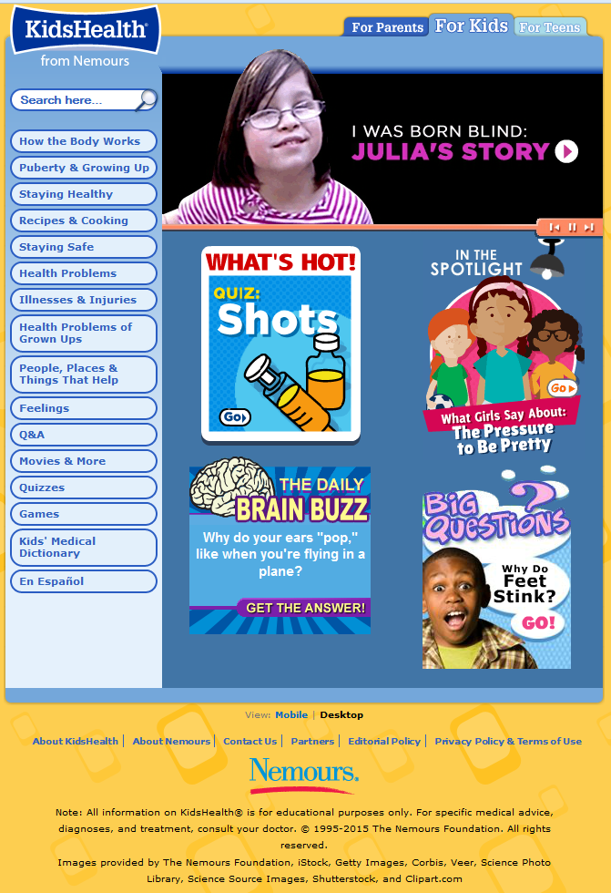

Slide 9
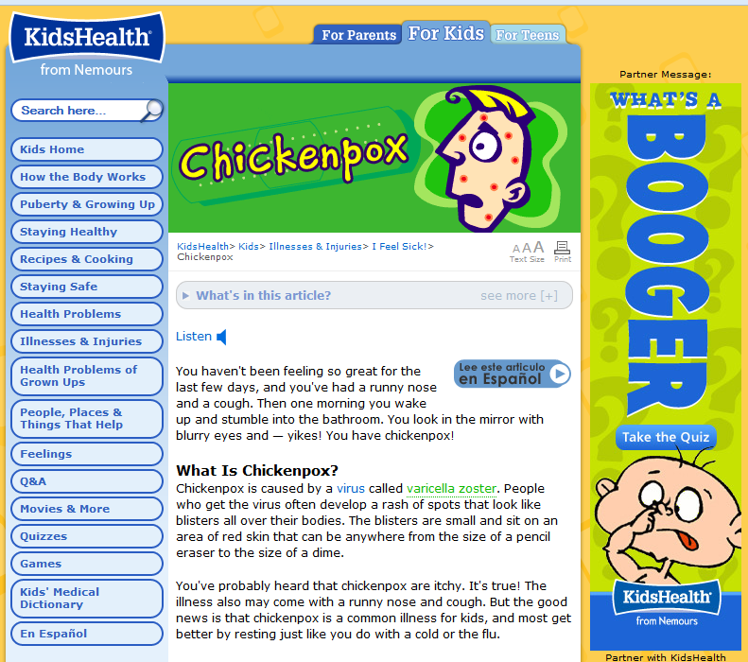
Notes:
Searched in Kids section for “chicken pox”. Can also search for “what’s a booger?”
Mention the “Kids Medical Dictionary”, Spanish pronunciations, quizzes, things they can vote on, etc.

Slide 10

NIH Senior Health
Notes:
Diana NIHSeniorHealth makes aging-related health information easily accessible for family members and friends seeking reliable, easy to understand online health information. This site was developed by the National Institute on Aging (NIA) and the National Library of Medicine (NLM) both part of the National Institutes of Health (NIH).
NIHSeniorHealth features authoritative and up-to-date health information from Institutes and Centers at NIH. In addition, the American Geriatrics Society provides expert and independent review of some of the material found on this Web site. Health topics include general background information, open-captioned videos, quizzes and frequently asked questions (FAQs). New topics are added to the site on a regular basis.
Mention: Health Topics A-Z, Each topic has a “Learn more section” with a link out to MedlinePlus for more information.

Slide 11
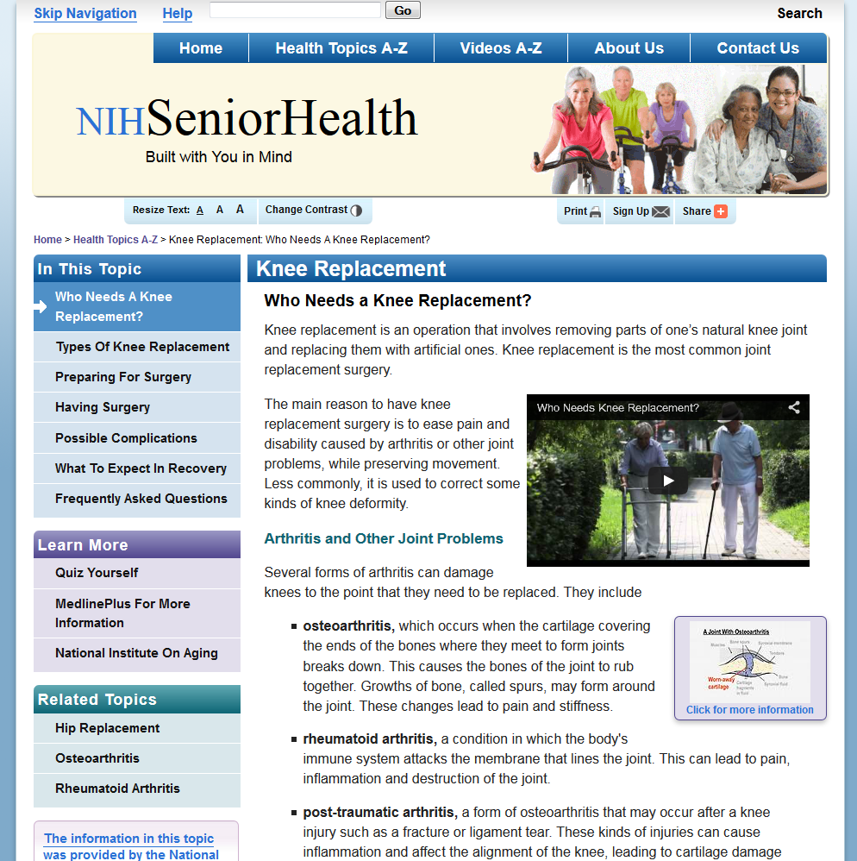

Slide 12
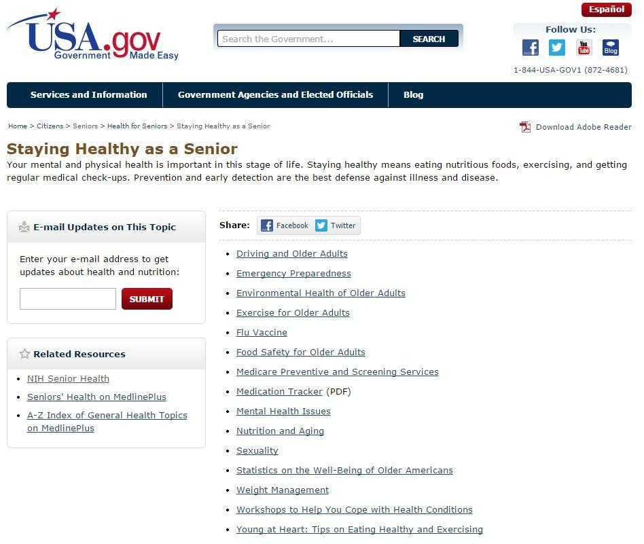
USA.gov For Seniors
Notes:
DianaSearch for “staying healthy AND senior”

Slide 13
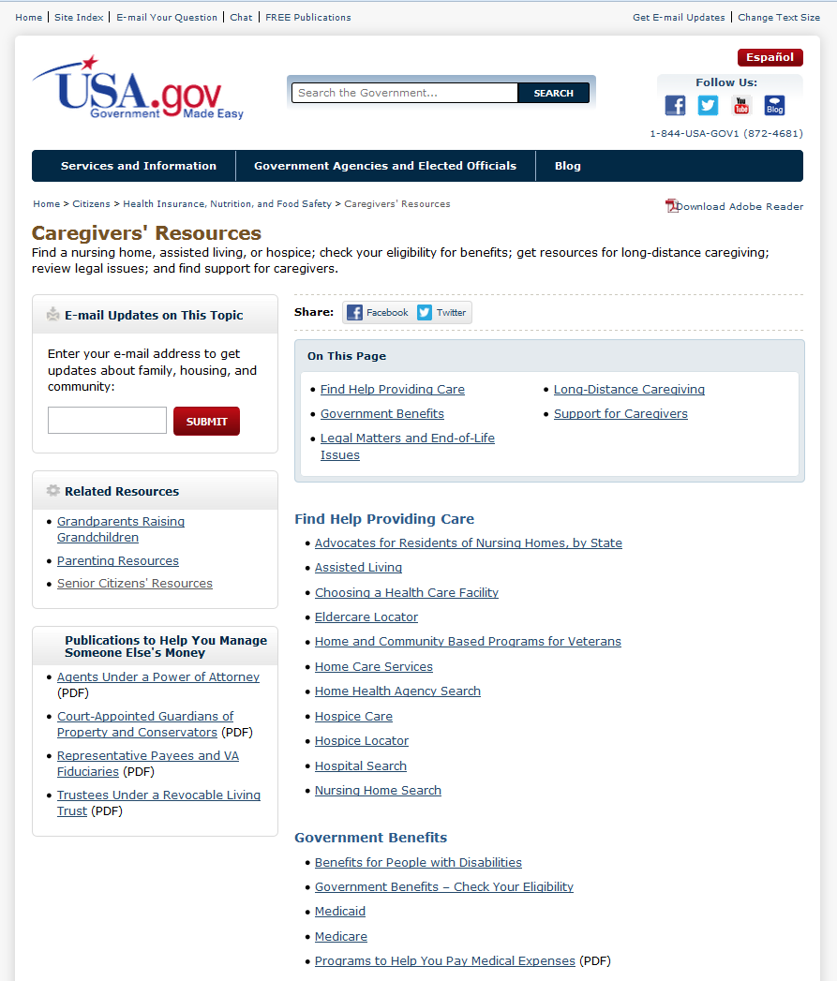
Notes:
Diana: Can search for “Caregiver’s Resources”

Slide 14
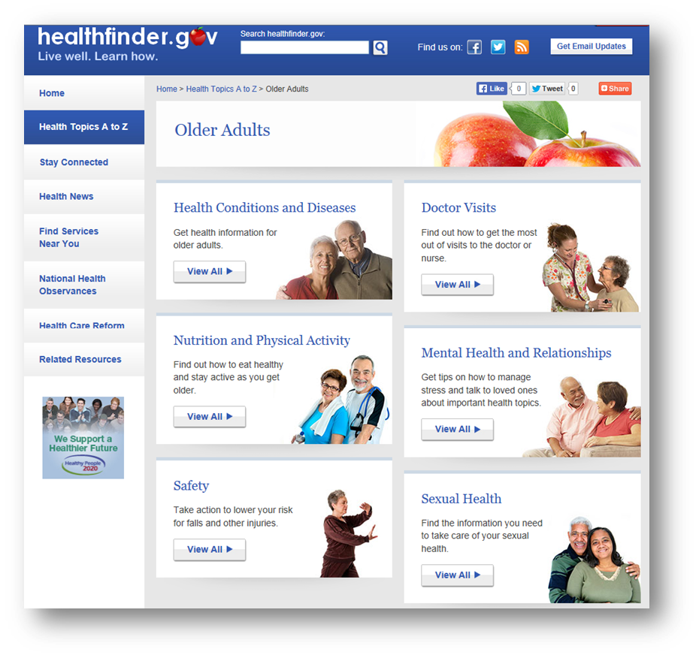
Healthfinder.gov
Notes:
Karen. When making decisions about your health, it’s important to know where to go to get the latest, most reliable information. healthfinder.gov has resources on a wide range of health topics selected from approximately 1,400 government and non-profit organizations to bring you the best, most reliable health information on the Internet.
healthfinder.gov will review and consider organizations and sponsored resources that meet the following required quality guidelines: http://healthfinder.gov/aboutus/QualityGuidelines.aspx

Slide 15
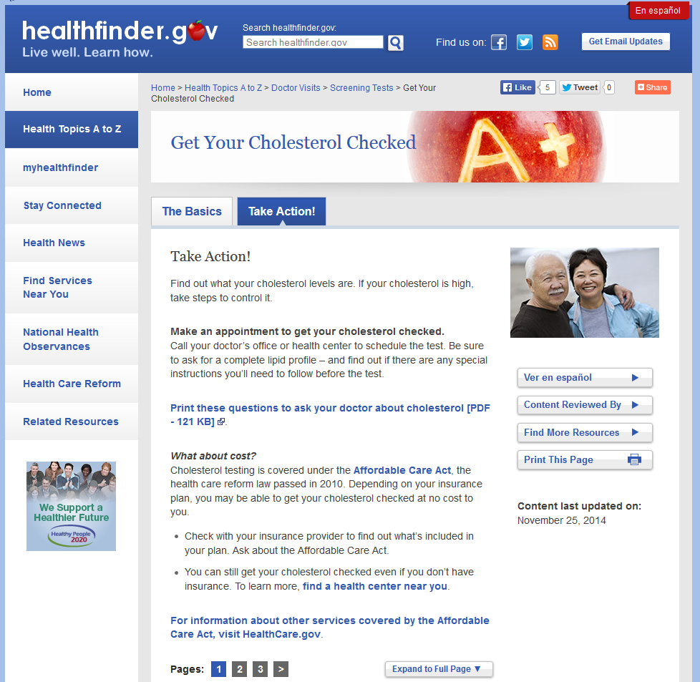
Notes:
Karen. Go to healthfinders.gov. Choose “Health Topics”, “Doctor Visits”, “Screening Tests”, “Cholesterol” and then select the “Take Action!” tab. Notice the PDF of questions to ask your doctor about cholesterol.

Slide 16
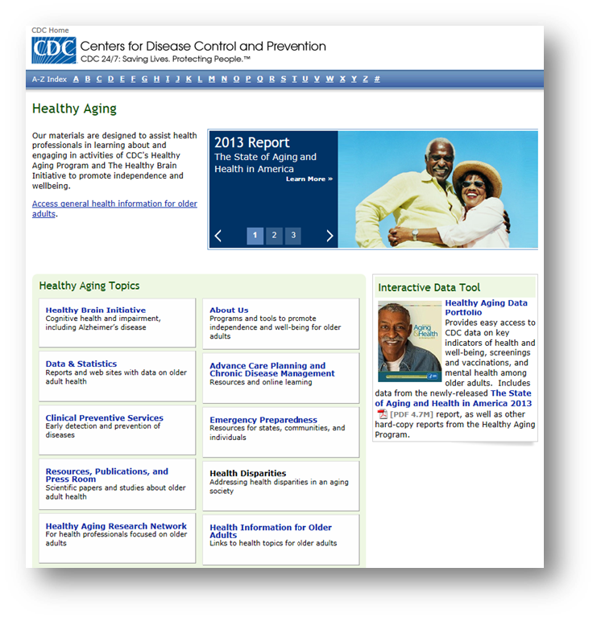
Centers For Disease Control (CDC)
Notes:
Karen. The Healthy Aging Program serves as the focal point at CDC for efforts to promote the health and quality of life of older Americans. Located within CDC’s National Center for Chronic Disease Prevention and Health Promotion, the Program focuses primarily on adults age 50 or older.
Our goals are to:
Enhance the ability of states and communities to identify and implement effective strategies and programs to promote and protect the health of older adults.
Expand integration of public health and aging services and enhance outreach for health promotion and disease prevention among older adults.
Promote health and preserve health-related quality of life for older adults through the health care system and other avenues.
Our current efforts focus on two important health issues for older adults:
Promote cognitive functioning and address impairment
Increasing the use of clinical preventive services

Slide 17
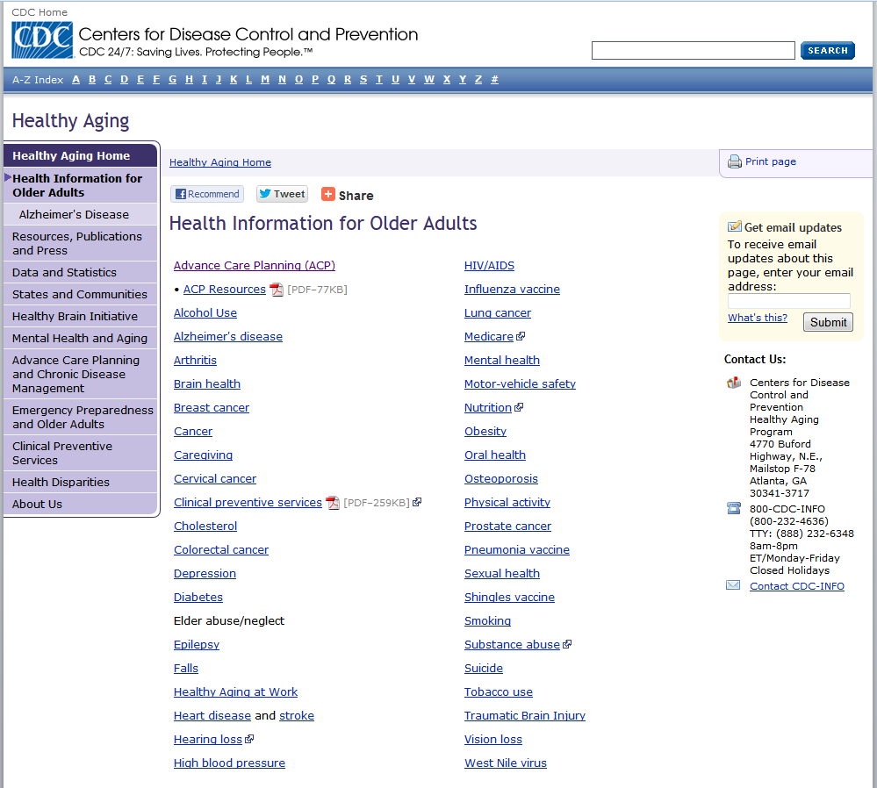
Notes:
Karen. Go to http://www.cdc.gov/aging/, click on “Access general health information for older adults.”

Slide 18
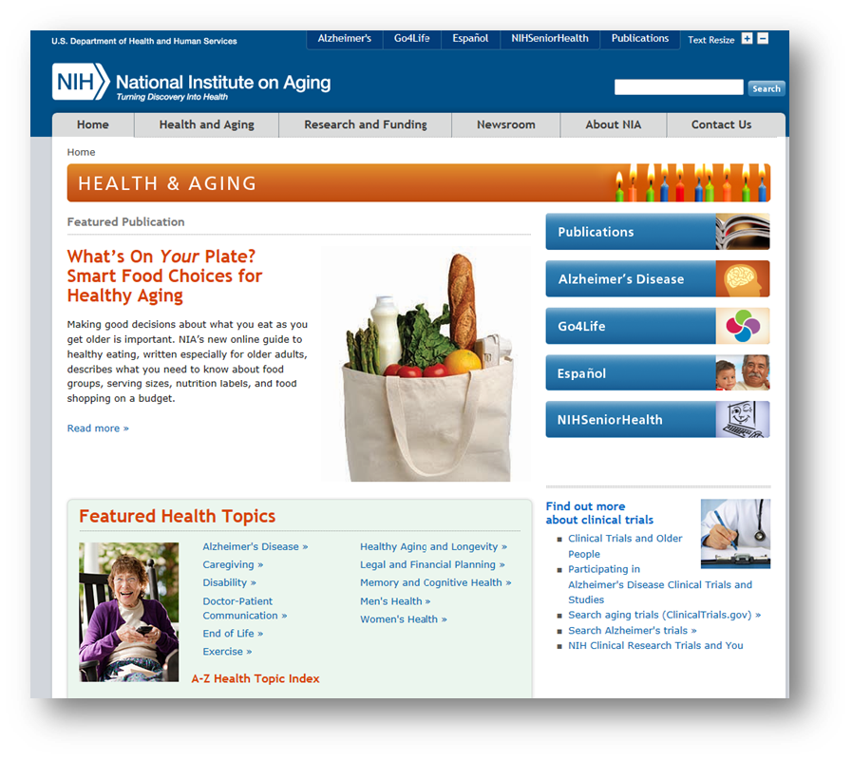
National Institute On Aging
Notes:
Karen.
Data from the Census Bureau tell us that there are currently around 39 million Americans age 65 and older, up from 25.5 million just 30 years ago. This population explosion is unprecedented in history, and the resulting demographic shift is causing profound social and economic changes. At NIA, our mission is to discover what may contribute to a healthy old age as well as to understand and address the disease and disability sometimes associated with growing older. In pursuit of these goals, our research program covers a broad range of areas, from the study of basic cellular changes that occur with age to the examination of the biomedical, social, and behavioral aspects of age-related conditions, including Alzheimer’s disease.
I invite you to explore our website and to learn more about the ground-breaking work of NIA researchers and the international community of scientists engaged in aging research. Take a look at some of the ways we are collaborating across the Institute and NIH on initiatives of special interest. For the general public and health professionals, we offer consumer-oriented information on a wide range of topics important to older people and their families. Scientists will find detailed information on areas of research interest and funding opportunities. If you're new to the NIA, our Strategic Directions document -- a road map for progress in aging research -- is a great place to start.
We thank you for your interest in aging research.
Richard J. Hodes, M.D.
Director, NIA

Slide 19
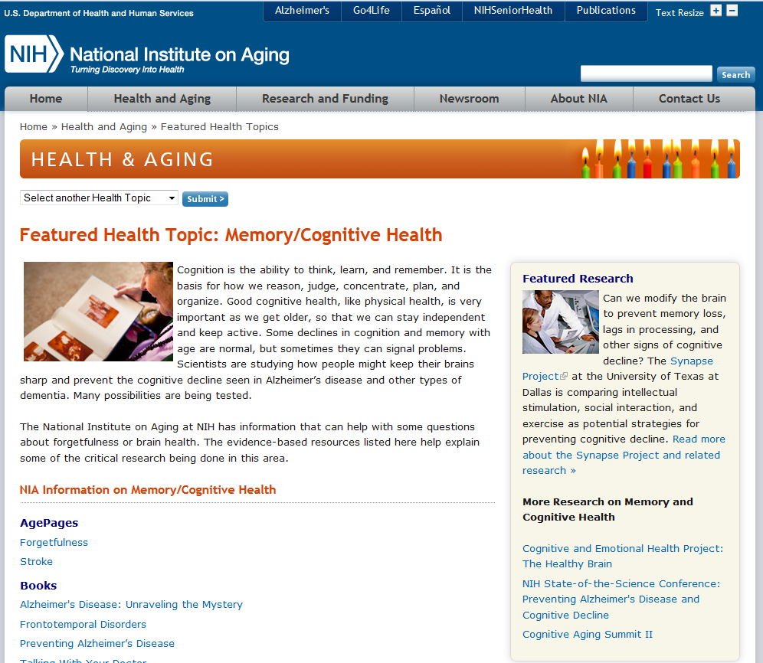
Notes:
Go to http://www.nia.nih.gov/health, then click on “Memory/Cognitive health”

Slide 20
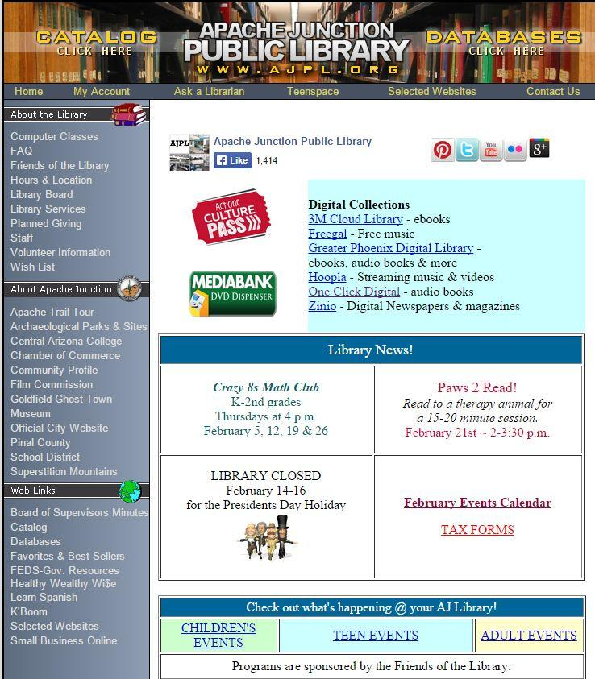
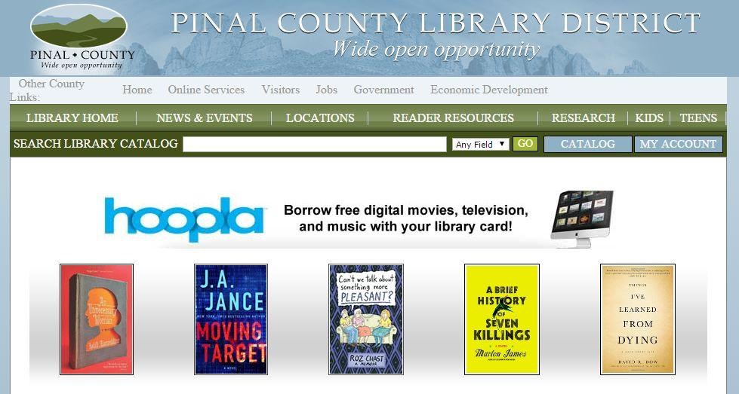
Pinal County Library District
Notes:
12 libraries located in the county. Apache Junction’s library is located at 1177 N. Idaho Rd. [Click on hours/locations & on media bank icon]. To get a card, you need a photo ID and a document with your current address. You may also register for a virtual card, which will give you access to online material such as ebooks, audio books and other virtual media.

Slide 21
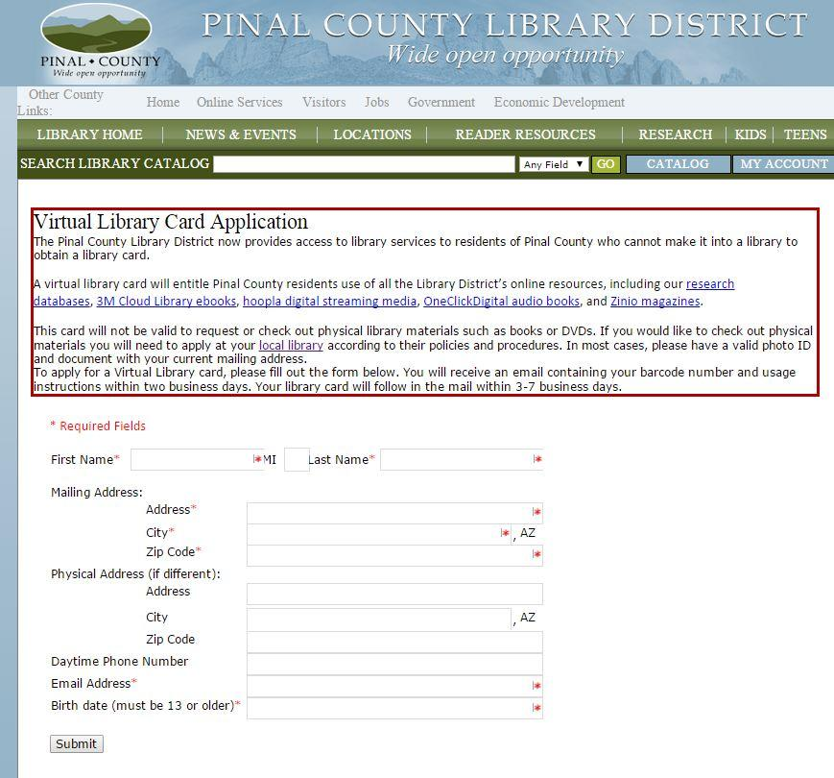
Notes:
If you can’t get to a library, you may apply for a virtual library card. There is a short online application. Once you receive your virtual card, you will have access to research databases, ebooks, streaming media, audio books (MP3) and some magazines
[Link is a little hard to find] http://www.pinalcountyaz.gov/Departments/Library/Pages/VirtualLibraryCardApplication.aspx

Slide 22
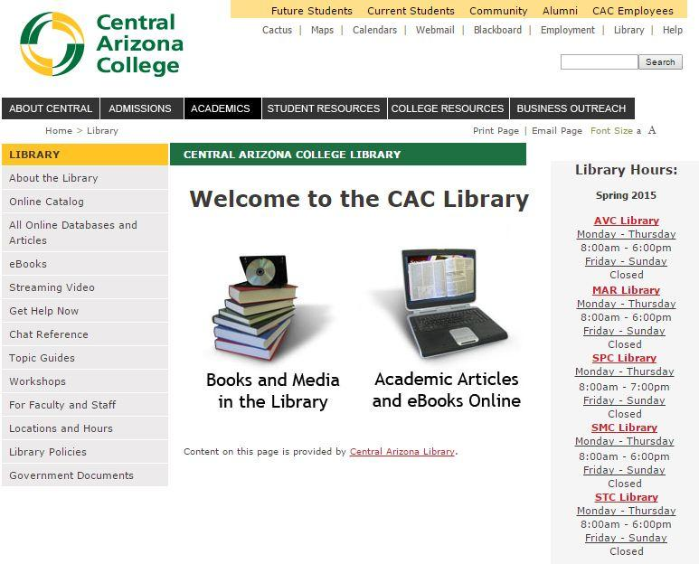
Central Arizona College Libraries
Notes:
5 CAC locations. Closest to you is likely SMC

Slide 23

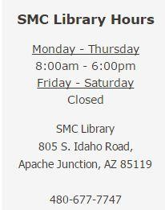
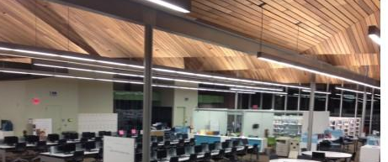
Notes:
SMC

Slide 24
Featured Resources
Centers for Disease Control (CDC): http://www.cdc.gov/
Central Arizona College Library: http://www.centralaz.edu/library/library.htm
Healthfinder.gov: http://healthfinder.gov/
MedlinePlus: http://www.nlm.nih.gov/medlineplus/
National Institute On Aging: http://www.nia.nih.gov/
NIH Senior Health: http://nihseniorhealth.gov/
KidsHealth from Nemours: http://kidshealth.org/
Pinal County Library District: http://www.pinalcountyaz.gov/Departments/Library/Pages/default.aspx
USA.gov For Seniors: http://www.usa.gov/Topics/Seniors.shtml

Slide 25
Questions?
Thank You
Notes:
Post questionnaire (place questionnaires in basket)

