Slide 1
Dissemination and Outreach: an overview
Karen Gutzman, Impact and Evaluation Librarian
Galter Health Sciences Library
Northwestern University, Feinberg School of Medicine
Presentation for: Dissemination, Impact, and Access Workshop
Thursday, July 20, 2017
10:00 am – 10:30 am
Baldwin Auditorium

Slide 2
Overview
Brief description of dissemination
Review of dissemination plans
Social Media Tools
Considerations for generating content and users
How to manage a social media
Navigating Risks of Online Communication

Slide 3
Let’s talk Dissemination
What is dissemination?
Active and planned efforts to communicate information to target groups.
Notes:
References
1) Greenhalgh T, Robert G, Macfarlane F, Bate P, Kyriakidou O. Diffusion of innovations in service organizations: systematic review and recommendations. Milbank Q 2004;82(4):581–629. Retrieved from: https://www.ncbi.nlm.nih.gov/pubmed/15595944
2) STELAR Center. ITEST Data Brief. STELAR 2017 JAN; 3(4): 1-2. Retrieved from: http://stelar.edc.org/publications/itest-data-brief-itest-dissemination-strategies

Slide 4
Let’s talk Dissemination
What is dissemination?
Active and planned efforts to communicate information to target groups.
With organizations under increasing pressure to demonstrate their relevance and contribution to society, a deliberate digital strategy is vital.
Why do dissemination?
Notes:
References
1) Greenhalgh T, Robert G, Macfarlane F, Bate P, Kyriakidou O. Diffusion of innovations in service organizations: systematic review and recommendations. Milbank Q 2004;82(4):581–629. Retrieved from: https://www.ncbi.nlm.nih.gov/pubmed/15595944
2) STELAR Center. ITEST Data Brief. STELAR 2017 JAN; 3(4): 1-2. Retrieved from: http://stelar.edc.org/publications/itest-data-brief-itest-dissemination-strategies

Slide 5
Let’s talk Dissemination
What is dissemination?
Active and planned efforts to communicate information to target groups.
With organizations under increasing pressure to demonstrate their relevance and contribution to society, a deliberate digital strategy is vital.
Why do dissemination?
How does dissemination happen?
Notes:
References
1) Greenhalgh T, Robert G, Macfarlane F, Bate P, Kyriakidou O. Diffusion of innovations in service organizations: systematic review and recommendations. Milbank Q 2004;82(4):581–629. Retrieved from: https://www.ncbi.nlm.nih.gov/pubmed/15595944
2) STELAR Center. ITEST Data Brief. STELAR 2017 JAN; 3(4): 1-2. Retrieved from: http://stelar.edc.org/publications/itest-data-brief-itest-dissemination-strategies

Slide 6

Let’s talk Dissemination
What is dissemination?
Active and planned efforts to communicate information to target groups.
With organizations under increasing pressure to demonstrate their relevance and contribution to society, a deliberate digital strategy is vital.
Why do dissemination?
How does dissemination happen?
Online Strategies
Website
Mailing Lists
Virtual Events
Social Media
(Twitter, Facebook, Podcasts, Blogs)
Notes:
References
1) Greenhalgh T, Robert G, Macfarlane F, Bate P, Kyriakidou O. Diffusion of innovations in service organizations: systematic review and recommendations. Milbank Q 2004;82(4):581–629. Retrieved from: https://www.ncbi.nlm.nih.gov/pubmed/15595944
2) STELAR Center. ITEST Data Brief. STELAR 2017 JAN; 3(4): 1-2. Retrieved from: http://stelar.edc.org/publications/itest-data-brief-itest-dissemination-strategies

Slide 7

Let’s talk Dissemination
What is dissemination?
Active and planned efforts to communicate information to target groups.
With organizations under increasing pressure to demonstrate their relevance and contribution to society, a deliberate digital strategy is vital.
Why do dissemination?
How does dissemination happen?
Online Strategies
In-person Strategies
Website
Mailing Lists
Virtual Events
Social Media
(Twitter, Facebook, Podcasts, Blogs)
Networking
Workshops or training
Meetings
Conference Presentations
Notes:
References
1) Greenhalgh T, Robert G, Macfarlane F, Bate P, Kyriakidou O. Diffusion of innovations in service organizations: systematic review and recommendations. Milbank Q 2004;82(4):581–629. Retrieved from: https://www.ncbi.nlm.nih.gov/pubmed/15595944
2) STELAR Center. ITEST Data Brief. STELAR 2017 JAN; 3(4): 1-2. Retrieved from: http://stelar.edc.org/publications/itest-data-brief-itest-dissemination-strategies

Slide 8

Let’s talk Dissemination
What is dissemination?
Active and planned efforts to communicate information to target groups.
With organizations under increasing pressure to demonstrate their relevance and contribution to society, a deliberate digital strategy is vital.
Why do dissemination?
How does dissemination happen?
Online Strategies
In-person Strategies
Print Strategies
Website
Mailing Lists
Virtual Events
Social Media
(Twitter, Facebook, Podcasts, Blogs)
Networking
Workshops or training
Meetings
Conference Presentations
Peer-reviewed journals
Newsletters
White papers
and so much more…
Notes:
References
1) Greenhalgh T, Robert G, Macfarlane F, Bate P, Kyriakidou O. Diffusion of innovations in service organizations: systematic review and recommendations. Milbank Q 2004;82(4):581–629. Retrieved from: https://www.ncbi.nlm.nih.gov/pubmed/15595944
2) STELAR Center. ITEST Data Brief. STELAR 2017 JAN; 3(4): 1-2. Retrieved from: http://stelar.edc.org/publications/itest-data-brief-itest-dissemination-strategies

Slide 9
Make a plan for dissemination
A simple plan might include:
  What do you want to achieve?
  Who is your target audience(s)?
  What tool, resource, or format do you want to use?
  Do you have content, or does it need to be generated?
More detailed plans and tools:
  Dissemination and Communication tools by Research Partnerships for Healthy Chicagoland Communities: http://arccresources.net/category/dissemination-communication-tools/
  Dissemination Planning Tool by AHRQ: https://www.ahrq.gov/professionals/quality-patient-safety/patient-safety-resources/resources/advances-in-patient-safety/vol4/planningtool.html
  Dissemination and Implementation Framework and Toolkit by PCORI: https://www.mathematica-mpr.com/our-publications-and-findings/projects/pcori-dissemination-and-implementation-framework-and-toolkit
  Recommendations for Research Dissemination by the Center for AIDS Prevention Studies at the University of California, San Francisco: https://caps.ucsf.edu/about/community-advisory-board/recommendations-for-research-dissemination/

Slide 10
Make a plan for dissemination
What do you want to achieve?
  Reach your audience in an eye catching way
  Make an impact on policy
  Expand your digital presence
  Reach non-academic audiences
Notes:
A general public awareness of your project can be achieved through a combined approach of mass and social media platforms to get you broad exposure, but if you are looking to change policy or behaviour in some substantial way, you will need to spend considerably more time understanding the motivations of the ecosystem of stakeholders, actively listening to the feedback and incorporating perspectives from these stakeholders into your research communication activity.

Slide 11
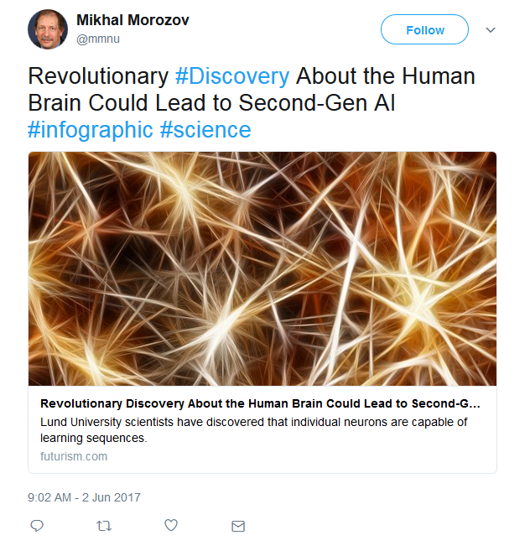
Make a plan for dissemination
(above) Example of an “eye catching” tweet that links to a research article by scientists at Lund University.
Notes:
A general public awareness of your project can be achieved through a combined approach of mass and social media platforms to get you broad exposure, but if you are looking to change policy or behaviour in some substantial way, you will need to spend considerably more time understanding the motivations of the ecosystem of stakeholders, actively listening to the feedback and incorporating perspectives from these stakeholders into your research communication activity.

Slide 12
Make a plan for dissemination
What do you want to achieve?
  Reach your audience in an eye catching way
  Make an impact on policy
  Expand your digital presence
  Reach non-academic audiences
Whatever your goal is, make note of it to focus your work toward that goal.
Notes:
A general public awareness of your project can be achieved through a combined approach of mass and social media platforms to get you broad exposure, but if you are looking to change policy or behaviour in some substantial way, you will need to spend considerably more time understanding the motivations of the ecosystem of stakeholders, actively listening to the feedback and incorporating perspectives from these stakeholders into your research communication activity.

Slide 13
Choosing an audience
Who is your target audience(s)?
  Consider different types of audiences. Who would benefit from this information?
  Consider what motivates your audiences. Why should they be interested?
  Consider how your audience should adopt or act on your information.
  Actively listen to their feedback and incorporate their perspectives.

Slide 14
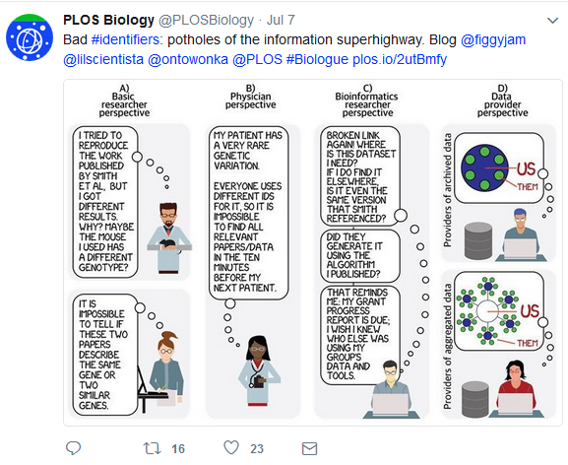
Choosing an audience
(above) Screenshot of tweet aimed at four different audiences on importance of universally used data identifiers by PLoS Biology on July 6, 2017.
https://twitter.com/PLOSBiology/status/883007654154686464
Notes:
A general public awareness of your project can be achieved through a combined approach of mass and social media platforms to get you broad exposure, but if you are looking to change policy or behaviour in some substantial way, you will need to spend considerably more time understanding the motivations of the ecosystem of stakeholders, actively listening to the feedback and incorporating perspectives from these stakeholders into your research communication activity.

Slide 15















Choosing a format or tool
What tool, resource, or format do you want to use?
A good resource for learning more about Social Media users: Pew Research Center’s “Social Media Fact Sheet” http://www.pewinternet.org/fact-sheet/social-media/
Notes:
A general public awareness of your project can be achieved through a combined approach of mass and social media platforms to get you broad exposure, but if you are looking to change policy or behaviour in some substantial way, you will need to spend considerably more time understanding the motivations of the ecosystem of stakeholders, actively listening to the feedback and incorporating perspectives from these stakeholders into your research communication activity.

Slide 16
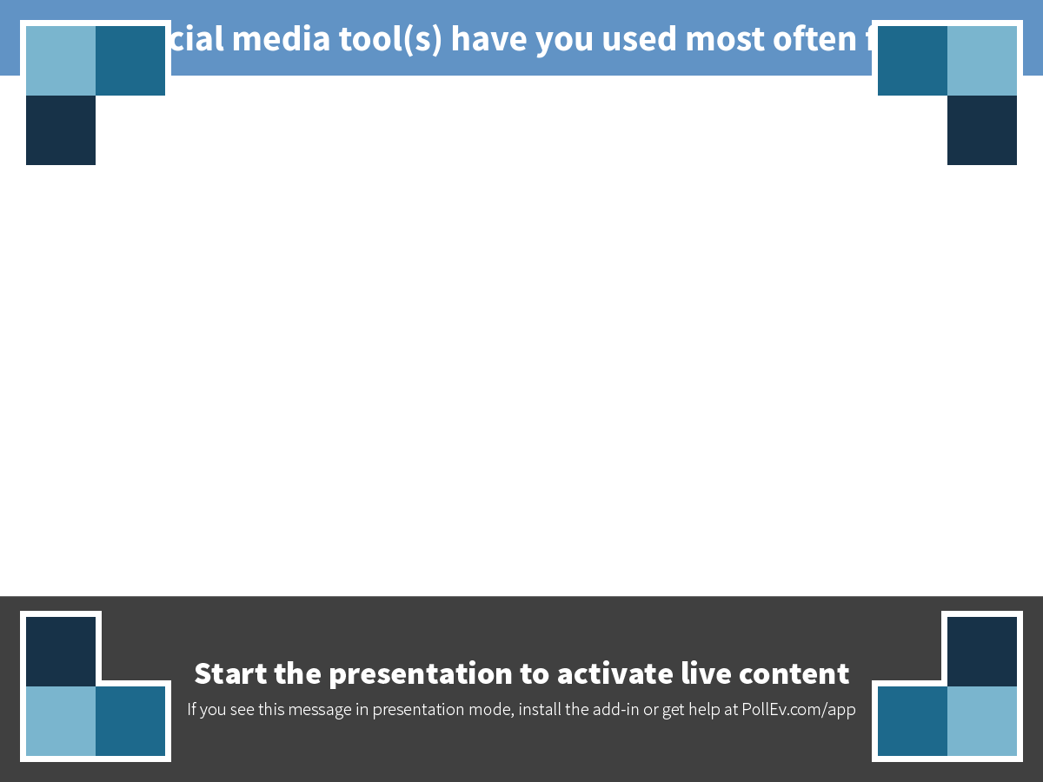
Notes:
Which social media tool(s) have you used most often for work?
https://www.polleverywhere.com/free_text_polls/qsGAGOhS833Lte5

Slide 17


Social Media Platforms
Number of active users (per month)
1.65 billion globally
310 million globally
Key audiences
87% of 18-29 year-olds world wide
77% of adult women online
66% of adult men online
37% of 18-29 year-olds world wide
21% of adult women online
24% of adult men online
Used for
Connecting personally with friends, family, and topics that we care about
Finding news and entertainment, online networking, and feeling connected to large trending debates
Why it is good for research
Huge user base. Great for building public and private groups around themed topics. Also great for sharing video.
Very popular social media network for connecting with other researchers and also journalists. Follow hashtags around research interests.
Adapted from:
1) Mollett A, Brumley C, Gilson C, Williams S. Communicating Your Research with Social Media: A Practical Guide to Using Blogs, Podcasts, Data Visualisations and Video. SAGE; p. 297, 2017.
2) Walters K. 125+ Essential Social Media Statistics Every Marketer Should Know. Hootsuite Blogs. Retrieved from: https://blog.hootsuite.com/social-media-statistics-for-social-media-managers/
Notes:
For example, if you are trying to reach teenagers in San Francisco to promote your project’s website about new mental health initiatives in the city, consider a targeted campaign using short video clips on platforms with large take-up by this group, such as Instagram and Snapchat. If, for the same project, you also want to raise awareness of your findings for teaching networks, consider a one-minute explainer video that could be shared in teacher Facebook groups and on resource websites. Again, for the same project, if you are looking to show the impact of your project to funders and how it was supported by local MPs and mentioned in a House of Commons debate, a 30-second slideshow of this footage to launch your report plus your other achievements might be part of the path to extra funding. Think about who will be interested in looking at and sharing your videos, photos and research, and map these out or list them – the more specific, the better.

Slide 18


Social Media Platforms
Number of active users (per month)
100 million globally
100 million globally
Key audiences
31% of 30-49 year-olds world wide
28% of adult women online
27% of adult men online
34% of 18-29 year-olds world wide
42% of adult women online
13% of adult men online
Used for
Professional networking and job hunting; an online CV
Curating images connected to hobbies, ideas, and aspirations
Why it is good for research
Good for sharing blog posts, developing a professional network.
For anyone working with infographics and images, this is a useful platform for connecting with students, colleagues, and smaller interest groups.
Adapted from:
1) Mollett A, Brumley C, Gilson C, Williams S. Communicating Your Research with Social Media: A Practical Guide to Using Blogs, Podcasts, Data Visualisations and Video. SAGE; 2017.
2) Walters K. 125+ Essential Social Media Statistics Every Marketer Should Know. Hootsuite Blogs. Retrieved from: https://blog.hootsuite.com/social-media-statistics-for-social-media-managers/
Notes:
For example, if you are trying to reach teenagers in San Francisco to promote your project’s website about new mental health initiatives in the city, consider a targeted campaign using short video clips on platforms with large take-up by this group, such as Instagram and Snapchat. If, for the same project, you also want to raise awareness of your findings for teaching networks, consider a one-minute explainer video that could be shared in teacher Facebook groups and on resource websites. Again, for the same project, if you are looking to show the impact of your project to funders and how it was supported by local MPs and mentioned in a House of Commons debate, a 30-second slideshow of this footage to launch your report plus your other achievements might be part of the path to extra funding. Think about who will be interested in looking at and sharing your videos, photos and research, and map these out or list them – the more specific, the better.

Slide 19


Social Media Platforms
Number of active users (per month)
400 million globally
1 billion globally
Key audiences
53% of 18-29 year-olds world wide
29% of adult women online
22% of adult men online
Almost a third of all people on the internet are YouTube users
Used for
Popular network for instantly sharing photos and videos. Enormous user base among young people around the world
Dedicated video platform where any individual, brand, or organization can show off their content in a sharable format
Why it is good for research
Offers a light and accessible way of sharing photos and videos with younger audiences. At the forefront of social media photo sharing.
Playlists show users more of your video content, and strong search and tagging function means your videos will be recommended to others.
Adapted from:
1) Mollett A, Brumley C, Gilson C, Williams S. Communicating Your Research with Social Media: A Practical Guide to Using Blogs, Podcasts, Data Visualisations and Video. SAGE; 2017.
2) Walters K. 125+ Essential Social Media Statistics Every Marketer Should Know. Hootsuite Blogs. Retrieved from: https://blog.hootsuite.com/social-media-statistics-for-social-media-managers/
Notes:
For example, if you are trying to reach teenagers in San Francisco to promote your project’s website about new mental health initiatives in the city, consider a targeted campaign using short video clips on platforms with large take-up by this group, such as Instagram and Snapchat. If, for the same project, you also want to raise awareness of your findings for teaching networks, consider a one-minute explainer video that could be shared in teacher Facebook groups and on resource websites. Again, for the same project, if you are looking to show the impact of your project to funders and how it was supported by local MPs and mentioned in a House of Commons debate, a 30-second slideshow of this footage to launch your report plus your other achievements might be part of the path to extra funding. Think about who will be interested in looking at and sharing your videos, photos and research, and map these out or list them – the more specific, the better.

Slide 20
Considerations for generating an audience
Ask “influencers” to share your content
Be responsive to users: shares, likes, questions, and inquiries
Consider timing:
  Tweet during a conference using their hashtag
  Post to Facebook if there’s recent media attention
Notes:
https://www.inc.com/brian-d-evans/how-to-get-100k-facebook-fans-in-30-days.html

Slide 21
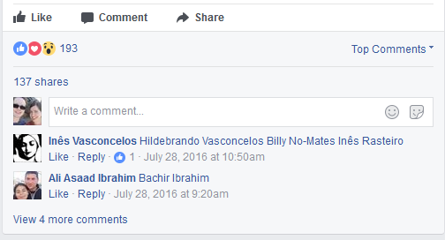
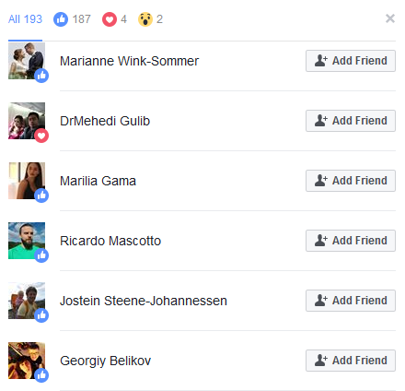
Considerations for generating an audience
Ask “influencers” to share your content
Be responsive to users: shares, likes, questions, and inquiries
Consider timing:
  Tweet during a conference using their hashtag
  Post to Facebook if there’s recent media attention
Many ideas online by searching “how to generate users for [social media platform]”
(above) screen shot of a Facebook post. Clicking on the 193 likes allows you to invite those users to follow your Facebook page.
Notes:
https://www.inc.com/brian-d-evans/how-to-get-100k-facebook-fans-in-30-days.html

Slide 22
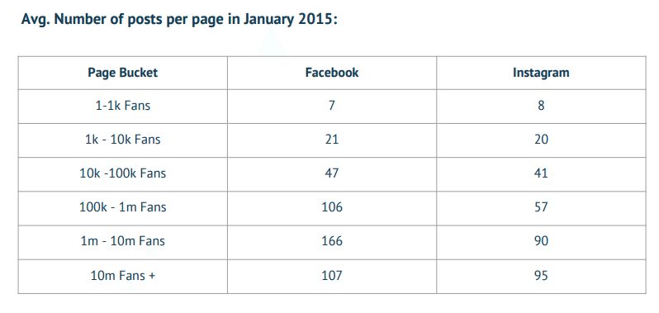
Considerations for generating an audience continued…
Be consistent with posting content. In general, “more successful” accounts tend to post with higher frequency.
(above) Figure showing the frequency of how often Facebook Fan page admins and owners of Instagram profiles post on their accounts. Quintly. Instagram Study. 2015 Retrieve from: http://press.quintly.com/100459-quintly-reveals-instagram-study-q1-2015
Notes:
http://press.quintly.com/100459-quintly-reveals-instagram-study-q1-2015

Slide 23
Considerations for generating content
Do you have content, or does it need to be generated?
  Interesting quotes from published literature
  Presentation slides that can be easily shared

Slide 24
Considerations for generating content
Do you have content, or does it need to be generated?
  Interesting quotes from published literature
  Presentation slides that can be easily shared
Plan to have both real-time and evergreen content
  Real-time content is connected to time-based events such as conferences, monthly themes, time-based statistics, current trends, etc.
  Evergreen content stays continually relevant and lasting long past its publication, such as reviews, lists, videos, etc.

Slide 25
Considerations for generating content
Do you have content, or does it need to be generated?
  Interesting quotes from published literature
  Presentation slides that can be easily shared
Plan to have both real-time and evergreen content
  Real-time content is connected to time-based events such as conferences, monthly themes, time-based statistics, current trends, etc.
  Evergreen content stays continually relevant and lasting long past its publication, such as reviews, lists, videos, etc.
Consider content on these topics:
  Discussion about research findings
  Raising questions about an area of research
  Comments on publications by other authors
  Recap of conferences attended
  Description of how research can relate to public policy
  Connection of current events (both public and research) to research area
  Plain language summary of research articles

Slide 26
Considerations for generating content continued…
Create opportunities for wider sharing
  Ask popular bloggers if researchers can write a guest blog post
  Ask organizations with larger mailing lists to send your content
Notes:
A general public awareness of your project can be achieved through a combined approach of mass and social media platforms to get you broad exposure, but if you are looking to change policy or behaviour in some substantial way, you will need to spend considerably more time understanding the motivations of the ecosystem of stakeholders, actively listening to the feedback and incorporating perspectives from these stakeholders into your research communication activity.

Slide 27
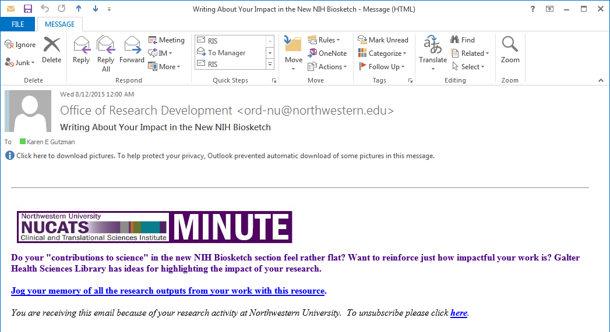
Considerations for generating content continued…
Create opportunities for wider sharing
  Ask popular bloggers if researchers can write a guest blog post
  Ask organizations with larger mailing lists to send your content
(above) Email from NUCATS on content generated by the Galter Library
Notes:
A general public awareness of your project can be achieved through a combined approach of mass and social media platforms to get you broad exposure, but if you are looking to change policy or behaviour in some substantial way, you will need to spend considerably more time understanding the motivations of the ecosystem of stakeholders, actively listening to the feedback and incorporating perspectives from these stakeholders into your research communication activity.

Slide 28
Considerations for generating content continued…
    A few other things:
  Review advice for writing plain language summaries: https://blog.growkudos.com/2015/12/04/explain-your-work-the-kudos-way/
  Add links back to research articles, presentations, or other content housed in DigitalHub
  Remember, you want to spark interest so people will consume, comment, like, or share your content.

Slide 29
Considerations for generating content continued…
    A few other things:
  Review advice for writing plain language summaries: https://blog.growkudos.com/2015/12/04/explain-your-work-the-kudos-way/
  Add links back to research articles, presentations, or other content housed in DigitalHub
  Remember, you want to spark interest so people will consume, comment, like, or share your content.
    Identified relevant keywords and hashtags
  Google Trends (www.google.com/trends): find keywords that people use to query a specific topic
  Hashtagify.me (http://hashtagify.me/): search popularity of hashtags
  Ritetag (https://ritetag.com/): search for trending hashtags

Slide 30
Example of dissemination in action
Let’s say your center works on mental health and wants promote their work to teens, general public, and to policy makers.
Notes:
For example, if you are trying to reach teenagers in San Francisco to promote your project’s website about new mental health initiatives in the city, consider a targeted campaign using short video clips on platforms with large take-up by this group, such as Instagram and Snapchat. If, for the same project, you also want to raise awareness of your findings for teaching networks, consider a one-minute explainer video that could be shared in teacher Facebook groups and on resource websites. Again, for the same project, if you are looking to show the impact of your project to funders and how it was supported by local MPs and mentioned in a House of Commons debate, a 30-second slideshow of this footage to launch your report plus your other achievements might be part of the path to extra funding. Think about who will be interested in looking at and sharing your videos, photos and research, and map these out or list them – the more specific, the better.

Slide 31
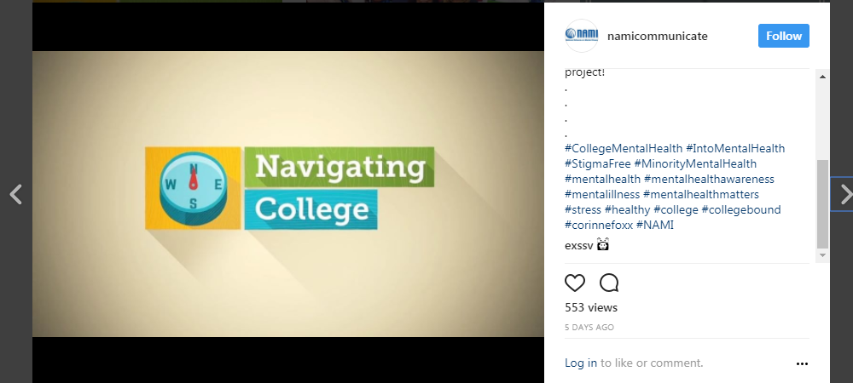
Example of dissemination in action
Let’s say your center works on mental health and wants promote their work to teens, general public, and to policy makers.
Promote mental health initiatives to teens using short video clips on platforms such as Instagram and Snapchap.
(right) Video on Instagram by National Alliance for Mental Health with 553 views #collegementalhealth
Notes:
For example, if you are trying to reach teenagers in San Francisco to promote your project’s website about new mental health initiatives in the city, consider a targeted campaign using short video clips on platforms with large take-up by this group, such as Instagram and Snapchat. If, for the same project, you also want to raise awareness of your findings for teaching networks, consider a one-minute explainer video that could be shared in teacher Facebook groups and on resource websites. Again, for the same project, if you are looking to show the impact of your project to funders and how it was supported by local MPs and mentioned in a House of Commons debate, a 30-second slideshow of this footage to launch your report plus your other achievements might be part of the path to extra funding. Think about who will be interested in looking at and sharing your videos, photos and research, and map these out or list them – the more specific, the better.

Slide 32
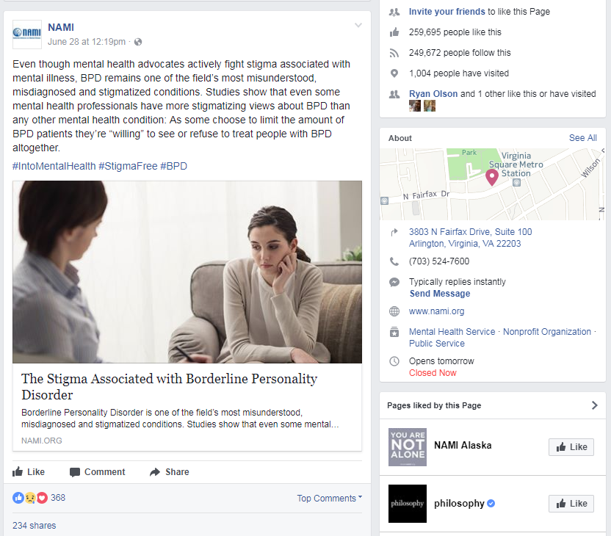
Example of dissemination in action
Let’s say your center works on mental health and wants promote their work to teens, general public, and to policy makers.
Promote mental health initiatives to teens using short video clips on platforms such as Instagram and Snapchap.
(right) Video on Instagram by National Alliance for Mental Health with 553 views #collegementalhealth
Promote plain language summaries of mental health research to the general public that can be shared in Facebook groups and on resource websites.
(right) Short article on Facebook by National Alliance for Mental Health with 368 shares #StigmaFree
Notes:
For example, if you are trying to reach teenagers in San Francisco to promote your project’s website about new mental health initiatives in the city, consider a targeted campaign using short video clips on platforms with large take-up by this group, such as Instagram and Snapchat. If, for the same project, you also want to raise awareness of your findings for teaching networks, consider a one-minute explainer video that could be shared in teacher Facebook groups and on resource websites. Again, for the same project, if you are looking to show the impact of your project to funders and how it was supported by local MPs and mentioned in a House of Commons debate, a 30-second slideshow of this footage to launch your report plus your other achievements might be part of the path to extra funding. Think about who will be interested in looking at and sharing your videos, photos and research, and map these out or list them – the more specific, the better.

Slide 33
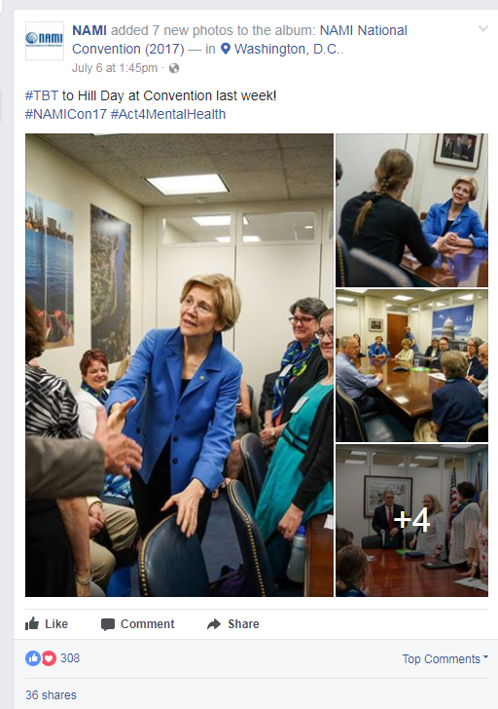
Example of dissemination in action continued…
Let’s say your center works on mental health and wants promote their work to teens, general public, and to policy makers.
Show the impact of work to funders and how it is supported by local policy makers with a short slideshow on Facebook.
(far right, top) White paper on Public Policy Platform of the National Alliance on Mental Illness https://www.nami.org/Learn-More/Public-Policy
(far left, top) Facebook slideshow of National Alliance on Mental Illness meetings with US Senators #Act4MentalHealth
(middle, bottom) Blog post for National Alliance on Mental Illness by guest blogger AJ Mendez https://www.nami.org/Blogs/NAMI-Blog/July-2017/Breaking-Tradition
Notes:
For example, if you are trying to reach teenagers in San Francisco to promote your project’s website about new mental health initiatives in the city, consider a targeted campaign using short video clips on platforms with large take-up by this group, such as Instagram and Snapchat. If, for the same project, you also want to raise awareness of your findings for teaching networks, consider a one-minute explainer video that could be shared in teacher Facebook groups and on resource websites. Again, for the same project, if you are looking to show the impact of your project to funders and how it was supported by local MPs and mentioned in a House of Commons debate, a 30-second slideshow of this footage to launch your report plus your other achievements might be part of the path to extra funding. Think about who will be interested in looking at and sharing your videos, photos and research, and map these out or list them – the more specific, the better.

Slide 34
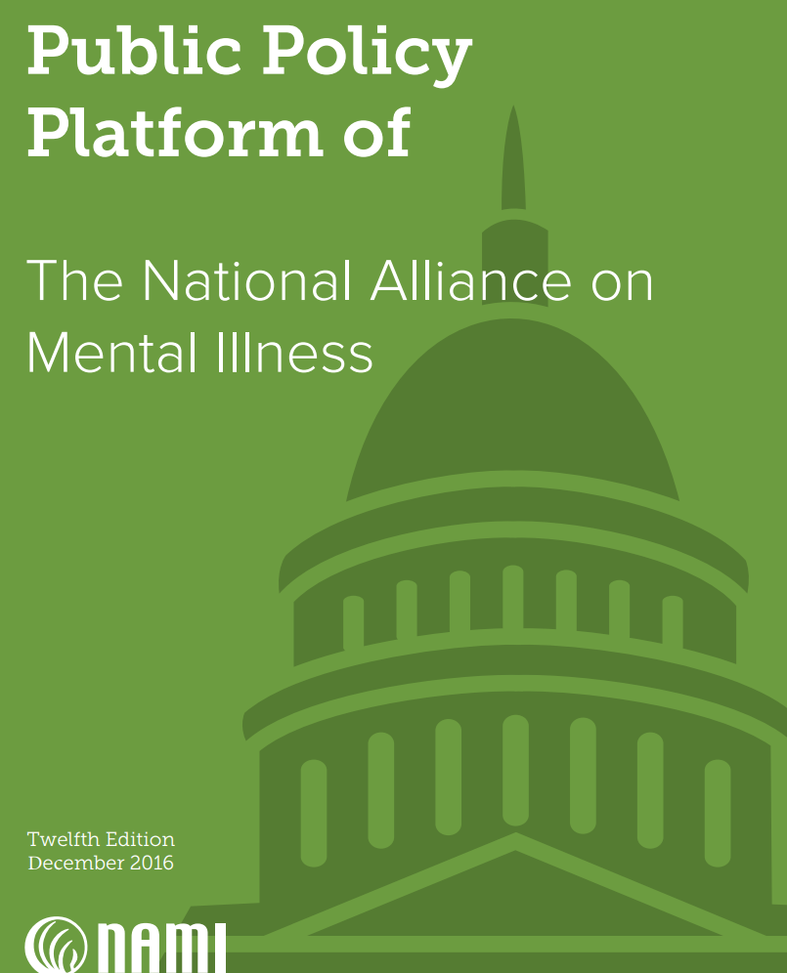
Example of dissemination in action continued…
Let’s say your center works on mental health and wants promote their work to teens, general public, and to policy makers.
Show the impact of work to funders and how it is supported by local policy makers with a short slideshow on Facebook.
Share a white paper on a website with recommendations for policy change.
(far right, top) White paper on Public Policy Platform of the National Alliance on Mental Illness https://www.nami.org/Learn-More/Public-Policy
(far left, top) Facebook slideshow of National Alliance on Mental Illness meetings with US Senators #Act4MentalHealth
(middle, bottom) Blog post for National Alliance on Mental Illness by guest blogger AJ Mendez https://www.nami.org/Blogs/NAMI-Blog/July-2017/Breaking-Tradition
Notes:
For example, if you are trying to reach teenagers in San Francisco to promote your project’s website about new mental health initiatives in the city, consider a targeted campaign using short video clips on platforms with large take-up by this group, such as Instagram and Snapchat. If, for the same project, you also want to raise awareness of your findings for teaching networks, consider a one-minute explainer video that could be shared in teacher Facebook groups and on resource websites. Again, for the same project, if you are looking to show the impact of your project to funders and how it was supported by local MPs and mentioned in a House of Commons debate, a 30-second slideshow of this footage to launch your report plus your other achievements might be part of the path to extra funding. Think about who will be interested in looking at and sharing your videos, photos and research, and map these out or list them – the more specific, the better.

Slide 35
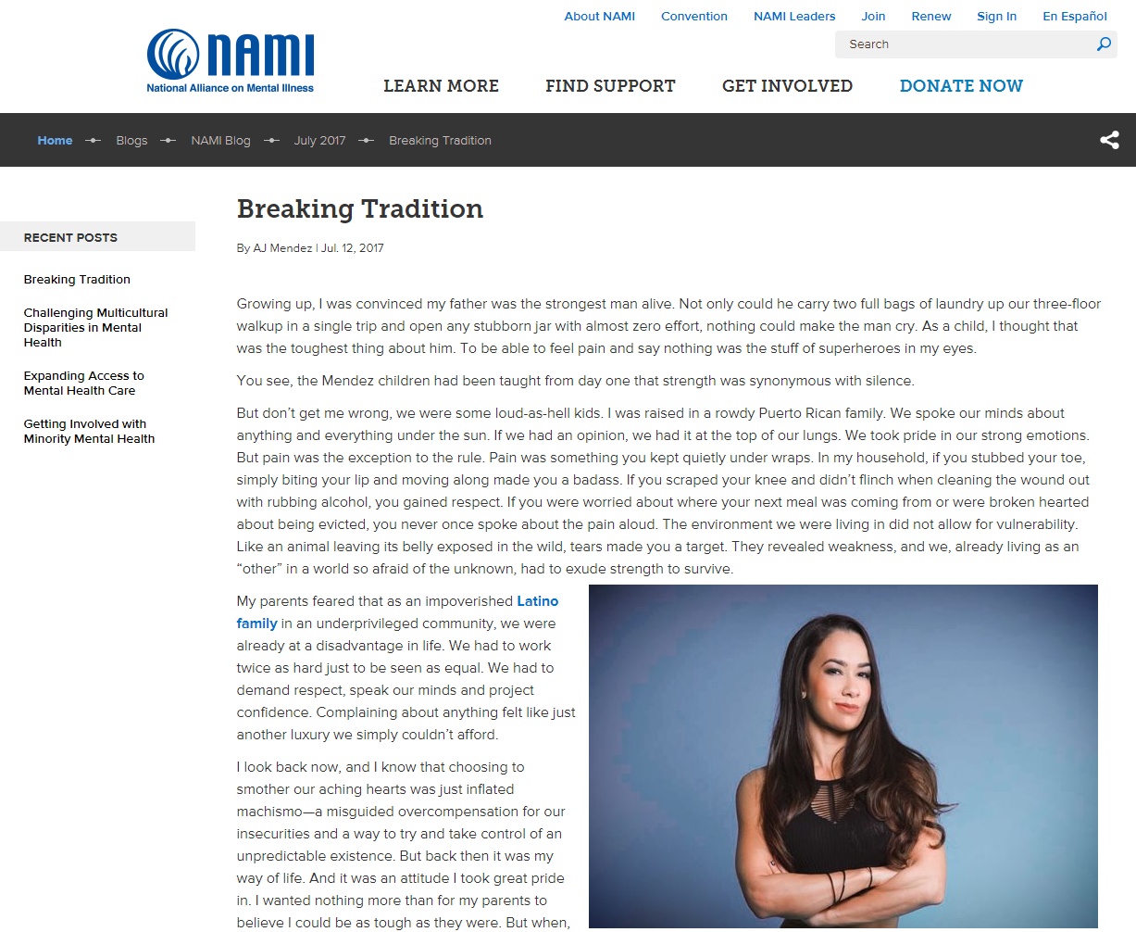
Example of dissemination in action continued…
Let’s say your center works on mental health and wants promote their work to teens, general public, and to policy makers.
Show the impact of work to funders and how it is supported by local policy makers with a short slideshow on Facebook.
Share a white paper on a website with recommendations for policy change.
Generate opportunities for researchers to be featured as guest bloggers on blogs of national organizations.
(far right, top) White paper on Public Policy Platform of the National Alliance on Mental Illness https://www.nami.org/Learn-More/Public-Policy
(far left, top) Facebook slideshow of National Alliance on Mental Illness meetings with US Senators #Act4MentalHealth
(middle, bottom) Blog post for National Alliance on Mental Illness by guest blogger AJ Mendez https://www.nami.org/Blogs/NAMI-Blog/July-2017/Breaking-Tradition
Notes:
For example, if you are trying to reach teenagers in San Francisco to promote your project’s website about new mental health initiatives in the city, consider a targeted campaign using short video clips on platforms with large take-up by this group, such as Instagram and Snapchat. If, for the same project, you also want to raise awareness of your findings for teaching networks, consider a one-minute explainer video that could be shared in teacher Facebook groups and on resource websites. Again, for the same project, if you are looking to show the impact of your project to funders and how it was supported by local MPs and mentioned in a House of Commons debate, a 30-second slideshow of this footage to launch your report plus your other achievements might be part of the path to extra funding. Think about who will be interested in looking at and sharing your videos, photos and research, and map these out or list them – the more specific, the better.

Slide 36



Managing Social Media Content
Three tools for managing social media content
  Hootsuite (https://hootsuite.com/)
    Free version for individual – only three social media networks (ex. Twitter, Facebook, Linked In)
    Monitor networks
    Publish to networks using a schedule
  Kudos (https://www.growkudos.com/)
    Free version for individual researcher
    Claim publications, write plain language summaries, and publish to Facebook, Twitter, Linked In, or get a traceable link to share across your email, Mendeley, ResearchGate, Academia.edu
    Tracks shares, mentions, readers, etc. across social media networks via Altmetric
  Microsoft Excel
    Share a spreadsheet with people working on content
    Easily keep a schedule for content review and publishing
    Quickly find past content for re-publishing

Slide 37
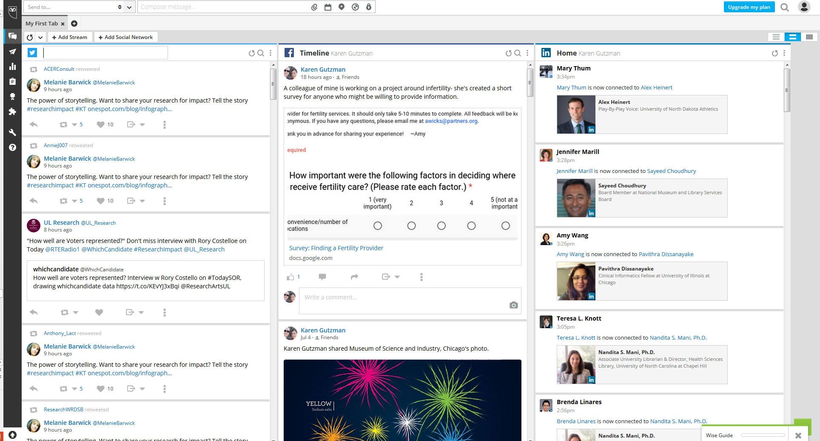
Hootsuite

Slide 38
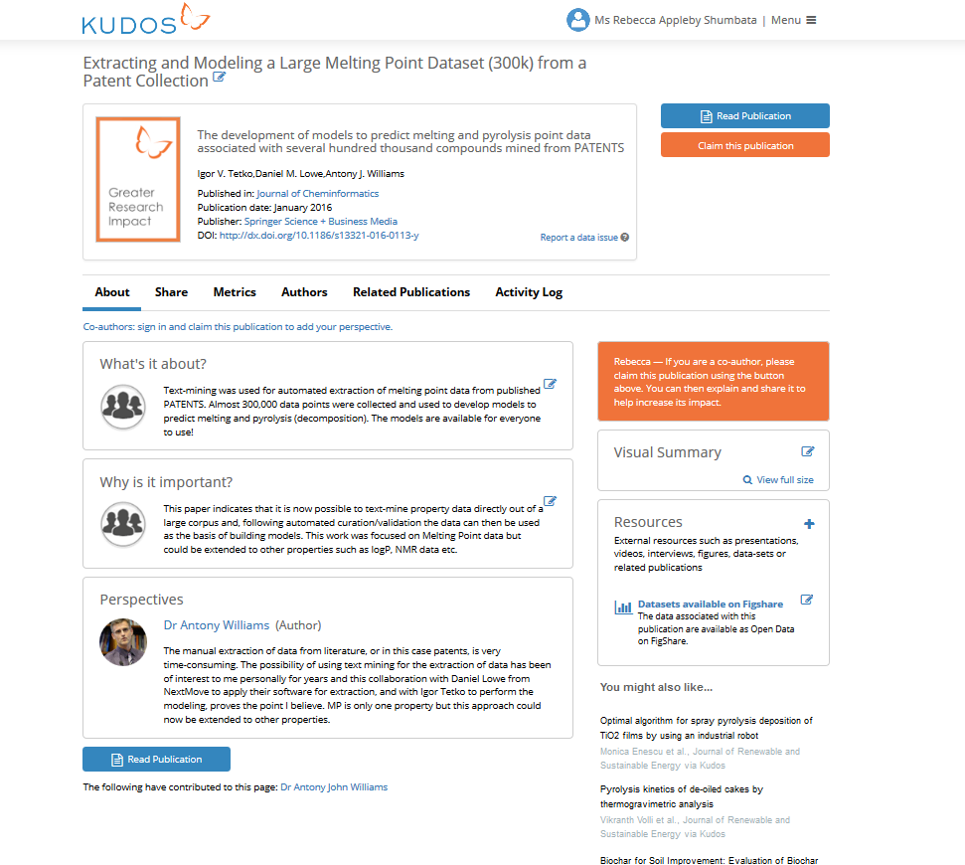
Kudos - Personal Dashboard
Notes:
In this environment, “standing out” requires a proactive approach – you can’t just publish, and expect that people will find, read and apply your work.
But the challenge is to know how to communicate – should you stick with email? If you experiment with social media or academic networks, which ones should you focus on?
It’s hard to connect meaningful publication metrics back to your communications to know what is actually increasing readership.

Slide 39




Managing Social Media Content continued…
Other tools for managing or monitoring social media
  Sprinklr: https://www.sprinklr.com/
  Spredfast: https://www.spredfast.com/social-marketing-platform
  Buffer: https://buffer.com/
  Tweetdeck: https://tweetdeck.twitter.com/
  Sysomos http://sysomos.com/

Slide 40
Navigating Risks of Online Communication
Review of “terms of service”
  When you publish on Twitter, you do not own your content.
  For example, if you post plain language summaries of research, you grant Twitter the right to use/copy/reproduce/adapt/distribute (etc.) that content.
    “By submitting, posting or displaying Content on or through the Services, you grant us a worldwide, non-exclusive, royalty-free license (with the right to sublicense) to use, copy, reproduce, process, adapt, modify, publish, transmit, display and distribute such Content in any and all media or distribution methods (now known or later developed).” (Twitter, 2016)
“For content that is covered by intellectual property rights, like photos and videos (IP content), you specifically give us the following permission, subject to your privacy and application settings: you grant us a non-exclusive, transferable, sub-licensable, royalty-free, worldwide license to use any IP content that you post on or in connection with Facebook (IP License).” (Facebook, 2016)
Have a plan for negative comments or “trolls”
  Contact the Office of Communication (see link on upcoming slide) for any complaints about the school or crisis situations (e.g. a crime or accident related to a student on campus)
Notes:
http://www.feinberg.northwestern.edu/communications/brand/social-media/index.html

Slide 41
Tracking attention on social media
Tracking social media through metrics
  How often are people viewing your articles?
  How often have people tweeted your articles?
  See upcoming session on: Tracking Outputs and Citation Impact
Where to host or collect scholarly content, if not on your webpage?
  See upcoming session on: DigitalHub: Making Research Open and Available

Slide 42
Resources at Northwestern
Center for Community Health
  http://www.feinberg.northwestern.edu/sites/cch/
  CCH’s mission is to catalyze and support meaningful community and academic engagement across the research spectrum to improve health and health equity.
NU FSM Office of Communications: Social Media Guidelines
  http://www.feinberg.northwestern.edu/communications/brand/social-media/index.html
  Northwestern University Feinberg School of Medicine strongly encourages our Feinberg community members to engage, build networks of like-minded scholars, stay connected, share information, and help us promote the medical school's goals and vision.

Slide 43
Thank You
Questions?
Thank you to Patty Smith and Linda O’Dywer for assisting with content development and reviewing slides.

Slide 44
Activity: Creating sharable content
What do you want to achieve?
  Increase awareness of importance of daily physical activity
Who is your target audience(s)?
  Workers who sit for 8 hours per day (i.e. office workers, transportation workers, etc.)
What format do you want to use?
  Facebook
Do you have content, or does it need to be generated?
  Yes! We have a recent study published about the health effects of prolonged sitting.
Ekelund U, Steene-Johannessen J, Brown WJ, Fagerland MW, Owen N, Powell KE, Bauman A, Lee I-M. Does physical activity attenuate, or even eliminate, the detrimental association of sitting time with mortality? A harmonised meta-analysis of data from more than 1 million men and women. The Lancet. 2016;388(10051):1302–1310.
http://www.thelancet.com/journals/lancet/article/PIIS0140-6736(16)30370-1/fulltext

Slide 45
Activity: Create sharable content
Article title
Does physical activity attenuate, or even eliminate, the detrimental association of sitting time with mortality? A harmonised meta-analysis of data from more than 1 million men and women
Background
High amounts of sedentary behaviour have been associated with increased risks of several chronic conditions and mortality. However, it is unclear whether physical activity attenuates or even eliminates the detrimental effects of prolonged sitting. We examined the associations of sedentary behaviour and physical activity with all-cause mortality.
Interpretation
High levels of moderate intensity physical activity (ie, about 60–75 min per day) seem to eliminate the increased risk of death associated with high sitting time. However, this high activity level attenuates, but does not eliminate the increased risk associated with high TV-viewing time. These results provide further evidence on the benefits of physical activity, particularly in societies where increasing numbers of people have to sit for long hours for work and may also inform future public health recommendations.
Ekelund U, Steene-Johannessen J, Brown WJ, Fagerland MW, Owen N, Powell KE, Bauman A, Lee I-M. Does physical activity attenuate, or even eliminate, the detrimental association of sitting time with mortality? A harmonised meta-analysis of data from more than 1 million men and women. The Lancet. 2016;388(10051):1302–1310.
http://www.thelancet.com/journals/lancet/article/PIIS0140-6736(16)30370-1/fulltext

Slide 46
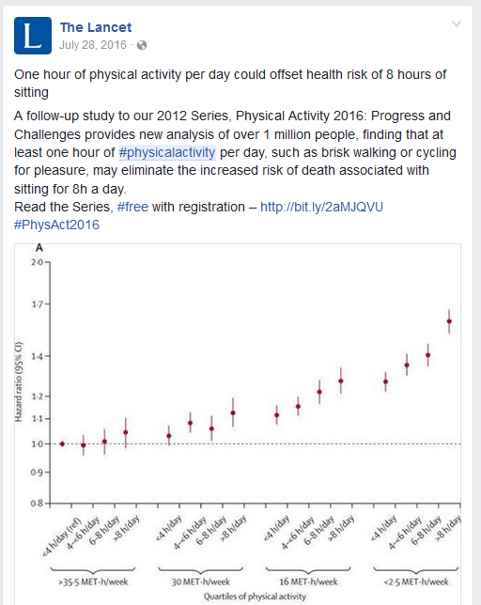

Slide 47
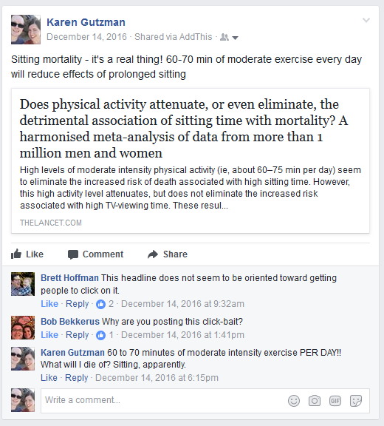

Slide 48
Activity: Create sharable content
Do you sit for more than 4 hour per day? You may be at risk for poor health.
A brisk walk is just what the doctor ordered! Decrease your risk of sitting mortality through 60 minutes of moderate intensity activity every day.
Feeling the effects of sitting all day long? Sitting for more than 4 hours a day is associated with increased mortality. Decrease your risk with 60 minutes of moderate exercise every day.
Hashtags:
  #physicalactivity
  #getfit
  #wellness
  #walking

