Slide 1
Agenda
Introductions/Workshop Background
Learning Objectives
Defining Alignment/Why Align/What to Align in Mentoring Relationships?
Breakout #1: Identifying and Addressing Misalignment
Tools for Aligning Expectations
Breakout #2: Alignment in Multidisciplinary Mentoring Teams
Mentoring in Crisis: Realigning Expectations
Wrap up and Next Steps

Slide 2
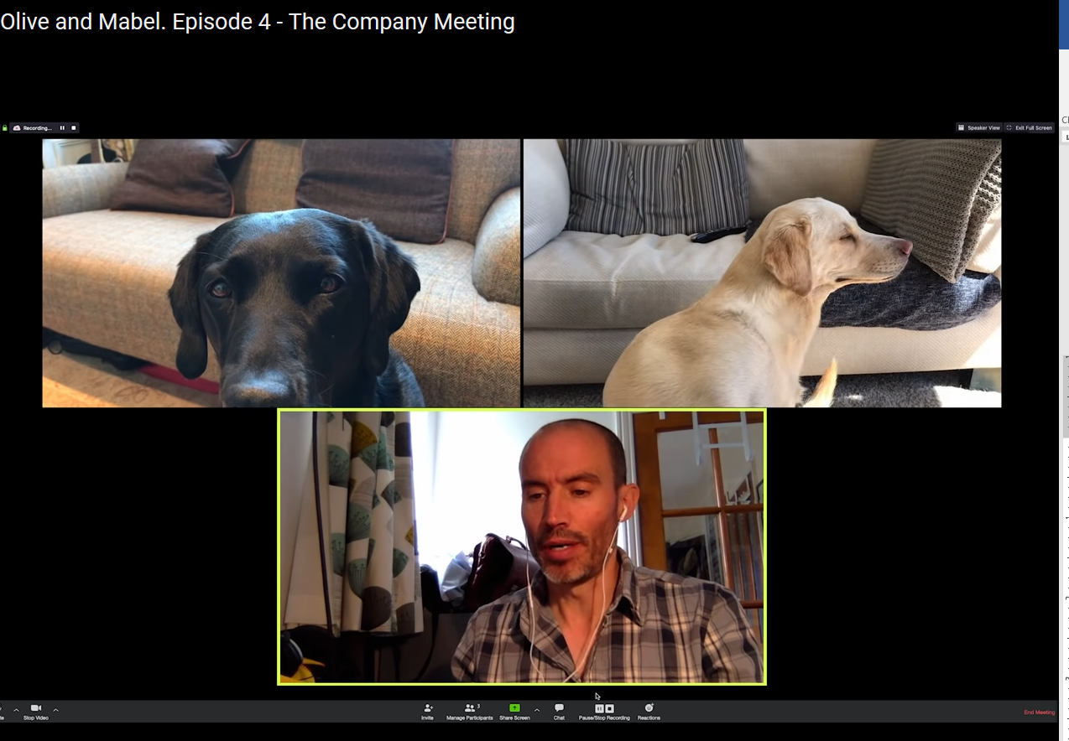
Participation Notes
Workshop is for you – apply principles to your own experiences
Zoom Etiquette
  Videos on as possible
  Mute in large group unless responding
  Unmute and engage in breakouts
    Be inclusive!
  Feel free to use chat and hand raise features
    Use chat if needed for tech or background noise reasons
Be Mabel, not Olive!
Mabel
Olive

Slide 3
NUCATS Mentoring Workshop Background
Entering Mentoring/Mentor Training for Clinical and Translational Researchers
National CTSA mentor working group led by Fleming from 2009-2013
  26 members from 16 level 1 universities
  Met for 4 years, wrote 13 papers, developed and tested a mentor training curriculum
  Came to a consensus on “best mentoring practices”
Delivered training to over 700 faculty at NU in half day live seminars
Evolved to enhance efficiency of delivery and requests for specific content
2020 – 2021: new NUCATS Series implemented

Slide 4
NUCATS Series on Developing and Enhancing Mentoring Relationships (reimagined Mentor Development Workshop)
All scheduled for 7:30 – 9:00 AM on Thursdays via Zoom until further notice Beginning Jan, is always 1st Thurs of the month
10/29/2020 | Articulating your Mentoring Needs
12/10/2020 | Establishing and Aligning Expectations in Mentoring
01/07/2021 | Maintaining Effective Communication/Difficult Conversations
02/04/2021 | Cultural Awareness in Mentoring across Differences
03/04/2021 | Creating SMART Goals for Your Feinberg Faculty Portal and Your Career Development Plan
04/08/2021 | Mentor Mapping and Mentor Networks
05/06/2021 | Evaluating Your Goals/Evaluating Your Mentee’s Goals
06/03/2021 | Articulating Your Mentoring Philosophy and Plan

Slide 5
Establishing and Aligning Expectations in Mentoring
Learning Objectives
By the conclusion of this workshop, attendees will:
  Examine existing expectations in your current mentoring relationships; question which expectations need to be revisited or discussed.
  Categorize your mentoring needs. Clarify and differentiate your expectations among multiple mentors (including secondary, team and/or peer mentors; coaches; and sponsors) to result in mutually beneficial relationships.
  Choose 1 – 2 behavior changes you can enact in the next 3 – 6 months to improve alignment in your mentoring relationships.

Slide 6
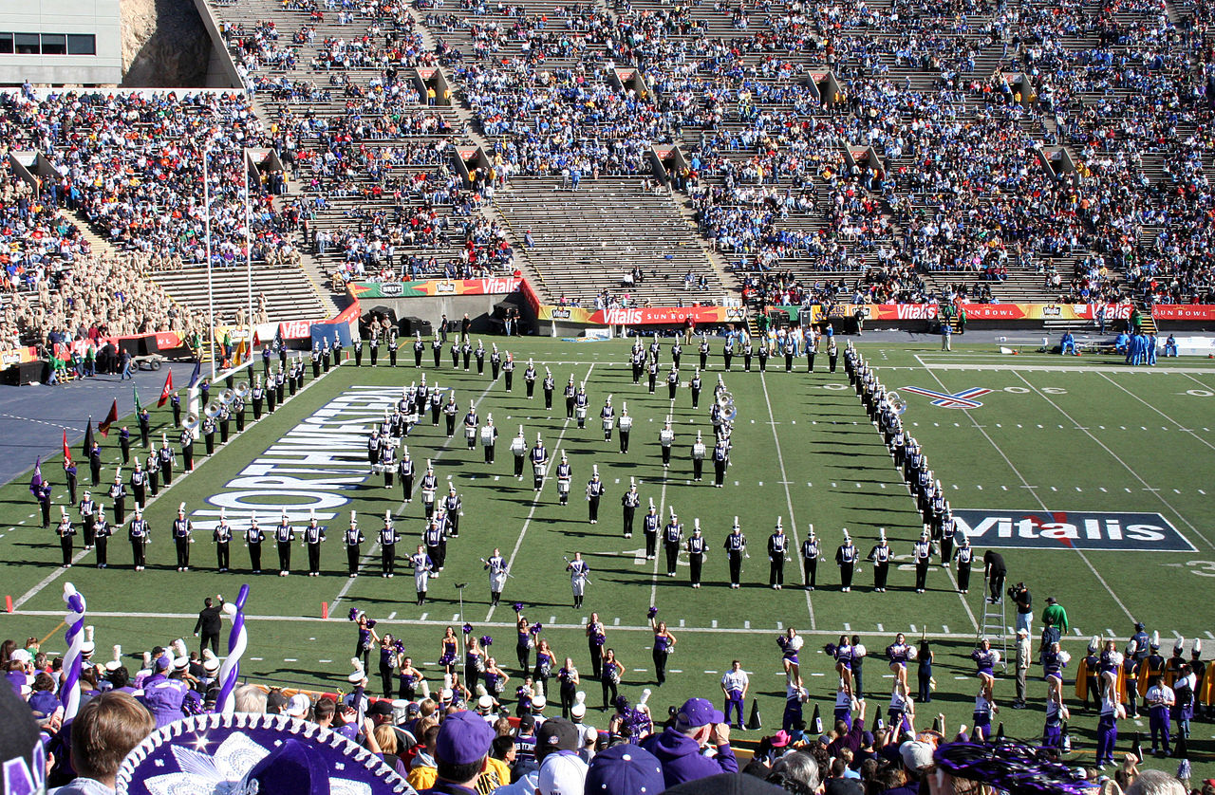
Aligning Expectations
Alignment: an agreement between people or groups who want to work together because of shared interests or aims
Expectation: the feeling or belief that something will or should happen

Slide 7
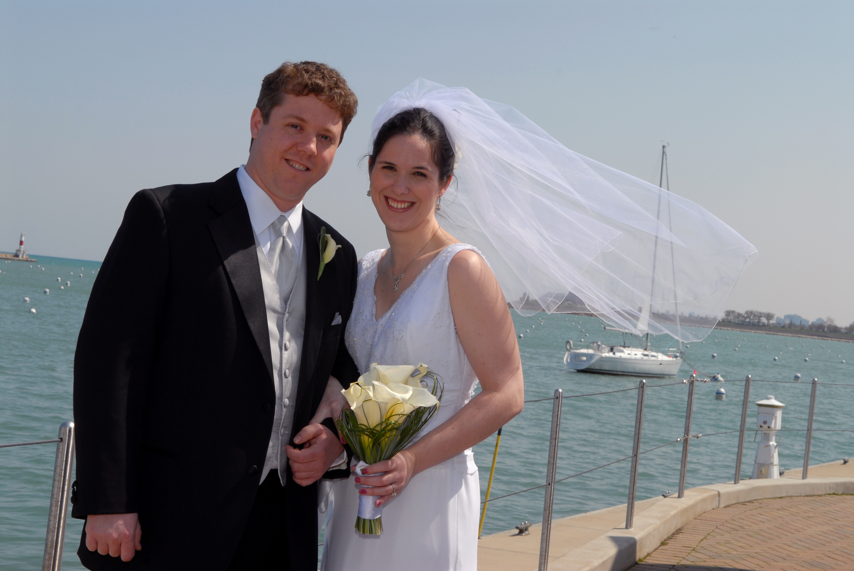
A Communication Scientist’s Wedding Vows
“And I love you because you know expectancy violation theory… and you use it!”
April 26, 2008

Slide 8
WHY Align Expectations?
Avoid miscommunication around roles and responsibilities
Avoid negative expectancy violations
Identify and achieve mutually beneficial goals
Assure that institutional and discipline-specific norms and standards are communicated
“So if you don’t have your expectations explicit up front, it makes it difficult to then go back and say, “Are you getting what you need?”
[Huskins et al. 2011, p. 441]
Abedin Z, et al. (2012). Clin Trans Sci.
Huskins WC et al. (2011). Clin Trans Sci.
Burgoon, Birk, Hall (1991). Human Comm Res

Slide 9
Alignment in Action….Pre-Survey
(please complete after this session if you have not yet done so)
What are you hoping to gain from participating in the NUCATS Mentoring Series?

Slide 10
WHAT to align in mentoring?

Slide 11
WHAT is “Alignment”?
Ultimate Career Goals
Process
Alignment challenges vary
  Faculty-student
  Faculty-postdoc/resident/fellow
  Senior-junior faculty
Differing interests and needs, e.g.:
  Mentor: productivity, bandwidth
  Mentee: training, independence, promotion/tenure, independent productivity
Explicit agreement around expectations for factors central to a productive working relationship:
  Time
    Time spent together
    Response time (emails, manuscripts, etc.)
    Critical timelines/deadlines
  Pre-meeting work (e.g., agenda setting)
  Meeting roles (“active” vs. “passive” role for mentor/mentee)
  Mentoring goals: content, methods, networking, professional development, etc.
  Project management
  Professional relationship management (internal and external)
  Extent of personal relationship
  Addressing conflicts/challenges
  Realignment/Ending Mentoring Relationships

Slide 12
BREAKOUT GROUPS – Misalignment (7 min)
Introduce yourself (BRIEFLY: Name, Division, Primary Role – e.g., research, teaching, clinical, administrative)
Choose scenario to focus on (30 seconds)
If possible, have group member share screen to project case study ( link available in chat)
Be prepared to share perspectives in larger group
What are the central challenges or themes raised in this case study?
What could have been done to avoid this situation?
Next steps:
a. What should the mentor do now?
b. What should the mentee do now?
Questions will be shared in the chat function

Slide 13
BREAKOUT GROUPS
The “Inefficient” Clinician
Passing the Torch
The Second-Year Blues
What are the central challenges or themes raised in this case study?
What could have been done to avoid this situation?
Next steps:
a. What should the mentor do now?
b. What should the mentee do now?
Questions will be shared in the chat function

Slide 14
HOW to align expectations?
Explicitly state objectives of mentoring relationship
  Include personal and career goals
  Consider timeframes
    Of mentoring relationship
    Upcoming deadlines and their importance (e.g., conferences, application deadlines) – explicitly identify and don’t assume!
Be honest in your communication
  what is asked and what is achievable (for both mentee and mentor)
Mutual accountability
Communicate regularly
  Use agendas to streamline and focus meetings
Use alignment tools/checklists

Slide 15
Aligning Expectations: Tools
Alignment Checklist(s)
Feinberg Faculty Profile
Goals (Research/Scholarship, Education, Clinical)
Support/Professional Development Needs
Campus Service/Citizenship
Individual/Career Development Plan
Compacts
Expectations to publish and present
Collaborations within group and beyond
Professional development (e.g., coursework, meeting training grant requirements)
Professional interactions (e.g., work hours, vacation, correspondence)

Slide 16
Logistics
  Meeting duration/frequency
  Preparation for meetings
  Lead/response times for requests
Mentoring Relationships
  Type (e.g., traditional mentor, coach, sponsor, connector)
  Expected benefits
  “Re-engage or Disengage” time
Career/Professional Development
  Goals (Short, Medium, Long-Term)
  Promotion/Tenure Recs, progress
Work-Life Integration
Education/Teaching
  Curriculum development
  Educational Scholarship
Research
  Authorship
  Research Independence
Clinical
  Responsibilities
  Challenges
  Leadership opportunities
Service
  Community/Extracurricular opportunities and involvement

Slide 17

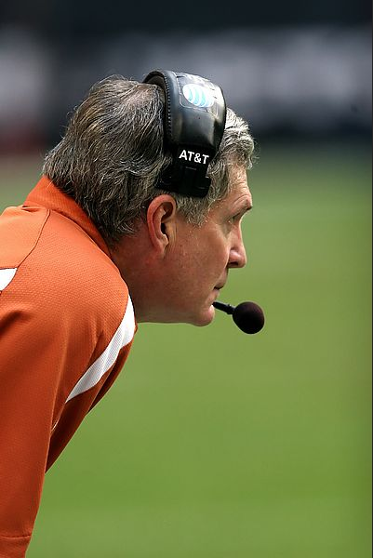

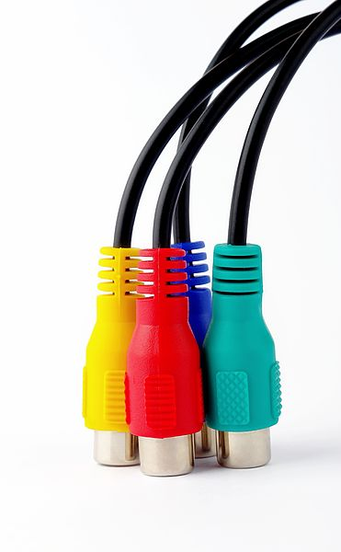
Alignment with Multiple Mentors
Traditional Mentor
Formal, Career-focused
Long-term
Reciprocal
Coach
Issue-focused
Short-term
Sponsor
Influential
Visibility-focused
Connector
Link mentees with others
Create networks
Focused on their field
Chopra V, Arora VM, Saint S. Will You Be My Mentor?—Four Archetypes to Help Mentees Succeed in Academic Medicine. JAMA Intern Med. 2018;178(2):175–176. doi:10.1001/jamainternmed.2017.6537

Slide 18
Alignment among a Mentoring TEAM
Move away from “guru mentor” to team mentoring
Mentoring for career advancement and career and life goals
Experts in:
  Content (scientific, clinical, educational) – may be primary mentor
  Methods
  Career path you wish to emulate
  Personal and Professional Roles
Alignment needed with each mentor – and across mentors as well

Slide 19
BREAKOUT GROUPS – 5 Minutes
Alignment in Multidisciplinary Mentoring Teams
What challenges are faced when working with multiple mentors?
How do personal and professional differences influence expectations (including differences across disciplines)?
How could you preemptively address identified challenges?
Questions will be shared in the chat function

Slide 20
Realigning Expectations
Discuss and be willing to revise expectations as needed
  Discuss potential options if expectations are not met before it becomes an issue
  Understand idea of expectancy violations (positive and negative)
Recognize that as a mentee – role is “to learn, not be perfect” (Vaughn, Saint, Chopra, 2017, JAMA)
  Reframe mistakes as improvement opportunities, not failures
  Address missteps directly and with candor
    Recognize such discussions can be learning opportunities for mentee and mentor

Slide 21
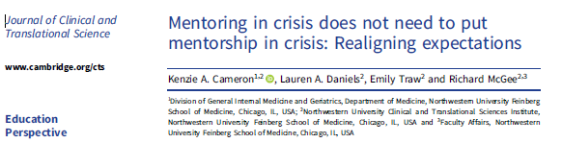
Mentoring in Crisis
Recognize the World in Crisis
Acknowledge Grief and Practice Compassion
Validate Shifting Professional and Personal Roles and Responsibilities
Realign Mentorship Expectations
Cameron, Daniels, Traw, McGee, 2020

Slide 22
Realign Mentorship Expectations
Mentoring in Crisis | Strategies
Acknowledge the importance of and need for reassessing goals | Identify safe spaces Practice mindful listening
Make time and space to engage in conversations with your mentees
Start the conversation with your mentee, then listen carefully
Be open and honest with your mentee | Engage in open conversation Share information
Be aware of the cultural differences and similarities between yourself and your mentees | Acknowledge diversity of person, position and life experiences

Slide 23
Balancing Mentor and Mentee Expectations
Mentoring Relationships should:
  Set Ground Rules (expectations)
  Be led by Mentee’s initiative (mentor should not be expected to be one to keep relationship going)
  Be mutually beneficial
  Be a partnership
  Meet mentors’ and mentee’s expectations for a productive relationship
  Prioritize honest and open communication (key to mutual satisfaction)
  View Alignment as a continuing process

Slide 24
Remember…
Everyone enters interactions with expectations (conscious or unconscious)
  Examine and reflect on your own expectations
Aligning expectations early (and often) may prevent negative interactions
Alignment is a joint process (team process if team of mentors)
Alignment is not a one-time, static event – Realign, recognize changing contexts
Upcoming Sessions – choose which will best fit your needs
  January 7, 2021: Maintaining Effective Communication/Difficult Conversations

Slide 25
What is your own Take Away?
What aspect of how you have approached aligning your mentoring relationship(s) do you plan to change moving forward?
  i.e., what individual behavior change(s) could you enact to improve alignment in your mentoring relationships?
    Share in chat if willing
  What is the time frame in which you intend to make that change?

Slide 26
Thank You for Attending
Please Complete Brief Evaluation via REDCap (will be emailed to you)
Questions:
Kenzie A. Cameron k-cameron@northwestern.edu
Susanna McColley SMcColley@luriechildrens.org
Resources and Opportunities on Website:
https://www.nucats.northwestern.edu/education-and-career-development/investigator-development/index.html

Slide 27
Questions?

