Slide 1
Mining for Gems
Gathering Research Impact Metrics
with a DIY approach
Karen Gutzman
Galter Health Sciences Library, Northwestern University Feinberg School of Medicine
Pamela Shaw
Galter Health Sciences Library, Northwestern University Feinberg School of Medicine
Stacy Konkiel
Altmetric
Homestead Mine, South Dakota
Photo by Bill Badzo, Flickr

Slide 2
Overview
Example case study: The CARDIA Study
Discussion on the gems we found
  Literature
  Citations in policies and guidelines
  Attention in scholarly and social networks
Organizing Information
Considering Indicators
Future Directions

Slide 3

Case: CARDIA Study
CARDIA examines how socio-economics, living habits, environment and several other factors affect wellness and aging
Study Type: population-based observational study
Timeline: 1985 to present
Includes: 5,115 black and white men and women
Ages: 18-30 years old
Location: Birmingham, AL; Chicago, IL; Minneapolis, MN; and Oakland, CA
Question: What kind of footprint has the study created?
Image from CARDIA project website: http://www.cardia.dopm.uab.edu/
Notes:
The CARDIA Study examines the development and determinants of clinical and subclinical cardiovascular disease and its risk factors.

Slide 4
Good practices
Working in our favor
  Researchers report publications and presentations to a central office
  Use of “CARDIA Study” in title or abstract
  Many output types over the long term
Possible challenges
  Not everything gets reported to central office
  Not everyone remembers to use “CARDIA study” in title or abstract
  Large volume of outputs over a long span of time
Please note: all data is preliminary
Notes:
We know they’re tracking: publications and conference presentations
Researchers report these to a central office
Use of “CARDIA Study” in title and/or abstract
Output types
Published articles
Conference papers and posters
Newsletters items
Press Releases and News Items
Lay Summaries
Measurement Instruments
Dissertations
Data repository
See a robust list of outputs and outcomes types:
The Becker Model for Assessing the Impact of Research
https://becker.wustl.edu/impact-assessment/information-resources

Slide 5
Literature Data Sources

Slide 6
Literature Data Sources: Characteristics
 | Publications (articles, reviews, editorials) | Conference Abstracts | Books | Reports, Magazines, Pamphlets | News or Media | Dissertations or Thesis | Patent Information | Citation Information | Alternative Metrics
Academic Search Complete |  |  |  |  |  |  |  | *
Altmetric Explorer
CINHAL |  |  |  |  |  |  |  | *
Consumer Health Complete
Embase |  |  |  |  |  |  |  | *
Google
Google Scholar
LexisNexis
PsychInfo |  |  |  |  |  |  |  | *
PubMed
Scopus
Web of Science
WorldCat
  *provides limited citation information

Slide 7
Literature Data Sources: Coverage
Article coverage
not in common
CARDIA coverage in common
Other output types not in common
Total
outputs
Academic Search Complete
312
Altmetric Explorer
224
CINAHL
235
Consumer Health Complete
51
PSYCHInfo
135
PubMed
441
Web of Science
851
Scopus
607
669 core articles
  Databases for future searching:
  Embase
  CINHAL
  Google Scholar
  LexisNexis
  WorldCat

Slide 8
Literature Data Sources: Challenges
  General issues
      Not all databases have unique identifiers for articles
      Not all documents have DOIs
  Google Scholar
    Counts citations to non peer-reviewed literature
    Some erroneous or duplicate citations
  Scopus and Web of Science
    Only count citations from sources that they index
    Consider using “Cited Reference Search” in Web of Science to find citations beyond the “Core Collection”

Slide 9
Policy and Guidelines

Slide 10









Policy and Guidelines: Web Sources, Scopus, Altmetric
Search Results
Relevant Documents
Search Strategy
Data Source
9
1
“CARDIA”
n/a
under Food and Nutrition →Policy, Reviews and Evaluations → Diet and Health
1
7
1
“CARDIA”
2
1
“CARDIA”
8
3
“CARDIA”
27
4
“CARDIA”
80
6
“CARDIA”
224
3
PMIDs and/or DOIs for the core 669 CARDIA documents
235
81
      669 CARDIA documents → view “Cited by” → Search within results for TITLE(guidelines) OR TITLE(“task force”) OR TITLE(committee) OR TITLE(recommendation)

Slide 11
Policy and Guidelines: Challenges
Policy and Guideline challenges
Nature of the document
Is this a whole document or an appendix? (for web searches)
Is this about a policy or is it actually a policy? (for “cited by” search in Scopus)
Search interface
Reference lists are not easily searchable (National Academies Press)
Difficult to find what CARDIA document the policy cites
Publishing details
Duplicates: Clinical guidelines are often published in more than one journal
Updates: Policies and guidelines are often updated on a schedule. Past updates can be difficult to find.

Slide 12
Policy and Guidelines: most cited CARDIA document
Most cited CARDIA documents in policy or guidelines
Number of
times cited
Friedman GD, Cutter GR, Donahue RP, et al. CARDIA: study design, recruitment, and some characteristics of the examined subjects. J Clin Epidemiol. 1988;41:1105–16
4
Manolio TA, Burke GL, Savage PJ, et al. Exercise blood pressure response and 5-year risk of elevated blood pressure in a cohort of young adults: the CARDIA study. Am J Hypertens 1994; 7: 234–41
4
Carnethon MR, Loria CM, Hill JO, Sidney S, Savage PJ, Liu K. Risk factors for the metabolic syndrome: the Coronary Artery Risk Development in Young Adults (CARDIA) study, 1985-2001. Diabetes Care 2004 Nov;27(11):2707-15.
4
Pereira MA, Kartashov AI, Ebbeling CB, et al. Fast-food habits, weight gain, and insulin resistance (the CARDIA study): 15-year prospective analysis. Lancet 2005;365:36-42.
4
Maron BJ, Gardin JM, Flack JM, Gidding SS, Bild DE, Kurosaki TT. Prevalence of hypertrophic cardiomyopathy in a general population of young adults: echocardiographic analysis of 4111 subjects in the CARDIA Study—Coronary Artery Risk Development in (Young) Adults. Circulation. 1995;92:785-789.
7

Slide 13
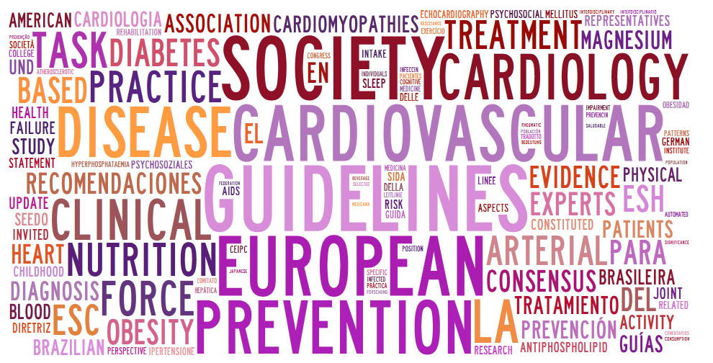
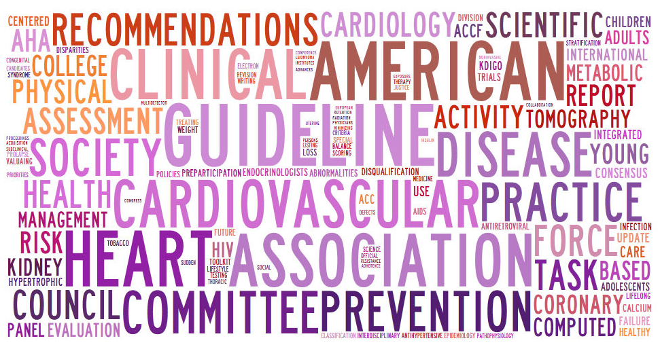
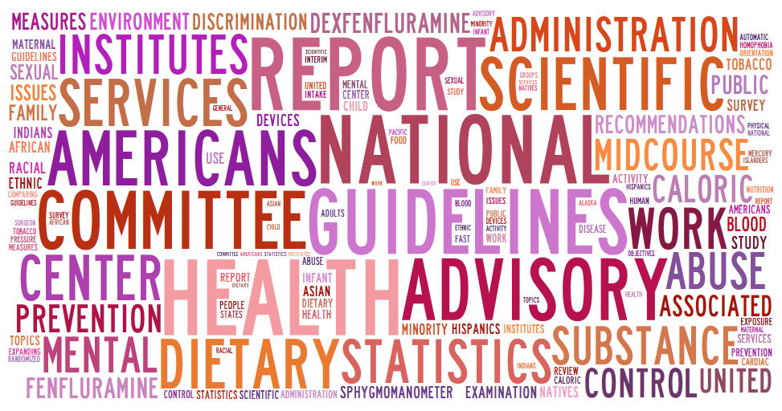
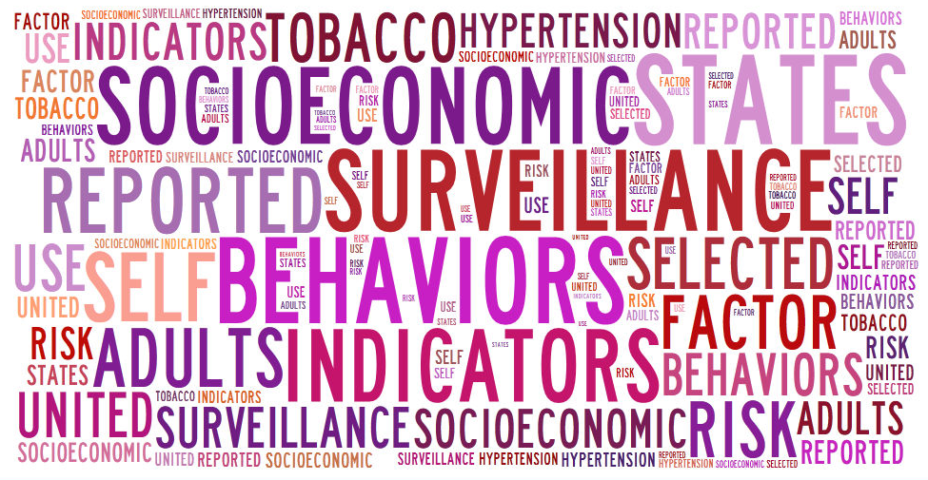
Policy and Guidelines: Dividing up the Results
International Policies and Guidelines
US Clinical Guidelines/Scientific Statements
41
59
16
2
US Governmental Policies and Guidelines
US State Policies and Guidelines
Numbers reflect citations in documents
Word clouds of document titles by tagxedo.com

Slide 14


Policy and Guidelines: The Olympics and CARDIA
1996
Cardiovascular Pre-participation Screening of Competitive Athletes (AHA)
  publishes report on screening cardiovascular abnormalities in athletes
  cites CARDIA document (Maron BJ et al., 1995)
2004
International Olympic Committee (IOC) Medical and Scientific Commission
  publishes report on screening for Sudden Cardiovascular Death in Sport
  no reference list available
  http://www.olympic.org/Documents/Commissions_PDFfiles/Medical_commission/IOC_CONSENSUS_STATEMENT_ON_SUDDEN_CARDIOVASCULAR_DEATH_IN_SPORT_2004.pdf
2006
International Olympic Committee (IOC) ad hoc Working Group on Sudden Death in Athletes
  publishes Position Paper (literature review) describing why the IOC consensus meeting accepted the proposed report in 2004 (Bille K, et al., 2006)
  cites CARDIA document (Maron BJ et al., 1995)
Notes:
1997 National Collegiate Athletic Association (NCAA) Committee on Competitive Safeguards and Medical Aspects of Sports
expresses concerns about recommendation
Cardiovascular Pre-participation Screening of Competitive Athletes (AHA)
responds to NCAA concerns with an addendum (Maron BJ et al. 1997)

Slide 15
Other data sources for uncovering gems
  Funding Information
  Project Specific websites
  Patents
  Other data sources

Slide 16
Gathering Attention

Slide 17
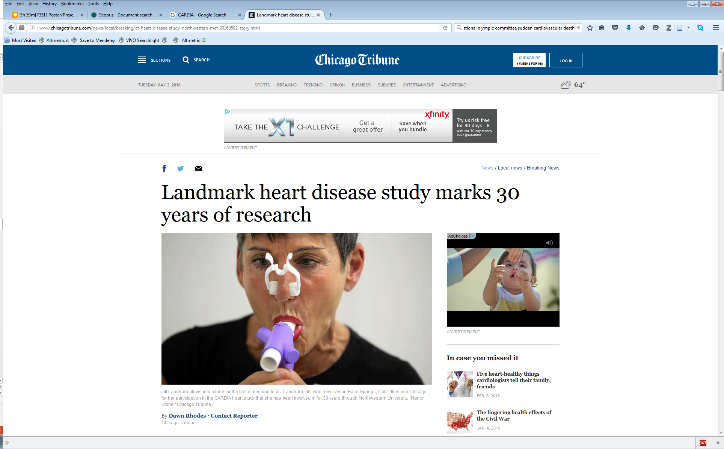
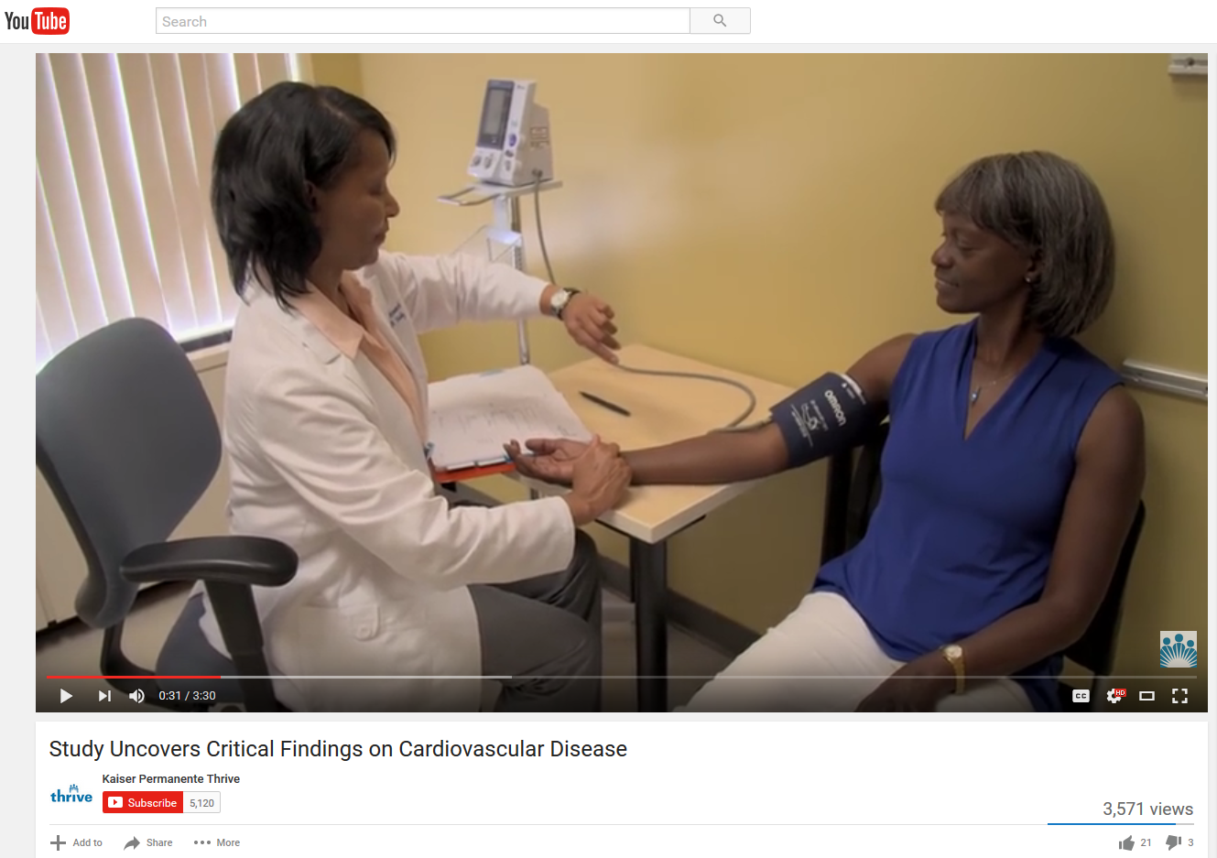
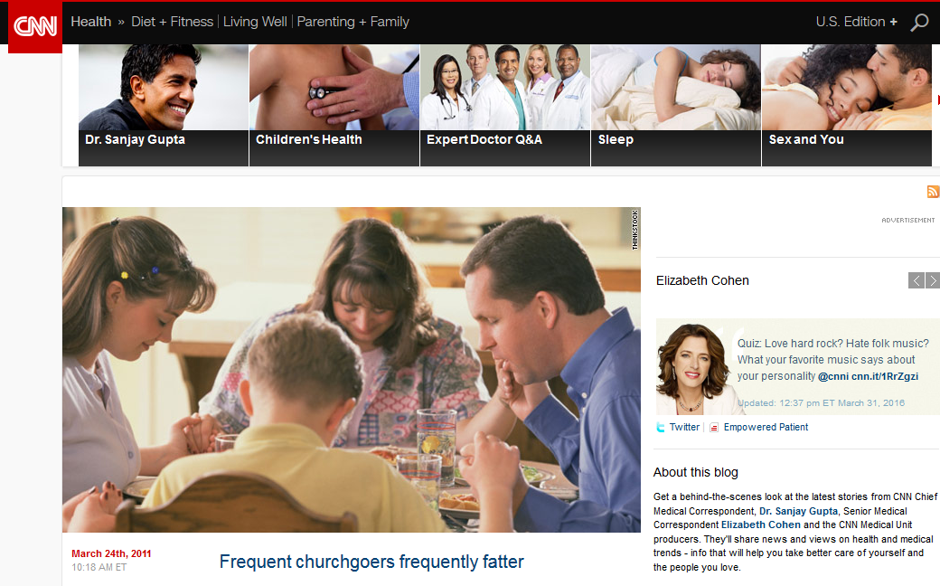
Gathering Attention: Google
Search Results
Data Source
Search Strategy
Google News
Google Blogs
Google Videos
Google Books
698
“CARDIA study” OR
“Coronary Artery Risk
Development in Young Adults”
15
542
8,560
Please note: number of non-relevant results not yet determined.
Tuesday, May 3, 2016
Chicago Tribune, front cover
Landmark heart disease study marks 30 years of research
December 2, 2015
YouTube
Study Uncovers Critical Findings on Cardiovascular Disease
March 24, 2011
CNN Blog
Frequent churchgoers frequently fatter

Slide 18
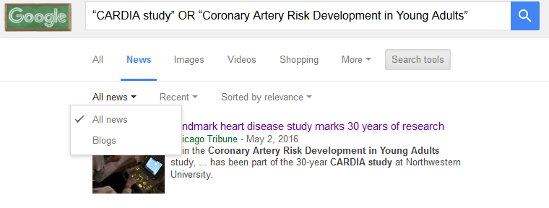
Gathering Attention: Google Challenges
Google challenges
CARDIA news coverage started in 2005
CARDIA video coverage started in 2003
Export options are extremely limited
Difficult to find which CARDIA document was cited
Google surprises
Generally relevant results
Under Books, can sort by Magazines
Under News, can sort by Blogs
Under Videos, can sort by duration, quality, source

Slide 19

Gathering Attention: LexisNexis
Search Results
Data Type
Search Strategy
35
Law reviews and Journals
Newspapers
Newswires & Press Releases
Web-based Publications
Magazines and Journals
Cases
Industry Trade Press
“CARDIA study”
34
7
4
2
1
1
Please note: number of non-relevant results not yet determined.
All (Food) Politics is Local: Increasing Food Access Through Local Government Action
Adults can undo heart disease risk
July 1, 2014
Summer, 2013 Emily M. Broad Leib
…"If you don't keep up a healthy lifestyle, you'll see the evidence in terms of your risk of heart disease," Spring said.
Scientists examined healthy lifestyle behaviors and coronary artery calcification and thickening among the more than 5,000 participants in the Coronary Artery Risk Development in Young Adults (CARDIA) study who were assessed at baseline (when participants were ages 18 to 30) and 20 years later…
…This article focuses on healthy-food access, one of the most urgent food policy issues because of its social and economic effects, as well as its public health impacts…
Cites: Janne Boone-Heinonen et al., Fast Food Restaurants and Food Stores: Longitudinal Associations With Diet in Young to Middle-Aged Adults: The CARDIA Study, 171 ARCHIVES INTERNAL MED. 1162, 1168 (2011)

Slide 20
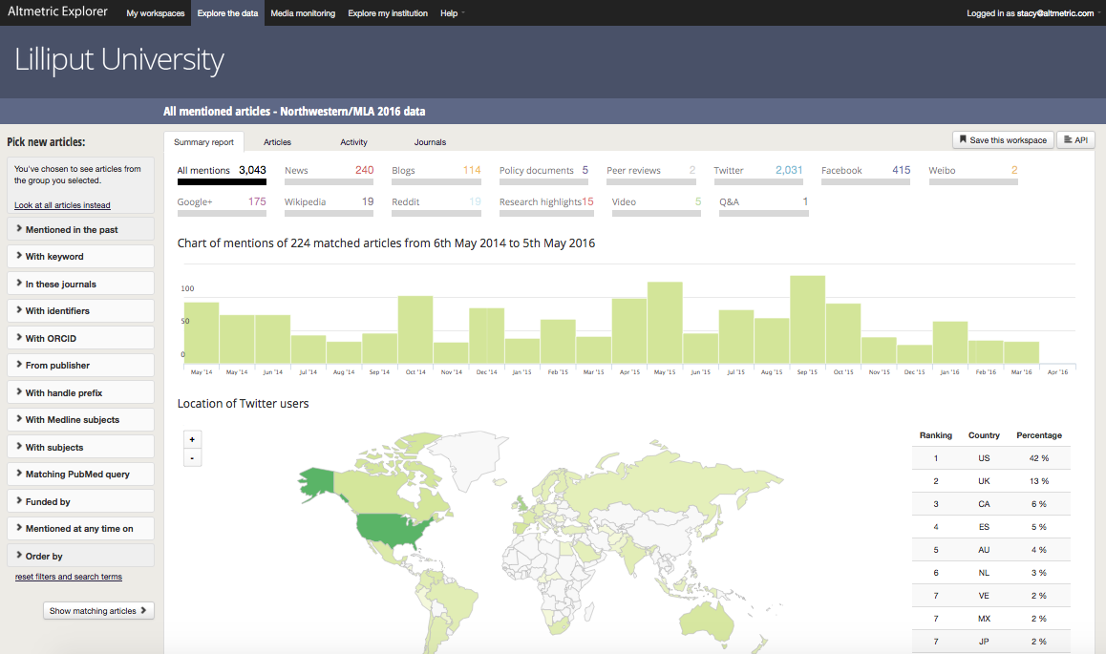
Gathering Attention: Altmetric Explorer
Searched for all CARDIA documents using DOIs and/or PMIDs
above: screenshot of Altmetric Explorer Summary Report results after searching using the DOI and/or PMID of the 669 CARDIA documents

Slide 21
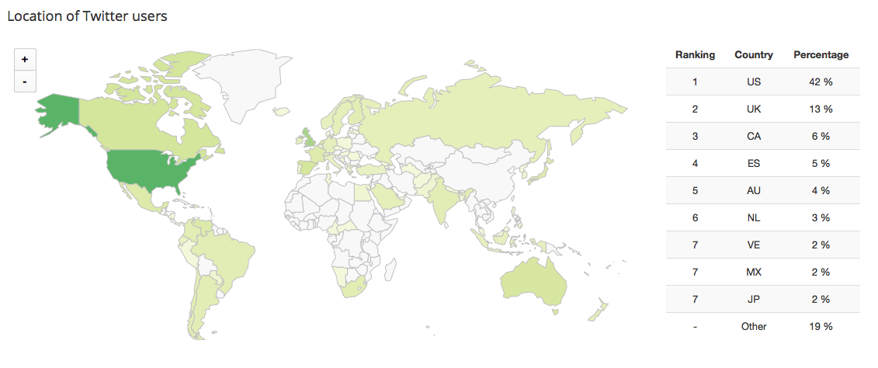
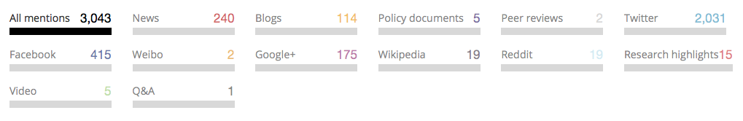
Gathering Attention: Altmetric Explorer
Searched for all CARDIA documents using DOIs and/or PMIDs
above: screenshot of Altmetric Explorer results from Twitter after searching using the DOI and/or PMID of the 669 CARDIA documents

Slide 22
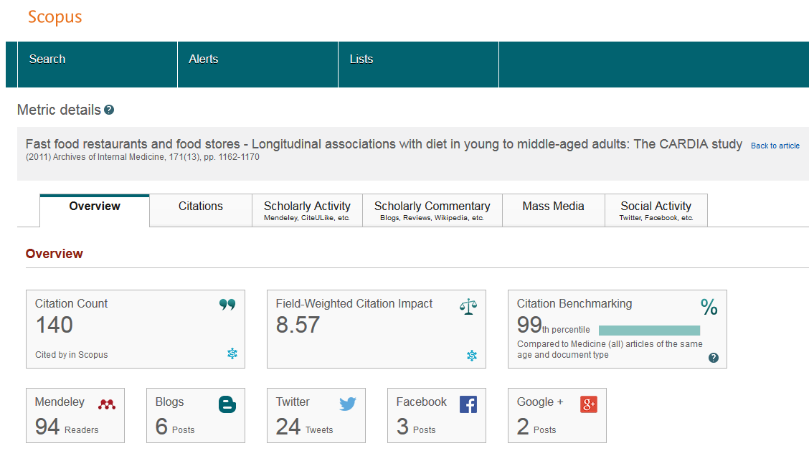
Gathering Attention: Altmetric for individual documents

Slide 23
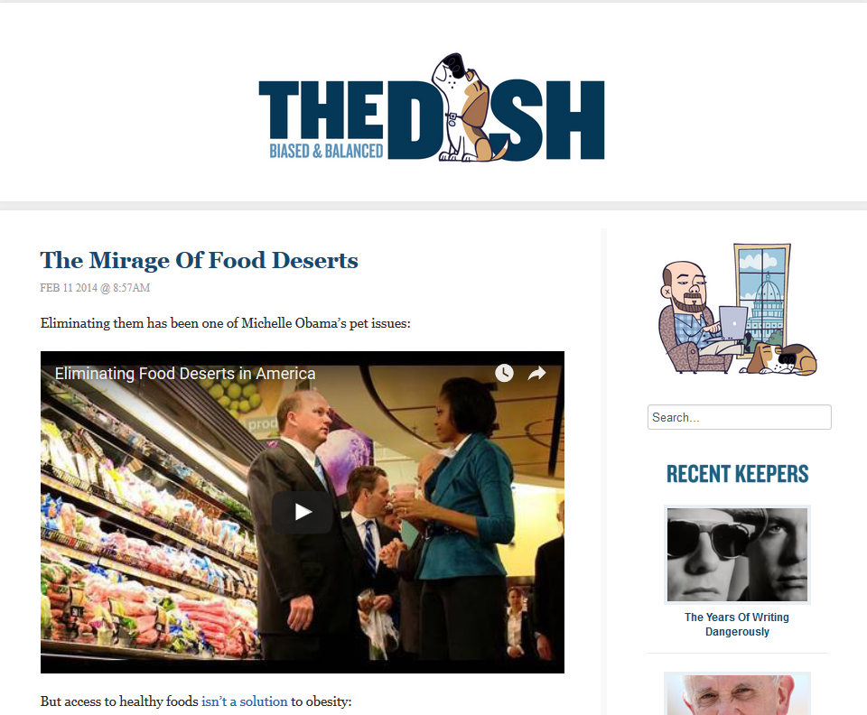
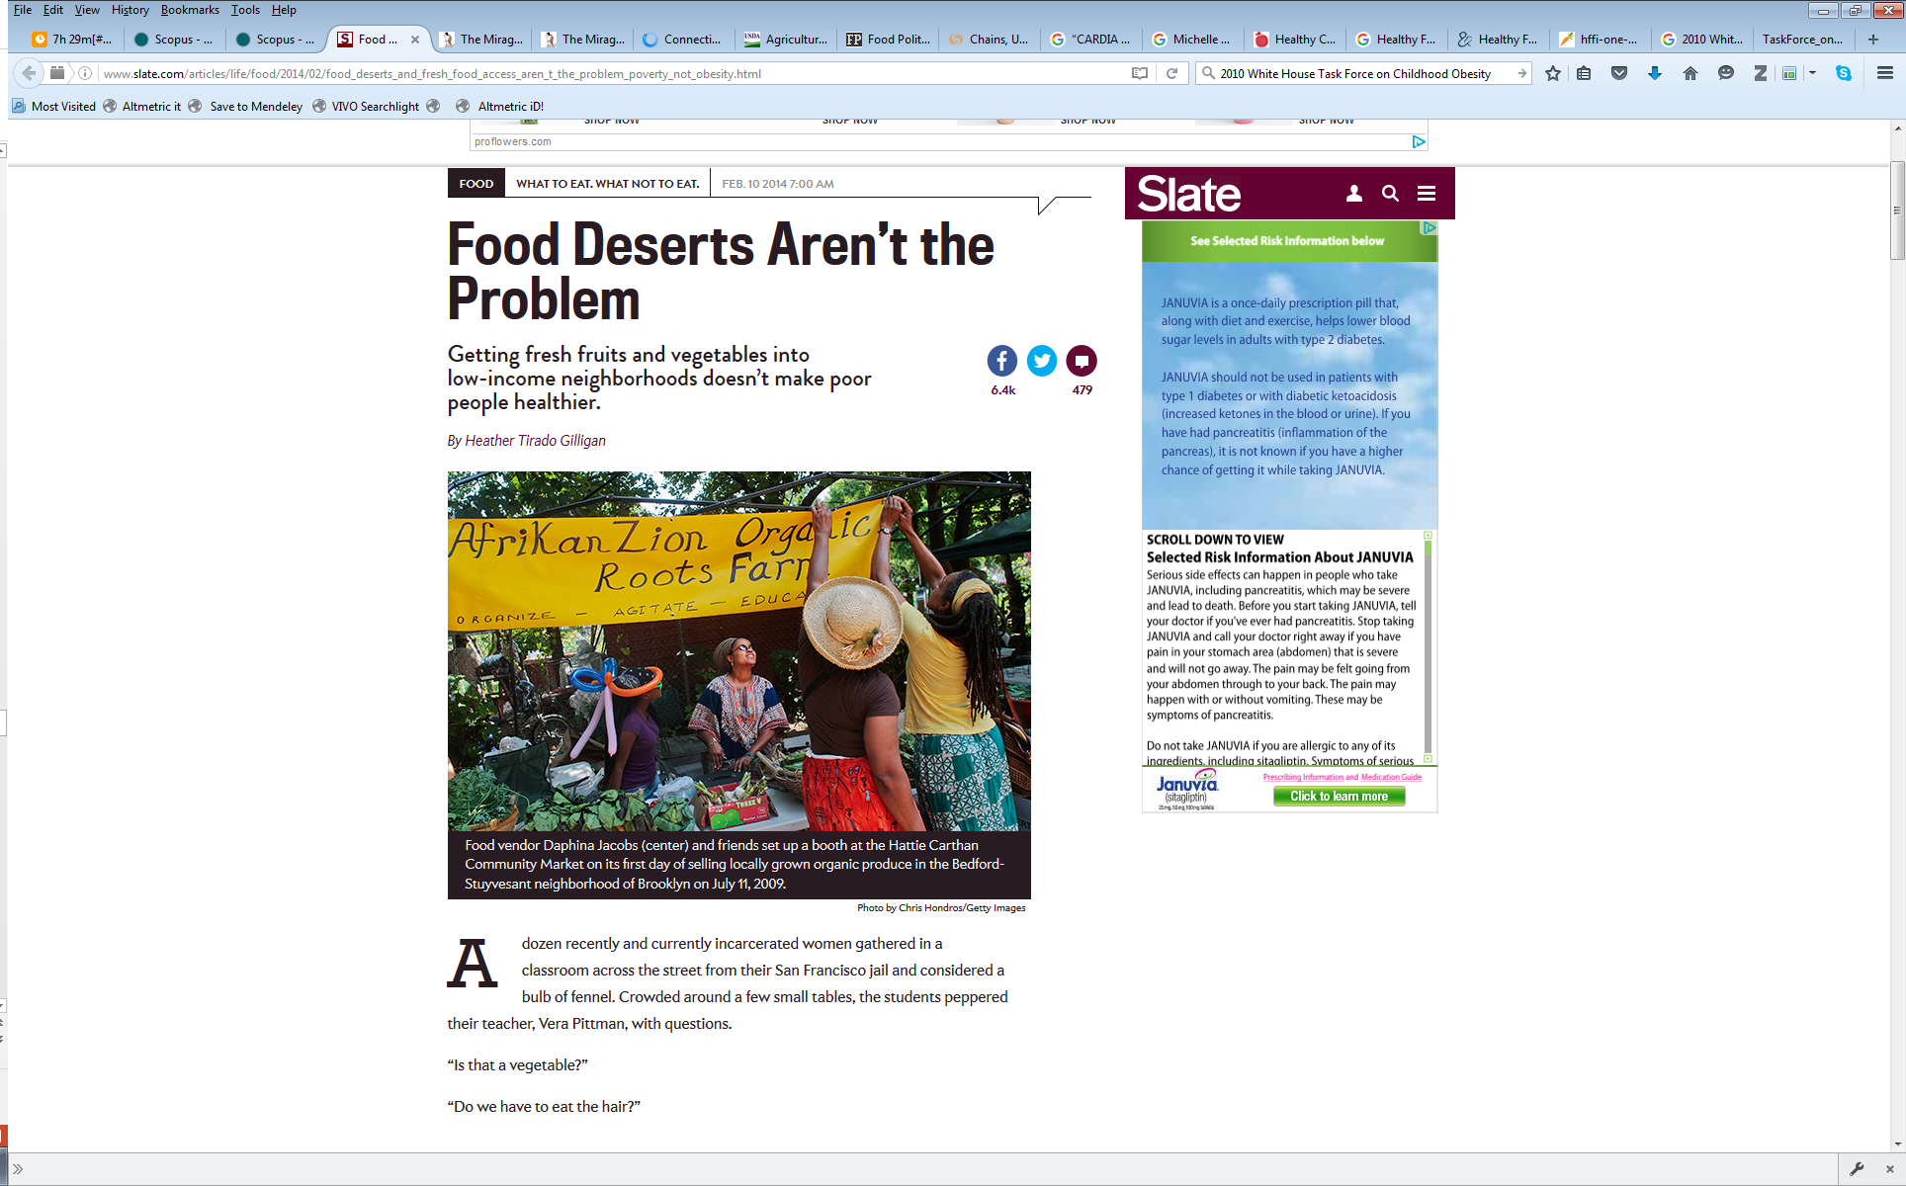
Gathering Attention: Altmetric and popular news
2011
Boone-Heinonen J, Gordon-Larsen P, Kiefe CI, Shikany JM, Lewis CE, Popkin BM. Fast food restaurants and food stores: Longitudinal associations with diet in young to middle-aged adults: The CARDIA study. Arch Intern Med 171(13):1162–70. 2011.
2014
cited in Andrew Sullivan’s “The Dish” article on The Mirage of Food Desserts
http://dish.andrewsullivan.com/2014/02/11/the-importance-of-food-deserts-is-a-mirage/?utm_source=feedburner&utm_medium=feed&utm_campaign=Feed%3A+andrewsullivan%2FrApM+%28The+Dish%29
cited in Slate.com article Food Deserts Aren’t the Problem
http://www.slate.com/articles/life/food/2014/02/food_deserts_and_fresh_food_access_aren_t_the_problem_poverty_not_obesity.html
2015
cited in report on 2015 Dietary Guidelines
U.S. Department of Health and Human Services and U.S. Department of Agriculture. Scientific Report of the 2015 Dietary Guidelines Advisory Committee. December 2015. Available at http://health.gov/dietaryguidelines/2015-scientific-report/
Notes:
2013 cited by National Center for Health Statistics Data Brief
Fryar, Cheryl, Bethene Ervin, R. Center for Disease Control and Prevention/ National Center for Health Statistics. Caloric Intake From Fast Food Among Adults: United States, 2007-2010. NCHS Data Brief No. 114, Feb. 2013. Available at: http://www.cdc.gov/nchs/data/databriefs/db114.htm

Slide 24
Gathering Attention: Other data sources
Other resources for finding attention
  Web of Science has usage metrics for books and articles
  Scopus has partnership with Altmetric for attention to books and articles
  Altmetric bookmarklet is good for all outputs, but best for articles
  Impactstory/Depsy is good for “alt” products like data and software
  Publisher or society websites generally provide downloads or views for articles
  Institutional repositories generally provide downloads or views for all outputs

Slide 25
Gathering Attention: Keep in Mind
  Data aggregators and their coverage can vary:
    Regional websites (i.e. Sina Weibo) are not usually represented
    Very Western-centric in information tracking
    Some platforms that are heavily used by researchers (Academia.edu, Google Scholar, etc.) don’t allow aggregators to harvest their metrics
  Data aggregators have different approaches:
    Altmetric and Impact Story only gather open mentions
    Altmetric and Scopus don’t include usage statistics, though Web of Science does
    No matter the source (Web of Science, Scopus, Altmetric, etc.) some mentions or citations are sometimes missed

Slide 26




















Gathering Attention: Keep in Mind continued...
Data
aggregator
Data source
(represented by logo or symbol)
Unique identifier
(used to identify and track an article)
Journals
DOIs
only
DOIs
only
Any
URI
The red bar represents data collected by Altmetric and licensed to third-parties.

Slide 27
Organizing Information

Slide 28
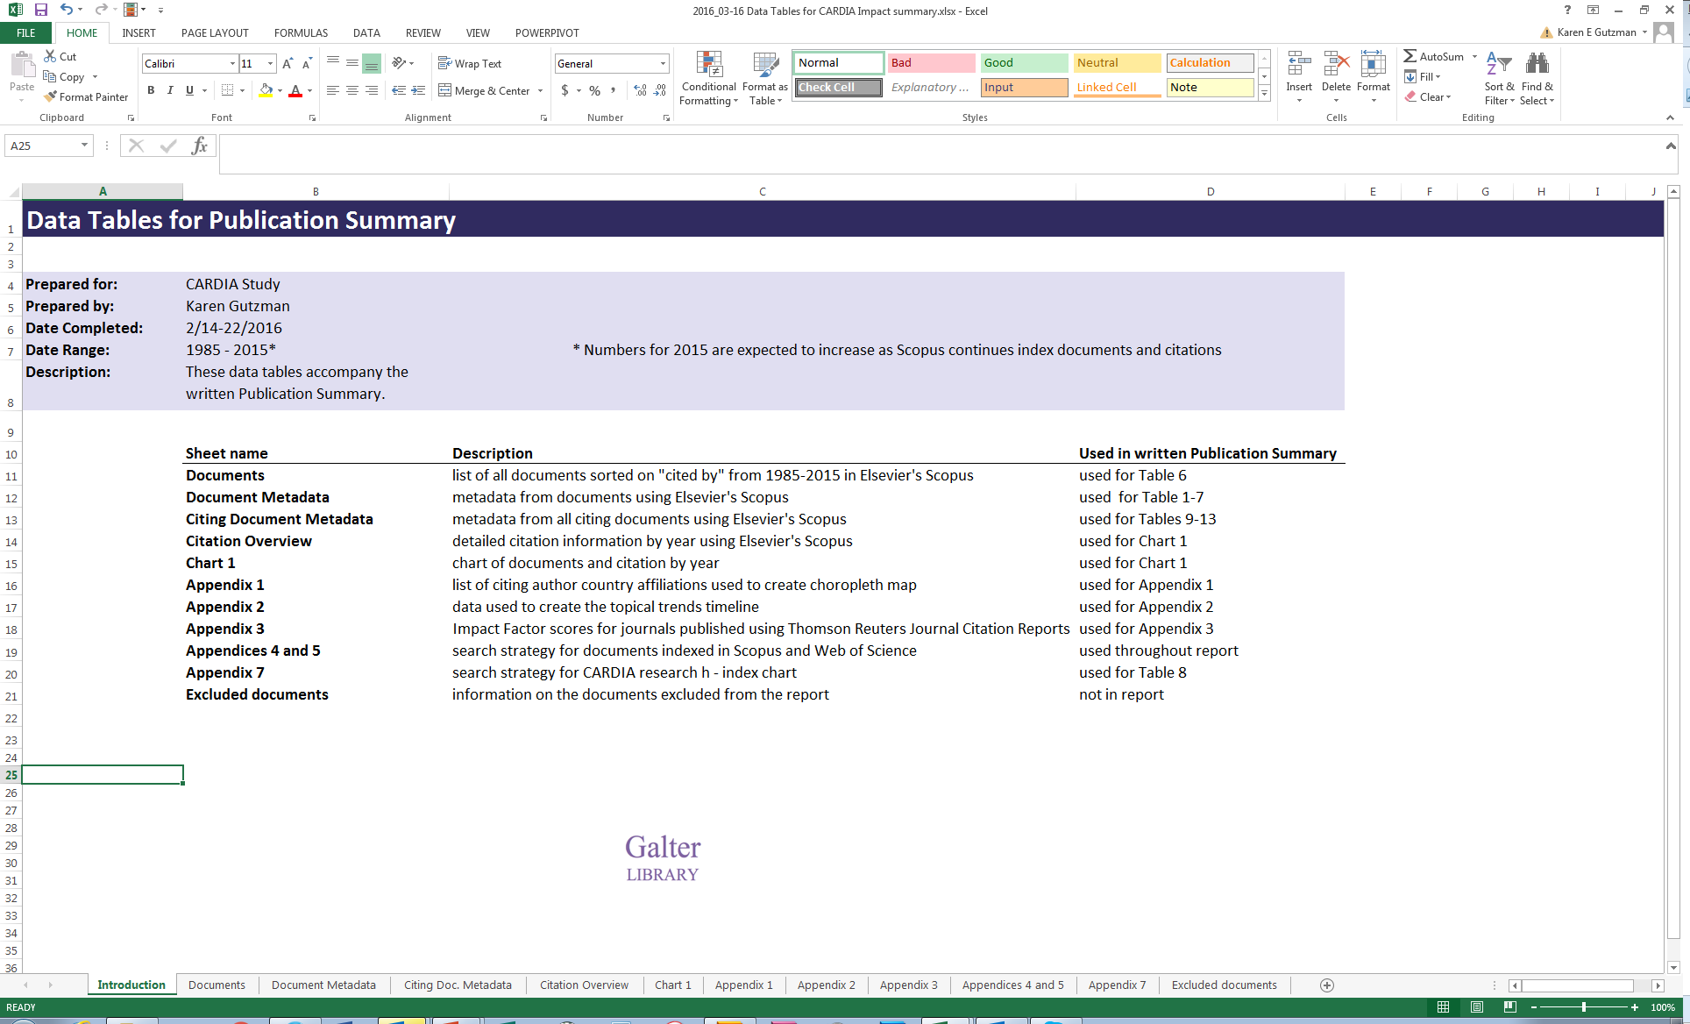
Organizing and Tracking Results
above: screenshot of excel file used to organize and track results

Slide 29
Organizing Challenges
Reproducibility
Easily answer questions about how you found or calculated certain results
Take the time to keep things organized
Take notes on the steps you used to clean the data
  Updating
  Updating reports can be difficult and time consuming
  Determine if, how often, or which parts of a report need to be updated
  Create a workflow for updating reports

Slide 30
Metrics, Indicators, and Telling Stories

Slide 31
Traditional Bibliometric Indicators
  Productivity Indicators
  Total published articles (career span and/or report timespan)
  Co-publications (within department or group)
  First Author/Last author publications
Innovation and Social Benefit Indicators
  Citations in patents
  Becker Model outcomes
Indicators of Disciplinary Influence
  h-index (individual or group)
  m-index
  Normalized h- index
Outcome Indicators
  Total citations (career span and/or report timespan)
  Citations per year (average or median)
  Citations per publication (average or median)
  Citations in the year an article or group of articles were published
  % Self Citations (number of self citations divided by total citations)
  Top publications (publications are grouped by type, age and/or subject then ranked by citations)
  Age of citations
  Percent of publications not cited
  Citations by year of publication per publication
  Most highly cited publication
  # of country affiliations of citing authors
  # of languages of citing articles
  # of unique source (journal titles) from citing articles
  # of unique country affiliations of citing authors
  # of unique institutional affiliations of citing authors
  Hot or Highly Cited publications
Research Infrastructure Indicators
    # of co-authors
    Co-citations (number of times two papers are cited in same article)
Impact Indicators
  Journal Impact Factor (JIF)
  Scimago Journal Rank (SJR)
  EigenFactor
  Co-authorship network analysis
  Median Journal Impact Factor
  Field-weighted Citation Impact (Scopus)
Please note: this is not an exhaustive list of indicators

Slide 32
Alternative Indicators
  Were research outputs shared?
  Popular press mentions
  Twitter retweets
  Facebook likes
  Pinterest Shares
  Were research outputs downloaded?
  web views
  PDF downloads
  Blog readers
  Podcast listens
  Time spent reading
  What was the engagement with research outputs?
  Event audience numbers
  Exhibition visits
  Practitioner networking events
  Were research outputs cited?
    Referenced in government, think tank, NGO reports
    Mentioned in legal arguments
    Used as a case study in evidence
  How were research outputs discussed?
  Utilized in public debate
  Referenced by journalists
  Reference in government debate
  How were research outputs used?
  academic as members in corporate boards
  members in government advisory positions
  As members o practitioner networks
  paid for research
  Were research outputs co-developed?
  utilized in teaching materials
  taken up by professional organizations
  built on to improve any kind of performance
Please note: this is not an exhaustive list of indicators.
Source: Konkiel S, Sugimoto C., Williams S. The Use of Altmetrics in Promotion and Tenure. 2016, March 7. EducauseReview. Available at: http://er.educause.edu/articles/2016/3/the-use-of-altmetrics-in-promotion-and-tenure
Notes:
List from: http://er.educause.edu/articles/2016/3/the-use-of-altmetrics-in-promotion-and-tenure

Slide 33
Indicator Challenges
  Many indicators cannot be normalized for comparison
  Indicators must be selected in consideration with different audiences
  Some indicators can only be applied to certain levels (i.e. discipline, individual)
  Context should be supplied for metrics
  For some individuals or groups, there may be little to report

Slide 34
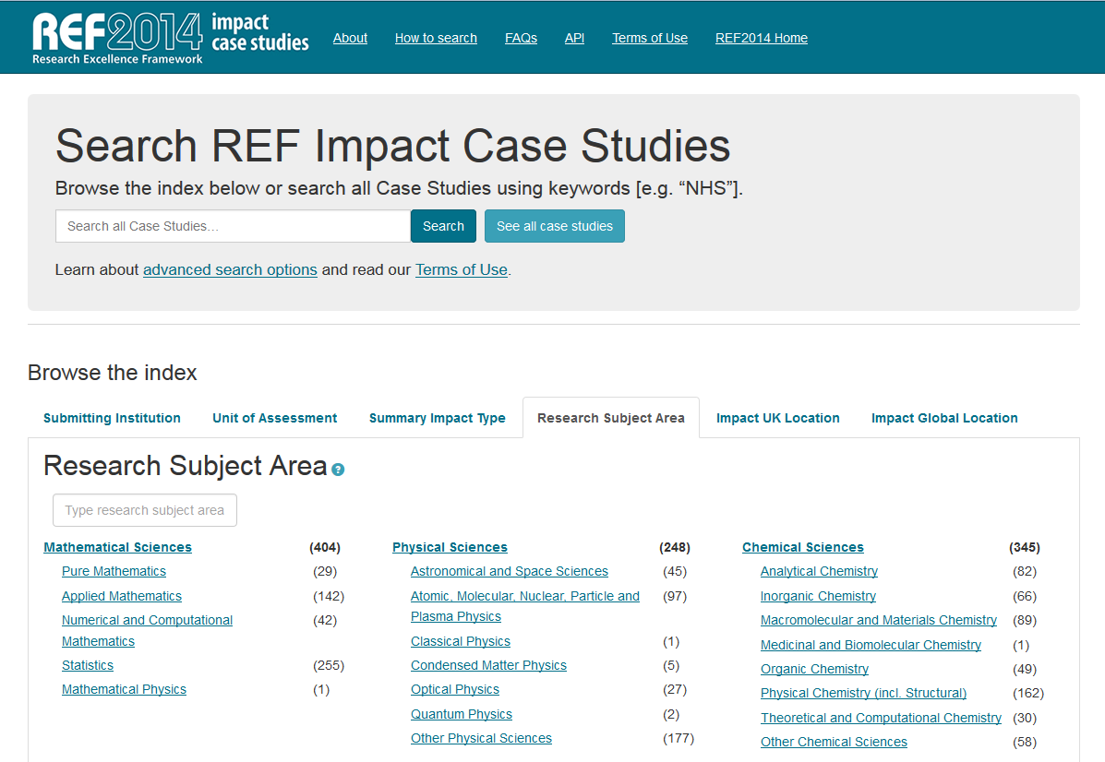
Telling Stories
above: screenshot of the REF Impact Case Studies homepage (http://impact.ref.ac.uk/CaseStudies/)

Slide 35
Future Directions
Continued harvesting and cleaning of data
Survey to CARDIA researchers
Considering what to report and ways to do it

Slide 36
Thank you
Karen Gutzman
Pamela Shaw
Stacy Konkiel

