Slide 1
Making Your Data FAIR
Sara Gonzales, MS, MLIS
Data Librarian
Galter Health Sciences Library & Learning Center

Slide 2

Data Sharing
Motivations for sharing data:
Preservation
Reproducibility
Publisher requirements
Funder mandates: Including the National Institutes of Health’s Final NIH Policy for Data Management and Sharing
Notes:
Final NIH Policy for Data Management and Sharing: https://grants.nih.gov/grants/guide/notice-files/NOT-OD-21-013.html

Slide 3
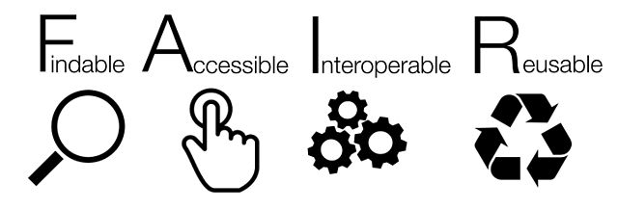
Don’t just share data – make it FAIR
The FAIR data principles were first outlined by FORCE11 in 2016. These principles emphasize that, beyond simple compliance with funder or publisher mandates, data sharing can be optimized to facilitate knowledge discovery by both humans searching for datasets, and machines crawling the web in order to aggregate data resources.
We will learn how to apply specific recommendations from the FAIR principles to ensure that research data deposited in repositories is Findable, Accessible, Interoperable, and Reusable.
Notes:
FORCE11, per their website, are “a community of scholars, librarians, archivists, publishers and research funders that has arisen organically to help facilitate the change toward improved knowledge creation and sharing.” https://www.force11.org/about

Slide 4
The FAIR Principles
To be Findable any data object should be uniquely and persistently identifiable
Data is Accessible if it can be always obtained by machines and humans
Data are considered Interoperable if they integrate well with other data for workflows, analysis, storage, and processing
Data objects are Reusable if they are well-described and can be ethically applied and manipulated in different settings
Adapted from: Guiding Principles for Findable, Accessible, Interoperable and Re-usable Data Publishing version b1.0 (https://www.force11.org/fairprinciples) and Fair Principles from Go-FAIR.org, https://www.go-fair.org/fair-principles/

Slide 5
When time and resources are short, what are practical tips for making datasets FAIR?

Slide 6
Findability: Four Characteristics
1. Apply globally unique, persistent identifiers not only to your deposited resource, but to every metadata element
Use registries (e.g., DataCite) for deposit
Use ontologies with resolveable prefixes for their entities to make a single URI pattern, e.g., MGI’s http://www.informatics.jax.org/accession/¹
2. Describe your data with rich metadata
Contextual: protocol used, keywords
Other types: Intrinsic (captured by devices), data units, measurement devices used, species studied, genes, proteins
3. Ensure that metadata record explicitly includes the identifier of data described
Dataset’s DOI should be included in any descriptive metadata records
4. Metadata registered or indexed in a searchable resource
Institutional repositories
Indexing services
Schema.org markup
Notes:
1. McMurry, Julie A et al. “Identifiers for the 21st century: How to design, provision, and reuse persistent identifiers to maximize utility and impact of life science data.” PLoS biology vol. 15,6 e2001414. 29 Jun. 2017, doi:10.1371/journal.pbio.2001414

Slide 7
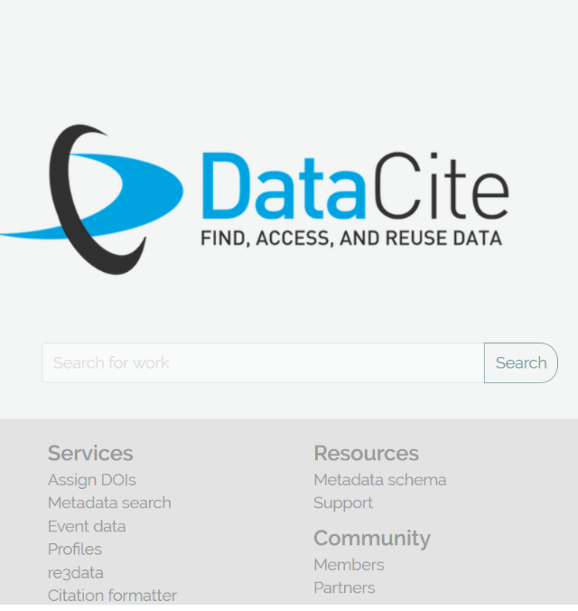
Findability 1: Persistent Identifiers (PIDS)
“Persistent identifiers are long-lasting references to a digital resource.” (ORCiD)
PIDs are often minted by registries, such as DataCite, a global non-profit organization that provides PIDs for research outputs. Outputs are then cataloged by their PIDs in DataCite’s searchable index.
EVERY metadata element in any repository record created to represent a resource can theoretically be populated with terms that also have their own unique online identifiers. Subject ontologies employing PIDs for their terms can be found at FAIRsharing.org.
Notes:
Why would I want a unique identifier for every term in my metadata records? Uniquely identified terms enable truly open science. In open science, the outputs of the scientific process are shared to both human and machine interpretation. Computers can more easily search, collate, and recombine metadata records if they employ terms that are unique, well-defined, and individually identifiable across the Web.
Medical Subject Headings (MeSH) employ PIDs for their terms. See “RDF Unique Identifier” in this record for Neoplasm: https://meshb.nlm.nih.gov/record/ui?ui=D009369

Slide 8



Findability 2: Rich Metadata
Contextual: Descriptive, keywords, contributors, concepts linking back to protocol
Intrinsic: produced automatically by devices that generate data
Other types of metadata to note:
Measurement devices used
Units of captured data
Species involved (UniProt, a taxonomy for species incorporating PIDs – see ‘human’ example: https://www.uniprot.org/taxonomy/9606)
Genes and proteins
In most data catalogs, this descriptive and often PID-identifiable information is found in the record’s metadata fields. Additional information, if the catalog has no fields for it, can be stored in Notes.
Notes:
When making your data Findable, it’s likely that you are depositing it in a digital repository that employs some version of an accepted metadata schema, like DataCite (https://schema.datacite.org/) or The Data Catalog Vocabulary (DCAT, https://www.w3.org/TR/vocab-dcat-2/). Each one has many fields at your disposal for creating rich descriptions of your data. ClinicalTrials.gov has a wealth of fields describing registered trials. Be as descriptive as possible, and if you have metadata for which there is no field in your chosen catalog, include it in a general notes or description field.

Slide 9
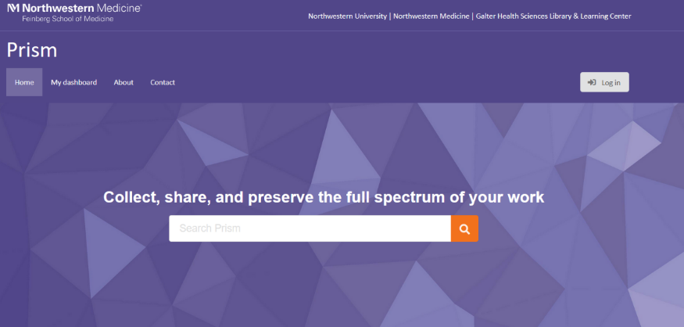
Findability 3 and 4: Store the data’s identifier in its metadata record, and register or index that metadata in a searchable resource
How research outputs can be found online:
Store resources in an internal database linked to your website; wait for site to be crawled by Google
Markup your resources with schema.org/dataset tags – findable by Google Dataset Search
Catalog a metadata record which includes your dataset’s DOI in an indexed, searchable resource. Such resources include:
  Institutional repositories
  Services like DataCite, CrossRef or EZID
Notes:
Cataloging resources in institutional repositories is especially effective if the repository registers a DOI for each deposit from a source like DataCite or EZID. Then brief records from the repository are also indexed in the registry service’s system.

Slide 10
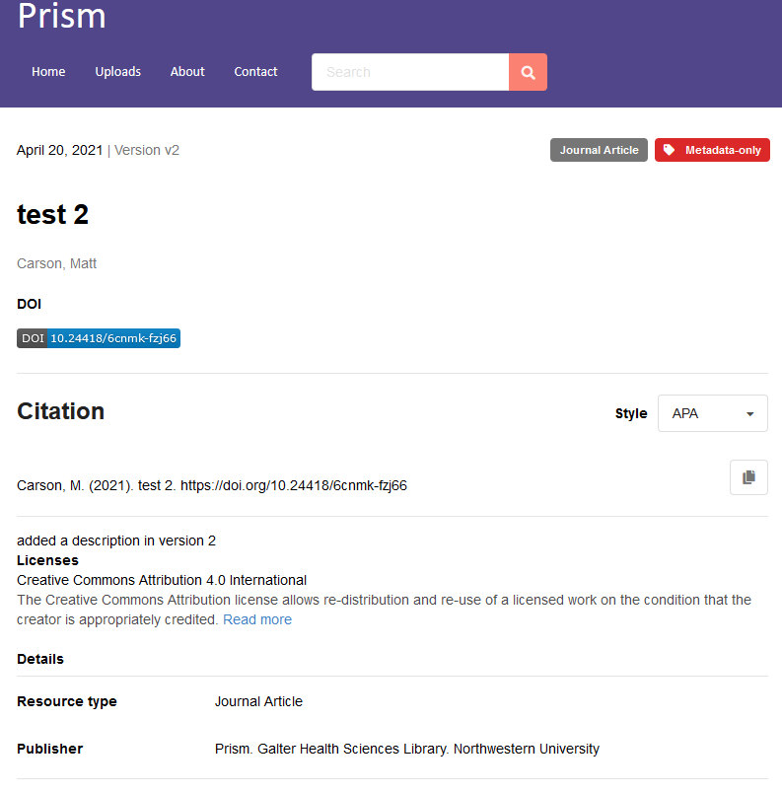
Findability: Practical Applications
Create metadata records in a repository that mints and supports DOIs
Prism and many repositories findable through resources such as the NIH’s Generalist Repository Ecosystem Initiative (GREI) support this requirement
Describe research outputs with rich metadata
Prism applies the DataCite metadata standard to all records. Outputs can be further described with standards, many of which can be found at FAIRsharing.org.
Apply permanent identifiers to all metadata descriptors when possible
Find ontologies which employ permanent identidiers at FAIRsharing.org
Notes:
Any repository that mints DOIs for deposits is already employing a registry (F1).

Slide 11
Accessibility: Two Characteristics
1. Data should be retrievable via its identifier through standard communication protocols (formats/rules that enable communication)
HTTP
FTP
SMTP
Telephone
1.1. The protocol should be free and universally implementable
Global data retrieval by any user with a computer and internet connection is enabled
Even sensitive data can be considered accessible with a metadata record and “Data Access”
1.2. Authentication can be enabled where necessary
Protected data that is deposited in a way allowing access by authenticated users both enables data sharing and allows layers of data protection
2. Metadata representing the data is accessible even when the data is not immediately available
Sensitive data (e.g., containing PHI) should not be posted to repositories
Metadata cheaper to maintain online than data itself
Data still Accessible if researcher can be contacted

Slide 12
Accessibility: Practical Applications
Web protocols
Metadata-only Records
Local solution: Prism
Repository should employ http or https
Compliance with OAI-PMH protocol allows harvesting of metadata records by data aggregators
REST APIs are another type of free and universal protocol for metadata retrieval
For sensitive files, metadata records representing them in repositories are still considered accessible
Authentication or user authorization is possible. User logs in and uses a Data Access function to contact data owner
Cheaper to maintain online than the data itself
Can remain online indefinitely
Employs the protocols: https, OAI-PMH, REST APIs
Metadata records can be created with a “Data Access” button to put user in contact with the record’s owner to access data
Open Access and public domain records need no login to access files or “Data Access” button
User account can be created to enable sharing private records
Data and metadata retained for lifetime of the repository

Slide 13
Interoperability: Three Characteristics
1. (Meta)data use a formal, accessible, shared, broadly applicable language for knowledge representation
Data should be readable by machines without use of special algorithms
Requires use of controlled vocabularies and good data models
2. (Meta)data use vocabularies that follow the FAIR principles
Controlled vocabularies employing PIDs are best
Vocabularies’ documentation must be accessible by data users
3. (Meta)data include qualified references to other (meta)data
Link your data to related files in the same repository
Explain the nature of the link between the two records and/or repository deposits
Why the (meta)?
Interoperability can apply both to our data itself, and to the descriptors we create about our data in order to describe and catalog it. For both data and metadata, when standards, vocabularies, and links are applied, similar datasets are more easily brought together.

Slide 14
Interoperability 1: Languages for Knowledge Representation
Deposit Data in Repositories using Common Data Exchange Formats
Local Solution: Prism
Further markup of your data
Native JSON schema empowered with serializers to allow exports to popular formats such as JSON-LD, BibTeX, CSL, DataCite, Dublin Core, and MARCXML
This makes your entire metadata record interoperable with hundreds of other repository systems
If terms in your data are linked to terms in data models such as DisGeNET or UniProt, they can be interoperable on the resource level
Resource Description Framework (RDF) – Dublin Core Schema is an example
OWL (Web Ontology Language)
JSON LD: JSON for linking data
Notes:
This ensures that (meta)data can be exchanged seamlessly with systems employing the same exchange formats and ontologies.

Slide 15
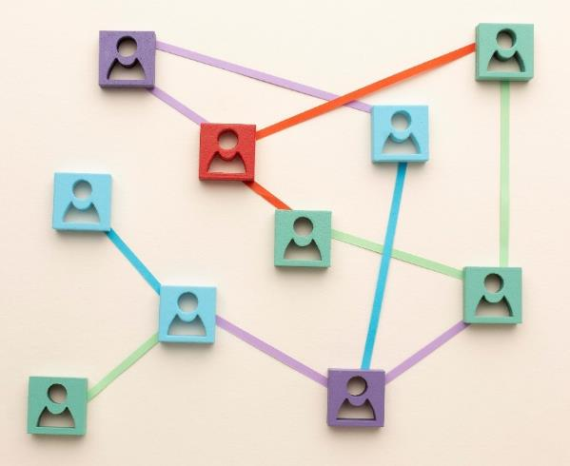
Interoperability 2: Vocabularies that follow the FAIR Principles
Controlled Vocabularies with Globally Unique PIDs
Local Solution: Prism
Prism employs all the vocabularies listed to the left and provides links to their documentation
Medical Subject Headings (MeSH)
Research Organization Registry (ROR)
CrossRef Funder Registry (FundRef)
GeoNames geographical database (GeoNames)
Place
Organization
Author
Funder
Image by Freepik.com

Slide 16
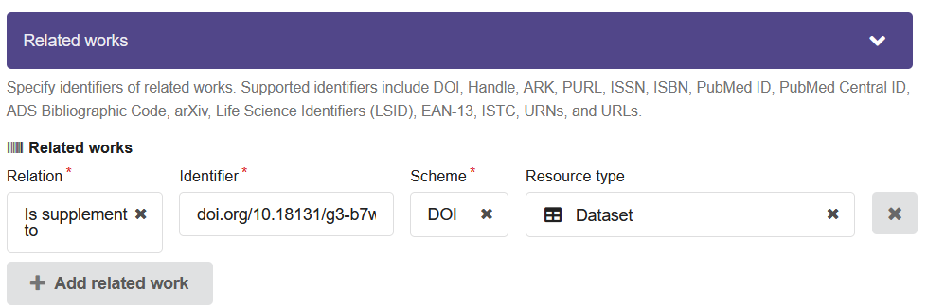
Interoperability 3: (Meta)data include qualified references to other (Meta)data
Related Works
Local Solution: Prism
Create a digital link between your research objects online and related research objects
Explain the nature of the two objects’ connection
Each deposited item can be linked to a related item within the repository
Using the DataCite RelationType vocabulary, the nature of the link between the two research objects can be specifically described.

Slide 17
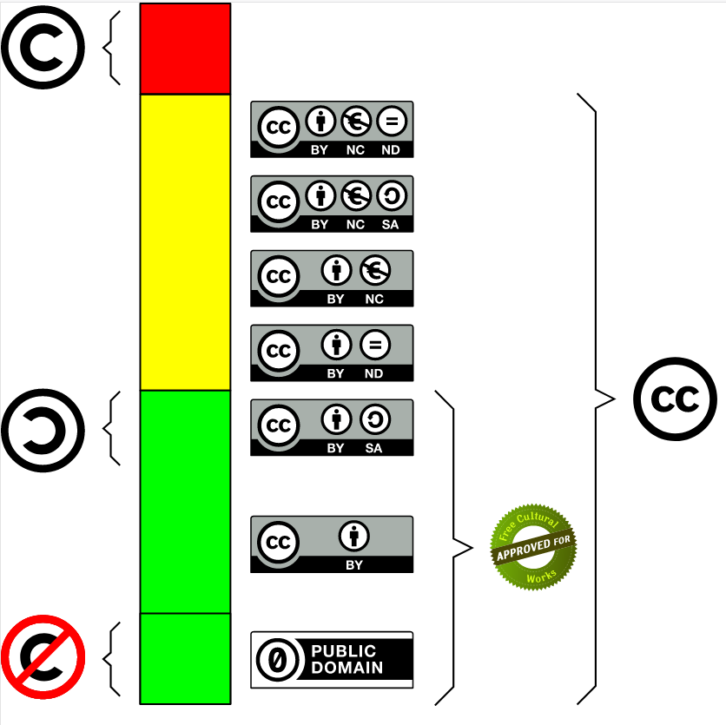
Reusability: Three Characteristics related to describing data richly with many relevant and accurate attributes
1.1. Clear and accessible data usage licenses
Legal interoperability: what users can and can’t do with data
Examples: Creative Commons, MIT, GNU General Public License
1.2. (Meta)data are associated with detailed provenance
Which organization and which researchers produced the data?
How was data collected?
Processing level
1.3. (Meta)data meet domain-relevant community standards
Use the same minimal information standards as your community
Image credit: Marko Txopitea - https://ikusimakusi.eus/2018/cc-traffic-light-3-0/, CC0, https://commons.wikimedia.org/w/index.php?curid=8480769

Slide 18
Reusability, According to Best Practice
Data should be sufficiently richly described so the user knows if they can, and if they want to, re-use it:
Scope of Data
Conditions of collection
Data processing history
Why was it collected?
Subject of Study
Timeframe of Study
Protocol
Names of machines
Lab conditions
Software names/versions
Raw or processed?
Analysis plan
Code
Variable Names
Versions
Licenses and Standards
Defined or self-explanatory
Data dictionary
Clearly document
Provide links to older versions if possible
Assign a clear license to allow re-use
Employ standards used by your research community

Slide 19
Local solution: How Prism helps with Reusability
Reusability Criteria | How Prism supports this criteria
Protocol/why was data collected? | Deposit protocol, link as related item
Subject of Study | Include in Description field
Timeframe of Study | Prism Customized Date field
Names of machines | Include in Description field
Lab conditions | Include in Description field
Software | Can link out to GitHub or other link
Raw or processed | Include in Description field
Analysis plan | Include in Description field
Code | Can link out to GitHub or other link
Variable names | Can deposit data dictionary and link
Version: document, link previous | Prism tracks versions
License | Prism supports robust license options
Standards used by community | Prism supports DataCite, many others
Notes:
Machines used, lab conditions, analysis plan, and raw or processed state of data can be included in Description field of a Prism record. The general metadata set for the record will meet DataCite standards. Additional metadata can be used to describe segments of your data as appropriate for your community. These metadata files can be included as part of your file uploads with your dataset.

Slide 20
Thank you!
Contact me at:
sara.gonzales2@northwestern.edu

Slide 21
Credits
Fair Principles from Go-FAIR.org, https://www.go-fair.org/fair-principles/
Guiding Principles for Findable, Accessible, Interoperable and Re-usable Data Publishing version b1.0, https://www.force11.org/fairprinciples
McMurry, Julie A et al. “Identifiers for the 21st century: How to design, provision, and reuse persistent identifiers to maximize utility and impact of life science data.” PLoS biology vol. 15,6 e2001414. 29 Jun. 2017, doi:10.1371/journal.pbio.2001414

