Slide 1
Creating SMART Goals for your Feinberg Faculty Portal and your Career Development Plan
NUCATS Series on Developing and Enhancing Mentoring Relationships
Welcome! We will start on time at 7:30.
Presenters: A. Charlotta Weaver, MD, MS

Slide 2

Today’s Facilitators
A Charlotta Weaver, MD, MS
a.charlotta.weaver@nm.org
Associate Professor of Medicine (Hospital Medicine)
Notes:
Talking Points:

Slide 3
Introductions
NUCATS Staff
Christine Charles
Jaime Ziegler
Emily Traw
Notes:
Talking Points:

Slide 4
Goal Setting the SMART Way
Charlotta Weaver, MD, MS
NUCATS Mentoring Workshop
March 4, 2021

Slide 5
Disclosures
Nothing to disclose

Slide 6
Learning Objectives
Describe the background and evidence-based benefits of goal setting.
Discuss and critique the 5 specific components of SMART goals.
Apply a goal setting framework to develop individualized goals to advance your career.

Slide 7
Agenda
Zoom Etiquette
Background of Goal Setting
Activity #1: Write down goals
SMART Goals
Case Studies
Activity #2: Refine goals
Pitfalls and Tips
Activity #3: Identify pitfalls, strategies for success, and next steps
Wrap-up

Slide 8
Zoom Etiquette
Videos on as possible
Mute yourself, unless responding
Unmute and engage in activities and break-out sessions
Feel free to use chat and hand raise
We will also be using annotating on the whiteboard

Slide 9
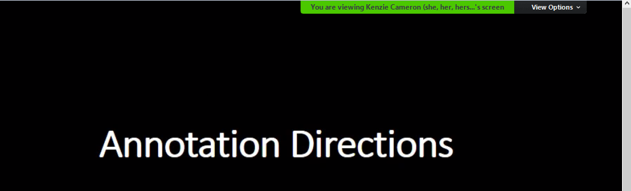
Annotation Directions
Click the arrow next to “View options”
Kenzie Cameron

Slide 10

Click on “Annotate”
A bar will appear that allows for annotation
Use:
TEXT
  (Format: if need to increase font)
STAMP
(Eraser if needed)
Kenzie Cameron

Slide 11

Benefits of Goal Setting
Notes:
There are many benefits to goal setting. Before I dive in to tell you all of them, I’d like to hear from you: what do you think are the benefits of goal setting? Why do you set goals for your self, for your career, for your team, or your family, or your work place?
Please use the annotate function: Annotate:
Provides Direction. First and foremost, goals give you a direction and destination. ...
Clearer Focus on what is important. ...
Clarity in Decision Making. ...
Gives you control of your future. ...
Provides Motivation. ...
Gives you a sense of personal satisfaction. ...
Gives you a sense of purpose in life.

Slide 12
I love deadlines. I like the whooshing sound they make as they fly by.
~Douglas Adams
Notes:
This is one of my favorite quotes by the author Douglas Adams
These days I try not to let them fly by me too often, but wow—deadlines still really make me crank my work.

Slide 13
The Background of
Goal Setting
Notes:
To give you some context, I’m going to tell you the origins of goal setting.

Slide 14

Defining Goal Setting
The development of an action plan designed to motivate and guide a person or group toward a goal.
Goal setting - Wikipedia
Notes:
But first, let’s define goal setting.
Goal setting is the development of an action plan designed to motivate and guide a person or group toward a goal.
We’re going to talk about the components of goals that make them strong goals, and then we’ll talk about ingredients of action plans that really make them stick, and help you carry your plan across the finish line.
From Wikipedia
Goals that are difficult to achieve and specific tend to increase performance more than goals that are not.^{[10]} A goal can be made more specific by:
quantification (that is, making it measurable), such as by pursuing "increase productivity by 50%" instead of "increase productivity",
enumeration, such as by defining tasks that must be completed to achieve the goal instead of only defining the goal.
Setting goals can affect outcomes in four ways:^{[11]}
ChoiceGoals may narrow someone's attention and direct their efforts toward goal-relevant activities and away from goal-irrelevant actions.EffortGoals may make someone more effortful. For example, if someone usually produces 4 widgets per hour but wants to produce 6 widgets per hour, then they may work harder to produce more widgets than without that goal.PersistenceGoals may make someone more willing to work through setbacks.CognitionGoals may cause someone to develop and change their behavior.

Slide 15
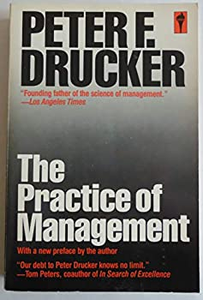

Origins of Goal Setting
Cascading of organizational goals and objectives
Visualizing and reinforcing accomplishments, leading to a positive work environment
Measurement and comparison of performance
Performance evaluation leading to engagement
Drucker, Peter. The Practice of Management. 1954.
Notes:
I’m talking about the origins of goal setting, and some of the research that’s been carried out in regards to behavior around goal setting—so that you have context for why we have acronyms like SMART goals, and other best practices, and why pitfalls can doom you to the giant waste land of unachieved goals.
Some of you may have heard of Peter Drucker, fondly known as the founder of modern management. He developed a widely used and modified strategy called Management by Objectives, MBO, which he described in his book The Practice of Management published in (1954.
Management by Objectives consisted of 4 main ideas:
- Cascading of organizational goals and objectives
Visualizing and reinforcing accomplishments, leading to a positive work environment
Measurement and comparison of performance
Performance evaluation leads to engagement

Slide 16
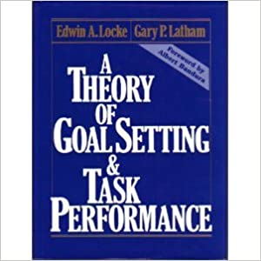
Locke and Latham: 5 Principles of Goal Setting
Clarity
Challenge
Commitment
Feedback
Task Complexity
Locke E.A., Latham, G.P. (2002). Building a Practically Useful Theory of Goal Setting and Task Motivation. American Psychologist. 2002.
Notes:
American Psychologists and researchers Locke and Latham carried Drucker’s work forward, and became Giants in the research of goal setting theory. After 35 years, they published their seminal paper, Building a Practically Useful Theory of Goal Setting and Task Motivation in 2002.
They concluded that:
Setting specific and relatively difficult goals leads to higher performance and
Also that having stated Goals increases performance because they direct and maintain attention on intended outcomes, and subsequently
motivate people to increase efforts in proportion to the difficulty level of the goal.
Having goals also motivates people to sustain these efforts until objectives are achieved.
They found that people use their existing knowledge and skills to design effective strategies to complete the task.
Their 5 principles of goal setting include:
Clarity is important when it comes to goals. Setting goals that are clear and specific eliminate the confusion that occurs when a goal is set in a more generic manner.
Challenging goals stretches people and helps them accomplish more.
Commitment is also important. Making sure attention is sustained toward the goal.
Feedback allows people to know how they are doing and how much progress they are making, so they can adjust their expectations and behavior towards achieving the goal.
Task Complexity : complexity of the task associate with the goal aligns with its level of challenge

Slide 17
Goal-Setting and Student Achievement
Students who choose their own goals perform at higher levels than students who have goals set for them (Mento, Steel, & Karren, 1987)
Goals designed and evaluated by students themselves are more authentic and meaningful to the students (Bellanca & Fogarty, 1991)
A stronger goal setting process leads to higher language achievement in high school Spanish language classes (Moeller, Theiler, and Wu, 2012)
Notes:
Researchers have built on Locke and Latham’s work. Some of the literature on goal-setting comes from studies on students, and these are just a few examples. Students who choose their own goals have improved performance; demonstrating the importance of autonomy in goal-setting; don’t let someone else choose your goals for you—which now seems obvious, but probably wasn’t always so.
Not only do students have higher levels of performance, they find their own goals more authentic and meaningful.
And, Researchers Moeller, Theiler, and Wu at the University of Nebraska, conducted a quantitative research study in 2012 on 1273 high school students learning Spanish over the course of 5 years, demonstrated that a stronger and more robust goal setting process led to higher language achievement.
I will then extrapolate and say that by using the principles you learn in this workshop and other readings, you can design a stronger process of goal setting, and also achieve better outcomes for your self.

Slide 18
“Hundreds of studies show that people who set specific goals perform better than individuals who have vague goals like ‘I will do my best.’…The best goals have the appropriate level of challenge.”
David et al. Beyond Goals: Effective Strategies for Coaching and Mentoring. 2013.
Sejts et al. Goal setting and goal orientation: an integration of two different yet related literatures. Academy of Management Journal. 2004.
Notes:
So we now know that “a large body of research show that people who…

Slide 19
Contemporary Goal Setting Theory
Goal setting is the most popular behavior change strategy.
The strength of goal setting is that it demands a focus on a clearly defined target, and demands movement towards that target within a specified time frame.
Feedback is the most important component; probably more important than commitment.
  Feedback mechanisms are ideally both positive and negative, and continuous and intermittent—tracking progress.
Feedback is key to effective goal completion
David et al. Beyond Goals: Effective Strategies for Coaching and Mentoring. 2013.
Notes:
Which leads us to contemporary goal setting theory:
These days, goal setting is the most popular behiavor change strategy (Think new year’s resolutions)
And that the strength of goal setting is that it demands a focus on clearly definted target, and demands movement towards that target in a specified time frame.
Some experts will say that feedback is the most important component of strong goal setting, and that feedback should be ideally both continuous and intermittent, demonstrating the importance of tracking progress and also getting objective feedback from other people or mechanisms.
Feedback is essential for effective goal completion. However, as we will learn later on in this workshop, there is newer wisdom challenging that feedback is THE most essential ingredient; we have a competitor.

Slide 20
Activity
Write down 2-3 personal or professional goals you have for the upcoming year.
Make sure at least one of them is a goal you are willing to share with the group.
Share one of your goals – speak up, raise your hand, or write in the chat
Notes:
And now for our first activity, which you have probably already guessed:

Slide 21
SMART Goals
Notes:
Now let’s talk about SMART goals.

Slide 22





SMART Goals
Specific
Measurable
Achievable
Relevant
Timebound
Notes:
SMART goals were first coined in 1981 (by a man named George Doran, published in Management Review).
They are so commonly used, because they’re easy to understand, easy to remember, and easy in a checklist—you know when you’ve written a SMART goal.
There is some variation in what the letters stand for, and this (more commonly accepted) representation is slightly different from the original.
For example, does R stand for relevant or realistic? Or resourcable Is A Achievable or Assignable?
Specific: means targeting a specific area of improvement. Most experts will say the more specific, the better.
Measurable means making sure the goal is quantifiable, or that you can at least come up with some indicator of progress.
Achievalbe, means just that—given current circumstances and resources, this goal can be accomplished.
Relevant: does this goal mean something important to you?
Time bound: please for the love of god put an end point to your goal.
Now let’s talk about each of these qualities in more detail.

Slide 23


Specific
The 5 W’s:
What do I want to accomplish?
Why is this goal important?
Who is involved?
Where is it located?
Which resources or limits are involved?
Make it Extremely Specific
Target Market by Invinic Studio from the Noun Project
Notes:
To add specificity to your goal, answer the 5 Ws:
I want to create a mentoring program.
I want to create a mentoring program, for early career hospital medicine faculty at NU, with senior faculty as mentors, so that hospitalists can get the mentoring they need to jump start their academic careers

Slide 24


Measureable
How much?
How many?
How will I know when it is accomplished?
Having measureable goals can help you stay motivated
Notes:
Figure out a way to quantify your goal
Making your goal measurable will enable you to track progress, which means you get feedback—and remember how important feedback is to accomplishing your goal?
I want to become an expert in time management.
Instead, I will learn more about time management by reading 3 books, 5 articles, and following 3 blogs in the next 3 months.

Slide 25


Achievable
How can I accomplish this goal?
How realistic is the goal, based on other constraints and responsibilities?
Is this goal within my control?
ACHIEVE by Adrien Coquet from the Noun Project
Notes:
Do your current circumstances, talents, and resources allow for the successful completion of your goal?
For example, Right now is not really the time to do research on how best to treat severe cases of influenza virus. (for those of you who may not be aware, we have had exactly one patient hospitalized with influenza this season)

Slide 26

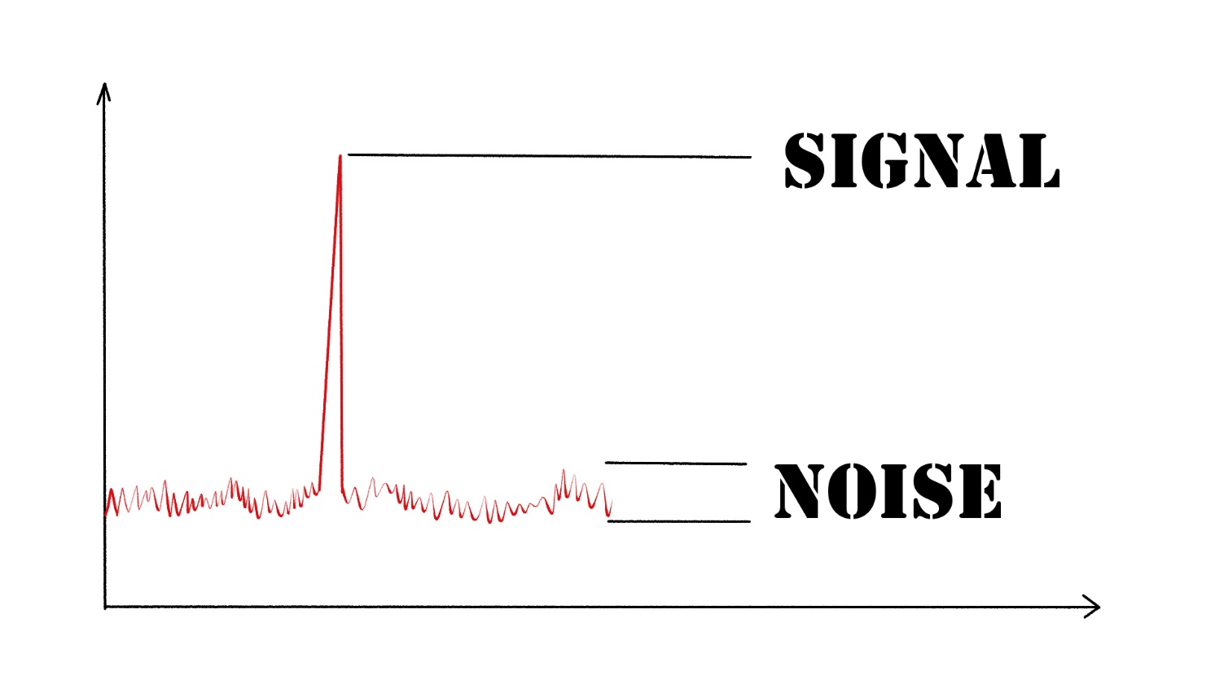
Relevant
Is this a worthwhile goal?
Is this the right time?
Do I have the skills needed to reach this goal?
Is it meaningful (enough) to me?
relevancy by Template from the Noun Project
Adam Grant Says Understanding 1 Thing Separates Successful People From Those Who Only Dream | Inc.com
Notes:
Goals really have to be interesting to you. It’s really tough to complete goals that are not your goals.
Ideally, they are also interesting and useful to the rest of the world as well.
Cue influenza virus again.

Slide 27


Time-Bound
What’s the timeline for this goal?
  Start
  Milestones
  End
When will I have achieved my goal?
When is it time to pivot?
timely delivery by Shocho from the Noun Project
Notes:
Not only is it a good practice to set and end to your goal (deadline), but creating a timeline of milestones will help you track progress, and provide that very important feedback you need to stick with your goal.
Please put an end to your goal, so you can move on.

Slide 28
Case Studies
Notes:
Ok, let’s look at a couple of case studies.

Slide 29
Case Study #1: I want to become grant funded by the end of the year.
What’s missing?
Lacks specificity
  What grant? When is it due?
  Who will help me?
Yes – the outcome. What about processes?
Not really achievable?
Relevant – probably
Timebound—yes, but realistic?
I will apply for institutional K award, RFA due xx/xx with the mentoring of my division chief or department chair, on the topic of studying effects of long-haul COVID on QOL. I will have these sections of the proposal completed by this date. To meet the deadline, I will schedule regular time to work on this grant proposal, and meet regularly with my mentor. I will track progress by making a detailed checklist with deadlines, and sharing this checklist with my mentor and colleagues.
Notes:
Write in chat box

Slide 30
Case Study #2: I want to become a better teacher.
What’s missing?
Lacks specificity
  What does “better” mean?
  Who are your learners?
  What/who will help you?
How will you measure success?
Achievable - yes
Relevant – hopefully
Timebound – by when?
I will improve my student and resident teaching skills by the end of next year, by working with my mentor, attending my division Teaching Skills workshops and at least 3 FAME/TIME lectures. I will ask for feedback from my learners after periods of interaction. To track progress, I will keep a notebook of the skills I learn and feedback I receive, and at the end of the year I will write a summary of my learnings.
Notes:
Write in chat box

Slide 31
Activity and Breakout Session #1
Briefly introduce yourselves
Choose one of your goals and describe it to your group.
Have the other members of your breakout group offer suggestions for how to make it more specific, measurable, achievable, relevant, and timebound.
Take turns, so each person has a chance to receive feedback.
Report out.

Slide 32
Pitfalls and Tips
Notes:
Of course—there’s more to goal setting than SMART goals.

Slide 33
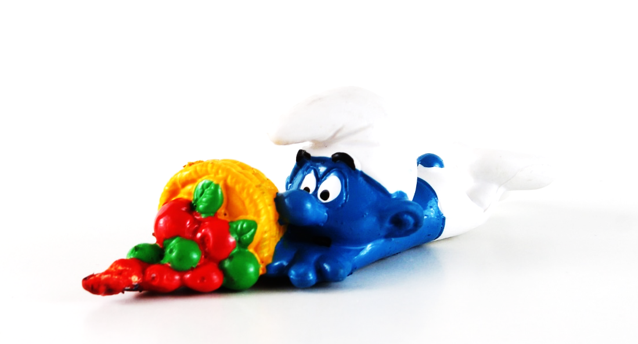
Best Practices to NOT Achieve Goals
No Goals | Don’t have any goals
Not Your Goals | You mistook someone else’s goals for your own
The Mind Meld | Don’t write them down
Goal-ish | Be vague. Add hand-waving.
Kitchen Sink Goals | Make a bunch of goals, and don’t prioritize
The Moonshot Goals | Make them REALLY big!
Lottery Goals | Make your goals dependent on luck
Stealth Goals | Don’t tell anyone about your goals
Imaginary Goals | Don’t ever check on progress
Stone Tablet Goals | Don’t ever revise, even if life changes
Miracle Goals | Don’t make a plan to achieve them
Whoosh goals | Underestimating timeline or horizon
Ten Best Practices for Missing your Goals by Leslie Dow - SavvyAuthors | SavvyAuthors.
https://www.mindtools.com/pages/article/goal-setting-mistakes.htm
David et al. Beyond Goals: Effective Strategies for Coaching and Mentoring. 2013.
Notes:
It’s good to identify where you are most likely to slip up when it comes to goal setting. These are some options.
Don’t have any goals. Hopefully, since you’re here, this one won’t apply to you.
Same for number 2. hopefully you’ve learned to write them down.
As we’ve seen several examples of, being vague in goal setting is one of the more common pitfalls.
The kitchen sink goal is my preferred pitfall—I have a really difficult time writing down less than 10 goals at a time. I have a kitchen sink list that I’m failing through as we speak.
Whoosh goals—watching those deadlines fly by…because you underestimated the timeline, or scoped your goal too big. Another very common pitfall.
Underestimating completion time
Most tasks take longer than you anticipate
Time optimism v. time realism
Goals that are too challenging
Will failure harm motivation and self-efficacy?
Appreciating failure as a powerful learning mechanism
Setting other people’s goals
People are more committed to goals they help set
But may be tempted to set easy-to-reach goals
Not reviewing progress or incorporating feedback
Inappropriate horizon
Make sure short-term goals do not harm long-term outcomes (alignment)
Eyes on the horizon: too much focus/dedication at the risk of missing new opportunities
Setting too many goals
Making sure goals are realistic and attainable

Slide 34
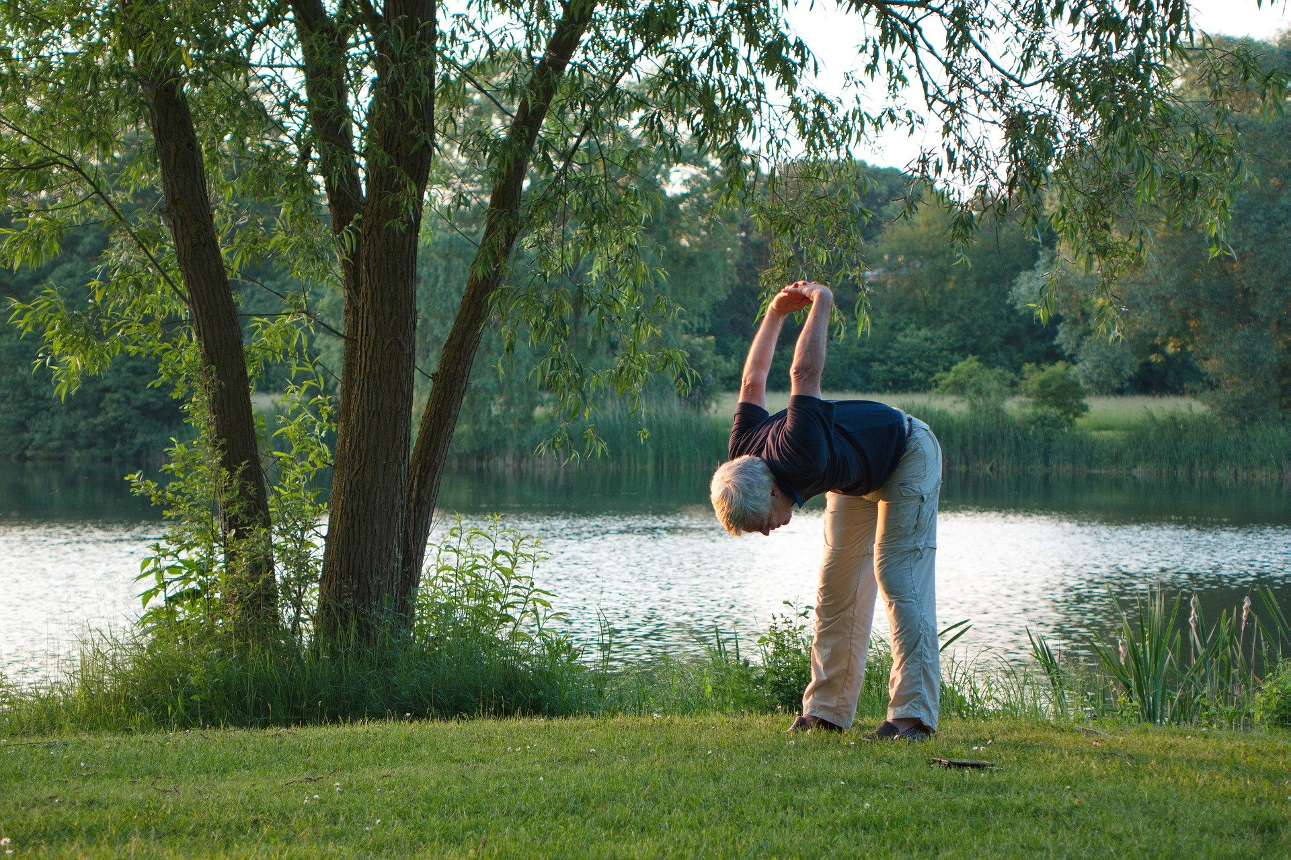

Tip #1: Stay Flexible
Notes:
I also have 5 tips to share with you, based on the latest thinking in goal setting theory and research.
First of all,
Stay Flexible and adaptable.
Keep your goals as flexible as your life. You have a life, and that life changes over the year. Think about last year at this time. Are you doing now what you expected? Or Did craziness happen this past year? And every year? If you don’t end up achieving your goals, instead of kicking yourself, reflect on the reasons why. Was it because your goal setting process was off? Or was it because your life changed, and it didn’t make sense to work towards your goal any more. Give yourself the permission to change your goals any time they are no longer working for you. You control your goals.

Slide 35
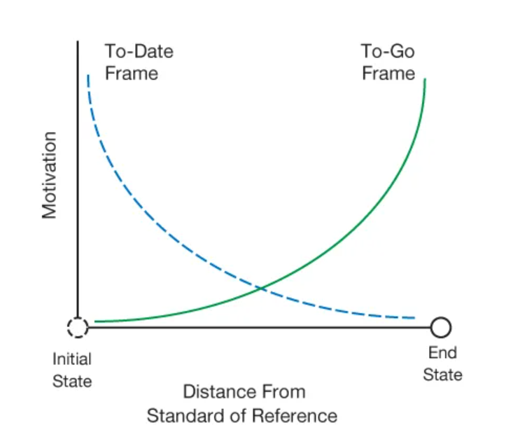
Tip #2: Stay Motivated
Don’t get stuck in the middle
Mastering Motivation (northwestern.edu)
Ten Best Practices for Missing your Goals by Leslie Dow - SavvyAuthors | SavvyAuthors
Notes:
Researchers at our own Kellogg School of Management, Brendl and Bonezzi, hypothesized and then had a series of experiments to prove that there’s a lag in the middle of pursuing a goal, which accounts for the tendency to get “stuck in the middle.”
They propose that the perception of motivation, and next steps toward a goal, differs depending on where we are in relation to the beginning or end. In the beginning, there is excitement and motivation. Close to the end, there is also excitement and motivation. In the middle, far from either the excitement of the beginning or the end, is when attention lags.
Maybe instead of a reward at the end, you need a reward in the middle, during that long schlog, to motivate you to keep going.
I’ve certainly seen this first and second hand: think about Tough degree programs: when does motivation wane? Not 1-2 classes in to the program, and not 1-2 classes from the end of the program. It’s the middle, when you’re in the middle of the ocean and can’t see land in any direction—that’s when you need a reward to keep the motivation going.

Slide 36

Tip #3: Feedback: Monitor Your Progress
Notes:
We’ve already talked about the importance of feedback. Monitor your progress in a way that is in sync with the way you think and work best. Create checklists, or graphs, or charts. On paper or online, using apps or post its. Whatever works for you. And then, check in with others to find out how they think you are doing. Because, hopefully your goals are not stealth goals.

Slide 37

Tip #4: Accountability Structure
Notes:
Matthews, a professor in Dominican University recruited 267 participants from a wide variety of businesses, organizations, and networking groups throughout the United States and overseas for a study on how goal achievement in the workplace is influenced by writing goals, committing to goal-directed actions, and accountability for those actions. Participants ranged in ages from 23 to 72 and represented a wide spectrum of backgrounds.
Matthews found that more than 70 percent of the participants who sent weekly updates to a friend reported successful goal achievement (completely accomplished their goal or were more than half way there), compared to 35 percent of those who kept their goals to themselves, without writing them down.
This accountability structure has certainly worked for me, when I use it. Having a partner to complete a goal together with, or report out to, makes it more likely that I will achieve my goal.

Slide 38
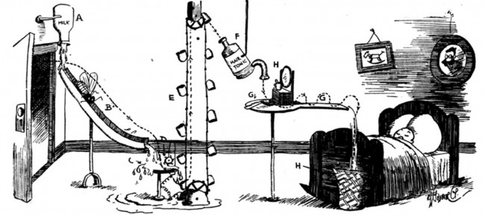
Tip #5: Focus on the Process
Adam Grant Says Understanding 1 Thing Separates Successful People From Those Who Only Dream | Inc.com
The Art and Wit of Rube Goldberg - Norman Rockwell Museum - The Home for American Illustration (nrm.org)
Notes:
This last tip comes from organizational psychologist Adam Grant, author of Give and Take, and more recently Think Again. Also the founder of the podcast WorkLife, with the tag line how to make work not suck.
He urges the development of structures and processes that work for you, and nudge you toward success. And proposes that it’s the processes and structure (one of them being accountability) that are the number one ingredient to making your goals successful—even more important than feedback.
For me, that means scheduled accountability. I work with a team toward a common goal, and we meet regularly to make sure we’re making progress. That’s how I created a mentoring program; I didn’t—my team and I did.
The key is to create a process that works for you, and nudges you toward a series of small improvements.

Slide 39
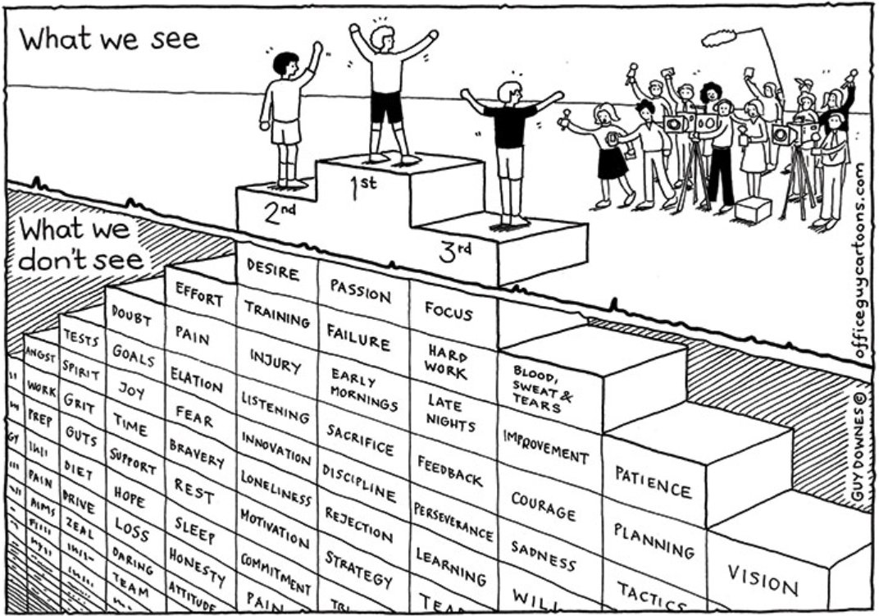
“The seeds of greatness are planted in the daily grind.” Adam Grant
https://t.co/b5FTdVN25B" / Twitter
Notes:
Also from Adam Grant: He says, People who achieve huge goals have dreams, but, more important, they create processes. They build systems. They consistently take the right steps that, over time, ensure they reach their ultimate goal.
And here's the thing: They don't obsess over their goals. They obsess over their processes, because greatness is the result not just of inspiration but of a relentless daily grind.

Slide 40

Notes:
Finally, and Arguably the most important aspect of goal setting: your goals should be meaningful and positive.

Slide 41
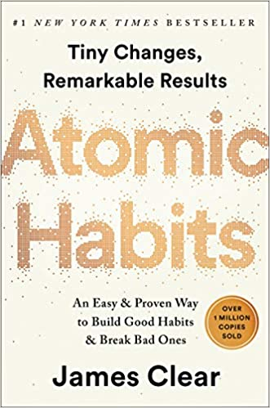
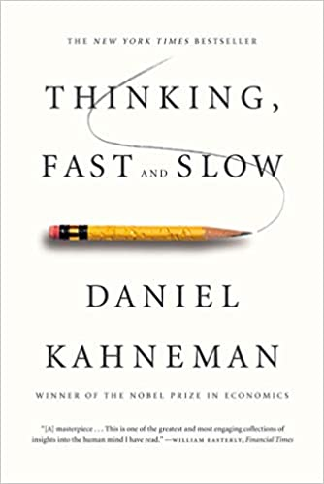
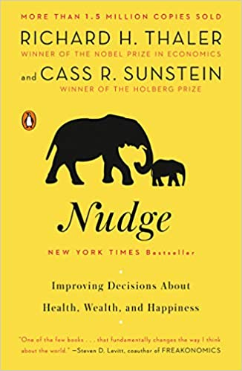
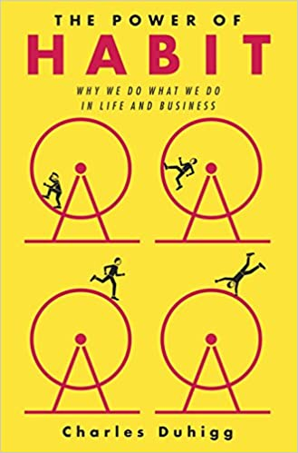
Notes:
These are a few books that break down the science of habits, and may help you develop processes that make your goals stick.
If I had to choose one of these to recommend, I d point to Atomic Habits.

Slide 42
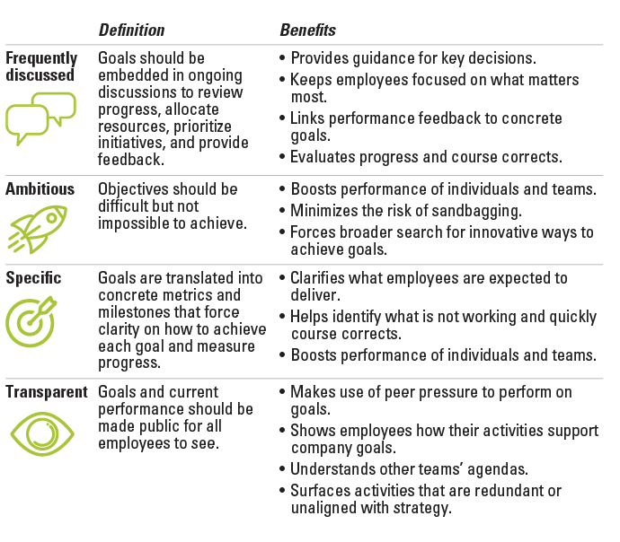
FAST goals
With Goals, FAST Beats SMART (mit.edu)
Notes:
According to conventional wisdom, goals should be specific, measurable, achievable, realistic, and time-bound. But SMART goals undervalue ambition, focus narrowly on individual performance, and ignore the importance of discussing goals throughout the year. Proponents at MIT published an article describing the FAST acronym: you should instead set goals that are FAST — frequently discussed, ambitious, specific, and transparent.
This framework, in difference to SMART, emphasizes the importance of having goals top of mind and embedded in covnersations ongoing, making sure goals are challenging enough, and that you are transparent about them.
This framework still does not emphasize the importance of feedback or processes that underlie the goal.

Slide 43
Activity and Breakout Session #2
1. Which pitfalls are you most likely to encounter in working toward your goals?
2. What tips for success can you implement to achieve your goals?
3. What is the very next step you will take today, tomorrow, or next week?
Notes:
Take 5 minutes to think about these questions, and then another 5 minutes to share with the rest of the group. And be prepared to share when you come back from the breakout session.

Slide 44
Final Thoughts

Slide 45
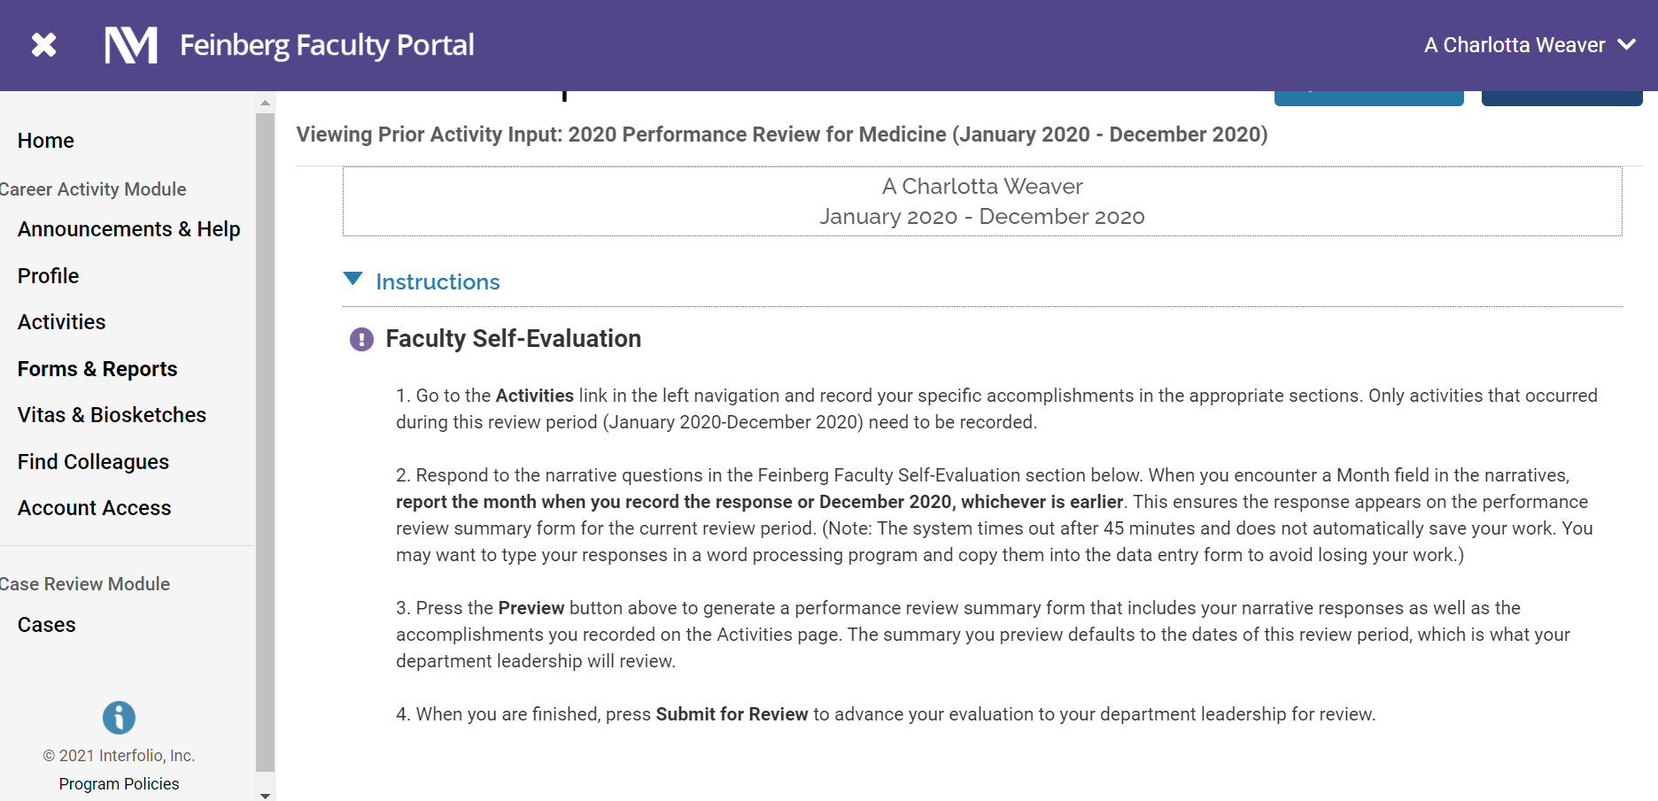

Slide 46
You have learned that…
Many studies demonstrate the effectiveness of goal-setting.
Applying the acronym SMART to goal setting creates a framework for formulating goals.
Awareness of pitfalls and implementing specific strategies can increase your chances of achieving your goals.

Slide 47

What I know for sure is this: The big secret in life is that there is no big secret. Whatever your goal for this year is, you can get there - as long as you're willing to be honest with yourself about the preparation and work involved. There are no back doors, no free rides. There's just you, this moment, and a choice.
~Oprah Winfrey

Slide 48
Thank You
a.charlotta.weaver@nm.org
a-weaver-0@northwestern.edu
Please fill out evaluation survey, which will be emailed to you
Most photos from Pixabay.com

