Slide 29
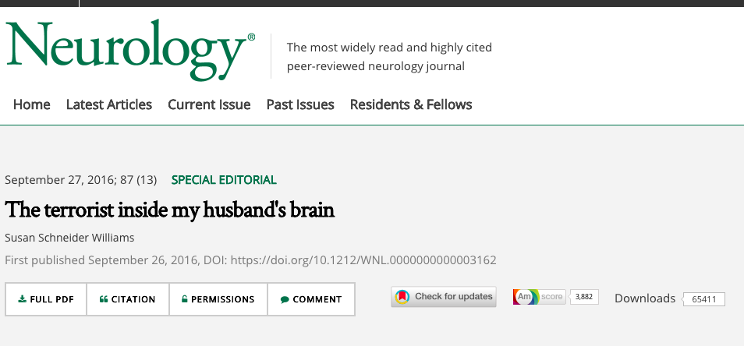
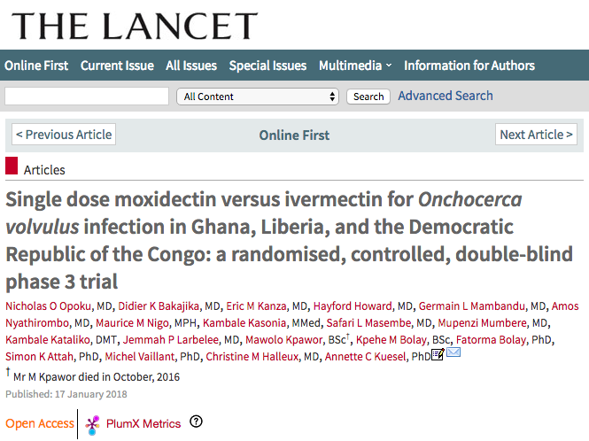
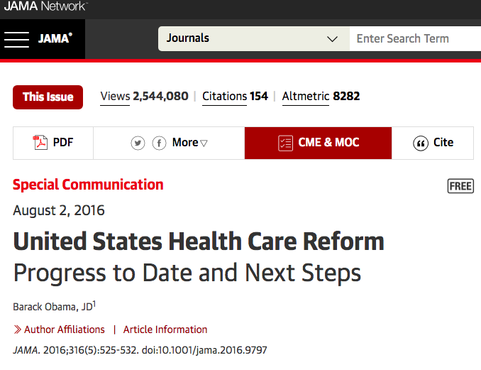

Slide 34
Hands-on demo
News attention
https://www.ncbi.nlm.nih.gov/pubmed/28509899
Link to Altmetric page: https://www.altmetric.com/details/20191355?src=bookmarklet
Policy citation
https://www.ncbi.nlm.nih.gov/pubmed/20187725
Link to Altmetric page: https://www.altmetric.com/details/15018084?src=bookmarklet
Impact story
https://profiles.impactstory.org/u/0000-0002-1197-3399
Metrics Toolkit
http://www.metrics-toolkit.org/

