Slide 1
DigitalHub:
Making Research Open and Available
Karen Gutzman, Impact and Evaluation Librarian
Eileen Wafford, Research Librarian
Ramune Kubilius, Collection Development and Special Projects Librarian
Galter Health Sciences Library
Northwestern University, Feinberg School of Medicine
Presentation for: Dissemination, Impact, and Access Workshop
Thursday, July 20, 2017
2:15 – 2:45 pm
Baldwin Auditorium

Slide 2
DigitalHub
Developed by Galter Health Sciences Library for Northwestern Medicine as a place to deposit and host scholarly outputs
Reasons to use Digitalhub
  easily share your research
  deposit your non-traditional scholarly outputs
  track views and downloads of your research
  make your research more discoverable to the global research community

Slide 3
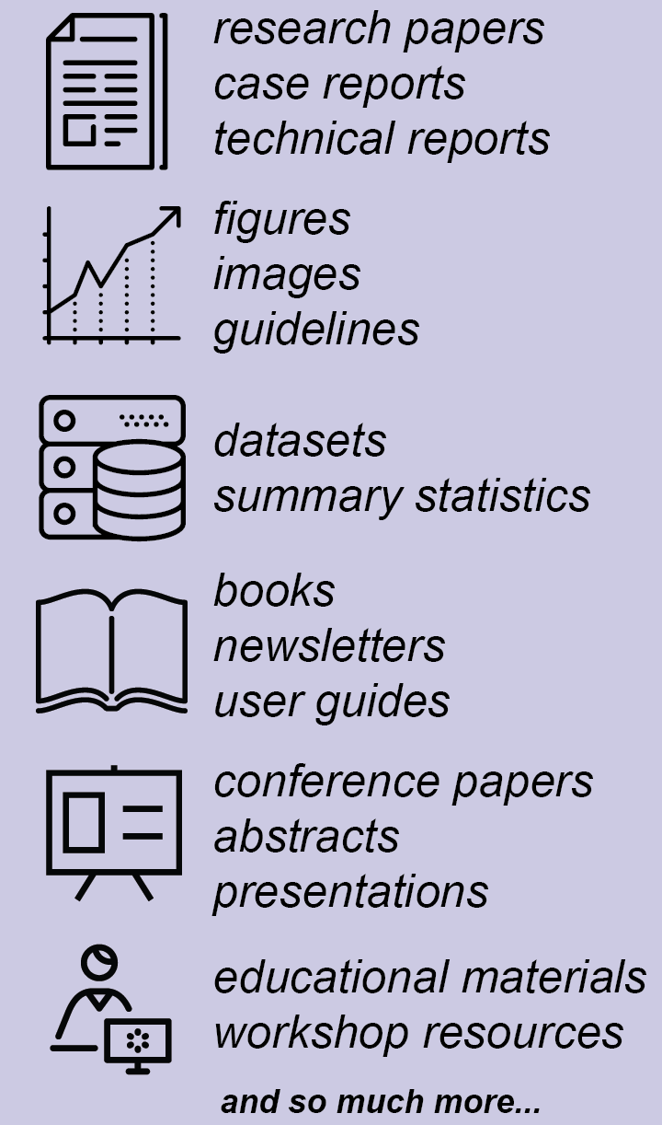
What can I deposit in DigitalHub?
Notes:
The repository provides stable, long-term storage and ongoing maintenance for content contained within the repository. Examples of items that the repository can accommodate at this time include:

Slide 4
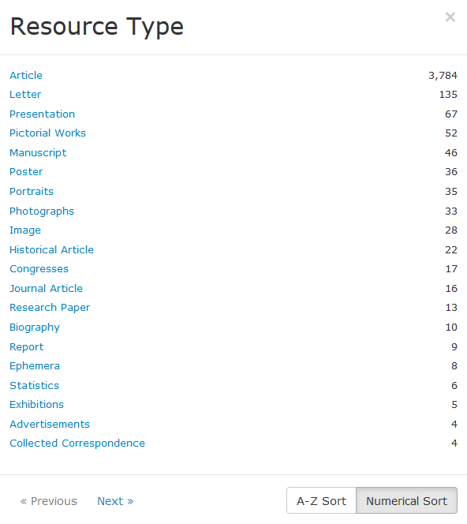
What can I deposit in DigitalHub?
Notes:
The repository provides stable, long-term storage and ongoing maintenance for content contained within the repository. Examples of items that the repository can accommodate at this time include:

Slide 5
What are the guidelines for submitting content in DigitalHub?
You must be affiliated with Northwestern Medicine.
You must have the rights to let Galter Library distribute it.
The content must be scholarly, educational, or related to the university's mission.
The content must be permanent. DigitalHub is intended to be an archive, not a storehouse for works in progress.
The content must be in a digital format.

Slide 6
What are the “terms of service”?
Copyright owners will retain copyright over their materials once they are deposited in DigitalHub!
By putting material into DigitalHub, you are granting Galter Library a non-exclusive license to distribute it, which means that you are authorizing Galter Library to make it available online.
But you are free to also distribute it through other mechanisms.
See the non-exclusive distribution license for more information.
Notes:
It is preferred but not required that materials be made available with a Creative Commons license. Many researchers and educational institutions are adopting Creative Commons licenses to provide wider access to their work. There are few different types of CC licenses that you can choose from and you also have an option to mark your item with the “All rights reserved” license. Through the Creative Commons attribution license, the copyright owner retains copyright, but the materials are open to others for use and make modifications as long as attribution to the original is made.

Slide 7
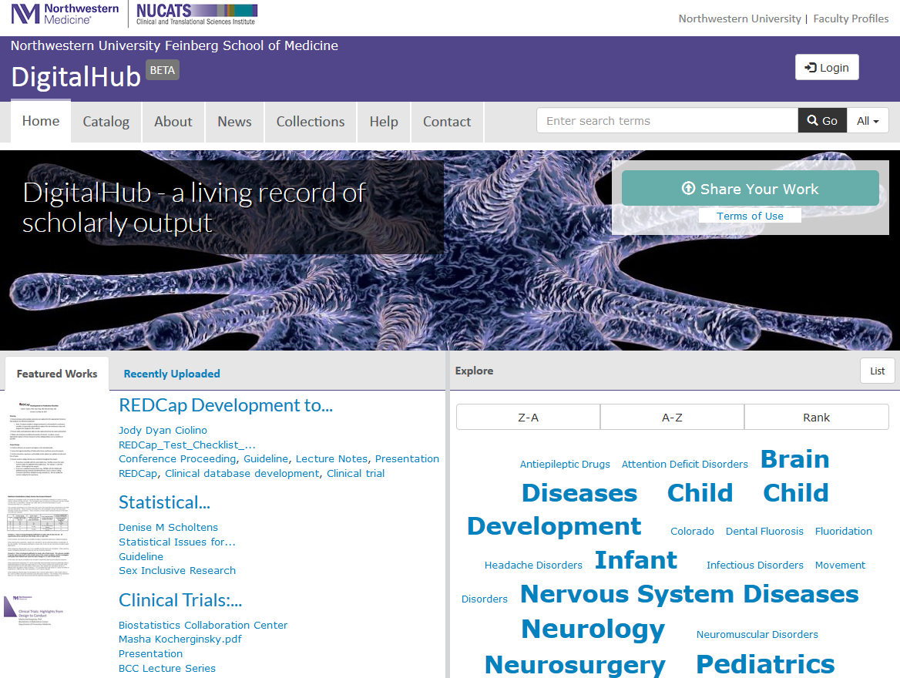
digitalhub.northwestern.edu

Slide 8

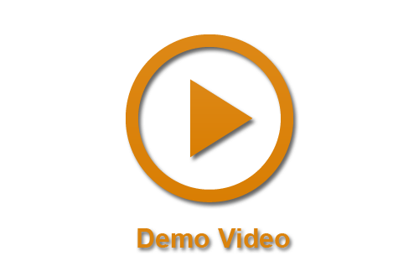
Submitting your work
User guide:
https://goo.gl/642uyx
Demo video:
https://goo.gl/9g89v1

Slide 9
Let’s get some practice
Let’s practice uploading an article and a presentation.
You can follow along on your computer or watch the instructor.
Practice Files are located here: https://goo.gl/nyHdxn
  DigitalHub Handout 1
  DigitalHub Handout 2
  DigitalHub Practice Article for upload
  DigitalHub Practice Presentation for upload

Slide 10
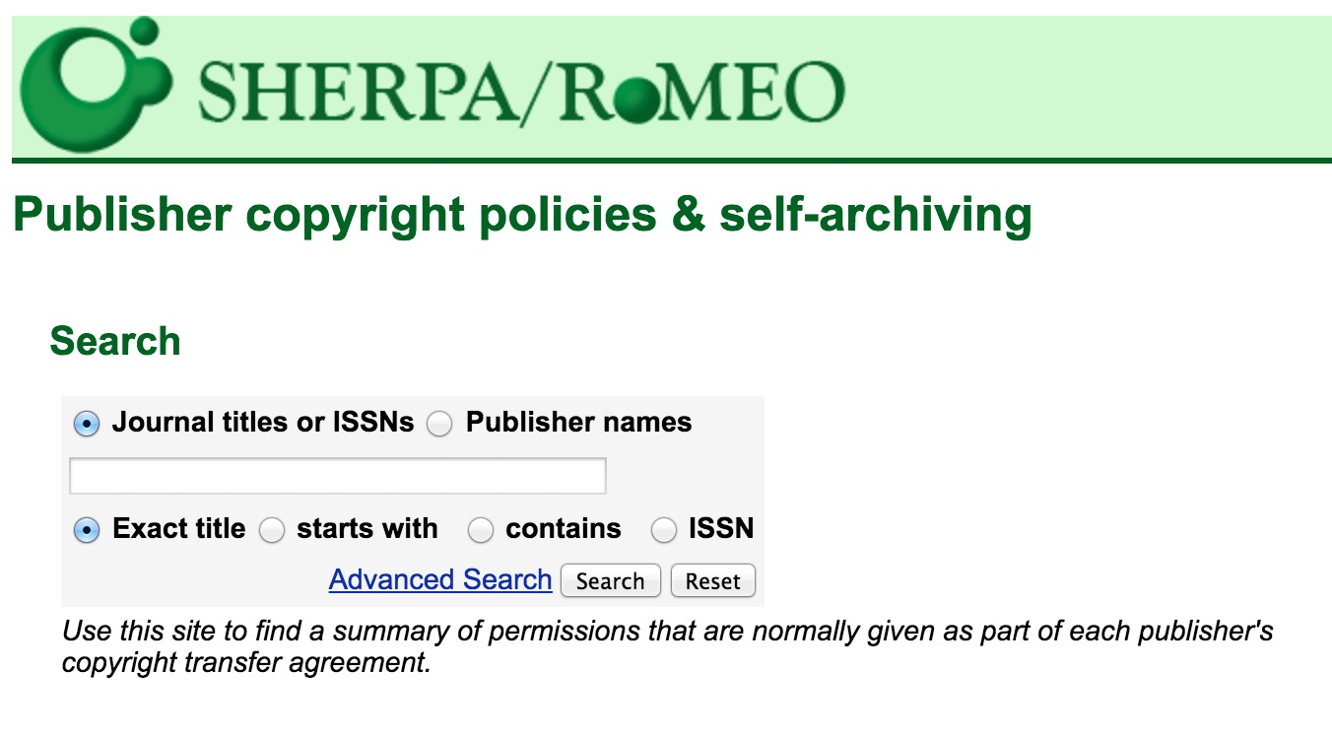
Checking publisher copyright policies & self-archiving
First stop: SHERPA/RoMEO http://www.sherpa.ac.uk/romeo/
Not sure? Contact your publisher

Slide 11
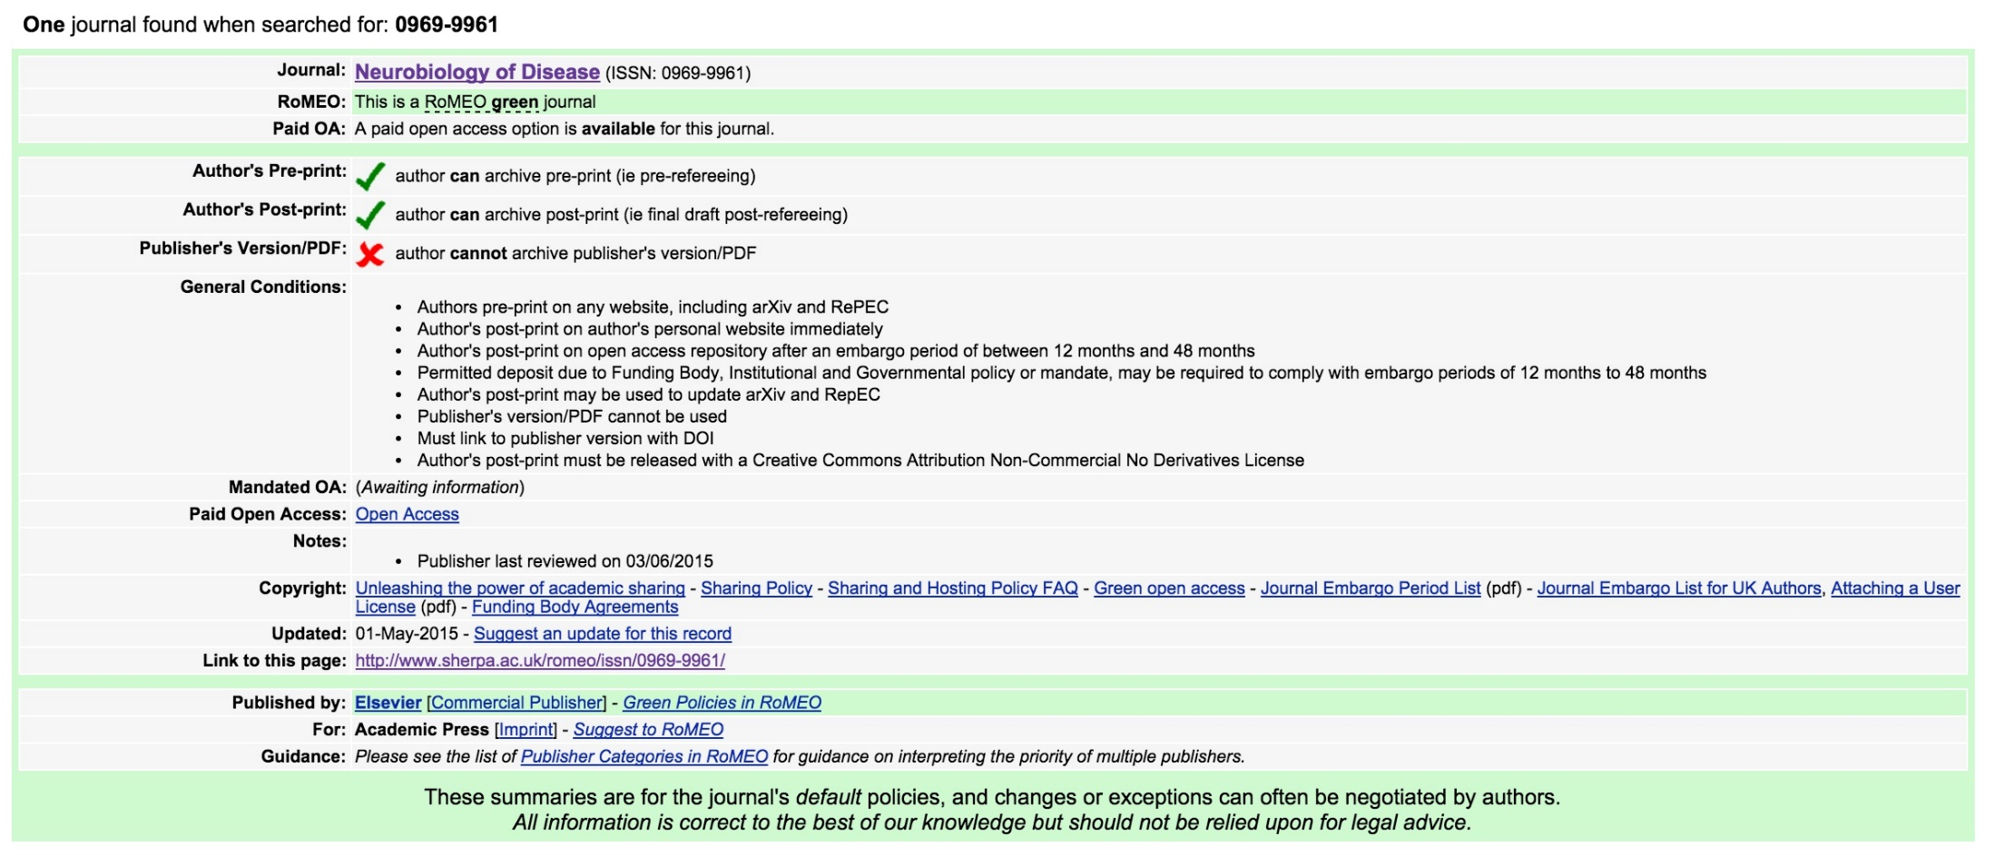
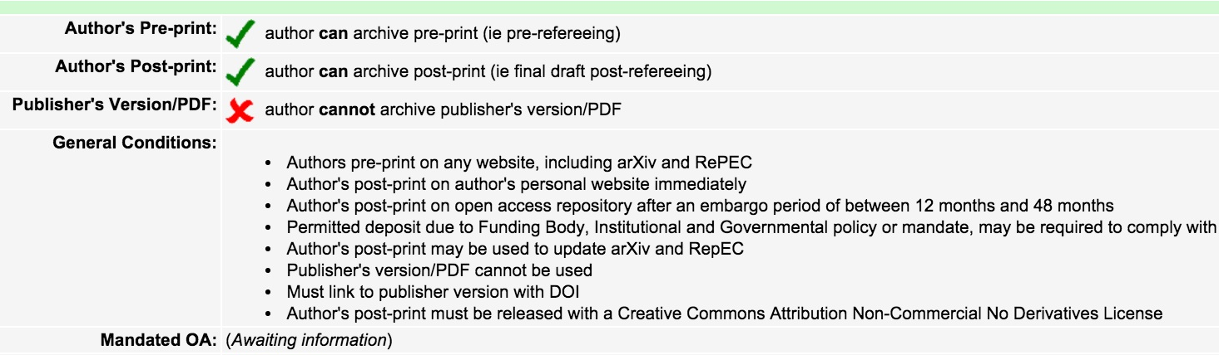
Using SHERPA/RoMEO
Example of a Journal that doesn’t allow archiving of the final published version

Slide 12
How to submit your work?
7 easy steps
Login to your account on DigitalHub
Select the “Upload” button
Read the deposit agreement and mark the checkbox if you agree to the terms.
Select a file you want to deposit and upload it.
Apply metadata (5 required fields)
Set permissions and visibility
Save your work in DigitalHub!

Slide 13
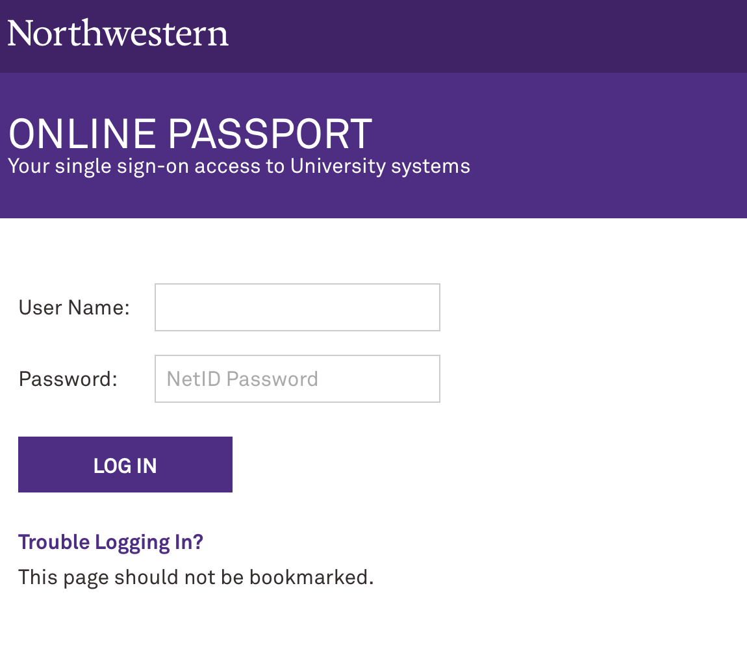
Submitting your work – step 1
Login to digitalhub.northwestern.edu
Authentication via Shibboleth

Slide 14
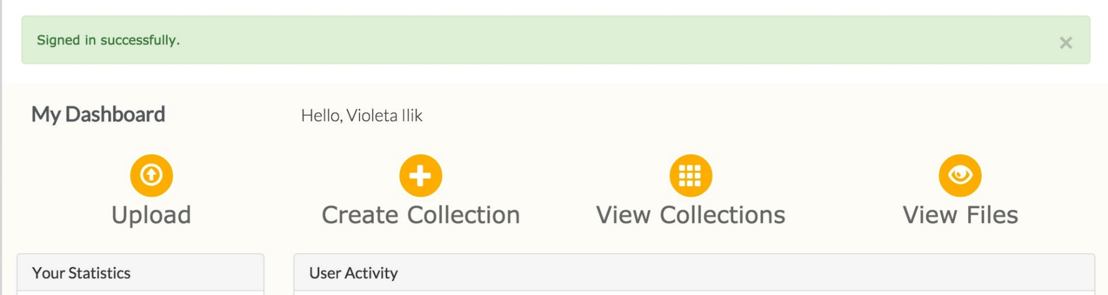
Submitting your work – step 2
Upload digitalhub.northwestern.edu/dashboard
You can also create a collection from here, too!

Slide 15
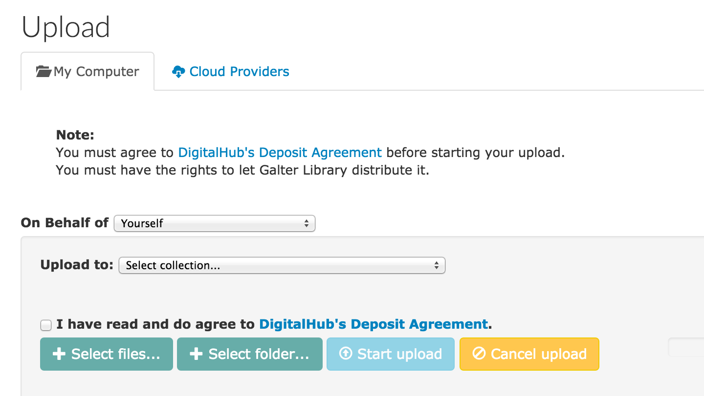
Submitting your work – step 3
Agree to the deposit agreement

Slide 16
Non-Exclusive Distribution License
By agreeing to this license, you grant to Galter Library the non-exclusive right to copy, display, reproduce (in the same or different formats), and distribute your submission worldwide in any medium, including but not limited to audio or video.
You agree that:
Galter Library may, without changing the content, convert the submission to any medium or format for the purpose of preservation.
Galter Library may keep more than one copy of the submission for purposes of security, back-up, and preservation.
Northwestern University bears no responsibility for the contents of your submission.
You warrant that all of the following are true:
The submission does not, to the best of your knowledge, infringe upon anyone's copyright.
Any third-party owned material included in the submission is clearly identified and acknowledged as such.
Any obligation required by a contract or agreement with a sponsoring or supporting person or agency has been fulfilled.
The submission has no right which has been sold, mortgaged, or otherwise disposed of, and all rights are free from exclusive claims.
The submission contains no libelous or other unlawful content, nor does it invade the privacy of any person or third party.
And you warrant that one of the following is true:
The submission is your original work and you have the right to grant the rights contained in this license.
You are one of the copyright owners of the submission and have permission from other owners to submit the item.
Another party is the copyright owner and you have permission to submit the item.
The submission is in the public domain or otherwise not subject to copyright restrictions.
Galter Library will clearly identify your name(s) as the author(s) or owner(s) of the submission, and will make no alteration, other than as allowed by this license, to your submission.
Notes:
In order for this repository to reproduce and distribute your work, a distribution license must accompany each submission. No copyright transfer is involved. As a final step in the submission process, please read the license text below, select ‘I Grant the License,’ and click ‘Complete Submission.’

Slide 17
Submitting your work – step 4
Start Upload

Slide 18
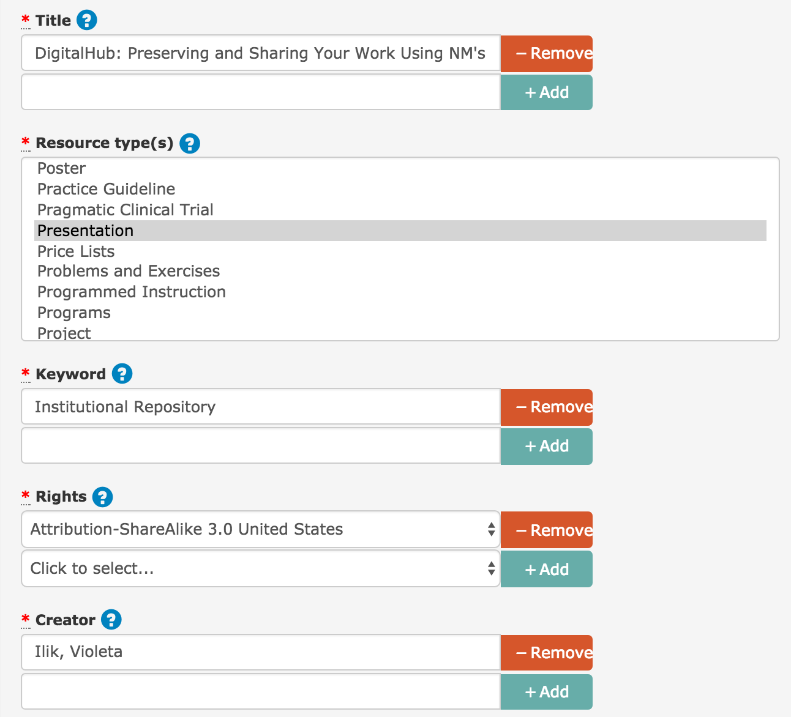
Submitting your work – step 5
Apply Metadata
5 required fields:
Title
Resource type
Keyword
Creator
Rights

Slide 19
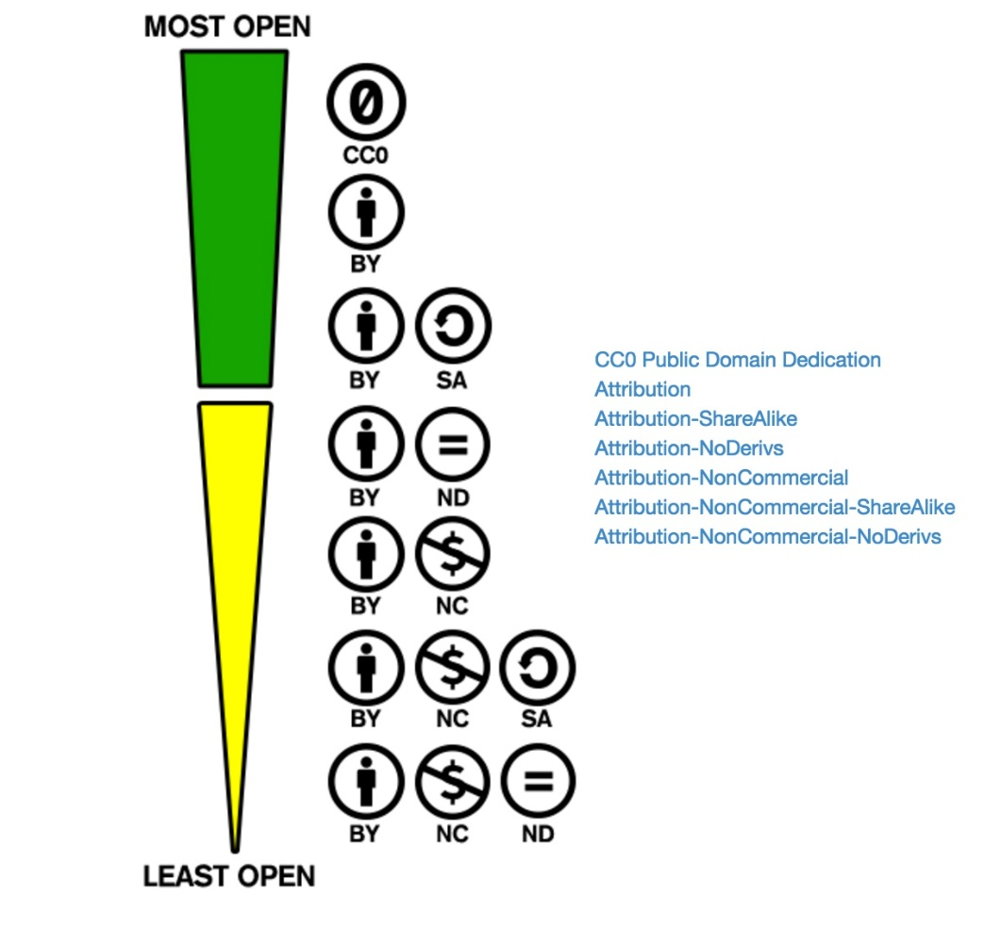
Creative Commons License
Choose your best option!
Visit:
http://creativecommons.org/examples#by

Slide 20
Creative Commons License
Courtsey of CC Australia

Slide 21

The MIT License (MIT)
Permission is hereby granted, free of charge, to any person obtaining a copy of this software and associated documentation files (the "Software"), to deal in the Software without restriction, including without limitation the rights to use, copy, modify, merge, publish, distribute, sublicense, and/or sell copies of the Software, and to permit persons to whom the Software is furnished to do so, subject to the following conditions:
  The above copyright notice and this permission notice shall be included in all copies or substantial portions of the Software.

Slide 22
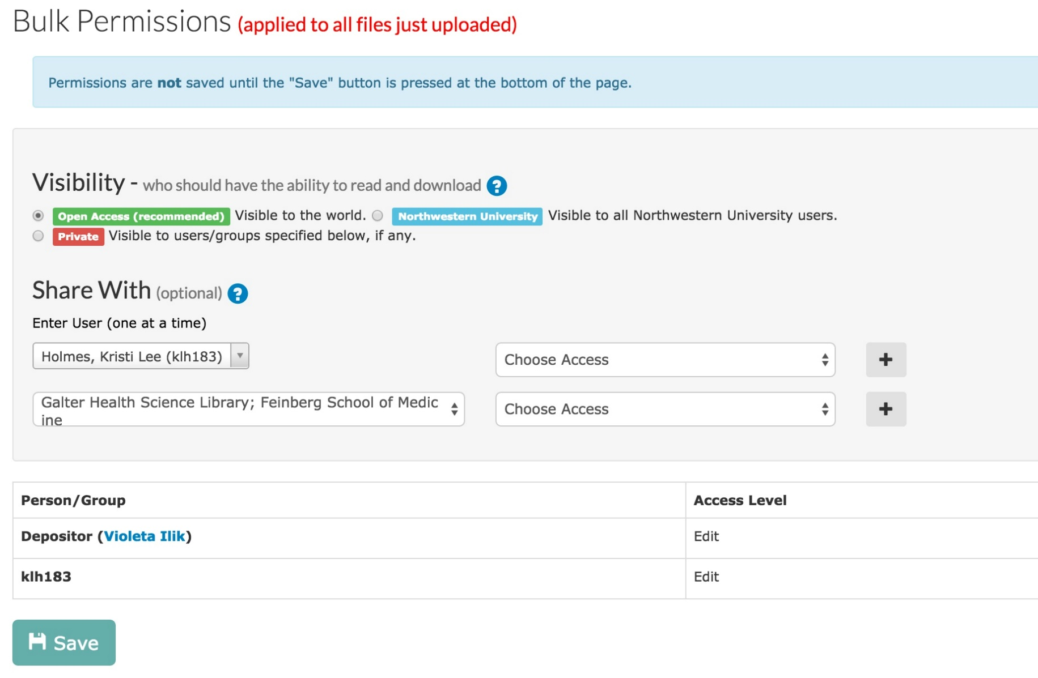
Submitting your work – step 6
Set visibility & permissions

Slide 23
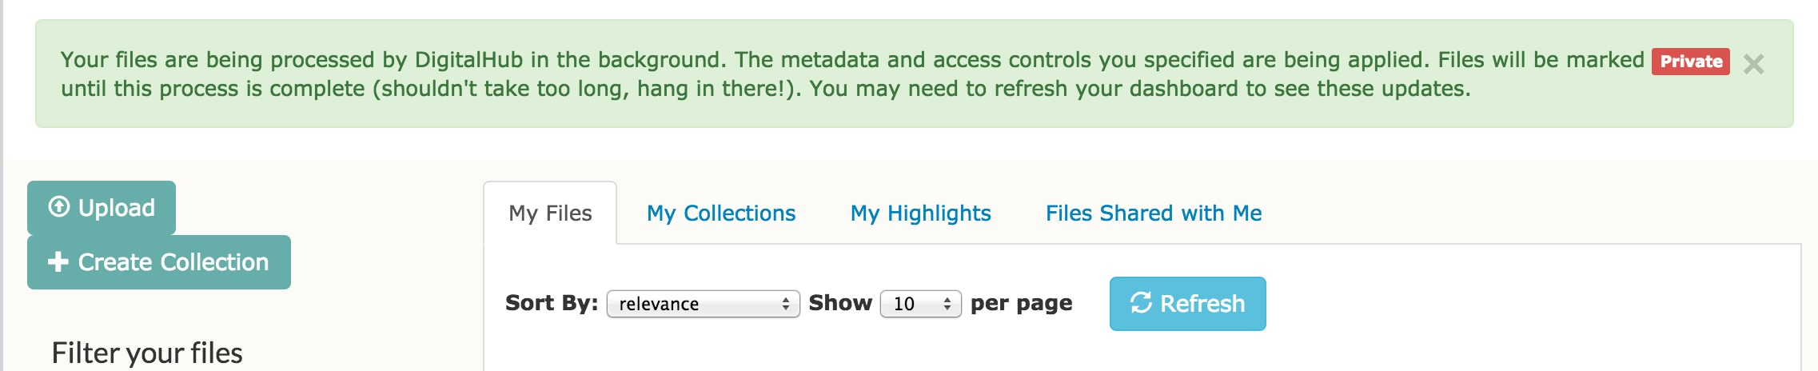
Submitting your work – step 7
Save!
Congratulations, you have submitted your work!

Slide 24
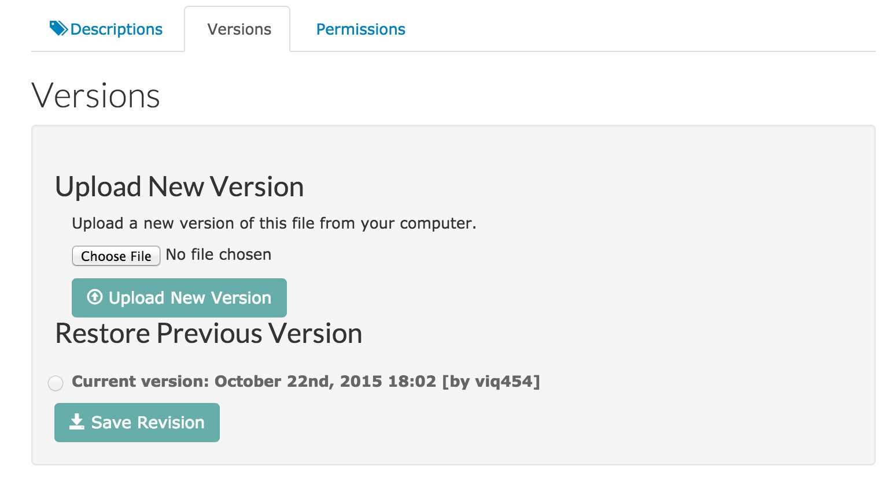
Note: Version – uploading a new version of the same work
NOTE: the file needs to be in the same file format as the originally uploaded file. Example: if you uploaded a pptx file the new version should also be in pptx file format.
Notes:
The repository provides stable, long-term storage and ongoing maintenance for content contained within the repository. Examples of items that the repository can accommodate at this time include:

Slide 25
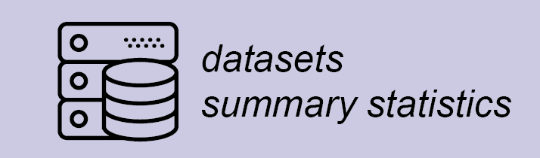
DigitalHub & datasets
The DigitalHub repository at Galter Health Sciences Library accepts deposit of datasets associated with publications to help investigators comply with journal data sharing policies
DigitalHub supports a variety of file and compression formats to meet your needs.
The current file size limit is 2 GB and supported compression file extensions include:
  zip - application/zip
  7z - application/x-7z-compressed
  bz2 - application/x-bzip2
  tar - application/x-tar and application/x-gtar
  gz - application/gzip and application/x-gzip

Slide 26
Thank You
DigitalHub@northwestern.edu

