Slide 1

Evaluating Research Impact
a sweeping view of the landscape
The road to nowhere in South Dakota
http://theplanetd.com/pictures-of-south-dakota/

Slide 2


A quick introduction to me
Impact and Evaluation Librarian
Galter Health Sciences Library
Northwestern University
2014 -
Associate Fellow
U.S. National Library of Medicine
2012-2014
Interested in: evaluation, bibliometrics, citizen science, American folk music

Slide 3
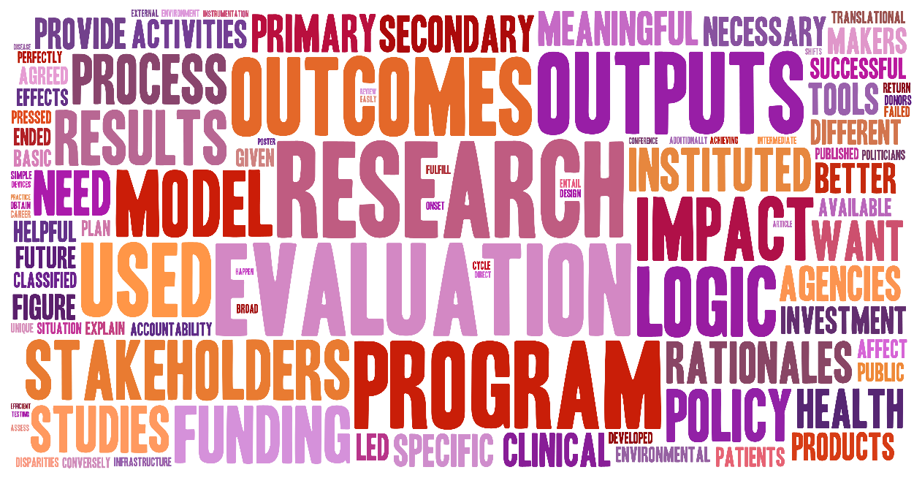
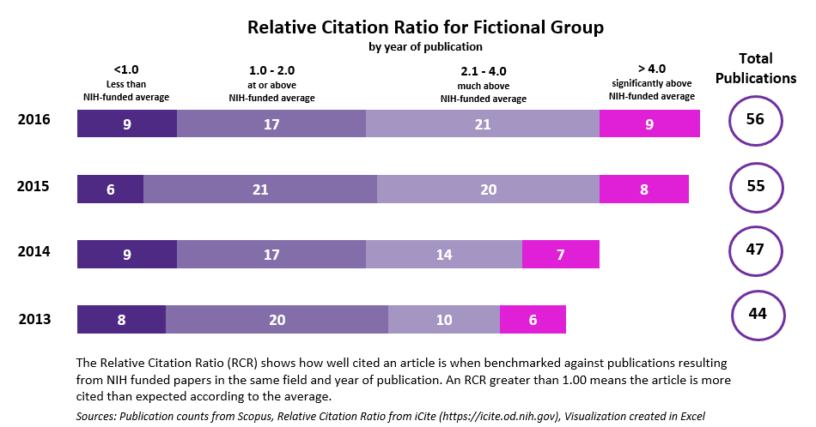
A quick introduction to this talk
What is research evaluation?
Recent evaluation projects

Slide 4
How familiar are you with research evaluation?
1 – not at all familiar
2 – slightly familiar (novice)
3 – moderately familiar (competent)
4 – very familiar (proficient)
5 – extremely familiar (expert)

Slide 5

Whoa! Take a step back

Slide 6




Why do we evaluate research?
Advocacy
Analysis
Accountability
Allocation
Guthrie S, Wamae W, Diepeveen S, Wooding S, Grant J. Measuring research. 2013. http://www.rand.org/pubs/monographs/MG1217.html.
Notes:
Advocacy: to demonstrate the benefits of supporting research, enhance understanding of research and its processes among policymakers and the public; to make the case for policy and practice change.
Accountability: to show that money has been used efficiently and effectively, and hold researchers to account.
Analysis: to understand how and why research is effective and how it can be better supported, feeding into research strategy and decision-making by providing a stronger evidence base.
Allocation: to determine where best to allocate funds in the future, making the best use possible of a limited funding pot.
“Interest in and demand for the evaluation of research is increasing internationally. This is linked to a growing accountability agenda, driven by the demand for good governance and management growing in profile on national and international stages and fiscal austerity in a number of countries. There is a need to show that policymaking is evidence based and, particularly in the current economic climate, to demonstrate accountability for the investment of public funds in research…Given this growing need for effective and appropriate evaluation of research, it is increasingly important to understand how research can and should be evaluated in different contexts and to meet different needs.”
http://www.rand.org/pubs/monographs/MG1217.html

Slide 7
Why do we evaluate research?
Advocacy
Analysis
Making the case for research
Accountability
Allocation
Guthrie S, Wamae W, Diepeveen S, Wooding S, Grant J. Measuring research. 2013. http://www.rand.org/pubs/monographs/MG1217.html.
Notes:
Advocacy: to demonstrate the benefits of supporting research, enhance understanding of research and its processes among policymakers and the public; to make the case for policy and practice change.
Accountability: to show that money has been used efficiently and effectively, and hold researchers to account.
Analysis: to understand how and why research is effective and how it can be better supported, feeding into research strategy and decision-making by providing a stronger evidence base.
Allocation: to determine where best to allocate funds in the future, making the best use possible of a limited funding pot.

Slide 8
Why do we evaluate research?
Advocacy
Analysis
Making the case for research
Accountability
Allocation
…to taxpayers and donors
Guthrie S, Wamae W, Diepeveen S, Wooding S, Grant J. Measuring research. 2013. http://www.rand.org/pubs/monographs/MG1217.html.
Notes:
Advocacy: to demonstrate the benefits of supporting research, enhance understanding of research and its processes among policymakers and the public; to make the case for policy and practice change.
Accountability: to show that money has been used efficiently and effectively, and hold researchers to account.
Analysis: to understand how and why research is effective and how it can be better supported, feeding into research strategy and decision-making by providing a stronger evidence base.
Allocation: to determine where best to allocate funds in the future, making the best use possible of a limited funding pot.

Slide 9
Why do we evaluate research?
Advocacy
Analysis
Making the case for research
Understanding what works
Accountability
Allocation
…to taxpayers and donors
Guthrie S, Wamae W, Diepeveen S, Wooding S, Grant J. Measuring research. 2013. http://www.rand.org/pubs/monographs/MG1217.html.
Notes:
Advocacy: to demonstrate the benefits of supporting research, enhance understanding of research and its processes among policymakers and the public; to make the case for policy and practice change.
Accountability: to show that money has been used efficiently and effectively, and hold researchers to account.
Analysis: to understand how and why research is effective and how it can be better supported, feeding into research strategy and decision-making by providing a stronger evidence base.
Allocation: to determine where best to allocate funds in the future, making the best use possible of a limited funding pot.

Slide 10
Why do we evaluate research?
Advocacy
Analysis
Making the case for research
Understanding what works
Accountability
Allocation
…to taxpayers and donors
Rewarding impact
Guthrie S, Wamae W, Diepeveen S, Wooding S, Grant J. Measuring research. 2013. http://www.rand.org/pubs/monographs/MG1217.html.
Notes:
Advocacy: to demonstrate the benefits of supporting research, enhance understanding of research and its processes among policymakers and the public; to make the case for policy and practice change.
Accountability: to show that money has been used efficiently and effectively, and hold researchers to account.
Analysis: to understand how and why research is effective and how it can be better supported, feeding into research strategy and decision-making by providing a stronger evidence base.
Allocation: to determine where best to allocate funds in the future, making the best use possible of a limited funding pot.

Slide 11
Why do we evaluate research?
Advocacy
Analysis
Making the case for research
Understanding what works
Understand the objective of the research evaluation
Accountability
Allocation
…to taxpayers and donors
Rewarding impact
Guthrie S, Wamae W, Diepeveen S, Wooding S, Grant J. Measuring research. 2013. http://www.rand.org/pubs/monographs/MG1217.html.
Notes:
Advocacy: to demonstrate the benefits of supporting research, enhance understanding of research and its processes among policymakers and the public; to make the case for policy and practice change.
Accountability: to show that money has been used efficiently and effectively, and hold researchers to account.
Analysis: to understand how and why research is effective and how it can be better supported, feeding into research strategy and decision-making by providing a stronger evidence base.
Allocation: to determine where best to allocate funds in the future, making the best use possible of a limited funding pot.

Slide 12
How do we evaluate research?
Basic tool of an evaluation: the Logic Model
Basic organizational diagram of a program.
What RESOURCES
are used?
What ACTIVITIES do we do with those resources?
What OUTPUTS
are produced?
What OUTCOMES do they create?
PROGRAM
Environmental factors: external influences on the process or program
Notes:
Shows an example of a traditional “cause and effect” logic model which describes how the available resources (also known as inputs) and program activities will lead to desired outputs and outcomes (both of which can be measured in the short , intermediate, or long term), given a specific environmental context.

Slide 13
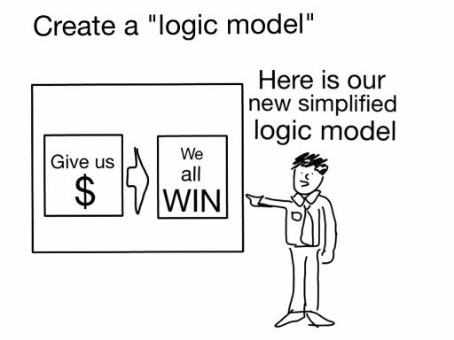
How do we evaluate research?
Freshspectrum.com
Notes:
Shows an example of a traditional “cause and effect” logic model which describes how the available resources (also known as inputs) and program activities will lead to desired outputs and outcomes (both of which can be measured in the short , intermediate, or long term), given a specific environmental context.

Slide 14
Evaluating a Pre-doctoral Training Program
Environmental factors: external influences on the process or program
What RESOURCES
are used?
What ACTIVITIES do we do with those resources?
What OUTPUTS
are produced?
What OUTCOMES do they create?
Program Manager
Researchers
Conference Room
Funding
Mentorship sessions
Training sessions
Certificate of completion
Joint publications between mentees and mentors
Increased career prospects of mentees
Pre-doctoral Training Program
Notes:
Shows an example of a traditional “cause and effect” logic model which describes how the available resources (also known as inputs) and program activities will lead to desired outputs and outcomes (both of which can be measured in the short , intermediate, or long term), given a specific environmental context.

Slide 15
Evaluating a Pre-doctoral Training Program
What RESOURCES
are used?
What ACTIVITIES do we do with those resources?
What OUTPUTS
are produced?
What OUTCOMES do they create?
What amount of time and money was used?
How many mentorship sessions?
How many attended or did not attend?
How many trainees completed the program?
How many documents were published in scholarly literature?
Did mentees have improved career prospects?
To what extent has the program developed the careers of mentees?
Evaluation Questions
Notes:
Shows an example of a traditional “cause and effect” logic model which describes how the available resources (also known as inputs) and program activities will lead to desired outputs and outcomes (both of which can be measured in the short , intermediate, or long term), given a specific environmental context.

Slide 16
Evaluating a Pre-doctoral Training Program
What RESOURCES
are used?
What ACTIVITIES do we do with those resources?
What OUTPUTS
are produced?
What OUTCOMES do they create?
Indicators
# of Staff
Costs
# of sessions held
Quality criteria of sessions
# of mentees
# and types of mentees reached
# of publications
% employed
% remain in research over time
Notes:
Shows an example of a traditional “cause and effect” logic model which describes how the available resources (also known as inputs) and program activities will lead to desired outputs and outcomes (both of which can be measured in the short , intermediate, or long term), given a specific environmental context.

Slide 17
Evaluating a Pre-doctoral Training Program
What RESOURCES
are used?
What ACTIVITIES do we do with those resources?
What OUTPUTS
are produced?
What OUTCOMES do they create?
Indicators
# of Staff
Costs
# of sessions held
Quality criteria of sessions
# and types of mentees reached
% employed
% remain in research over time
Process Indicators
Impact Indicators
Notes:
Shows an example of a traditional “cause and effect” logic model which describes how the available resources (also known as inputs) and program activities will lead to desired outputs and outcomes (both of which can be measured in the short , intermediate, or long term), given a specific environmental context.
Outcomes and Impacts are downstream measures of performance.

Slide 18
Evaluating a Pre-doctoral Training Program
What RESOURCES
are used?
What ACTIVITIES do we do with those resources?
What OUTPUTS
are produced?
What OUTCOMES do they create?
Indicators
# of Staff
Costs
# of sessions held
Quality criteria of sessions
# and types of mentees reached
% employed
% remain in research over time
Process Indicators
Impact Indicators
Notes:
Shows an example of a traditional “cause and effect” logic model which describes how the available resources (also known as inputs) and program activities will lead to desired outputs and outcomes (both of which can be measured in the short , intermediate, or long term), given a specific environmental context.

Slide 19
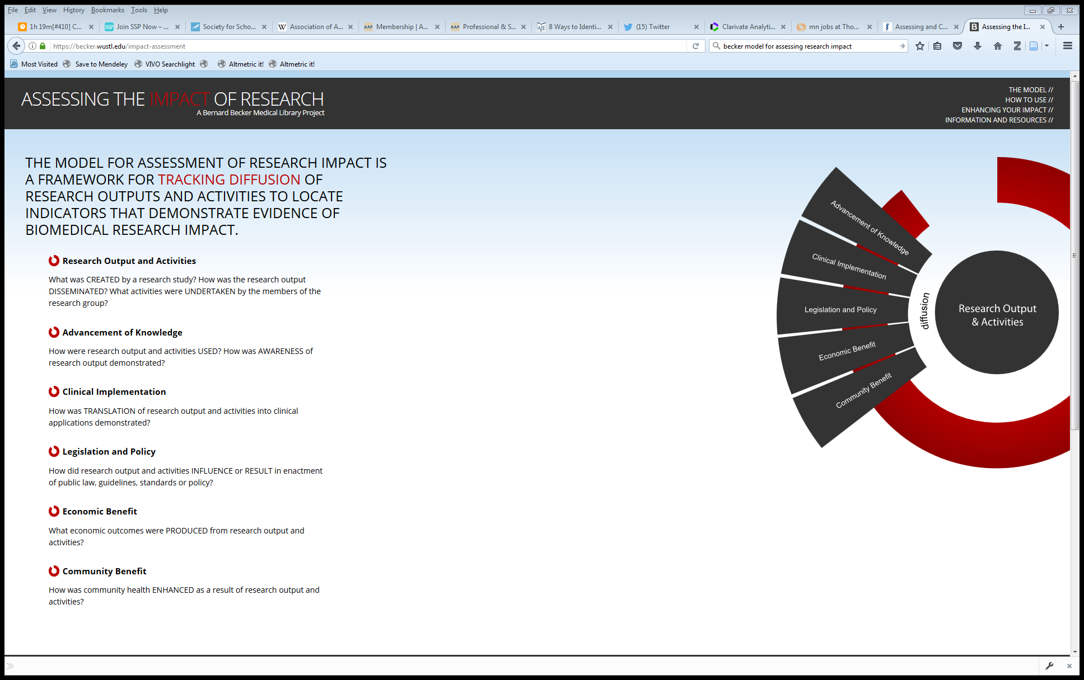
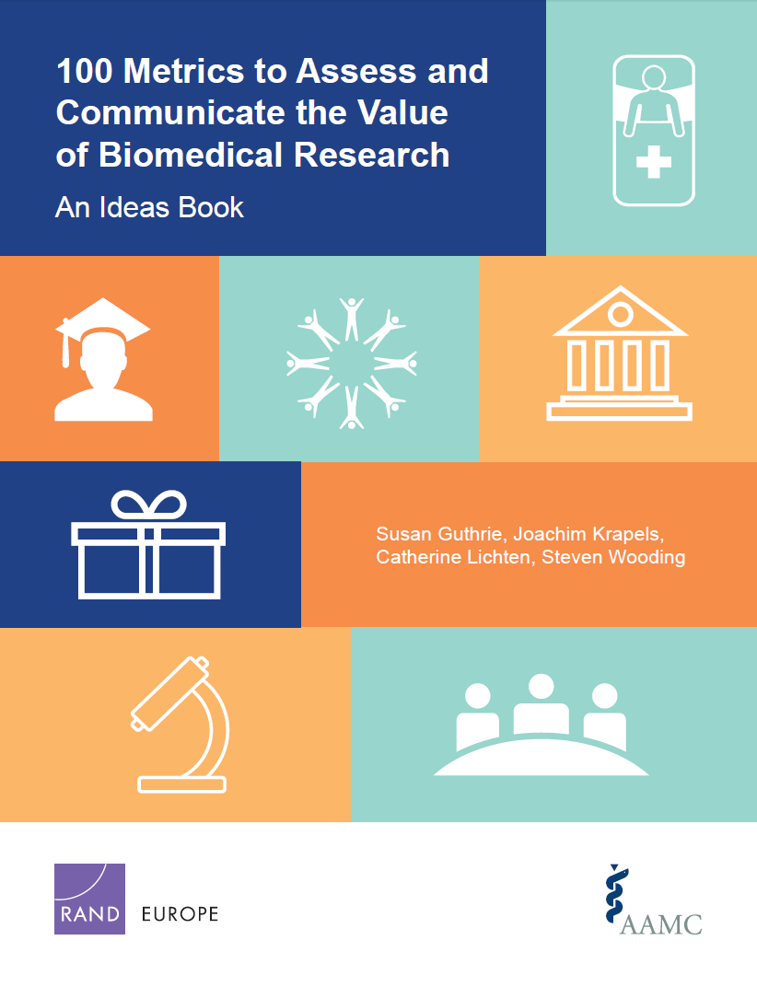
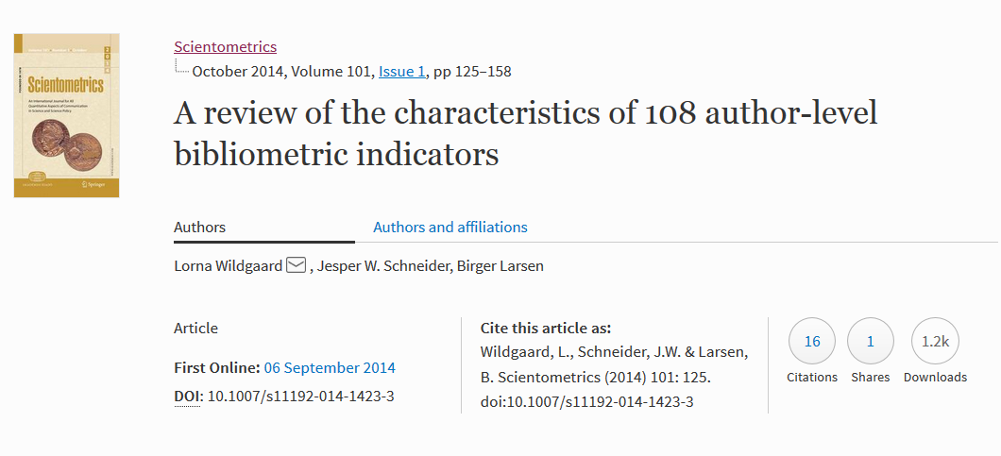
Building a library of indicators
https://becker.wustl.edu/impact-assessment
http://www.rand.org/pubs/research_reports/RR1606.html
https://arxiv.org/abs/1408.5700

Slide 20

Building a library of indicators
100 Metrics to Assess and Communicate the Value of Biomedical Research
Research Impacts
Number of journal articles published | The number of peer-reviewed journal articles published over a particular timeframe is a quantitative metric of the volume of research produced by an individual or institution.
Number of citations | Measures of citations to published articles are used as a proxy for article quality. Can include Highly Cited Papers, Normalized Citation Score, etc.
Number of research output downloads | The number of times a research output has been downloaded gives an indication of how much it is being of use and the level of interest in it.
Mentions in Social Media | Information on who is citing the institution in social media can help identify where the influence of the medical school or teaching hospital is being felt across the sector, noting that this may be within academia.
http://www.rand.org/pubs/research_reports/RR1606.html

Slide 21


Building a library of indicators
Becker Medical Library Model for Assessment of Research Impact
https://becker.wustl.edu/impact-assessment
Advancement of Knowledge
Books or Book Chapters | Book or book chapters generated by the research study is noted in a bibliography. Book is used as a textbook for higher education. Translations of the book. Book or book chapter cited in subsequent publications.
Change in Understanding and Awareness | Research study findings represent a paradigm shift in a field. Research study findings lead to change in understanding a problem.
Citations to Publications | Number of first generation citations. Number of second generation citations. Countries represented by citations. Institutions represented by citations. Languages represented by citations.

Slide 22
Building a library of indicators
A review of the characteristics of 108 author-level bibliometric indicators
https://arxiv.org/abs/1408.5700
Indicators of publication count
P (total publications) | Count of production used in formal communications
FA (first author counting) | Credit given to first author only
Co-authors | Indicates cooperation and growth of cooperation at inter- and national level
Noblesse Oblige (last author counting) | Indicates importance of the last author for the project behind the paper

Slide 23
Research Evaluation Projects
What is research evaluation?
Recent evaluation projects

Slide 24
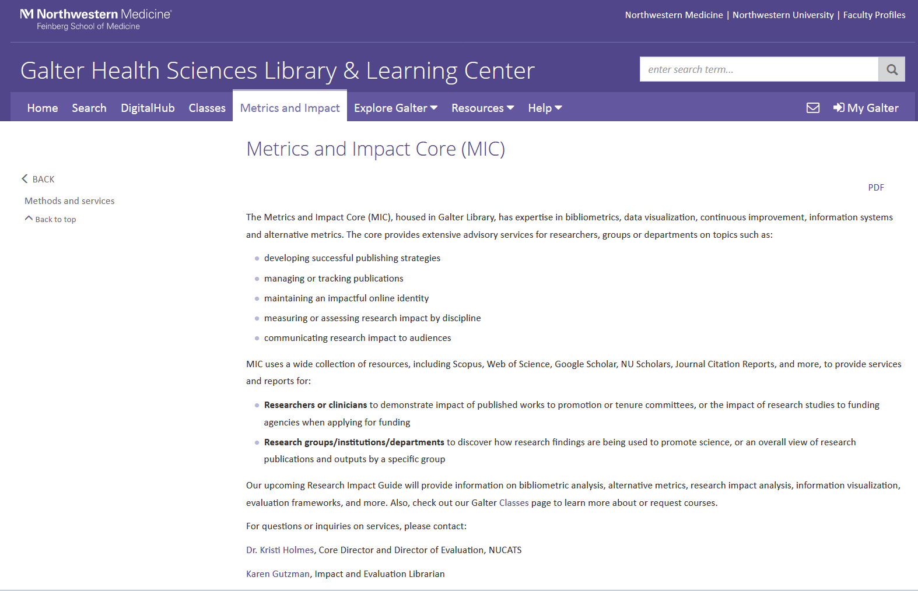
Metrics and Impact Core
https://galter.northwestern.edu/request-services-and-materials/metrics-and-impact-core-mic

Slide 25
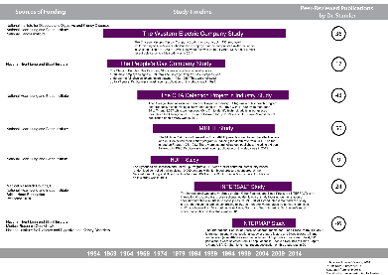
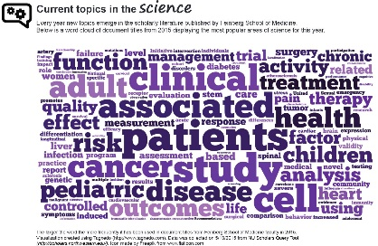
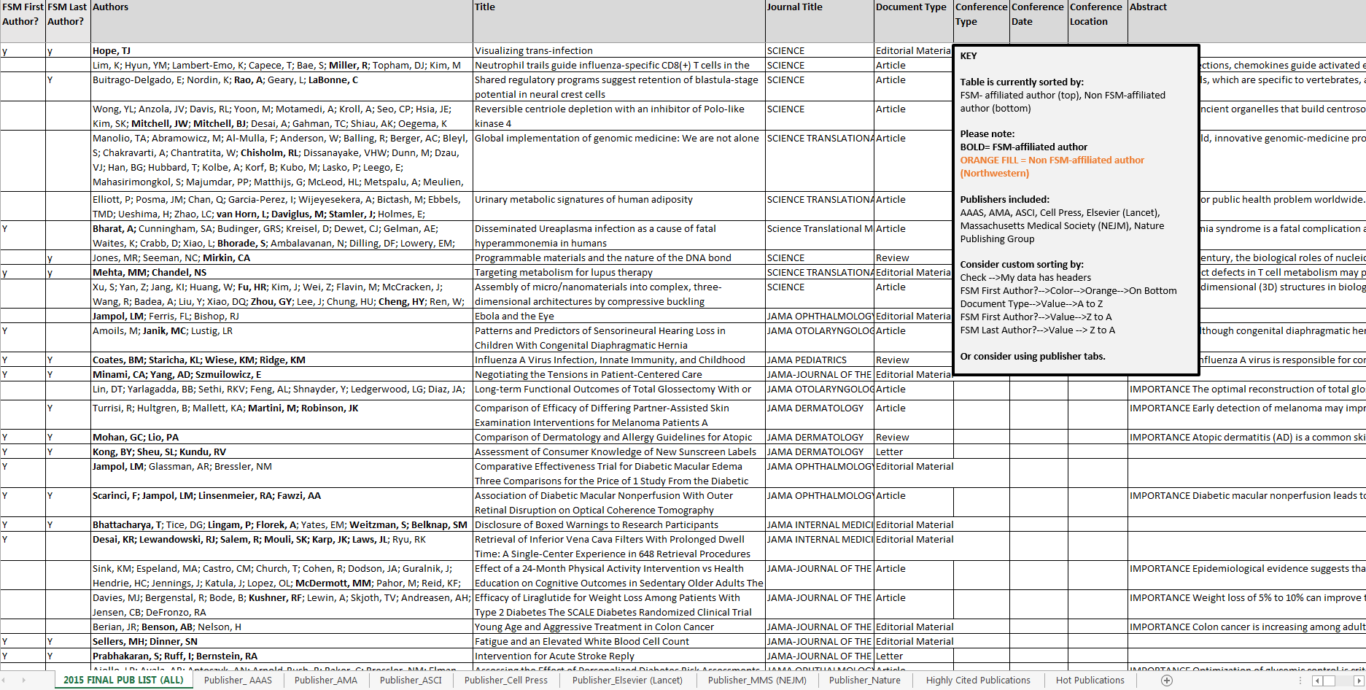
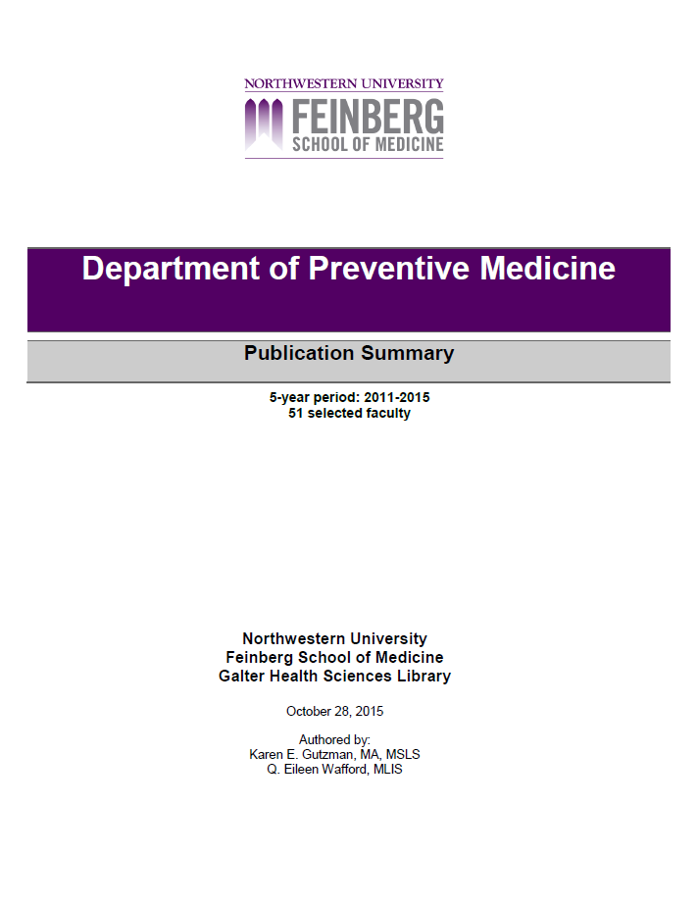
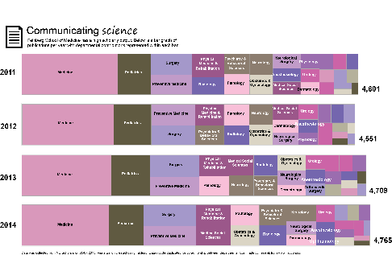
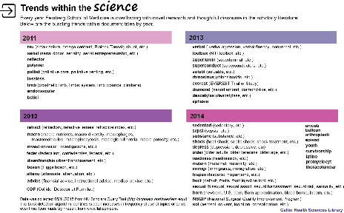

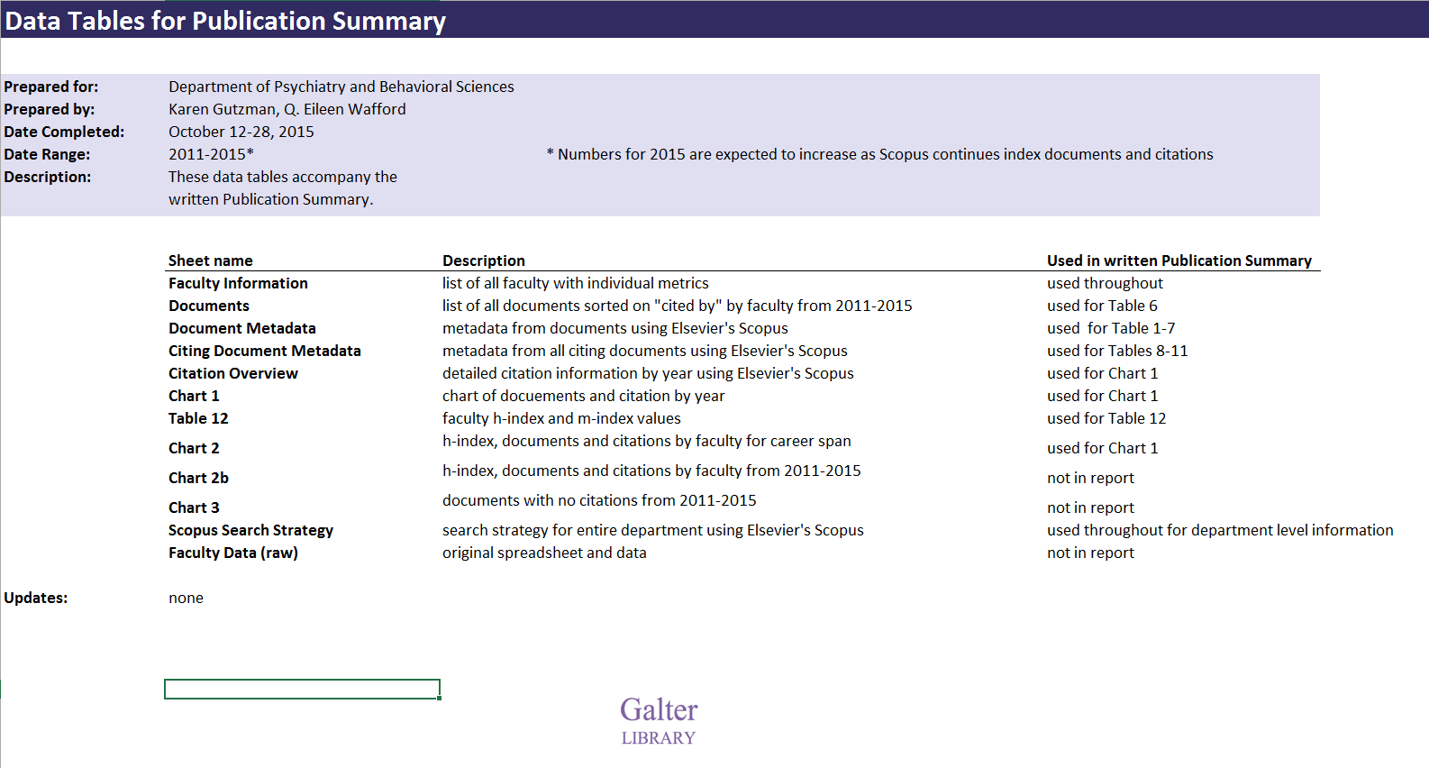
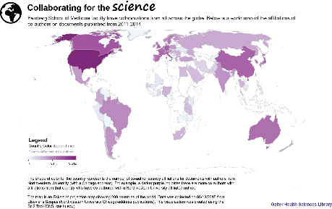
Metrics and Impact Core
The library offers expertise in bibliometrics, data visualization, continuous improvement, information systems and alternative metrics through the Metrics and Impact Core.
Custom Reports
Publication Summaries
Visualizations
Indicator and Measurement Overview
Productivity: how much research was produced and who produced it
  # of researchers in department
  # of articles published by faculty
  Average articles per year
  # of unique source (journal) titles
Collaboration: who worked together to make the research happen
  # of country affiliations of co-authors
  # of top institutional affiliations of co-authors
  Listing of funding organizations from 2014 to present
Research Topics: what the research was about
  Document types for published articles
  Top key words used in articles
  Top subject areas of source (journal) titles
Citation Impact for Department: the impact it had on subsequent scientific research
  Total citations
  Average citations per year
  Average citations per publication
  Citations by year of publication
  Citations cumulative
  Citations by year of publication per publication
  Most highly cited publication
  # of country affiliations of citing authors
  # of languages of citing articles
  # of unique source (journal titles) from citing articles
  # of unique country affiliations of citing authors
  # of unique institutional affiliations of citing authors
  h- index of departmental documents
  # of documents with no citations
  Hot or Highly Cited publications
    Citation Impact for Individuals: the impact he/she had on subsequent scientific research
  Total published articles (career span and report timespan)
  Total citations (career span and report timespan)
  h-index
  m-index
  # of co-authors
Karen Gutzman is our Impact and Evaluation Librarian. Contact her directly or through your liaison librarian. Visit the Metrics and Impact Core online.
https://galter.northwestern.edu/request-services-and-materials/metrics-and-impact-core-mic

Slide 26
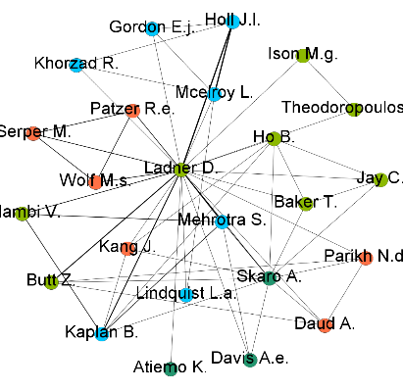
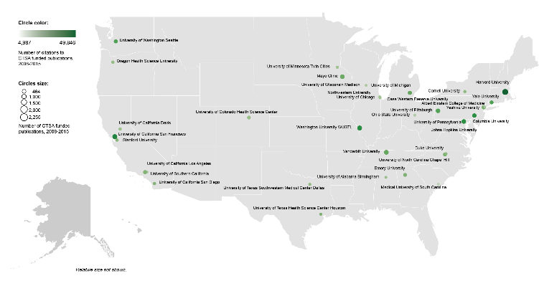
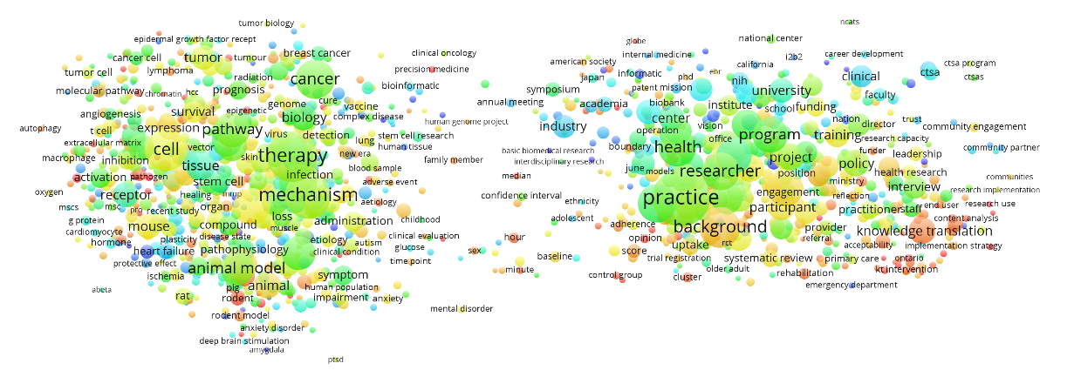

Data Sources and Tools
Bibliographic databases:
  Scopus (Elsevier)
  PubMed (NLM)
  Web of Science (Clarivate Analytics)
  NU Scholars (PURE from Elsevier)
  Google Scholar
  Sympletic Elements
Other databases:
  InCites (Clarivate Analytics)
  Scholarly Database
  NIH RePORTER
  Essential Science Indicators (Clarivate Analytics)
Visualization Tools
  Sci2 Tool
  Gephi
  Pajek
  VOSviewer
  CitNetExplorer
  Tableau
  Microsoft Excel
Gephi
Tableau
VOSviewer

Slide 27
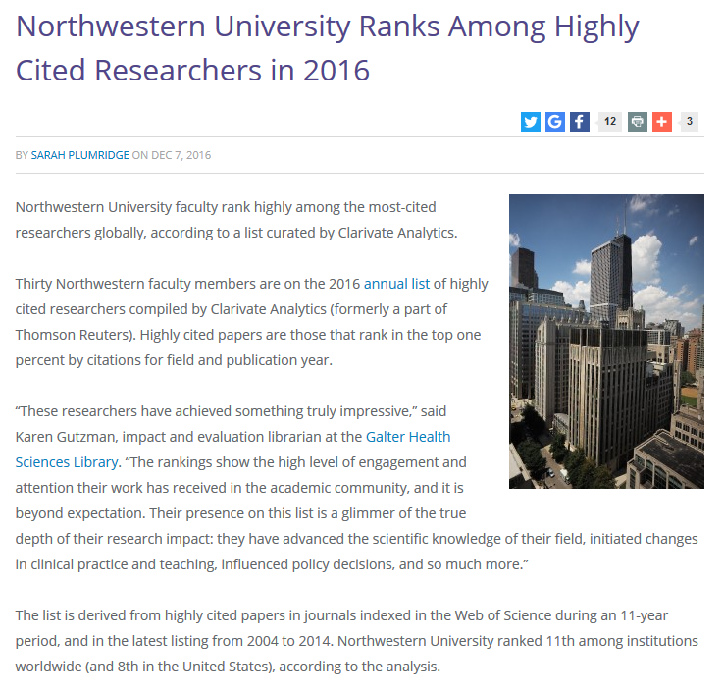



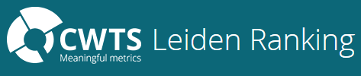


Keeping track of rankings
SciVal Usage Guidebook
Incites Indicator Handbook
http://news.feinberg.northwestern.edu/2016/12/northwestern-university-ranks-among-highly-cited-researchers-in-2016/

Slide 28
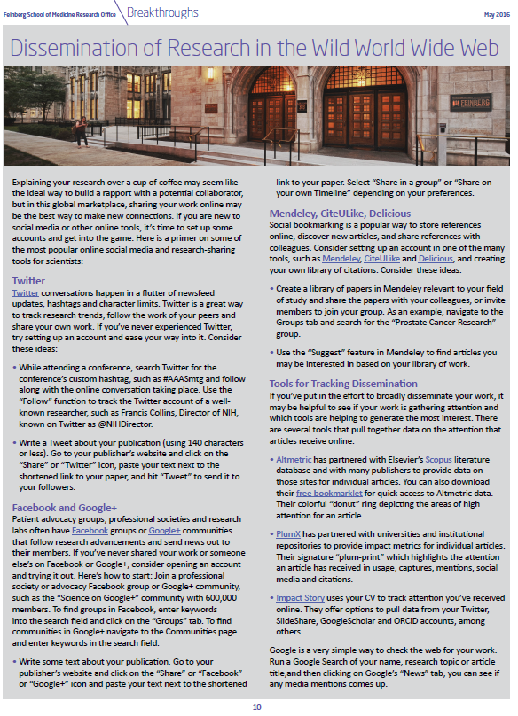
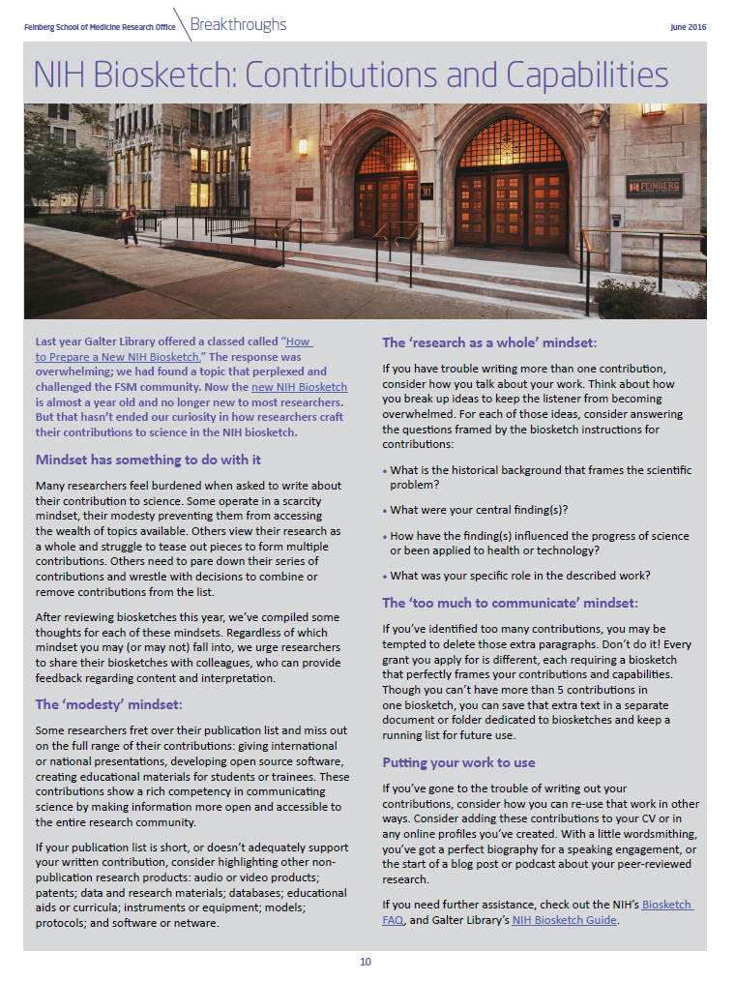
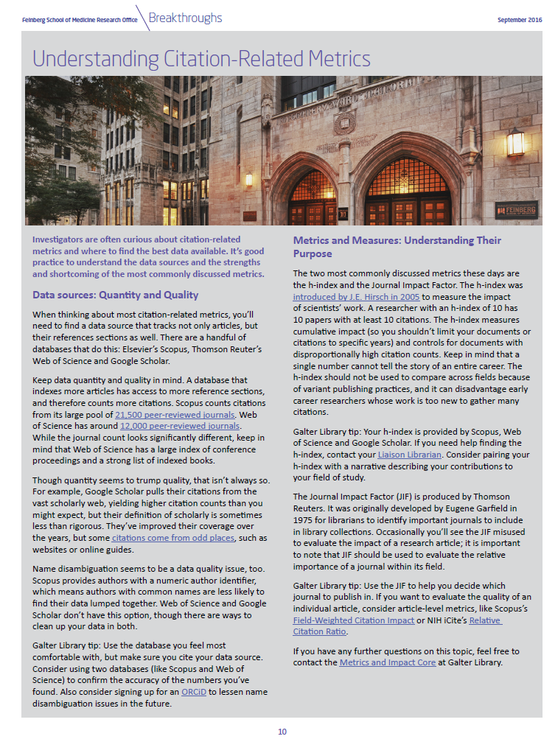
Communicating Information
    Sample news items for research newsletter
    Writing About Your Impact on the New NIH Biosketch
    Sharing, Publishing, and Archiving Your Work
    Visualizing Science at Feinberg School of Medicine
    Matchmaker, Make Me a Match: Choosing a Journal
    Dissemination of Research in the Wild World Wide Web
    Optimizing your article for discovery
    The Relative Citation Ratio: a new metric from the NIH Office of Portfolio Analysis
    Keeping score of CiteScore
    Metrics and Measures: Understanding quality and purpose

Slide 29





Research Evaluation Projects
Partners that we have worked with:
Departments
Notes:
Add departments

Slide 30

CARDIA Study: overview
Timeline: began in 1985-6
Participants: 5115 black and white men and women aged 18-30 years
Location: Birmingham, AL; Chicago, IL; Minneapolis, MN; and Oakland, CA.
Specific Goal:
Examine the development and determinants of cardiovascular disease
Broad Goal:
Generate important new knowledge to inform health promotion and disease prevention efforts
Please note: all data is preliminary

Slide 31
CARDIA Study: Evaluation Objectives
Advocacy
Large-scale, long-term observational studies are beneficial to human health
Outputs from the study have benefited many stakeholders
Making the case for research
Accountability
Funds have been used efficiently and effectively
Stated research goals have been met
Important stakeholders have been engaged
…to taxpayers and donors

Slide 32
CARDIA Study: Evaluation Questions
Our evaluation focuses on outputs and outcomes
Knowledge Production
  How much knowledge has this study produced?
  How can we classify the types of knowledge that have been produced?
Quality of Research Communication
  Which high quality communication channels have the researchers published in?
  Has the knowledge being produced been effectively communicated to the research community and other stakeholders?
Advancement of Knowledge
  Has the study advanced the knowledge of the research community?
  Has the study openly shared knowledge with the research community?
  How impactful have the gains in knowledge been to the research community?

Slide 33
CARDIA Study: Evaluation Questions
Legislation and Policy Impacts
  Has the knowledge gained from the study directly or indirectly influenced legislation or policy development at global, national, state and local levels?
  Have the researchers involved with the study advocated for changes in legislation or policy at the global, national, state and local levels?
Health Impacts and Clinical Implementation
  Has the knowledge gained from the study influenced healthcare practices?
Research Effect in Industry not covered in this presentation
  Has the study directly or indirectly influenced innovation or commercialization of health products or practices?
Research Engagement not covered in this presentation
  Do the researchers involved with they study have strong connections with collaborators and support from viable research infrastructure?

Slide 34
CARDIA Best Practices
Working in our favor
  Researchers report publications and presentations to a central office
  Use of “CARDIA Study” in title or abstract
  Many output types over the long term
  PubMed Search
  “CARDIA study"[TIAB] OR "Coronary Artery Risk Development in Young Adults" OR "CARDIA cohort" OR CARDIA[Author - Corporate]
Notes:
We know they’re tracking: publications and conference presentations
Researchers report these to a central office
Use of “CARDIA Study” in title and/or abstract
Output types
Published articles
Conference papers and posters
Newsletters items
Press Releases and News Items
Lay Summaries
Measurement Instruments
Dissertations
Data repository
See a robust list of outputs and outcomes types:
The Becker Model for Assessing the Impact of Research
https://becker.wustl.edu/impact-assessment/information-resources

Slide 35
Literature Data Sources: Characteristics
 | Publications (articles, reviews, editorials) | Conference Abstracts | Books | Reports, Magazines, Pamphlets | News or Media | Dissertations or Thesis | Patent Information | Citation Information | Alternative Metrics
Academic Search Complete |  |  |  |  |  |  |  | *
Altmetric Explorer
CINHAL |  |  |  |  |  |  |  | *
Consumer Health Complete
Embase |  |  |  |  |  |  |  | *
Google
Google Scholar
LexisNexis
PsychInfo |  |  |  |  |  |  |  | *
PubMed
Scopus
Web of Science
WorldCat
  *provides limited citation information
Notes:
13 sources of data

Slide 36
Literature Databases: Coverage
Literature Database Coverage of CARDIA documents

Slide 37
Literature Databases: Coverage
Literature Database Coverage of CARDIA documents

Slide 38
CARDIA Study: Evaluation Indicators
Knowledge Production
Aspirational indicators
Indicator | Indicator Description
Total Documents | Raw count of documents during project/career span
Growth of documents over time | Percentage increase in documents for a specified time period
Types of Documents | Count of different document types
Documents (by year) | Count of documents per year
Documents (in specific year span) | Raw count of documents for a specified time period
Total documents in selected databases (i.e. PubMed, Scopus, WOS) | Documents indexed in specific databases for a specified time period
Number of non-publication outputs | Raw count of non-publication outputs for a specified time period
Types of non-publication outputs | Count of different output types for a specified time period. Types include software code, educational materials, consumer health materials, conference abstracts, methodology, laboratory techniques and procedures, etc.
Growth of non-publication outputs over time | Percentage increase in outputs for a specified time period
Number/amount/percentage of research data made available in repositories | Quantifying amount of data housed on laboratory websites, available in repositories that are open or restricted, or as supplementary materials in journal articles
Role in Document | Defined role in document publication (using CREDIT or other taxonomy)

Slide 39
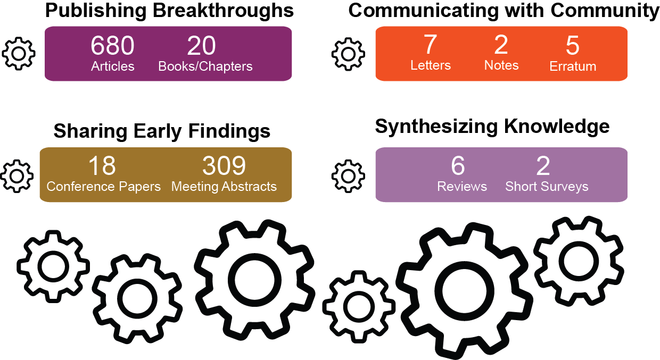
CARDIA Study: Evaluation Indicators
Knowledge Production
Source: Scopus, Web of Science
Notes:
Publishing breakthroughs could further be divided into transformative research vs. incremental research.

Slide 40
CARDIA Study: Evaluation Indicators
Quality of Research Communication
Indicator | Indicator Description
Average Journal Impact Factor | Average Journal Impact Factor for a set of journals (metric from Journal Citation Reports)
Average CiteScore | Average CiteScore for a set of documents (metric from Scopus)
Number of outputs in DigitalHub | Raw count of outputs made openly available in DigitalHub
Average Journal Normalized Citation Impact | Average Citation impact (citations per document) normalized for journal, year and document type (metric from Journal Citation Reports)
Proportion of publications that are open access | Percentage of publications in open access journals or in open access repositories
Number of Media Mentions | Counts of mentions in Media sources
Number of Mentions in Social Media | Counts of mentions in Social Media sources

Slide 41
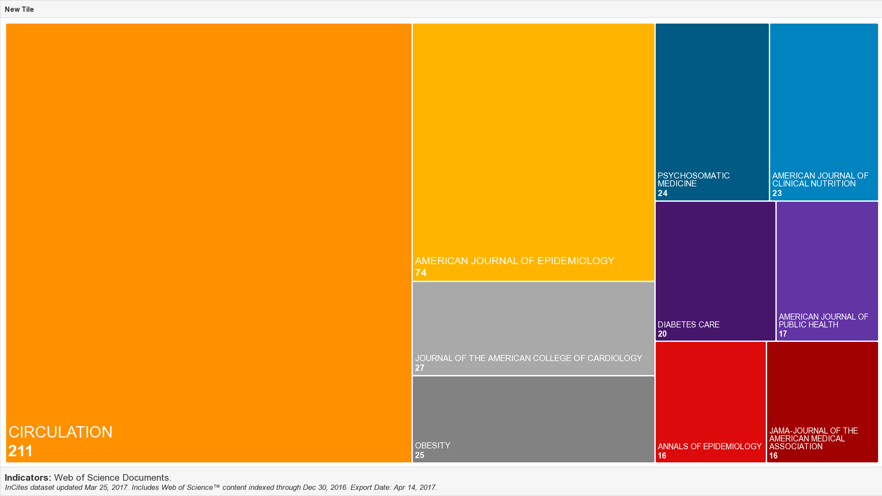
CARDIA Study: Evaluation Indicators
Quality of Research Communication
Top 10 Journals by number of publications with Impact Factor
IMPACT FACTOR 5.036
Impact Factor 17.759
IMPACT FACTOR: 17.202
IMPACT FACTOR: 3.614

Slide 42
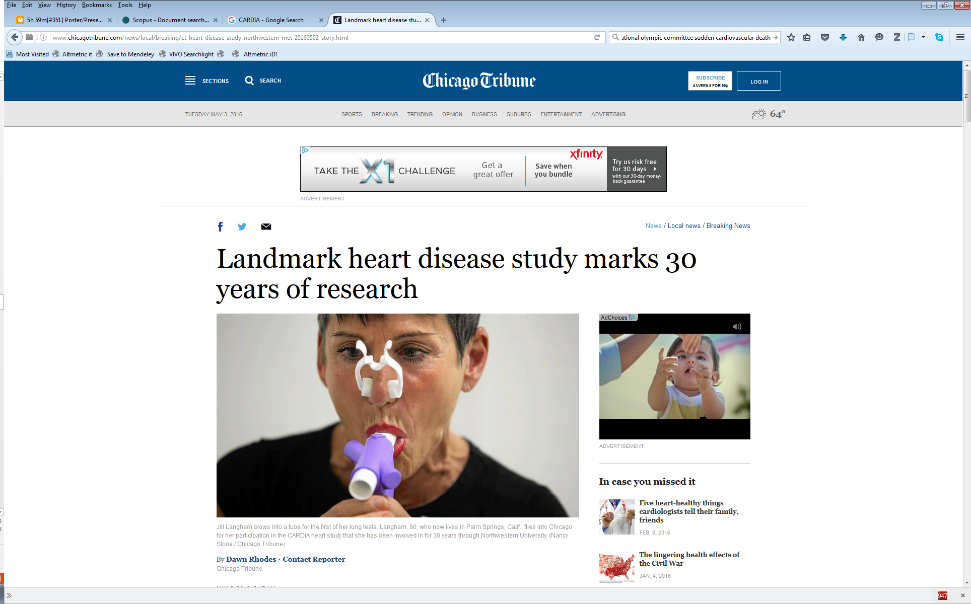
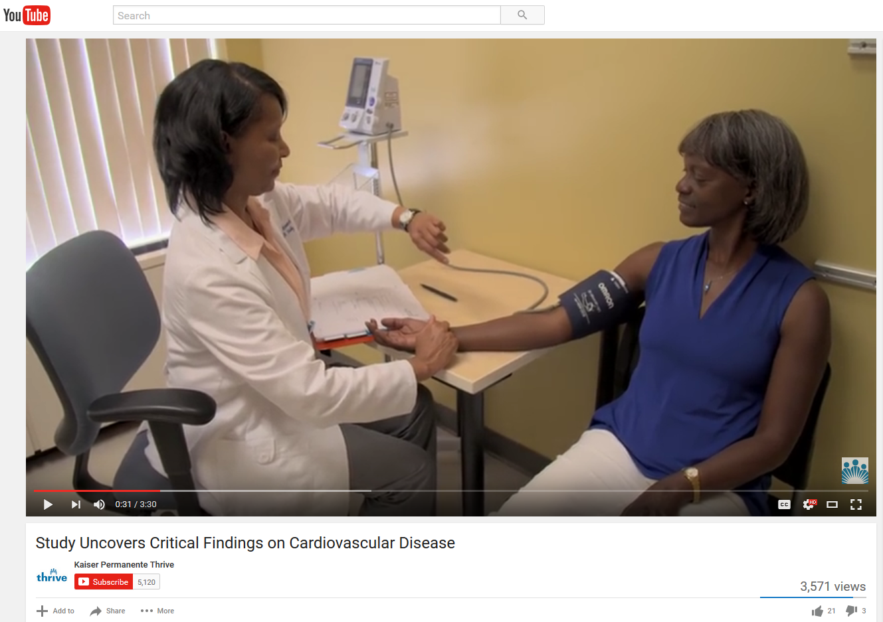

CARDIA Study: Evaluation Indicators
Quality of Research Communication
Google Results
Search Results
Data Source
Search Strategy
698
Google News
Google Blogs
Google Videos
Google Books
“CARDIA study” OR
“Coronary Artery Risk
Development in Young Adults”
15
542
8,560
Please note: number of non-relevant results not yet determined.
Tuesday, May 3, 2016
Chicago Tribune, front cover
Landmark heart disease study marks 30 years of research
December 2, 2015
YouTube
Study Uncovers Critical Findings on Cardiovascular Disease
March 24, 2011
CNN Blog
Frequent churchgoers frequently fatter
Notes:
Google challenges
CARDIA news coverage started in 2005
CARDIA video coverage started in 2003
Export options are extremely limited
Difficult to find which CARDIA document was cited
Google surprises
Generally relevant results
Under Books, can sort by Magazines
Under News, can sort by Blogs
Under Videos, can sort by duration, quality, source

Slide 43

CARDIA Study: Evaluation Indicators
Quality of Research Communication
Lexis Nexis Results
Search Results
Data Type
Search Strategy
35
Law reviews and Journals
Newspapers
Newswires & Press Releases
Web-based Publications
Magazines and Journals
Cases
Industry Trade Press
“CARDIA study”
34
7
4
2
1
1
Please note: number of non-relevant results not yet determined.
All (Food) Politics is Local: Increasing Food Access Through Local Government Action
Adults can undo heart disease risk
July 1, 2014
Summer, 2013 Emily M. Broad Leib
…"If you don't keep up a healthy lifestyle, you'll see the evidence in terms of your risk of heart disease," Spring said.
Scientists examined healthy lifestyle behaviors and coronary artery calcification and thickening among the more than 5,000 participants in the Coronary Artery Risk Development in Young Adults (CARDIA) study who were assessed at baseline (when participants were ages 18 to 30) and 20 years later…
…This article focuses on healthy-food access, one of the most urgent food policy issues because of its social and economic effects, as well as its public health impacts…
Cites: Janne Boone-Heinonen et al., Fast Food Restaurants and Food Stores: Longitudinal Associations With Diet in Young to Middle-Aged Adults: The CARDIA Study, 171 ARCHIVES INTERNAL MED. 1162, 1168 (2011)

Slide 44
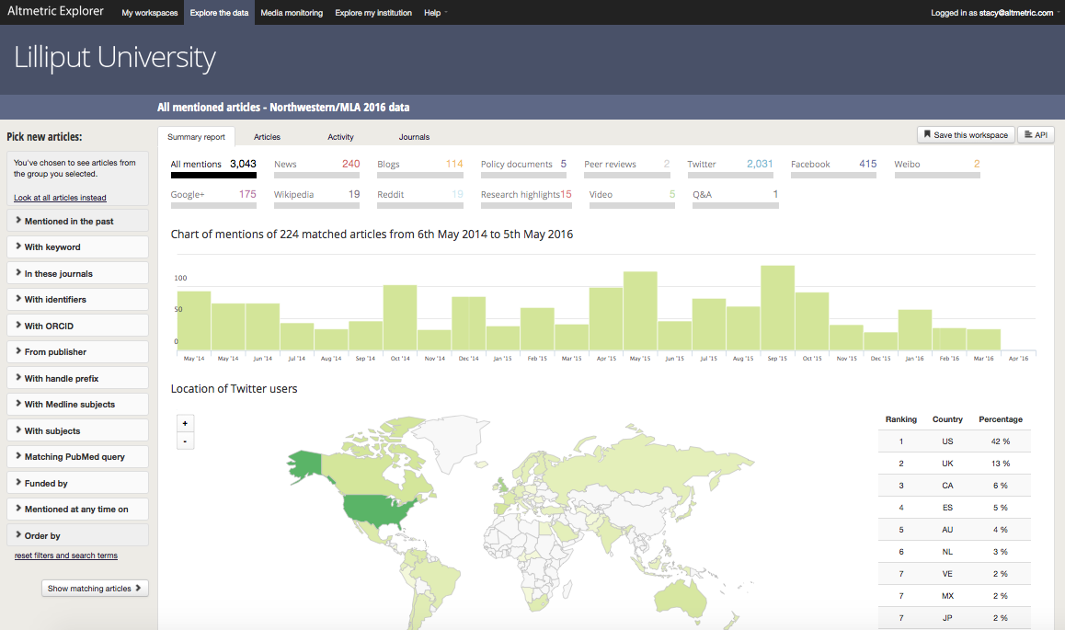
Gathering Attention: Altmetric Explorer
CARDIA Study: Evaluation Indicators
Quality of Research Communication
Altmetric Explorer Results
Searched for all CARDIA documents using DOIs and/or PMIDs
above: screenshot of Altmetric Explorer Summary Report results after searching using the DOI and/or PMID of the 669 CARDIA documents from 1985-2015.

Slide 45
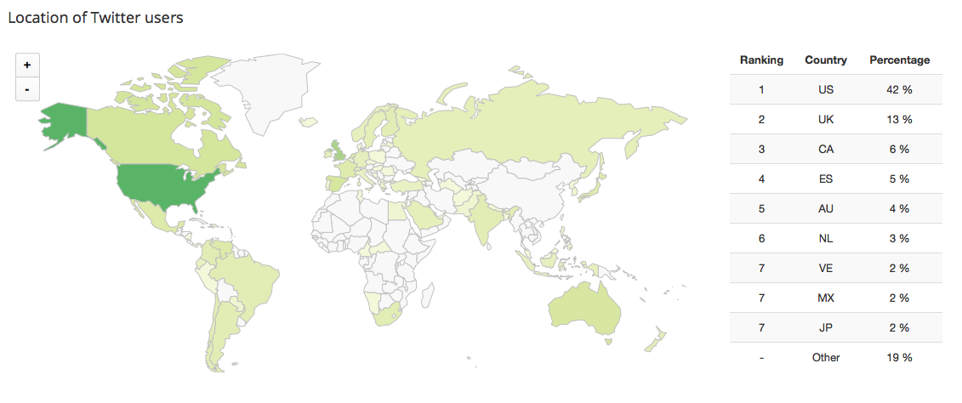
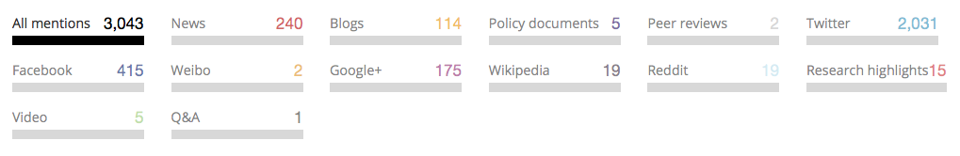
CARDIA Study: Evaluation Indicators
Quality of Research Communication
Altmetric Explorer Results
Searched for all CARDIA documents using DOIs and/or PMIDs
above: screenshot of Altmetric Explorer results from Twitter after searching using the DOI and/or PMID of the 669 CARDIA documents from 1985 – 2015.

Slide 46
CARDIA Study: Evaluation Indicators
Advancement of Knowledge
Aspirational indicators
Indicator | Indicator Description
Number of citations (with self citations, study/career span) | Number of times the set of documents has been cited including self citations
Percent of documents cited | Share of documents that have been cited after a specified time period
Percent of documents not cited | Share of documents never cited after a specified time period
Highest cited document | Most highly cited document in a set of documents
Average cites per document | Average citation count per document (also called Citation Impact)
Median cites per document | Median number of citations per document
Types of citing documents | Description of the types of citing documents (i.e. meta-analyses, review articles, classical articles, etc.)
Country affiliations of citing authors | Number of countries accounted for by affiliations of citing authors
Languages of citing documents | Number of languages accounted for by publications of citing authors
h-index | Cumulative achievement (measure of quality)
m- index | Cumulative achievement, accounting for length of scientific career (measure of quality)
Average Relative Citation Ratio | Average (mean) of all RCR scores (metric from NIH)
Average Category Normalized Citation Impact | Citation impact (citations per paper) normalized for field, year and document type (metric from InCites)
Average Field Weighted Citation Impact | Average citation impact (citations per paper) normalized for field, year and document type (metric from Scopus)
Hot Papers | Percentage of documents that are assigned as Hot Papers (top 0.1% by citations for field and age) (metric from Essential Science Indicators)
Highly Cited Papers | Percentage of documents that are assigned as Highly Cited (top 1% by citations for field and year)(metric from Essential Science Indicators)
Total views in DigitalHub | Total counts of the number of times an outputs has been viewed in DigitalHub
Total downloads in DigitalHub | Total counts of the number of times an outputs has been downloaded in DigitalHub

Slide 47
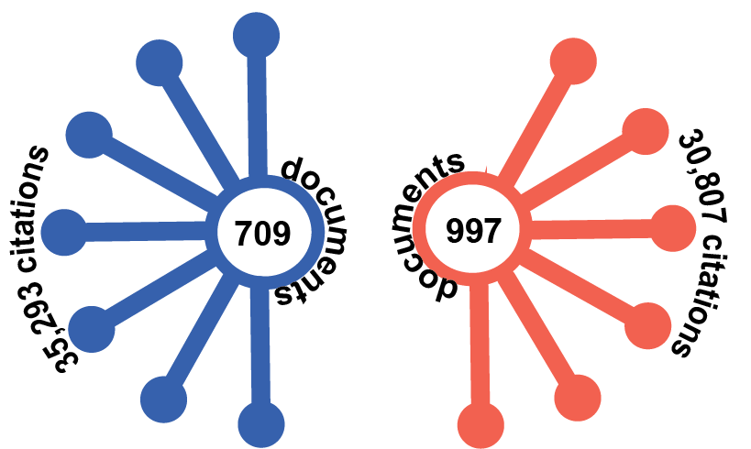
CARDIA Study: Evaluation Indicators
Advancement of Knowledge
Total Citations in Scopus and Web of Science
Scopus
Web of Science

Slide 48
CARDIA Study: Evaluation Indicators
Advancement of Knowledge
Relative Citation Ratio by year of publication
less than
NIH-funded average
at or above
NIH-funded average
much above
NIH-funded average
significantly above
NIH-funded average
The Relative Citation Ratio (RCR) shows how well cited an article is when benchmarked against publications resulting from NIH-funded papers in the same field and year of publication. An RCR of greater than 1.0 means the article is more cited than expected according to the average.
Sources: Publication counts from PubMed. RCR from iCite (https://icite.od.nih.gov), Visualization created in Excel.

Slide 49
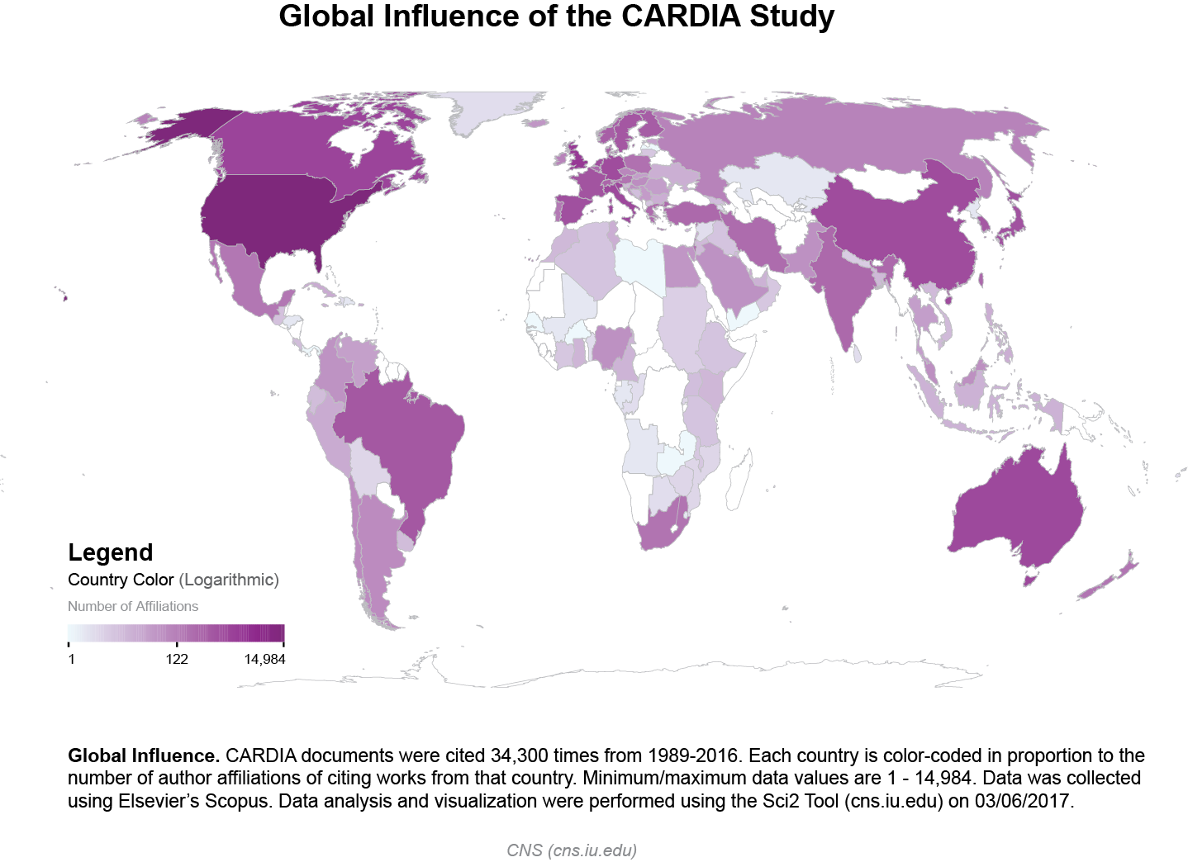
CARDIA Study: Evaluation Indicators
Advancement of Knowledge
Global Influence: Country Affiliations of Citing Authors

Slide 50
CARDIA Study: Evaluation Indicators
Legislation and Policy Impacts
Indicator | Indicator Description
Number of citations in policy documents | Count or description of citations in documents related to policy or legislation
Number of appointments to policy groups | Appointment to a policy task group or working group implies a well-developed network and good reputation
Number of invitations from policymakers/provide testimony | Number of times policymakers seek information or advice from researchers. Captures information on researcher's relationship with policymakers and reputation
Health Impacts and Clinical Implementation
Indicator | Indicator Description
Number of citations in clinical guidelines | Citations in clinical guidelines (by both governmental agencies and non-governmental organizations) reflect the utility and quality of a research output and indicate impact on health policy.
Number of citations in clinical decision aids or online clinical support tools | Citations in clinical decision aids reflect the utility of research output and impact on clinical care decisions.

Slide 51









CARDIA Study: Evaluation Indicators
Search Results
Relevant Documents
Data Source
Search Strategy
9
1
“CARDIA”
n/a
1
under Food and Nutrition →Policy, Reviews and Evaluations → Diet and Health
7
1
“CARDIA”
2
1
“CARDIA”
8
3
“CARDIA”
27
4
“CARDIA”
80
6
“CARDIA”
224
3
PMIDs and/or DOIs for the core 669 CARDIA documents
235
81
      669 CARDIA documents → view “Cited by” → Search within results for TITLE(guidelines) OR TITLE(“task force”) OR TITLE(committee) OR TITLE(recommendation)

Slide 52
CARDIA Study: Evaluation Indicators
Search Results
Relevant Documents
Data Source
Search Strategy
9
1
“CARDIA”
n/a
1
under Food and Nutrition →Policy, Reviews and Evaluations → Diet and Health
7
1
“CARDIA”
2
1
“CARDIA”
8
3
Will soon be searching state-level public health websites
“CARDIA”
27
4
“CARDIA”
80
6
“CARDIA”
224
3
PMIDs and/or DOIs for the core 669 CARDIA documents
235
81
      669 CARDIA documents → view “Cited by” → Search within results for TITLE(guidelines) OR TITLE(“task force”) OR TITLE(committee) OR TITLE(recommendation)

Slide 53

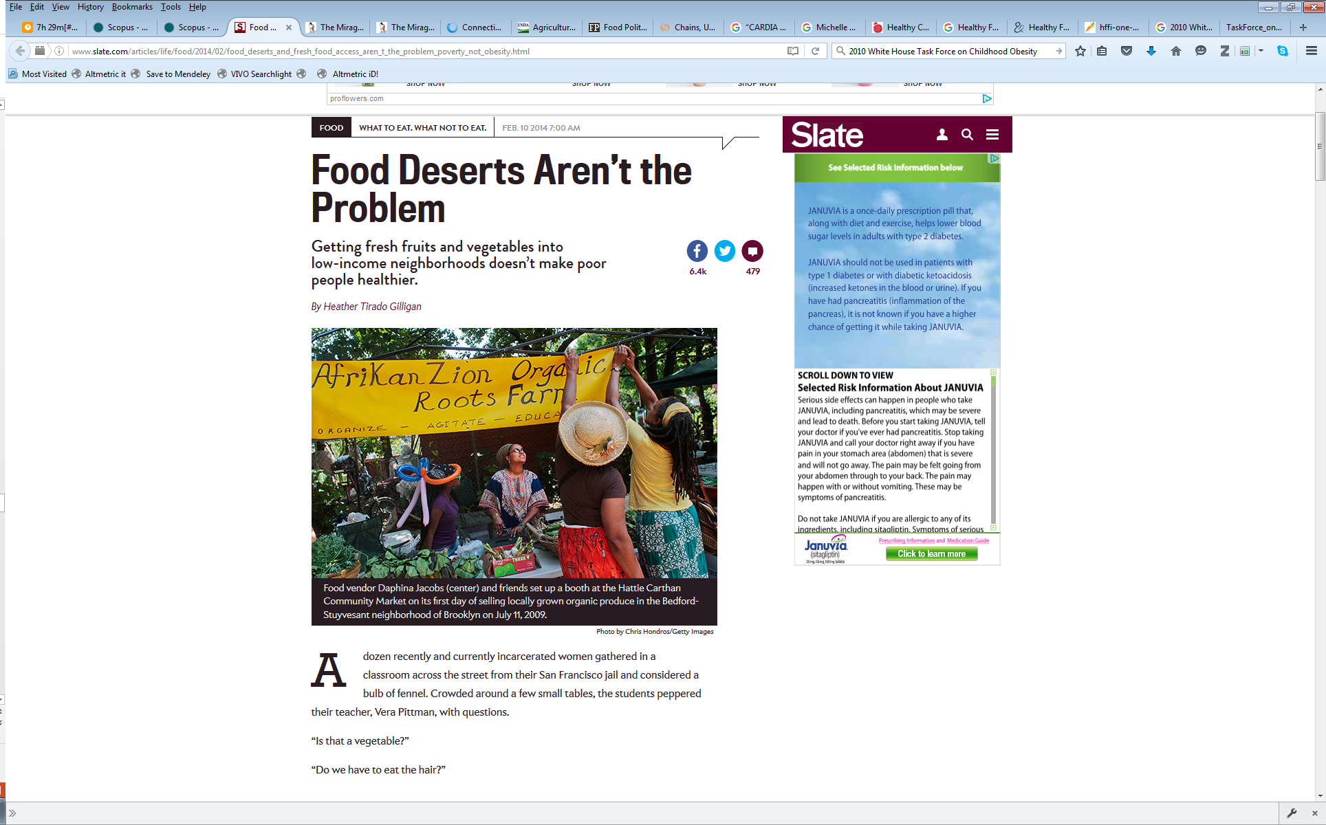
CARDIA Study: Evaluation Indicators
2011
Boone-Heinonen J, Gordon-Larsen P, Kiefe CI, Shikany JM, Lewis CE, Popkin BM. Fast food restaurants and food stores: Longitudinal associations with diet in young to middle-aged adults: The CARDIA study. Arch Intern Med 171(13):1162–70. 2011.
2014
cited in Andrew Sullivan’s “The Dish” article on The Mirage of Food Deserts
http://dish.andrewsullivan.com/2014/02/11/the-importance-of-food-deserts-is-a-mirage/?utm_source=feedburner&utm_medium=feed&utm_campaign=Feed%3A+andrewsullivan%2FrApM+%28The+Dish%29
cited in Slate.com article Food Deserts Aren’t the Problem
http://www.slate.com/articles/life/food/2014/02/food_deserts_and_fresh_food_access_aren_t_the_problem_poverty_not_obesity.html
2015
cited in report on 2015 Dietary Guidelines
U.S. Department of Health and Human Services and U.S. Department of Agriculture. Scientific Report of the 2015 Dietary Guidelines Advisory Committee. December 2015. Available at http://health.gov/dietaryguidelines/2015-scientific-report/
Notes:
The study found:
Fast food consumption was related to fast food availability among low-income respondents, particularly within 1.00 to 2.99 km of home among men (coefficient, 0.34; 95% confidence interval, 0.16-0.51). Greater supermarket availability was generally unrelated to diet quality and fruit and vegetable intake, and relationships between grocery store availability and diet outcomes were mixed.
Also relevant:
2013 cited by National Center for Health Statistics Data Brief
Fryar, Cheryl, Bethene Ervin, R. Center for Disease Control and Prevention/ National Center for Health Statistics. Caloric Intake From Fast Food Among Adults: United States, 2007-2010. NCHS Data Brief No. 114, Feb. 2013. Available at: http://www.cdc.gov/nchs/data/databriefs/db114.htm

Slide 54
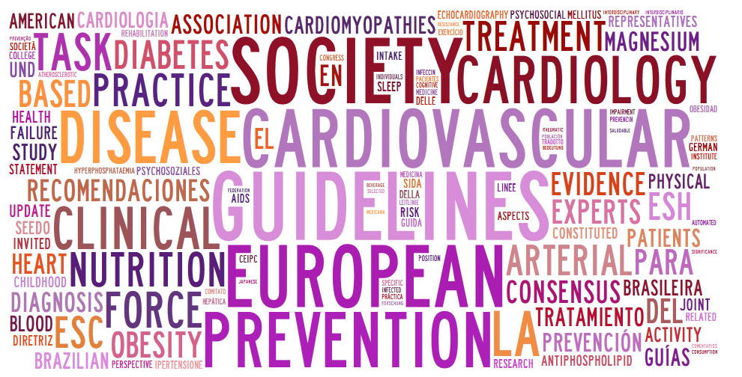

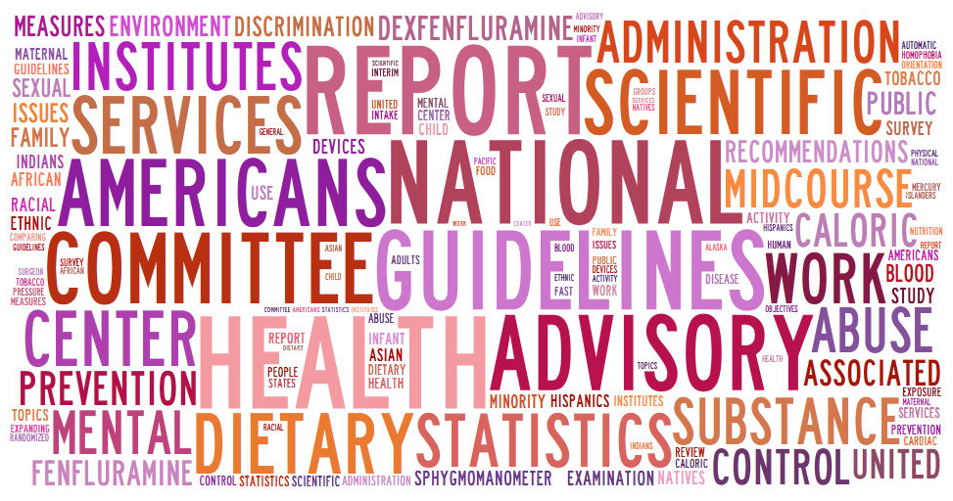
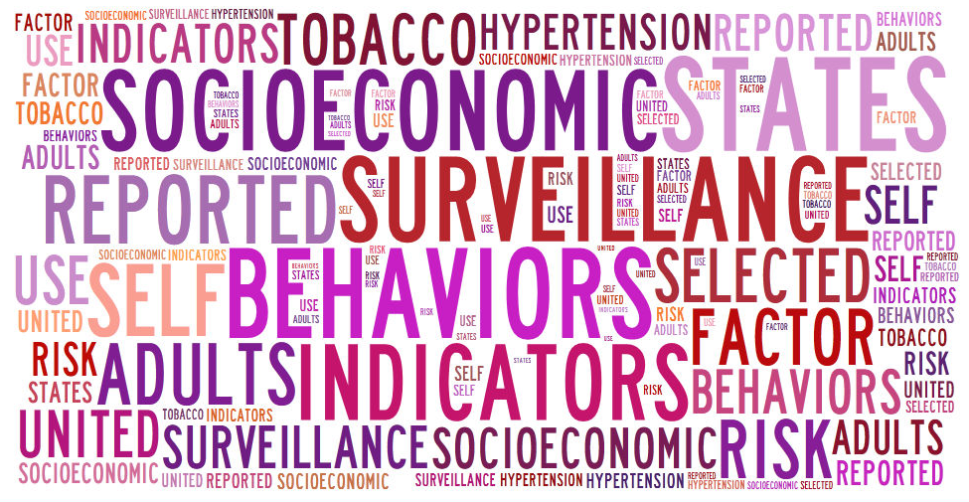
CARDIA Study: Evaluation Indicators
International Policies and Guidelines
US Clinical Guidelines/Scientific Statements
41
59
16
2
US Governmental Policies and Guidelines
US State Policies and Guidelines
Numbers reflect citations in documents. Word clouds of document titles by tagxedo.com

Slide 55


CARDIA Study and the Olympics…
1995
Maron BJ, Gardin JM, Flack JM, Gidding SS, Bild DE, Kurosaki TT. Prevalence of hypertrophic cardiomyopathy in a general population of young adults: echocardiographic analysis of 4111 subjects in the CARDIA Study—Coronary Artery Risk Development in (Young) Adults. Circulation. 1995;92:785-789.
1996
Cardiovascular Pre-participation Screening of Competitive Athletes (AHA)
  publishes report on screening cardiovascular abnormalities in athletes
  cites CARDIA document (Maron BJ et al., 1995)
2004
International Olympic Committee (IOC) Medical and Scientific Commission
  publishes report on screening for Sudden Cardiovascular Death in Sport
  no reference list available
  http://www.olympic.org/Documents/Commissions_PDFfiles/Medical_commission/IOC_CONSENSUS_STATEMENT_ON_SUDDEN_CARDIOVASCULAR_DEATH_IN_SPORT_2004.pdf
2006
International Olympic Committee (IOC) ad hoc Working Group on Sudden Death in Athletes
  publishes Position Paper (literature review) describing why the IOC consensus meeting accepted the proposed report in 2004 (Bille K, et al., 2006)
  cites CARDIA document (Maron BJ et al., 1995)
Notes:
The study found:
HCM was present in about 2 of 1000 young adults. These unique population-based data will aid in assessments of the impact of HCM-related mortality and morbidity in the general population and the practicality of screening large populations for HCM, including those comprising competitive athletes.
What is Hypertrophic Cardiomyopathy?
Hypertrophic cardiomyopathy (HCM) is very common and can affect people of any age. It affects men and women equally. It is a common cause of sudden cardiac arrest in young people, including young athletes. Hypertrophic cardiomyopathy occurs if heart muscle cells enlarge and cause the walls of the ventricles (usually the left ventricle) to thicken. The ventricle size often remains normal, but the thickening may block blood flow out of the ventricle. If this happens, the condition is called obstructive hypertrophic cardiomyopathy. In both obstructive and non-obstructive HCM, the thickened muscle makes the inside of the left ventricle smaller, so it holds less blood. The walls of the ventricle may stiffen, and as a result, the ventricle is less able to relax and fill with blood. It is rare, but some people with hypertrophic cardiomyopathy can have sudden cardiac arrest during very vigorous physical activity. The physical activity can trigger dangerous arrhythmias. Ask your doctor what types and amounts of physical activity are safe for you.
Resource: http://www.heart.org/HEARTORG/Conditions/More/Cardiomyopathy/Hypertrophic-Cardiomyopathy_UCM_444317_Article.jsp#.WP42zme1vmE
Other happenings:
1997 National Collegiate Athletic Association (NCAA) Committee on Competitive Safeguards and Medical Aspects of Sports
expresses concerns about recommendation
Cardiovascular Pre-participation Screening of Competitive Athletes (AHA)
responds to NCAA concerns with an addendum (Maron BJ et al. 1997)

Slide 56
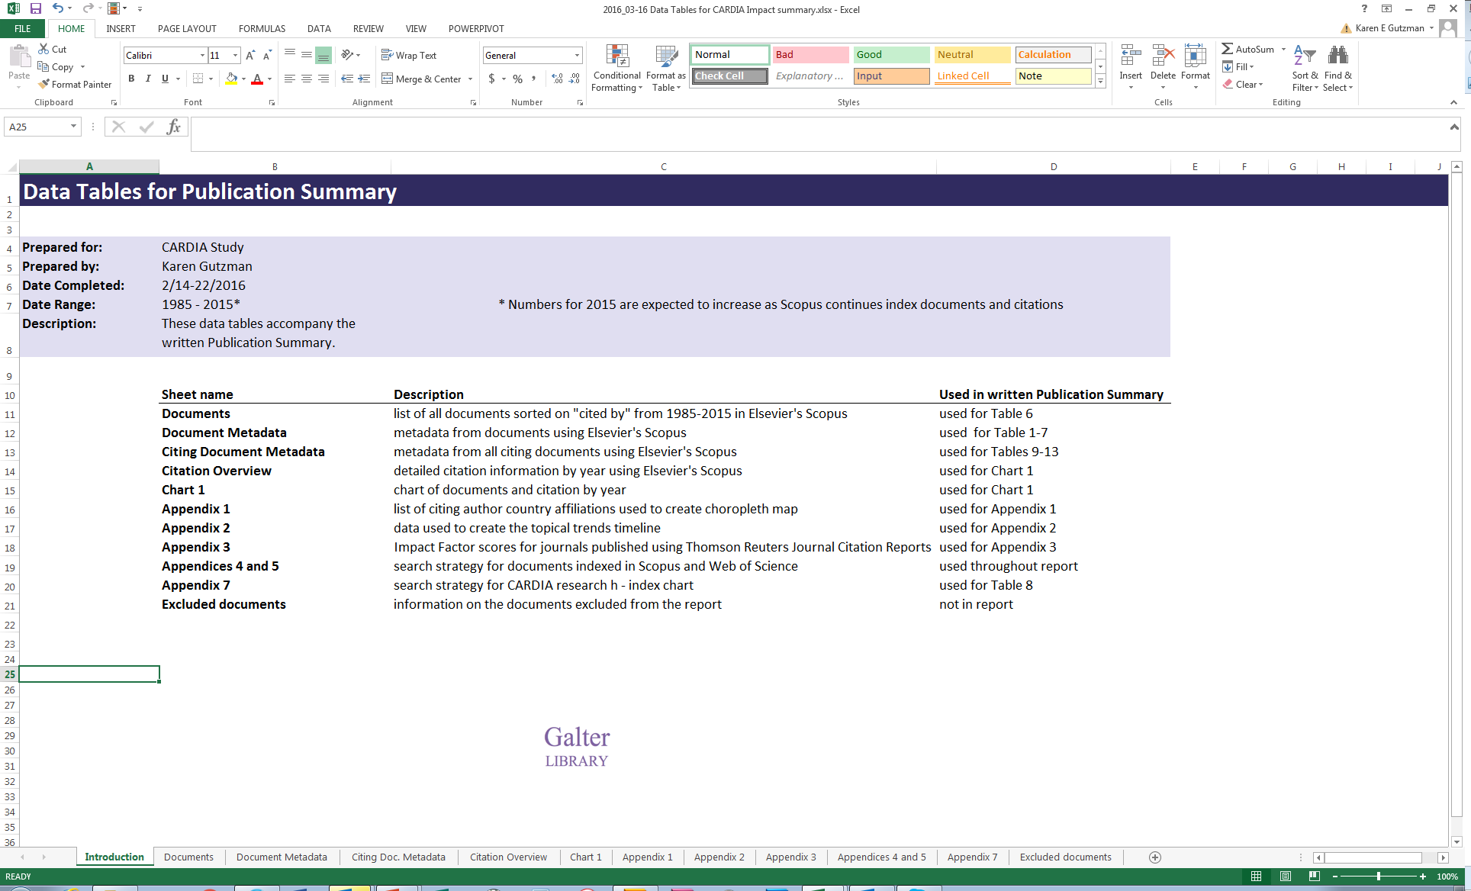
Organizing and Tracking Results
CARDIA Study: Reporting back
above: screenshot of excel file used to organize and track results

Slide 57
Wrap up
What is research evaluation?
Recent evaluation projects

Slide 58
Thank you!
Karen Gutzman
Impact and Evaluation Librarian
Galter Health Sciences Library
Northwestern University
Contact Information:
Karen.gutzman@northwestern.edu
312-503-8121

