Slide 1
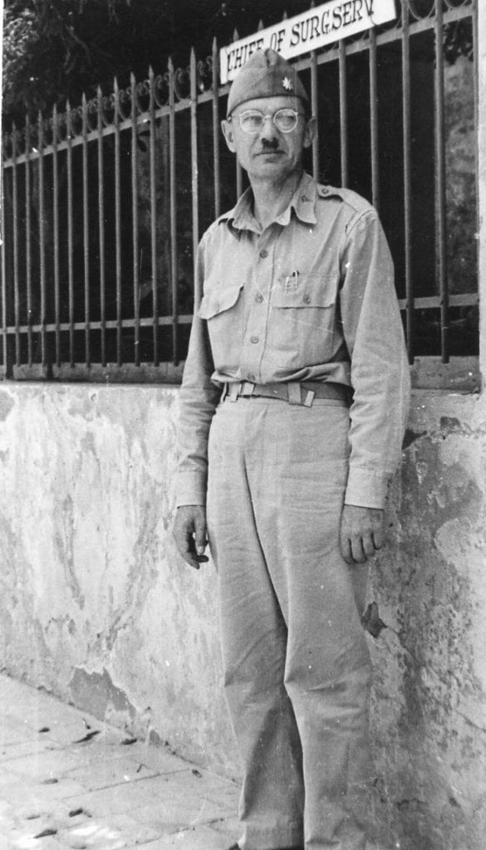
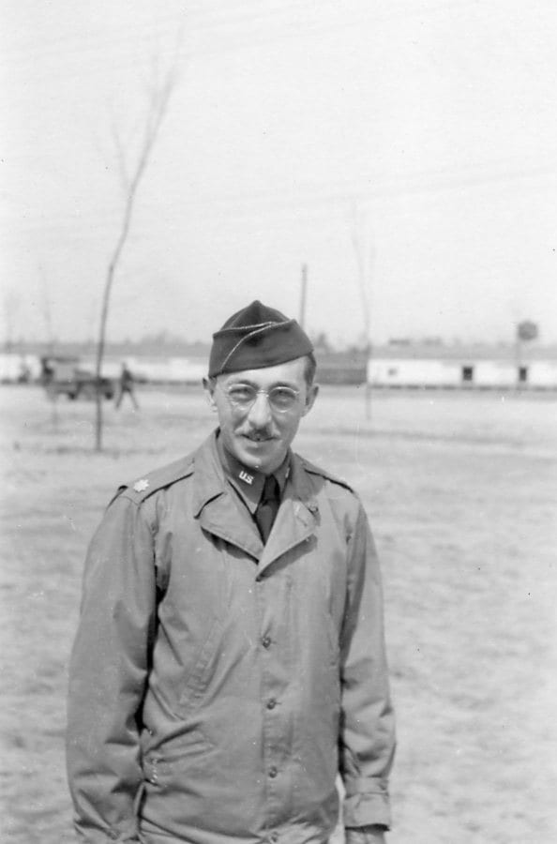
From Ward to War: Northwestern during World War II
Gabrielle Barr, MSI
September 20, 2019
Michael L. Mason
James A. Conner
Notes:
Good afternoon. My name is Gabrielle Barr. I had the privilege to be hosted by Galter Health Sciences Library & Learning Center for the 2nd year of the National Library of Medicine Associate Fellowship program. This presentation will focus on the history of the 12th General Hospital Unit, Northwestern Medical School’s Unit during WWII and will discuss my efforts last year to share its legacy with the Northwestern community and public at large

Slide 2
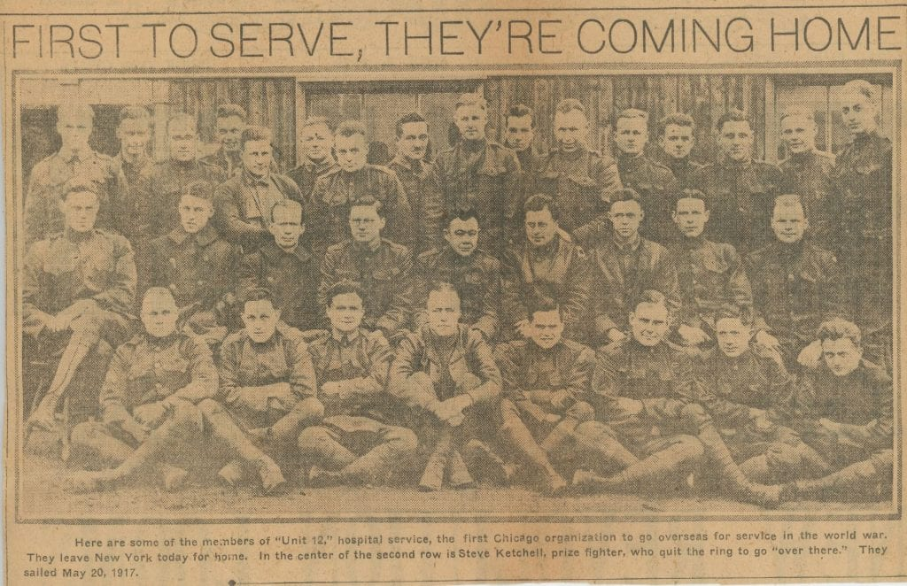
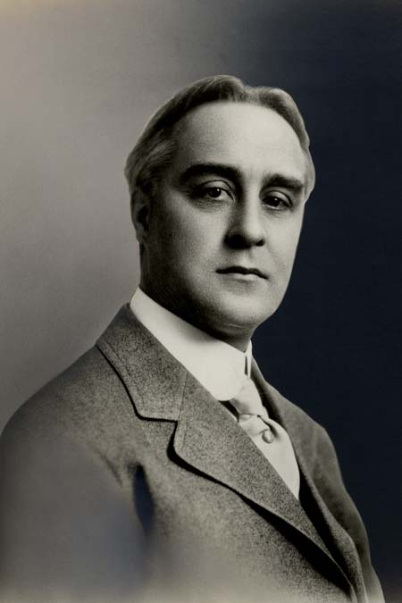
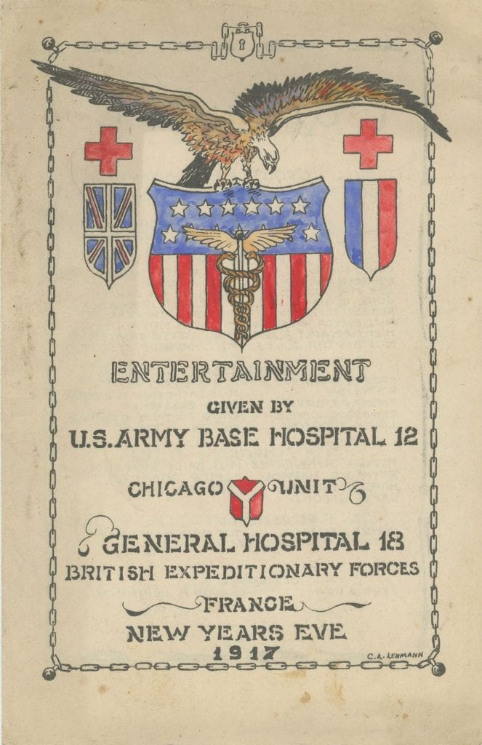
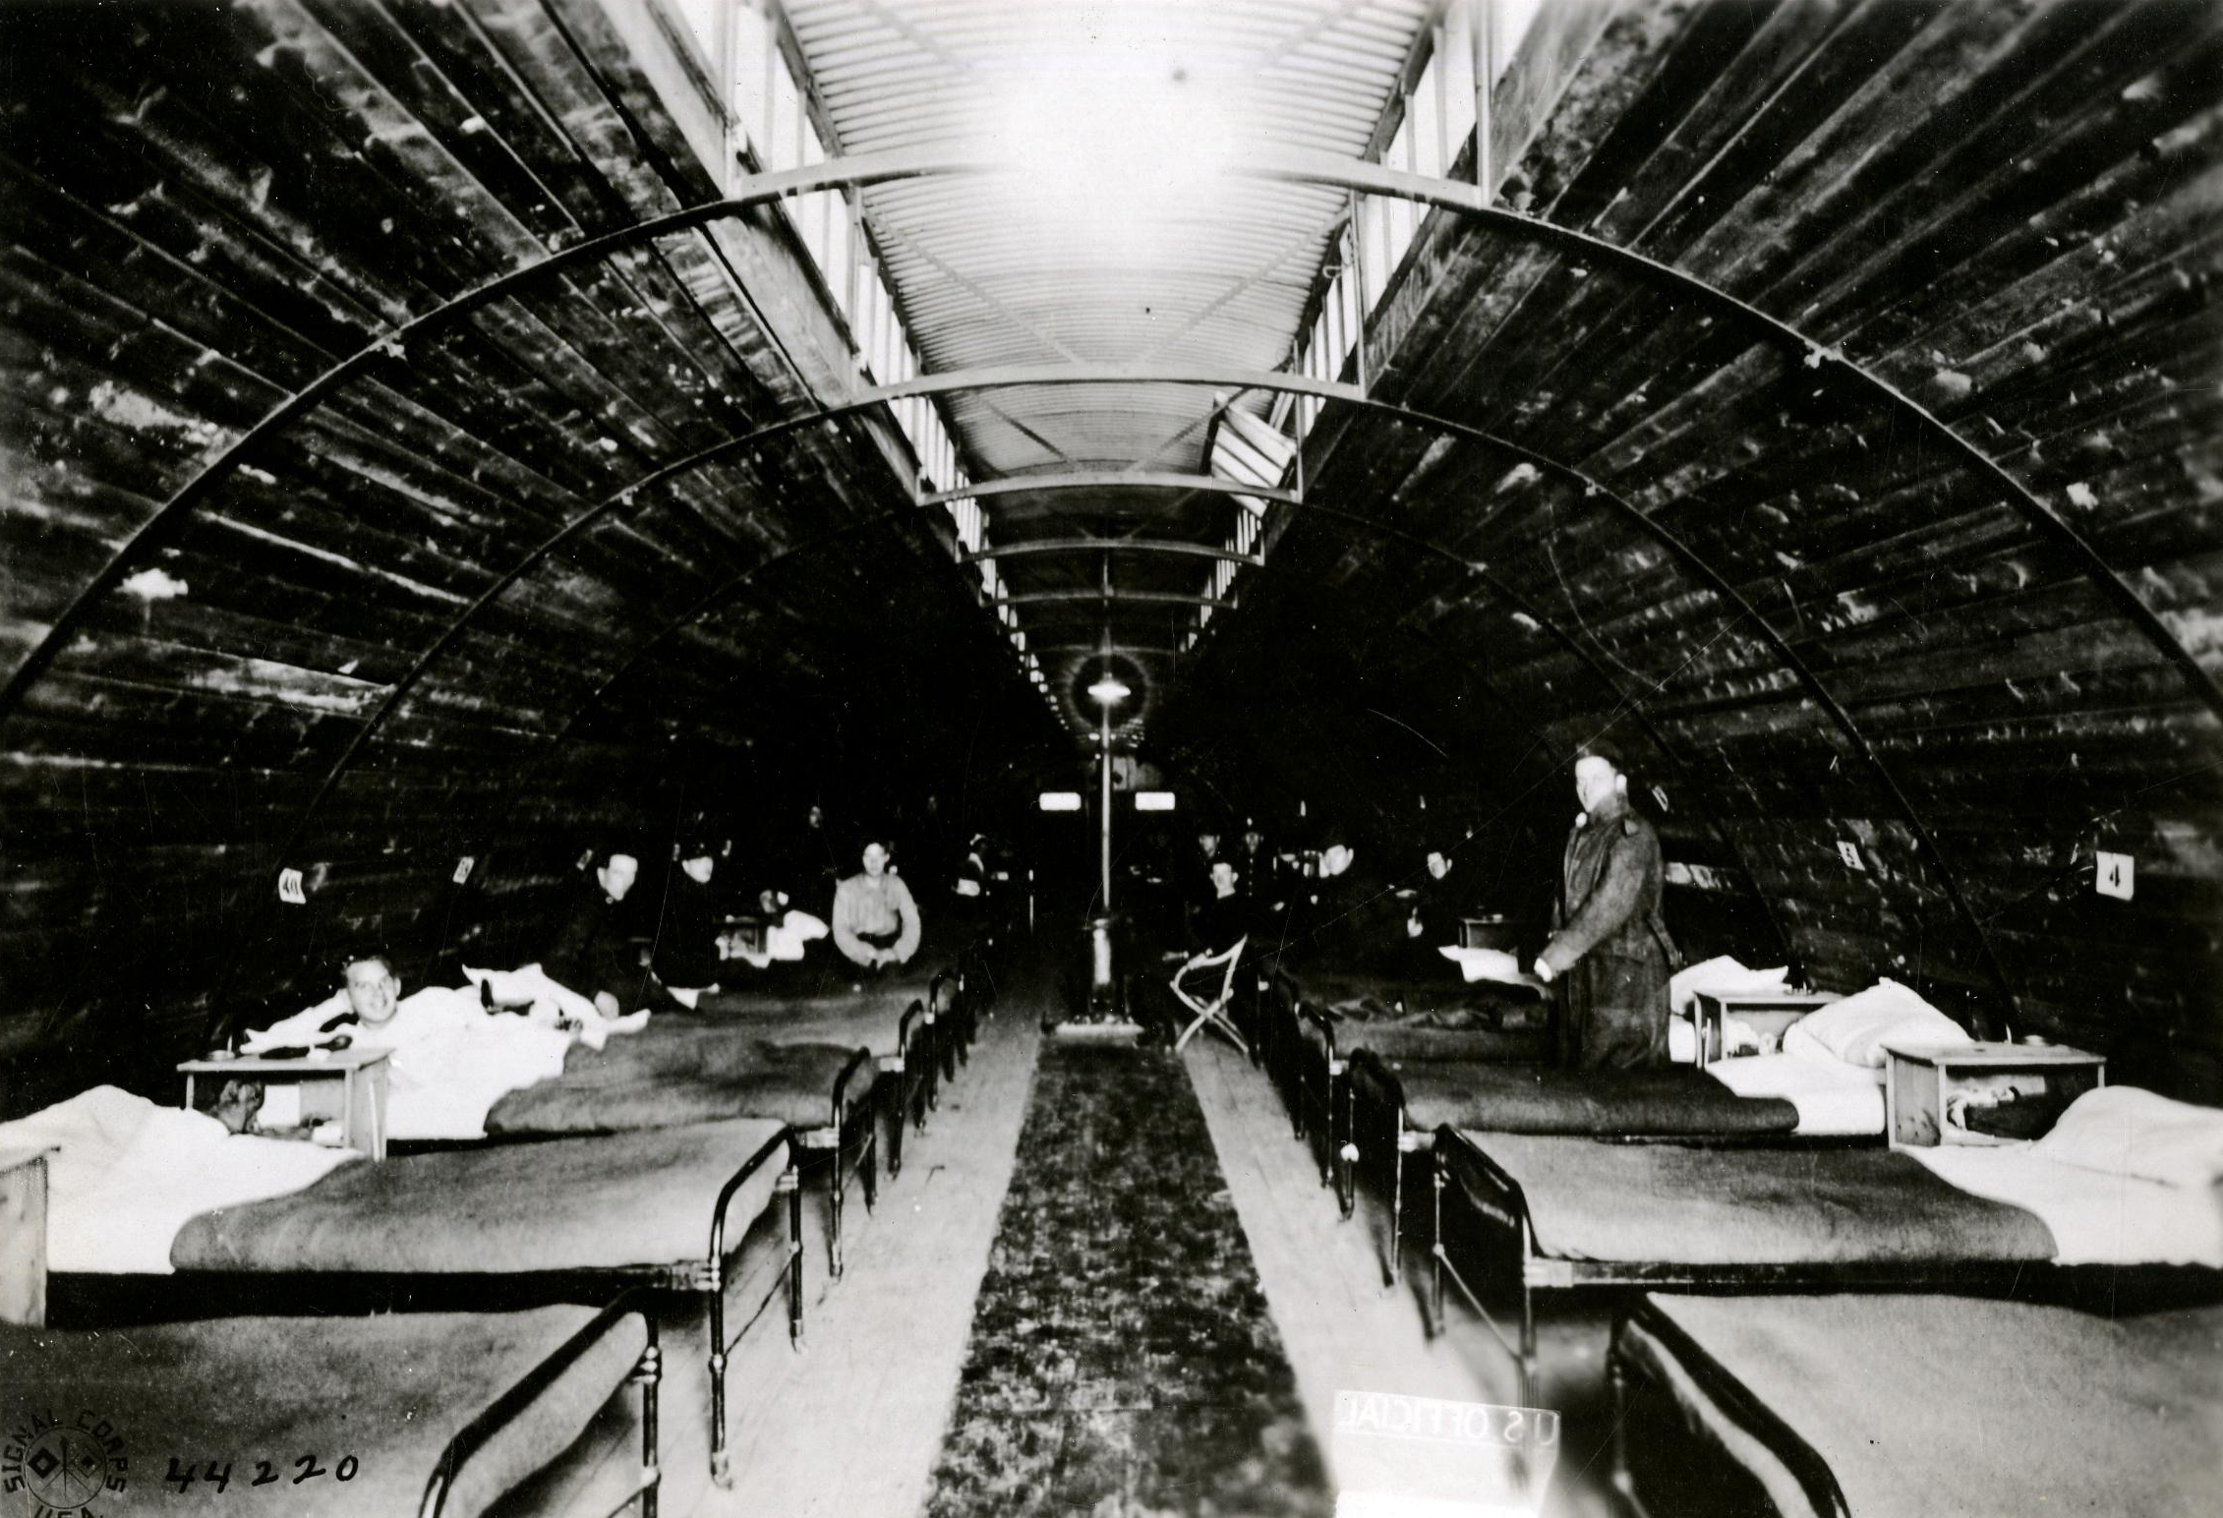
Base Hospital #12
Notes:
During World War I, Northwestern Medical School students and faculty formed Base Hospital #12, which was the first unit of its kind. Base Hospital #12, headed by Frederic A. Beasley, served in two locations in France for 22 months, treating 61, 000 patients.

Slide 3
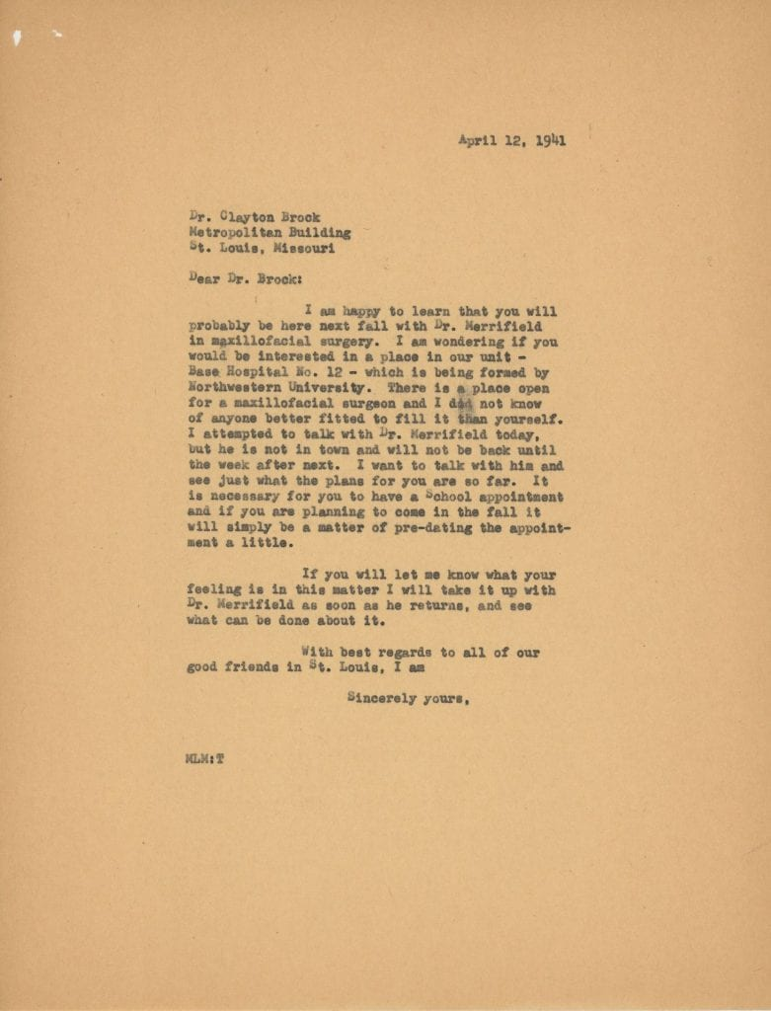
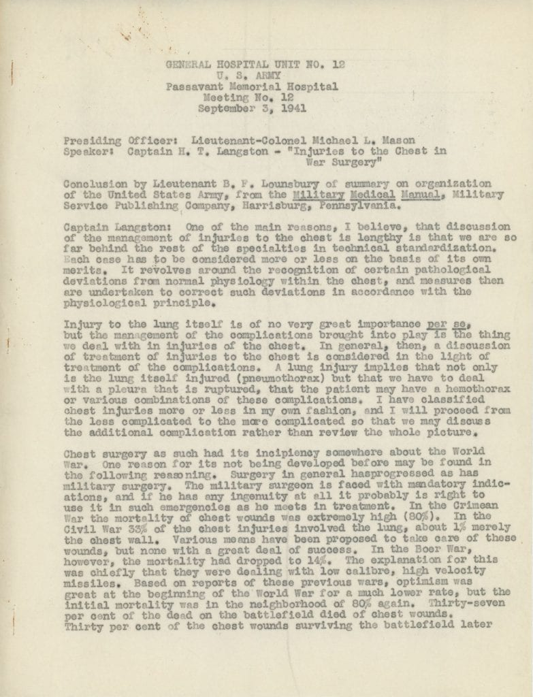
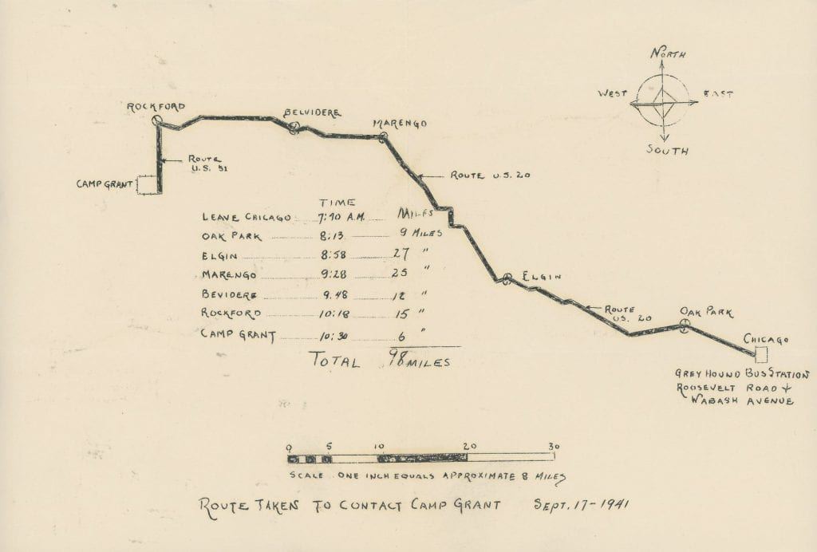
Beginning to Prepare for War
Meeting Minutes from Passavant
Training at Camp Grant
Recruitment Letter
Notes:
With tensions mounting in Europe, the Unit was reconstituted in September of 1936 and was renamed the 12th General Hospital Unit. In July of 1940, it became an inactive unit of the regular army. Along with undergoing some basic training at Camp Grant, attending military related lectures, convening at Passavant Memorial Hospital to discuss military medicine, Michael L. Mason, a surgeon who had served with Base Hospital #12 began recruiting his colleagues, but with the United States not formally involved in the War, received a lukewarm response.

Slide 4
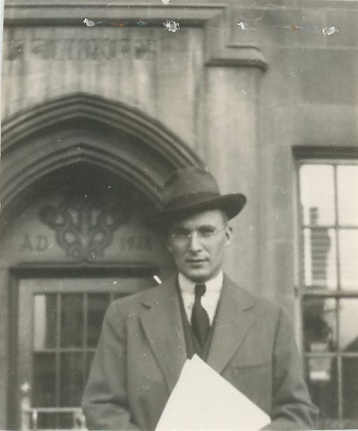
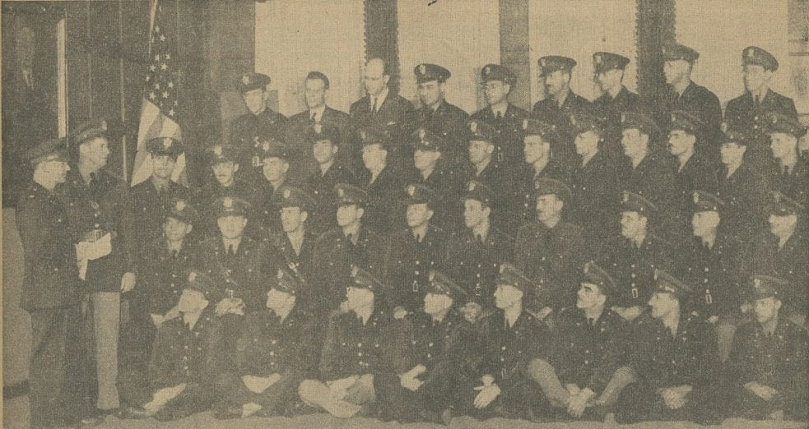
Recruitment
Notes:
The attack on Pearl Harbor on December 7, 1941 is what catalyzed those affiliated with Northwestern Medical School to join. In the end, around 57 doctors and dentists enlisted, which means there were faculty and staff who chose to enlist in other branches of the military and even other units of the Army. Katherine Baltz, who served as the Chief Nurse, had the daunting task of recruiting 120 nurses in the span of three weeks, which was a challenge despite the fact there were 38 accredited nursing programs in the Chicagoland area at the time. These hurdles were the result of the specific criteria that included that the nurse be single, under 40, meet the physical requirements, be a graduate of an accredited nursing school, and be a member of the American Red Cross. She recruited 96 nurses, and more nurses were added to the Unit before they were sent abroad. The Northwestern doctors and dentists and Chicago-area nurses met the hundreds of enlisted men from all over the country that formed the backbone of the Unit during training.

Slide 5
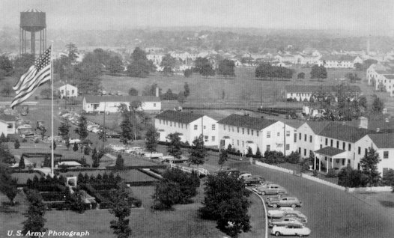
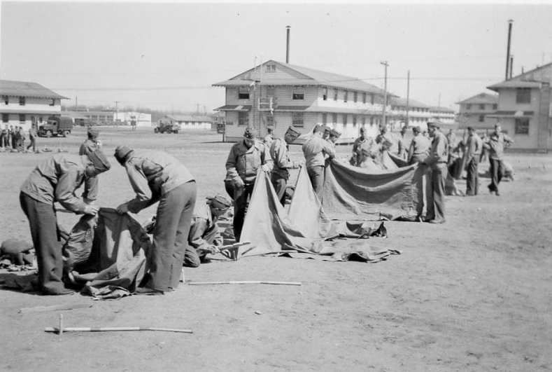
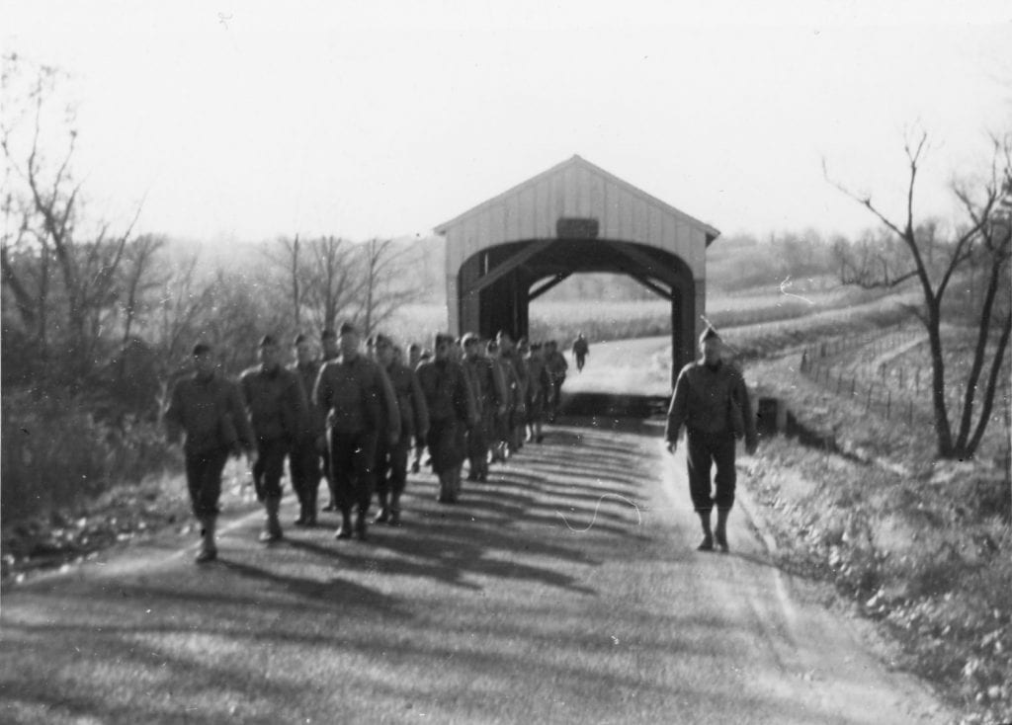
Training
Camp Kilmer
Ft. Custer
Ft. Benjamin Harrison
Notes:
For nearly a year, the Unit underwent training at Fort Custer, near Battlecreek, Michigan, Fort Benjamin Harrison on the outskirts of Indianapolis, and Camp Kilmer in New Jersey. During training, the enlisted men became familiar with how to perform medical procedures through instruction and through experience in station hospitals and clinics. The Northwestern faculty and nurses became acquainted with the expectations of the Army through drills, meetings, and War Department films, which was not easy for many of the older physicians who were not used to taking orders. Though training could be tedious and difficult, it was a time to build camaraderie through shared exercises and leisurely pursuits like athletics and spending evenings at the officers’ club.

Slide 6
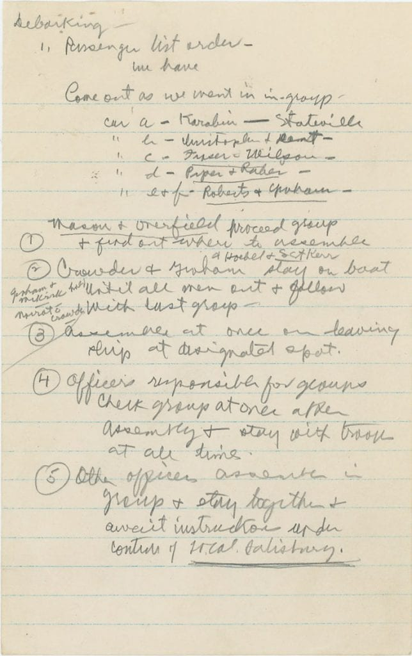
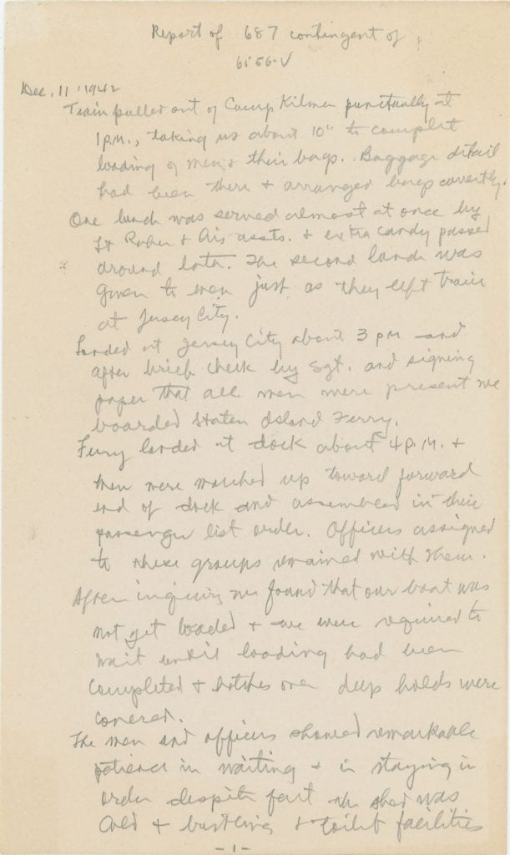
Voyage Overseas
Notes:
On December 12, they set off for Ain-el-Turck, a seaside resort in Algeria. They were divided amongst three ships in a convoy along with 346 tons of supplies that ranged from gas masks to brooms to x-ray machines. It was a trying journey for a variety of reasons including rough weather, German U boats, and the fact that one of the ships, the Florence Nightingale, was hit by another ship in the convoy swerving away from a U boat and unfortunately, an enlisted man died.

Slide 7
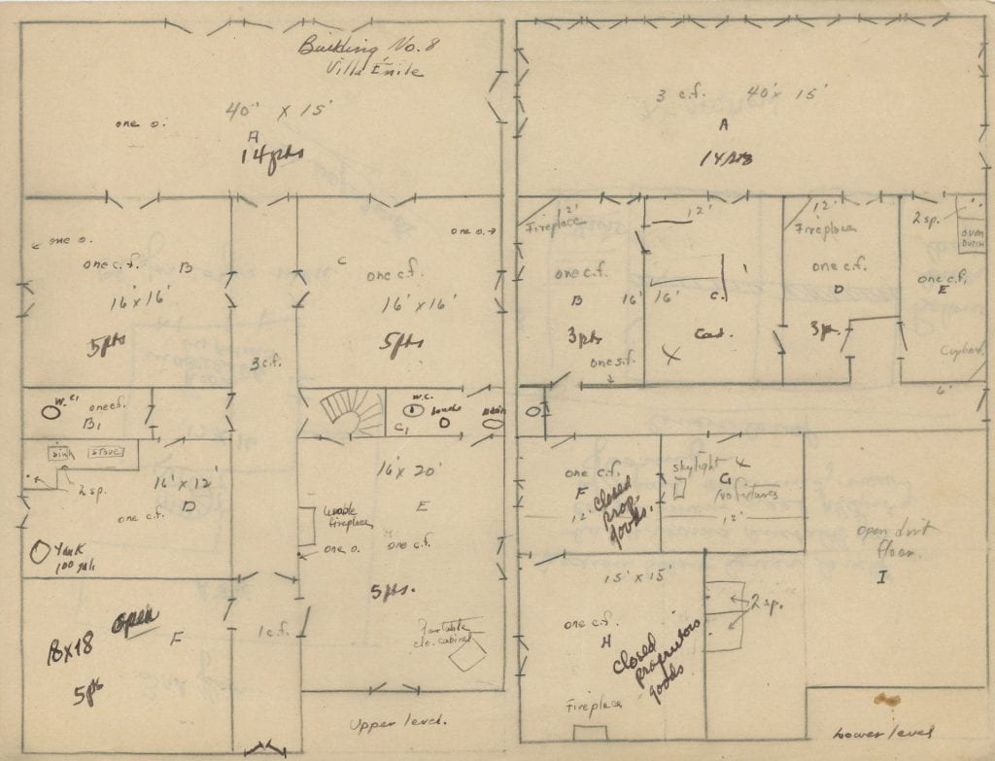
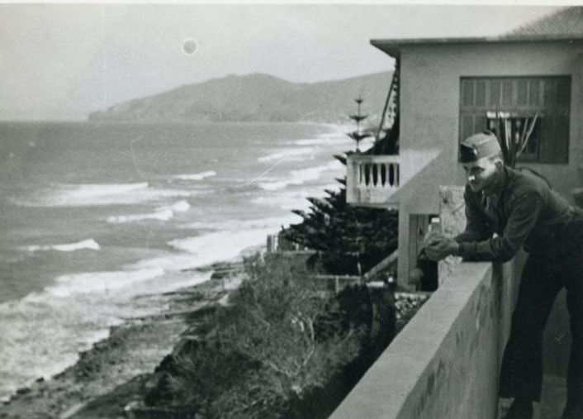
Arriving in Ain-el-Turck
Notes:
They arrived in Ain-el-Turck in late December and established the hospital in 105 villas that belonged to French vacationers. These villas were not ideal places to care for thousands of wounded and sick patients, given the fact that that there were persistent problems with plumbing, electricity, and water, they were situated on three levels of road so patients had to be carted from their ward to their medical appointments by ambulance, and the small and narrow structures themselves were not suited for stretchers. Nevertheless, the 12th General Hospital personnel adapted to their surroundings, even without most of their supplies which was taken by another Unit.

Slide 8
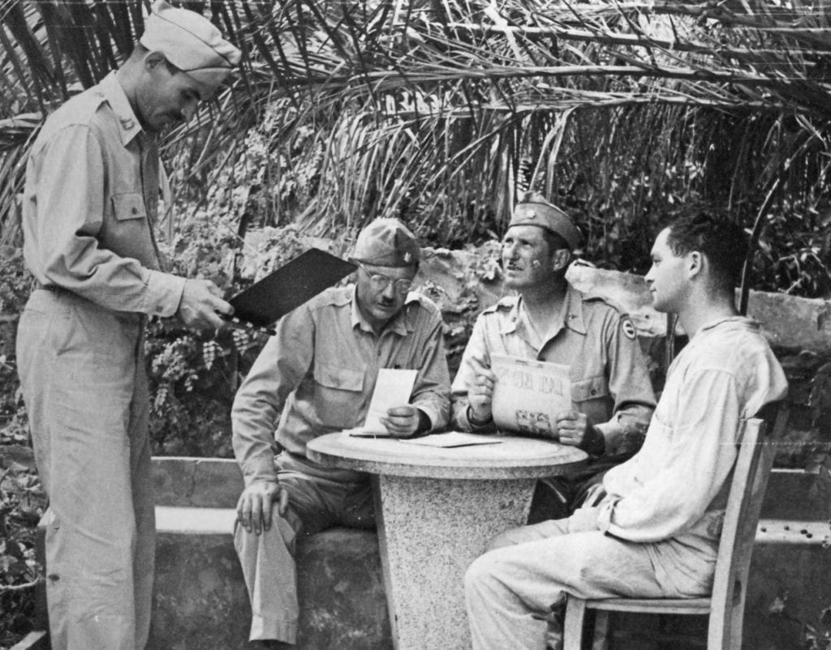
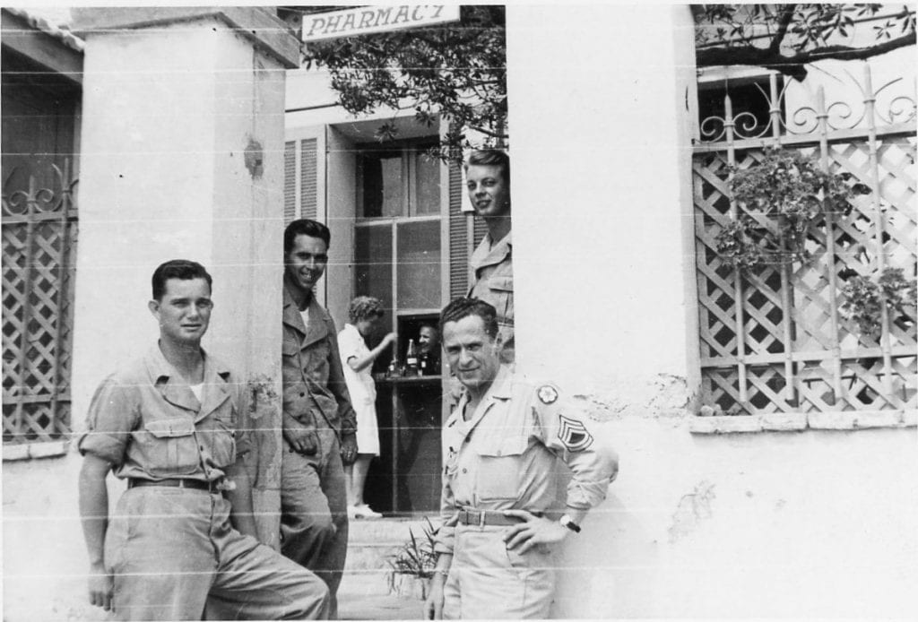
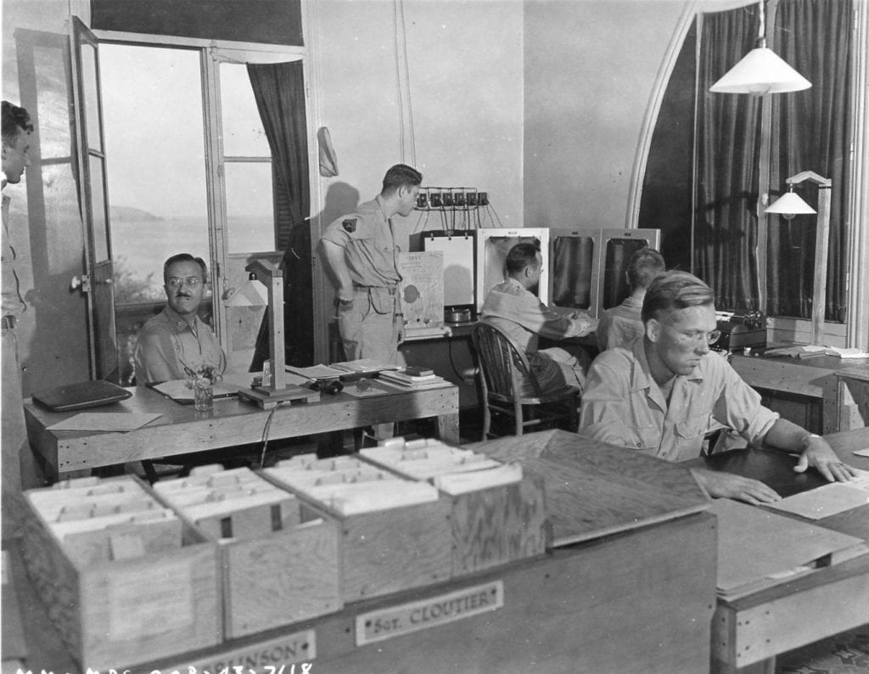
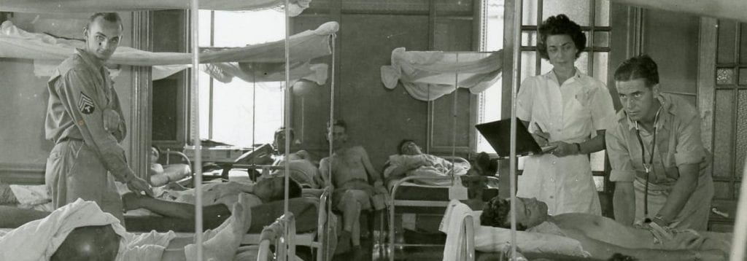
Tending to Patients in Ain-el-Turck
Notes:
In Ain-el-Turck, the majority of the casualties came from the Tunisian Campaign and the invasion of Sicily and Italy. There were some civilian cases like car crashes.

Slide 9
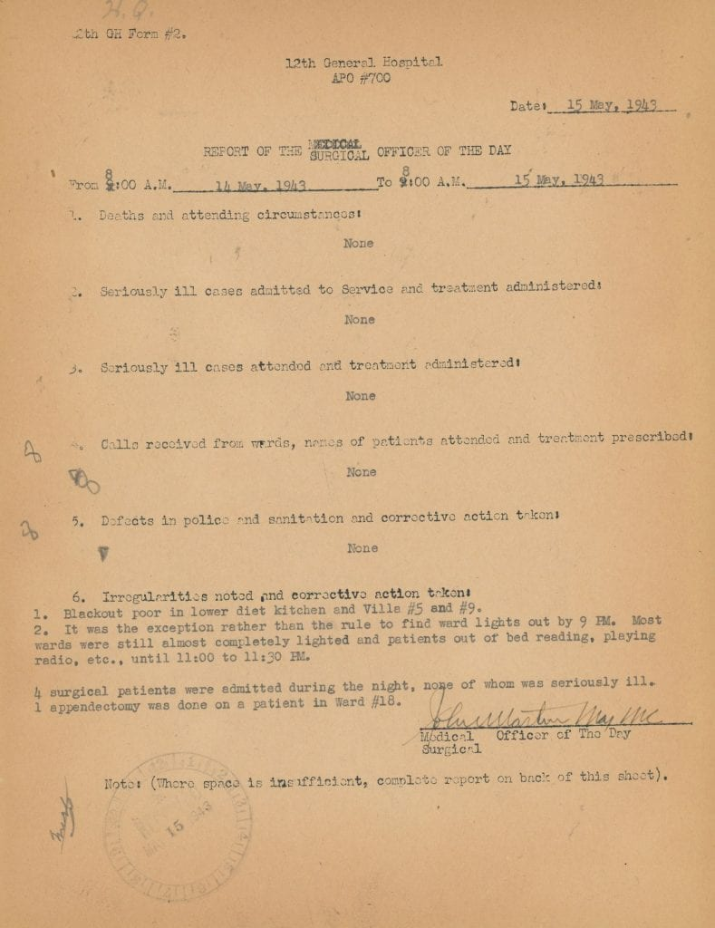
Rounds & Reports
Notes:
Both ward and operating procedures were put in place such as the rounds of the Surgical Officer of the Day, that produced reports that describe in detail the ins and outs of running a hospital from new patients, problematic patients who went AWOL or started fights, to maintenance issues with the buildings.

Slide 10
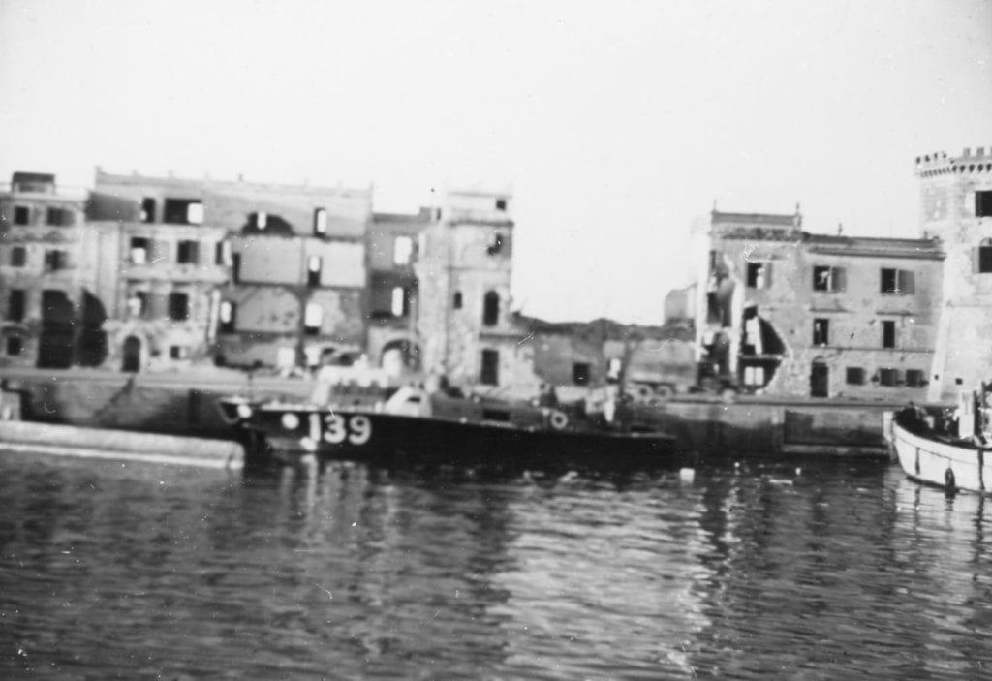
Naples
Anzio Harbor
Notes:
In December of 1943, the Unit left Ain-el-Turck for Naples, which sustained substantial destruction from the Allied air raids and heavy fighting in its environs. Epidemics of various types ensued in the ravaged region. The 12th General Hospital Unit was not able to secure a space that could accommodate a General Hospital and so they set up their headquarters in Mussolini’s fair grounds and went on detached service.

Slide 11
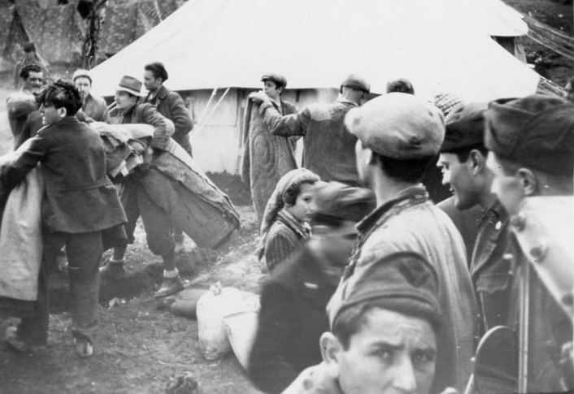
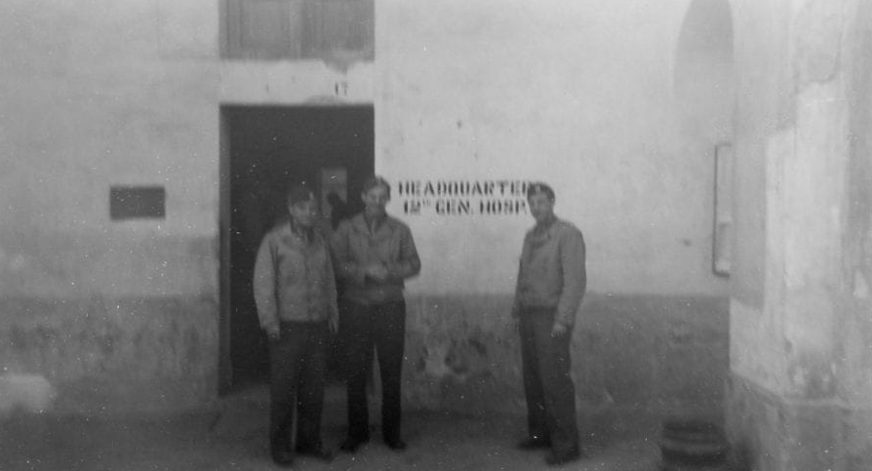
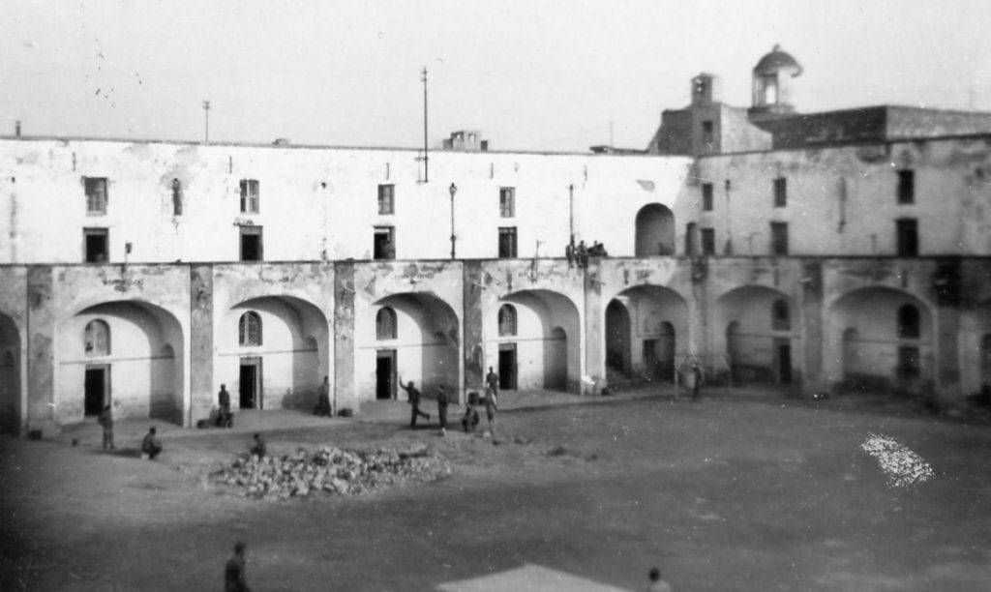
Detached Service in Naples
Dusting Refugees with DDT
Headquarters
Courtyard of the Victor Emanuel
Caserma
Notes:
Members of the Unit engaged in scientific research, took part in the groundbreaking Typhus and Malaria Commissions, and treated troops with venereal disease with penicillin. Naples was a time where the more seasoned staff of the 12th General Hospital guided greener divisions, but it was also a time where Northwestern personnel picked up new techniques and approaches like secondary closure that they implemented in their own institution once they reconvened.

Slide 12
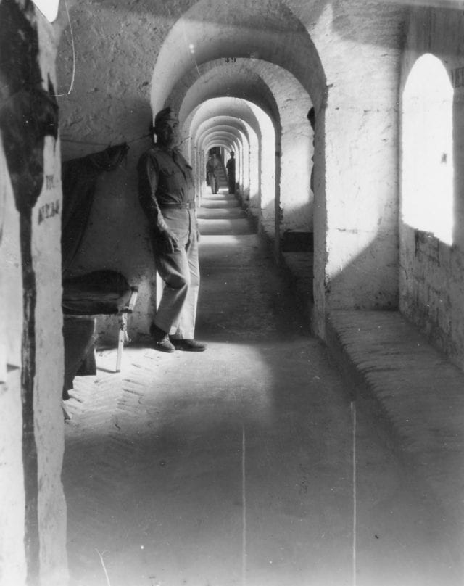
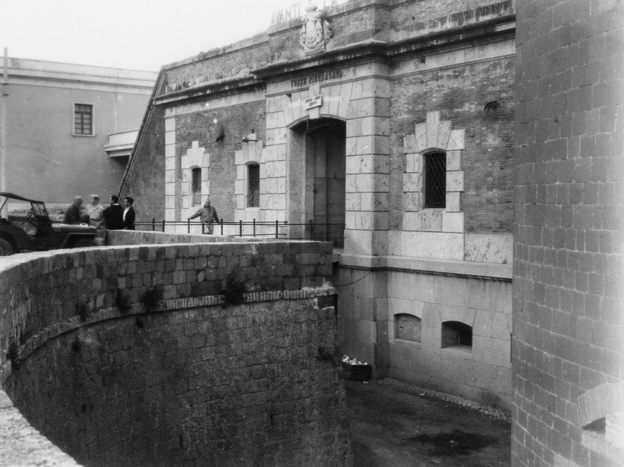
Rome
Notes:
After six months, the Unit was sent to Rome, where they converted this complex that consisted of newer barracks on top of an old fort into a 2000-bed hospital to quickly swelled to more than 3000 patients at any time. In Rome, the 12th General Hospital took on more emergency situations that were usually dealt with by other types of medical facilities due to their proximity to the front lines. As a result, there were changes to the administrative operations such as the creation of rotating surgical teams being on call 24 hours a day.

Slide 13
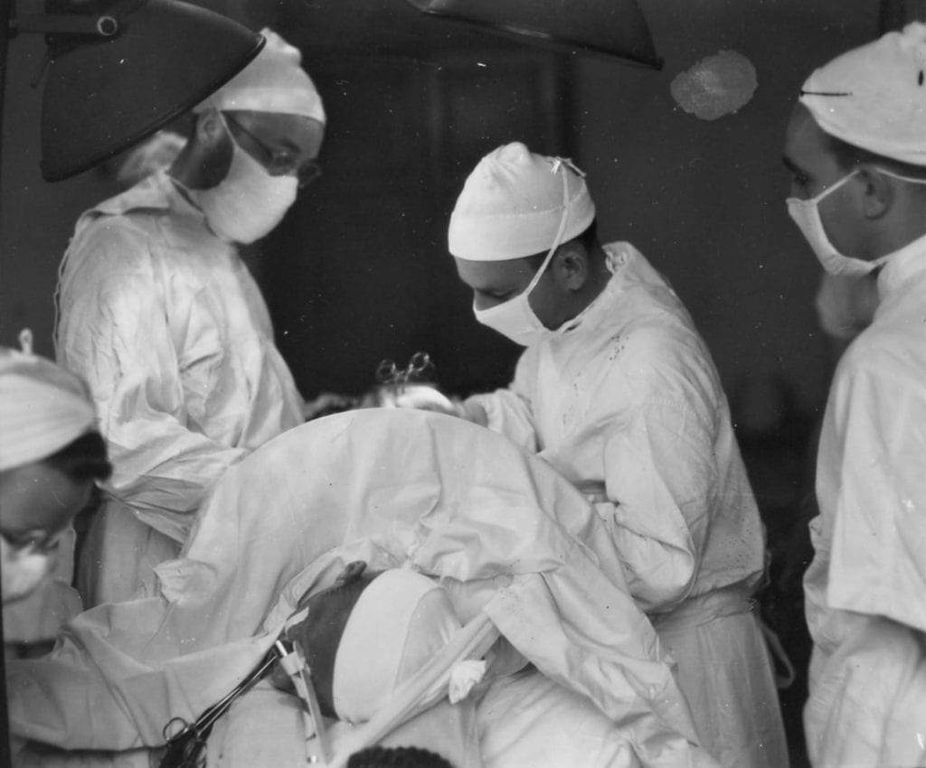
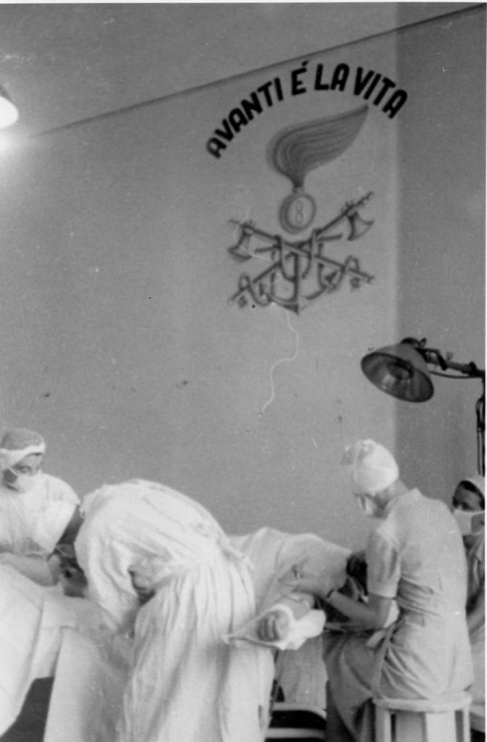
Operating Room
Notes:
Rome was the city where the 12th General Hospital treated the most patients during their service abroad. It was normal for surgeons to perform more than 70 operations a day lit by only battery-powered lamps, yet there was also state-of the art equipment in the room that resembled that from operating theaters in United States. They treated all kinds of injuries, particularly leg injuries and compound fractures, but they also attended to common issues like hernias and appendicitis. They saw some wounds they were not so familiar with like renal injuries and wounds in certain conditions like being infested with maggots. Some of the patients received multiple surgeries such as those who needed skin grafts, and almost all of the patients recuperated in the wards for months.

Slide 14
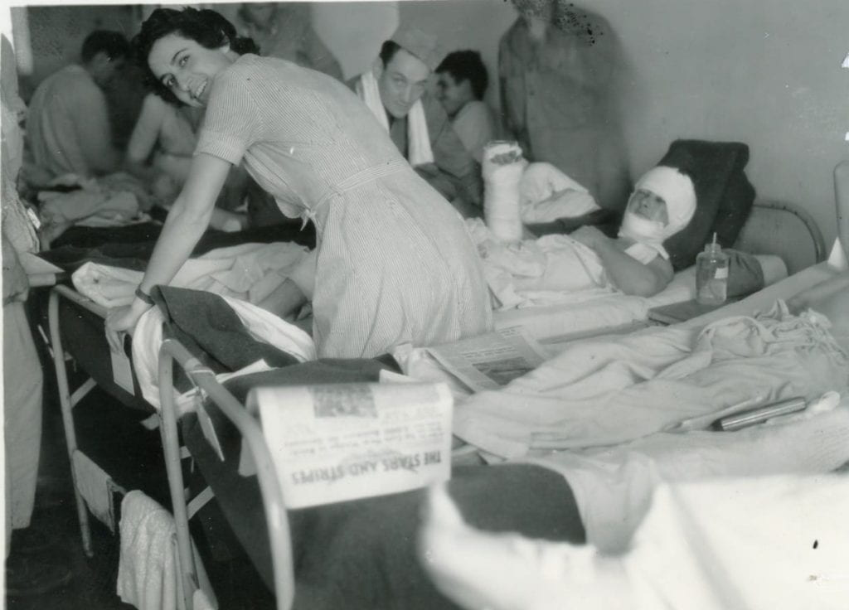
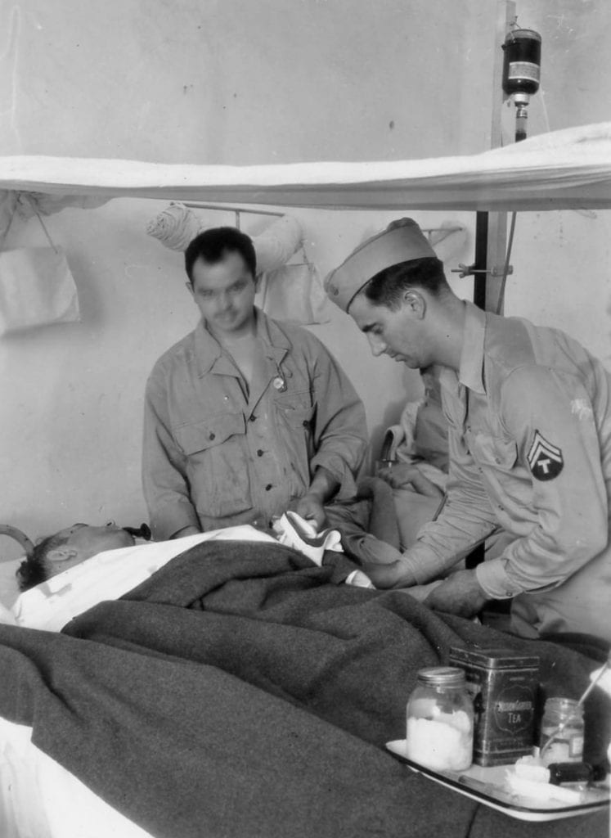
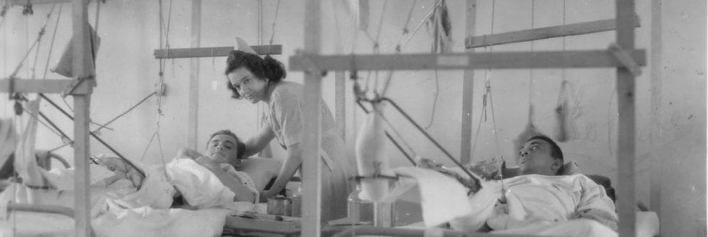
In the Wards
Tending to Patients
Enlisted Men Caring for Patient
“Cat’s Cradle”
Notes:
Nurses, enlisted men, and fellow patients tended to the invalids in the wards and did everything from feeding and bathing them, to taking vitals, to administering medicine, to maintaining records. Nurses along with members of the Red Cross were responsible for comforting the men, who had undergone trauma. Psychological issues were beginning to be recognized in World War II, but not all those in higher command positions regarded them as legitimate diseases. Roger Boshes, the son of Benjamin Boshes who was in charge of the neurology division of the Unit, recounted a story about how General Patton when he came to visit insisted that a mentally and emotionally disturbed soldier stand up and salute him and the soldier kept falling down. Boshes ultimately wrote an incensed letter to Eisenhower about the situation.

Slide 15
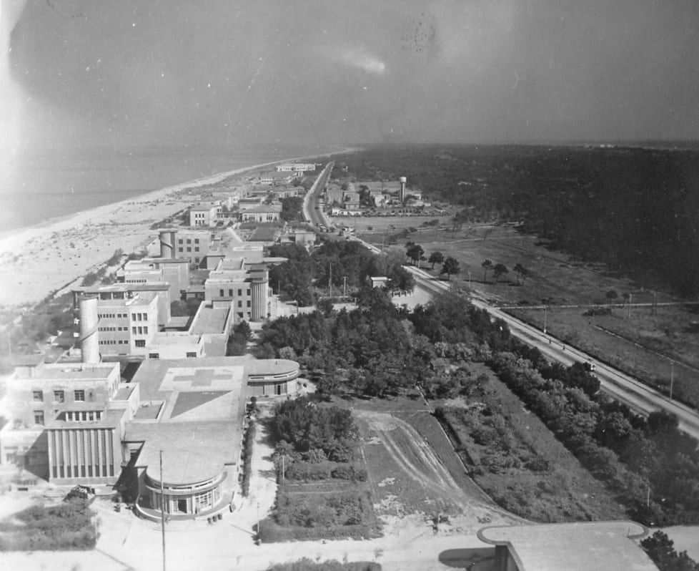
Leaving for Livorno (Leghorn)
Notes:
In November of 1944, the Unit was stationed in Livorno in what had formally been a school.

Slide 16
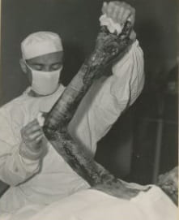
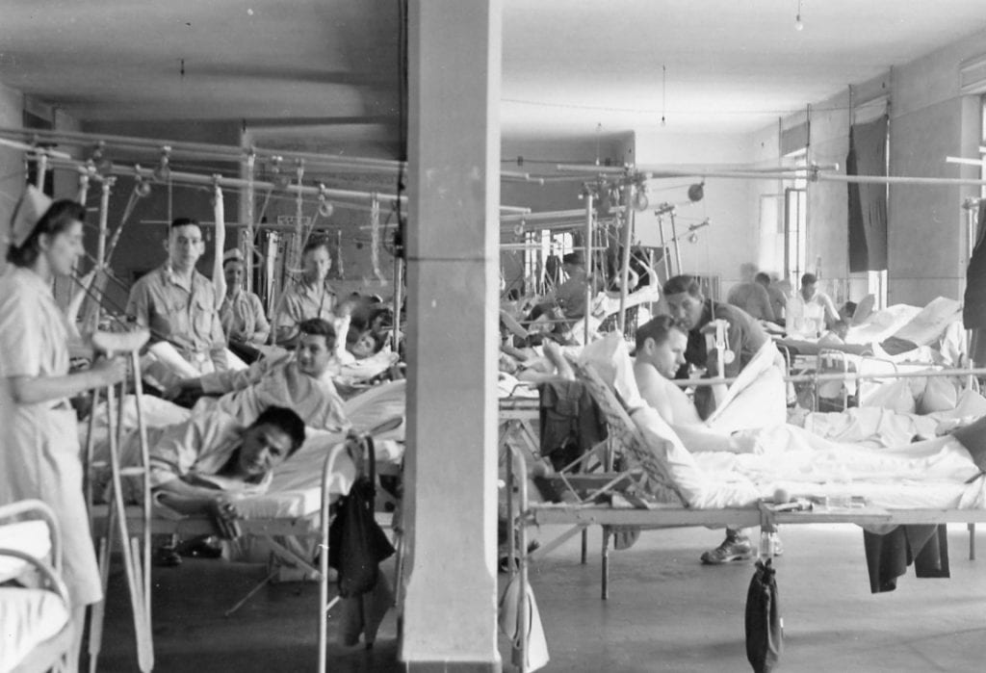
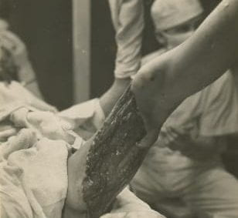
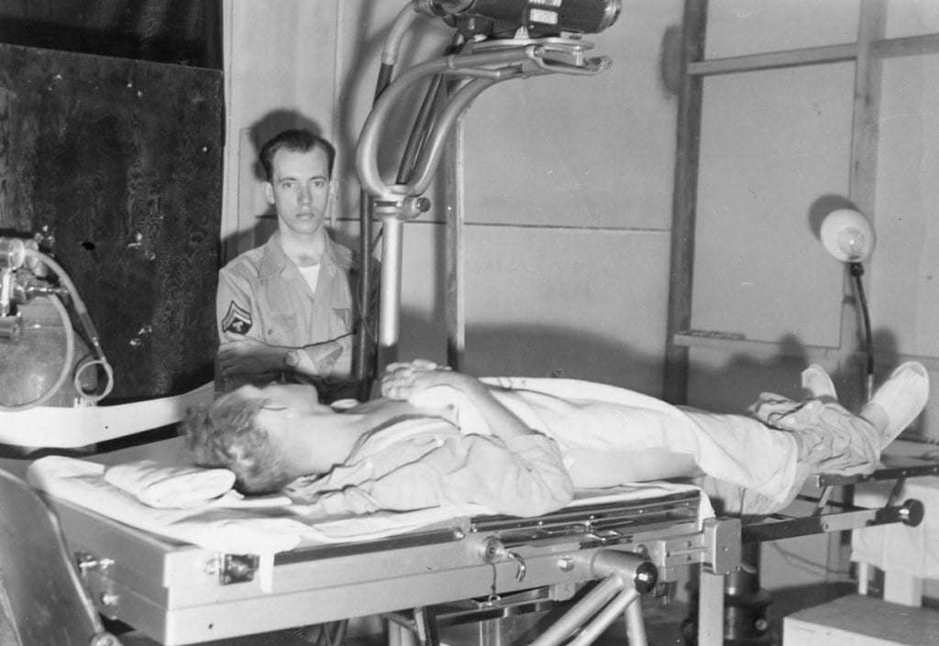
Treating Patients In Livorno (Leghorn)
Notes:
This building like those in Ain-el-Turck and Rome were converted by skilled enlisted men who removed mines, got the water running, made furniture, installed generators. The operation of a facility of this size depended on the contributions of these men as well as help from local people and prisoners of war who were assigned to tasks like laundry, cleaning, carrying the patients, and even technical jobs like fitting casts and filling out paperwork in the registrar’s office.

Slide 17
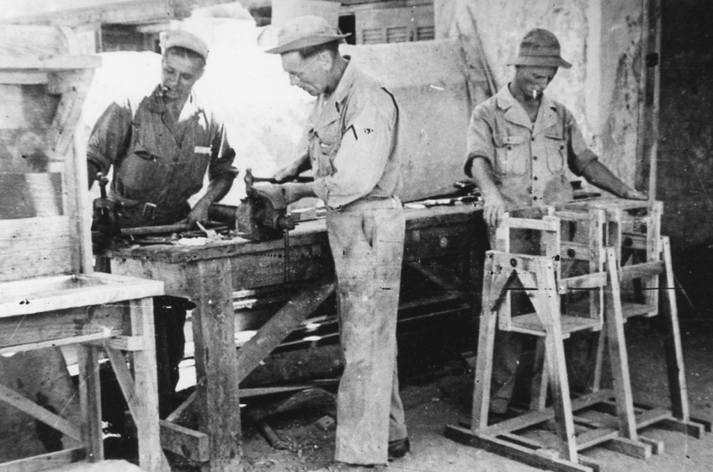
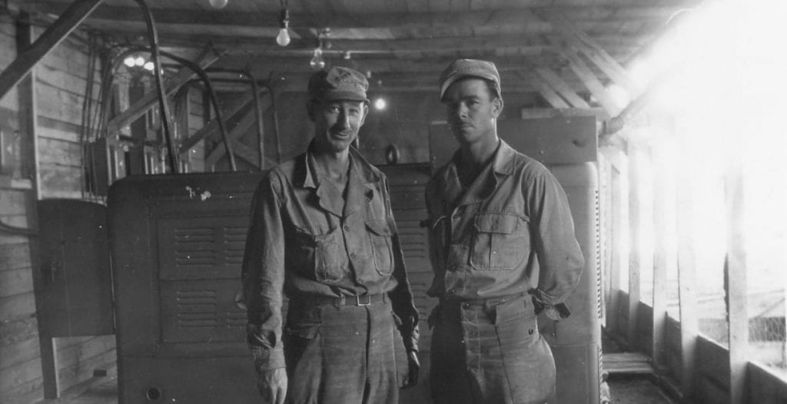
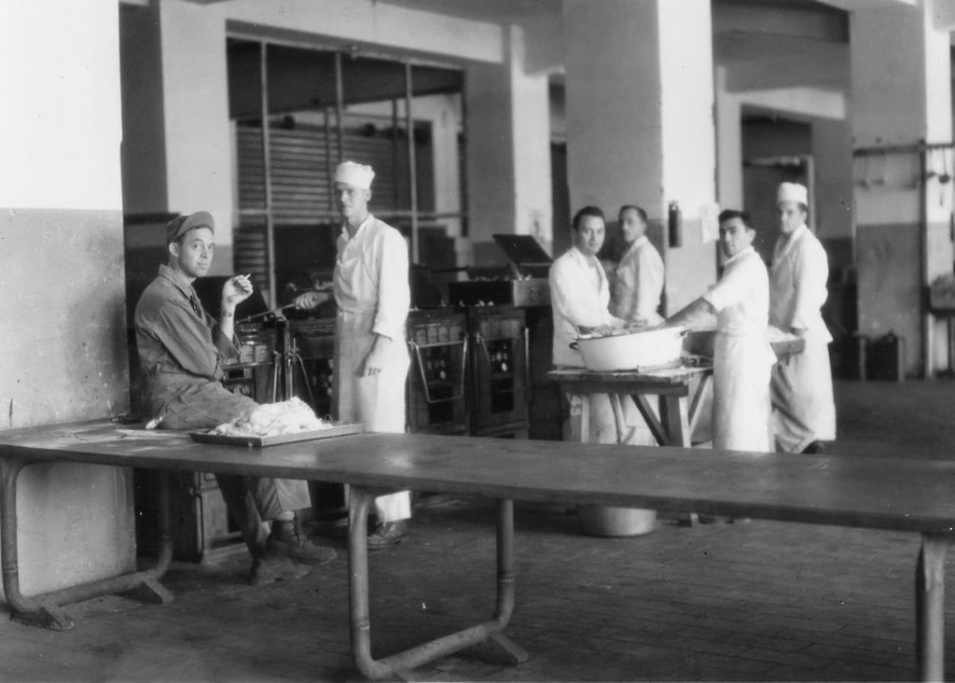
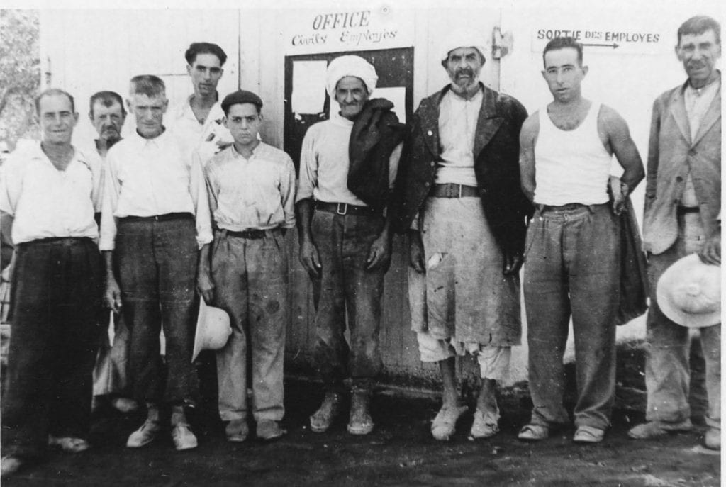
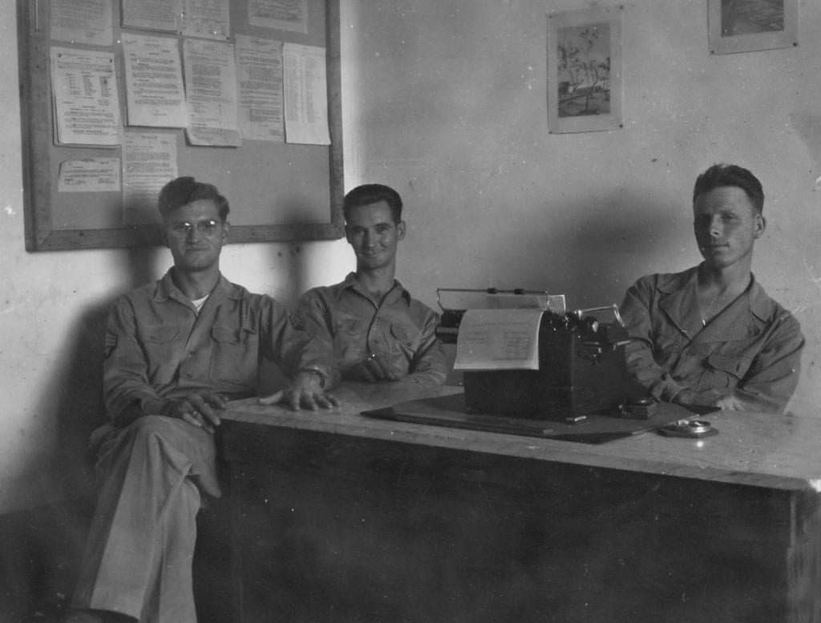
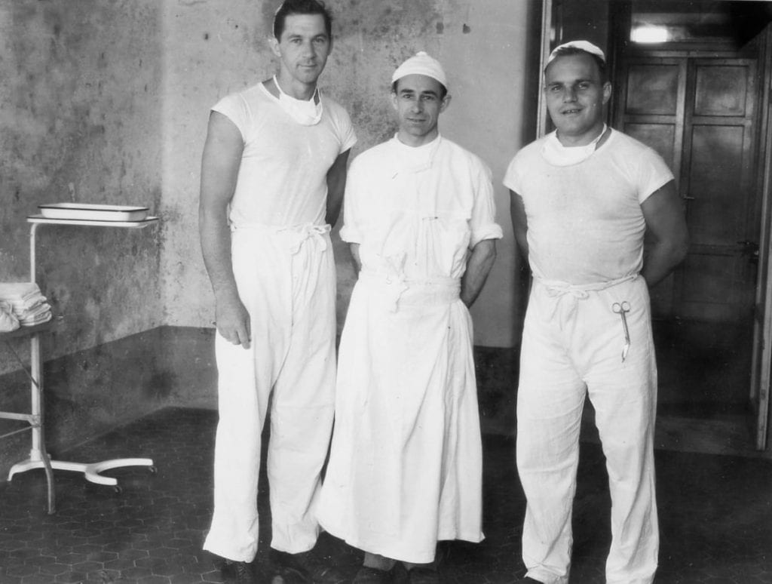
Medical Services & Support Staff
Notes:
Medical personnel continued to see up to 3000 patients at a time, some of whom were brought in from battles in France and Germany in the beginning of 1945, but the numbers gradually declined after the war ended on the Western Front on May 8. In July, they discharged the last patients and spent the remainder of the summer and early-fall accounting for equipment and furnishing reports. Some of the members had the fortune to return home earlier than others while others were deployed to the Pacific.

Slide 18
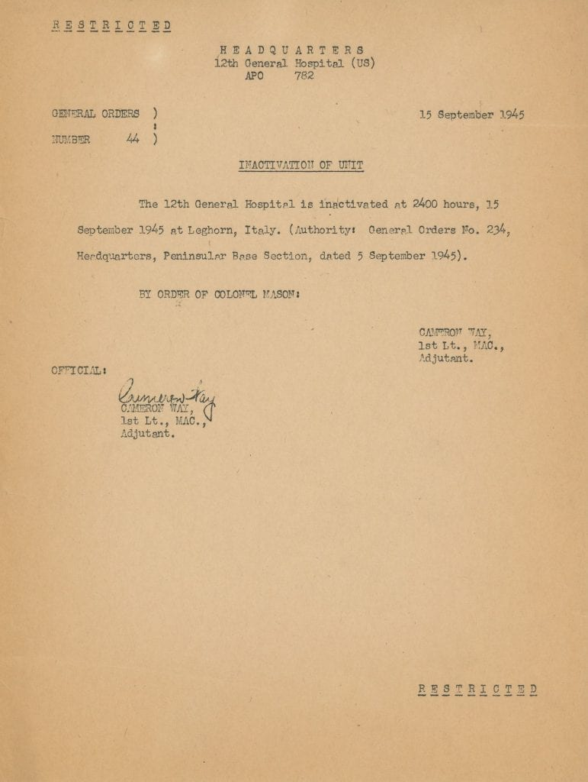
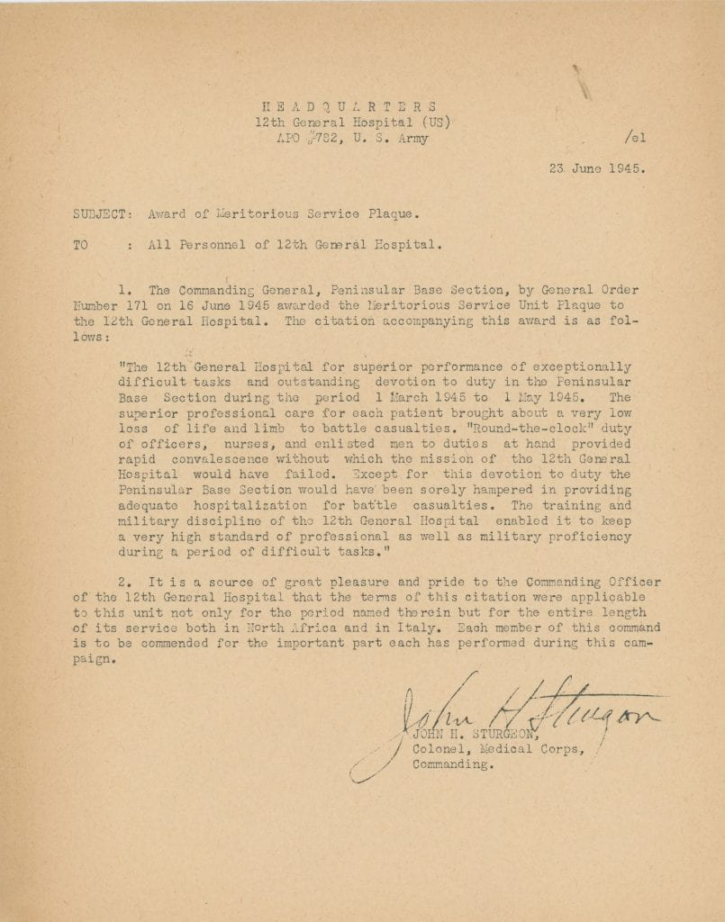
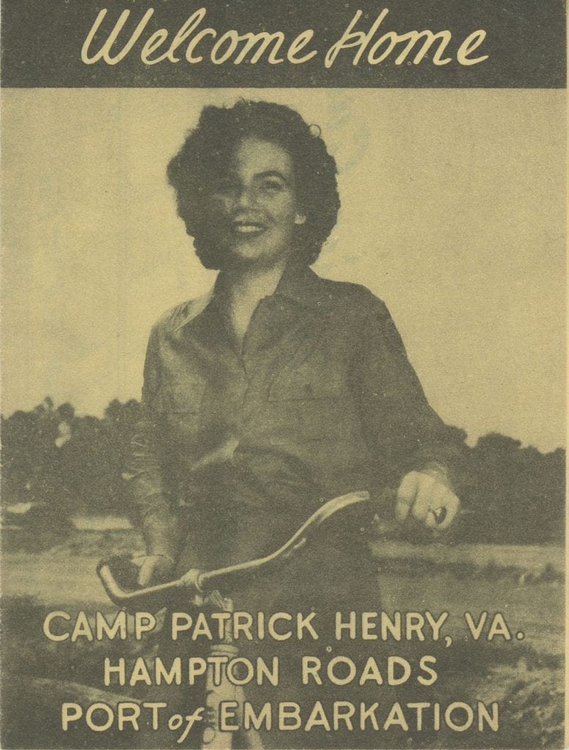
Conclusion of the War
Notes:
The 12th General Hospital Unit treated 29, 799 patients during their deployment in Ain-el-Turck, Rome, and Livorno and for their service received individual honors as well as the meritorious plaque.

Slide 19
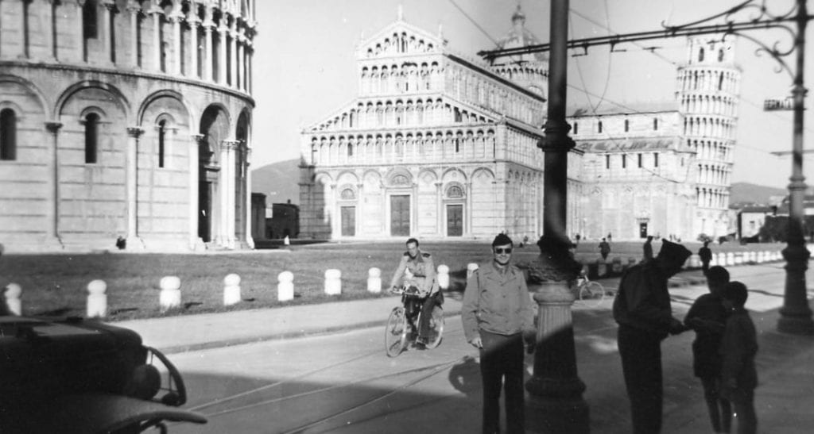
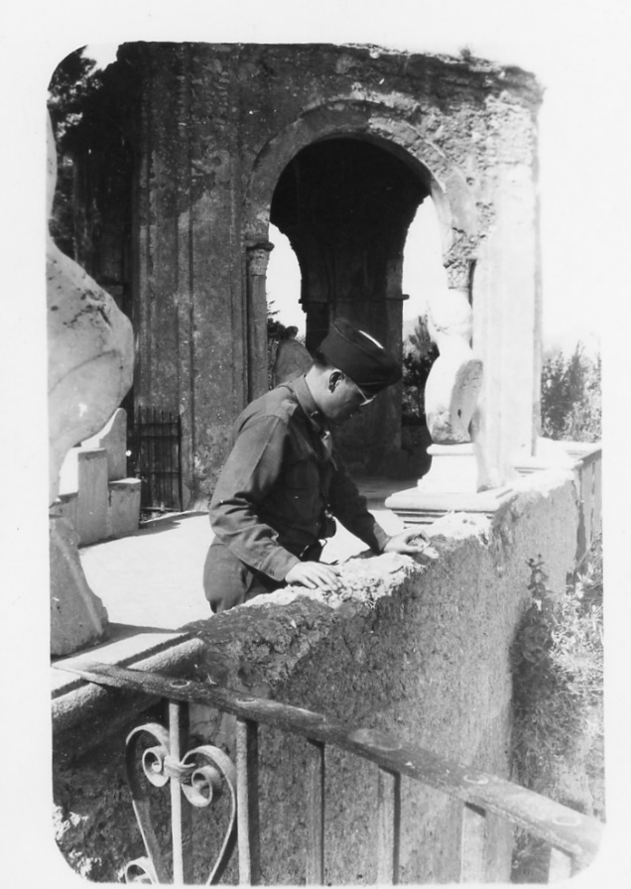


Impact
Notes:
These men and women who believed in their mission to serve their country made an impact on the lives of thousands, but the War also had a profound impact on them. They had the opportunity to witness cases they would have never encountered in civilian practice, meet colleagues from across the country, and explore the world. Jane H. Kramer, the daughter of Irvin Harris a dentist, shared how incredible it was for her father to hear in opera in Rome, have an audience with the pope, and experience the cultures of many places where he would have never had the chance to visit if not for his military service.

Slide 20

Back in the USA
Notes:
When those from Northwestern returned to Chicago, many went back to their practices and teaching appointments. Some of them encountered hardship when integrating into civilian life. They remained close over the next few decades going to formal and informal reunions and from speaking to the children of the veterans, perceived each other as extended family.

Slide 21



Highlighting Northwestern’s History
Processing
DigitalHub
Digitization
Notes:
Bringing the history of the 12th General Hospital to the forefront required processing the papers of Michael L. Mason and James A. Conner, digitalizing more than 1000 items, and uploading the majority of these images into DigitalHub, Northwestern’s digital repository with corresponding metadata.

Slide 22

Operation Saving Lives: Northwestern as the 12th General Hospital during WWII
Notes:
Wanting to showcase the story of the 12th General Hospital Unit in a more cohesive and dynamic fashion, my supervisor, Karen Gutzman and a former employee in user services, Brett Cimbalik created an online exhibit where we were able to incorporate interactive features like the timeline, maps, and visualizations, include media from other sources like family members and other repositories in the area that have related materials, and provide further information such as a roster and some of the memories of the family members.

Slide 23



Event
Notes:
On August 14 to celebrate the launch of the exhibit, Galter hosted Dr. Sanders Marble, senior historian for the United States Army Medical Department, who spoke about surgery during World War II. Members of the Special Collections Working Group, Karen Gutzman, and Mary Anne Zymnski also produced a traveling banner display that you may have seen, that is already slated to go places and an open-house following the presentation. The publicity the Library conducted for the event whether that be the emails to Chicago cultural institutions and veteran groups, social media posts, announcements on lists servs, phone calls, flyers, and even hand-written notes to the found family members of those who served in the 12th General Hospital Unit drew attention to the collection. Certainly the article in the Chicago Tribune and WBEZ segment brought awareness to the public. To date, these promotional efforts have a yielded use of the collection by family members and those who feel a connection to the topic. I have no doubt that this collection will continue to garner interest, and there is no shortage of innovative ways to share the stories of those in the 12th General Hospital Unit that are part of the history of Northwestern, Chicago, and the United States.

Slide 24

Questions

