Slide 1
Establishing and Aligning Expectations NUCATS Series on Developing and Enhancing Mentoring Relationships
Welcome! We will start on time at 9:00 AM.
Presenters: Kenzie A. Cameron, PhD, MPH
Mercedes Carnethon, PhD

Slide 2

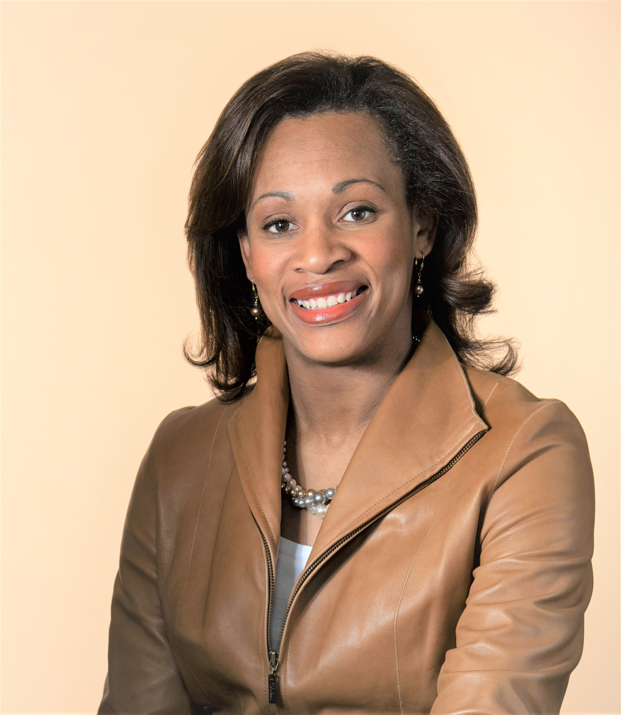
Today’s Facilitators
Mercedes Carnethon, PhD
Kenzie A. Cameron, PhD, MPH
carnethon@northwestern.edu
k-cameron@northwestern.edu
Co-Director, Center for Education and Career Development
Mary Harris Thompson Professor, Preventive Medicine (Epidemiology) and Medicine (Pulmonary and Critical Care)
Director, NUCATS Mentoring Programs
Research Professor, Medicine (General Internal Medicine and Geriatrics), Medical Education, Medical Social Sciences, and Preventive Medicine

Slide 3
Introductions
NUCATS Staff
Christine Charles
Emily Traw
Jaime Ziegler

Slide 4
Agenda
Introduction
Aligning Expectations
Tools for Aligning Expectations
Team-Based Mentoring
Mentoring in Crisis
Wrap up and Next Steps

Slide 5
2009 – 2013
National CTSA working Group Developed Mentoring Best Practices
2013 - 2015
Mentor Development Workshops Implemented at Northwestern, Department by Department
2015 - 2019
Mentor Development Workshops provided annually for new faculty/faculty wishing refresher
2021 – 2022
NUCATS Workshop Series
Mentor Training Certificate Program Launched
2020 – 2021
NUCATS Workshop Series on Developing and Enhancing Mentoring Relationships (monthly Sept – June)

Slide 6
Establishing and Aligning Expectations in Mentoring
Learning Objectives
By the conclusion of this workshop, attendees will:
Examine existing expectations in your current mentoring relationships; question which expectations need to be revisited or discussed.
Recognize and describe how one can apply a variety of tools to promote alignment in mentoring relationships.
Choose 1 – 2 behavior changes you can enact in the next 3 – 6 months to improve alignment in your mentoring relationships.

Slide 7
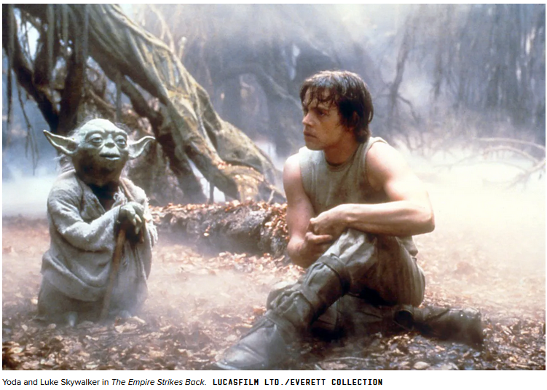
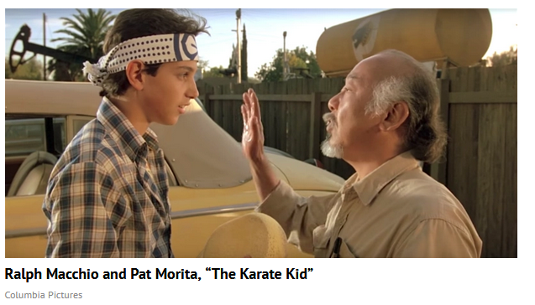
Mentor: “A wise and trusted counselor or teacher”

Slide 8
Mentor: “A wise and trusted counselor or teacher”

Slide 9
Mentor: “A wise and trusted counselor or teacher”

Slide 10
Mentoring for What?
EXCELLENCE FOR ALL
(which may look different for all)

Slide 11
“Effective Mentorship cannot exist without menteeship”
Chopra, Woods, Saint, BMJ, 2016

Slide 12
Agenda
Introduction
Aligning Expectations
Tools for Aligning Expectations
Team-Based Mentoring
Mentoring in Crisis
Wrap up and Next Steps

Slide 13
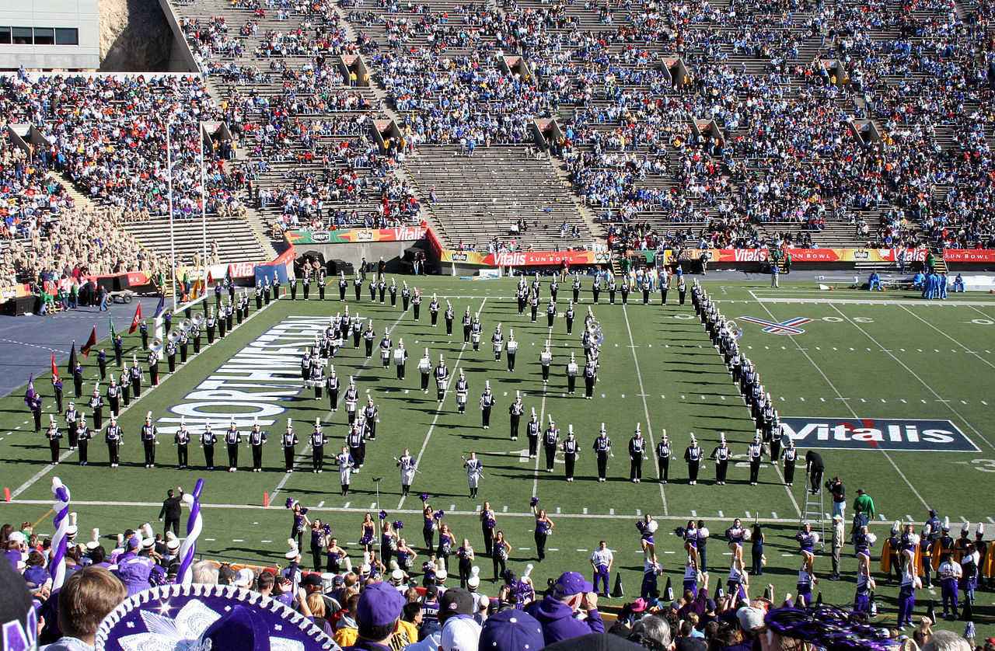
Aligning Expectations
Alignment: an agreement between people or groups who want to work together because of shared interests or aims
Expectation: the feeling or belief that something will or should happen

Slide 14
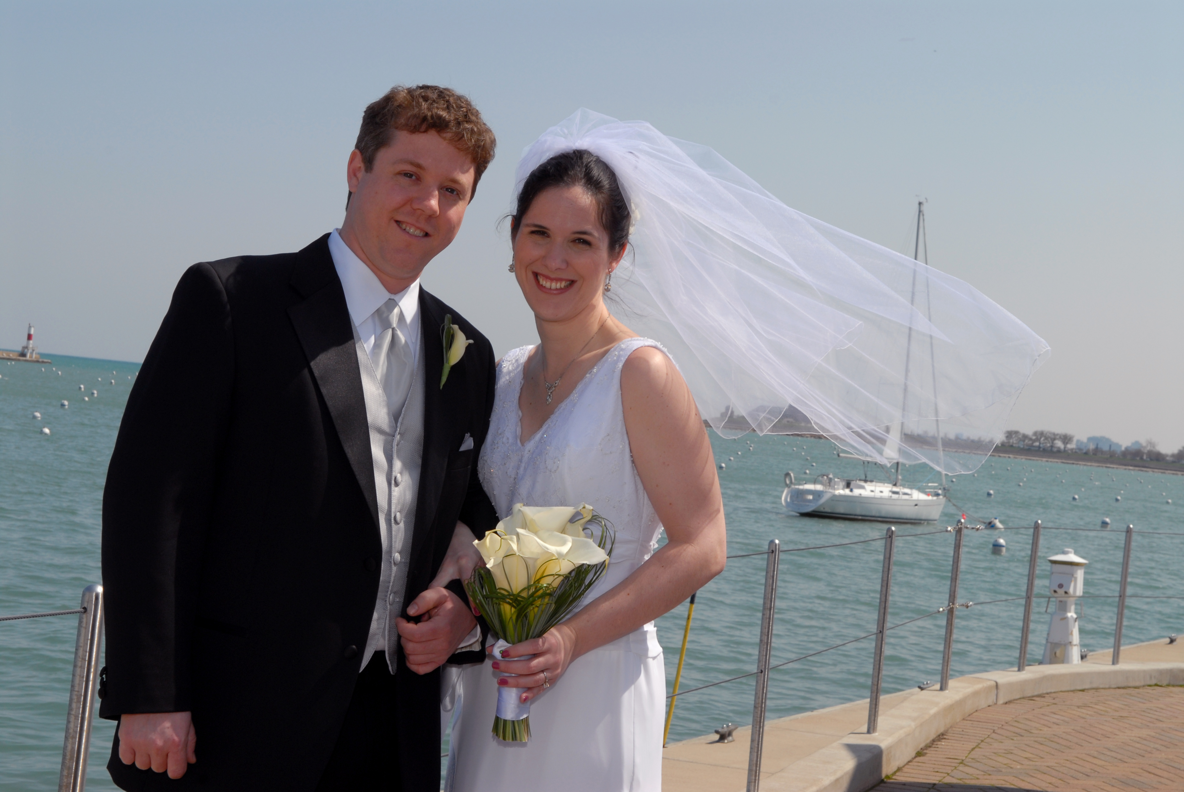
A Communication Scientist’s Wedding Vows
“And I love you because you know expectancy violation theory… and you use it!”
April 26, 2008

Slide 15
WHY Align Expectations?
Avoid miscommunication around roles and responsibilities
Avoid negative expectancy violations
Identify and achieve mutually beneficial goals
Assure that institutional and discipline-specific norms and standards are communicated
“So if you don’t have your expectations explicit up front, it makes it difficult to then go back and say, “Are you getting what you need?”
[Huskins et al. 2011, p. 441]
Abedin Z, et al. (2012). Clin Trans Sci.
Huskins WC et al. (2011). Clin Trans Sci.
Burgoon, Birk, Hall (1991). Human Comm Res

Slide 16
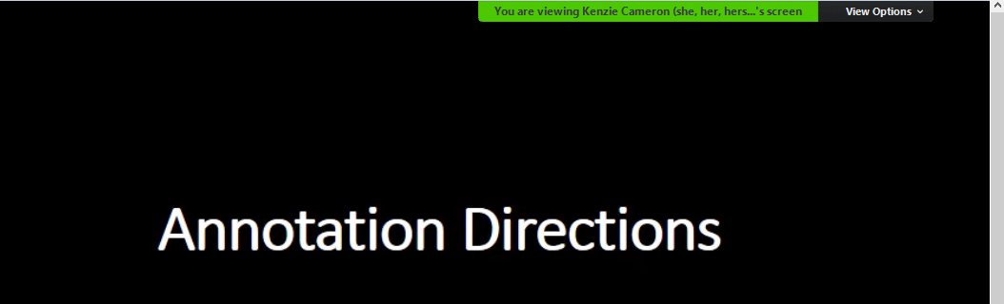
Annotation Directions
Click the arrow next to “View options”

Slide 17
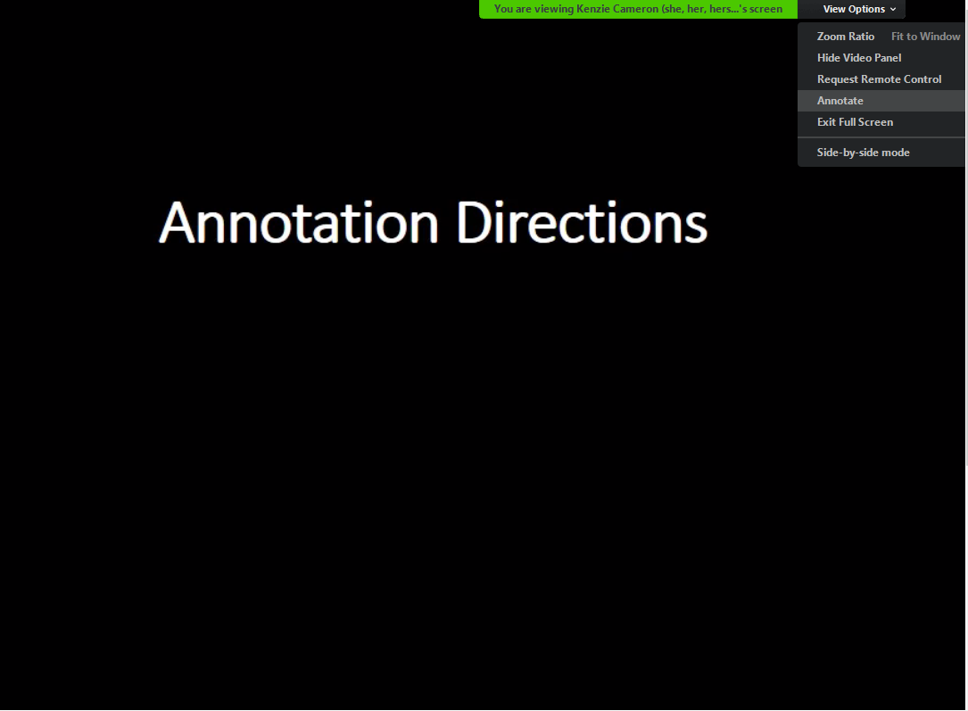
Click on “Annotate”
A bar will appear that allows for annotation
Use:
TEXT
(Format: if need to increase font)
STAMP
(Eraser if needed)

Slide 18
WHAT to align in mentoring?

Slide 19
Mentors and mentees share the responsibility to ensure expectations are identified and aligned*
*degree of responsibility varies over time and throughout your career

Slide 20
Candidates for Alignment
The mentoring relationship
Logistics to maximize the mentoring relationship
Input on career and professional development
Integrating work and life
Research execution
Educational roles
Clinical responsibilities
Service
As in all things, specifics and details matter

Slide 21
Logistics
Meeting duration/frequency
Preparation for meetings
Lead/response times for requests
Mentoring Relationships
Type (e.g., traditional mentor, coach, sponsor, connector)
Expected benefits
“Re-engage or Disengage” time
Career/Professional Development
Goals (Short, Medium, Long-Term)
Promotion/Tenure Recs, progress
Work-Life Integration
Education/Teaching
Curriculum development
Educational Scholarship
Research
Authorship
Research Independence
Clinical
Responsibilities
Challenges
Leadership opportunities
Service
Community/Extracurricular opportunities and involvement

Slide 22
BREAKOUT GROUPS – Misalignment (7 min)
Introduce yourself (BRIEFLY: Name, Division, Primary Role – e.g., research, teaching, clinical, administrative)
If possible, have group member share screen to project case study ( link available in chat)
Be prepared to share perspectives in larger group
What are the central challenges or themes raised in this case study?
What could have been done to avoid this situation?
Next steps:
a. What should the mentor do now?
b. What should the mentee do now?
Questions will be shared in the chat function

Slide 23
BREAKOUT GROUPS
The Second-Year Blues
What are the central challenges or themes raised in this case study?
What could have been done to avoid this situation?
Next steps:
a. What should the mentor do now?
b. What should the mentee do now?
Questions will be shared in the chat function

Slide 24
Agenda
Introduction
Aligning Expectations
Tools for Aligning Expectations
Team-Based Mentoring
Mentoring in Crisis
Wrap up and Next Steps

Slide 25
HOW to align expectations?
Explicitly state objectives of mentoring relationship
Include personal and career goals
Consider timeframes
Of mentoring relationship
Upcoming deadlines and their importance (e.g., conferences, application deadlines) – explicitly identify and don’t assume!
Be honest in your communication
what is asked and what is achievable (for both mentee and mentor)
Mutual accountability
Communicate regularly
Use agendas to streamline and focus meetings
Use alignment tools/checklists

Slide 26
Aligning Expectations: Tools
Career Advancement Plan
Feinberg Self-Evaluation on Interfolio
Meeting Agendas
“Laboratory” Expectations and Guidelines

Slide 27
Tools: Career Advancement Plan and Faculty Profile
Similar tools, but different level of detail on each
Encourage mentees to complete both
Asking mentees to complete some version of a career advancement plan provides a starting point for discussion
To the extent that goals entered in the CAP or Feinberg Faculty Profile are SMART, the mentor can use that information to guide priorities in the mentoring relationship
Can be used to guide forward progress for the mentee and for the mentor

Slide 28
Tools: Meeting Agendas
Allows both parties to prepare for meetings and focus on points that require discussion vs. notification of progress
Enhances meeting efficiency
Keeping a record of the agendas can allow for tracking on progress
Is there an agenda item that never resolves?
When distributed in advance can allow both parties to insert their priority items

Slide 29
Tools: Lab Expectations
Example provided in supplemental materials
Rationale for writing up “team” or “laboratory” expectations is to offer insights about how the group functions
Allows both parties the opportunity to agree upon expectations or adapt as needed
Presenting at the outset avoids a default which is to react and set guidelines when problems arise
Serves as an dual accountability tool

Slide 30
Agenda
Introduction
Aligning Expectations
Tools for Aligning Expectations
Team-Based Mentoring
Mentoring in Crisis
Wrap up and Next Steps

Slide 31

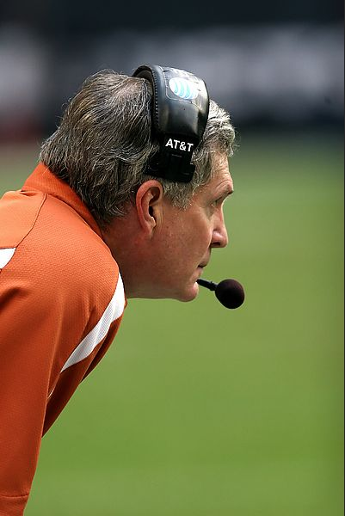

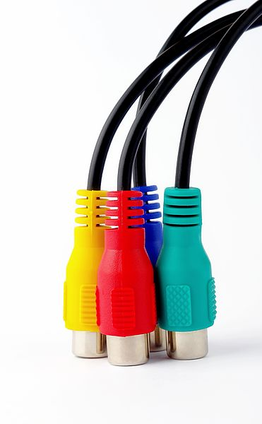
Alignment with Multiple Mentors
Traditional Mentor
Formal, Career-focused
Long-term
Reciprocal
Coach
Issue-focused
Short-term
Sponsor
Influential
Visibility-focused
Connector
Link mentees with others
Create networks
Focused on their field
Chopra V, Arora VM, Saint S. Will You Be My Mentor?—Four Archetypes to Help Mentees Succeed in Academic Medicine. JAMA Intern Med. 2018;178(2):175–176. doi:10.1001/jamainternmed.2017.6537

Slide 32
Alignment among a Mentoring TEAM
Move away from “guru mentor” to team mentoring
Mentoring for career advancement and career and life goals
Experts in:
Content (scientific, clinical, educational) – may be primary mentor
Methods
Career path you wish to emulate
Personal and Professional Roles
Alignment needed with each mentor – and across mentors as well

Slide 33
GROUP DISCUSSION
Alignment in Multidisciplinary Mentoring Teams
What challenges are faced when working with multiple mentors?
How could you AS A MENTOR preemptively address identified challenges?

Slide 34
Agenda
Introduction
Aligning Expectations
Tools for Aligning Expectations
Team-Based Mentoring
Mentoring in Crisis
Wrap up and Next Steps

Slide 35
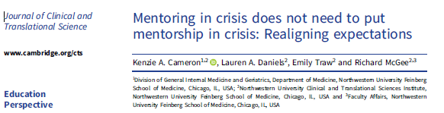
Mentoring in Crisis
Recognize the World in Crisis
Acknowledge Grief and Practice Compassion
Validate Shifting Professional and Personal Roles and Responsibilities
Realign Mentorship Expectations
Cameron, Daniels, Traw, McGee, 2020

Slide 36
Realign Mentorship Expectations
Mentoring in Crisis | Strategies
Acknowledge the importance of and need for reassessing goals | Identify safe spaces Practice mindful listening
Make time and space to engage in conversations with your mentees
Start the conversation with your mentee, then listen carefully
Be open and honest with your mentee | Engage in open conversation Share information
Be aware of the cultural differences and similarities between yourself and your mentees | Acknowledge diversity of person, position and life experiences

Slide 37
Realigning Expectations
Discuss and be willing to revise expectations as needed
Discuss potential options if expectations are not met before it becomes an issue
Understand idea of expectancy violations (positive and negative)
Recognize that as a mentee – role is “to learn, not be perfect” (Vaughn, Saint, Chopra, 2017, JAMA)
Reframe mistakes as improvement opportunities, not failures
Address missteps directly and with candor
Recognize such discussions can be learning opportunities for mentee and mentor

Slide 38
Agenda
Introduction
Aligning Expectations
Tools for Aligning Expectations
Team-Based Mentoring
Mentoring in Crisis
Wrap up and Next Steps

Slide 39
Aligning Mentor and Mentee Expectations: Best Practices
Mentoring Relationships should:
Set ground rules (expectations)
Develop reasonable/realistic goals
Be led by mentee’s initiative (mentor should not be expected to be one to keep relationship going)
Be mutually beneficial
Be a partnership
Meet mentors’ and mentee’s expectations for a productive relationship
Be inclusive and safe
Prioritize honest and open communication (key to mutual satisfaction)
Be respectful of time
View alignment as a continuing process
Acknowledgements: Passman R. How to be an effective and productive research mentor to students, trainees, and junior faculty, NU DOM Faculty Workshop, December 7, 2020 and Goodman A. Articulating your mentoring philosophy and plan. NUCATS Series on Developing and Enhancing Mentoring Relationships, June 3, 2021.

Slide 40
Remember…
Everyone enters interactions with expectations (conscious or unconscious)
Examine and reflect on your own expectations
Aligning expectations early (and often) may prevent negative interactions
Alignment is a joint process (team process if team of mentors)
Alignment is not a one-time, static event – Realign, recognize changing contexts
Upcoming Sessions – choose which will best fit your needs
November 11, 2021: Work-Life Integration

Slide 41
What is your own Take Away?
What aspect of how you have approached aligning your mentoring relationship(s) do you plan to change moving forward?
i.e., what individual behavior change(s) could you enact to improve alignment in your mentoring relationships?
Share in chat if willing
What is the time frame in which you intend to make that change?

Slide 42
ZOOM POLL

Slide 43
NUCATS Series on Developing and Enhancing Mentoring Relationships: Upcoming
Scheduled for 9:00 – 10:30 AM on 2nd Thursdays of the month via Zoom (except April)
10/14/2021 | Establishing and Aligning Expectations in Mentoring
11/11/2021 | Work-Life Integration
01/13/2022 | Goal Planning at Different Stages of One’s Career*
02/10/2022 | Cultural Awareness in Mentoring across Differences
03/10/2022 | Dealing with Mentoring Challenges*
04/07/2022 | Fostering Independence/Transitioning your Mentee to Independence*
05/12/2022 | Maintaining Effective Communication/Difficult Conversations
06/09/2022 | Articulating Your Mentoring Philosophy and Plan
*Sessions may change month based on speaker availability

Slide 44
Mentor Training Certificate Program
Train faculty in becoming effective clinical and translational research mentors
Participants: Faculty with appointments in NUFSM. (Faculty in other schools may participate if they are engaged in biomedical research)
Request indication of intent to enroll in program: this short form
Requirements:
Required Workshops (4.5 hours) | Elective Workshops (4.5 hours)
Establishing and Aligning Expectations Cultural Awareness to Enhance Mentoring Across Differences Articulating your Mentoring Philosophy and Plan | Any other workshops in NUCATS series, starting in 2020
Complete Baseline survey, evaluations for every session, annual NUCATS mentoring Survey Requirements to be completed within three years May receive “retroactive credit” if participated previously

Slide 45
Thank You for Attending
Please Complete Brief Evaluation via REDCap (will be emailed to you)
Required if pursuing Certificate
Questions:
Kenzie A. Cameron k-cameron@northwestern.edu
Mercedes Carnethon carnethon@northwestern.edu
Resources and Opportunities on Website:
https://www.nucats.northwestern.edu/education-and-career-development/investigator-development/developing-mentoring-relationships.html

Slide 46
Questions?

