Slide 1
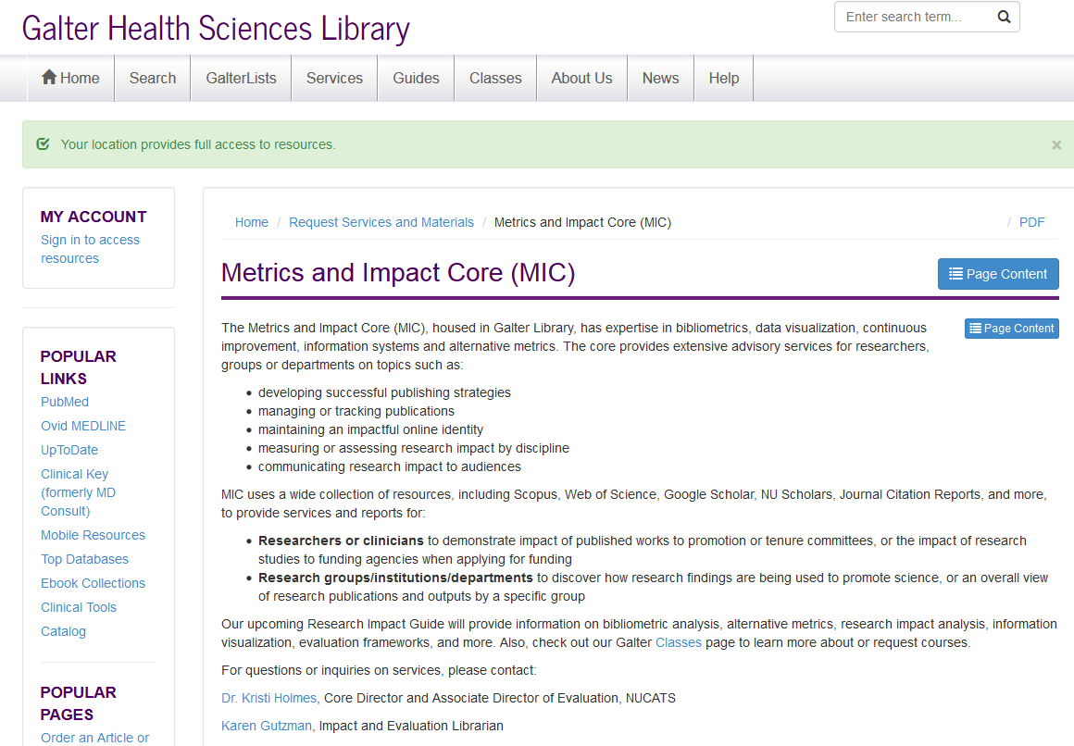
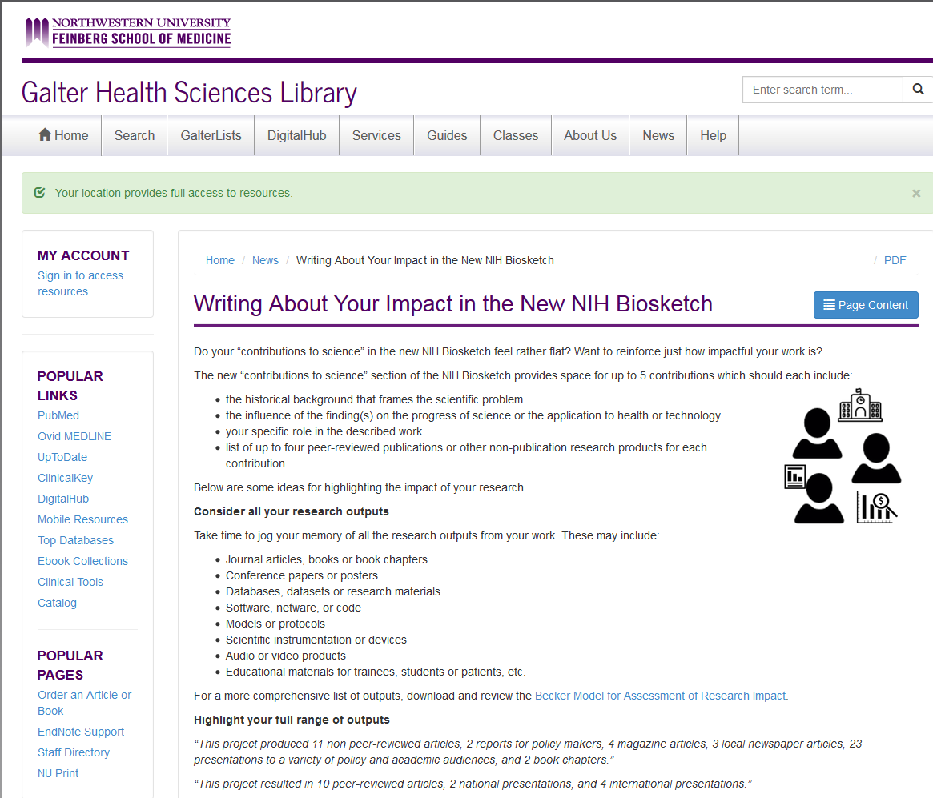
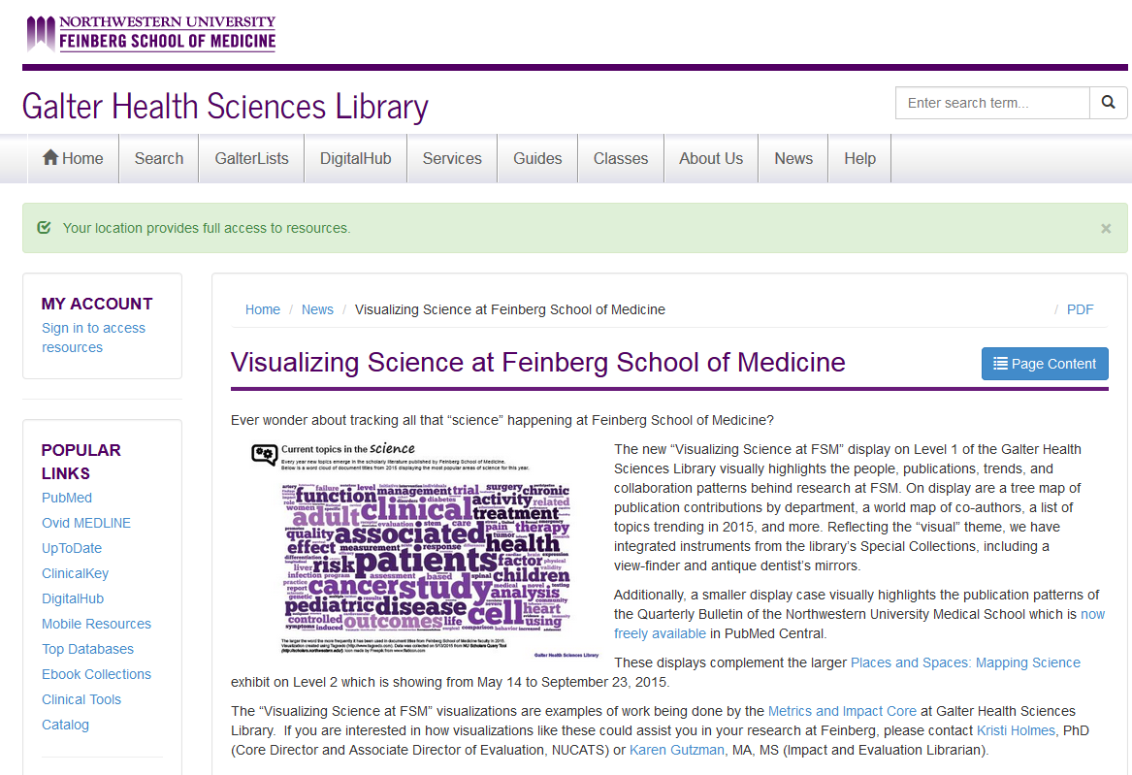
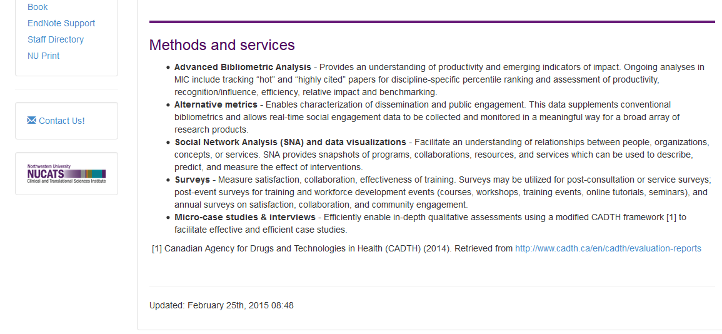
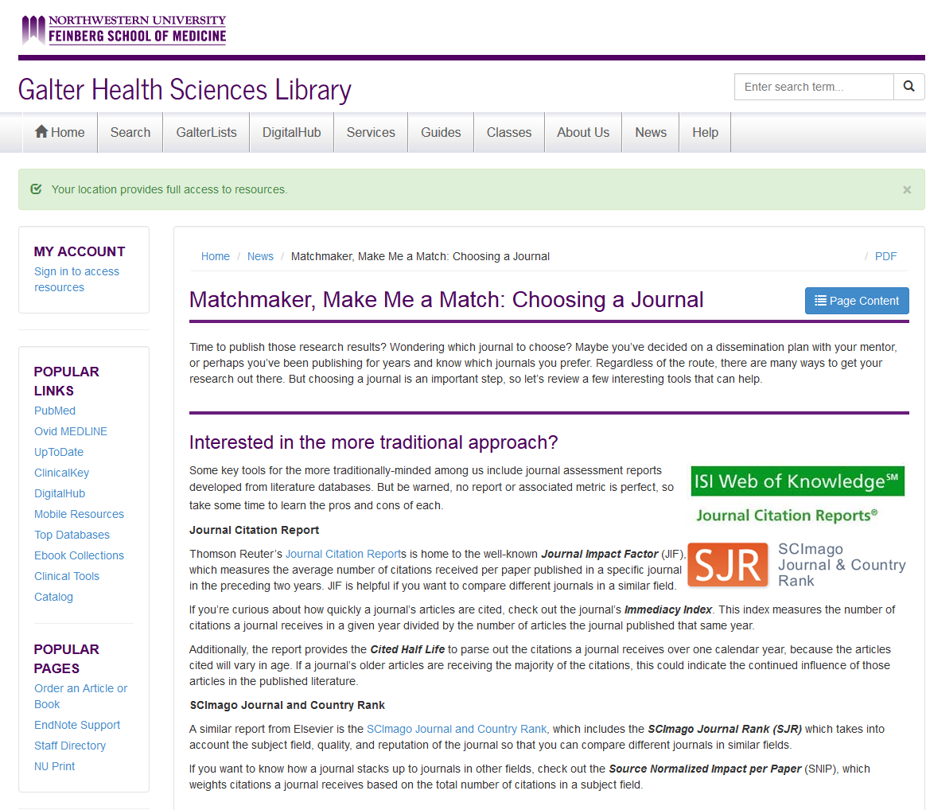






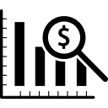


A library evolving: providing research impact and evaluation services
Karen E. Gutzman, MA MS; Kristi L. Holmes, PhD
Galter Health Sciences Library, Feinberg School of Medicine, Northwestern University
Metrics and Impact Core
Service examples
Background
Research Impact Visualizations in Cardiovascular Disease Epidemiology
Created visualizations using Sci2 tool, Adobe Illustrator, Tagxedo, and more
Deliverables included: Microsoft PowerPoint presentation, two large research posters and descriptive text for each visualization
Research Impact of Patient Simulation in Medical Education
Created patient simulation search strategy for PubMed, Scopus, and Web of Science
Created visualizations using Sci2 tool, Gephi and VosViewer
National Institutes of Health (NIH) Biographical Sketch
Created presentation on “New NIH Biosketch”
Partnered with Altmetric.com for webinar
Deliverables included: one large research poster, descriptive text for each visualization, dynamic social network graph
Delivered one-on-one consultations and reviews of biosketches, departmental presentations, and library classes
Research Impact of Distinguished Alumni
Created visualizations using Sci2 tool, Adobe Illustrator, Tagxedo, and more
Deliverables included: Microsoft PowerPoint presentation and descriptive text for each visualization
National Institutes of Health (NIH) Grant Applications
Assisted research groups in completing tables related to publications in grant applications
Delivered tables for U01 CTSA Program Grants, TL1 Training Program Grants, KL2 Career Development Grants, P30 Center Core Grants, X02 Collaborative Grants, and more
Library Exhibit on Research Impact of School of Medicine
Created visualizations using Sci2 tool, Sankeymatic, Adobe Illustrator, Tableau, and more
Deliverables included: six visualizations in large format for exhibit space and descriptive text for each visualization
Research Impact of Coronary Artery Risk Development in Young Adults Study
Researched the impact of a research study over time using various data sources
Deliverables included: research impact report with several visualizations, search strategies in various data sources, table of journal impact factors, hot and highly cited publication lists, and more
Researcher Publication Summaries
Created a report template for providing researchers with an overview of their research outputs
Delivered 10+ reports on request to researchers working on grant applications
Developed one-on-one consultation format on “increasing research dissemination and enhancing research impact”
Compiled and analyzed results, and created an Endnote library of publications
Researched the impact of a distinguished professor in cardiovascular disease epidemiology using several data sources including PubMed, Scopus, Web of Science, NIH RePORTER, and more
Researched the impact of several distinguished alumni using data sources including PubMed, Scopus, Web of Science, NIH RePORTER, and more
In early 2014, Northwestern University’s Galter Library began implementing a cohesive set of services around research evaluation and impact assessment, formally structured in the library as the Metrics and Impact Core (MIC).
Many of the MIC services utilize the library’s expertise in bibliographic data, which can be mined, analyzed, and visualized using a variety of techniques to gain a better understanding research impact.
Metrics and Impact Core webpage and news items
Tools and data sources:
http://galter.northwestern.edu/Request-Services-and-Materials/metrics-and-impact-core-mic
Who we serve:
Bibliographic databases:
Scopus (Elsevier)
NU Scholars (Elsevier)
PubMed (NLM)
Web of Science (Thomson Reuters)
Google Scholar
Other databases:
Scholarly Database
NIH RePORTER
Essential Science Indicators (Thomson Reuters)
Altmetric.com
Individuals
Promotion and tenure
Annual review
Tracking research outputs
New NIH Biosketch format
Research Groups, Departments, Institutes, Centers or Programs
Future Directions
Develop presentations on:
Bibliometric Training for Researchers
Enhancing Your Research Impact
Hot or Not? Making the case for your research
Further develop online resources on:
Managing your online presence
Creating a research dissemination plan
Emphasizing collaboration and team science activities
Symplectic Elements implementation
Advancement of science
Advocating for funding
Planning for infrastructure
Highlight expertise of members
Rankings or comparisons
Frameworks and Resources
Becker Model for Assessing the Impact of Research
Academic Careers Understood through Measurement and Norms
(ACUMEN) Project
Canadian Academy of Health Sciences (CAHS) Framework
Research Excellence Framework (REF) Impact Case Studies
http://www.cahs-acss.ca/wp-content/
uploads/2011/09/ROI_FullReport.pdf
Icons by Freepik.
http://impact.ref.ac.uk/CaseStudies/
What can your library do for you?
https://becker.wustl.edu/
impact-assessment
http://research-acumen.eu/

