Slide 1
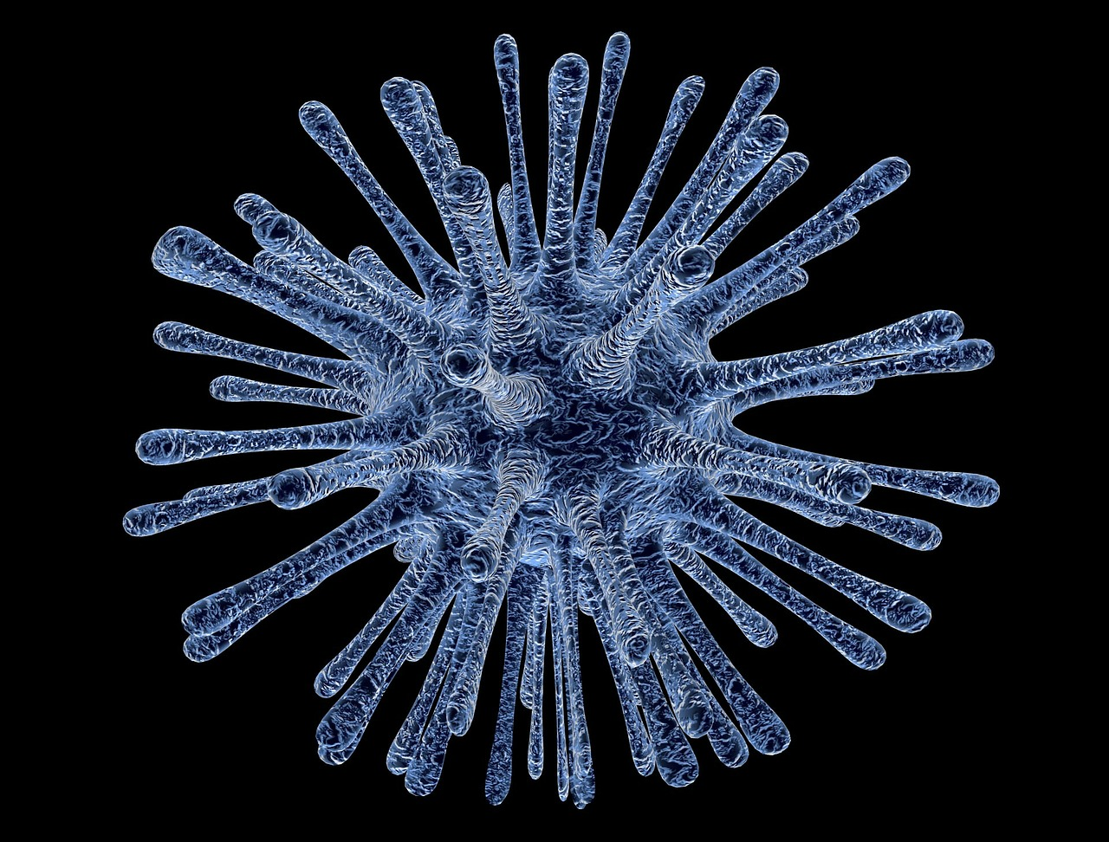



DigitalHub: Preserving and Sharing Your Work Using NM's Repository
Violeta Ilik
Galter Health Sciences Library

Slide 2
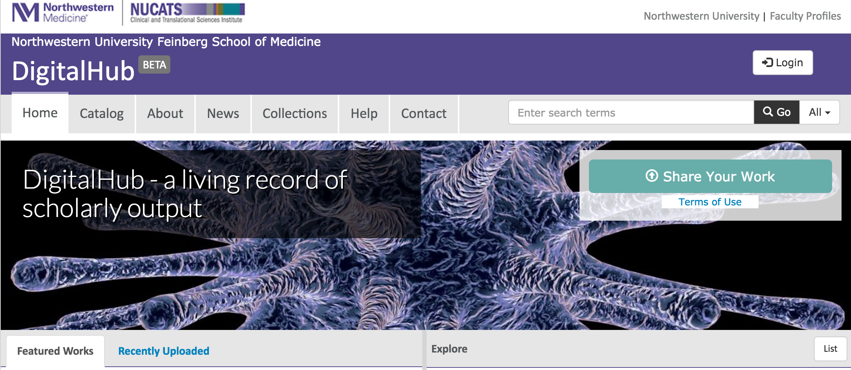
DigitalHub – a living record of scholarly output
We want to optimize discoverability and dissemination of content and enhance the impact of FSM, NUCATS, and our Northwestern Medicine community.
Notes:
Our repository runs Fedora 4.2 and is front-ended by heavily customized version of Sufia 6.0. We have integrated the authentication with LDAP and groups used for authorization are also sourced from LDAP. Furthermore, certain metadata fields such as ‘Creator’ only allow entries that are verifiable in LDAP to consistently identify individuals. We have added additional verification against the NU VIVO instance run by the fine people at Center for Data Science and Informatics who’s leader is Justin Starren one of this year invited speakers at the VIVO conference.

Slide 3
DigitalHub – Vision Statement
DigitalHub facilitates the discovery and recognition of research and scholarship at Northwestern Medicine by bringing together, in one place, open access to research, both traditional and non-traditional, and information on scholarly activities across all disciplines. Populated with institutional and public data sources, DigitalHub represents a living record of scholarly output.
Notes:
Our repository runs Fedora 4.2 and is front-ended by heavily customized version of Sufia 6.0. We have integrated the authentication with LDAP and groups used for authorization are also sourced from LDAP. Furthermore, certain metadata fields such as ‘Creator’ only allow entries that are verifiable in LDAP to consistently identify individuals. We have added additional verification against the NU VIVO instance run by the fine people at Center for Data Science and Informatics who’s leader is Justin Starren one of this year invited speakers at the VIVO conference.

Slide 4
Objectives
At the completion of this class, the participant will:
Know the basic principles of an institutional repository such as DigitalHub
Know what types of scholarly output can be included in the repository
Know the rights to deposit previously published work in the DigitalHub
Understand the principles and advantages of making deposits publicly accessible
Know how to upload scholarly output into DigitalHub
Know how to create a collection in DigitalHub
Learn about ways to describe deposits in DigitalHub

Slide 5
Why do you want to use DigitalHub
easily share your research
deposit your non-traditional scholarly outputs
track views and downloads of your research
make your research more discoverable to the global research community

Slide 6
What is DigitalHub?
DigitalHub, developed by Galter Health Sciences Library, is a place to deposit your research outputs and make them publicly available. This institutional repository will provide open access to the scholarly outputs of Northwestern Medicine and stable, long-term preservation and ongoing maintenance for content contained within the repository.

Slide 7
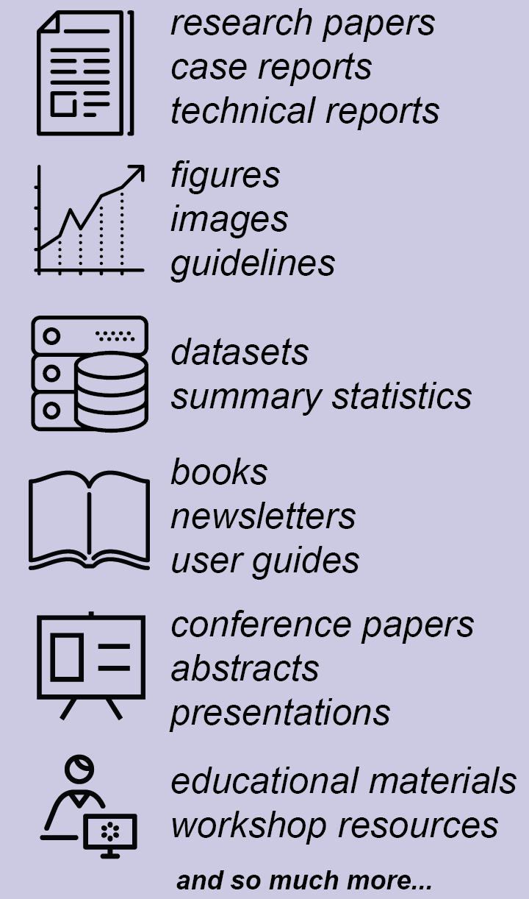
What can I deposit in DigitalHub?
Research papers:
  published or unpublished
Case reports, technical reports
Supplemental images
Datasets
Open access books
Conference papers
White papers
Presentations and lectures
Educational materials
Posters
Images
…and more!
Notes:
The repository provides stable, long-term storage and ongoing maintenance for content contained within the repository. Examples of items that the repository can accommodate at this time include:

Slide 8
What are the guidelines for submitting content in DigitalHub?
You must be affiliated with Northwestern Medicine.
You must have the rights to let Galter Library distribute it.
The content must be scholarly, educational, or related to the university's mission.
The content must be permanent. DigitalHub is intended to be an archive, not a storehouse for works in progress.
The content must be in a digital format.

Slide 9
Do I retain copyright over archived content?
Yes, copyright owners retain copyright over their materials. By putting material into DigitalHub, you are granting Galter Library a non-exclusive license to distribute it, which means that you are authorizing Galter Library to make it available but can also distribute it through other mechanisms.
See the non-exclusive distribution license for more information.
Notes:
It is preferred but not required that materials be made available with a Creative Commons license. Many researchers and educational institutions are adopting Creative Commons licenses to provide wider access to their work. There are few different types of CC licenses that you can choose from and you also have an option to mark your item with the “All rights reserved” license. Through the Creative Commons attribution license, the copyright owner retains copyright, but the materials are open to others for use and make modifications as long as attribution to the original is made.

Slide 10
Non-Exclusive Distribution License
By agreeing to this license, you grant to Galter Library the non-exclusive right to copy, display, reproduce (in the same or different formats), and distribute your submission worldwide in any medium, including but not limited to audio or video.
You agree that:
Galter Library may, without changing the content, convert the submission to any medium or format for the purpose of preservation.
Galter Library may keep more than one copy of the submission for purposes of security, back-up, and preservation.
Northwestern University bears no responsibility for the contents of your submission.
You warrant that all of the following are true:
The submission does not, to the best of your knowledge, infringe upon anyone's copyright.
Any third-party owned material included in the submission is clearly identified and acknowledged as such.
Any obligation required by a contract or agreement with a sponsoring or supporting person or agency has been fulfilled.
The submission has no right which has been sold, mortgaged, or otherwise disposed of, and all rights are free from exclusive claims.
The submission contains no libelous or other unlawful content, nor does it invade the privacy of any person or third party.
And you warrant that one of the following is true:
The submission is your original work and you have the right to grant the rights contained in this license.
You are one of the copyright owners of the submission and have permission from other owners to submit the item.
Another party is the copyright owner and you have permission to submit the item.
The submission is in the public domain or otherwise not subject to copyright restrictions.
Galter Library will clearly identify your name(s) as the author(s) or owner(s) of the submission, and will make no alteration, other than as allowed by this license, to your submission.
Notes:
In order for this repository to reproduce and distribute your work, a distribution license must accompany each submission. No copyright transfer is involved. As a final step in the submission process, please read the license text below, select ‘I Grant the License,’ and click ‘Complete Submission.’

Slide 11
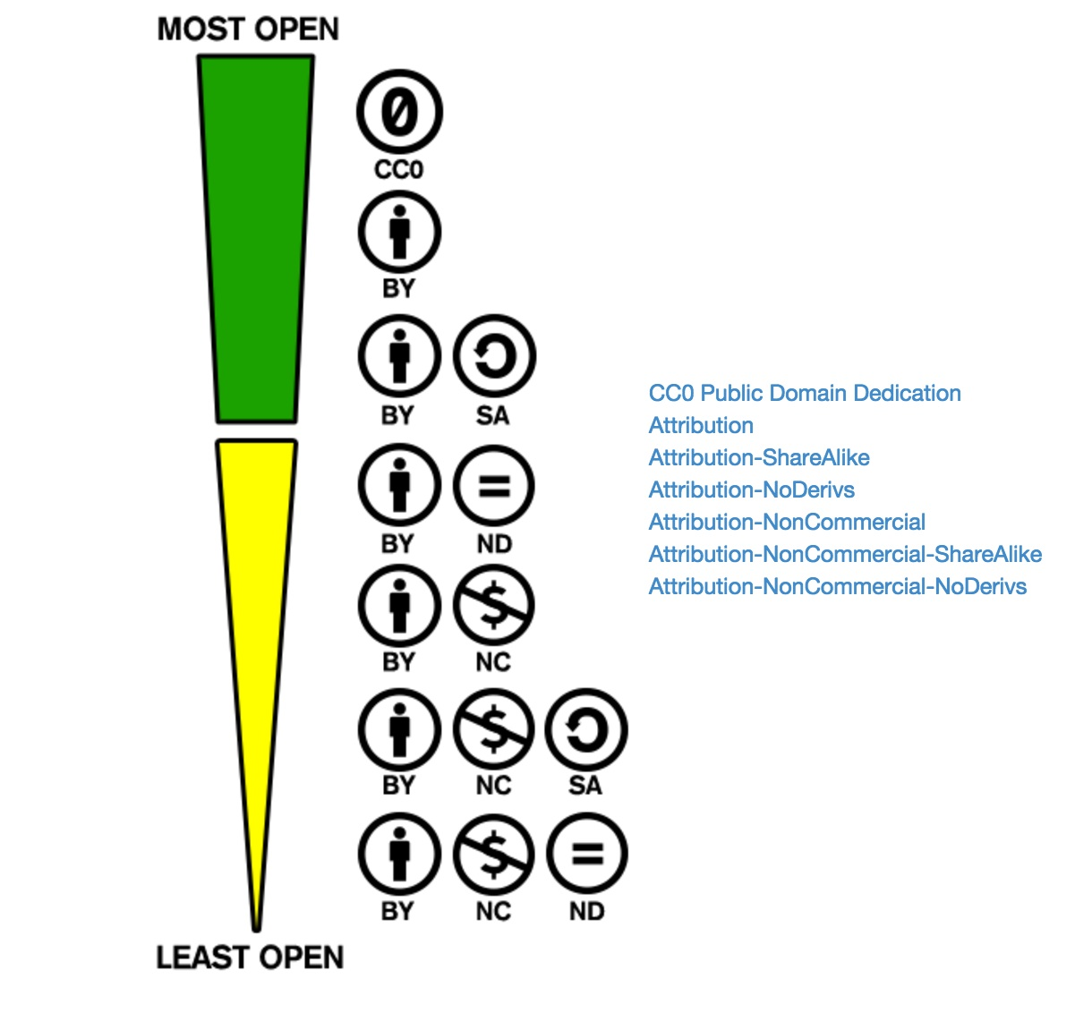
Creative Commons License
Chose your best option!
Visit:
http://creativecommons.org/examples#by

Slide 12
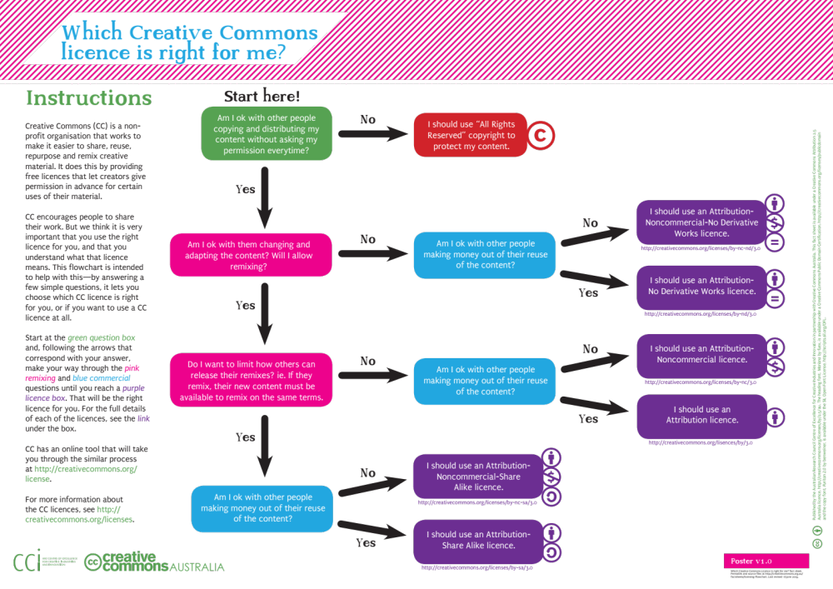
Creative Commons License
Courtsey of CC Australia

Slide 13
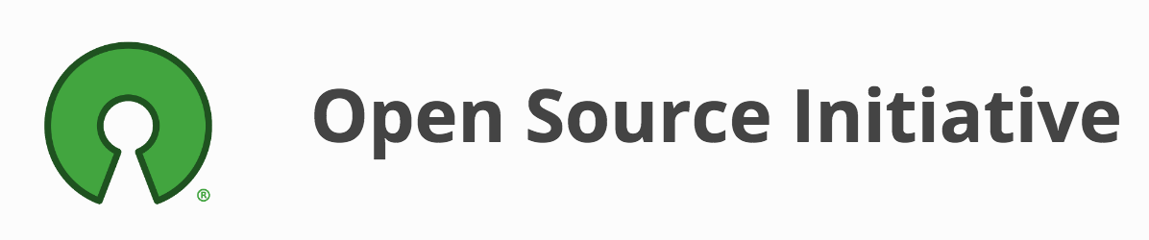
The MIT License (MIT)
Permission is hereby granted, free of charge, to any person obtaining a copy of this software and associated documentation files (the "Software"), to deal in the Software without restriction, including without limitation the rights to use, copy, modify, merge, publish, distribute, sublicense, and/or sell copies of the Software, and to permit persons to whom the Software is furnished to do so, subject to the following conditions:
  The above copyright notice and this permission notice shall be included in all copies or substantial portions of the Software.

Slide 14
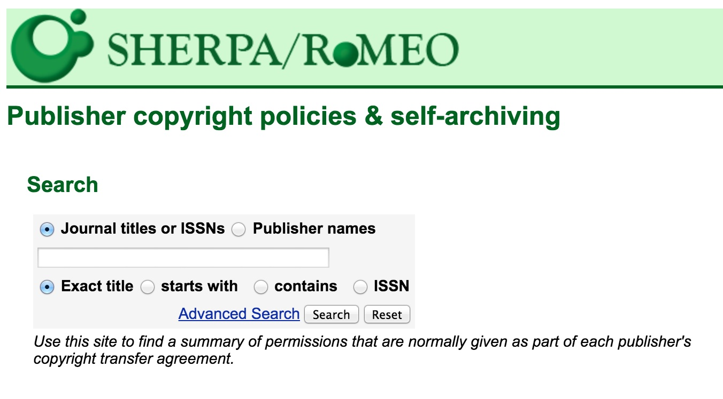
Checking publisher copyright policies & self-archiving
First stop: SHERPA/RoMEO http://www.sherpa.ac.uk/romeo/
Not sure? Contact your publisher

Slide 15
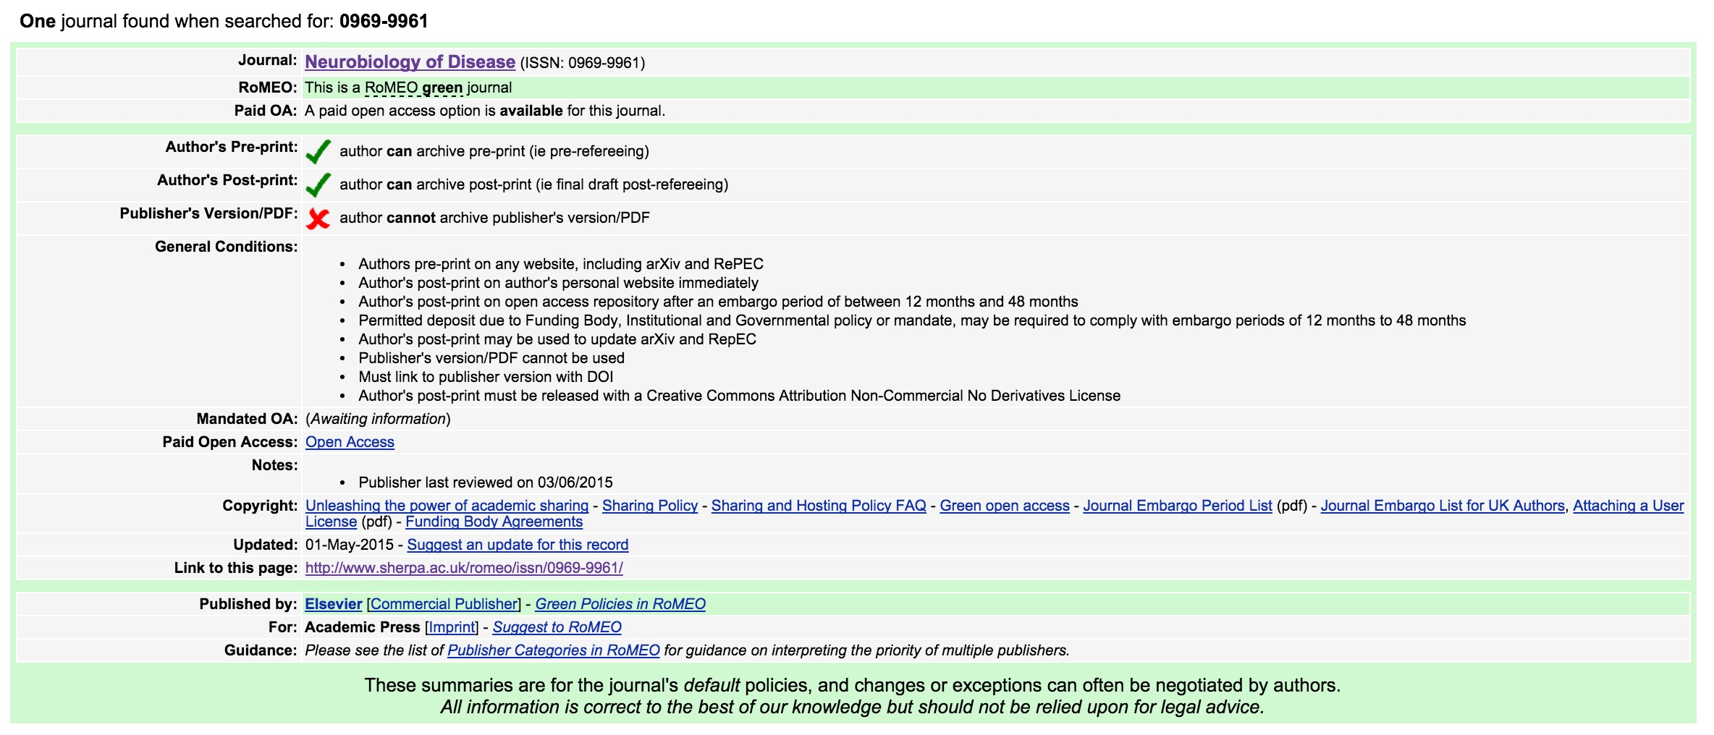
Using SHERPA/RoMEO
Example of a Journal that doesn’t allow archiving of the final published version

Slide 16
How to submit your work?
7 easy steps
Login to your account on DigitalHub
Select the “Upload” button
Read the deposit agreement and mark the checkbox if you agree to the terms. If you do, then continue …
Select a file you want to deposit and upload it.
Apply metadata (5 required fields)
Set permissions and visibility
Save your work in DigitalHub!

Slide 17

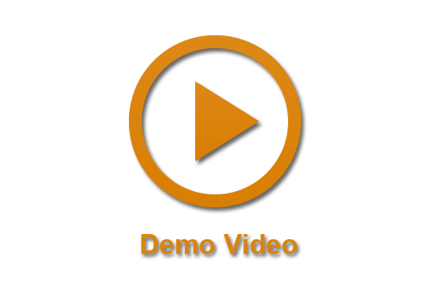
Submitting your work
User guide:
https://goo.gl/642uyx
Demo video:
https://goo.gl/9g89v1

Slide 18
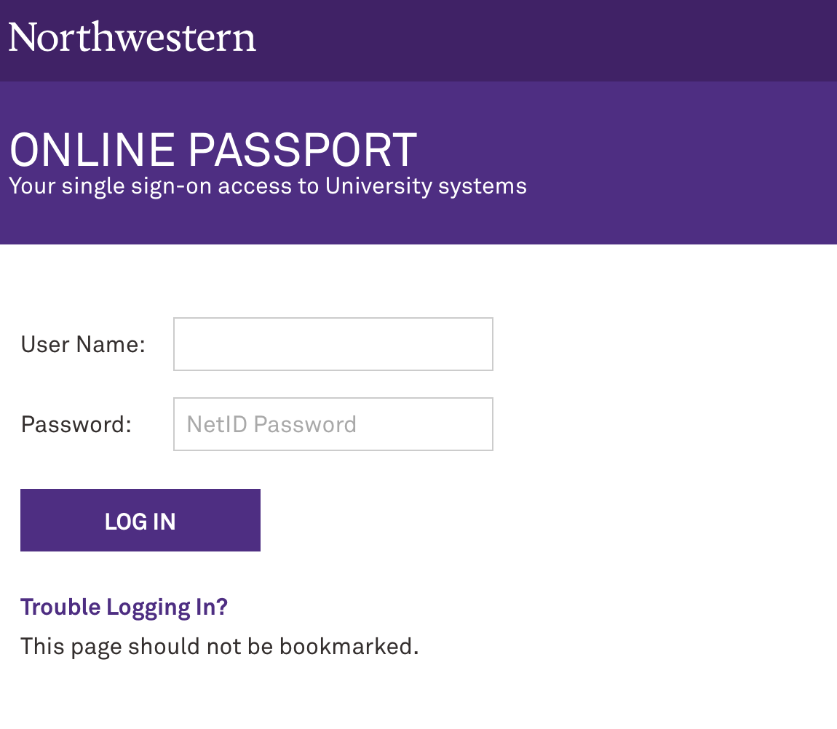
Submitting your work – step 1
Login to digitalhub.northwestern.edu
Authentication via Shibboleth

Slide 19
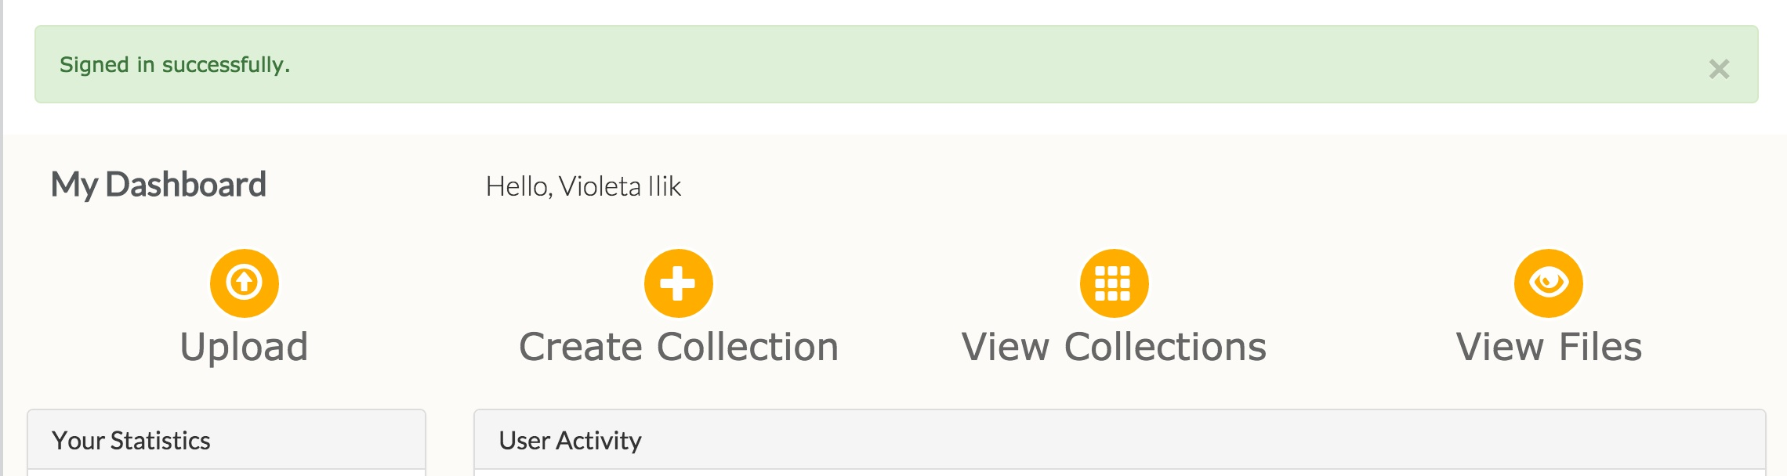
Submitting your work – step 2
Upload digitalhub.northwestern.edu/dashboard

Slide 20
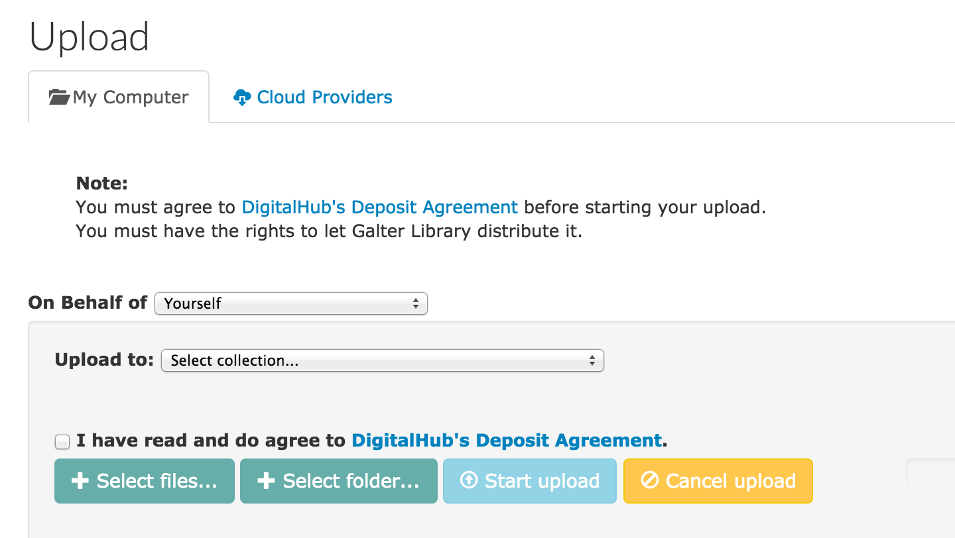
Submitting your work – step 3
Agree to the deposit agreement

Slide 21
Submitting your work – step 4
Start Upload

Slide 22
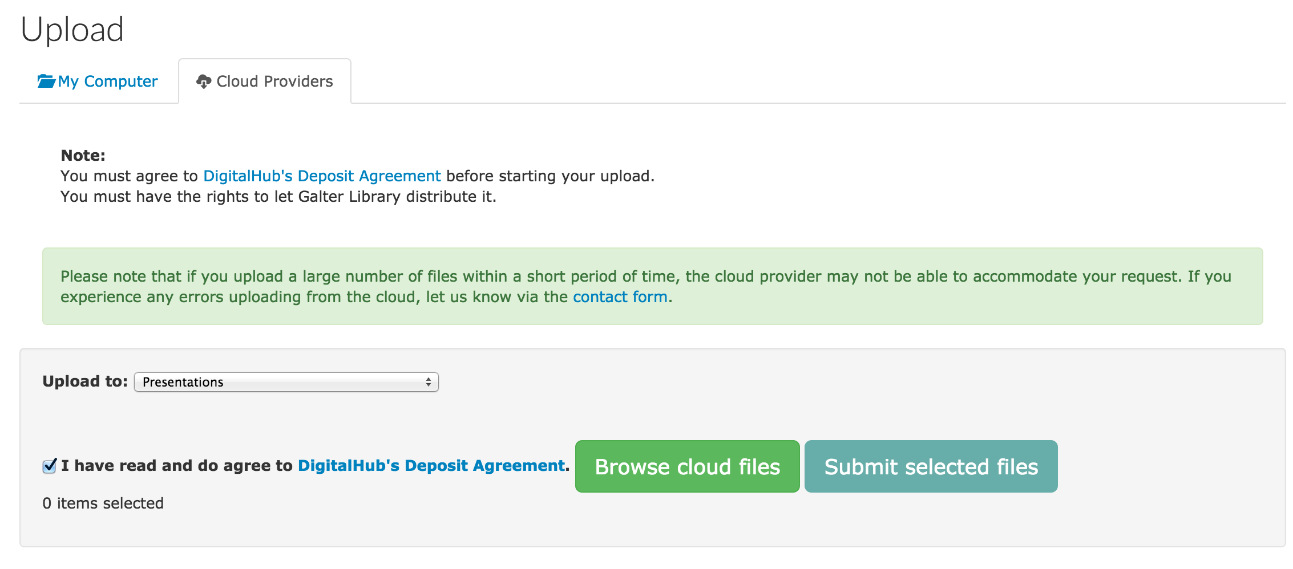
Submitting your work – step 4
Start Upload from Cloud Providers

Slide 23
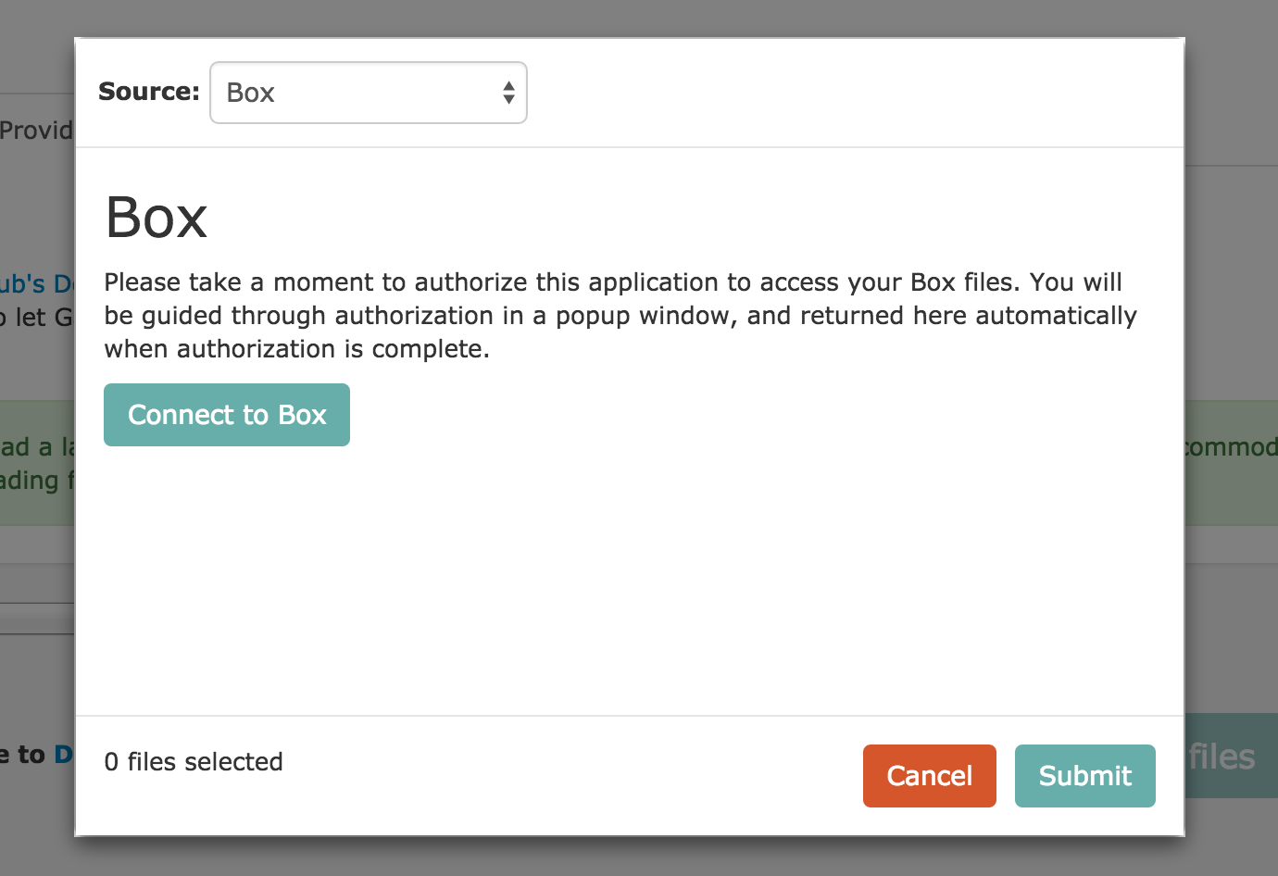
Submitting your work – step 4
Example: Box

Slide 24
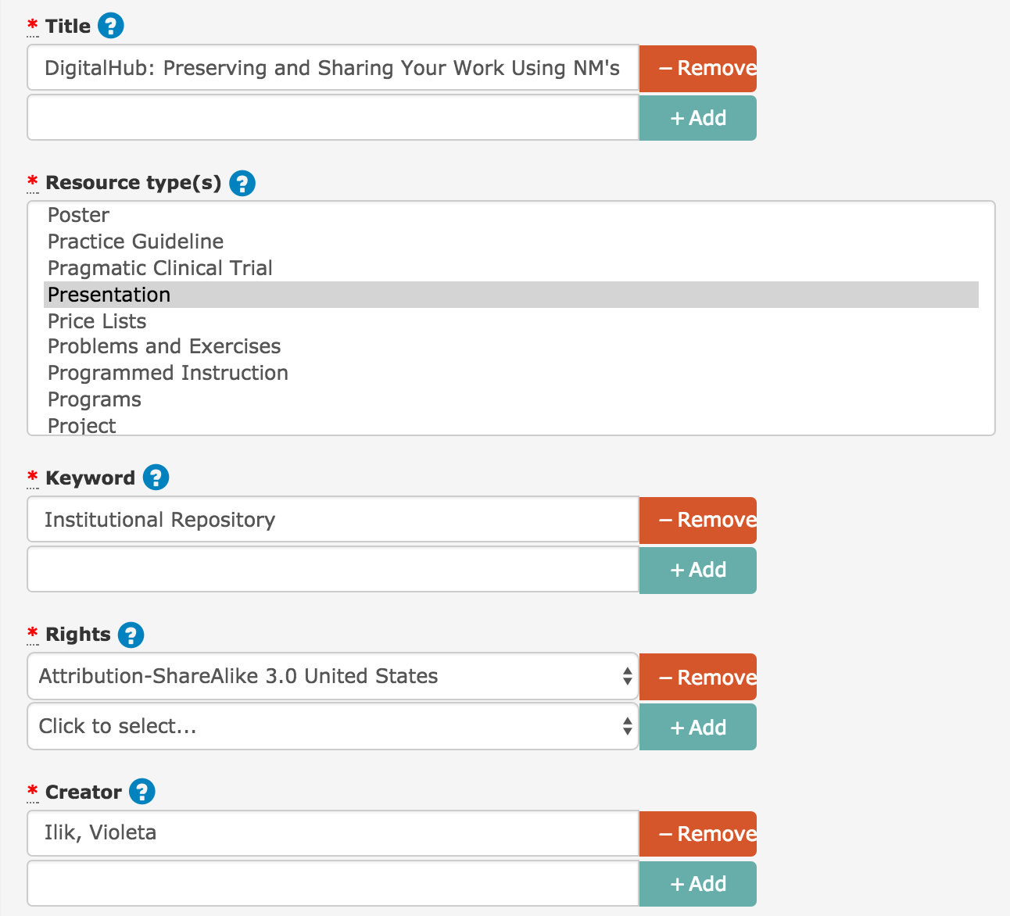
Submitting your work – step 5
Apply Metadata
5 required fields:
Title
Resource type
Keyword
Creator
Rights

Slide 25
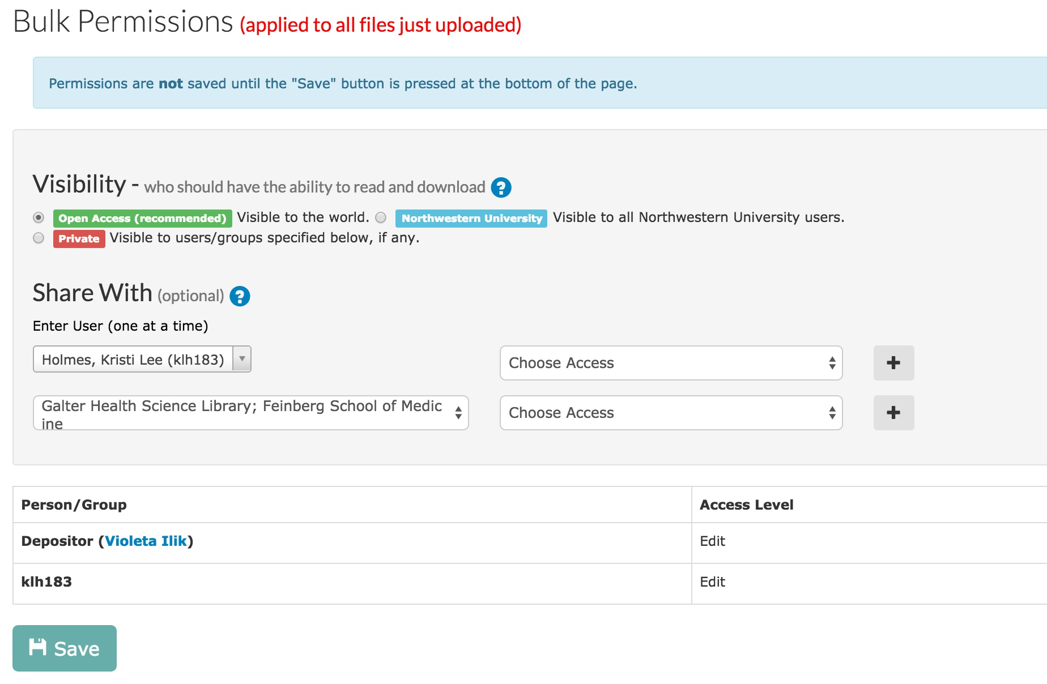
Submitting your work – step 6
Set visibility & permissions

Slide 26
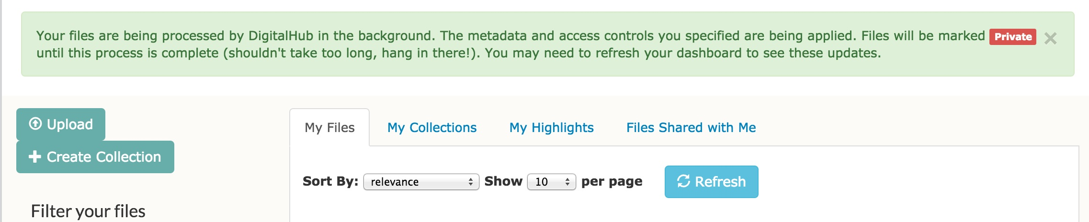
Submitting your work – step 7
Save!
Congratulations, you have submitted your work!

Slide 27
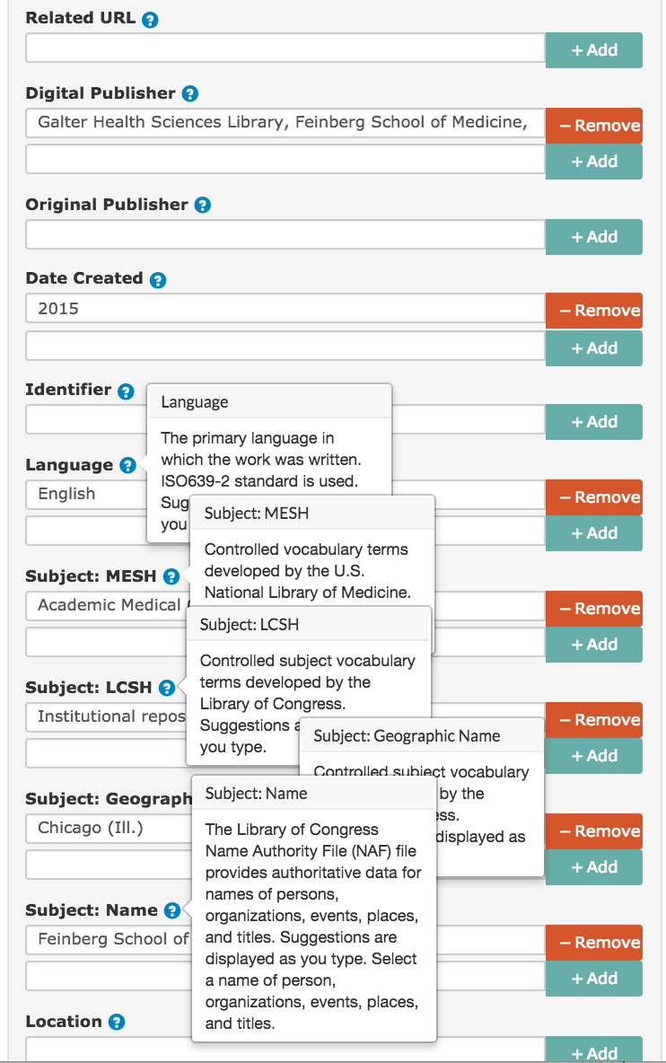
Additional metadata for describing your work
  Descriptive, administrative and structural metadata
  Use of university databases – campus directory
  Use of established standards (date, language)
  Use of established controlled vocabularies
Controlled vocabularies

Slide 28
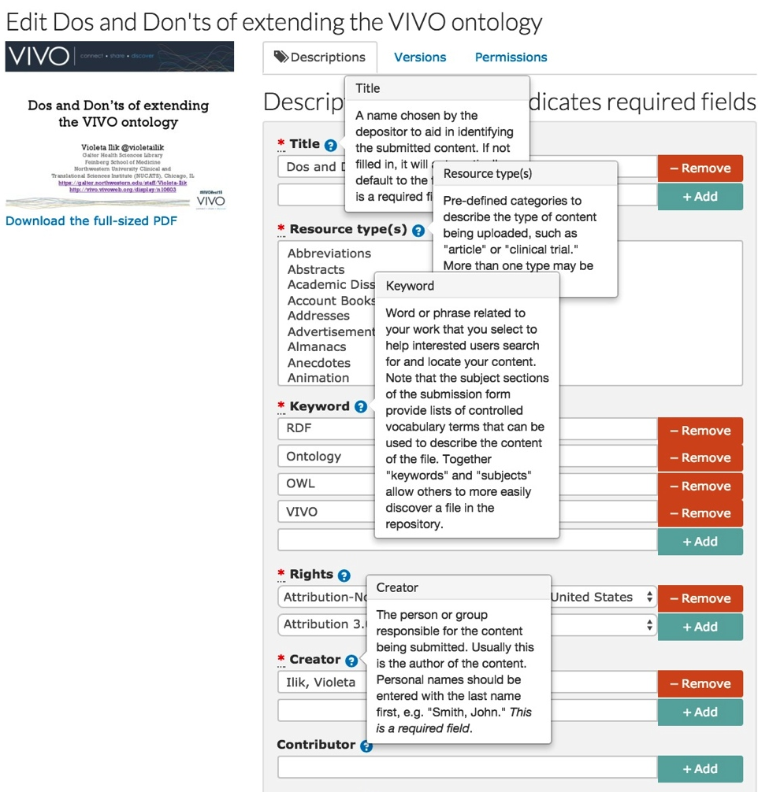
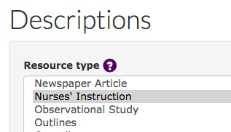
Using National Library of Medicine MeSH publication types
  Descriptive, administrative and structural metadata
  Use of established controlled vocabularies
  Use of university databases – campus directory
  Use of established standards (date, language)
  Using NLM MeSH
NLM-MeSH classes

Slide 29
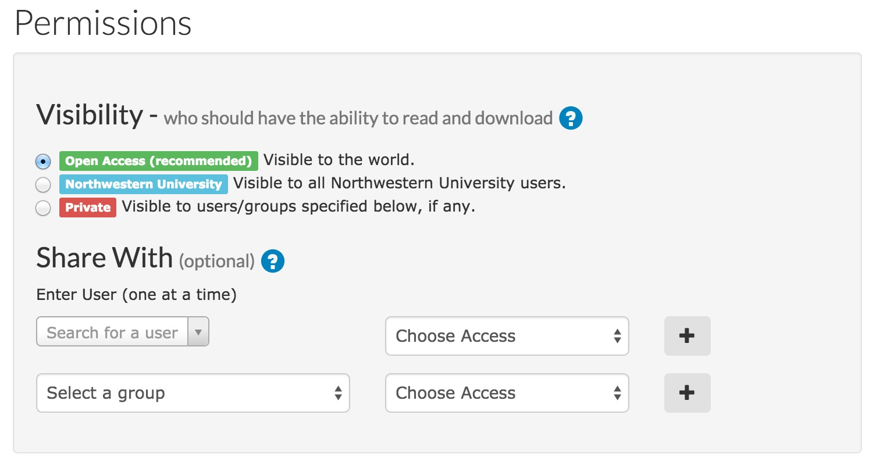
Note: Visibility - who should have the ability to read and download your files

Slide 30
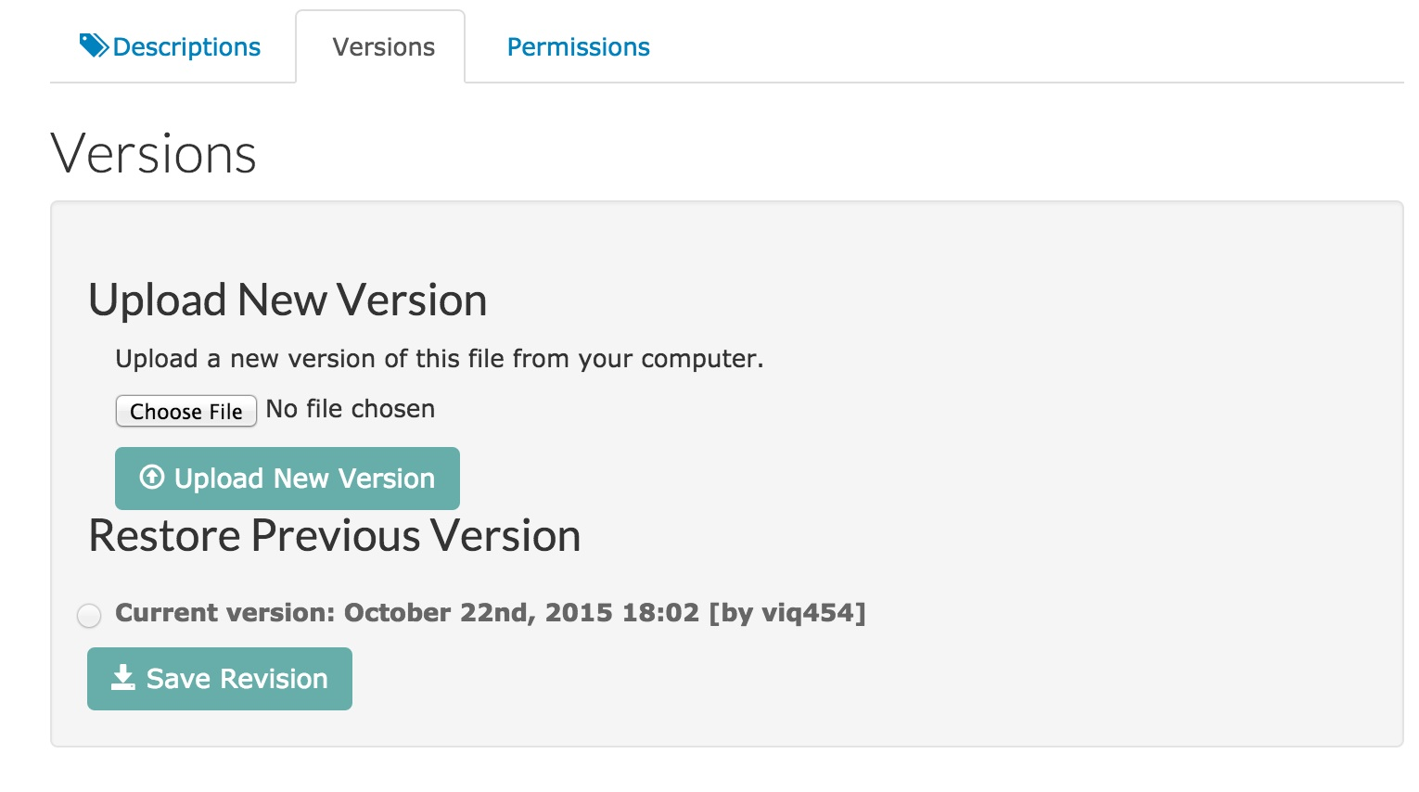
Note: Version – uploading a new version of the same work
NOTE: the file needs to be in the same file format as the originally uploaded file. Example: if you uploaded a pptx file the new version should also be in pptx file format.
Notes:
The repository provides stable, long-term storage and ongoing maintenance for content contained within the repository. Examples of items that the repository can accommodate at this time include:

Slide 31

Persistent unique identifiers - Digital Object Identifiers (DOIs) and Archival Resource Keys (ARKs)
For all of the scholarly works deposited into DigitalHub. This ensures reliable data management, data sharing, and citation tracking. A "persistent identifier" will not change if the item is moved or renamed, and so provides for consistent referencing of scholarly works for future access by humans and software.
Persistent identifiers like DOIs and ARKs can help:
Meet funders’ sharing requirements
Promote scientific re-use of your work
Track re-use and discussion of your work
Ensure transparency and accountability
How do you get DOIs and ARKs for your scholarly works? Deposit your work in DigitalHub at digitalhub.northwestern.edu and these unique identifiers will be automatically assigned.

Slide 32
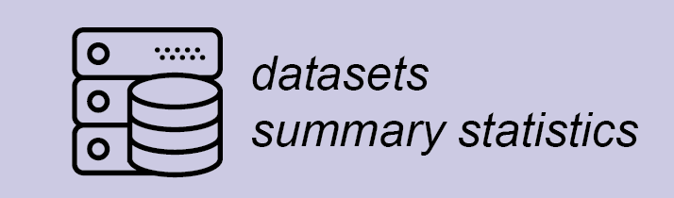
DigitalHub & datasets
The DigitalHub repository at Galter Health Sciences Library accepts deposit of datasets associated with publications to help investigators comply with journal data sharing policies
DigitalHub supports a variety of file and compression formats to meet your needs.
The current file size limit is 2 GB and supported compression file extensions include:
  zip - application/zip
  7z - application/x-7z-compressed
  bz2 - application/x-bzip2
  tar - application/x-tar and application/x-gtar
  gz - application/gzip and application/x-gzip

Slide 33
How to create a collection
Login to your account on DigitalHub
From your Dashboard:
  Select “Create Collection”
Describe your collection
Select a file you want to add to your collection (previously uploaded content by you)
Set permissions and visibility for your collection
OR:
  If you have previously uploaded files in DigitalHub from your Dashboard navigate to “My Files” by selecting “View Files” and select the files you want to add to your collection

Slide 34
How to create a multipage image collections
Login to your account on DigitalHub
From your Dashboard:
  Select “Create Collection”
Mark the checkbox next to “Multipage”
Describe your collection
Select the images (previously uploaded) you want to add to your multipage collection
Create the collection by clicking the “Create collection” button
Go back to each individual image and assign numbers in the “Page number” field to each image in the order you want them displayed.

Slide 35
Creating collections
User guide:
https://goo.gl/LLtTdm
Demo video:
https://goo.gl/ZB7SRu

Slide 36
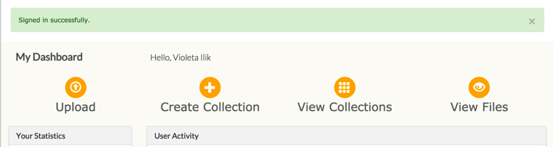
Creating collections - step 1
Create Collection
Notes:
The repository provides stable, long-term storage and ongoing maintenance for content contained within the repository. Examples of items that the repository can accommodate at this time include:

Slide 37
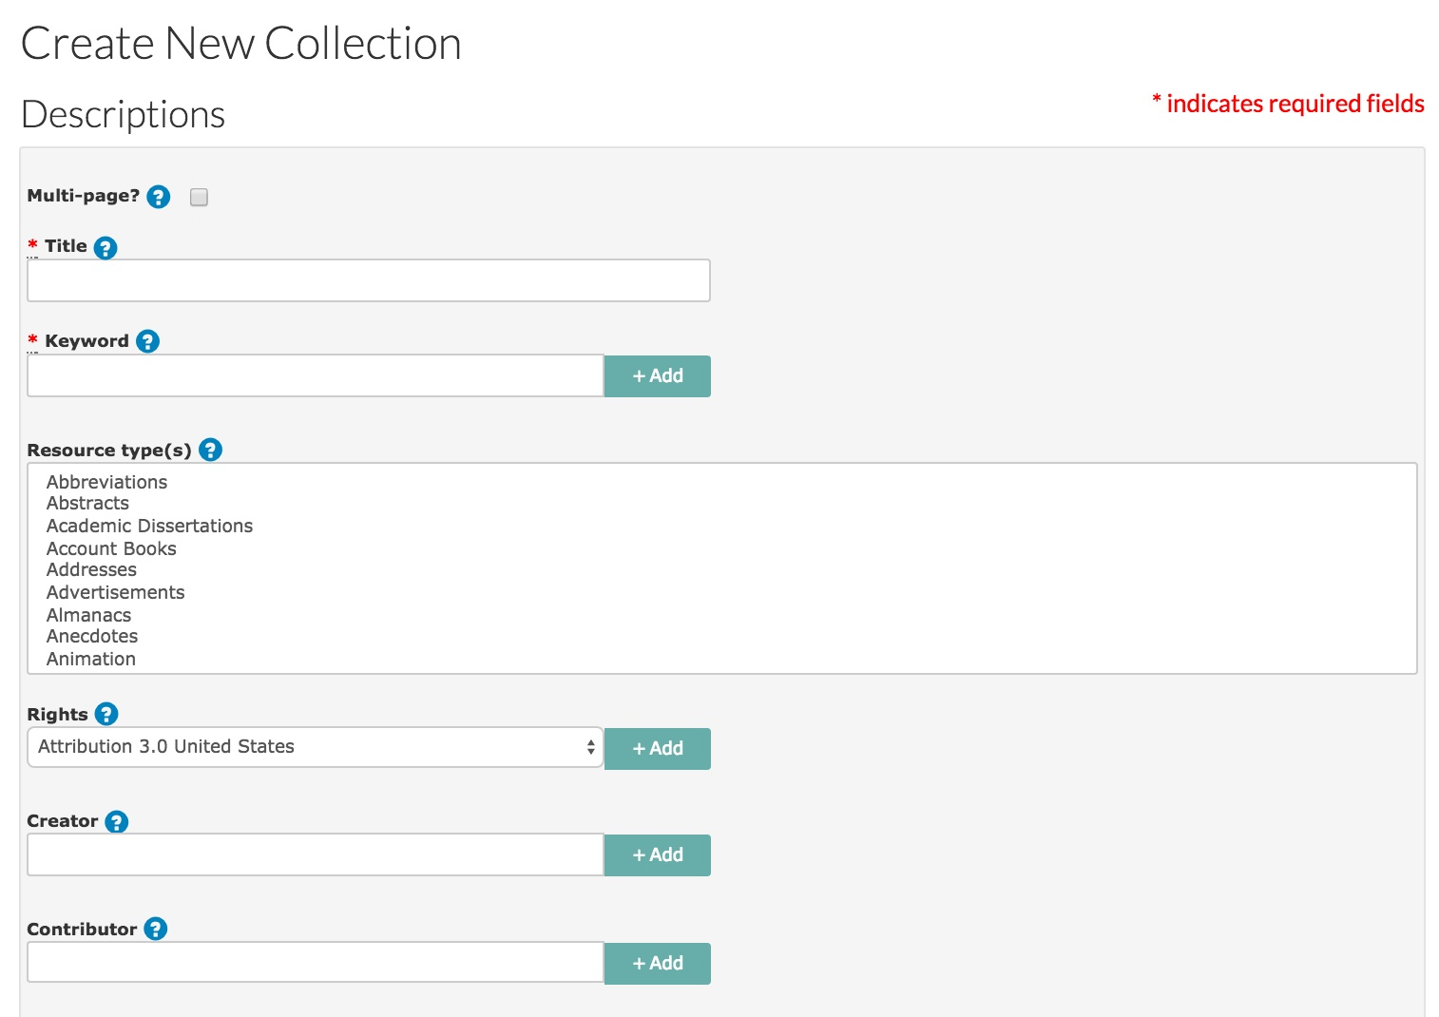
Creating collections – step 2
Describe your collection

Slide 38
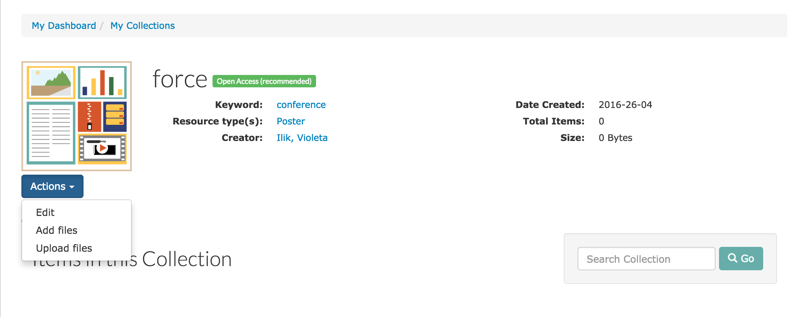
Creating collections – step 3
Add files

Slide 39
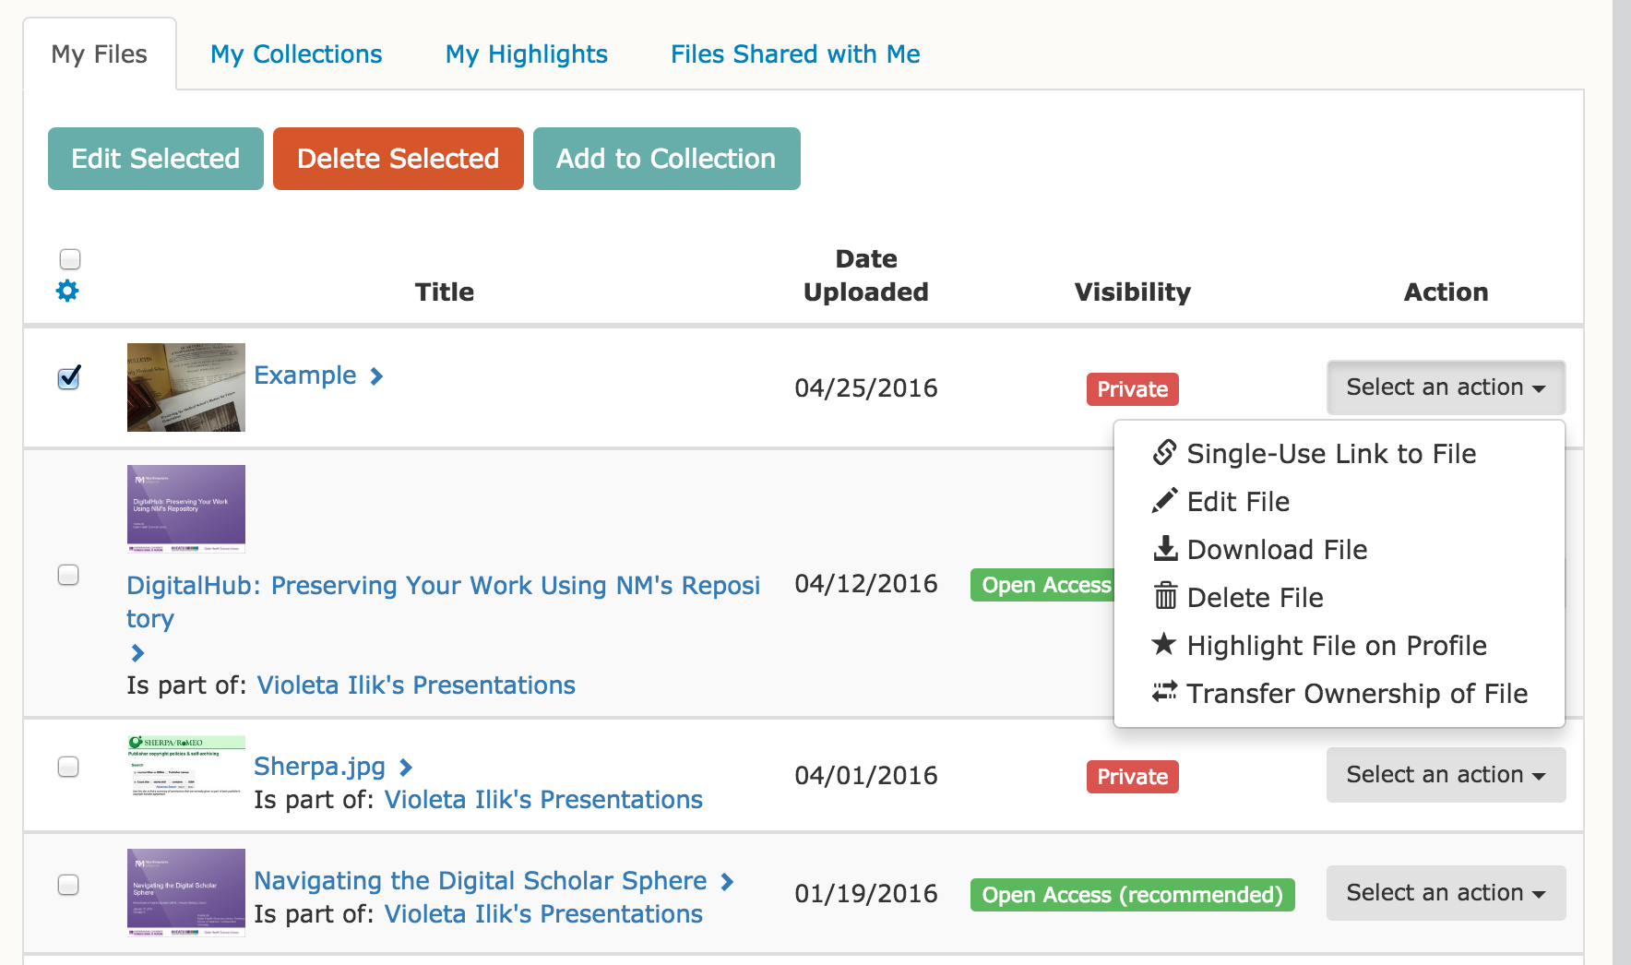
Creating collections – step 4
Select files

Slide 40
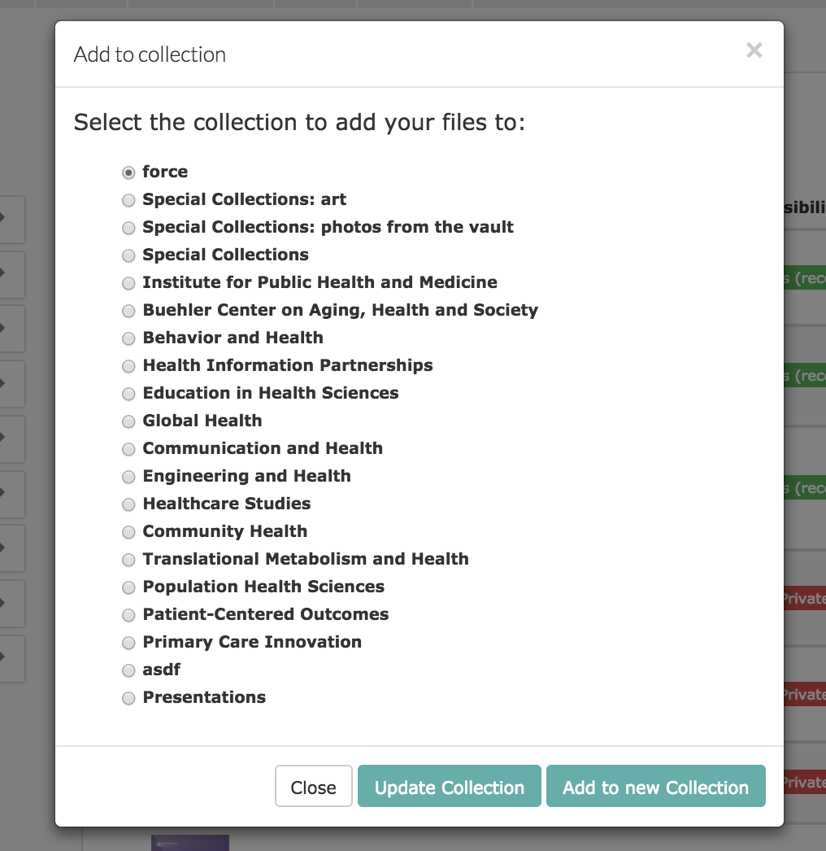
Creating collections – step 4
Add to collection
Options: Update Collection or Add to new Collection

Slide 41
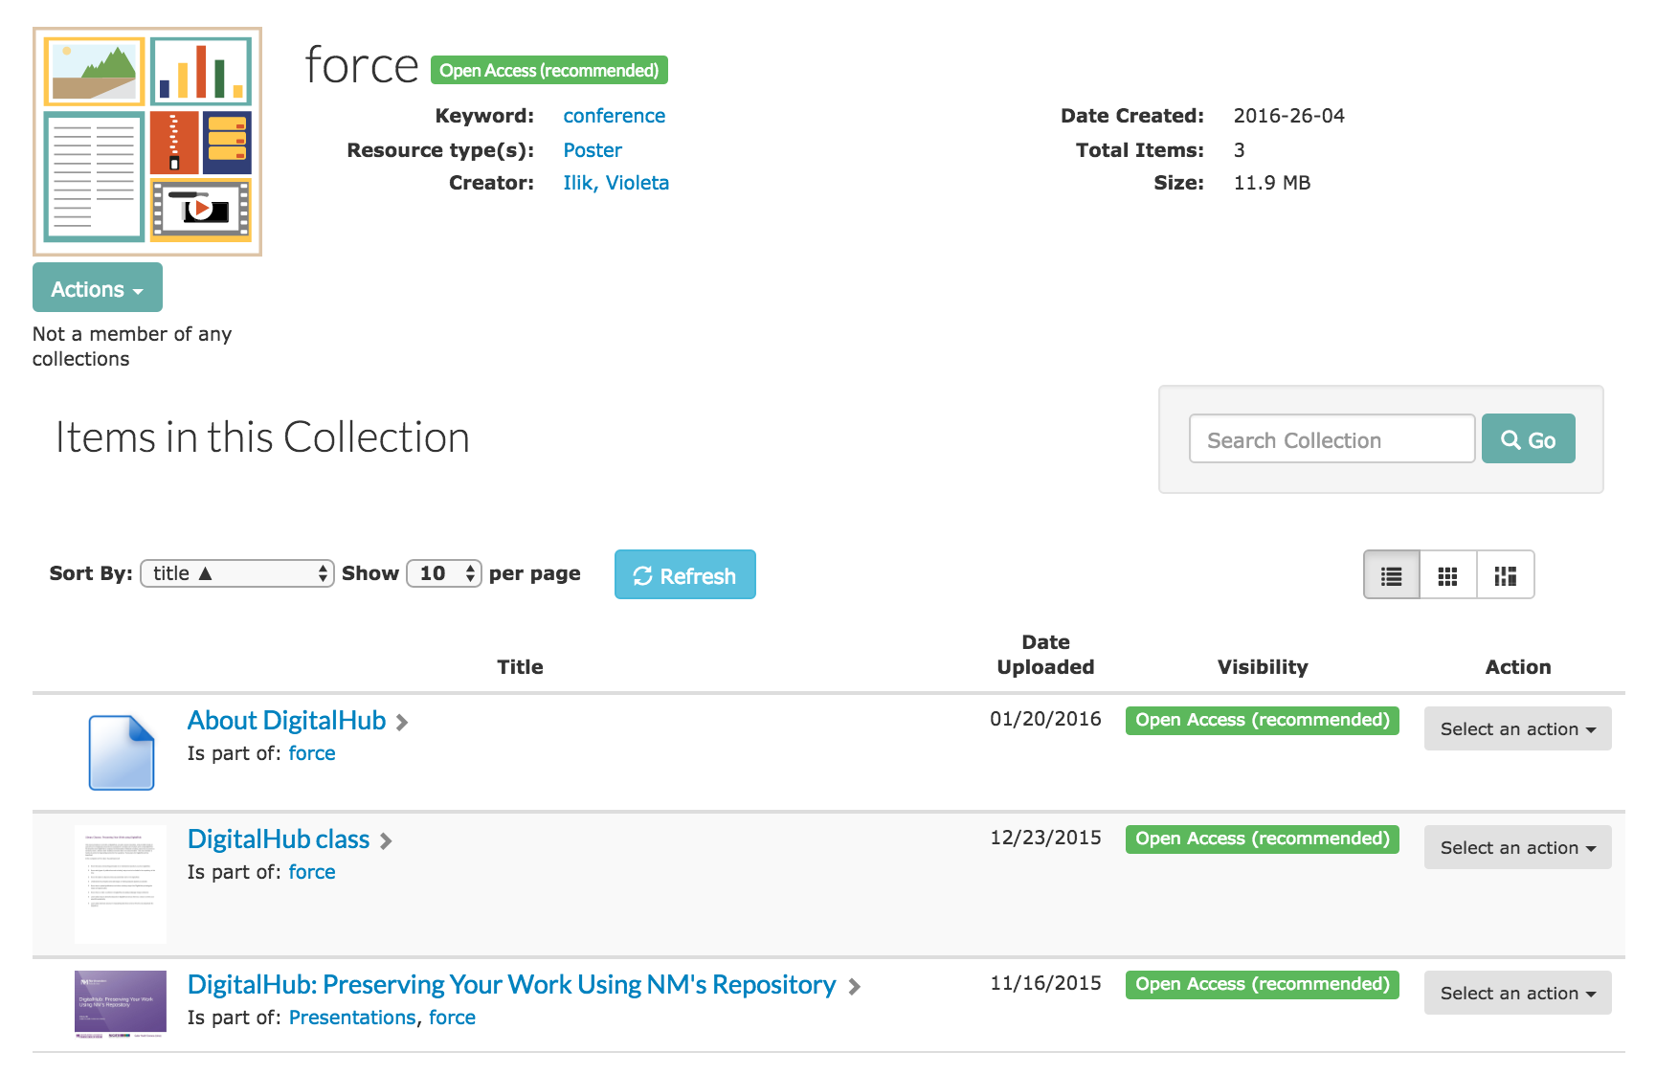
Creating collections – congratulations!

Slide 42
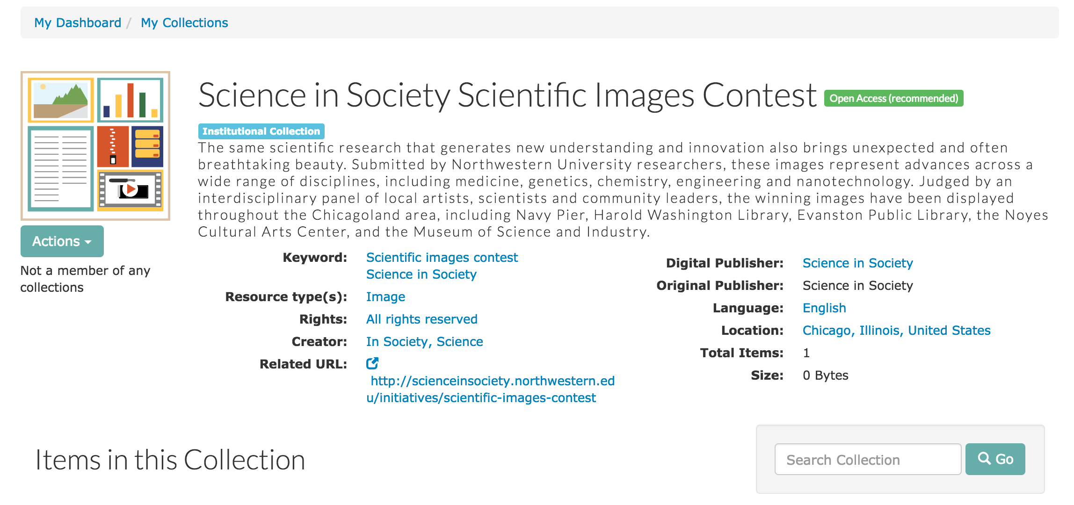
Example of multipage collection

Slide 43
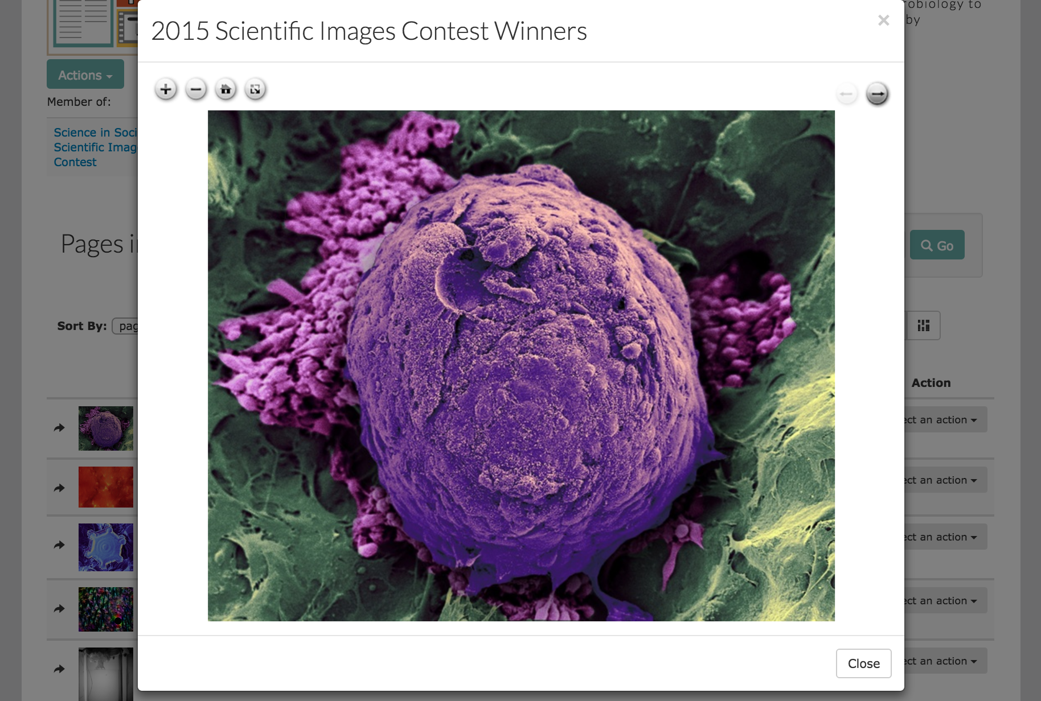
Example of multipage collection
multi-page collections created with an IIIF viewer

Slide 44
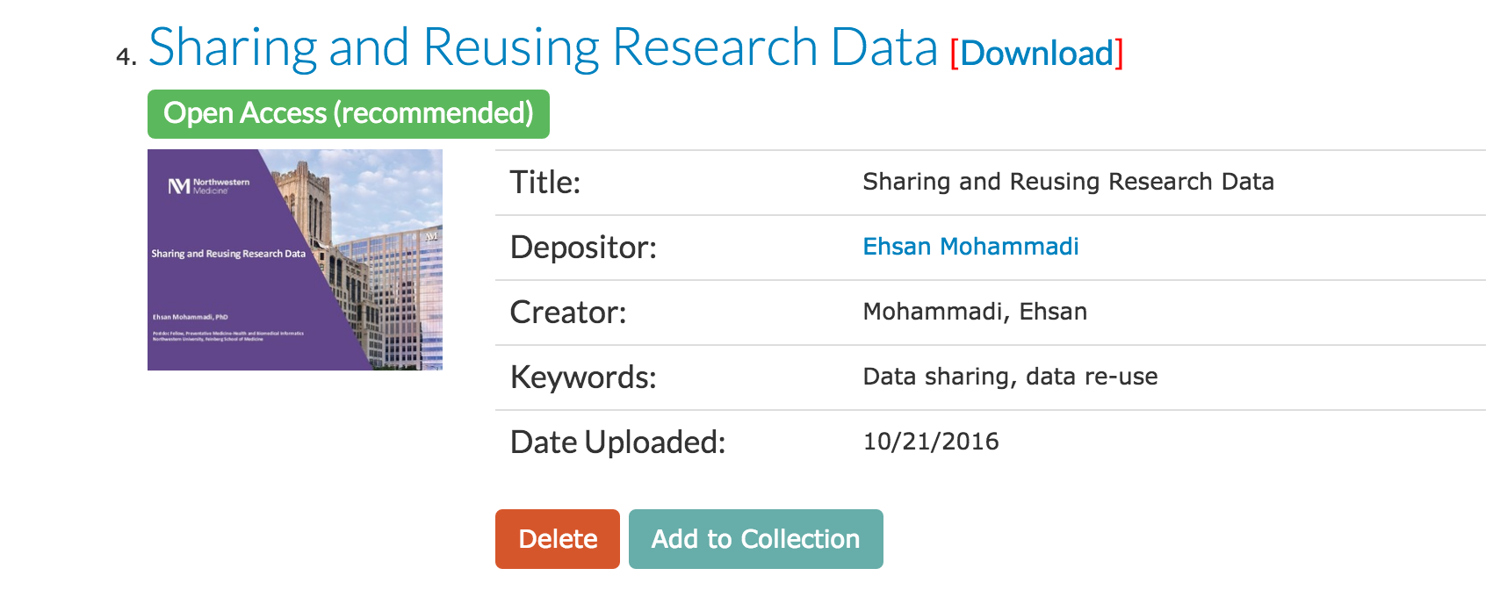
Collections – admin and editors can add items to collections

Slide 45
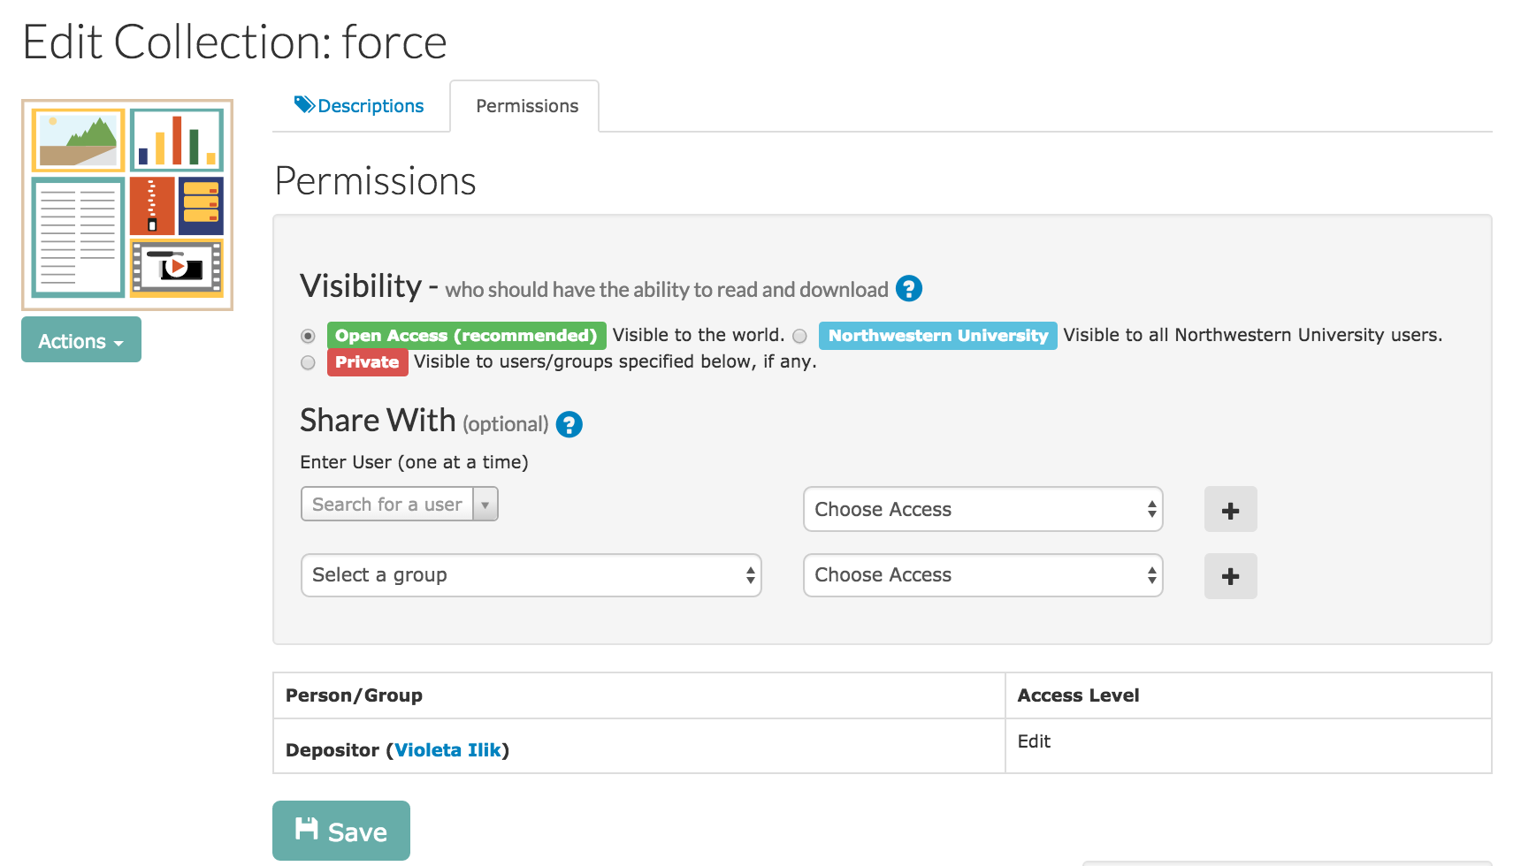
Collections – setting permissions

Slide 46
Wrap up
You are ready to use DigitalHub
You know the basic overarching principles of an institutional repository such as DigitalHub.
You know what types of publications and scholarly output can be included in the repository at this time.
You know if you have the right to deposit your previously published work in the DigitalHub.
You understand the principles and advantages of making deposits publicly accessible.
You know how to upload publications and other scholarly output into DigitalHub (including the steps and agreements).
You know how to create a collection in DigitalHub (including multipage image collection).
You have learned about ways to describe deposits in DigitalHub and use them as a way to archive your scientific productivity.

Slide 47
How can the library help?
Presentations at department meetings
Consultations
Contact us at DigitalHub@northwestern.edu

Slide 48
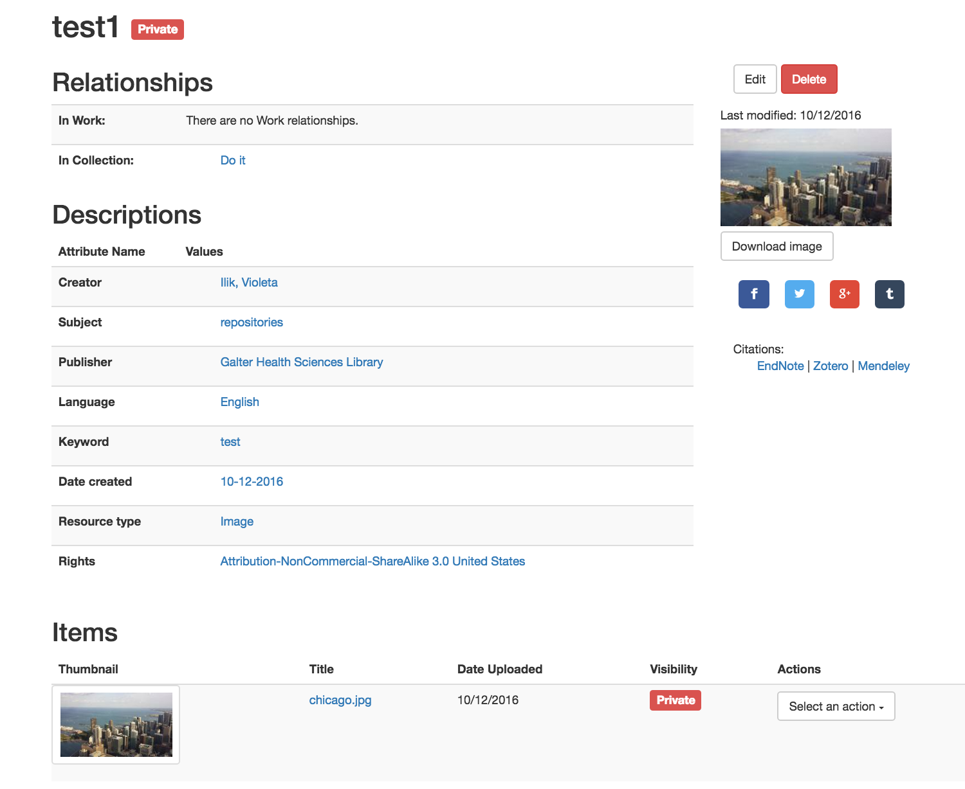
Coming Soon
Upgrade to new version of the software

Slide 49
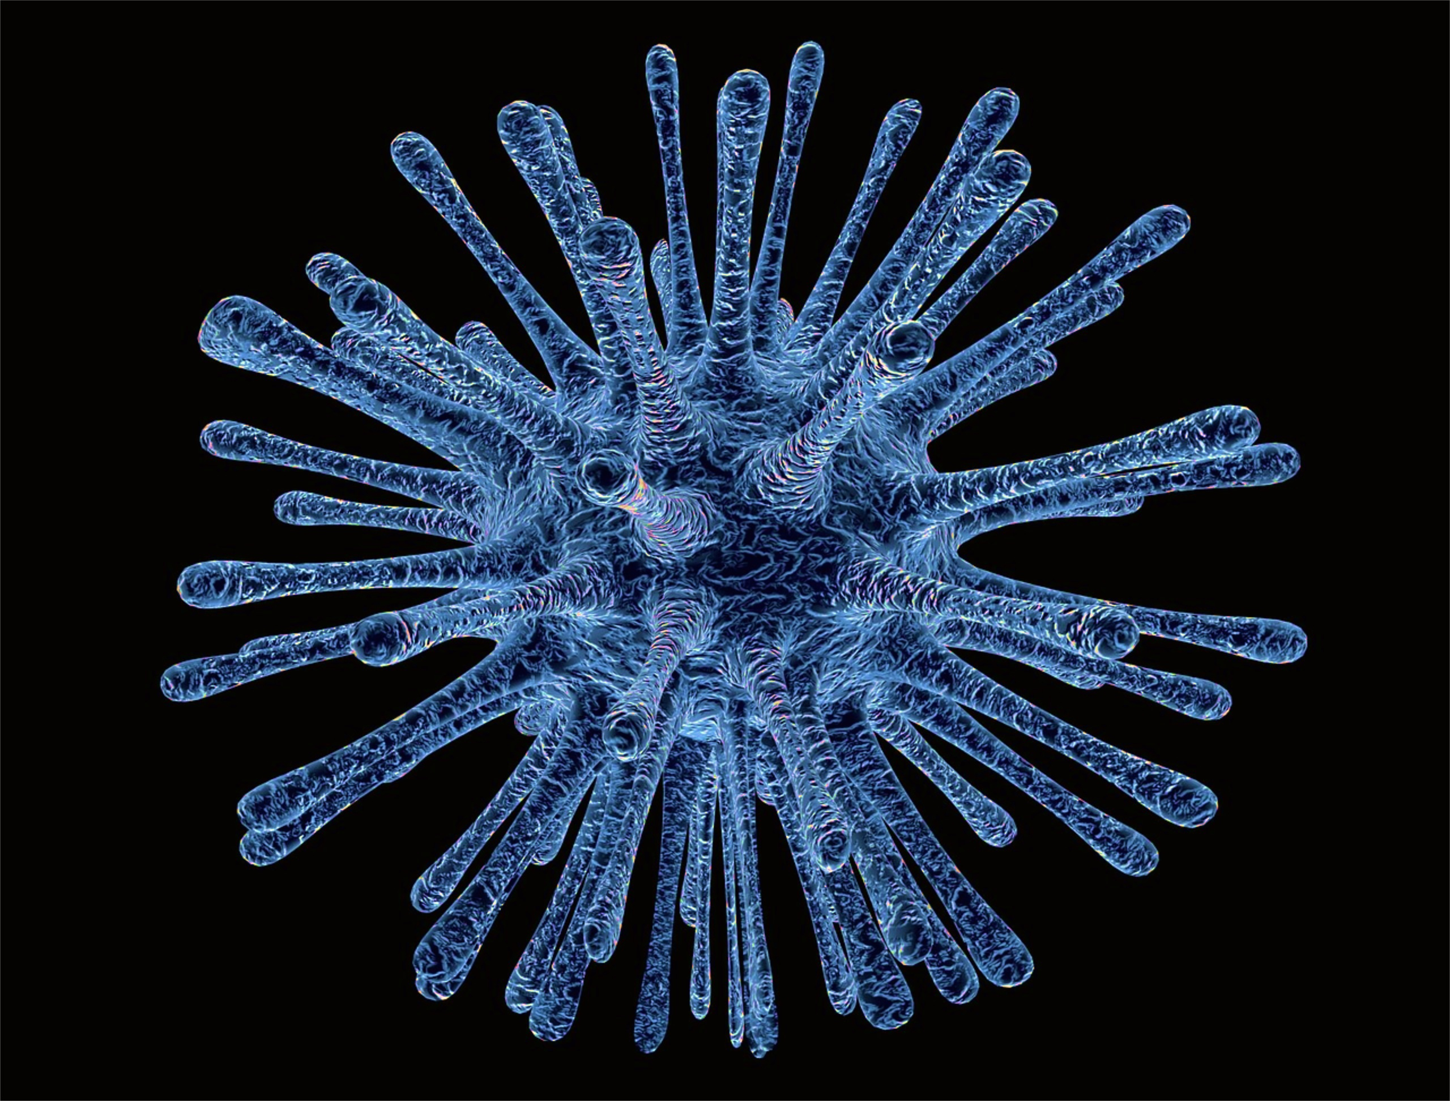
Thank you
Questions?
Thank you
Violeta Ilik
Contact us at: DigitalHub@northwestern.edu
https://digitalhub.northwestern.edu/

