Slide 1
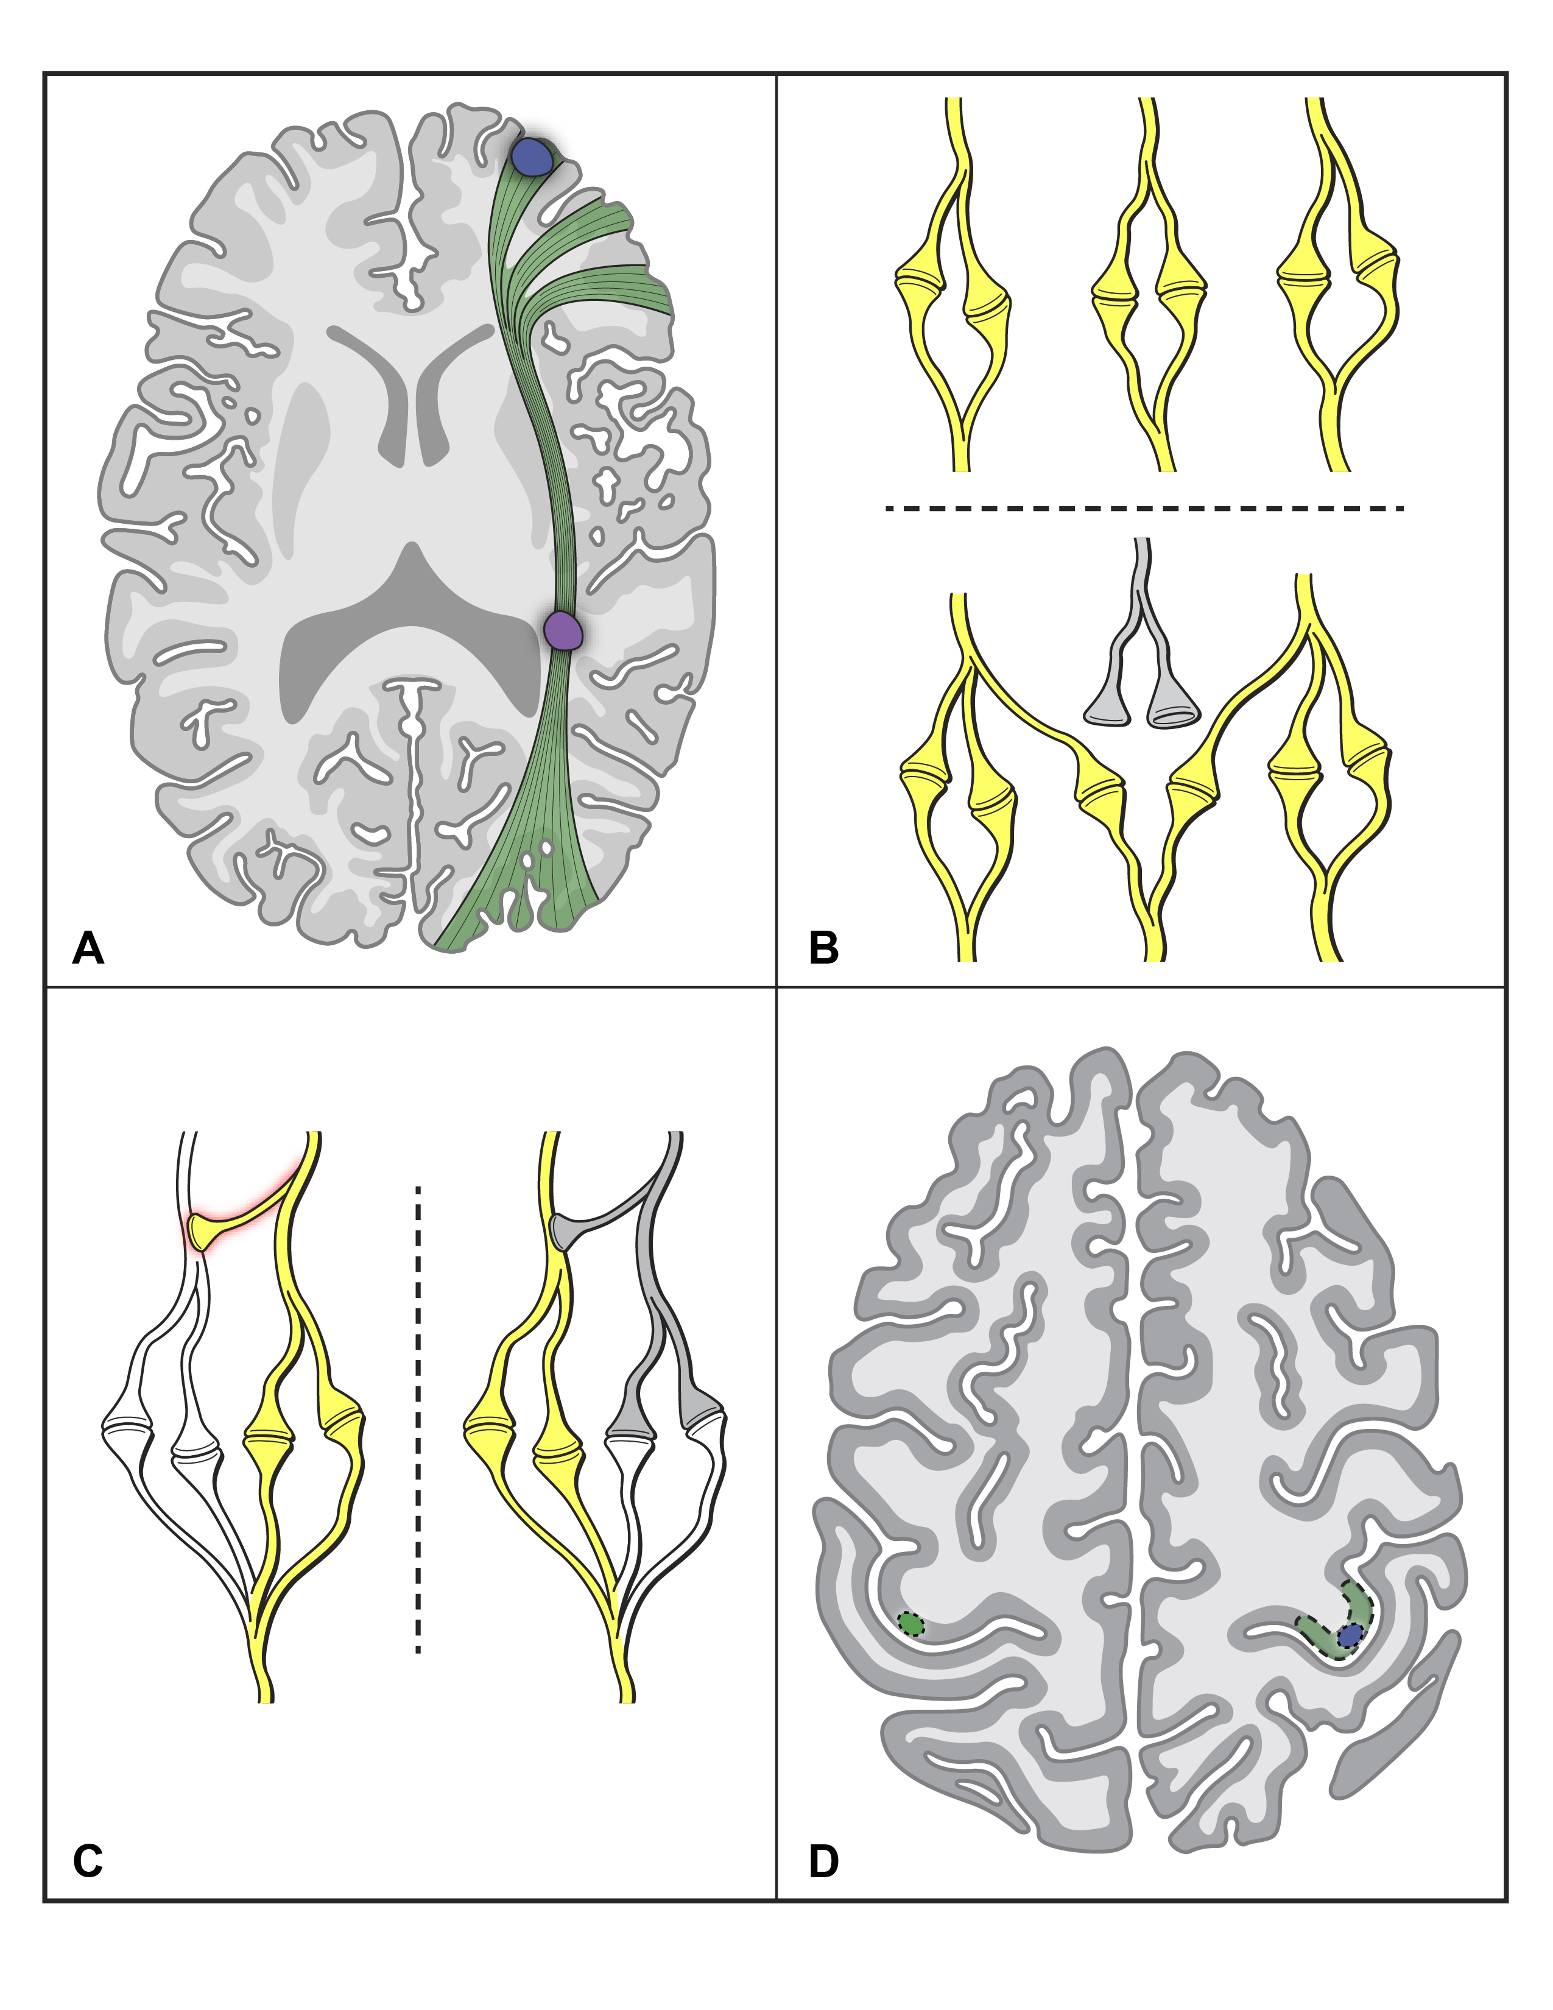
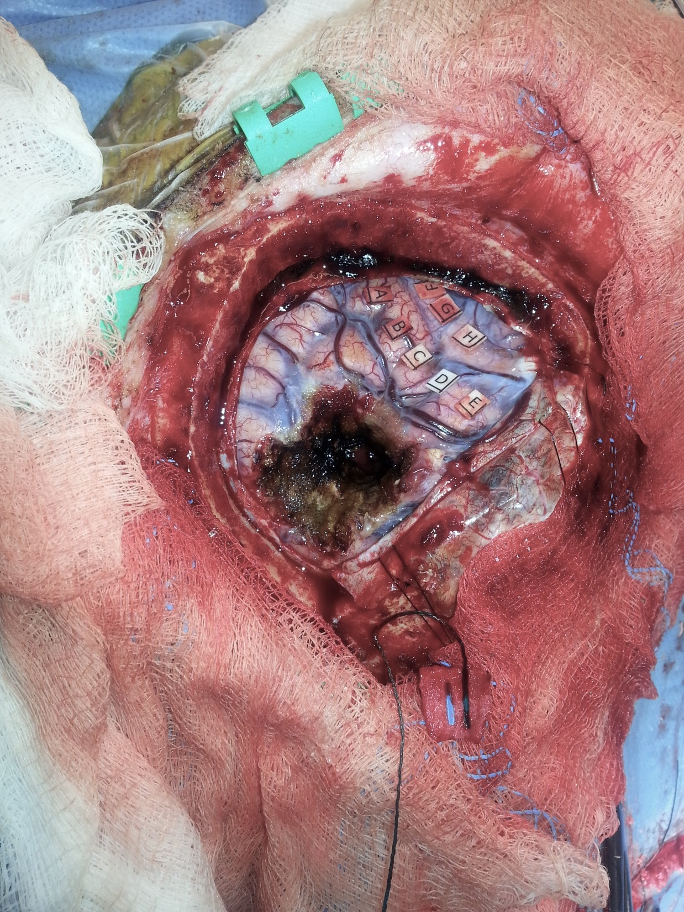
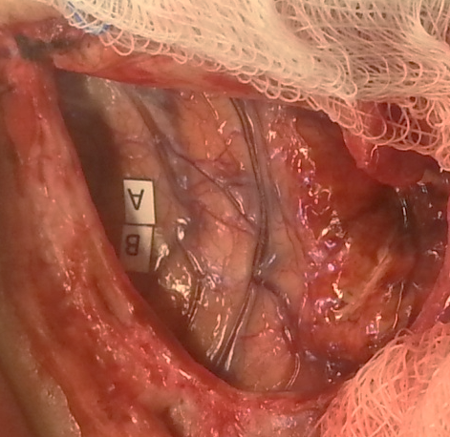
Neuroplasticity in primary cortex: a study of glioblastoma patients undergoing repeat awake craniotomy using direct electrocortical stimulation
Wil Gibb | Nathan Kong | Matthew Tate, MD, PhD
Department of Neurological Surgery, Northwestern University Feinberg School of Medicine
Neuroplasticity
Abstract: Glioblastoma is both the most deadly and most common primary brain tumor in adults. Despite its impact, we know very little about if, and how, the brain preserves function in response to this tumor. The ability of the brain to reorganize function, known as neuroplasticity, is common in the developing brain but has not been studied in adults with glioblastoma. In this study, we examined neuroplasticity within primary motor (M1) and somatosensory (S1) cortex in glioblastoma patients undergoing repeat awake craniotomy using direct electrical stimulation. Five of six patients exhibited plasticity within M1 or S1. Out of 51 total sites stimulated in both surgeries, 32 (62.7%) demonstrated plasticity. Of these sites, 18 were in S1 (56.3%) and 14 were in M1 (43.7%). This is the first study to demonstrate primary cortical plasticity in glioblastoma patients. In understanding the mechanisms driving this plasticity, we hope to provide insight that will guide management and treatment of patients with this devastating diagnosis.
Results
Neuroplasticity: The ability of the brain to preserve function in response to tumor, stroke, or other injury.
Summary
• 63% of total sites demonstrated neuroplasticity
• Five of six patients demonstrated neuroplasticity
• 56% of the plastic sites were in M1 and 44% were in S1
• Four different modalities of plasticity were present in these patients
Mechanisms of Neuroplasticity
Figure 1: Illustrated in panels A-D are the four primary mechanisms of neuroplasticity.
A. Subcortical vs. cortical plasticity: The ability of the brain to recover from a lesion in the subcortical white matter tracts (purple) is decreased compared to a cortical lesion (blue).
B. Cortical recruitment: When a cortical injury occurs (grey), perilesional synapses can be recruited to maintain synaptic integrity.
C. Cortical redundancy: Redundant synapses are normally inhibited by interneurons (red shadow). Upon injury (grey), this inhibition is lost and the redundant connection compensates.
D. Contralateral recruitment: A lesion (blue circle) in the hand motor area (green dashed region) can promote recruitment of the analogous contralateral hand area (green circle) to rescue hand function.
Figure 3: Example of somatosensory neuroplasticity- The was a complete loss of functional activation (A-E) at the second surgery, without functional sensory deficit. Therefore, this function has reorganized elsewhere in the cortex, which is a direct example of neuroplasticity.
Anterior
Surgery 1
Surgery 2
Patient | Sex | Age, first surgery | Surgical Interval (days) | Tumor Pathology | Previous surgery? | Tumor volume (cm^3) | Tumor Location
1 | M | 54 | 278 | GBM | No | 96.1 | L frontal
2 | M | 55 | 198 | GBM | No | 63.6 | R postcentral
3 | M | 63 | 231 | GBM | No | 16.2 | L precentral
4 | M | 21 | 170 | GBM | Yes | 3.1 | R parietal
5 | F | 50 | 204 | GBM | Yes | 2.5 | L postcentral
6 | M | 37 | 238 | GBM | Yes | 3.1 | L temporal
Methods
Inclusion criteria
• Adult patients with biopsy-confirmed glioblastoma multiforme
• Patients had two awake craniotomies using direct electrocortical stimulation
• The same brain region was exposed during both operations
• Six patients fit these criteria at NMH between 2010-2016
Table 1- Patient demographics: The average age at the time of the first surgery was 46.7 years ± 15.2 years. The average interval between the first and second surgery was 219.8 days ± 37.5 days. Each patient’s tumor was biopsy-positive for glioblastoma multiforme at both surgeries. Three patients had a previous craniotomy for tumor resection by a different surgeon prior to their repeat awake craniotomies in this study. The average tumor volume was 30.8 cm³ ± 39.7 cm³. The tumors were distributed throughout the frontal, temporal, and parietal lobes; four were located in the left hemisphere and two were in the right hemisphere.
Knowledge gaps in plasticity research
There is evidence for plasticity within the human cortex. However, much of this evidence:
• Is from non-primary association cortex, like the supplementary motor area, which has a greater innate capacity for neuroplasticity
• Relies on indirect measures of brain activity, such as fMRI
• Is in acute pathology, like stroke
• Is in the developing brain
Total Sites | Plastic sites | Sensory plastic | Motor plastic
51 | 32 | 18 | 14
 | 62.7% | 56.3% | 43.7%
Plastic sites | -/-, no deficit | -/+ sites | +/-, no deficit | +/+, change
32 | 10 | 9 | 9 | 4
 | 31% | 28% | 28% | 13%
Measuring neuroplasticity
• 1x1 cm grid overlay on M1 and S1 (primary motor and somatosensory cortex)
• Each 1cm² region = 1 stimulation point
• For example, stimulation points A-H in Figure 2 correspond to certain motor/sensory functions
Table 2- Motor and somatosensory plasticity summary: Fifty-one sites were stimulated between both surgeries for all six patients (102 sites stimulated overall). Thirty-two of these sites (62.7%) demonstrated plasticity. Of these 32 plastic sites, 18 were sensory (56.3%) and 14 (43.7%) were motor.
Table 3- Categories of motor and somatosensory plasticity: Motor and somatosensory plasticity was categorized in four ways. Sites that were negative in both surgeries, but presented with no functional deficit, comprised ten (31.3%) of the thirty-two plastic sites (-/-, no deficit). Nine sites (28.1%) were negative at the first surgery and positive at the second (-/+ sites). Nine sites (28.1%) were positive at the first surgery and negative at the second, with no corresponding functional deficit (+/-, no deficit). Four sites (12.5%) were positive at both surgeries, with a different function being elicited at the second surgery (+/+, change).
Anterior
Purpose
Significance and Future Directions
To address the knowledge gaps above, we aim to:
• Demonstrate plasticity in traditionally non-plastic cortex, namely primary motor (M1) and somatosensory cortex (S1)
• Measure this plasticity directly in the operating room, using the gold standard for measuring cortical function: direct electrocortical stimulation
• Measure this change in plasticity over time, by studying patients who have had two awake brain surgeries
• Measure this plasticity in adults with glioblastoma, a population which has not been studied in neuroplasticity research
Central sulcus
Figure 2: Example of 1x1 cm grid on cortex. M1 is anterior to central sulcus, S1 is posterior to central sulcus.
Defining neuroplasticity
• Gain, loss, or change of function at one 1cm² stimulation point between surgeries without corresponding functional deficit
• For example, if stimulation point E in Figure 2 was hand sensation at surgery 1 and changed to hand motor at surgery 2, that is neuroplasticity
• Furthermore, if stimulation point E was hand sensation at surgery 1 and disappeared at surgery 2, with no functional deficit, that would be neuroplasticity
• First study to directly show plasticity in glioblastoma patients
• Plasticity within M1 and S1 is robust and can occur on a short time scale
• Cortical plasticity can occur through multiple modalities
• Future: combine these data with fMRI to localize plastic function
• Future: use these data for management and surgical planning of tumors
Acknowledgements
• Dr. Matthew Tate, MD, PhD for his mentorship and guidance throughout this project
• Nathan Kong, for this collaboration
• Michael Gallagher, for illustrating Figure 1
• Northwestern University Feinberg School of Medicine and Department of Neurological Surgery, for funding this project

