Slide 1
Leaving a paper trail
Tracking scholarly legacy with bibliometrics
Christina Gattone, MLS
Research Impact Librarian
Galter Health Sciences Library
Feinberg School of Medicine
Northwestern University
Notes:
Narrative:
Thank you for the opportunity to speak with you all today and share a new research project, looking at the intersection of scholarly legacy and bibliometrics. This is in the early stages, and I look forward to sharing my progress as well as your questions and feedback.

Slide 2
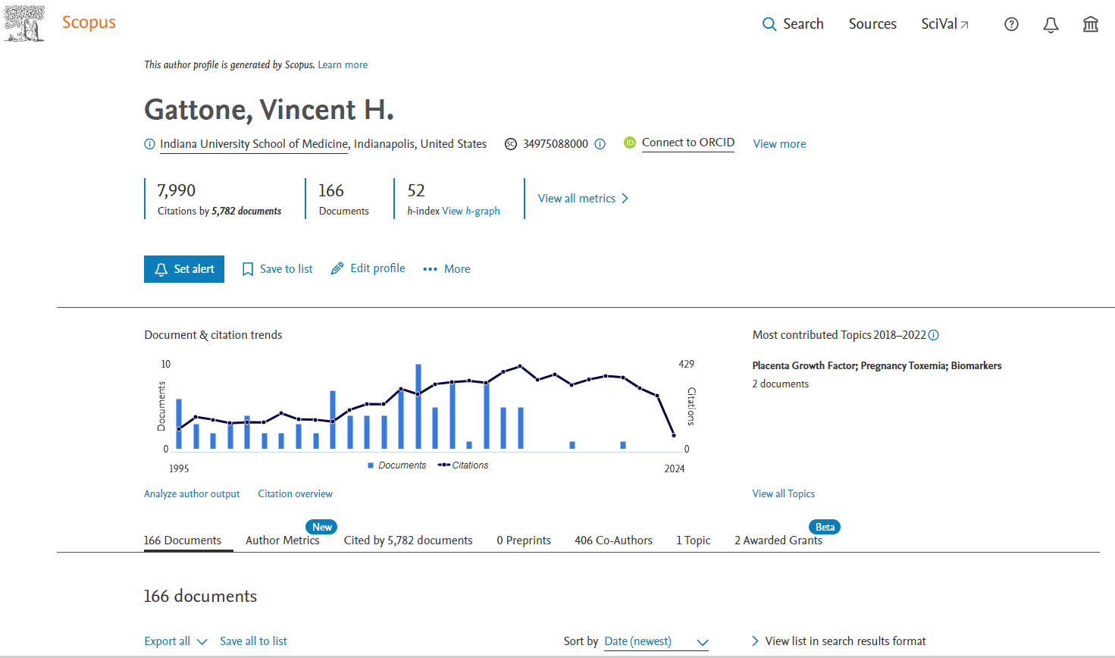
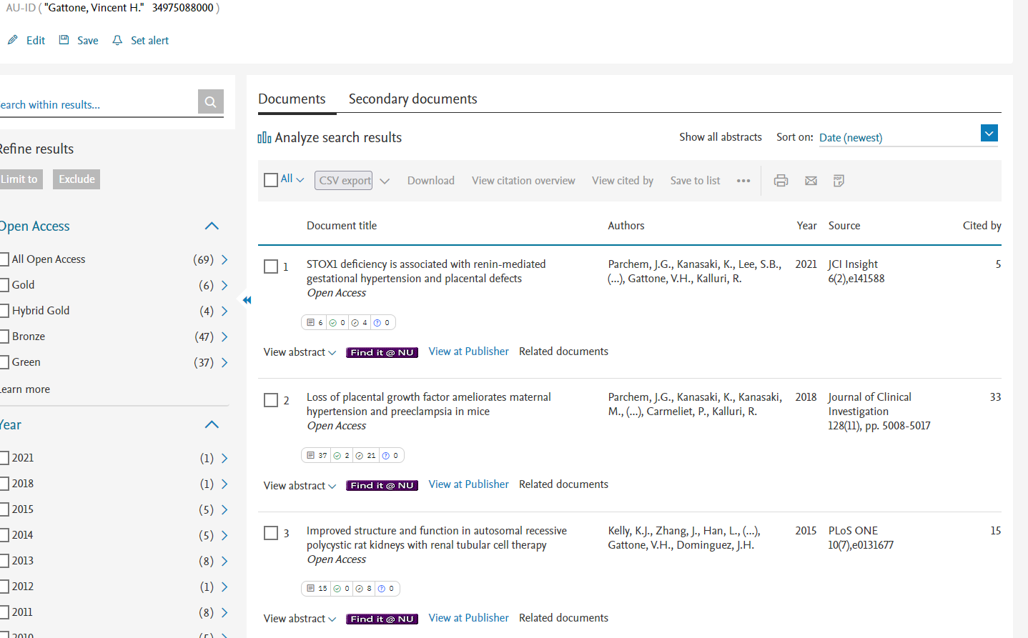
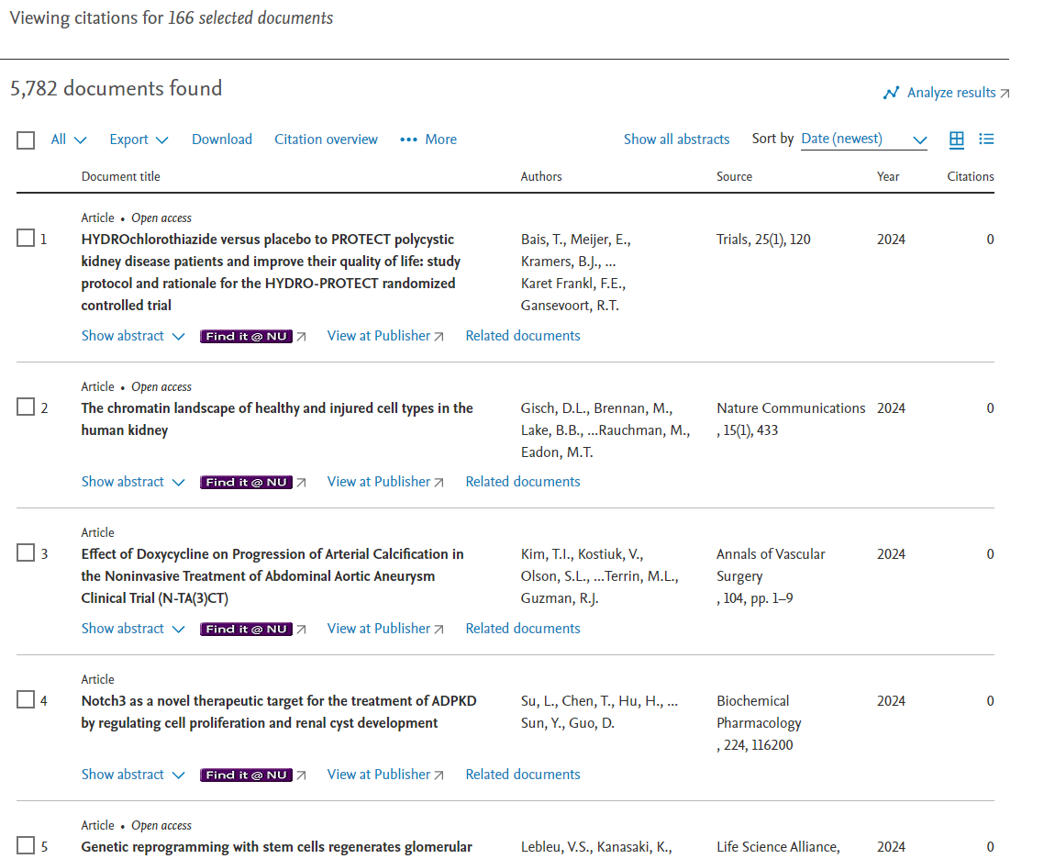
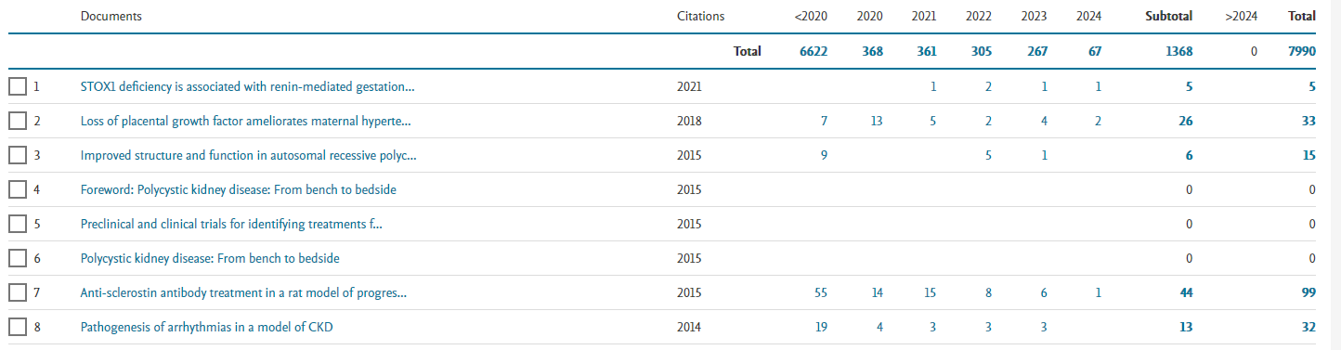
First things first…
Notes:
Narrative:
Settling on scholarly legacy and bibliometrics was as much a personal decision as a professional one. I grew up as the daughter of a medical researcher and professor and given my current professional role, it is interesting to see how citation-based metrics demonstrate the impact of my father’s work over a long career and into the present.
Here, we can see his author profile in Scopus and an overview of his work; second, a list of his documents in search results format; third, an overview of citations in both numbers and across time; and fourth, a list of documents that have cited his work. At first glance, we might see a pattern to how he published and is cited and make some assumptions, maybe piece together a story about his career. We can also immediately see that his publications have tapered off over the past ten or so years and accordingly, the number of citations that his work has garnered. He was last listed as an author in 2021, and his body of work had already gathered 67 citations by late April of this year. What accounts for this drop-off? A general winding down in his career? Going half-time at work so that he can indulge his favorite hobbies, travelling and photography? Full retirement?

Slide 3
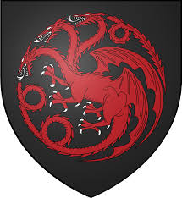
Defining legacy
“the action or act of bequeathing – a bequest,” or “a tangible or intangible thing handed down by a predecessor; a long-lasting effect of an event or process”
Notes:
Narrative:
In January 2014, my father passed away following a terminal cancer diagnosis the previous year. He spent much of that previous year, up until the last few weeks of his life and well into hospice care, wrapping up projects and handing off work to his graduate students and colleagues, many of whom he’d collaborated with over his entire career, and ensuring that his work would continue.
I do not want to force a conversation about death or mortality, with either you or the researchers that I speak with regarding their scholarly legacy; that is no winning strategy for gaining the trust of future interviewees or keeping your attention. What I am interested in are discussions about scholarly legacy and the many ways that that can be conferred.
Legacy is defined by the Oxford English Dictionary both as “the action or an act of bequeathing – a bequest” and “a tangible or intangible thing handed down by a predecessor; a long-lasting effect of an event or process.” And as a librarian who primarily works in research impact, I am interested in where and how bibliometrics and scholarly legacy intersect. Just as bibliometrics might tell a story about a researcher’s work, I am interested in seeing how bibliometrics might tell a story about a researcher’s scholarly legacy: their bequest, if you will.
Resource(s):
“Legacy: noun & adjective.” Oxford English Dictionary. Available at: https://www.oed.com/dictionary/legacy_n?tl=true
Image:
https://gameofthrones.fandom.com/wiki/House_Targaryen

Slide 4
Perspectives from both ends of the spectrum
Early-career
Assistant professor→
finished PhD in 2021 →
finished fellowship in 2023 → assistant professor as of 2023
Number of papers as a first author
“Me” search, as a Black immigrant → research
Late-career
Tenured senior professor →
finished PhD in 1973 →
phasing into retirement Fall 2024
Large body of work & highly impactful publications
Commitment to teaching & mentoring students: “an important scholarly function as well as a piece of my heart”
Notes:
Narrative:
Although in my day-to-day work I tend to use bibliometrics for some immediate use, such as to support a grant application or a tenure or promotion package, I am interested in viewing bibliometrics through a different lens and timeline: to determine how bibliometric patterns over a researcher’s career and across their body of work indicates both immediate impact and long-term legacy. To that end, I am currently interviewing early-career and late-career biomedical researchers individually to determine what, if any, patterns arise among and between researchers at different stages of their careers. Since legacy is determined at the end of a career, I imagined that those at different stages will have different views, based not only on their proximity to when that legacy might be better realized, but also their larger values and career objectives. There were differences, to be sure, but the commonly-held views were interesting.
Today, I want to share two such interviews, one with an early-career researcher and one with a late-career researcher at my own institution, both of whom I worked with in the past and when I settled on this new research topic and was determined to use interviews as a jumping-off point, they were both top of mind. I had one-on-one meetings with both, for approximately one hour, recorded our conversations, and after transcribing and de-identifying the scripts, wiped the recordings.
My early-career researcher finished his PhD and fellowship just in the past few years and moved into an assistant professorship in the last year. A couple of things stood out to me when I first met with him to review his biosketch for a funding application to the National Institutes of Health: that had already published several papers as a first author as well as his path towards becoming a medical researcher. He shared that watching family members, who are Black immigrants, have poor experiences in the US health care system inspired him to study social determinants of health, specifically for Black and immigrant communities.
My later-career researcher is a tenured senior professor with over forty years of work experience and will begin phasing into retirement in the fall. He has a large body of work that has been highly-cited, as one would expect from a researcher at his career stage, and what stands out to me about him is his commitment to teaching and mentorship. In our interview, he called it “an important scholarly function as well as a piece of my heart.”

Slide 5
Questions posed
How would you define “scholarly legacy”? Who comes to mind? Why? Who would you want to emulate/have emulated?
What does it mean to build off someone else’s work?
What do you remember from your early career, before you had an idea of where your career would go? Or where do you imagine your career might take you?
What excites you about where you are in your career (stage of career)? What is challenging about where you are in your career?
What do the following terms mean to you: mentorship, collaboration, impact...?
How do you view your own scholarly contributions? What does it mean to you to contribute to a research field?
How do you feel that the value of your work is measured or demonstrated? How have you known when you did something impactful/what did it look like? How have you experienced it? If you evaluate or review your colleagues’ work, what do you consider impact?
What role do metrics, such as citation counts, play in conferring impact or validation of your work? Traditional bibliometrics vs. Altmetrics?
Notes:
Narrative:
I posed the questions listed out here though I was mindful to let the conversations unfold organically and was pleased for those moments where my interviewees answered one question in such a way that provided a neat transition to the next. The questions in italics were follow-ups that I might ask if the interviewee needed further prompting or clarification.
These were probing questions, and I appreciate the candor with which my researchers spoke. It quickly became apparent that legacy was something that both had given thought to. While my late-career researcher answered these questions in a reflective manner, my early-career researcher mainly drew on present or near-past experiences or how he imagined his career might progress.

Slide 6
How do you define “scholarly legacy”?
Early-career
“Genealogy type of aspect”
→“child of my PhD advisor…their academic legacy kind of lives through me as well”
“Bibliometrics…the h-index, the number of citations, those types of things”
Late-career
“As part of a much larger continuum…hopefully…the work that I’ve done will be a foundation or basis for the people that are a part of my life now and who will follow”
Notes:
Narrative:
Although separated by more than forty years in age and work experience and at different places in their individual careers, both had given thought to the notion of scholarly legacy and had arrived at similar definitions: considering scholarly legacy as being part of a “continuum” or a “genealogy”, that they are continuing the work of those that came before them. (My early-career researcher called himself the “child of my PhD advisor” and also credited her with the fact that he’d already been a first author on many papers). And they immediately talked about their mentors, advisors, scholars they were inspired by or worked with as students and trainees, and touched on those that will come after them, especially the late-career researcher. At the end of his answer, he told me: “hopefully…the work that I’ve done will be a foundation or basis for the people that are a part of my life now and who will follow.”
Although they both spoke in this similar vein, it was only my early-career researcher who brought up bibliometrics. In fact, he talked about them before launching into his other views. I cannot help but wonder if he did so for two reasons. First, to kindly validate the work that I do (and which I must discourage my interviewees from doing in future). But also, for his more vulnerable position, as a non-tenured professor who has significant hurdles to clear, in terms of promotion, and is currently applying as a co-PI for funding from the NIH for the first time. As the importance of metrics are central to his current and near-future work, it makes sense that he attributes that same importance to his legacy.

Slide 7
Interview highlights
Early-career
Late-career
Excited for independence, found balance of demands challenging
Impact → “broader that just the academic community”
Scholarly contributions → forward movement, “running a marathon”
Importance of opening up medical research to people traditionally excluded, allowing them “to be part of telling the story”
Academics (& bibliometrics) as a “game”
Mentorship,
collaboration → all about finding the right people
Importance of real-world impact
Excited by his colleagues, finds transitioning to retirement challenging
Impact → the H-index, laying a foundation, items not measurable
Concern that “the numbers of the index have got in the way of making an informed decision based on more reasonable criteria that you couldn’t put a number on”
Notes:
Narrative:
A central recurring theme was the notion of academics being a “game,” a term that was brought up by both of my researchers. And interestingly, that was also a term they both used to describe bibliometrics. This is all to say that there are definite hoops that the academic researcher jumps through, and I wonder if I am not the only person in this room who has watched what academic researchers are put through and likened it to a show animal being put through their paces. And it should be admitted that some of these hurdles can appear to be arbitrary or that their real value lies in their being measurable.
Both shared a view of the importance of working relationships, that they went both ways and were symbiotic. It was important to work with a mix of people with complementary views and areas of expertise. Both acknowledged how central collaboration is to scientific research, one commenting: “No one works alone at all anymore…Collaboration is now not just national, but it’s worldwide. And I communicate almost on a daily basis, certainly a weekly basis, with colleagues around the world.” The other shared: “Collaboration is foundational to science…If you’re trying to push the science forward, make discoveries, do this or that, you need to collaborate with folks, you can’t do the work on your own.”
When asked about what the term “impact” meant to them, my late-career researcher acknowledged that: “The H-index, I guess, is really important for some people…some people take that seriously. I think what impact means [is] are your ideas and the scholarly legacy that you’ve been working on for a long time, are they maintained and do they contribute to the growth and thriving of the profession? Are you laying your own foundation on top of the work that your predecessors had done in a way that will continue the advance in the field?” He also shared some surprises from along the way: the notes and emails he might receive from someone who attended a talk he gave or read one of his papers and how it was meaningful it was to them or continued to resonate many years into their own careers. And for him personally, those were signs that his own scholarly contributions were just not academically valuable, but also “made an impact on what they do on Tuesday at home.”
Somewhat similarly for my early-career researcher, he would be disappointed to do work that was only academically impactful, that he wants for his work to benefit the people whose experiences he studies, telling me: “The true impact, I think, is your work actually helping change people’s lives? Is your work actually making people healthier? Is your work making the world a better place?” Regarding his own scholarly contributions, my early-career researcher stated that he doesn’t feel that he’s made much of a contribution, and he acknowledges that he’s playing a long game, likening his work to running a marathon: “The runner taking one or two steps, it’s not major, and it’s relatively minor and even minute in the grand scheme of things. But it’s one step forward.”

Slide 8
Views on bibliometrics & alternative metrics
Playing the game
Early-career researcher
“To see that someone has been doing work that’s highly cited kind of gives them a leg up”
Acknowledges an “inherent belief” that highly-cited work = highly-impactful work
Alternative metrics
Late-career researcher
Part of the game → “Anytime you can come up with an index that seems to be a reliable indicator of performance or achievement. Whether it is or not…”
“The most important metrics are whether or not ideas have a life of their own or are maintained and serve as a foundation for advancing scholarship in different ways. So, to the extent that my work is cited as foundational material, I think that’s great. If it’s dismissed, well, there’s probably a reason for that too. But that’s okay.”
Notes:
Narrative:
With regards to bibliometrics and alternative metrics, my two researchers both agreed that citation-counting and tracking how one’s work is used by other scholars is both important and, at least to some extent, a game.
My late-career researcher takes a, for lack of a better term, casual view of bibliometrics: “So, to the extent that my work is cited as foundational material, I think that’s great. If it’s dismissed, well, there’s probably a reason for that too. But that’s okay.” This is not to say he’s dismissive, but rather confident and maybe a little world-weary after a 50-year career.
My early-career researcher acknowledges how top-of-mind metrics such as citation counts can be and how easy it is to equate high citation counts with highly-impactful work. Given that traditional bibliometrics most benefit researchers further on in their careers, as citations simply take time to accrue, I tend to emphasize alternative metrics with early-career researchers for the more immediate impact they might indicate. Interestingly, he brought up an issue with altmetrics that I feel I should have anticipated. Eager for his work to have real-world impact and to influence policy, he is open to mentions in patents and policy documents, but when I initially asked him about altmetrics, he immediately thought of Twitter and other social media, and he was conflicted about his work being discussed there. Academic credentials and expertise are valuable currency in academia but not necessarily on social media, where misinformation and disinformation are, at best, given equal weight to evidence-based science and at worst, are used to used to discredit it. Honestly, I cannot blame him, as his work is very personal to him: an attack on his work would be an attack on himself, and vice versa.

Slide 9
Individual publication summaries
Using metadata from in Scopus, Web of Science/InCites, Altmetric
Early-Career Researcher
Dr. xx has published 26 peer-reviewed articles and conference papers, and his work has been cited at least 160 times (Scopus). He has collaborated with 100 co-authors from 23 institutions, and his work has yielded a highly impactful paper ranked in the top 10% for citation impact in its field (Web of Science/InCites). Additionally, his work has garnered interest outside of traditional scholarly communications, with 7 documents receiving a combined total of 35 news mentions and 23 documents receiving 310 tweets (Altmetric).
Late-Career Researcher
Dr. zz has published 237 peer-reviewed articles, reviews, conference papers, and book chapters over his career, and his work has been cited at least 15,490 times (Scopus). He has collaborated with 362 co-authors from 68 institutions, and his work has yielded many highly impactful papers, including 58 ranked in the top 10% for citation impact in its field, of which 36 are ranked in the top 5% (Web of Science/InCites). Additionally, his work has garnered interest outside of traditional scholarly communications, with 12 documents receiving a combined total of 39 news mentions, 15 receiving 28 mentions in policy documents, and 5 receiving 6 mentions in patents (Altmetric).
Notes:
Narrative:
Here, I followed my department’s template to create individual publication summaries for each of my two researchers. Using metadata from Scopus, Web of Science/InCites, and Altmetric, I crunched the numbers and wrote up impact statements as seen here. These are often used by our researchers when they are putting together their application materials for tenure and promotion or for some award or recognition. Even without having labeled each summary as “late-career researcher” or “early-career researcher,” I think anyone would have been able to guess which summary corresponded to which researcher because of expectations about what different career-stage experiences will look like.
By highlighting achievements and qualifying them, my colleagues and I turn spreadsheets filled with rows of numbers, author names, article titles, and subject areas into stories that connect. Stories are important: humans are a story-telling species by nature. They speak to us in ways that the metadata alone cannot, but when metrics are contextualized in a narrative, that is when they are most impactful.

Slide 10
What does the literature tell us?
Researchers (individuals and those part of a group) (Geistfeld, 2010; Haacke, 2005; Hamilton, 2006; Hines, 2013; Joshi & Deng, 2024; Kassow & Bergman, 2022; Mowery, 2015; Nielsen et al, 2023; Owusu-Kwarteng, 2021; Pereira et, 2021; Quinney, 2019; Rochon et al, 2023; Sivkov, 2022; Smit, 2007; Sántha, 2003; Valeev & Valeeva, 2022; Woodside, 2018)
Scholarly legacy & bibliometrics (Li et al, 2020; Ormond et al, 2021; Rainone et al, 2024)
Notes:
Narrative:
Much of literature on scholarly legacy focuses on individual researchers or those who are part of a larger group or academic movement, often written at the end of their careers or after their deaths, both in medical research and other disciplines. Unsurprisingly, the focus is on their publications, and connections are not only made between those publications and the larger scholarly conversations into which they fit, but also the relationships between researchers.
There is little scholarship on scholarly legacy and bibliometrics though was I’ve found has been published only in the last few years, so I wonder if this is an area that might be picking up interest. One study that stood out to me followed the alumni of a neurosurgery fellowship and the possible influence on their future research and the academic careers they built following it, again looking at their publications and how they performed among other things.
References on Slides 13-16

Slide 11
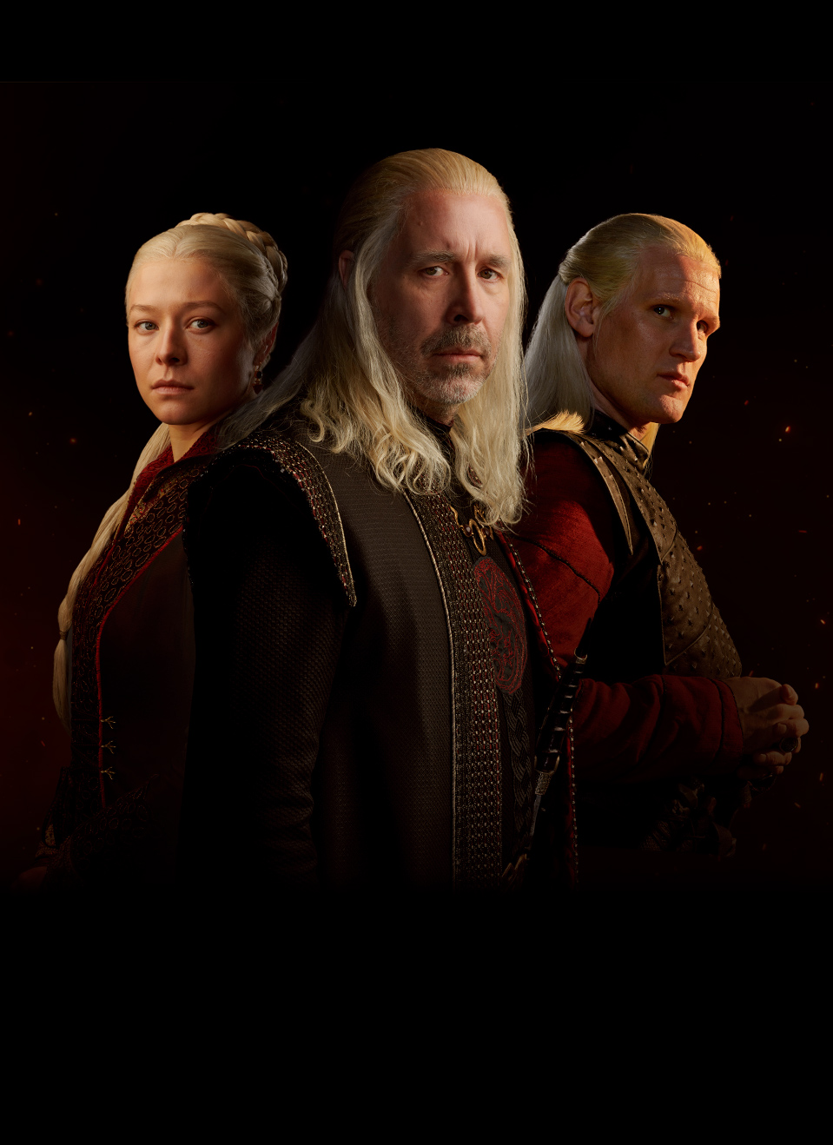
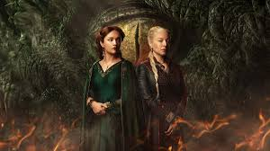
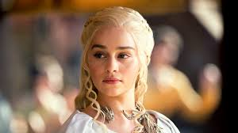
Moving on…
Next steps in this project
Exploring the many experiences of an increasingly-diverse profession
Looking at the bodies of work of retired faculty
Speaking with researchers with non-traditional career paths or who experienced some disruption to their career
Notes:
Narrative:
As stated earlier, this project is very much so at its beginning; but I think it has viability, and that there are many directions in which this might grow.
Both in my conversations and literature searches, it was further confirmed that there is no single “type” of biomedical researcher, no one path nor one experience of an academic career. Although diversity is still very much an issue in biomedical research, women, persons of color and ethnic minorities, immigrants, first-generation university attendees, among others – in short, those who have traditionally been underrepresented or marginalized in academia – are making significant strides in the profession, including my researchers here. There is some scholarship in these areas, and I’m eager to explore it further and hopefully contribute to it.
I’d also be interested in speaking with retired faculty and looking at how their scholarly publications have “performed” in the time since they’ve stepped away from full-time careers.
Another potential area of interest would be looking at the work of medical researchers whose career routes were non-linear or for whom academic research is a second or third or fourth career, or researchers who have experienced a disruption to their career – like an illness or family or caregiving responsibilities – and how that has impacted them. I look forward to where this work takes me and to continuing to center researcher experiences.
Images:
https://www.hbo.com/house-of-the-dragon/official-guide
https://www.hbo.com/house-of-the-dragon
https://www.hbo.com/game-of-thrones/cast-and-crew/daenerys-Targaryen

Slide 12
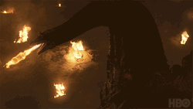
Thank you!
Questions?
Notes:
Narrative:
Thank you for your kind attention. Any questions? Fire away.
Image:
https://gifdb.com/gif/house-of-the-dragon-fire-attack-lieu844nxcdzcdee.html

Slide 13
References
Abbas, A. E., & Bell, D. E. (2022). Introduction: Special Issue Honoring Kenneth Arrow [Article]. Operations Research, 70(3), 1293-1295. https://doi.org/10.1287/OPRE.2022.2296
As'ad, M., Zainuddin, M., & Samsul Hady, M. (2023). The western perspective on islam: Reading the legacy of snouck hurgronje on islamic studies [Article]. Teosofi: Jurnal Tasawuf dan Pemikiran Islam, 13(1), 80-104. https://doi.org/10.15642/teosofi.2023.13.1.80-104
Atamer, T., Durand, R., Monin, P., & Very, P. (2022). A Tribute to Roland Calori's Scholarly Legacy, 20 Years Later Testimonies and memories by Tugrul Atamer, Rodolphe Durand and Philippe Very, coordinated by Philippe Monin [Article]. Management (France), 25(2), 77-82. https://doi.org/10.37725/mgmt.v25.8700
Ben-Peretz, M., & Craig, C. J. (2018). Intergenerational impact of a curriculum enigma: the scholarly legacy of Joseph J. Schwab [Article]. Educational Studies, 44(4), 421-448. https://doi.org/10.1080/03055698.2017.1387099
Berg, D. N., & Smith, K. K. (2017). The Professional Life of Clayton Paul Alderfer [Article]. Journal of Applied Behavioral Science, 53(2), 156-179. https://doi.org/10.1177/0021886317702609
Borokh, O. N. (2020). From Western Knowledge to a National Textbook: The Evolution of Li Quanshi's Socio-economic Views [Article]. Vestnik Sankt-Peterburgskogo Universiteta Vostokovedenie i Afrikanistika, 12(3), 426-451. https://doi.org/10.21638/spbu13.2020.308
Botterbush, K. S., Zhang, J. K., Chimakurty, P. S., Mercier, P., & Mattei, T. A. (2023). The life and legacy of John Robert Cobb: the man behind the angle [Article]. Journal of Neurosurgery: Spine, 39, 839-846. https://doi.org/10.3171/2023.7.SPINE23146
Breen, O. B. (2020). Regulating European Philanthropy: Lessons from the Scholarly Legacy of Evelyn Brody [Article]. Nonprofit Policy Forum, 11(3), Article 20200021. https://doi.org/10.1515/npf-2020-0021
Brown, F., Beresin, A., Henricks, T., Meckley, A., & Patte, M. (2017). Brian Sutton-Smith memorial panel–a celebration of the life and works of Brian Sutton-Smith [Article]. International Journal of Play, 6(1), 96-111. https://doi.org/10.1080/21594937.2017.1288377

Slide 14
References
Bulanin, D. M. (2022). Francis Thomson and his “Clavis” to Ancient Slavic Translated Literature [Article]. Slovene, 11(1), 379-396. https://doi.org/10.31168/2305-6754.2022.11.1.16
Buzzanell, P. M., & Stohl, C. (1999). The redding tradition of organizational communication scholarship: W. charles redding and his legacy [Article]. Communication Studies, 50(4), 324-336. https://doi.org/10.1080/10510979909388503
Cardona-López, J. J. (2008). Presentación [Article]. Romance Quarterly, 55(4), 243-245. https://doi.org/10.3200/RQTR.55.4.243-245
Cokley, K., Palmer, B., & Stone, S. (2019). Toward a Black (and Diverse) Psychology: The Scholarly Legacy of Joseph White [Article]. Journal of Black Psychology, 45(2), 112-121. https://doi.org/10.1177/0095798419828243
Davis, N. Y. (2006). Intellectual inspiration [Article]. Arctic Anthropology, 43(2), 51-53. https://doi.org/10.1353/arc.2011.0018
Fjalldal, M. (2011). Greatness and Limitations: The Scholarly Legacy of Finnur Jónsson [Article]. Neophilologus, 95(2), 329-339. https://doi.org/10.1007/s11061-010-9227-z
Frank, A. L. (1992). The academic legacy of Kurt W. Deuschle [Article]. The Mount Sinai journal of medicine, New York, 59(6), 447-449.
Geistfeld, L. V. (2010). ACCI memorial paper: The scholarly legacy of E. Scott Maynes [Article]. Journal of Consumer Affairs, 44(1), 247-258. https://doi.org/10.1111/j.1745-6606.2010.01165.x
Haacke, J. (2005). Michael Leifer and the balance of power [Article]. Pacific Review, 18(1), 43-69. https://doi.org/10.1080/09512740500047108
Hamilton, M. (2006). New Imaginings: The Legacy of Benedict Anderson and Alternative Engagements of Nationalism [Article]. Studies in Ethnicity and Nationalism, 6(3), 73-89. https://doi.org/10.1111/j.1754-9469.2006.tb00099.x

Slide 15
References
Hines, J. (2013). Review article: The final publication of the series 'on the iconology of the gold bracteates' and Karl Hauck's legacy [Article]. Medieval Archaeology, 57(1), 251-261. https://doi.org/10.1179/0076609713Z.00000000024
Joshi, K. D., & Deng, X. N. (2024). IT Research in Marginalized Contexts: An Evolving Landscape [Article]. Data Base for Advances in Information Systems, 55(2), 6-13. https://doi.org/10.1145/3663682.3663684
Kassow, S. D., & Bergman, E. (2022). The scholarly legacy of Ruta Sakowska [Article]. East European Jewish affairs, 52(2-3), 295-320. https://doi.org/10.1080/13501674.2023.2250272
Li, J., Goerlandt, F., & Reniers, G. (2020). Trevor Kletz's scholarly legacy: A co-citation analysis [Article]. Journal of Loss Prevention in the Process Industries, 66, Article 104166. https://doi.org/10.1016/j.jlp.2020.104166
Mowery, D. C. (2015). Steven Klepper and business history [Article]. Industrial and Corporate Change, 24(4), 755-768. https://doi.org/10.1093/icc/dtv023
Nielsen, S. B., Lemire, S., & Montague, S. (2023). Using Evaluative Information Sensibly: The Enduring Contributions of John Mayne [Article]. Canadian Journal of Program Evaluation, 37(3), 473-493. https://doi.org/10.3138/cjpe.75444
Ormond, D. R., Abozeid, M., Kurpad, S., & Haines, S. J. (2021). For the further training of individuals in neurosurgery II: The academic legacy of the William P. Van Wagenen Fellowship [Article]. Journal of Neurosurgery, 134(1), 304-313. https://doi.org/10.3171/2019.9.JNS191998
Owusu-Kwarteng, L. (2021). ‘Educated and educating as a Black woman’–an auto/biographical reflection on my grandmother’s influence on my academic and professional outcomes [Article]. Gender and Education, 33(7), 881-897. https://doi.org/10.1080/09540253.2019.1632811
Pereira, H. S., Williams, K. D., & de Belle, J. S. (2021). Marla Sokolowski: and now for someone completely different [Article]. Journal of Neurogenetics, 35(3), 112-116. https://doi.org/10.1080/01677063.2021.1940175

Slide 16
References
Quinney, K. M. (2019). Ideas are Weapons: On the academic legacy of Professor David F. Schmitz [Article]. Pacific Historical Review, 88(4), 685-695. https://doi.org/10.1525/phr.2019.88.4.685
Rainone, G. J., Nugent, J. G., Yeradi, M., Ramanathan, S., & Lega, B. C. (2024). Bibliometric Analysis and Applications of a Modified H-Index Examining the Research Productivity of Neurosurgery Faculty at High-Ranking Academic Institutions [Article]. World Neurosurgery, 181, e925-e937. https://doi.org/10.1016/j.wneu.2023.11.015
Rochon, L. P., Vidal, G., & Marshall, W. C. (2023). The Legacy of Alain Parguez and his Ongoing Research Agenda: Capitalism, the Financial Circuit and the State [Article]. International Journal of Political Economy, 52(3-4), 270-281. https://doi.org/10.1080/08911916.2023.2280369
Sivkov, I. (2022). THE ZAYDĪ IMĀMATE THEORY AS EXPLICATED IN “AL-ASĀS LI-‘AQĀ’ID AL-AKYĀS” OF THE IMĀM AL-MANSŪR BI-LLĀH [Article]. Shidnij Svit, 2022(1), 65-82. https://doi.org/10.15407/orientw2022.01.065
Smit, D. J. (2007). Interpreter interpreted: A reader's reception of lategan's legacy [Article]. Novum Testamentum, Supplements, 124, 3-25.
Sántha, I. (2003). The Siberian journeys and legacy of Vilmos Diószegi [Article]. Acta Ethnographica Hungarica, 48(3-4), 313-325. https://doi.org/10.1556/AEthn.48.2003.3-4.2
Valeev, R. M., & Valeeva, R. Z. (2022). Unpublished Correspondence of A. E. Krymsky and V.F. Minorsky [Article]. Res Militaris, 12(3), 1046-1054.
Woodside, A. G. (2018). Have your cake and eat it too: Achieving scientific legitimacy [Article]. Industrial Marketing Management, 69, 53-61. https://doi.org/10.1016/j.indmarman.2018.01.028

