Slide 1
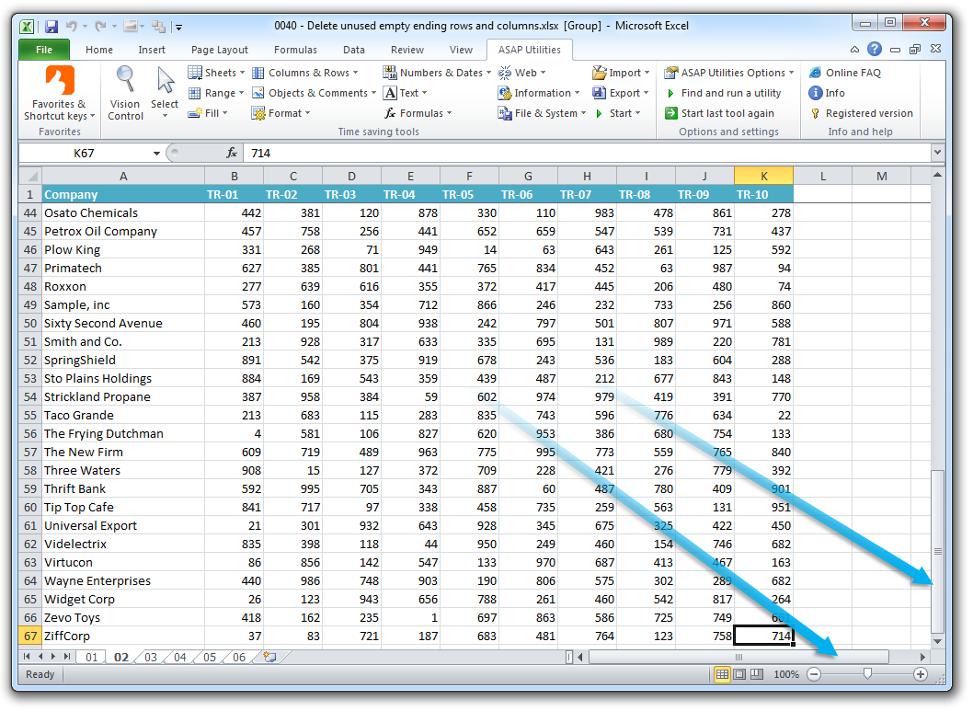
10 Simple Rules for
Data Cleaning with Excel
Sara Gonzales, MLIS
Data Librarian
Galter Health Sciences Library & Learning Center
Northwestern University Feinberg School of Medicine
Disclaimer: This class is not a general Excel class, but rather a specialized application of Excel. Galter Health Sciences Library & Learning Center does not provide technical support for any Microsoft Products.

Slide 2
A freebie! The Rules Go to 11
Helpful keyboard shortcuts in Excel:
(Ctrl key in Windows, Cmnd key in Mac)
Ctrl + Right Arrow to move right, Ctrl + Left Arrow to move left
Ctrl + Down Arrow to move down to the end of the column. Ctrl + Up Arrow to move to the top
Ctrl + 1 – Brings up format menu
Ctrl C – Copy
Ctrl V – Paste
Ctrl Z – Undo
Ctrl + Alt +V – Paste Special. Use to paste with special formatting.
Ctrl + F – Find. Brings up a dialog box to type the string of characters you’d like to find
Alt + Shift + Tab – Brings up the quick menu to the other programs you have open

Slide 3
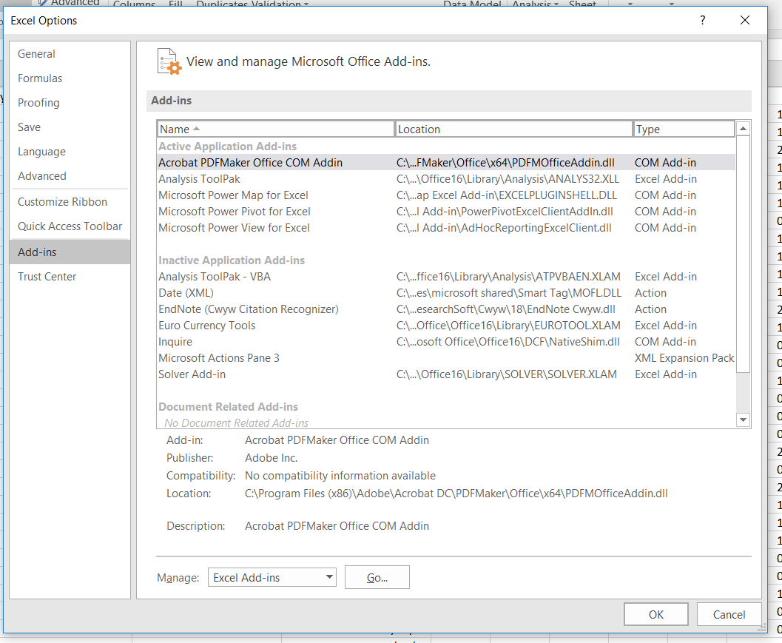

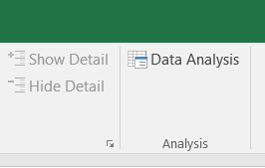
Rule 1: Load the Analysis ToolPak in Excel
Click File tab → Options (last choice on the left) → Add-ins (second to last choice on left)
Choose Analysis ToolPak, click OK
The ToolPak is installed correctly if “Data Analysis” shows up as the last choice on the right in the Data tab of the Excel ribbon

Slide 4
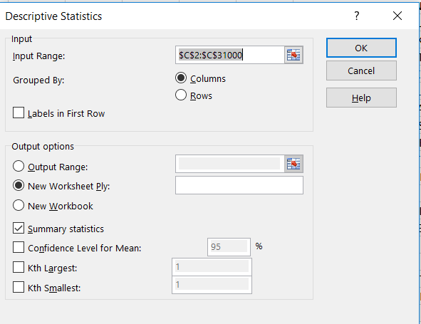
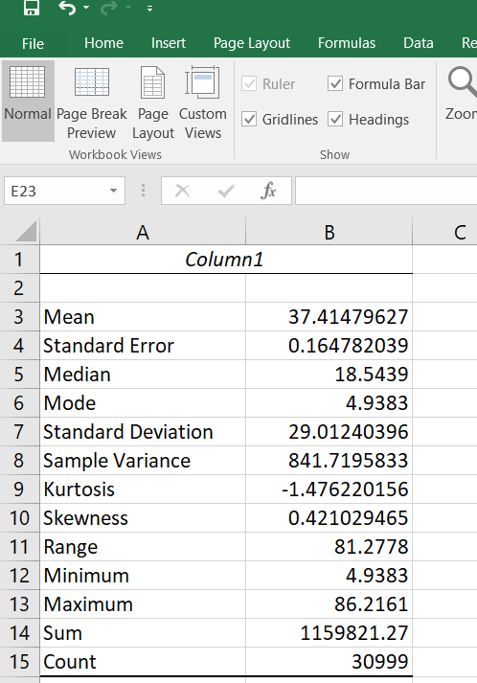
Rule 2: Summary Statistics for Quick Checks
To see summary statistics for a numeric column:
Data Tab → Data Analysis → Descriptive Statistics
Enter the Input range
Check Summary Statistics box
Your statistics will open in a new worksheet by default; can choose new workbook
In addition to these statistics being useful for a preliminary analysis, you can also use them to check for errant data values.
A mean or median that is way off what you expected could indicate errors in data-entry in this column.

Slide 5
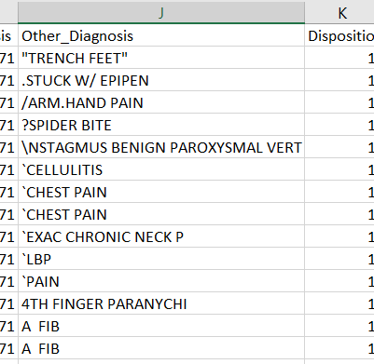
Rule 3: Harness the Power of the Simple Sort
Simple sort instructions:
Select All by clicking the triangle in the far left of the screen
Data Tab → Sort
In dialog box, check “My data has headers”
From “Sort by,” choose Other_Diagnosis
Click OK
Simple sorts will quickly show data entry errors in data points consisting of only a few words (such as “ABSCESS” and “LOW BACK PAIN” in the Other_Diagnosis column).
Simple sorts will also bring fields beginning with unusual characters to the top.

Slide 6
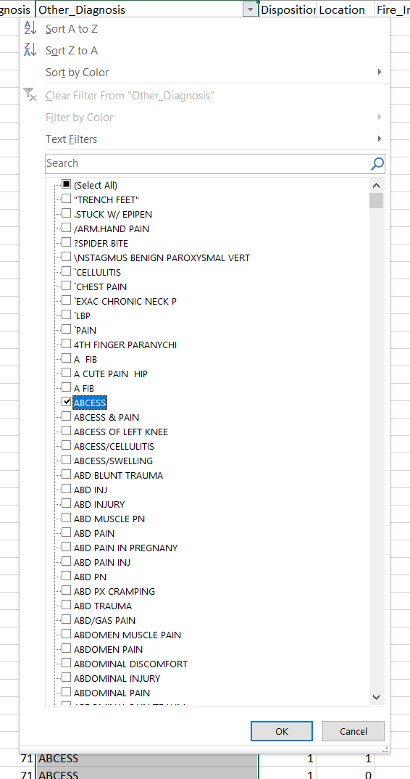
Rule 4: Harness the Power of the Simple Filtering
Simple filter instructions:
Go to Data Tab → Filter
Click the drop-down arrow that’s now at the top of your chosen column
You can search for a string of characters in the filter choices
You can “Unselect All” (All is selected by default) and choose one or a handful of terms to filter on
Excel displays rows only for the filters you have chosen
Simple filters are good for:
Finding and fixing data entry errors and typos
Making quick changes to subsets of the data
Spot-checking data

Slide 7
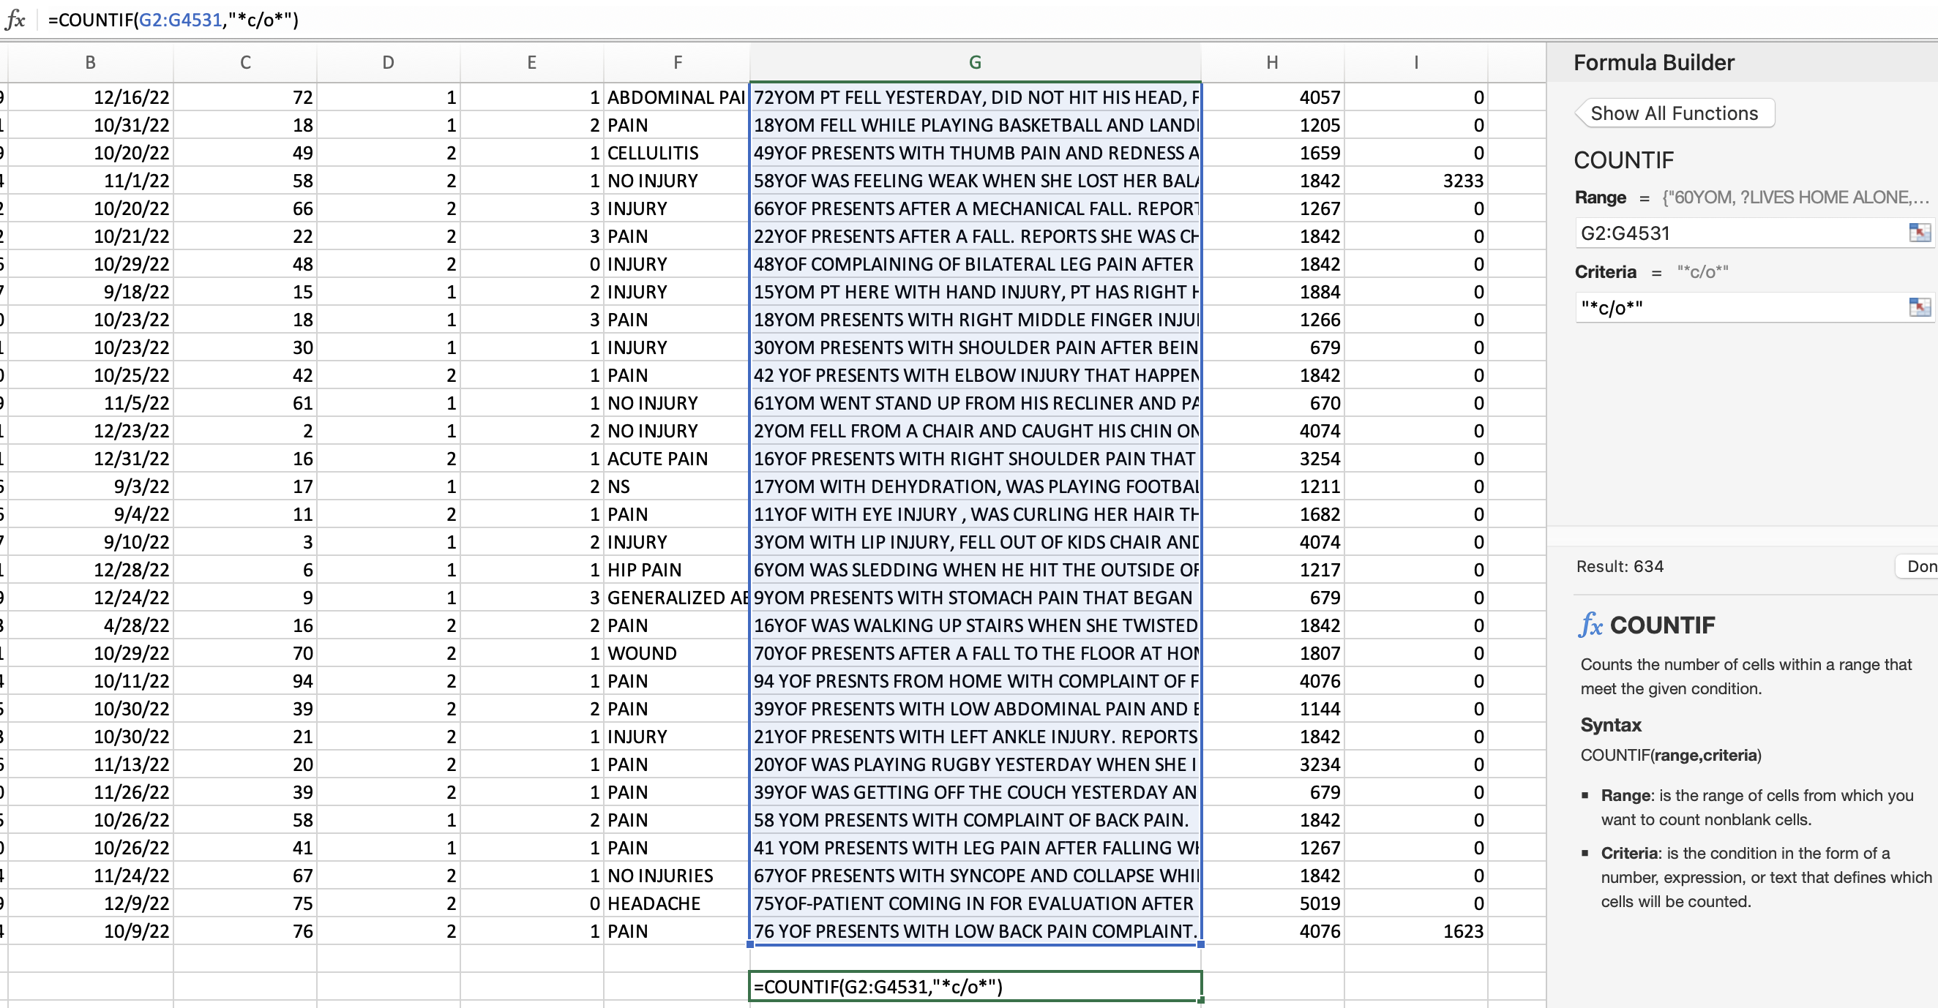
Rule 4: Explore your data with COUNTIF
COUNTIF instructions:
Select a column, then choose an empty cell beneath it
From Formulas tab, choose “Insert Function” and search for COUNTIF
Enter a range of cells over which to count
Enter criteria
  Use format “*text*” if you want to search for a string of characters, no matter where they occur
Notes:
In our example, we searched for all the fields in Narrative_1 where “c/o” occurs, to let us know how many records contain the “complaining of” shorthand. The result should be 634 records.

Slide 8
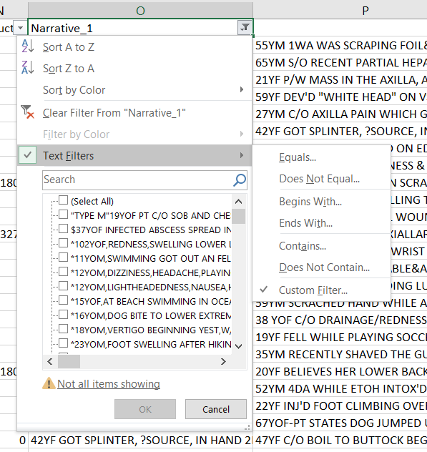
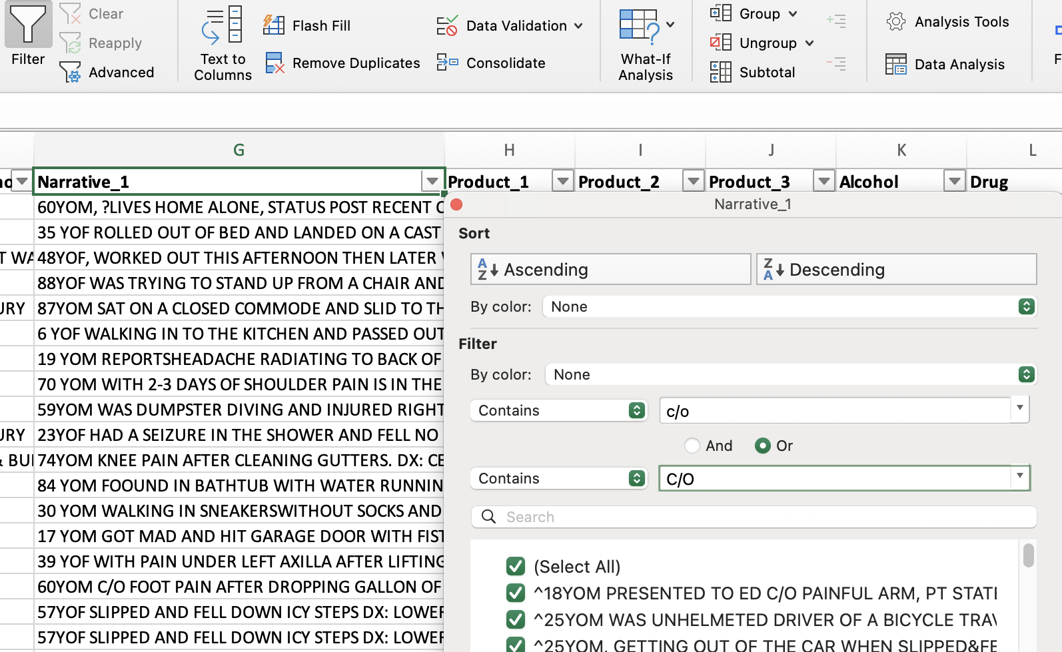
Rule 4: Advanced Filters
* This is a fairly simple example of applying Advanced Filter criteria. To see instructions for more complicated criteria, see: https://support.office.com/en-us/article/filter-by-using-advanced-criteria-4c9222fe-8529-4cd7-a898-3f16abdff32b
Simple steps to create a custom text filter:
From the Data tab, choose Filter, → Text Filters → Custom Filter
Next choose specific criteria such as Contains, Begins with, Ends with, etc.
Choose two instances from this menu to join filters
Notes:
The Custom Text Filter allowed us to filter for every record where “c/o or “C/O” was used in the Narrative_1 column. With our next tip, we can quickly update many of these instances so “c/o” or “C/O” is changed to “complaining of”.

Slide 9
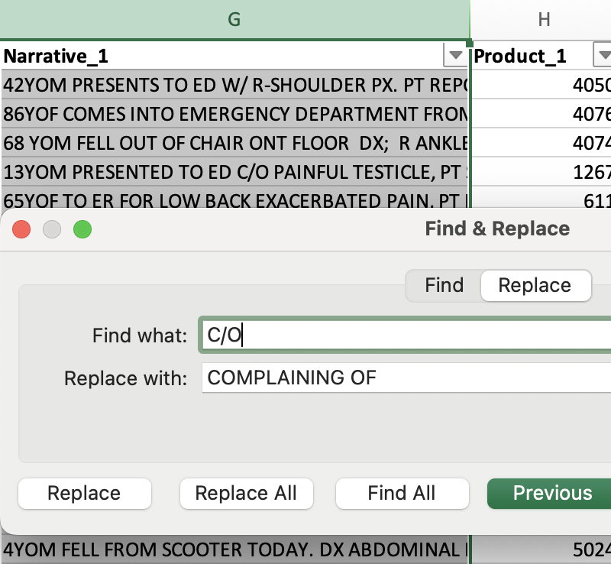
Rule 4.1: Find and Replace
Find and Replace instructions:
Select the Narrative_1 column
From the Home tab choose Find and Replace (magnifying glass near right end of ribbon)
Search for a string (e.g., C/O) and replace it with the desired text (COMPLAINING OF)
Using the Filter arrow still at the top of Narrative_1, go back to Text Filter → Custom Filter and re-run it. There should now be no results, because all the instances of C/O have been replaced. If there are results, check for spelling anomalies
Repeat the above step as many times as necessary to update any instances with spelling anomalies
* This is a fairly simple example of applying Advanced Filter criteria. To see instructions for more complicated criteria, see: https://support.office.com/en-us/article/filter-by-using-advanced-criteria-4c9222fe-8529-4cd7-a898-3f16abdff32b
Notes:
The Custom Text Filter allowed us to filter for every record where “C/O” was used in the Narrative_1 field. Using Find and Replace, we can quickly update these records to read “COMPLAINING OF” instead.

Slide 10
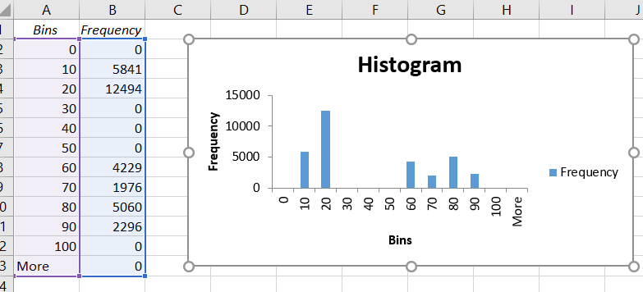
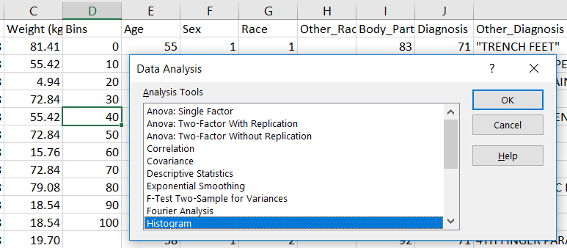
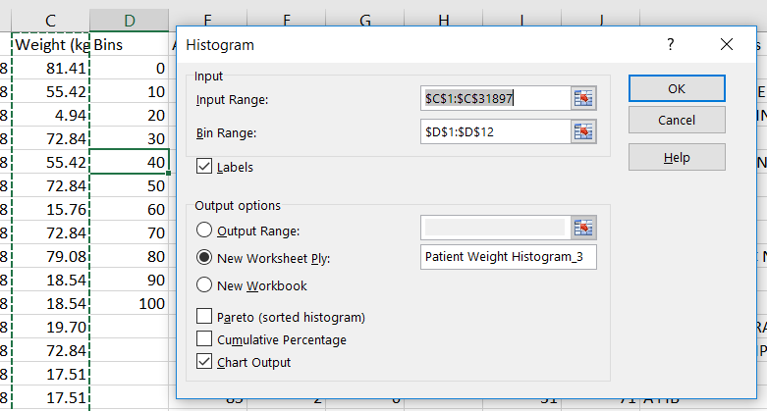
Rule 5: Visualize your data with Histograms
Histogram instructions:
Create a new column with Bins from 0 – 100, in increments of 10
Go to Data tab → Data Analysis → Histogram
Most importantly, enter the column range and Bin range with $ before each column letter and row number (this makes the formula work on the entire data range selected, including anything hidden). This can also be done by placing the cursor in the box and selecting the corresponding range on the worksheet
As with sorting and filters, this brings to light outliers in the data or surprises, which may denote data-entry errors
Notes:
The bins contain the numbers “up to” the number listed (for example, the 10 bin contains all weights from 0 – 10 kg. It’s either a particular trait or an anomaly in the dataset that there are no patients in the weight categories 20 – 30 kg, 30 – 40 kg, or 40 – 50 kg. The histogram helps us to see this without having to scroll through or sort the data.

Slide 11
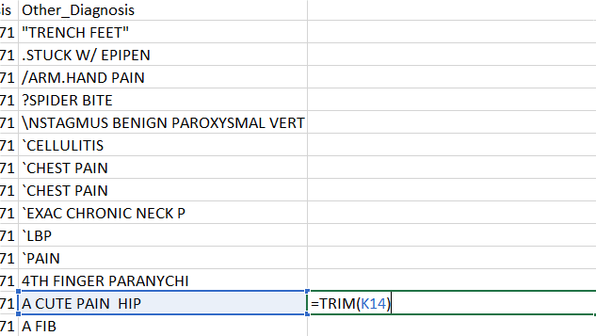
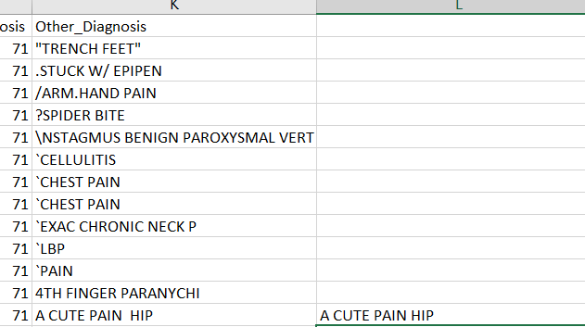
Rule 6: Automatically trim extra whitespace
Trim instructions:
Create a new column next to the one where whitespace needs to be trimmed
Either for the whole range, or cell-by-cell, enter =TRIM(), with the cells you’d like to trim inside the parentheses
Two spaces
Now one space
Trim will not fix space-related spelling errors! It will only look for instances of two spaces next to each other, or leading or trailing whitespace on strings.

Slide 12
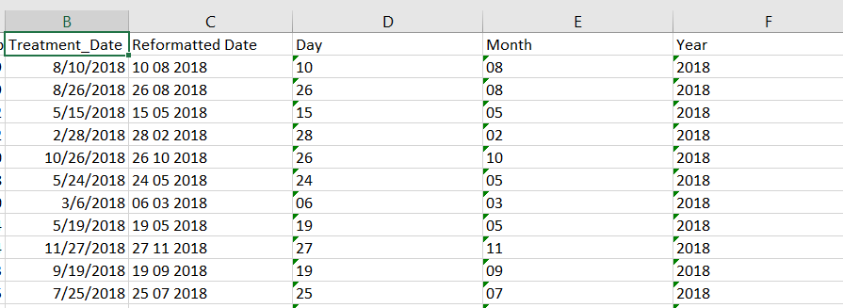
Rule 7: Split multi-valued cells
In this example, the Treatment Date fields represent fields with multiple values, separated by a slash, which we would like to examine individually
Steps:
Convert the dates to text. Add a new column (which will be column C) and title it “Reformatted Date”. In field C2, type the formula =TEXT(B2, “dd mm yyyyy”), then double click the plus sign at the bottom of C2 to copy the formula down the entire spreadsheet
Create three new columns next to Reformatted Date and title them Day, Month, and Year (columns D-F)
Excel still thinks of column C’s values as a formula. To replace the formula with the values themselves, click on C2, then hit Ctrl + Shift + Down arrow. This selects all the values in column C. Click Ctrl + C to copy all the values, then right click on C2, scroll down to Paste Special, and choose the third option (Values)
Click on C2, then hit Ctrl + Shift + Down arrow to select all the text date values again. Click on Data Tab → Text to Columns
In dialog box, choose Delimited, then check the box by Space (uncheck others). For each of the thee new columns you can see in the Data preview window, change the Column data format to Text. In Destination, click the white box, then click into the first field of the destination in the spreadsheet (D2, the first field in the Day column), then type : , delete anything that auto-filled and type $F$4531 (this represents the last field in the Year column). Click Finish
The three new columns have filled with only the day, month, and year respectively of the original dates

Slide 13
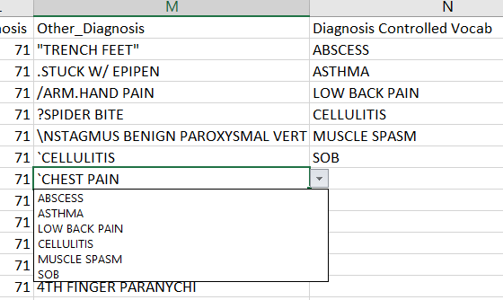
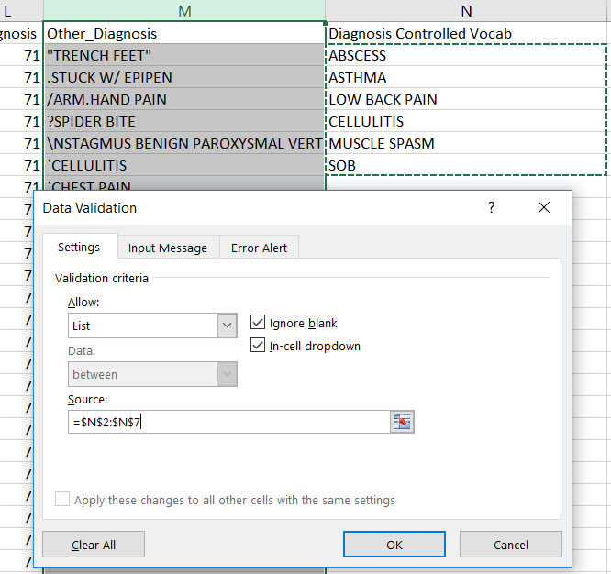
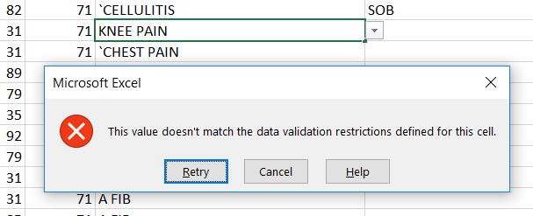
Rule 8: Cell Validation
When complete, cells in column M will only accept items from the Diagnosis Controlled Vocab list as values
Steps:
Create a new column titled “Diagnosis Controlled Vocab” next to Other_Diagnosis. Fill it with as many terms as you like.
Select your cells to validate (either all of column M or M2:M4531)
From the Data Tab choose Data Validation, and Data Validation from the drop-down
Under Validation criteria you have many choices of the kinds of values you can allow, such as numbers formatted certain ways, dates, etc. Choose “List”
For the Source, click in the white box, then in the first cell of the values in “Diagnosis Controlled Vocab”. Type a colon (:), then delete the row number from the auto-fill and replace it with the number of the last row in “Diagnosis Controlled Vocab” (should look something like: $N$2:$N$7)
Notes:
Using Cell Validation, you can set up your cells to only accept certain values, even from the beginning of data collection. Much like a validated field in REDCap, this prevents unvalidated terms from being entered as data values.

Slide 14
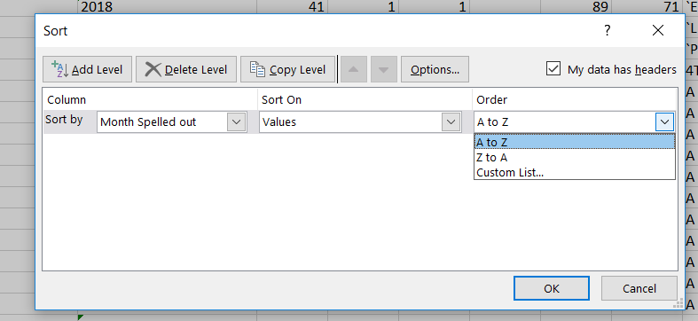
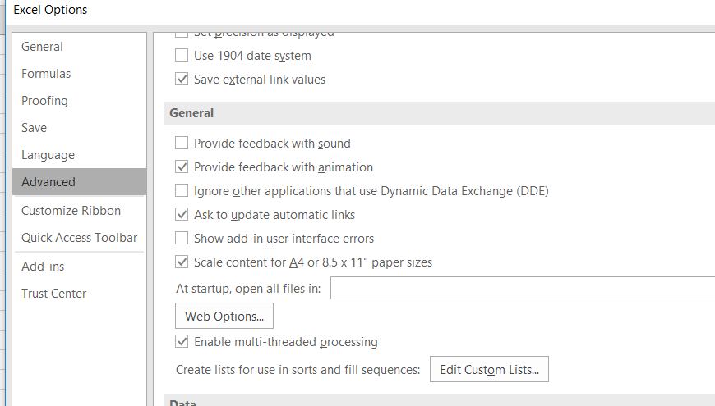
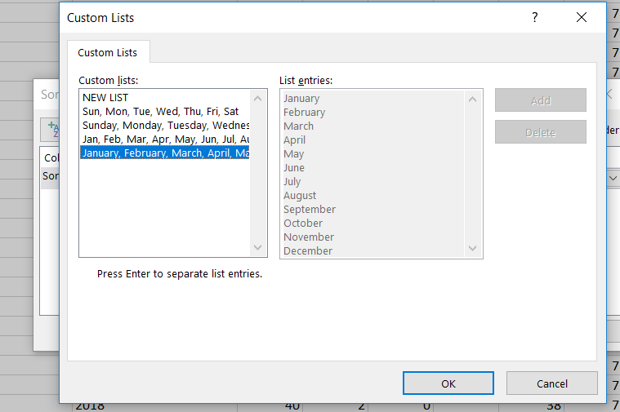
Rule 9: Custom Lists
Creating a custom list to sort records by the months of the year
Steps:
Insert new column next to Month called “Month Spelled Out” (column F on my screen)
In the first cell (row 2) enter the formula: =TEXT(E2*29, "mmmm"). This converts the number for the month to the spelled out month name
Double click in the lower right corner to copy the formula down the spreadsheet
Go to File → Options → Advanced → General, then click the “Edit Custom Lists” button
Choose the last option, with the months of the year spelled out. Note that there is also a NEW option to create a list of your own. Click OK.
Go to Data Tab → Sort. In dialog box, check that your data has headers, sort by Month Spelled Out, and in Order choose Custom List. Choose the months option
Notes:
When a custom list is used, the sort will occur in the order specified in the list. Notice when we complete the sort following these steps, that the information in the spreadsheet is organized by the order in which the months occur in the year (just as the list is organized), rather than alphabetically by month name.

Slide 15
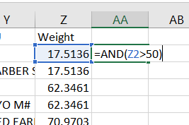
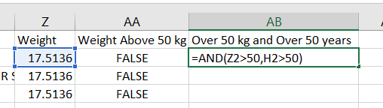
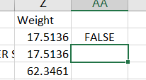
Rule 10: Logical Operators
Boolean formulas can combine multiple conditions and become very complicated. Here is a relatively simple AND statement combining two conditions. It is checking to see whether the patient is over 50 kg and over 50 years old.
Write a formula to check whether the patient weighs over 50 kg. If this condition is not met, the Boolean value returned is “FALSE”
The basic Boolean operators are AND, OR, and NOT. The two values that statements involving them will return are TRUE and FALSE
AND – returns the value “TRUE” if all conditions specified are true
OR – returns the value “TRUE” if at least one of the specified conditions is true
NOT – returns “TRUE” if the condition specified is not met
Benefits:
After applying a Boolean statement to a column of data, you can sort and filter by whether the conditions you specified were met
Narrow in on very specific slices of data that meet very specific conditions. For guidance on how to create more complex Boolean statements, see Excel Boolean logic: How to sift spreadsheet data using AND, OR, NOT, and XOR by JD Sartain

Slide 16
Credits
“The Excel Minute for Healthcare Professionals” (keyboard shortcuts) by Patrick Randolph, https://www.youtube.com/watch?v=HSYdd2jfM-A
“Load the Analysis ToolPak in Excel” by Microsoft Office, https://support.office.com/en-us/article/load-the-analysis-toolpak-in-excel-6a63e598-cd6d-42e3-9317-6b40ba1a66b4
“Essential Skills for Data Analytics in Healthcare” by Susan Fenton, RHIA, PhD, UTHealth School of Biomedical Informatics, https://www.txhima.org/resource/resmgr/convention/2017/doc_fenton_susan_data_analyt.pdf
“Split a Cell” by Microsoft Office, https://support.office.com/en-us/article/split-a-cell-f1804d0c-e180-4ed0-a2ae-973a0b7c6a23
“How to Use Data Validation in Excel – custom validation rules and formulas by Svetlana Cheusheva via Ablebits.com, https://www.ablebits.com/office-addins-blog/2017/08/17/use-data-validation-excel-custom-rules-formulas/
“How to Convert 1-12 To Month Name in Excel?” by ExtendOffice, https://www.extendoffice.com/documents/excel/5146-excel-convert-1-12-to-month.html
“Excel Boolean logic: How to sift spreadsheet data using AND, OR, NOT, and XOR” by JD Sartain, part of the Max Productivity series on PCWorld.com, https://www.pcworld.com/article/2985015/excel-boolean-logic-how-to-sift-spreadsheet-data-using-and-or-not-and-xor.html
Developed resources reported in this presentation are supported by the National Library of Medicine (NLM), National Institutes of Health (NIH) under cooperative agreement number 1UG4LM012346. The content is solely the responsibility of the authors and does not necessarily represent the official views of the National Institutes of Health.
Thank you!
Contact me at: sara.gonzales2@northwestern.edu

