Slide 1
Mapping the OMOP Common Data Model to Neo4j for Pneumonia Therapy Response:
SCRIPT Case Study
Mengjia (Marjorie) Kang
marjorie.kang@northwestern.edu
Division of Pulmonary and Critical Care, Northwestern University

Slide 2
Agenda
OMOP CDM v5.3.1
Mapping OMOP to Neo4j for SCRIPT
Next Steps
Q & A
SCRIPT Introduction

Slide 3
SCRIPT Introduction
Basic information + Motivations

Slide 4
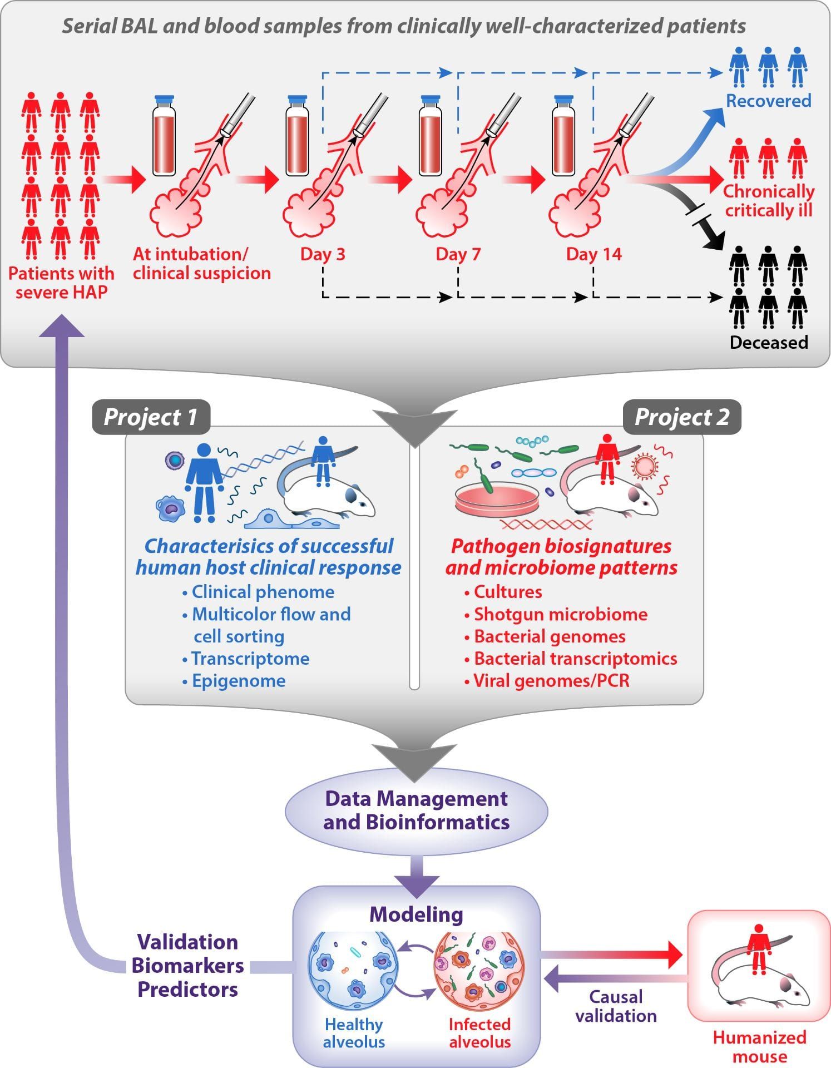
SCRIPT (Successful Clinical Response In Pneumonia Therapy)
Summary
https://script.northwestern.edu/research/

Slide 5
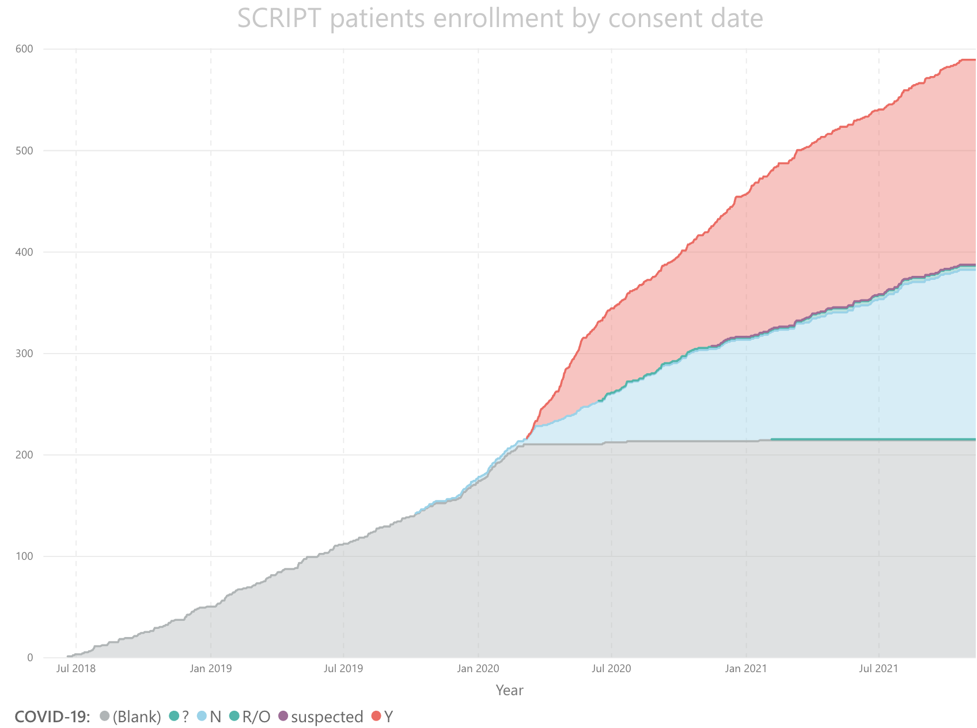
SCRIPT (Successful Clinical Response In Pneumonia Therapy)
Summary
#script_cytokines
#covid_waves
#long_covid
https://script.northwestern.edu/research/

Slide 6
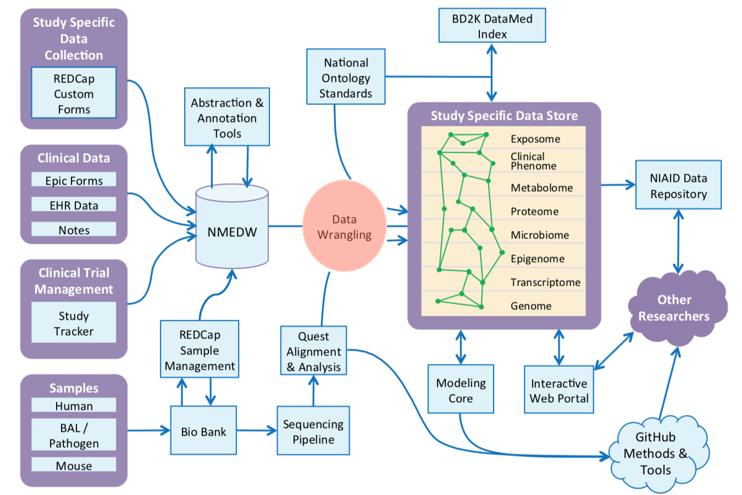
SCRIPT Data Flow
https://script.northwestern.edu/people/data-management-and-bioinformatics-core/

Slide 7
SCRIPT Venn Diagram
Clinical.tables
(e.g., bal_results, basic_endpoints from EDW reports)
(7 tables)
OMOP EMR
(9 tables)
Clinical.patient
(NOTE:
This is a linking table
cp.cohort_patient_id = person_id,
cp.case_number = pt_study_id,
cp.ir_id = patient_ir_id)
Multi-omics
(RNAseq, Metagenomics, Bacterial whole genome)
REDCap
(18 forms)
RNAseq/metagenomics
Metadata
(libarary prep info)
These 5 data sources are LDS
(IRB required for access)
bal_sample_id
Accession_numbers_id
cohort_patient_id
batch_sample_id
bal_sample_id
This data source are fully de-ided
(all research members can access)
patient_ir_id
bal_sample_id

Slide 8
SCRIPT Venn Diagram
Clinical.tables
(e.g., bal_results, basic_endpoints from EDW reports)
(7 tables)
OMOP EMR
(9 tables)
Clinical.patient
(NOTE:
This is a linking table
cp.cohort_patient_id = person_id,
cp.case_number = pt_study_id,
cp.ir_id = patient_ir_id)
Multi-omics
(RNAseq, Metagenomics, Bacterial whole genome)
REDCap
(18 forms)
RNAseq/metagenomics
Metadata
(libarary prep info)
These 5 data sources are LDS
(IRB required for access)
bal_sample_id
Accession_numbers_id
cohort_patient_id
batch_sample_id
bal_sample_id
This data source are fully de-ided
(all research members can access)
patient_ir_id
bal_sample_id

Slide 9
SCRIPT goals
Clinically
  Pneumonia is a complex disease - we wanted to find the mechanism of host responses to severe pneumonia infection
  Many clinical decisions need to be careful adjudicated, the knowledge network and graph algorithms can help with the process

Slide 10
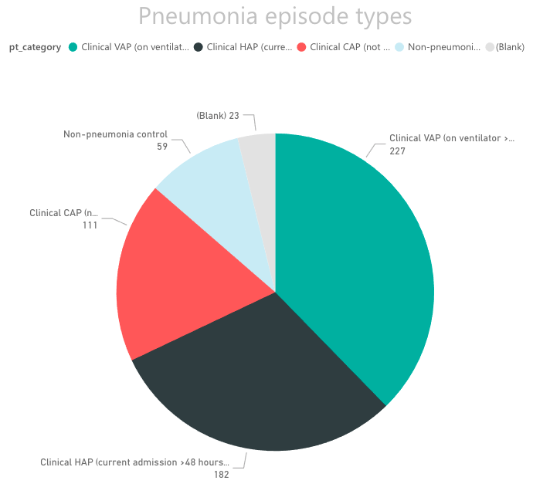
SCRIPT goals
Clinically
  Pneumonia is a complex disease - we wanted to find the mechanism of host responses to severe pneumonia infection
  Many clinical decisions need to be careful adjudicated, the knowledge network and graph algorithms can help with the process

Slide 11
SCRIPT goals
Clinically
  Pneumonia is a complex disease - we wanted to find the mechanism of host responses to severe pneumonia infection
  Many clinical decisions need to be careful adjudicated, the knowledge network and graph algorithms can help with the process
Technically
  The datasets we are collecting are diverse and we wanted to make full use of them
  EMR and omics datasets are inherently highly connected, Neo4j graph network can help with finding potential patterns/paths behind them.

Slide 12
OMOP CDM v5.3.1

Slide 13
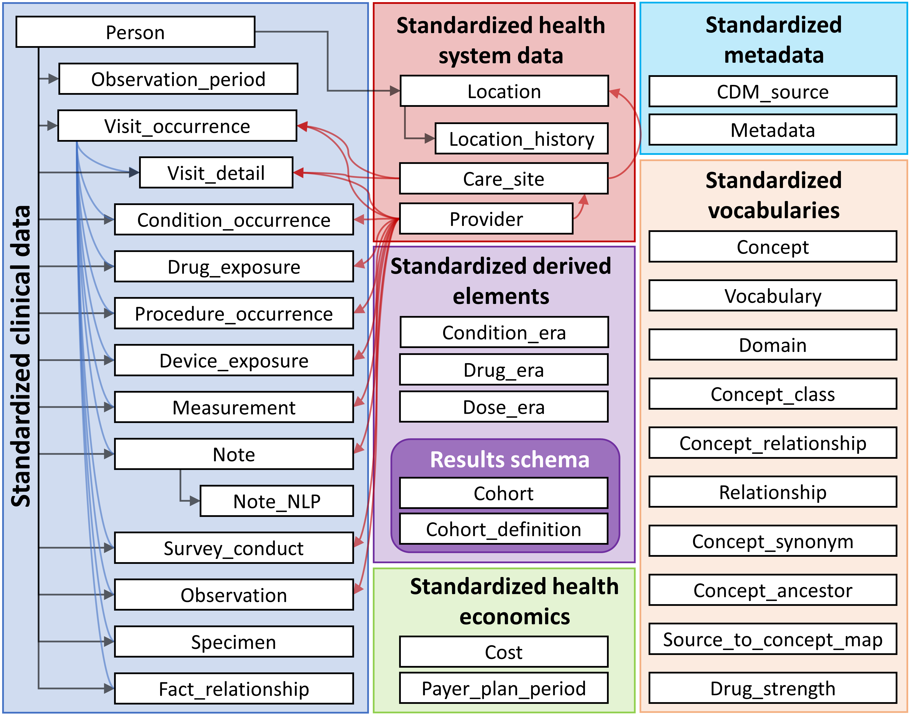
OMOP CDM v5.3.1

Slide 14
Mapping OMOP to Neo4j for SCRIPT
Schema + local & global analysis examples

Slide 15
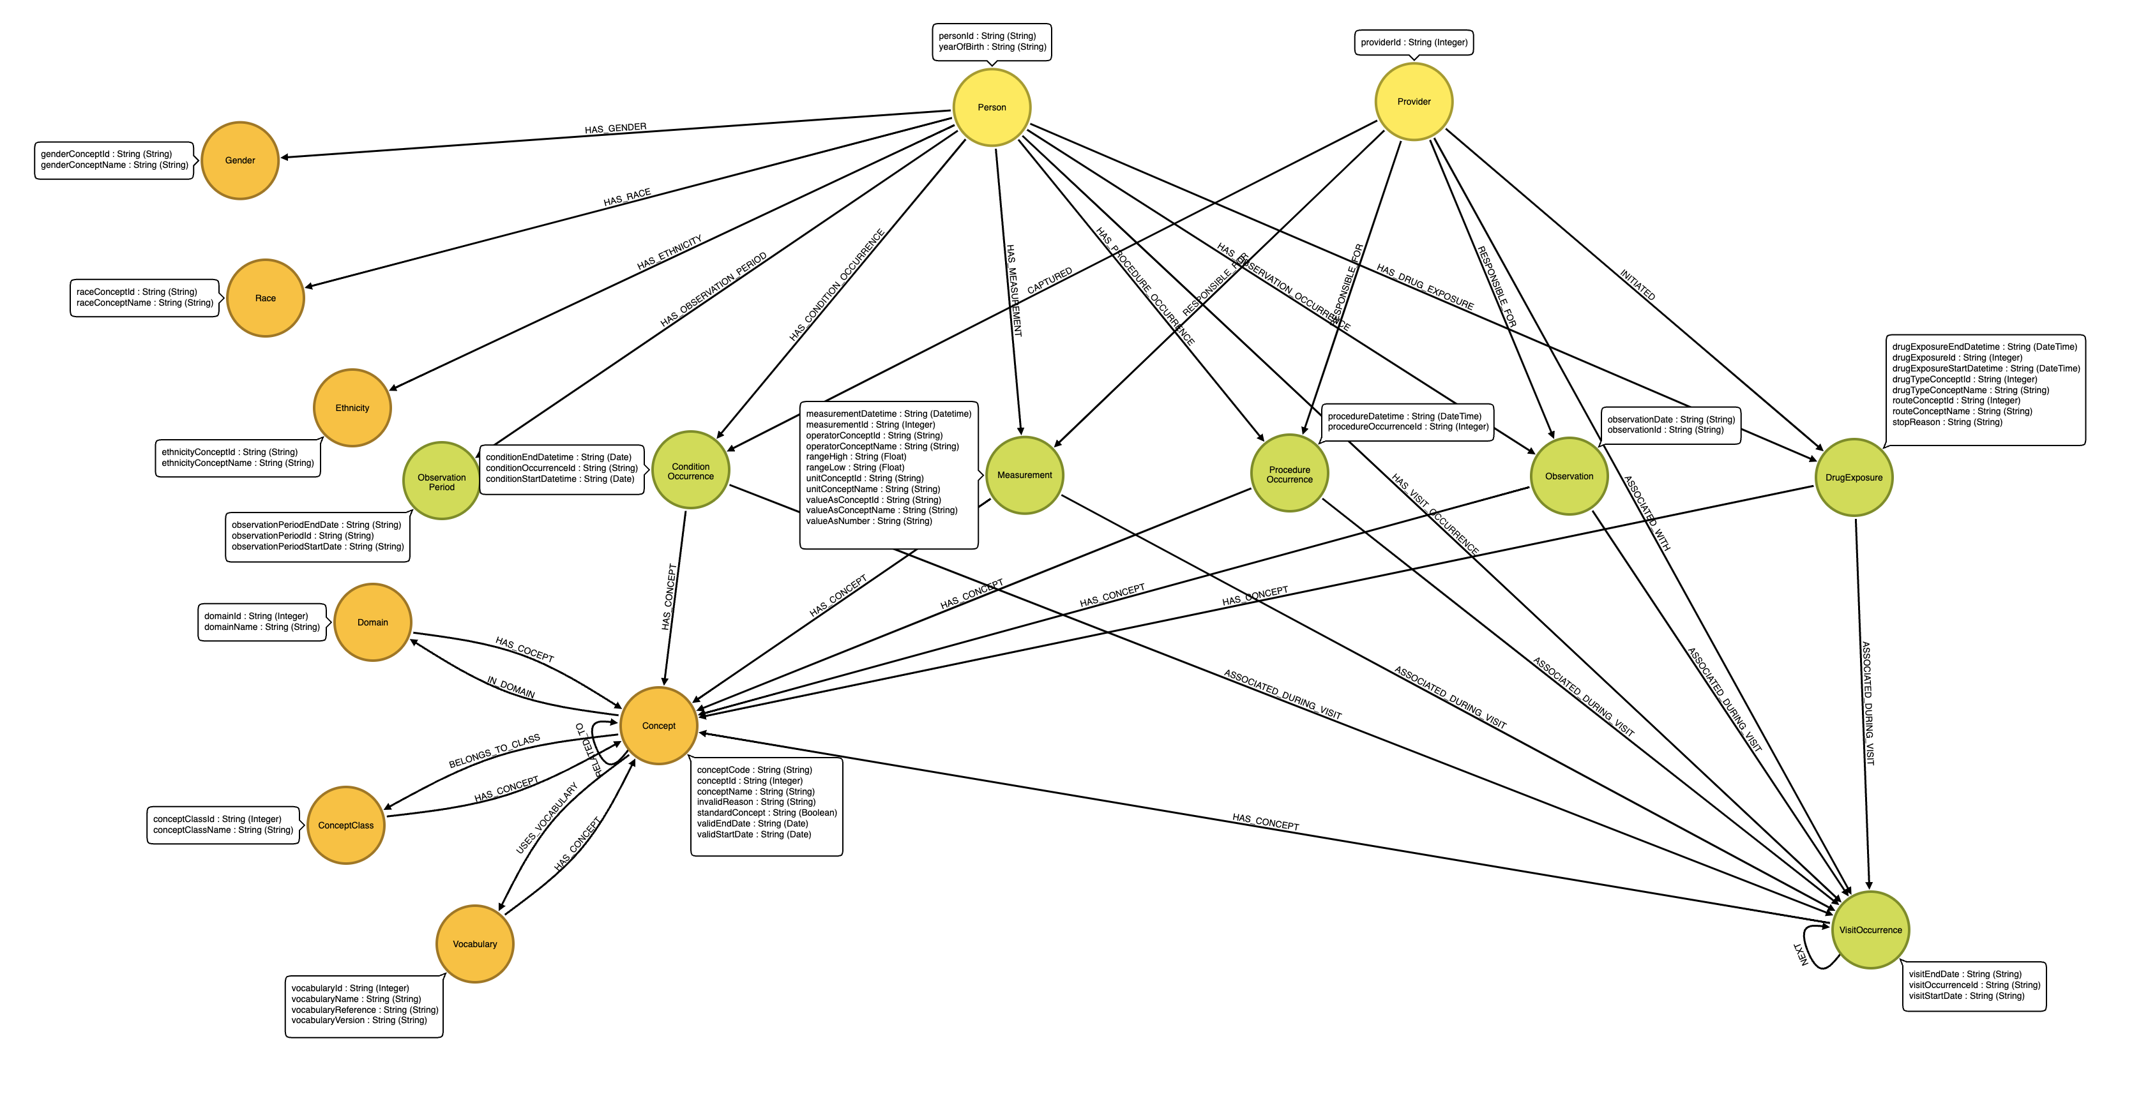
Neo4j Graph Schema
16 types of nodes (entities) and 22 types of edges (relationships) and 55 node properties.
Nominal and categorical data -> nodes
Foreign keys -> edges
Numerical values to node or edge properties as appropriate

Slide 16
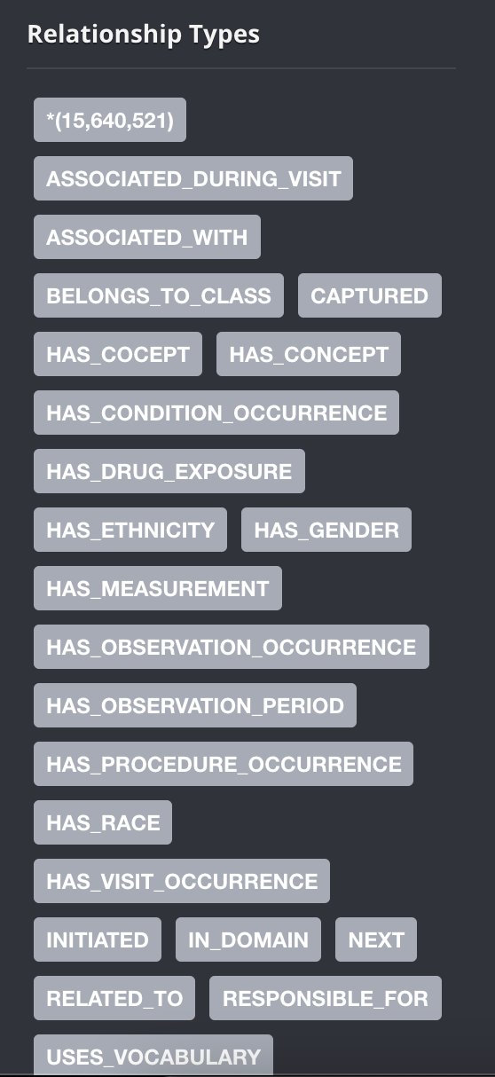
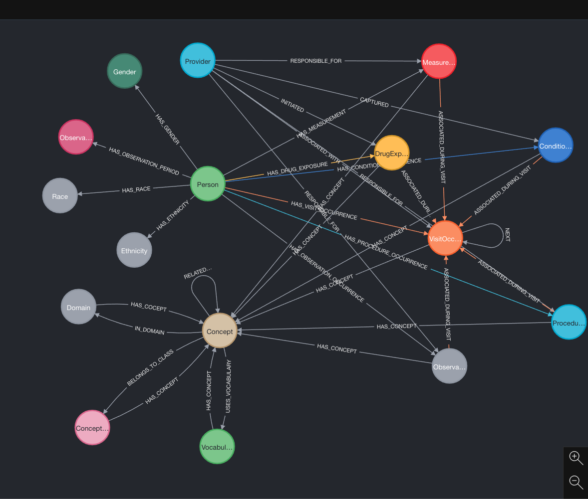
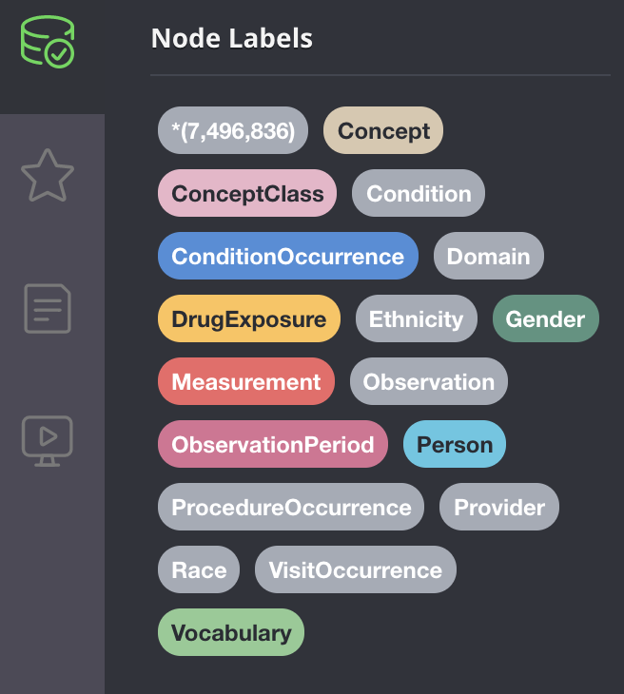
Neo4j database snapshot:
~7M nodes and ~15M edges for 553 patients

Slide 17
Neo4j graph database details
Label | Count
Observation | 39,761
Gender | 3
Measurement | 4,722,097
DrugExposure | 548,236
Person | 554
ObservationPeriod | 554
ProcedureOccurrence | 273,999
Provider | 82,907
Label | Count
Ethnicity | 4
Race | 7
ConditionOccurrence | 554,187
Concept | 1,095,984
VisitOccurrence | 177,996
Domain | 49
Vocabulary | 83
ConceptClass | 415

Slide 18
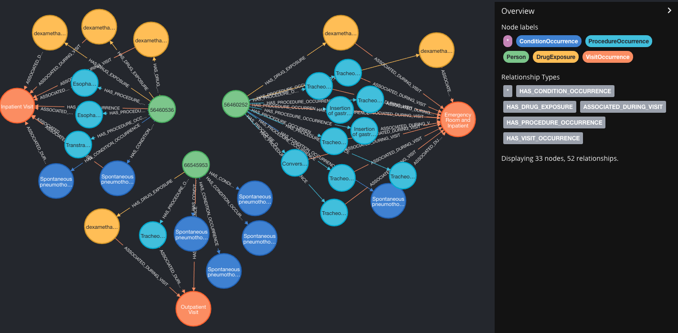
Local Analysis example
Find out the patients who has ‘Spontaneous Pneumothorax’ and has ‘dexamethasone’ prescribed, and has ‘tube’ related procedure

Slide 19
Global Analysis Pipeline for Patient Clustering
NMEDW
Neo4j
Azure/local JupyterLab
Load OMOP to Neo4j
Load communities
NMEDW to OMOP
Node similarity
Filtering diagnoses to consider
Plot and explore groups
Calculate TF/IDF
Weakly connected components
See *
Louvain community detection
Build edges
FSM SQL Server
* Details
Merge with Acute/chronic indicators
Prepare shared conditions edges for patients
Prepare subgraph/parameters
Extract from OMOP
Identify communities
Extract TF/IDF and communities

Slide 20
Patient Clustering Results
Found five distinct clusters
Each cluster has a dominate type of disease group (cancer, respiratory, chronic diseases, etc.)
However, none of the five groups match exactly the pneumonia types (CAP, VAP, HAP, non-pneumonia control) as we expected
community/pneumonia category | CAP | VAP | HAP | CTL
c1 | 12 | 33 | 19 | 1
c2 | 24 | 18 | 13 | 3
c3 | 11 | 10 | 37 | 14
c4 | 10 | 11 | 38 | 9
c5 | 14 | 14 | 14 | 15

Slide 21
Next Steps
Use degree centrality score as the criteria for data cleaning
Build bipartite graph instead of monopartite graph for patient similarities
Include REDCap survey data
Integrate genomics, transcriptomics, bacterial whole genome .etc
Model patient events (diagnoses, procedures, labs) trajectory

Slide 22



Acknowledgements
SCRIPT - Luke Rasmussen, Justin Starren, Richard Wunderink, Dong Fu, Catherine Gao, Daniel Schneider, Prasanth Nannapaneni, Benjamin Singer, Helen K. Donnelly, Nicholas Soulakis, Yuan Luo, Yiqing Zhao and all SCRIPT researchers
Neo4j - José Alvarado-Guzmán
Neo4j enthusiast - David Stumpf, Narciso Albarracin

Slide 23
Thank you!

Slide 24
Q & A

