Slide 1

Cleaning Spreadsheet Data with OpenRefine The Powerful Tool for Cleaning Messy Data
Sara Gonzales, MLIS
Data Librarian
Galter Health Sciences Library & Learning Center
Northwestern University Feinberg School of Medicine
Adapted from Library Carpentry OpenRefine, Copyright © 2016–2019 Library Carpentry, CC BY 4.0.

Slide 2
What is OpenRefine?
An open source tool first developed by Google (originally called GoogleRefine)
A data-cleaning machine that requires no coding knowledge
(although it helps to learn a few ‘expressions’ – more on this later!)
A secure tool that runs in your local browser window, but does not share your data online

Slide 3

What can you do with OpenRefine?
Resolve inconsistencies in data
-Review large chunks of data at a glance
-Correct errors in data entry
Split data into more granular elements
-Create new columns when two values have mistakenly been entered in one
Reformat data
-Change dates to different formats
-Change spellings and capitalizations
Compare/match data against controlled sources
-Match author names against the Library of Congress Name Authority File
-Match against other sources such as WikiData
Make all these changes and more without changing your original data file! Export a new version from OpenRefine

Slide 4
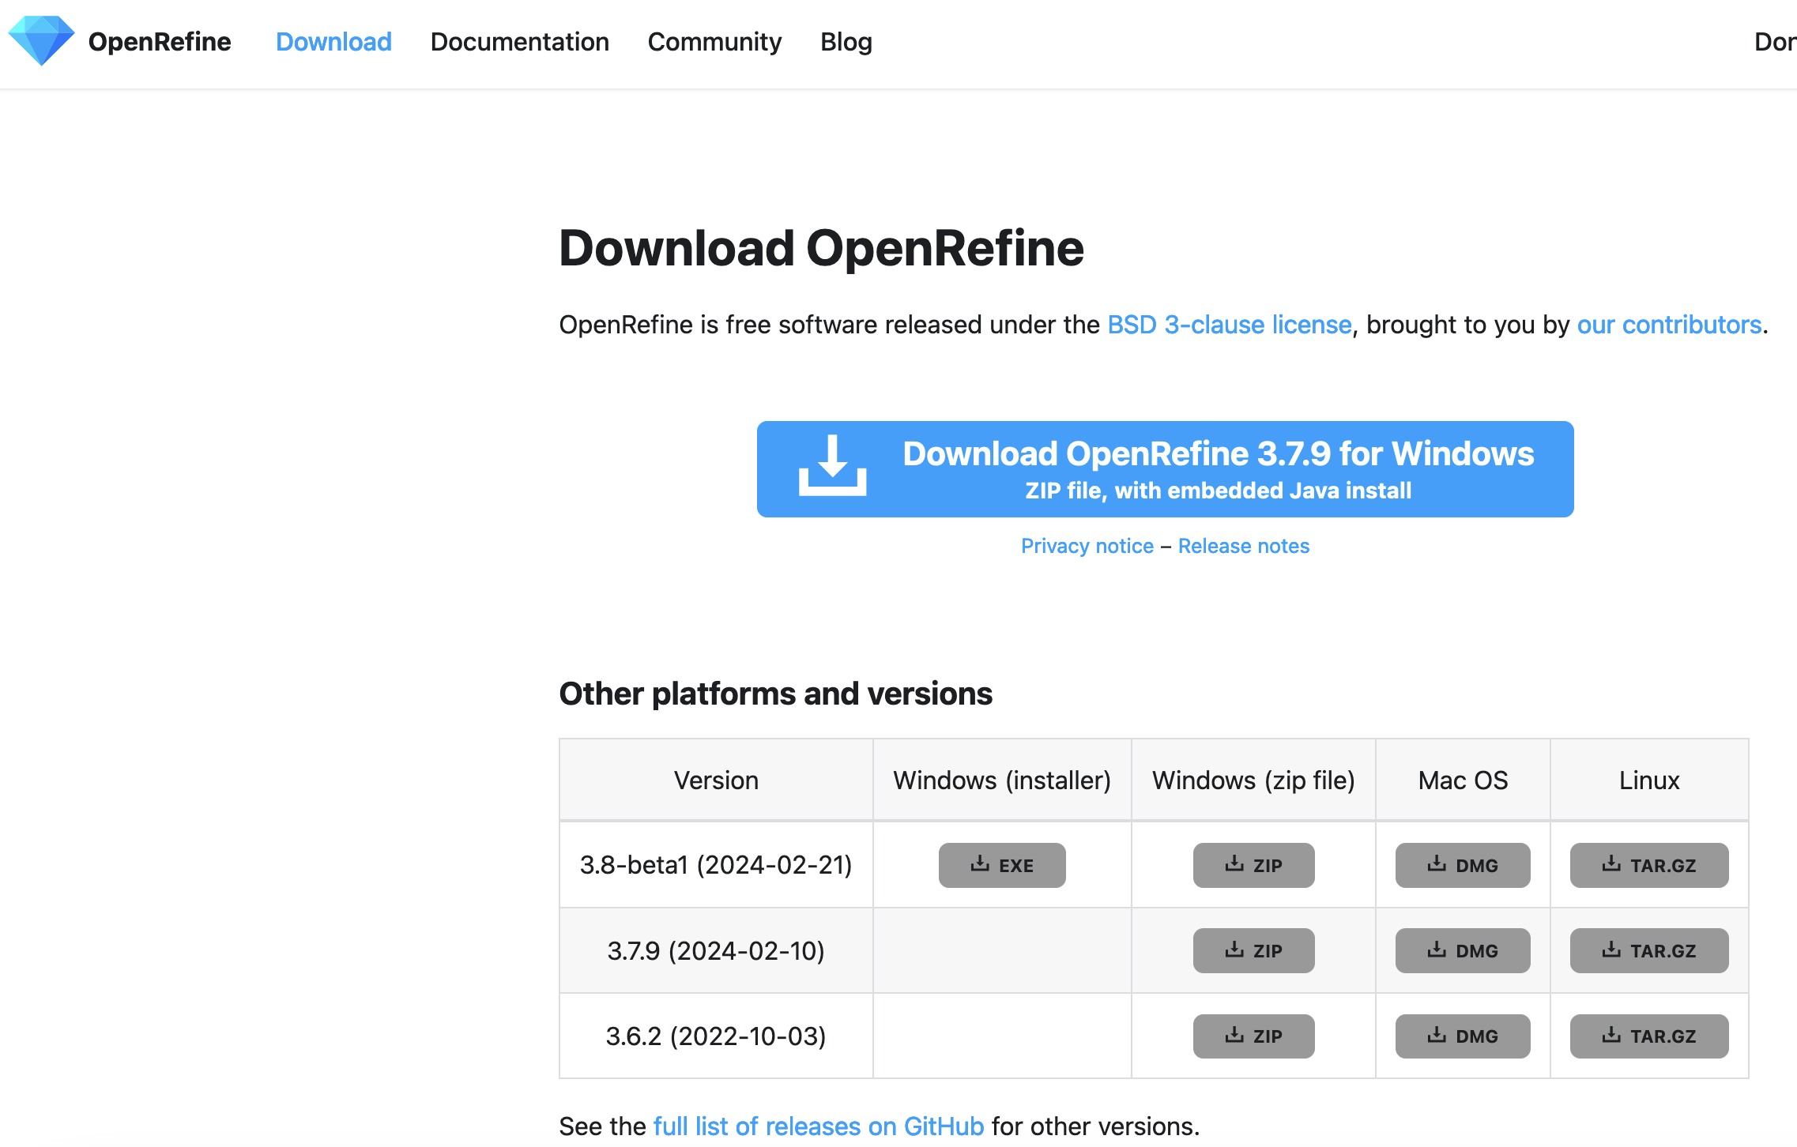
Download
Download OpenRefine from: http://openrefine.org/
Download the dataset for this class:
https://drive.google.com/file/d/16CYfmWcx9ecXEdRYDd3A7-KC_2CUyepz/view?usp=sharing
“2018_NEISS_SmallSubset.csv”
Notes:
-It’s best to download the latest, non-beta version. This is the version that is most likely to support any add-on features you might like to use, like reconciliation services
-Once downloaded, extract the files from the Zip folder, then open the .exe (executable file) and run it

Slide 5
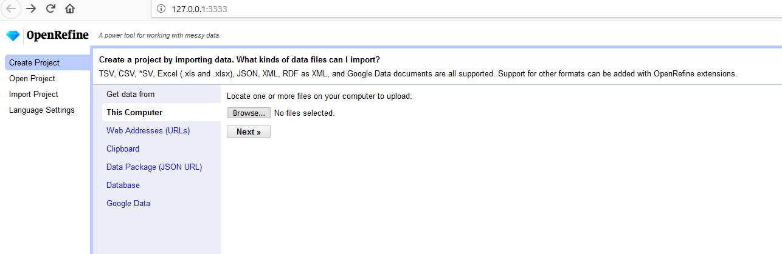
Open a Project
-Open CSV, Excel, JSON, and XML files stored on your computer
OR
-Fetch data from a Web Address

Slide 6
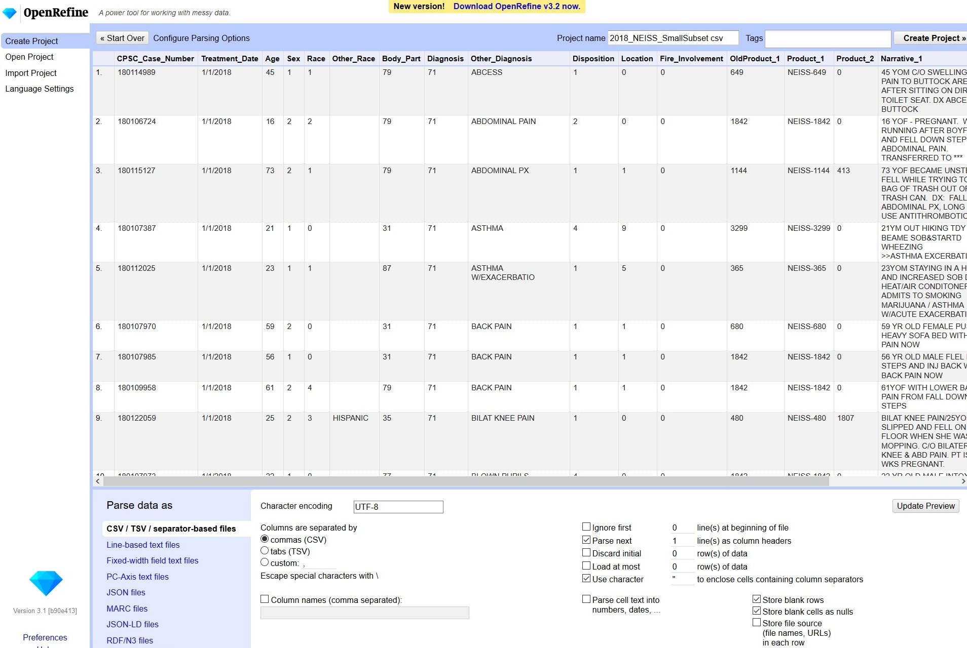

Uncheck this box
Notes:
You will see a preview of the first ten or so rows of data immediately upon upload. At the bottom of the screen you’ll have some choices to make which will affect how your data will display. In “Character encoding,” click in the box and choose UTF-8. Check the box to parse the text of the first line of your data as column headers. For the purposes of this class, make sure that “Parse cell text into numbers, dates, etc.” is unchecked so OpenRefine won’t automatically try to identify numbers and dates. When the “Configure Parsing Options” screen looks like this, click “Create Project” in the upper right corner.
When working on your own, you can configure the parsing options any way you’d like. Experiment with changing the settings on a dummy dataset like this before trying the changes on a real project.

Slide 7
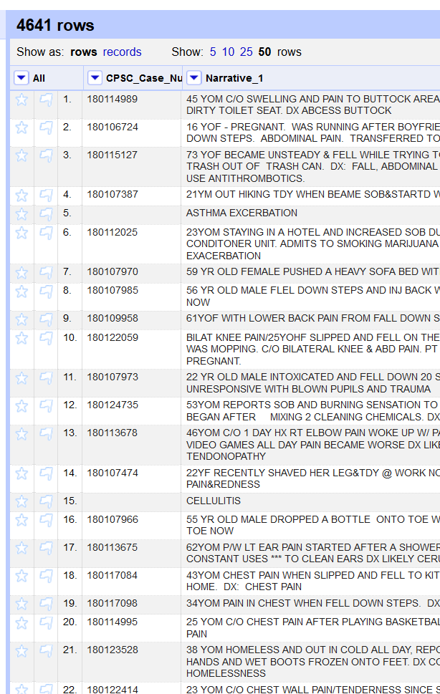
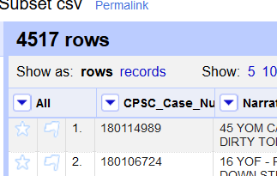
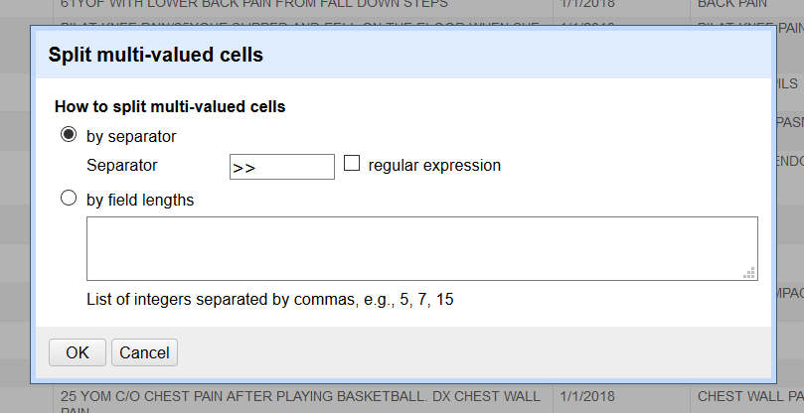
Rows, Records, and Splitting cells
Notes:
OpenRefine displays data in a tabular way, much like a spreadsheet. In this format, a row is equivalent to a record, and the columns represent the types of data stored in the records.
By default only 5 or 10 rows may be shown. You can change the view to 50 to see more of your data records. Use the “next” and “last” links at the top to scroll through all your rows of data.
What is the difference between records and rows? If you split multi-valued cells, this will create more rows, but Open Refine remembers that the values all belong to one record.
The down-pointing arrow at the top of each column shows you your options for editing data in this column. When you transform data in a column, only that column is affected, but the entire data project allows for the change.
Let’s split cells in the Narrative_1 column. Choose “Edit cells –> Split multi-value cells” Before the split occurs, You will have a choice of splitting by a separator that exists in the data, or by a field length (which you might use if you have a lot of fixed-length strings in your data cells, like 4-digit years). In the Narrative_1 column we’ll split on the separator “double carats” ( >> ) since that symbol appears as a separator denoting the diagnosis in some fields.
Now you can see that the number of rows has increased from 4517 to 4641. That is because each record that incorporated the “>>” symbol has been provided with a new row to hold the data that appears after the split, which is the diagnosis. OpenRefine “remembers” which records the new rows belong to, and does not consider the new rows to be new records.

Slide 8
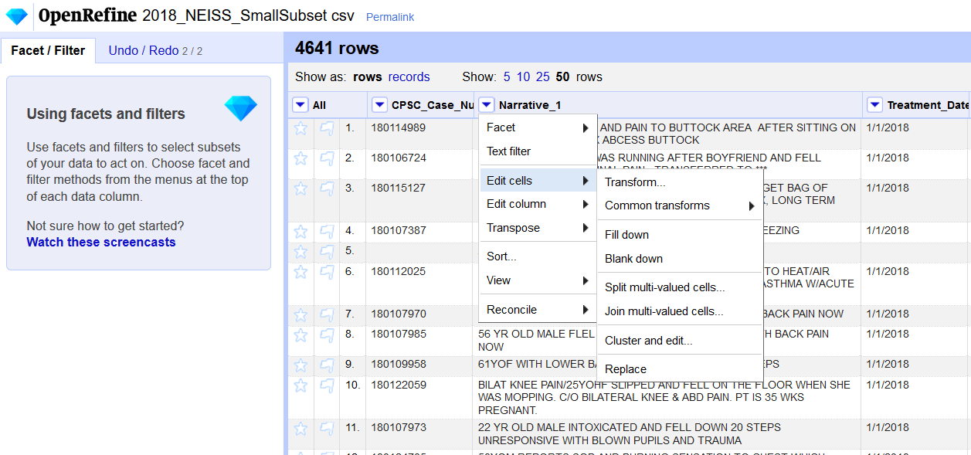
Joining Cells
Edit cells → Join multi-valued cells to re-join the split cells
Notes:
What if we decide we don’t want those rows split? We can join up multi-valued cells again by choosing the option pictured. You will be asked which separator you would like between the joined values. This can be anything you like, be it a comma, a space, etc. Let’s use the double carats ( >> ) again, since that was in the records before. Now you’ll see that rows are re-joined, and the diagnoses are back in their original fields with “>>” before them. Also we now have the same number of rows and records again, 4517.
If you will re-join values often, be mindful of the separator you use. Don’t use a comma if commas come up frequently in your data values. Choose a symbol that is unlikely to appear in the data.
The main reason for splitting rows like this and re-joining them would be to clean the values row-by-row first by doing some transformations on the data when it’s parsed into individual rows. The cleaned values can then be joined back up again. Transformations are covered later in the class.

Slide 9
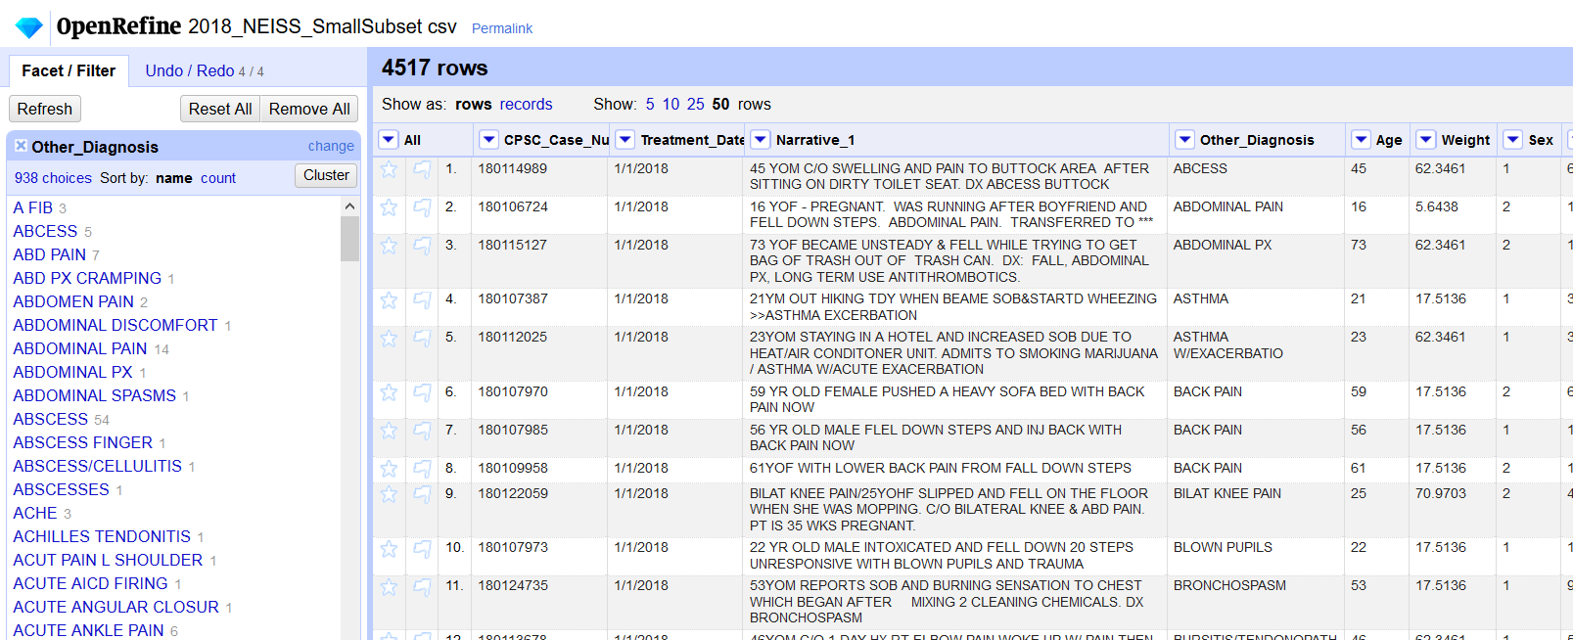
Facets and Filtering
Facets: one of the most powerful features of OpenRefine. Faceting counts the values in every cell in a column and displays them in a box on the left side of the screen. This lets you see quickly where there might be inconsistencies in the data.
Examine values in the facets: for every listed value you have the choice to either include it or exclude it in any clustering operation you might do.
Clustering: If you have similar values in the facets, you can include them in a clustering operation, another powerful feature of OpenRefine. Clustering uses different algorithms to bring together values with similar words and spelling.
Notes:
If you have created facets that you no longer want to work with, you can simply x out of the facet box by clicking the x in the upper left corner. This changes nothing in the underlying data, as long as you haven’t transformed the data.
You can also do numeric facets, which will display a graph instead of a list of values. You can use the slider on the graph to limit the range of the numeric fields you might want to transform. In general this facet gives you a good sense of the range of certain number values in your data, so you can see if there are outliers or anything seems incorrect. Timeline facets works similarly.
Scatterplot facets are a little less commonly used. Learn more about scatterplot facets at: https://openrefine.org/docs/manual/facets#scatterplot-facet

Slide 10
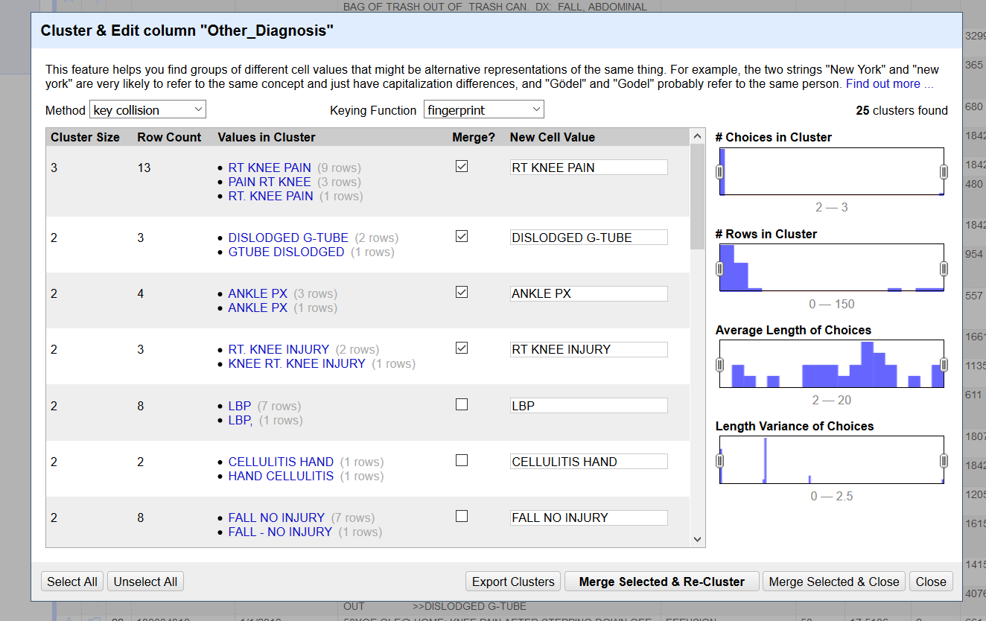

Clustering
From the top of your chosen column, choose “Edit Cells → Cluster and Edit.”
Examine the outputs of the various algorithms until you find what works best for your data
Change the New Cell Value manually if the value suggested by OpenRefine is not correct.
Check the check-box to merge all the values to the New Cell Value.
Click “Merge Selected & Re-Cluster” at the bottom of the screen
Notes:
Let’s take a quick look at another powerful feature of OpenRefine: Clustering. Let’s use the “Other_Diagnosis” column.
-From the column drop-down, choose “Edit Cells → Cluster and Edit.” The results should look like this. Notice the drop-downs at the top. OpenRefine used a key collision method and a fingerprint algorithm to combine various diagnoses into clusters based on their similarity, and in order to suggest the preferred term (generally the term that was used in the most rows). You can change these settings to see if another algorithm might work better for your data. Here some manual curation is involved, since you will have to examine the results and decide whether the system got it right. You can also manually change the term in the whitespace if you desire. When you believe that the best term has been chosen and that it is correctly mapped to all its respective cells, click the merge checkbox to merge terms. This will change the terms as listed in OpenRefine to the new formats, but remember that none of these transformations changes your original data file.

Slide 11
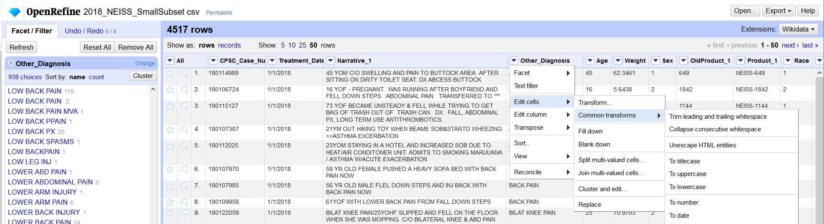

Transformations
Transformations are another powerful aspect of OpenRefine. Some common transformations are pre-loaded into OpenRefine such as trimming leading and trailing whitespace, changing all text in a cell to titlecase, uppercase, or lowercase, or transforming values in cells to number, date, or text.
Notes:
Let’s try a common transformation on data in the Other_Diagnosis field. First, so we can see it a little more easily, let’s move the column to the left. In the “All” column on the left-hand side, click the drop-down and choose “Edit columns → Re-order/remove columns”. The columns will then be listed, top to bottom, in the same order in which they occur left to right in the program. Drag Other_Diagnosis up on the list so it can be seen more easily.
First do a text facet on the Other_Diagnosis field. Note how many choices there are (938). Scroll to “Low Back Pain” and note that it seems to be listed twice, once with 118 occurrences, and once with only two.
Now choose “Edit Cells → Common transforms → Trim leading and trailing whitespace.” Once you make this choice, the transformation will run automatically, even with the text facet applied.
Look at the facet block. There is now only one choice for “Low Back Pain”, and it has 120 occurrences, the combination of the 118 and 2 of the previously existing occurrences. All that has changed is that OpenRefine removed the extra spaces, or whitespace, at the end of the second “Low Back Pain” listing. This made the system recognize that the two “Low Back Pain” values were the same.

Slide 12
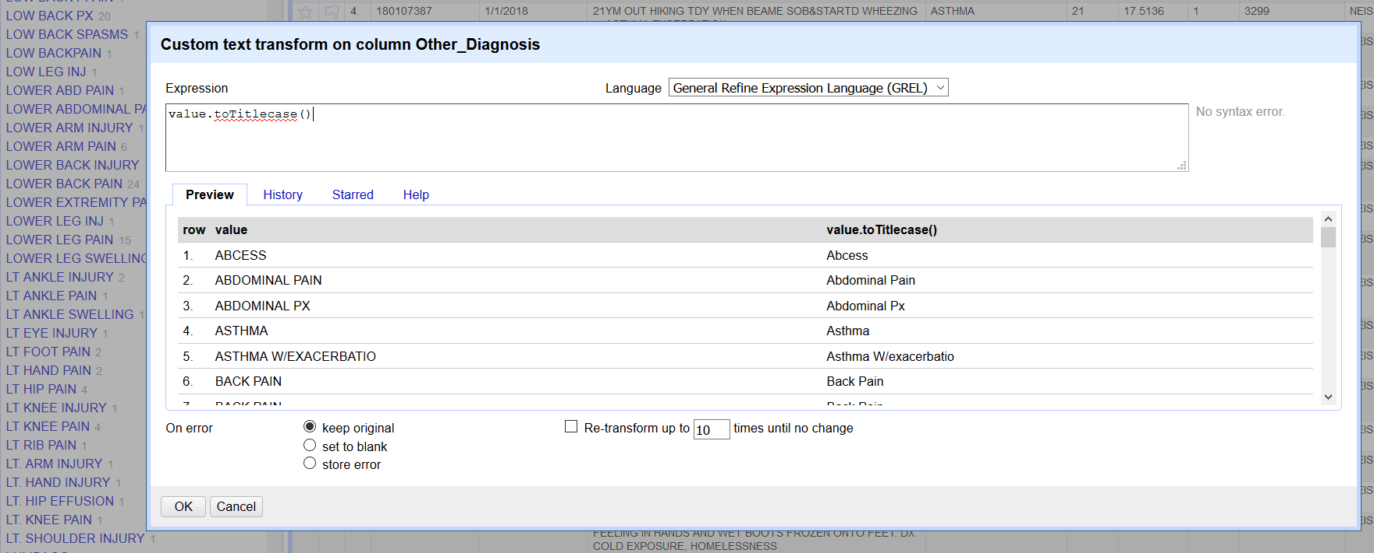
Writing Transformations
To make transformations that are not pre-programmed, use GREL (General Refine Expression Language) expressions. A list of GREL expression functions by type can be found here: https://openrefine.org/docs/manual/grelfunctions
Notes:
There are dozens of GREL recipes on the web that you can use to transform data in many ways. In this example, I’m showing a recipe that is actually available in a pre-programmed form in OpenRefine (Accessed from the Column drop-down menu, Edit Cells → Common transforms → To Titlecase). Here is an example of one way to write a GREL expression. In this method, a value is given to a function, with the options listed within the parentheses (open parentheses meaning “all values”). GREL expressions can also be written with the function first, and in parentheses listing the value then the options, separated by a comma.
The method of writing the transformation is up to you. The first few rows of data on which the transformation will be worked are displayed beneath the expression, to give you a sense of whether the transformation will produce the desired result. Experiment with the recipes until you find ones that work for you. You can always cancel, or click the Undo/Redo link at the top of the main screen to go back to a point in your changes before the transformation took place. Just remember that anything else that was done since the point you choose to go back to will be lost, so if you’re going back, remember to record the steps you’d like to re-do.

Slide 13
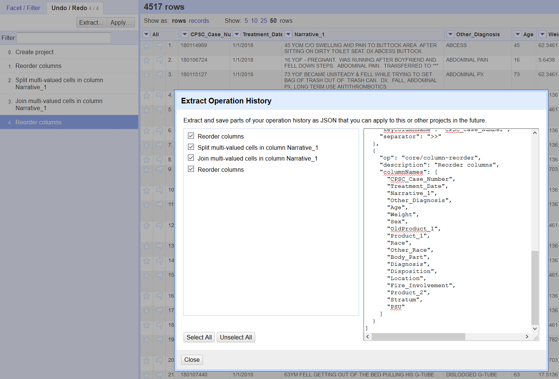
Undo/Redo and Extract & Apply
Undo/Redo in the upper left corner of the main screen will show every step you’ve taken in data transformation
You can undo at any step, but if you undo before the last step, remember that all the changes beneath that step will also be lost
Extract: Clicking extract will allow you to copy your entire change history in JSON format. You can apply these same changes again to the project, or use them in another project (by using “Apply)

Slide 14
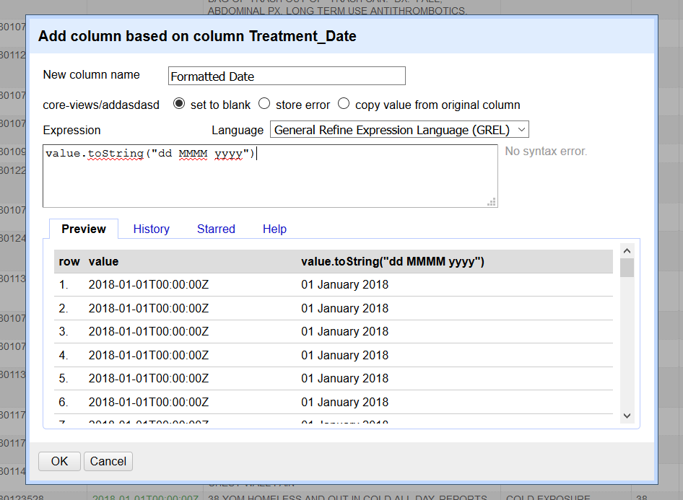
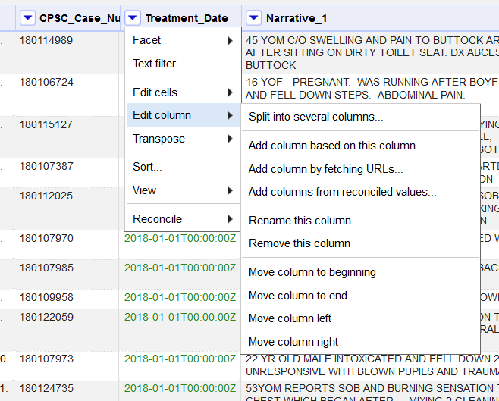
Transforming Dates and Numbers
Notes:
So far we have been transforming string data. A string is simply a series of letters, a chunk of text. But OpenRefine recognizes a few other data types, including Numbers, Dates and Booleans. You can do operations on these data types that can’t necessarily be done on strings.
To illustrate, we’ll change a set of strings in this data into dates. First, x out of all facets and filters. Then on the Treatment_Date column, use the dropdown to select Edit cells → Common transforms → To date. Now you can see that the dates are listed in a particular format (ISO 8601), with the year first, then month, then day, and even the time, preceded by a “T”. What if we didn’t want all that information?
In the Date column dropdown, select Edit column → Add column based on this column. By doing this function, we’re creating a new column that we can manipulate, while leaving all the original date data in its old column.
In the new column name field, type “Formatted Date.” In the expression box type the GREL expression value.toString(“dd MMMM yyyy”). Click OK. Now you can see that we’ve created a column based on the first one that shows the date in string format, with the day first, the spelled-out month second and the year last.

Slide 15
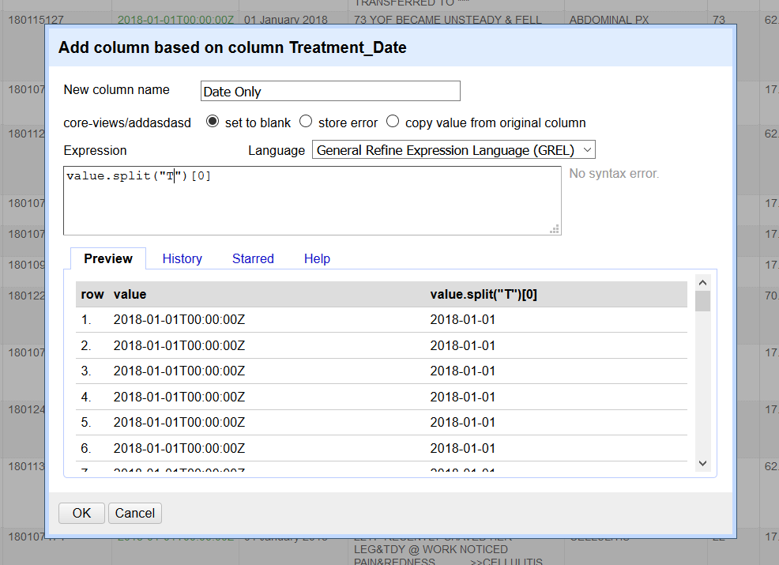
More on Number Fields
Split out values from numeric fields using the GREL expression: value.split(“xx”)[0]
xx represents the character on which you’d like to create a split
Result: Something like an array is produced, where OpenRefine considers everything “before” the T and everything “after” it. By including [0] at the end we’re telling OpenRefine to only display the first element, which occurs before the T
(Split is like Python arrays, where the 0th item is actually the first)
Replace the 0 with 1, and the second element would be displayed (00:00:00Z)
Notes:
-To complete this transformation, start on the Treatment_Date column and choose “Add a Column Based on this Column”
-Give the new column the title “Date Only”
-In the Expression box, type in the following GREL formula: value.split(“T”)[0]

Slide 16
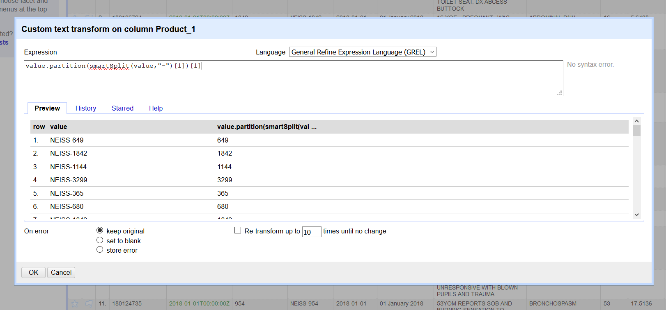
More on Working with Numbers
Notes:
-Another helpful split to try is the GREL recipe shown above, which allows you to trim a leading string code from numeric values that follow.
-To complete this transformation, go to All –> Edit Columns –> Reorder/Remove columns and drag “OldProduct_1” and “Product_1” upwards, or toward the left of the screen. Here in Product_1 I’ve added “NEISS-” to each cell’s value to help us with this exercise. Use the column “OldProduct_1” to check that the transformation worked correctly.
-In “Product_1”, from the drop-down go to Edit Cells –> Transform. Type the following GREL recipe: value.partition(smartSplit(value,"-")[1])[1] This is going to create a partition based on the hyphen, and it will display the “1th” element, which is actually the second, which is the number code we want to display, without the “NEISS-” You can also Add a New Column Based on this column as the first step, to retain the original column.
**Remember! Though the numbers have been split from the original values of these cells, the format of the cells still needs to be changed to number. To do this, go to Edit Cells -> Common Transforms -> To number.

Slide 17
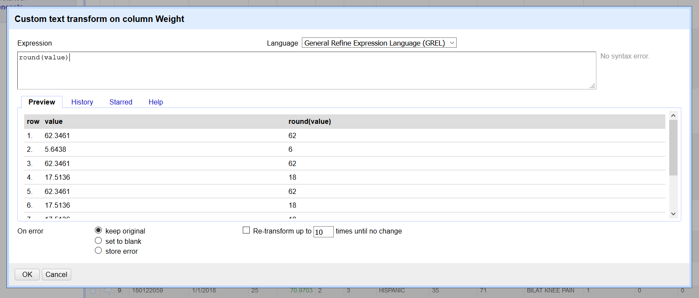
GREL Math Functions
https://openrefine.org/docs/manual/grelfunctions#math-functions
Rounding: round(value)
-rounds to nearest integer
Log: log(value)
Raise numbers to a certain power:
pow(value,xx)
-value is raised to the xx^{th} power
Notes:
-Important first step: In Weight column, do “Edit Cells -> Common Transforms -> To number” first!

Slide 18
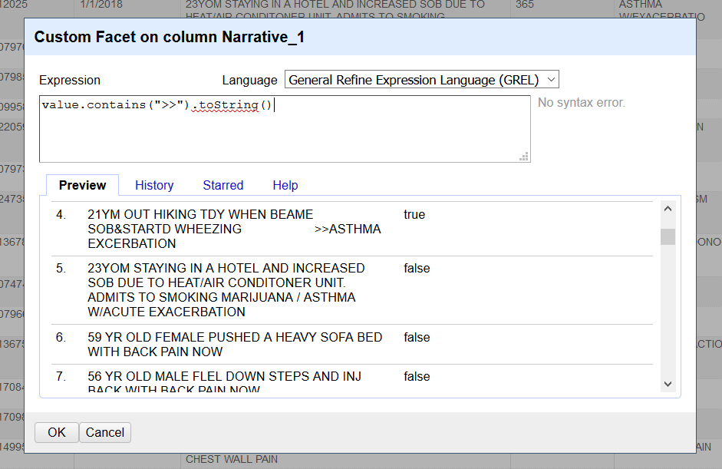
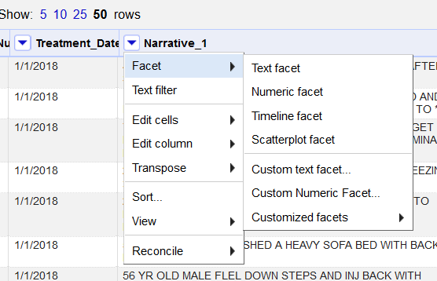

Transforming Booleans
Notes:
Booleans in OpenRefine refer to values that can be either true or false. You can create such values in OpenRefine by writing certain expressions.
One way we can create an expression that will result in values being either true or false is to create one that asks whether the strings of the cell’s values contain something. We can search on the “double carats” (>>) in the Narrative_1 fields. The only values that should populate as “True” are the cells that have the (>>) symbol in them, which indicates diagnosis
To do this, in the Narrative_1 column dropdown select “Facet → Custom text facet.” On the next screen in the Expression box type value.contains(“>>”).toString(). In the Preview box you will be able to see how OpenRefine is already sorting all the values in the Narrative_1 column into the two Boolean types of true or false. Click OK, then look at the facet box on the next screen. You’ll see that most of the Narrative_1 values are false, or don’t have the (>>) symbol, but 124 are true, meaning they do contain the (>>). Now suppose we wanted to take the string that appears after the (>>), the diagnosis, and place this “first” in these 124 cells. How would we achieve that?

Slide 19
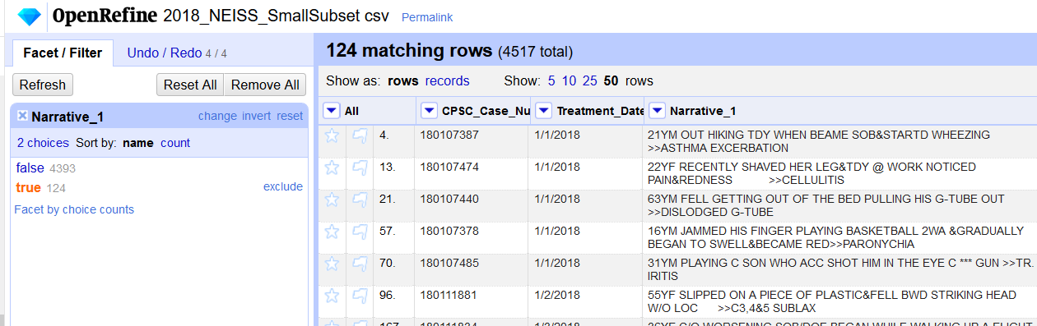
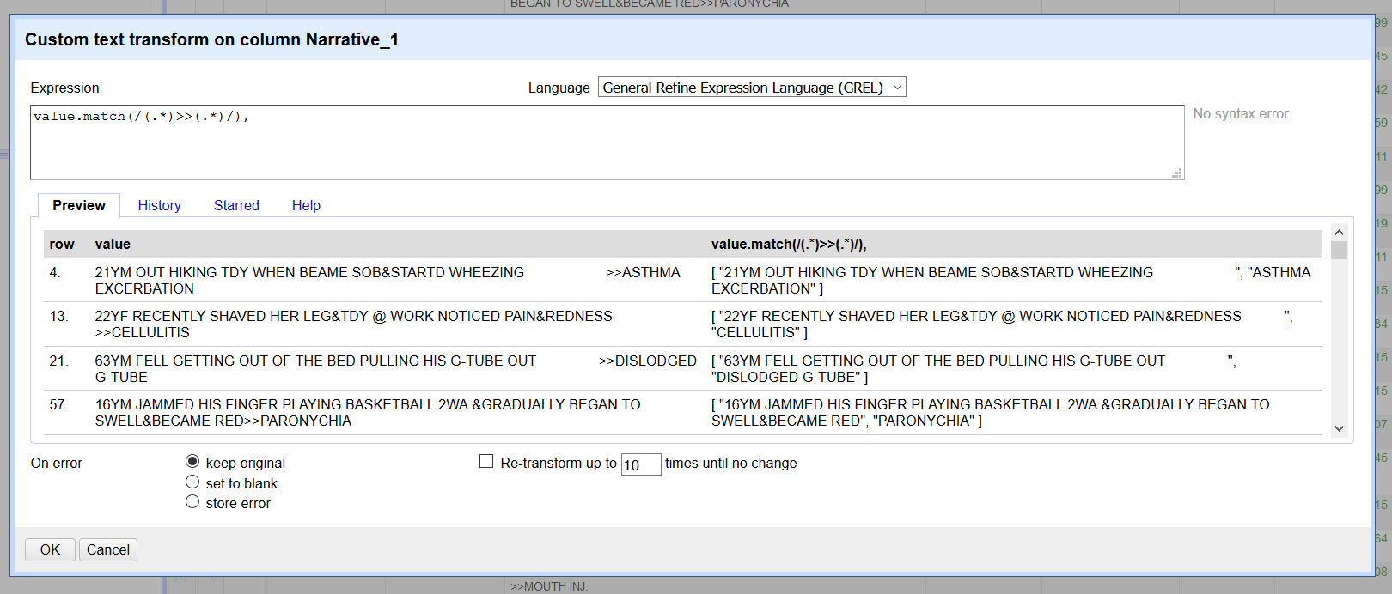
Transforming Arrays
Arrays: lists of values. OpenRefine represents these lists within square brackets, with the values surrounded by quotation marks and separated by commas. An example would be: [“cat”, “dog”, “fish”, “turtle”]
Strings can be made into arrays by using a split function: value.split(). They can also be sorted and re-joined.
Arrays
Notes:
Continuing from our previous example, select “true” to narrow down the rows we’ll be working on to only those Narrative_1 fields which contain the double carats (>>) symbol.
To reverse the elements of these fields so that the diagnosis is listed first requires writing a slightly complicated expression. The point of the expression is to make the data within the Narrative_1 values appear as an array.
In the Narrative_1 column, use the dropdown to select Edit cells → Transform. Then in the Expression box type: value.match(/(.*)>>(.*)/) This is actually two expressions in one: a regular expression (contained within the / /) and a GREL expression (contained within the outer parentheses). Regular expressions are written in Java syntax. It is not necessary to memorize these expressions. For hybrid regular-GREL expressions commonly used in OpenRefine, see the many OpenRefine recipes available at: https://github.com/OpenRefine/OpenRefine/wiki/Recipes
The hybrid expression above is matching any character, no matter how many times it occurs, then the “>>” symbol, then matching another set of any number of characters. When you run the expression, you can see in the Preview box that this creates an array with two members in each row. DON’T click OK yet!
When we see that the array has been created correctly, we can now flip the order of the diagnosis and the description, listing diagnosis first. Add to the expression we just wrote until it reads: value.match(/(.*)>>(.*)/).reverse().join(" ") Here we have called the reverse function, and you should see the diagnosis segments line up ahead of the description segments. Then we called the join function, which puts the elements back together in string format. Now click OK.

Slide 20
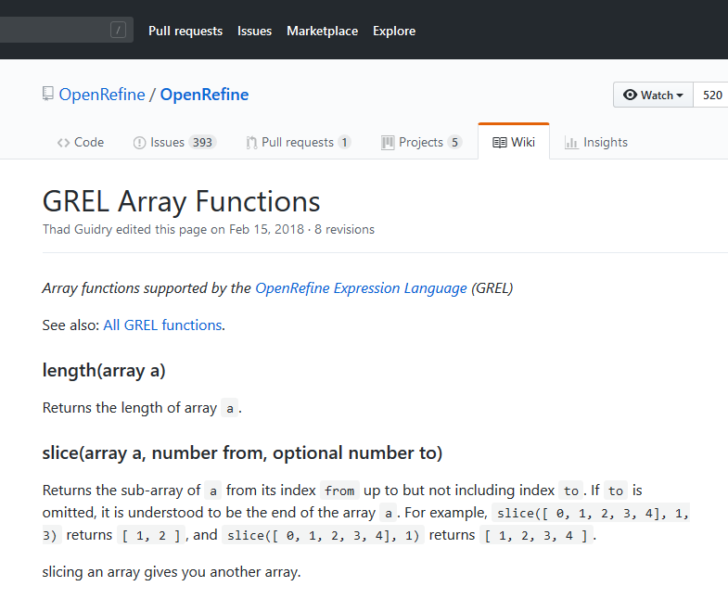
A Note about Arrays, and Exporting your Project
Arrays don’t appear directly in OpenRefine cells. They are only seen when working in GREL Array Functions. Recipes for these functions are available from: https://github.com/OpenRefine/OpenRefine/wiki/
Exporting your file:
When you have finished making all data changes in your project, look for the export button in the upper right-hand corner of OpenRefine’s main screen. There are multiple data options for export, including many comma-separated value options. Remember that OpenRefine will export the new, cleaned data file, which will be different from the original file you uploaded. The automatically-generated filename will be similar, so be sure to change it to reflect that this is a new, cleaned data file.

Slide 21
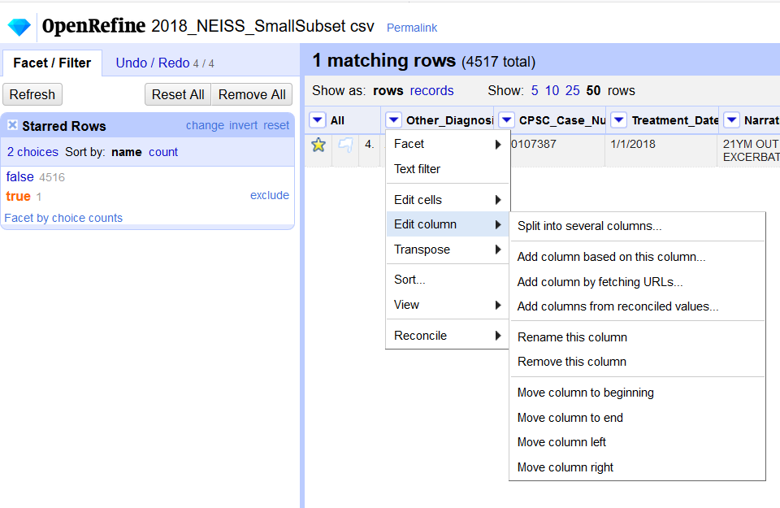
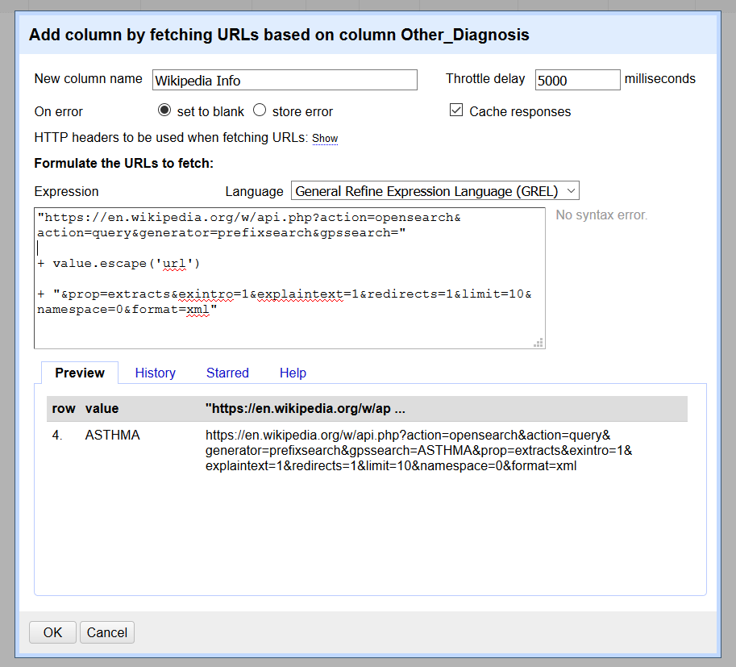
Advanced: Retrieving Data from URLs
Another powerful feature of OpenRefine is the ability to pull external data from URLs. Try this on the Other_Diagnosis column. Star one record, then in the “All” column, facet by the star. Choose “true” in the Facet screen, then from the Other_Diagnosis column drop-down choose “Edit column → Add column by fetching URLs.”
Notes:
This brings you to a new Expression box. Title your new column “Wikipedia Info.” In the expression box, type the GREL expression (with spaces, as pictured above):
"https://en.wikipedia.org/w/api.php?action=opensearch&action=query&generator=prefixsearch&gpssearch="
+ value.escape('url')
+ "&prop=extracts&exintro=1&explaintext=1&redirects=1&limit=10&namespace=0&format=xml“
The Expression may run slowly, as it is querying the URL we provided and accessing the data. We are only working on one record in this example. When fetching information from URLs for many records, it can sometimes take a few minutes to run. The result will be a new column with a long string of HTML code.
We can extract information that we want to display from the HTML code by parsing it – see how on the next slide.

Slide 22
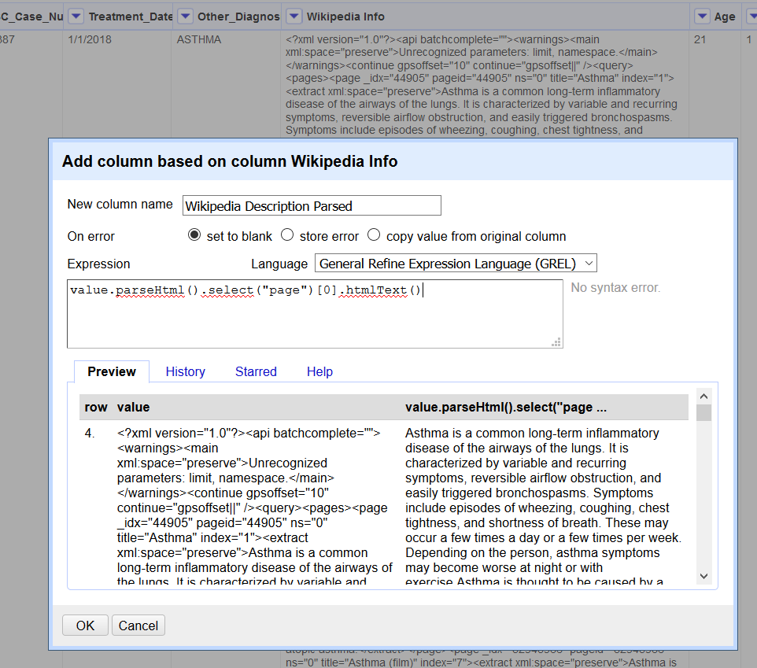
Parsing HTML in OpenRefine cells
Wikipedia Info column with long string of HTML code
GREL expression to parse the Description from the rest of the HTML code.
For more on GREL parsing functions, see: https://openrefine.org/docs/manual/grelfunctions#other-functions.
Notes:
To parse the Description of Asthma from the HTML code, we’ll click on the “Wikipedia Info” column drop-down and select “Edit column → Add column based on this column”
Title this new column “Wikipedia Description Parsed”. In the GREL expression box type: value.parseHtml().select("page")[0].htmlText() You should see the Description in the Preview box before performing the operation.
Click OK to add the new “Wikipedia Description Parsed” column. In this example, we added a new column based on the HTML column simply to retain the HTML in case we might want to extract more data from it. If we did not want to retain the HTML code, we could transform the column directly from code to the parsed Wikipedia description by choosing “Edit cells → Transform” from the Wikipedia Info column drop down, and type the same expression into the GREL Expression box.

Slide 23
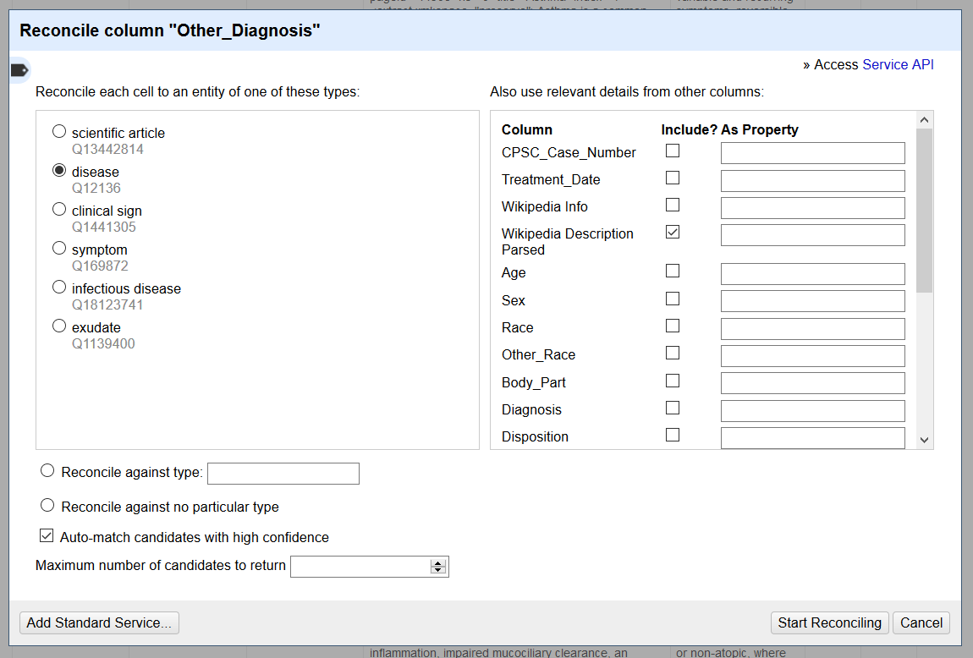
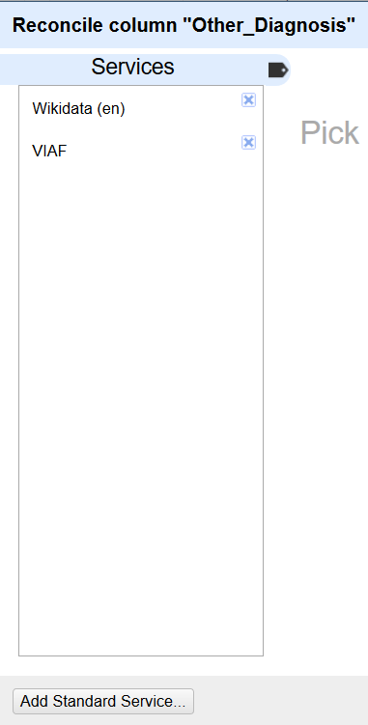
Reconciliation using URLs
Notes:
Reconciliation services allow you to look up terms from your data source in other sources online that maintain controlled vocabularies, such as the VIAF (Virtual International Authority File) or Wikidata. This allows you to add to your project metadata values that are expressed in controlled ways, which can help with interoperability. In this example, we will reconcile the values in the Other_Diagnosis field against Wikidata.
To start, click the Other_Diagnosis column drop-down and choose: Reconcile → Start reconciling. (We’re using Wikidata, which is built into OpenRefine. If you want to use another service such as the VIAF, you’ll need to add it as a standard service. Click “Add Standard Service” and in the URL pop-up enter: http://refine.codefork.com/reconcile/viaf to access the online VIAF reconciliation service.)
When you’ve brought up the Reconciliation screen, choose “disease” from the cell entities on the left and Wikipedia Description Parsed from the columns on the right. The latter choice will use the information from Wikipedia Description Parsed to help match the term to the available Wikidata Asthma terms. Click “Start Reconciling.” Be prepared to wait a few minutes while OpenRefine queries the Reconciliation service.

Slide 24
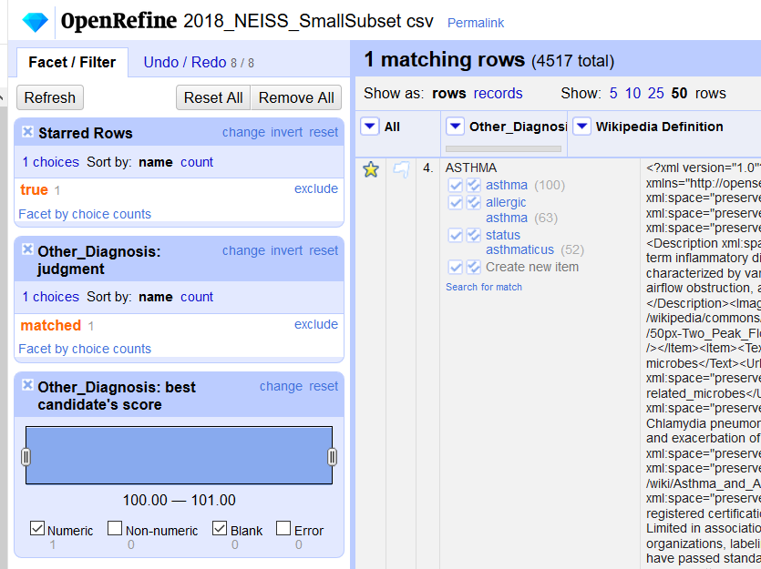
Reconciliation Results
Single check-box: will accept the reconciled value only in this cell
Double check-box: will accept the reconciled value for every identical cell
Notes:
After reconciling, two new facets appear: Other_Diagnosis: judgment and Other_Diagnosis: best candidate’s score. The judgment facet shows which values have been matched. Near “matched,” there may also be a value, “none,” if you ran the Reconciliation over multiple rows and some items failed to match. As you make matches between your values and the reconciled terms, the number in ‘none’ will go down and the ‘matched’ number will go up. The best candidate’s score facet has to do with how well the values matched against those from the online authority file, based on fuzzy matching.
Notice the check-marks next to the choices for matched values back in our original Other_Diagnosis column. As you can see, you can choose to match your original term to the term “asthma” or to two other related terms. To complete the Reconciliation, we can choose one or the other. Clicking the single-check box will accept the answer for one cell. Clicking the multi-check box will accept the new value for all cells in which it appears.
Keep in mind that this function worked quickly in class because we starred and faceted on one row, and therefore were only reconciling one term. The more terms you reconcile at once, the longer it will take for OpenRefine to complete the function. For more on OpenRefine Reconciliation services, see: https://github.com/OpenRefine/OpenRefine/wiki/Reconcilable-Data-Sources

Slide 25
Some final OpenRefine tips
When working with larger datasets, you may want to allocate more memory to OpenRefine. Methods for increasing memory vary by operating system and also according to which version of Java you have.
For a guide on allocating more memory, see: the Installing OpenRefine page in the User Manual
Extensions can be added to OpenRefine to add increased functionality. Installing extensions might involve installing various additional software programs on your computer. Check with NUIT or FSMIT when in doubt.
A list of extensions is available on the OpenRefine extensions page
There is a wealth of additional OpenRefine educational material online! Here is a small sample:
The Google Refine introduction series (pre-dates OpenRefine’s name change, but still useful): https://www.youtube.com/watch?v=B70J_H_zAWM)
A library-focused OpenRefine blog by Owen Stephens
Cleaning Data with OpenRefine by Seth van Hooland, Ruben Verborgh, and Max DeWilde
Getting Started with OpenRefine by Thomas Padilla

Slide 26
Credits
The OpenRefine lesson on which this class is based can be found at Library Carpentry: OpenRefine, (https://librarycarpentry.org/lc-open-refine/), and is copyright © 2016–2019 Library Carpentry. Class materials are available for adaptation under the CC BY 4.0 license.
Slides and NEISS dataset segment used for this class can be found at: https://github.com/saragon02/Class_materials
Cover slide image by kues1, accessed at: https://www.freepik.com/free-photo/old-files_1012333.htm
Developed resources reported in this presentation are supported by the National Library of Medicine (NLM), National Institutes of Health (NIH) under cooperative agreement number 1UG4LM012346. The content is solely the responsibility of the authors and does not necessarily represent the official views of the National Institutes of Health.
Thank you!

