Slide 1
Hack the Link Resolver
A DIY, tailored approach to full text linking in PubMed
Jonathan Shank, MLIS
Acquisitions & E-Resources Librarian
Northwestern University Galter Health Sciences Library
ER&L Conference, Austin, TX
April 4, 2016

Slide 2
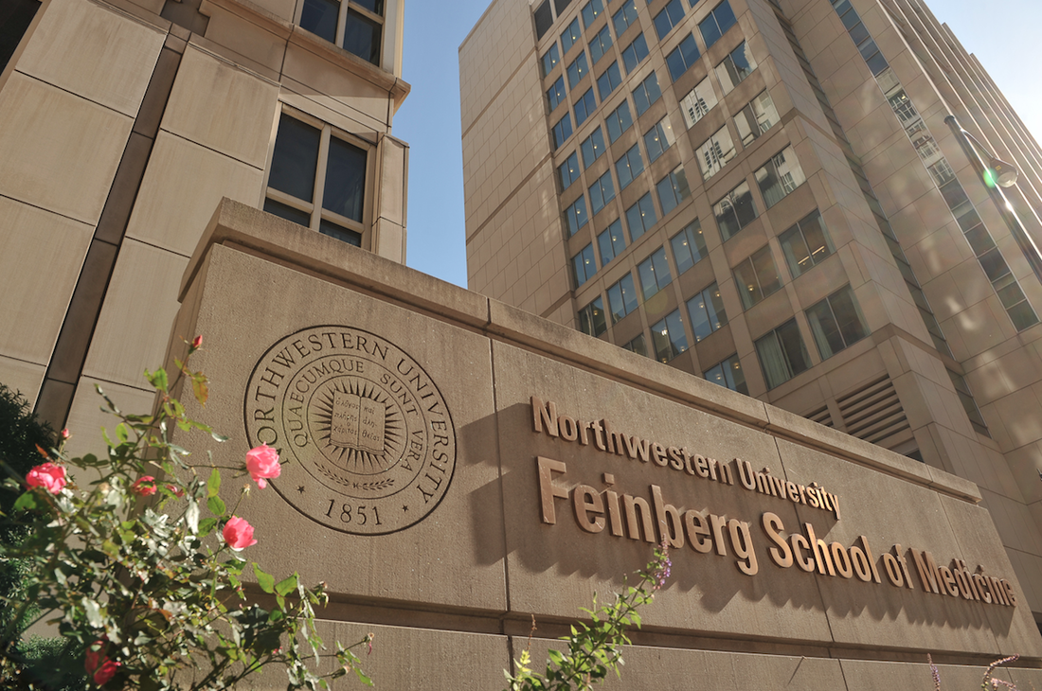
Institutional Context
Galter Health Sciences Library
Northwestern University Chicago campus
Administratively separate library
Two developers on staff
Systems
Migrated to Alma in summer of 2015
Shares ILS with all NU affiliated libraries and hospitals
Manages our own Primo front-end, but…

Slide 3

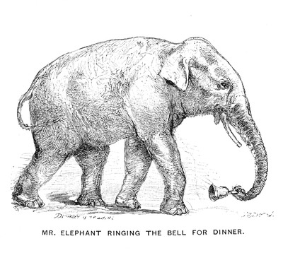
Institutional Context
Notes:
The users in our context rely on PubMed the MOST, it’s almost the elephant in the room with our discussions related to ER’s & discovery. Always have to consider, will our users just be going to PubMed instead?

Slide 4
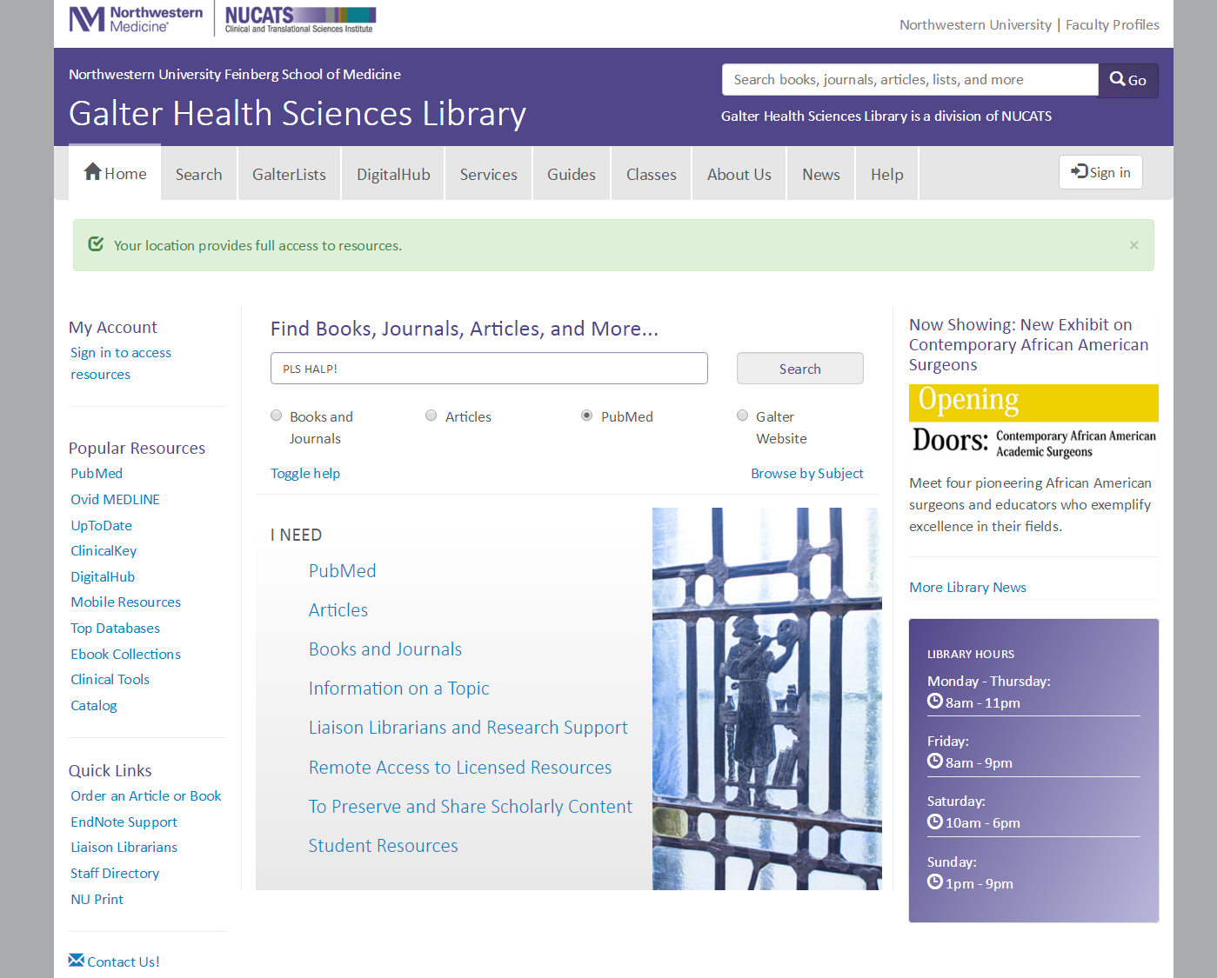
Notes:
As a result, we incorporate a PubMed search in our site. We do this by querying the NCBI database with their API, and display the results locally through customized RAILS application that brings them into a uniform search interface on our site, alongside our Primo front-end. It’s offered as a search scope on our main search.

Slide 5
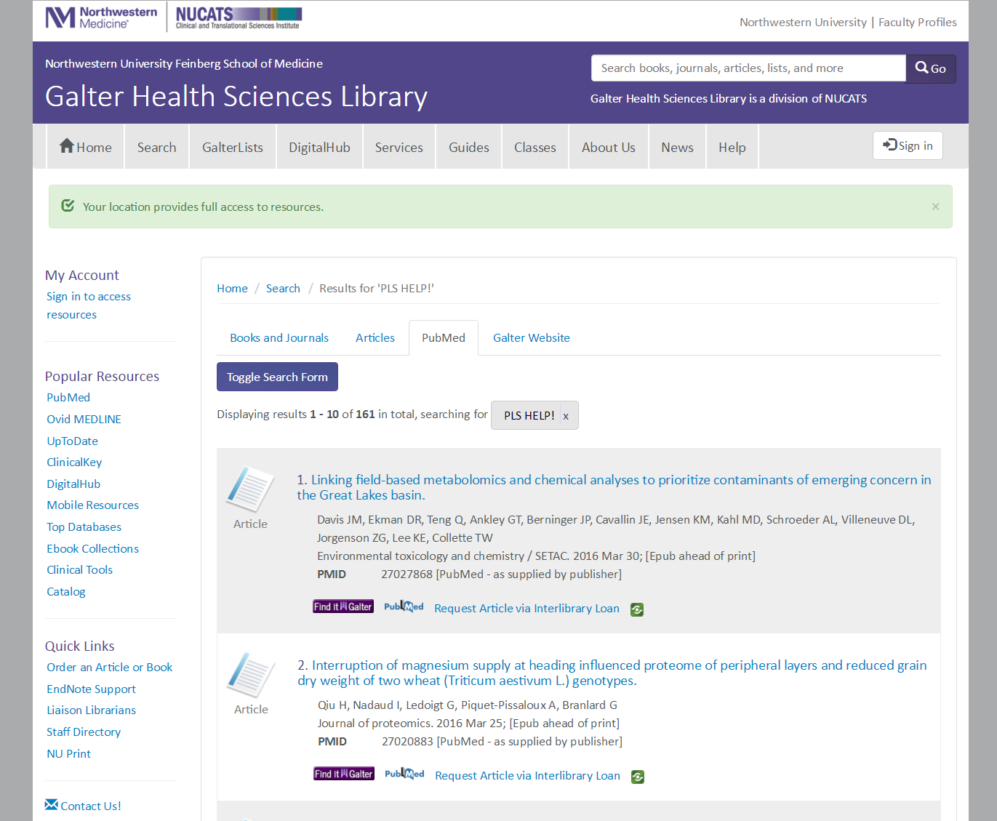
Notes:
And this is just how our local PubMed search looks…

Slide 6
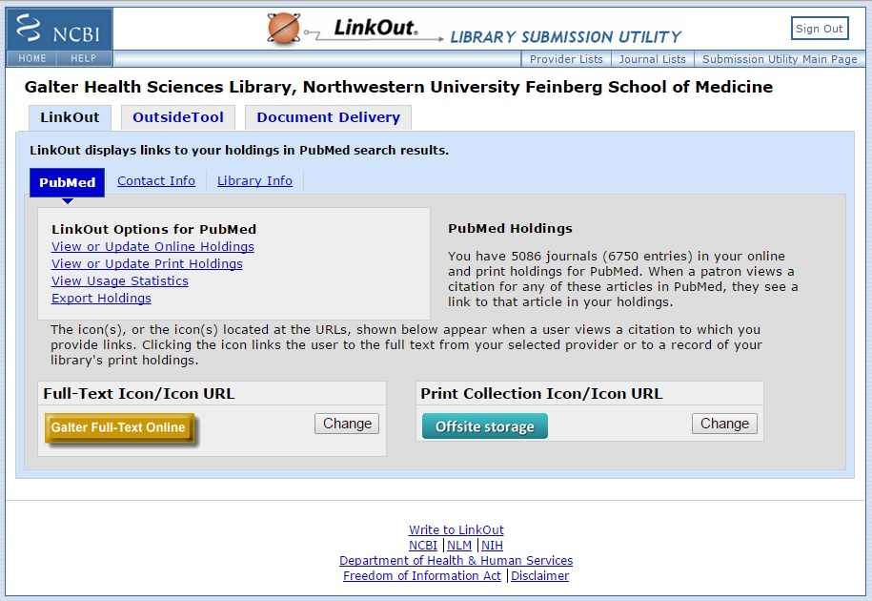
PubMed Configuration
Notes:
So for anyone who’s not all that familiar with PM, for the most part it works like any other OpenURL referring database. At Galter we use LinkOut, and their OpenURL resolver called…

Slide 7
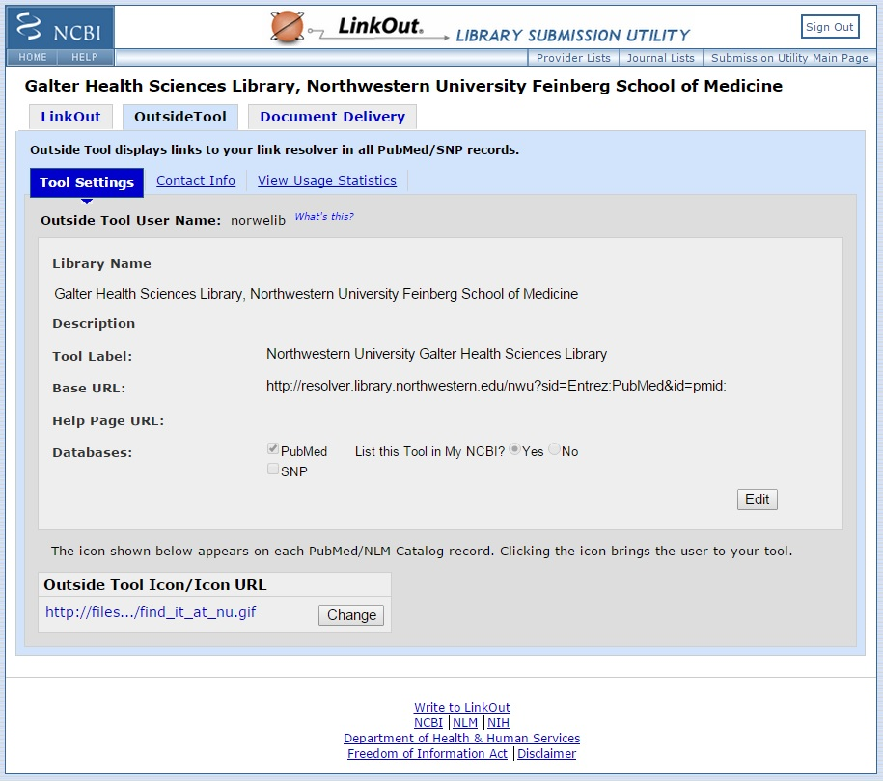
PubMed Configuration
Notes:
…OutsideTool, which is where you put the URL for your link resolver. In our case this used to be SFX, and it worked quite well.

Slide 8
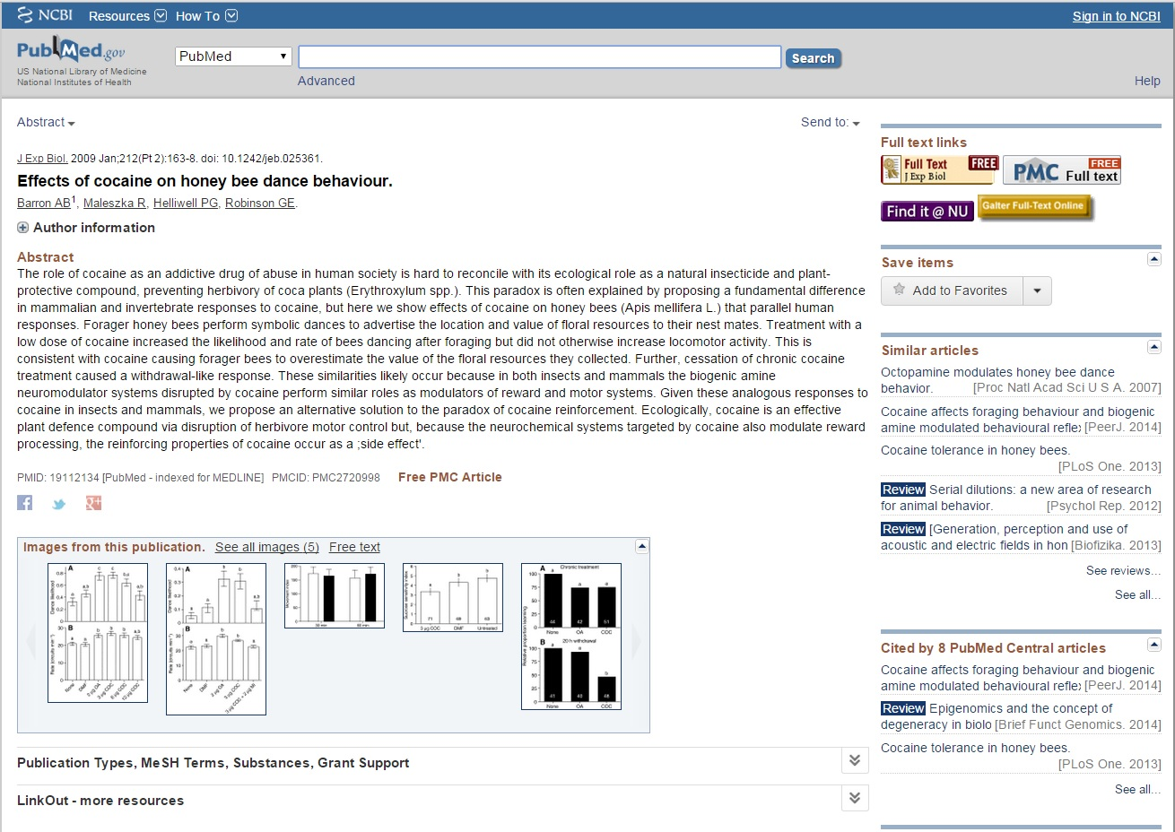
PubMed Configuration
Notes:
Here’s how the various linking buttons appeared to the user. The gold button is LinkOut. The purple button is the Otool. After we switched to Alma, the purple button here was sending our users to the Alma resolver menu, and that’s where our problems started…

Slide 9
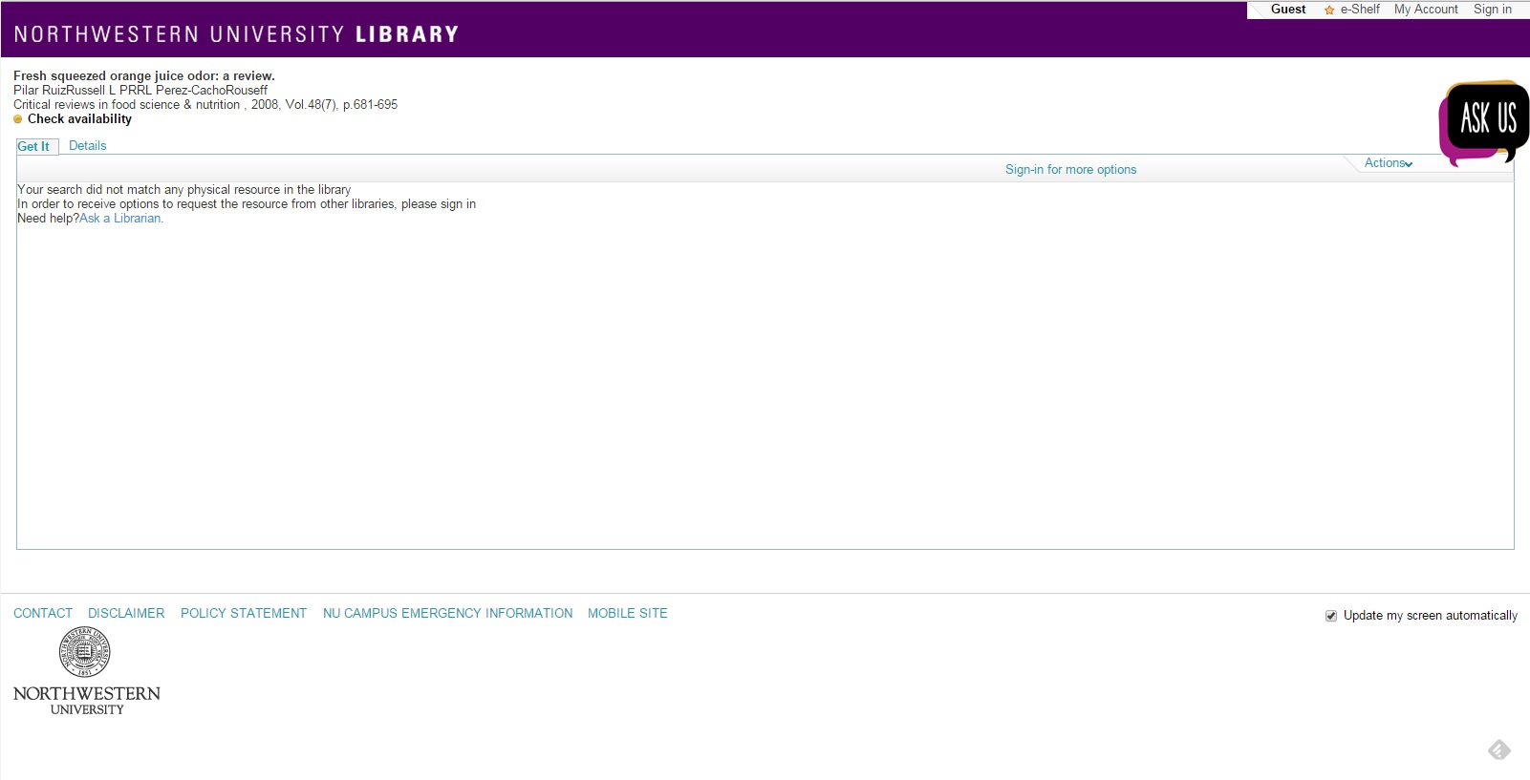
Problems with the Alma resolver
Inter-Library Loan difficult to find
Notes:
One big one for us was that you actually have to sign-in using the link at the right before the ILL links are displayed. This is fine if you assume users are already signed in before hitting this screen, but since most of the HSL people go straight to PM, this was a problem for us.

Slide 10
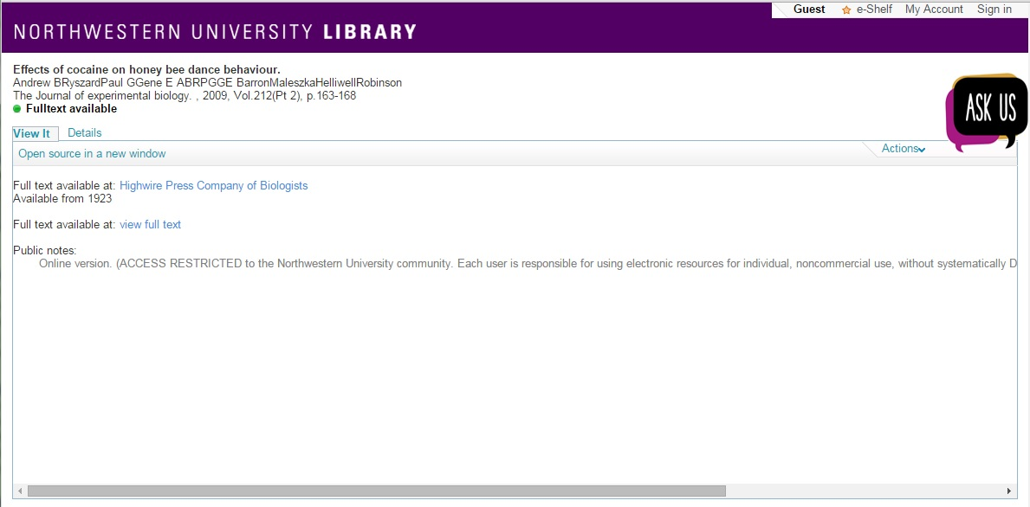
Problems with the Alma resolver
Jumbled names and confusing links
Notes:
Another problem we had was a weird bug where author names from PubMed articles were getting jumbled together. ExL had a timeline for this being fixed but it was several months off. Frankly I’m not sure if this bug is still there. Links were also displaying quite confusingly. The spacing was awkward, it was difficult to sometimes tell what target was connected to what link and there were also redundant text strings like “Full text available at view full text.”

Slide 11
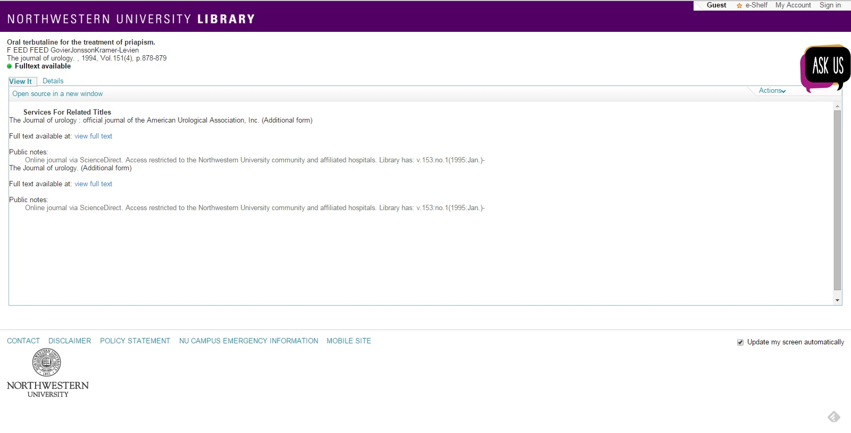
Problems with the Alma resolver
Related title fail
Notes:
Finally, there was the issue of related titles. Anyone who’s familiar with SFX or the Alma resolver is likely aware of the dilemma here, and how you’re basically damned if you do, damned if you don’t. It an essential feature in some instances but, for PubMed it was causing all kinds of trouble.
This is the Alma resolver menu for an article we DON’T have full text access too, but for the user it’s almost impossible to determine that. You have a green light “full text is available” and several linking options. But these are all from a related title, i.e. a completely different serial. None of these links actually take you to the article.
Also you can see the names are screwed up here again, and don’t ask me what the F EED FEED part is…
For the record, I think most of these issues have since been fixed by our main library.

Slide 12
Why not just fix Alma?
Notes:
So at this point you’re probably wondering…
For us there were a number of reasons. Any Alma menu configuration changes would be enterprise-wide, and effect the menu behavior from various databases, and on different library websites. It wasn’t really an option to tweak the menu specifically for PM. Also, since we have full autonomy over our site search and RAILS app, it was frankly easier to make tweaks and adjustments within our own system, rather than trying to navigate Alma or rely on EL support.

Slide 13

The Solution
Use the article’s PMID to query our local PubMed search and display a single result
PMID
individual article
new Otool button
Notes:
What we decided to do was replace the otool in our PubMed configuration with our own button that points directly back to our own site’s local PubMed search. A user finds an article in PubMed, clicks the new otool button, which takes ONLY the PMID from the article and queries our local PubMed index.

Slide 14
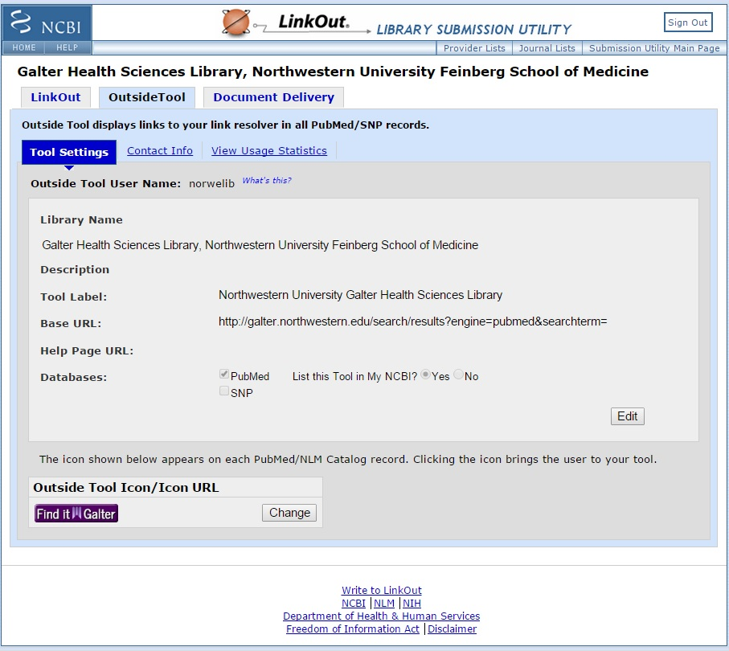
The Solution
New OutsideTool configuration
Notes:
So as you can see here, we replaced our university-wide Find it @ NU button with a slightly tweaked Find it @ Galter button, just to make it clear that it was doing something different. This is where we updated the otool url as well.

Slide 15
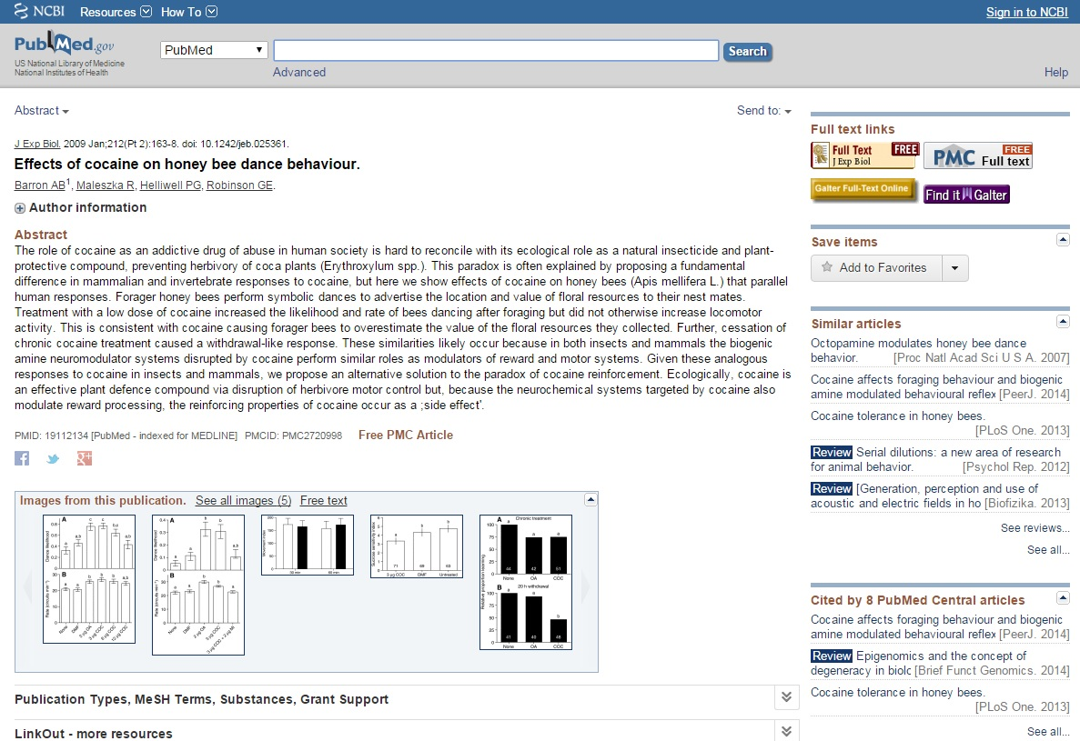
The Solution
New OutsideTool configuration
Notes:
And here’s what it looks like the user. As you can see, it’s only subtly different at this point, with the different button, however when they click on it instead of being taken to the buggy Alma resolver menu they arrive at…

Slide 16
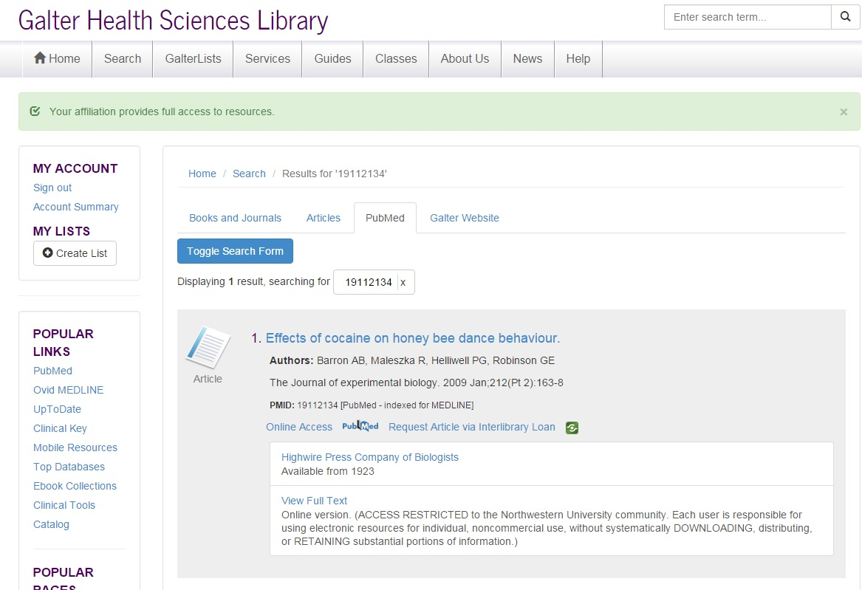
The Solution
New “resolver menu”
Notes:
The new “resolver menu,” which addresses all of the problems identified earlier.
ILL is a clear and prominent choice,
names are displayed correctly,
redundant text is removed, and
different providers are clearly delineated.
This is where the real technical legwork happened. In order to bring the links in to get this to work, we are essentially reverse engineering how the Alma resolver is normally queried, using the PMID as a match. The API’s offered by ExL aren’t really designed for this, so our developers basically had to do some hacking and lots of trial and error to get this to work.
This also took some customizations and tweaking of our RAILS search front-end. Our normal search results don’t display like this. We created a rule so that when a search brings up a single article, as is the case when coming from a PMID, all of the possible links would be automatically expanded. Each link requires a separate query to the Alma resolver, so we can only do this when there is a single result. On a normal search with dozens of results, users have to expand results to display the full linking options. This prevents us from running dozes of simultaneous queries against Alma.

Slide 17
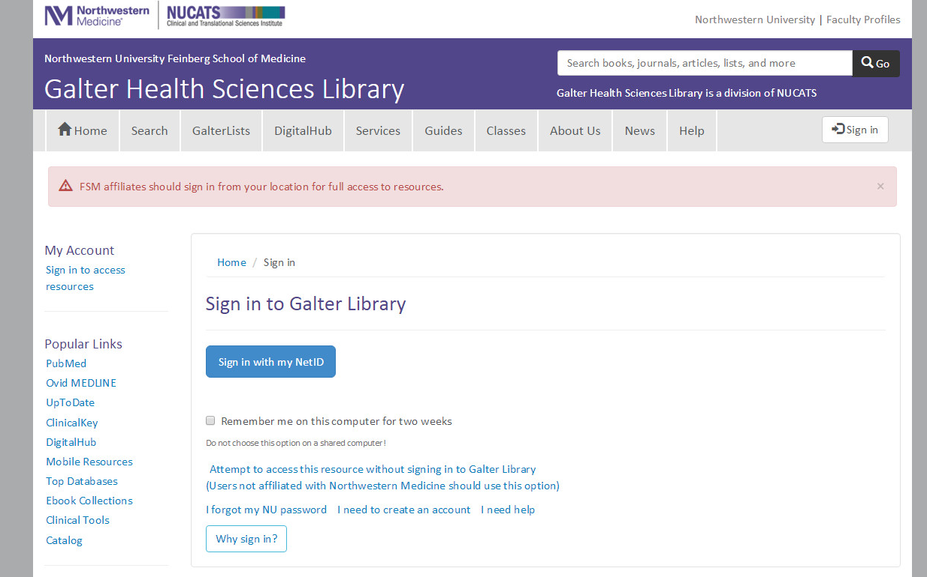
The Solution
Unforeseen consequences
Notes:
As in any complex environment, our little project had some unforeseen consequences. Remember all of talk earlier about the needs of “our users” i.e. the health sciences folks? Well it turns out they aren’t the only ones who rely heavily on PubMed [duh]. After we went live with our new setup, we discovered that many non-med school users also relied heavily on our configuration of PubMed. We have a Pubmed record in ou discovery tool Primo, and those users were accessing it through the university library’s website in order to take advantage of our full text linking. Once they clicked our new find it button, they were redirected to our site, which they weren’t familiar with, and hit this nasty sign on screen. This sign is uses the same SSO authentication as all of the other university systems, so if the non-medical users actually attempted to sign in here, they would go through the proxy is and still get access. The problem was the confusing text and layout of this screen. It made the non-medical school users think they hit a dead end because they didn’t have an account on “our site.” We had an option at the bottom for them to pass through without signing in, but it wasn’t prominent enough. So…

Slide 18
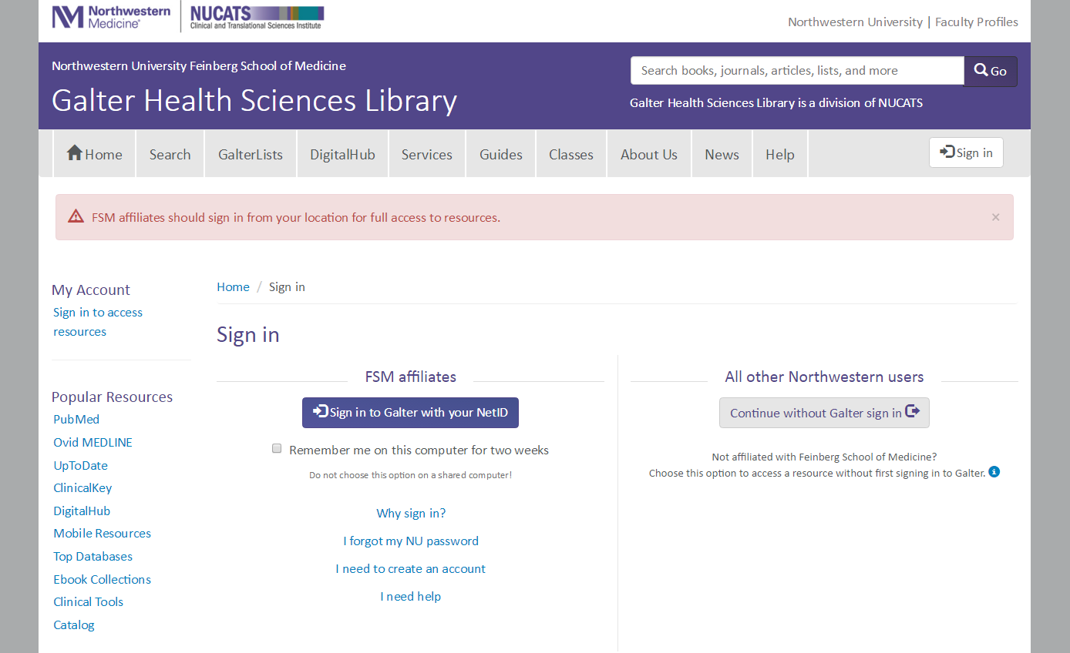
The Solution (v. 2)
… to the unforeseen consequences of our original solution
Notes:
Here’s what we changed the sign in page to. This basically provides a clear oath for all of our different PubMed users. Most of them are affiliated with the med school and will use the purple button. Anyone else without FSM affiliation, can continue without signing in to our website. This same option was available before, but it wasn’t so clear. This is still a bit convoluted, but it works for now, and satisfied our colleagues at NUL in Evanston.

Slide 19
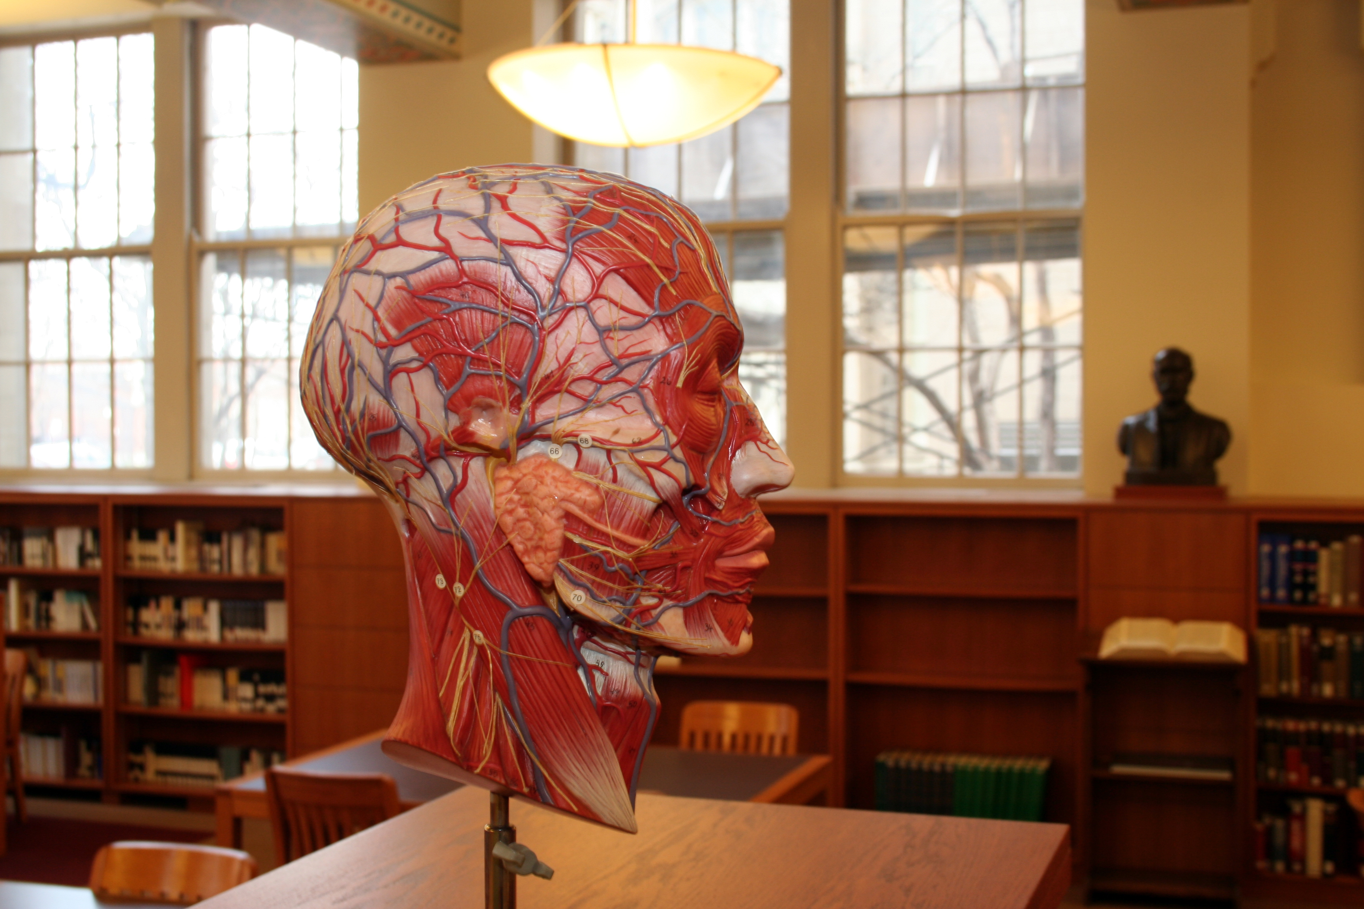
Final Takeaways
It works great! (for us)
If possible, try to fix the OOTB resolver first
Leverage the resources you have
Consistent and reliable article-level identifier is essential
Prepare for new problems
Similar solution could be used for other referring databases
Notes:
Leverage the resources you have, in our case since we already maintained a local version of PubMed, that was a big help. Plus, it wouldn’t have been possible without having a custom site and developers who can hack it.

Slide 20
Questions?
@ShankLib
j-shank@northwestern.edu

Slide 21
Thank You!
Contributors
Piotr Hebal, Senior Developer
Jason Stirnaman, Digital Library Programmer

