Slide 1
Liaison Librarian DigitalHub In-Service
Monday, July 24, 2017
1:00 – 3:30 pm
Learning Resources Center
Classroom 1-413
Ramune Kubilius
Karen Gutzman
Joelen Pastva

Slide 2
Goals for this In-Service
Increase familiarity with DigitalHub contents, uploading content, and lesser known features
Explore alternative outputs available at Northwestern
Better understand the institutional repository environment
Increase capacity to answer or anticipate questions from users about document types, enhancements, constraints, and so on
Notes:
Karen
Last time for this was November 2015. Keep up the momentum.

Slide 3
Outcomes for this In-Service
Provide feedback to the Digital Initiatives Working Group about DigitalHub.
Liaison Librarians incorporate DigitalHub into conversations, presentations, etc.
Consider researchers to approach for uploading alternative outputs into DigitalHub
Notes:
Karen

Slide 4
Overview of this In-Service
Update on DigitalHub
Activities
  Activity 1: Explore DigitalHub and Alternative Outputs
  Activity 2: Explore Repositories in General
  Activity 3: New Happenings in the World of Repositories
  Activity 4: Create a Collection of Alternative Outputs in DigitalHub
  Activity 5: Explore NU FSM websites for DigitalHub ideas
  Activity 6: Brainstorm Institutional Repositories and Constraints
Wrap up
Notes:
Karen

Slide 5
Update on DigitalHub
Notes:
Ramune

Slide 6
Update on DigitalHub
Purpose: Orient liaison librarians to any updates with DigitalHub and review goals for DigitalHub in year 2 of existence. This is only an overview, a more in-depth activity will orient them to new collections and content in DigitalHub in later on.
Time: 10 minutes
Presenter(s): Ramune, Karen, Joelen
1:10 pm – 1:20 pm
Notes:
Ramune

Slide 7
Update on DigitalHub
Increase uploads of traditional and alternative outputs
  Pilot project underway with Preventive Medicine to automatically upload publications in Open Access Journals
Communication and Outreach Planning
  Liaison Librarian In-Service
  Update DigitalHub Class slides (i.e. new screenshots, if needed)
  Creation of the “constraints” and “responses” document (see Activity 6)
  News Items
    June 2017: DigitalHub grows with each new submission: https://galter.northwestern.edu/news/digitalhub-grows-with-each-new-submission
    August 2017: How DigitalHub can work for your lab (upcoming)
    September 2017: Uploading your conference outputs with DigitalHub
    November 2017: Highlight of new DigitalHub Collections
1:10 pm – 1:20 pm
Notes:
Ramune

Slide 8
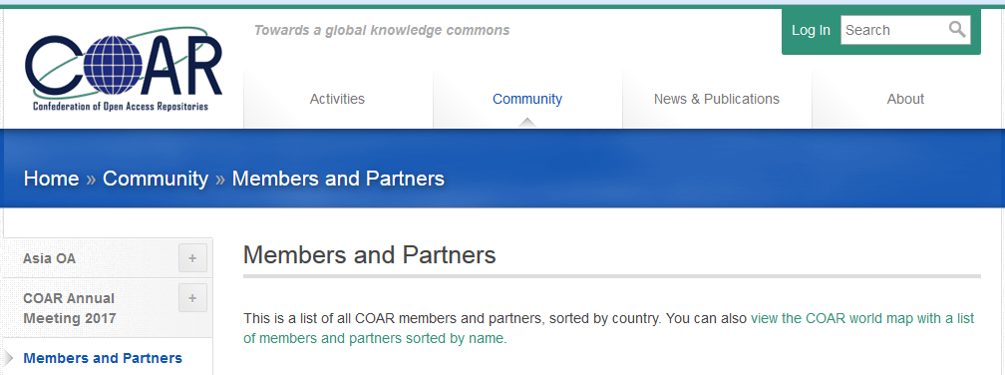
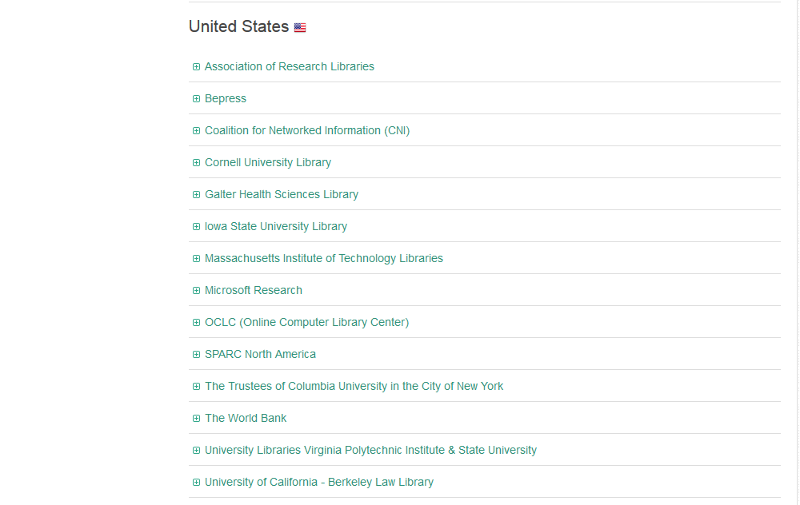
DigitalHub Updates
Membership in Confederation of Open Access Repositories (COAR): https://www.coar-repositories.org/community/members-and-partners-by-country/
Benefits of COAR: https://www.coar-repositories.org/files/20160513_COAR-infographic_finalversion.pdf
1:10 pm – 1:20 pm
Notes:
Karen
Around June 14, 2017
Dear Violeta, Kristi and Rebecca
On behalf of the Executive Board, I'd like to officially welcome the Galter Health Science Library, Northwestern University to COAR. We are very pleased to have you as a new member.
First of all, I want to give you some information about COAR. With members from Australia, Africa, Latin America, North America, Europe, and Asia, COAR is supporting the open access movement and networking of repositories around the world. Please have a look at our website to see the list of members and our major activities (www.coar-repositories.org/).
COAR represents the voice of the repository community at the international level. We advocate for the role of repositories and articulate the value of repositories within the broader research community. And COAR is a community of practice. Through COAR, repository managers can exchange best practices, discuss challenges, and work on common issues.
COAR is also involved in a major effort to align regional repository networks world-wide with the aim of creating a truly global repository network of interoperable repositories. We have also recently announced an accord to align regional networks around common standards, practices and services: https://www.coar-repositories.org/activities/advocacy-leadership/aligning-repository-networks-across-regions/
In addition, we have been working with an international group of experts to define the functionalities of next generation of repositories. Our preliminary use cases for this work is available here: https://www.coar-repositories.org/activities/advocacy-leadership/working-group-next-generation-repositories/
We will be publishing and promoting the final recommendations in September 2017
We have also just published (today June 9) a survey of open access in the Asian region: https://www.coar-repositories.org/community/asia-oa/
COAR has a number of Interest Groups and Task Forces, described in the attached document. You or any of the staff at your institution to join one or more of these groups.
We welcome you and your staff to attend the the next COAR webinar, that will be discussing the connection between repositories and CRIS systems. The webinar will take place early July: https://www.coar-repositories.org/activities/webinar-and-discussion/
Please send the COAR office the email addresses of anyone you would like to add to the COAR members mailing list.
And, if you have any questions, please feel free to get in touch with me any time.
With kindest regards,
Kathleen
Kathleen Shearer
Executive Director, Confederation of Open Access Repositories (COAR)
m.kathleen.shearer@gmail.com - +1 514 992 9068
Skype: kathleen.shearer2 - twitter: @KathleeShearer

Slide 9
Current Technology
“What front/backend system do we use for the repository?”
The repository back end is a combination of:
  1) the 'Fedora Commons' repository (http://fedorarepository.org/)
  2) 'Apache Solr,' which is used for search indexing (http://lucene.apache.org/solr/)
'Hydra' (now called 'Samvera') is the web application framework that sits on top of the back end (https://samvera.org/)
'Sufia' (http://sufia.io/about/) is the front end and extends Hydra (now called Samvera), providing the user interface and associated features.
1:10 pm – 1:20 pm
Notes:
Joelen

Slide 10
Future Technology
Invenio is an interesting new software for institutional repositories.
  http://invenio-software.org/ (once there please select showcase to explore some of the sites.)
  https://github.com/inveniosoftware/invenio
“Invenio, developed under the auspices of CERN is open source software created to address the major areas of involvement for libraries associated with research organizations. The software can be used to support institutional repositories, manage digital assets or multimedia content, provide digital preservation,
manage data sets associated with research projects, and to manage library materials.”
    Smart Libraries. ALA Tech Source. 2015. pg 2-3. Retrieved from: https://journals.ala.org/sln/issue/download/517/272
    Also see: TIND Technologies & Invenio: https://americanlibrariesmagazine.org/2017/05/01/library-systems-report-2017/
1:10 pm – 1:20 pm
Notes:
Joelen

Slide 11
Activity 1
Explore DigitalHub and Alternative Outputs
Notes:
Karen

Slide 12
Activity 1: Explore DigitalHub and Alternative Outputs
Purpose: Gain familiarity with DigitalHub and the alternative outputs in DigitalHub so that Liaisons can recall this information when speaking to faculty, staff, and students.
Time: 15-20 minutes
Presenter: Karen
1:20 pm – 1:40 pm
Notes:
Karen

Slide 13
Activity 1: Explore DigitalHub and Alternative Outputs
Directions:
Find 2 items in DigitalHub related to these resource types:
      Letter
      Presentation
      Pictorial Works
      Advertisements
      Thesis
      Ephemera
      Statistics
Download the item, export the citation to EndNote, and check on the Analytics.
Check out any related URLs that an item has in their record.
Search for the item using “keywords” in Google, Google Scholar, Microsoft Academic.
Search for the item using the “creator” in Google, Google Scholar, Microsoft Academic.
Be prepared to briefly present these 2 items to the group. You can show them item(s), the analytics, and the results of your online searches, etc.
1:20 pm – 1:40 pm
Notes:
Karen

Slide 14
Activity 1: Explore DigitalHub and Alternative Outputs
Discussion Questions:
Was anyone surprised by what they found or didn’t find in DigitalHub?
Related to this exercise, what are the features in DigitalHub that you might want to emphasize to researchers/students/staff?
What features might be confusing to researchers/students/staff? How might you explain these features before they become a confusion?
Did anyone find a record in which the metadata hasn't been enhanced? Violeta, Tony, Joelen and Susan work to enhance the metadata fields for each new upload.
1:20 pm – 1:40 pm
Notes:
Karen

Slide 15
Activity 2
Explore Repositories in General
Notes:
Ramune

Slide 16
Activity 2: Explore Repositories in General
Purpose: Gain a familiarity with institutional repositories and the types of collections housed within them to inspire Liaison Librarians on what can be collected for DigitalHub
Time: 30 minutes
Presenter: Ramune
1:40 pm – 2:10 pm
Notes:
Ramune

Slide 17
Activity 2: Explore Repositories in General
Choose one repository from the list below
Cal Tech http://authors.library.caltech.edu/
University of California http://escholarship.org/homepage.html
Columbia University Libraries: https://academiccommons.columbia.edu/
Cornell https://ecommons.cornell.edu/
Duke https://repository.duke.edu/
Harvard https://dash.harvard.edu/
Purdue http://docs.lib.purdue.edu/
University of Massachusetts http://escholarship.umassmed.edu/
University of Michigan https://deepblue.lib.umich.edu/
Thomas Jefferson University http://jdc.jefferson.edu/
Washington University http://digitalcommons.wustl.edu/
Touro Scholar http://touroscholar.touro.edu/
1:40 pm – 2:10 pm
Notes:
Ramune

Slide 18
Activity 2: Explore Repositories in General
2. Explore the features of the repository (do at least 3 of the following):
    Find a Conference Poster
    Find educational materials
    Find a thesis
    Find a department-level or research lab-level collection
    Find something interesting to you
3. Present what you found to the group using the discussion questions as a guide for your presentation.
    What items in the repository did you find most interesting?
    Where there any items that you expected to find, but did not?
    Any interesting features (helpful or not helpful) of those repositories?
    Are these features in DigitalHub or can you see how they could be replicated in DigitalHub (or should be considered)?
1:40 pm – 2:10 pm
Notes:
Ramune

Slide 19
Activity 2: Explore Repositories in General
At this time, Northwestern has at least five (5) repositories beyond DigitalHub:
  Northwestern Law Scholarly Commons
    http://scholarlycommons.law.northwestern.edu/
  Northwestern University Library’s Research Repository, called “Arch”:
    https://arch.library.northwestern.edu/
  Northwestern Repository “Images”
    https://images.northwestern.edu/
  Northwestern Repository “Audio +Video”
    http://media.northwestern.edu/
  Northwestern Repository “Faculty Projects”
    http://www.library.northwestern.edu/libraries-collections/digital-collections/faculty-projects.html
1:40 pm – 2:10 pm
Notes:
Ramune

Slide 20
Activity 2: Explore Repositories in General
If time is available, we will visit as a group:
  Directory of Open Access Repositories (DOAR) http://www.opendoar.org/
  Repository type: Institutional, Subject area: Health & Medicine...
  Disciplinary repositories
  http://oad.simmons.edu/oadwiki/Disciplinary_repositories
  Repository types, parts...
  https://www.lib.purdue.edu/repositories/epubs/about

Slide 21
Activity 3
New Happenings in the World of Repositories
Notes:
Ramune

Slide 22
Activity 3: New Happenings in the World of Repositories
Purpose: Share updates on institutional repositories to give liaison librarians context of what’s happening around the world
Time: 10 minutes
Presenters: Joelen, Karen, Ramune
2:10 pm – 2:20 pm
Notes:
Ramune

Slide 23
Activity 3: New Happenings in the World of Repositories
How many medical schools have institutional repositories?
  2010 AAHSL survey on services provided by their 117 members in the U.S. and Canada: 35.9 % (42) reported offering IR services, 34.2% (40) planned or considering IRs.
  Referenced in 2014 paper: http://escholarship.umassmed.edu/lib_articles/152
How many law schools have institutional repositories?
  In 2011, there were some 30 law schools with such repositories; now (2016): 80 of the top 100 law schools have their own or participate in a university-wide repository wherein the law school has an identifiable, school-specific collection or community.
  https://www.wshein.com/blog/2016/02/29/law-school-institutional-repositories-a-survey/
2:10 pm – 2:20 pm
Notes:
Ramune

Slide 24
Activity 3: New Happenings in the World of Repositories
Number of repositories worldwide: 2874 repositories (May 2015)
  "... just under 85%, are IRs hosted and managed mainly by research institutions or universities, but there are also some very important and highly valued thematic repositories, including arXiv and PMC, and journal repositories, including SciELO and Redalyc.
  https://www.coar-repositories.org/files/COAR-State-of-Repositories-May-2015-final.pdf
Of possible interest: Ranking Web of Repositories (2017 2.0 beta)
  "... The web indicators are used here to measure the global visibility and impact of the scientific repositories."
  http://repositories.webometrics.info/en/Objetives
Notes:
Ramune

Slide 25
Activity 3: New Happenings in the World of Repositories
As the number of institutional repositories increases globally, we deal with:
  Content duplication
  Researcher self-archiving is a “minority sport”
  Difficult to search across institutional repositories
  From overview: Clifford Lynch 2016 interview with Richard Poynder http://www.richardpoynder.co.uk/Clifford_Lynch.pdf
2:10 pm – 2:20 pm
Notes:
Ramune

Slide 26
Activity 3: New Happenings in the World of Repositories
Despite researchers’ low involvement with self-archiving, open access continues to grow, but how?
  Mediated deposit in institutional repositories
  Gold Open Access, also known as “pay to publish” or “hybrid OA” where the journal has a subscription model, but authors can pay to make their article open access
  Green Open Access, also known as “self-archiving in institutional repository” due to NIH and other US federal agencies public access policies http://blogs.nature.com/news/2013/02/us-white-house-announces-open-access-policy.html
  European Union set goal in 2016 to achieve 100% open access of publicly funded scientific papers by 2020 https://www.theguardian.com/science/2016/may/28/eu-ministers-2020-target-free-access-scientific-papers
2:10 pm – 2:20 pm
Notes:
Ramune

Slide 27
Activity 3: New Happenings in the World of Repositories
What can Galter Library do to address these issues?
  DOIs. Content that has a DOI should be entered on upload
    Except in the case of pre-prints vs. published articles, where both are given DOIs
    If a DOI is not entered into the DOI metadata field during initial deposit, DH will assign the item a DOI
    Galter Library receives it’s DOIs from the University of California Digital Library EZID service (https://ezid.cdlib.org/)
  Related URLs. Use the “Related URL” metadata field in DH to link pre-prints to published manuscripts on publisher website
  COAR membership. Join organizations like COAR, DOAR, SHARE
  Symplectic Elements. Assist researchers with upload through Symplectic Elements OA connection tool (though not compatible with our repository, currently). http://symplectic.co.uk/products/elements/integrations/
  Mediated deposit. Our current pilot project with Preventive Medicine to verify OA articles and uploading them to DH.
      Data comes from various APIs (Web of Science, DOAJ, CrossRef) using author name and zip code
      Currently it’s an automated process that can be run quarterly
      Covering anything that’s currently available as open access
      Planning to utilize the oaDOI tool (https://oadoi.org/)
2:10 pm – 2:20 pm
Notes:
Joelen

Slide 28
Activity 3: New Happenings in the World of Repositories
PubMed and Institutional Repository connection
  As of March 2017: PubMed users can now see the icon that links to the full text deposited at an IR using LinkOut.
  The new IR icons will link you to free full text of the article at an institutional repository that it is not available free from the journal or PMC.
  See NLM announcement: https://www.nlm.nih.gov/pubs/techbull/ma17/ma17_linkout_institutional_repository_icon.html
Galter Library has not yet implemented the connection.
See link below for a list of IRs that currently participate: https://www.ncbi.nlm.nih.gov/projects/linkout/journals/htmllists.cgi?type_id=16#institutional%20repository
2:10 pm – 2:20 pm
Notes:
Joelen

Slide 29
Activity 3: New Happenings in the World of Repositories
Update on Primo's New User Interface, called the Collections Discovery User Interface
Ex Libris is developing a collections discovery results page that displays repository collections within Primo results.
A not fully functional demo can be viewed here: http://primo-demo.exlibrisgroup.com:1701/primo-explore2/primo-mock/#/results-collections
NU's Primo team is still monitoring and testing whether the IR records or data would be ingested and/or integrated into Primo.
The ultimate goal should be to have all of our content, including content from the repository, discoverable in one place.
2:10 pm – 2:20 pm
Notes:
Joelen

Slide 30
Activity 3: New Happenings in the World of Repositories
“[E]fforts to fill IRs with copies of peer reviewed papers that are already available OA somewhere else, such as the publisher’s site or a repository like PubMed Central, are misguided. Such efforts, which consume a considerable amount of energy for some IR managers, have not achieved their intended benefits, and they divert resources from other activities that would have a much greater benefit. I suggest that we take a deep breath, reassess what’s working and what we’re trying to achieve, and, for at least some IRs, shift priorities.”
- T Scott Plutchak, Director of Digital Data Curation Strategies at University of Alabama at Birmingham
2016 NASIG vision speech
(The Serials Librarian (2017), 72:1-4, 27-35)
Galter Library is committed to identifying and supporting upload of alternative outputs into DigitalHub
2:10 pm – 2:20 pm
Notes:
Karen

Slide 31
Activity 4
Create a Collection of Alternative Outputs in DigitalHub
Notes:
Karen

Slide 32
Activity 4: Create a Collection of Alternative Outputs
Purpose: Gain familiarity with uploading various alternative items to DigitalHub and familiarity with creating a collection.
Time: 30 minutes
Presenter: Karen
2:20 pm – 2:50 pm
Notes:
Karen

Slide 33
Activity 4: Create a Collection of Alternative Outputs
Directions:
Upload three (3) alternative items to DigitalHub. Use the metadata, rights, and visibility/permissions provided.
  Photo
  Conference Poster
  Book
  Lab protocol
  Figure
Create a collection of those items called “YOUR NAME’s Collection”
Upload and add this one item to your collection:
  Thesis
Add the person to your left as a “proxy” to your account
Upload this one item into the collection for which you are now a proxy (person to your right’s collection):
  Data from a research study
Change the visibility settings on your collection to "private" and give access to only two colleagues of your choice.
Try to access a work that has been made private (shouldn't work...)
Change the visibility settings on your collection back to open access
2:20 pm – 2:50 pm
Notes:
Karen

Slide 34
Activity 4: Create a Collection of Alternative Outputs
Discussion Questions
How would you describe creating a collection to someone?
What types of questions do you anticipate from users when uploading alternative outputs?
Answer these following reference-type questions about DigitalHub:
  How do I add my administrative assistant as a proxy to the department’s collection?
  I want to change the privacy settings on my thesis to be open access, how do I do that?
  I don’t have copyright to a figure I posted in DigitalHub, what do I do?
2:20 pm – 2:50 pm
Notes:
Karen

Slide 35
Activity 5
Explore NU FSM websites for DigitalHub ideas
Notes:
Karen

Slide 36
Activity 5: Explore FSM websites for DigitalHub ideas
Purpose: identify FSM online items that could find a long-term home in DigitalHub
Time: 10 minutes
Presenter: Karen
2:50 pm – 3:00 pm
Notes:
Karen

Slide 37
Activity 5: Explore FSM websites for DigitalHub ideas
Directions:
1. Explore one department’s home page and one laboratory’s webpage.
  Department http://www.feinberg.northwestern.edu/depts/index.html
  Laboratory: http://labs.feinberg.northwestern.edu/
2. Share your findings with the group.
Discussion Questions:
What materials did you find that could be uploaded to DigitalHub?
What can you envision for a collection of items for this laboratory, department, or group?
In the next activity we will discuss opportunities and constraints in using DigitalHub.
2:50 pm – 3:00 pm
Notes:
Karen

Slide 38
Activity 6
Brainstorm Constraints and Responses
Notes:
Karen

Slide 39
Activity 6: Brainstorm Constraints and Responses
Purpose: Brainstorm constraints and responses to those constraints.
Time: 20 minutes
Presenter: Ramune, Karen
3:00 pm – 3:20 pm
Notes:
Karen

Slide 40
Activity 6: Brainstorm Constraints and Responses
Directions:
Discuss as a large group:
  What constraints exist for depositing into repositories?
  What benefits exist for depositing into repositories?
  How can we or can we not address these constraints?
3:00 pm – 3:20 pm
Notes:
Karen

Slide 41
Activity 6: Brainstorm Constraints and Responses
What types of collections have not (yet) successfully been solicited for DigitalHub?
  What were the constraints?
  How did we address them?
What collections were successfully deposited into DigitalHub?
[Pediatric Neurology Briefs, scientific images, FSM biographies, lecture series]
  What were the constraints?
  How did we address them?
What collections are "in process"?
[Theses]
"Constraints" FAQ for the Liaison Librarians and DIWG-curated responses
3:00 pm – 3:20 pm
Notes:
Karen and Ramune
* Tried unsuccessfully: For IPHAM, we created Collections by Centers. Ce-PIM webinars and videos.
* Successful but with some constraints: Biographies (NU Only); Science in Society Scientific Images Contest (restricted)
* Successful collections created by researcher (Matt C, pre-GHSL): Biostatistics Collaboration Center Lecture Series

Slide 42
Wrap up
Notes:
Karen

Slide 43
Wrap up
Did we accomplish our session goals? (what still needs to be done?)
  Increase familiarity with DigitalHub contents, uploading content, and lesser known features
  Explore alternative outputs available at Northwestern
  Better understand the institutional repository environment
  Increase capacity to answer or anticipate questions from users about document types, enhancements, constraints, and so on
What feedback do you want the Digital Initiatives Working Group (DIWG) to know most from this session?
3:20 pm – 3:30 pm
Notes:
Karen

Slide 44
Digital Initiatives Working Group
DIWG meetings: Friday mornings (alternate Fridays focused on Symplectic Elements). Members since 2015 to date have included:
  Austin, Joelen, Jon, Karen, Kristi, Matt, Piotr, Ramune, Susan, Tony, Violeta (initial DIWG lead), Jason (former member)
  And other staff as needed
NOTE: Summer 2017 staff transitions will affect this group for a time. Stay tuned...
3:20 pm – 3:30 pm
Notes:
Karen

Slide 45
Thank You

