Slide 1
Journal Article Tag Suite (JATS) extension: supporting NISO’s
Recommended Practices for
Online Supplemental Journal Article Materials
Karen Gutzman
Associate Fellow, 2012-2013
National Library of Medicine
July 24, 2013

Slide 2
Overview
Purpose: Create an Extension to JATS
  Supplementary Material
  JATS: in a nutshell
  Document Modeling
    Exercise
    Why do it well?
  Using the extension in practice
Notes:
The purpose of this project was to create an extension to JATS. Now many of you may already know about JATS but before I had chosen this project, I didn’t know much about it, and so this project provided me with many opportunities to gain training in areas that were very new to me.
[click: sup-mat]
[click: JATS]
Today I will discuss supplementary material and some of the challenges it poses, and review what JATS is.
[click: Document modeling]
[click: exercise]
I will walk you through a document modeling exercise that I completed in order to prepare myself for the project and through that we will discuss why it is important to model documents well.
[click: using extension]
I will also schematically show you the extension and explain how it is used in practice.

Slide 3





Supplementary Material
Traditional vs. Non-Traditional
Publishing
Notes:
As you are aware, we live in a time of transition between print and electronic publishing for journal articles.
[click: bean guy]
And while we live in this hybrid place, where both are happening, we need to acknowledge that print often controls how we think about publishing issues. One of these issues is how we deal with information that is supplementary to a journal article.
In the beginning of the transition from print only, to print and electronic, supplementary material was defined as either traditional or nontraditional.
[click: bean man disappear]
[click: stack of paper]
Traditional supplementary material was anything that due to page limitations would not fit in the text of a printed article.
[click: movie reel]
Non-traditional supplementary material included anything that could not be printed in the text of the article because of formatting issues, such as a movie file or computer program.
And these definitions work okay, except that increased use of electronic publishing brought increasing loads of supplementary materials.

Slide 4

Supplementary Material
Wild West
No recognized set of practices to:
  Guide for selection
  Delivery
  Aids to discovery
  Preservation plans
Notes:
As the practice of including supplementary materials with journal articles grew, it became clear that there were no recognized set practices to
[click]
guide how to define what material was supplementary and what was not;
[click]
[click]
how to deliver the material to users, or how to help users discover the material.
[click]
And there were no recognized practices in regards to who was to preserve the information or even how to preserve it.
Everyone was “wrangling” supplementary material in their own ways.

Slide 5
In Practice
Journal of Cell Science
  Digital journal is “replica of print”
  Peer review
  Movies and large datasets
  No supplementary text files
Journal of Neuroscience
  No submission of additional material
  Journal does not host
    Authors can include footnote with link
    Not reviewed by journal
Notes:
One example of what this “wrangling” looked like comes from the Journal of Cell Science.
The Journal of Cell Science imposes an 8000 word limit, and an 8 figure limit for articles. Supplementary material is limited to 5 megabytes per article.
They want their digital journal to be a replica of their print journal. All material undergoes peer review.
Their policy is that supplementary material should only be comprised of “data that cannot be present in the main text” such as movies and large datasets.
They do not publish supplementary text files (such as methods, results or discussions) because they believe this material should be included in the article itself.
So this is an example of a journal making their own distinctions between what is and what isn’t supplementary material.
[click: Journal of Neuroscience]
Another example of differing policies regarding supplementary material is from the Journal of Neuroscience.
Beginning in late 2010 the journal no longer allowed authors to include supplementary material when they submitted new manuscripts. The journal will not host supplemental material on its website for articles.
Authors are allowed to include a footnote with a URL that points to supplemental material on a site which is supported and maintained by the author. None of the supplemental material will be reviewed or hosted by the journal.
This is an example of a journal making decisions about discovery and preservation issues that may not reflect what another journal may do.
So there are different practices going on in regards to supplementary material. In 2009, NISO put together a committee to review these issues.

Slide 6
NISO Recommended Practices
Best practices aimed primarily at publishers
Included:
  Documentation
  Tag library
  Example articles with tagging
Notes:
[click: best practices]
In 2013 that NISO committee came out with a set of best practices of how to best support supplementary material.
[click: included]
They provided an example set of rules of how XML can represent supplementary material, a tag library and example articles with tagging.
NISO challenged us to think about supplementary materials in a more complex way than just traditional or nontraditional. They provided a framework which identifies the level of importance of an information object to an article.

Slide 7
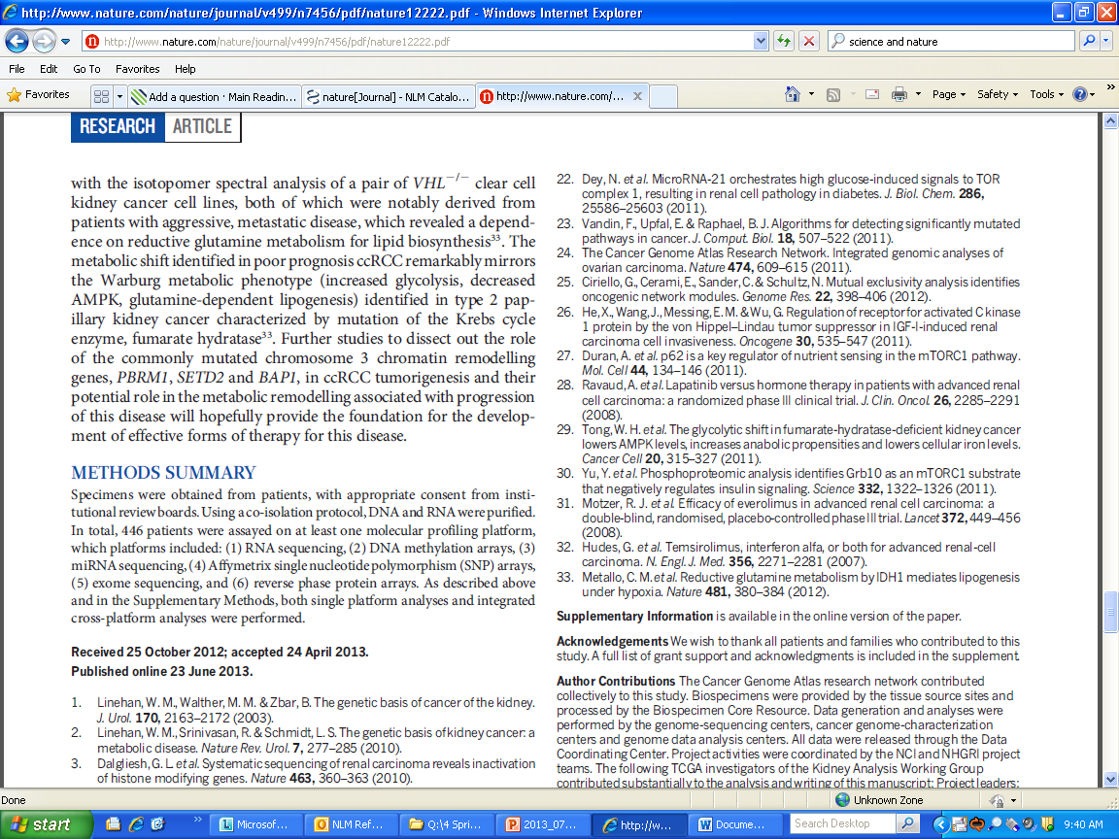
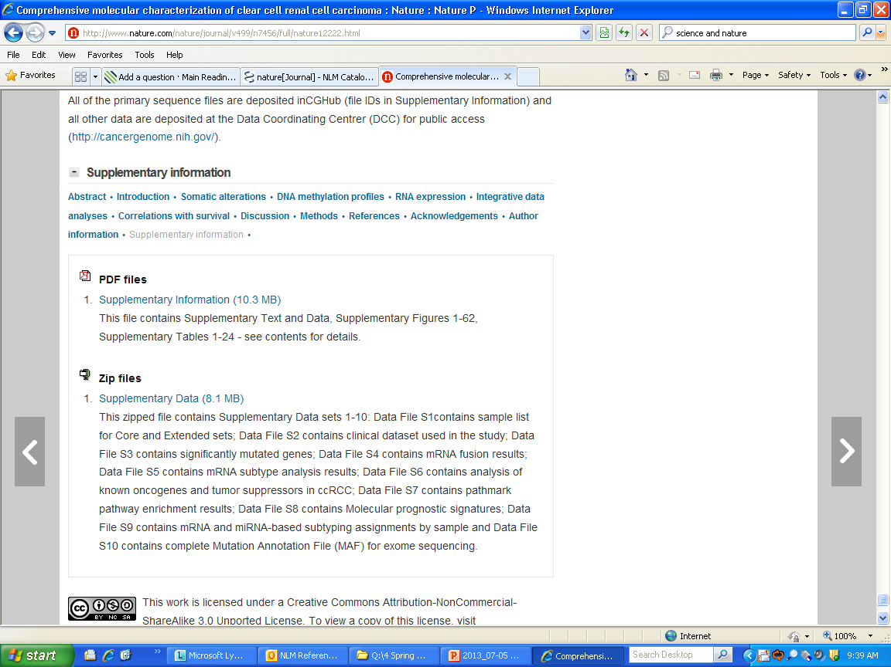
Supplementary Material
Level of Importance: Additional
The Cancer Genome Atlas Research Network. (2013, July 4). Comprehensive molecular characterization of clear cell renal cell carcinoma. Nature 499(43-49). doi:10.1038/nature12222
Notes:
[click: article]
Supplementary Additional Material Content that provides additional, relevant, and useful expansion of the article in the form of text, tables, figures, multimedia, or data, and that may aid any reader to achieve deeper understanding of the current work through added detail and context.
So we have an example ere of supplementary additional material.
[click: print]
This is the print version of an article and I’ve highlighted here the publishers instructions to the reader that supplementary materials can be found online.
[click: online]
And if we go online we see a .PDF and a ZIP file available for viewing. And this isn’t a small file of information. The PDF contains Figures 1-62, and Tables 1-24. So we’ve got a lot of information here- more than what would have ever been reasonable in a print publication.

Slide 8
Supplementary Material
Level of Importance: Additional
Publisher responsible for hosting
Editing not always possible
  Indicate level of editing
Notes:
[click: publisher]
NISO recommends for best practices that while the author creates the content, the publisher would take responsibility to host it.
[click: editing]
Additional content may be so large, such as the example we just reviewed, that resources for editing it may not be available. For this reason, NISO recommends that publishers indicate either in the material itself or in the article the level of editing the additional content has undergone.

Slide 9

Supplementary Material
Level of Importance: Integral
Liisberg Aune, U., Ruiz, L., Kajimura, S. Isolation and Differentiation of Stromal Vascular Cells to Beige/Brite Cells. J. Vis. Exp. (73), e50191, doi:10.3791/50191 (2013).
Notes:
Supplementary Integral Material that is essential for the full understanding of the work but is placed outside the article for technical, business, or logistical reasons.
And example of supplementary integral information is a movie that the author regards as very important to the understanding of the article. In the journal’s electronic format, the movie may perhaps be the first thing you view.
However, if the publisher wants the electronic publication to be an exact replica of the print, the movie will be considered Supplemental material because it can’t be published in print, but since it is integral to the understanding of the article, we will consider it supplementary integral information.

Slide 10
Supplementary Material
Level of Importance: Integral
Publisher responsible for hosting
Editing at same as core article
In future:
  Move away from “supplementary”
  Move towards better definitions of importance
Notes:
NISO recommends that generally the publisher should maintain the responsibility for hosting and curating the content in the same manner as the article. They also recommend that any editing should be done at the same level as the core article.
What is considered supplemental material and published outside of the core of the article today, may be incorporated into a new hybrid-like article in the future. If this happens, we may see a move away from the term supplementary and simply talk about any figure or table’s level of importance to an article, perhaps with new and improved terms beyond additional or integral.
However, today we remember that we live in a world of transition, and therefore we need to represent the transition as it is, and not force it into a model that it is not ready for.

Slide 11
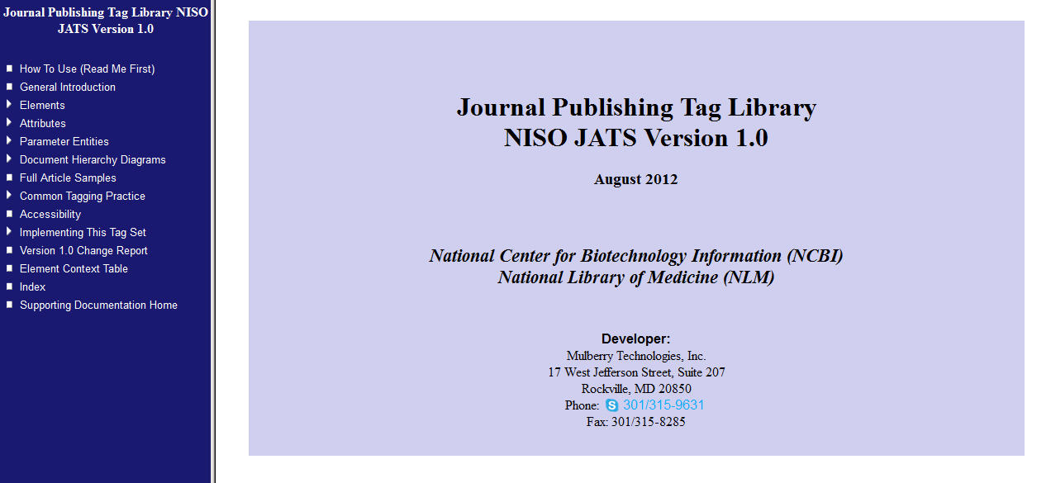
JATS: Journal Article Tag Suite
Notes:
So the purpose of this study was to create an extension to JATS to better support supplementary materials, using some practices recommended by the NISO committee. But in order to go into that we need to step back and review what JATS is.
The National Library of Medicine collaborated on a tagging structure for journal articles, called “Journal Article Tag Suite.” JATS is a collection of XML elements and attributes used to describe the content of journal articles. It is a NISO standard which was created to provide a common format in which publishers and archives could exchange journal content. All journal articles in PMC are stored in the JATS XML format.
Pictured here is the opening page of the JATS tag library.
But, some of you (like myself at the beginning of this project) may be unfamiliar with JATS and XML, might wonder why we tag journal articles with XML? What advantage does this provide? I’ll cover two advantages which will help us later on understand how an extension to JATS is needed to better support supplementary material.

Slide 12
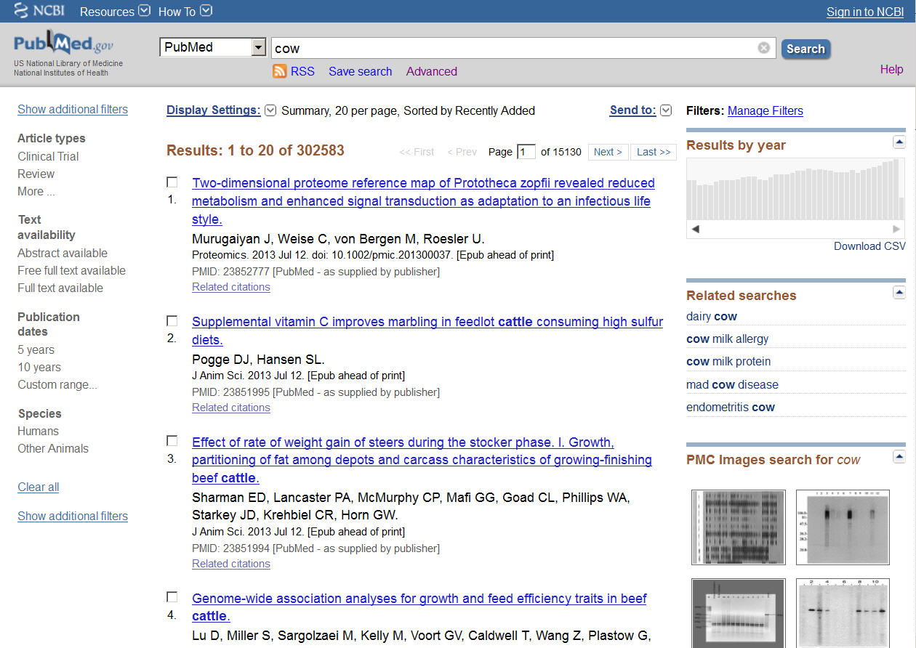
XML
Processing
http://www.ncbi.nlm.nih.gov/pubmed/?term=cow
Notes:
XML allows for automated processing of all elements in a document. An example of this is using XML to create a display of Journal Titles, like the one shown here in PubMed by an automated pulling and gathering of all title elements from a list of journal articles.
Here we see a list of titles, authors and so on. If we select one of the articles and view the XML…we see the <articletitle> element. This is the element being pulled to form the PubMed display of article titles.
Even if we look at the MEDLINE view, the TI field is being populated from the XML.
All of these formats under the “Display Settings” list are being rendered from the XML.

Slide 13

XML
Information Retrieval
Notes:
Another great quality of XML is that it supports information retrieval by allowing elements to be treated as fields in a database. So a user can request all titles that contain a particular chemical, or disease.
In order to take full advantage of what XML offers, we need to use it well. To learn about how to use XML well, my project sponsors asked me to complete a document modeling exercise. The purpose of the exercise was to help me understand some of the complexities we need to consider when representing information in a document with XML, and this would lead me into doing the same exercise, but with supplementary material.

Slide 14
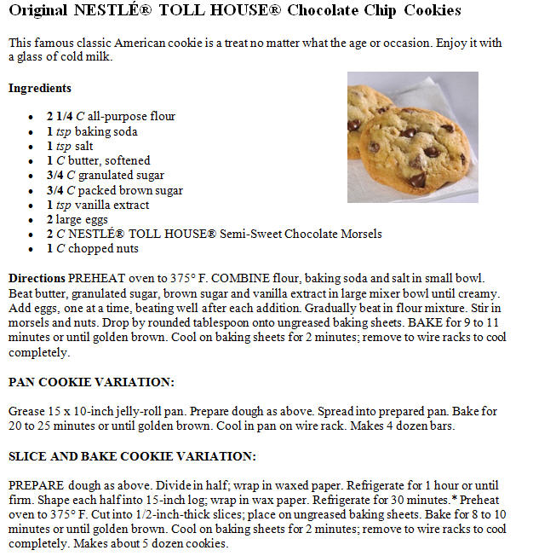
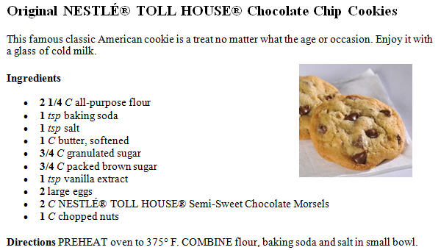
<recipe>
<title>
</title>
<p>
</p>
<ing-list>
<image>
<title>
</title>
</image>
<dirct-list>
</ing-list>
</dirct-list>
</recipe>
Notes:
I was to take two separate recipes and think of all the tags I wanted to use, and then write some documentation so that the computer would know what to expect from that document. And we’ll do that schematically now, just so we can experience some of the complexities that come up.
Let’s say we want to create a set of tags that we can use over and over again to tag recipes. Now, XML is really going to help us out because it will allow us to do some of the things we talked about earlier, such as information retrieval. We will be able to search for recipes with specific ingredients, such as “flour” or “eggs.” If we didn’t use XML, would have rely on full text search of all our recipes, which means a search for “flour” could bring back the term flour in the directions “flour the cake pan.”
So we begin with the Toll House Chocolate Chip Cookie Recipe, my favorite. We will use the root tag <recipe>. This tells the computer where the entire document will begin and end. We decide there is a Title, paragraph of text, and ingredient list. The ingredient list has a title, so we will create a title as a child of the element <ing-list>.
There is also an image and a list of directions. But remember, we want to make sure our recipe is searchable with better retrieval results. We want the computer to recognize individual ingredients, so we’ll have to work more closely with the ingredient list- create more children.

Slide 15
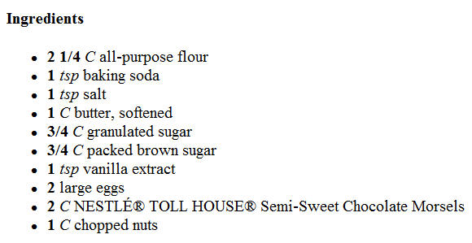
<ing-list>
<title>
</title>
<ingredient amount=“2 ¼” units=“C”>
all-purpose flour
</ingredient>
</ing-list>
Notes:
So we have the ingredient list with the child <title>.
Then we’ve decided another child of ingredient-list will be the element <ingredient>. And ingredient has some attributes. Such as amount and units.

Slide 16

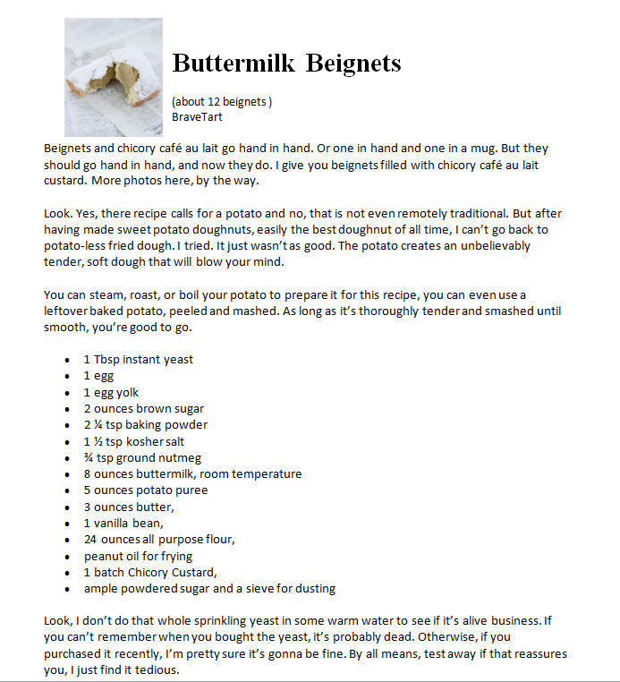
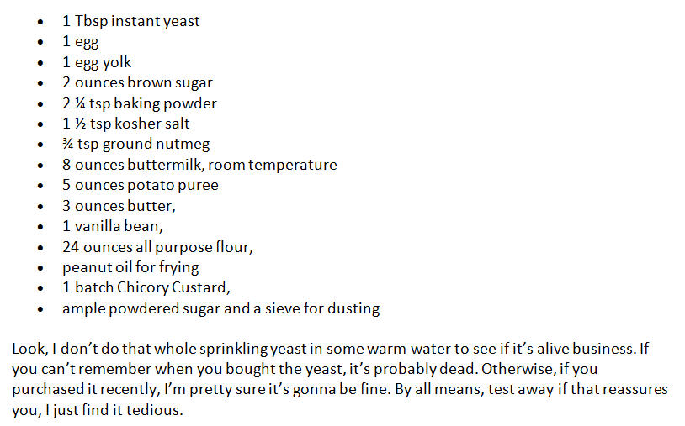
<recipe>
<image>
<title>
</title>
<subtitle>
</subtitle>
<author>
</author>
</image>
<ing-list>
<ingredient amount=“1” units=“Tbsp”>
instant yeast
</ingredient>
</ing-list>
<note>
</note>
</recipe>
Notes:
Now we move to the next recipe. Everything starts off fine, you have the root element <recipe>, <title>, <image> and then you notice that there is an amount listed and an author. We don’t have these tags in our group yet.
Now we’ve got to make some decisions.
Do we want to tag all recipe documents as they actually exists, which means adding tags and tag structures whenever something new comes up?
Do we want to have one tag model that we hope all recipes will fit into? Well, for today we are going to decide to add some more tags to our group, because we think that amount and author are pretty important, even though our first recipe didn’t have them.
You also notice that there is no title for the ingredient list, so you have to make sure that the rules you write to accompany this group of tags lets the computer know that ingredient lists don’t have to have titles, or do you enforce titles?
Then you get down to the what you think are directions. But wait, it says “Look, I don’t do that whole sprinkling yeast in some warm water to see if its alive business. If you can’t remember when you bought the yeast, it’s probably dead.”
That is not a direction. That’s more of a note. So we’ll add the tag <note>.
So you see there are some complexities to modeling documents.

Slide 17
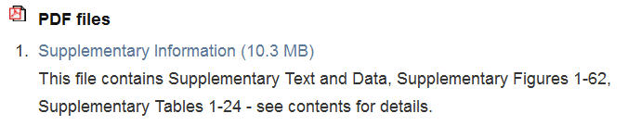
What would JATS do?
<supplementary-material>
<media xlink:href=“http://www.nature.com/...nature12222-s1.pdf”>
<caption>
<title>
<p>
</title>
</p>
</caption>
</media>
</supplementary-material>
Notes:
So we’ve discuss supplementary material and some of the challenges it poses.
We’ve covered what XML can do if it is used well through our document modeling exericse.
We know there was what I called a “wild west” of publishers wrangling supplementary material in many different ways, so how did JATS wrangle it? What does JATS do with supplementary material?
[click: supplmentary material]
[click: sup-mat open tag]
[click: sup-mat close tag]
And this model is OK, it does provide us with the knowledge that the supplementary material exists. But it doesn’t go very in-depth in describing the supplementary material.
But we think back to our cookie recipe and how we decided to tease out the individual ingredients because we know that XML used well will allow us to retrieve information in a meaningful way.
We begin to notice that is current model in JATS wouldn’t allow us to search the titles of these 62 figures, or to make a table of contents of the 24 tables, because the JATS supplementary material model doesn’t tag the titles or captions of the tables and figures themselves. It doesn’t really capture anything below the file name and some overall information.

Slide 18
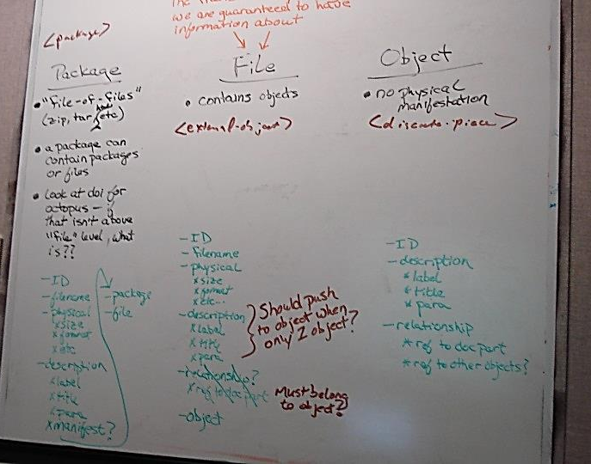
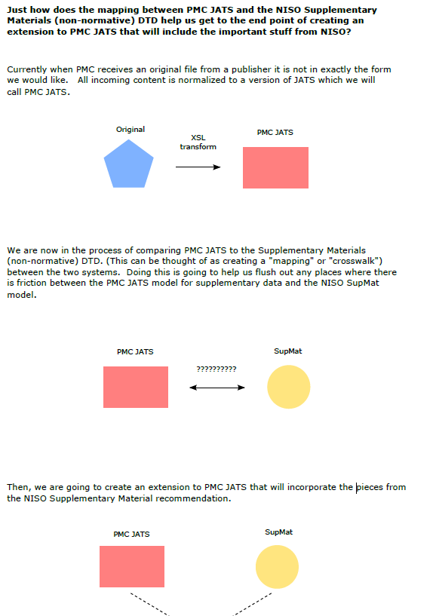
Creating the Extension
Support NISO Recommended Practices
  “NISO RP”
Close reading of NISO RP
Discussion of new model
Document Modeling
Notes:
In order to create an extension to JATS to better support supplementary material, and use the recommendations provided by NISO we had to closely read the document that NISO provided and really think about what they were trying to represent.
We then discussed possible models for JATS. This involved a lot of mapping out our ideas on white boards and drawing each other figures so make sure everyone was understanding the possibilities.
We also looked at a lot of documents with supplementary material and tried to create a model which would support all of the many differences we found. Finally we came up with a model and tested that model on the NISO example articles and on difficult examples we found in PMC.

Slide 19
Creating the Extension
Work within JATS structure
  <history> model
Include NISO RP elements when needed
  <preservation> model
Element name changes
  <sup-mat-object-metadata>
  becomes <resource>
One-to-one mapping
  NISO RP = agnostic structure
JATS
EXT
Notes:
The new model we came up with was called the EXT.
We made a few decisions during the modeling process, which helped to guide our work.
[click: work within JATS]
We decided to work within the JATS structure as much as possible, use JATS elements which hold the same meaning as NISO RP elements. An example of this is that the NISO RP recommended a structure for history which was not as robust as the model that JATS currently held. So we applied the JATS structure to supplementary material, rather than the NISO RP.
[click: Include NISO...]
We would add NISO RP elements and deprecate JATS elements only when necessary. The NISO RP model for <preservation> did not exists in the JATS structure, so we used the NISO RP model instead.
[click: Element name…]
In addition any NISO RP elements or models added to the EXT could undergo a name change if we felt it would facilitate a better understanding of the EXT structure. The NISO RP element <sup-mat-object-metadata> became <ext:resource>.
[click: One-to-one]
I think it is important to note that the examples I provided above make it seem as though we could directly map the NISO RP to JATS, and where JATS was deficient, we could just add in the necessary elements from the NISO RP.
But this was not the case. While there was some one-to-one mapping that could be done, it is important to note that the NISO RP was meant to be a stand alone structure. NISO recommended how to deal with supplementary material as though it was the only thing that existed.
However, in JATS, supplementary material is always supplementary to an article…so it exists with an article, and is not standing alone. And it is important to note that the NISO RP was not meant to be overlaid upon a structure such as JATS…which is why we spent so much time building a structure that complemented JATS and modeling it against supplementary material.

Slide 20

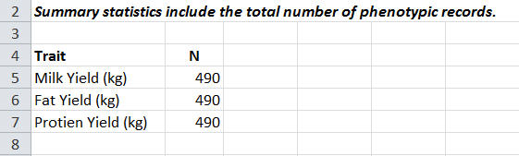
Supplementary Material
Additional file 1:
Summary statistics for the cow dataset.
Click here for file (14K, XLS)
<supplementary-material>
<caption>
<title>
</title>
<p>
</p>
<resource>
</caption>
<resource-meta>
<filename>
1471-2156-13-21-S1.XLS
</filename>
<format>
XLS
</format>
<size units=“KB”>
14
</size>
<item>
</resource-meta>
<caption>
<title>
</title>
</caption>
</resource>
</item>
</supplementary-material>
Notes:
Now I’ll go over an example of the Extension in schematic way.
The structure of the extension is complex and so I tried to select a basic example that works well schematically here on the screen.
[click: <supplementary –material>]
We begin with some supplementary material that you may recognize from PMC. And if we were to click to open the file, we would get an excel table.
So we are going to start off with a <supplementary-material> wrapper. And we are going to by pass the Supplementary Material heading here that PMC puts on- it is a presentational element that we don’t need to worry about right now in our model.
We see that the supplementary material has a title and a piece of information, “Summary statistics for the cow dataset”. In our structure titles and paragraphs are wrapped in the <caption> element.
And then we have file that we will wrap in a<resource> element. A resource which we define as an information object that is addressable in a file system.
And we’ve decided that resources have metadata. So we’ll add the <resource-meta> wrapper which has child elements <file-name>, <format> and <size>. Note that size has an attribute for units.
And then the resource, which is the object as it is addressable in a file system, has an item, which is a table. And the table has a title and paragraph of explanatory text. So, we’ll wrap it in the element <ext:item>.
And that is just a brief example of the structure of the extension for supplementary material.

Slide 21

JATS Extension
Available at: http://www.jats.nlm.nih.gov
Tag Library: http://www.ncbi.nlm.nih.gov/staff/beck/sme/el-ext-resource.html
Notes:
The extension will be made available with other JATS extensions on the JATS documentation site at <http://jats.nlm.nih.gov> .
We have also created a tag library for the extension.
We will be presenting the at JATS Con which is a conference held here on the NIH campus for users of the Journal Article Tag Suite. We hope that the JATS community will provide their feedback on the extension.

Slide 22

Independent Validation and Verification
“…we consider this a successful exercise, because the tag set created would achieve the stated goals, in many cases very well, and far more important, it reveals several issues that must be resolved before a production version of this enhanced tagging can be developed….An experiment that points out this many problems is, by definitions, a success.”
Notes:
In addition we sent the extension out for a independent validation and verification through Mulberry Technologies, who specialize in XML. This step was done to provide us with an outside perspective. There is a large constituency outside of the NLM that use JATS, and we want to be sure that we are also representing their experiences.
“…we consider this a successful exercise, because the tag set created would achieve the stated goals, in many cases very well, and far more important, it reveals several issues that must be resolved before a production version of this enhanced tagging can be developed….An experiment that points out this many problems is, by definitions, a success.”

Slide 23
Acknowledgements
Project Managers
  Jeff Beck, Technical Information Specialist
  Kimberly A. Tryka, Staff Scientist
Supporters
  Kathel Dunn and Beth Weston
  Kathy Kwan, Deborah Lapeyre, Alexander Schwarzman, Lou Knecht
  Dr. Lindberg and Betsy Humphreys, Joyce Backus, Dianne Babski
Notes:
I would like to thank the project managers, Jeff and Kim for all of the training and guidance they have provided me.
I would also like to thank those who have supported me in other ways during this project.
Thank you.

Slide 24
Questions or Comments

