Slide 1


National Library of Medicine
2nd Year Associate Fellowship
Washington University in St. Louis
Karen Gutzman
Associate Fellow

Slide 2
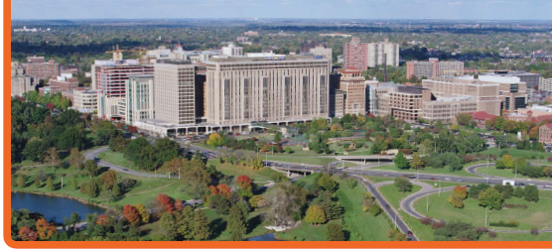
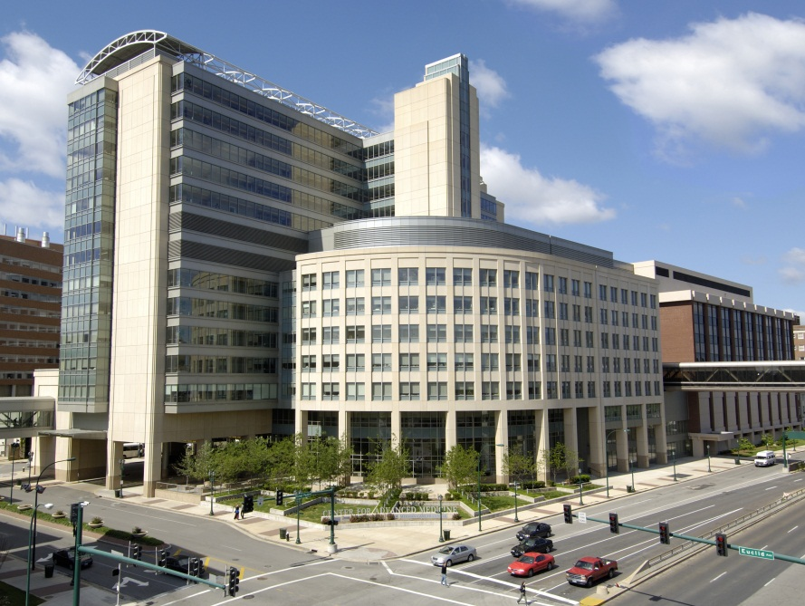
Washington University in
St. Louis School of Medicine
Notes:
Founding of the School of Medicine in 1891. The School of Medicine is one of seven schools of Washington University in St. Louis.
Washington University provides clinical services in partnership with Barnes-Jewish Hospital and St. Louis Children’s Hospital — both nationally-recognized, world-class teaching hospitals on the campus of Washington University Medical Center.
The School of Medicine is a robust research enterprise and received more than $596 million in gifts and grants during the fiscal year ending June 30, 2010. Our faculty, staff and students are committed to advancing the application of research discoveries to clinical care through multidisciplinary collaborations, such as BioMed 21. Our clinical faculty experts oversee a wide array of clinical trials, which offer patients the opportunity to participate in the evaluation of innovative treatments and prevention strategies.
The Alvin J. Siteman Cancer Center at Barnes-Jewish Hospital and Washington University School of Medicine is an international leader in cancer treatment, research, prevention, education and community outreach. It is the only cancer center in Missouri to hold the prestigious Comprehensive Cancer Center designation from the National Cancer Institute and membership in the National Comprehensive Cancer Network. - See more at: http://www.siteman.wustl.edu/about-us.aspx#sthash.FOCMMseL.dpuf
Siteman offers the expertise of more than 350 Washington University research scientists and physicians who provide care for 8,500 newly diagnosed cancer patients each year. A full range of advanced diagnostic and treatment services are available for patients with all types of cancer, many of them provided in a state-of-the-art outpatient facility that opened in 2001. - See more at: http://www.siteman.wustl.edu/about-us.aspx#sthash.FOCMMseL.dpuf

Slide 3
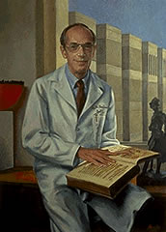
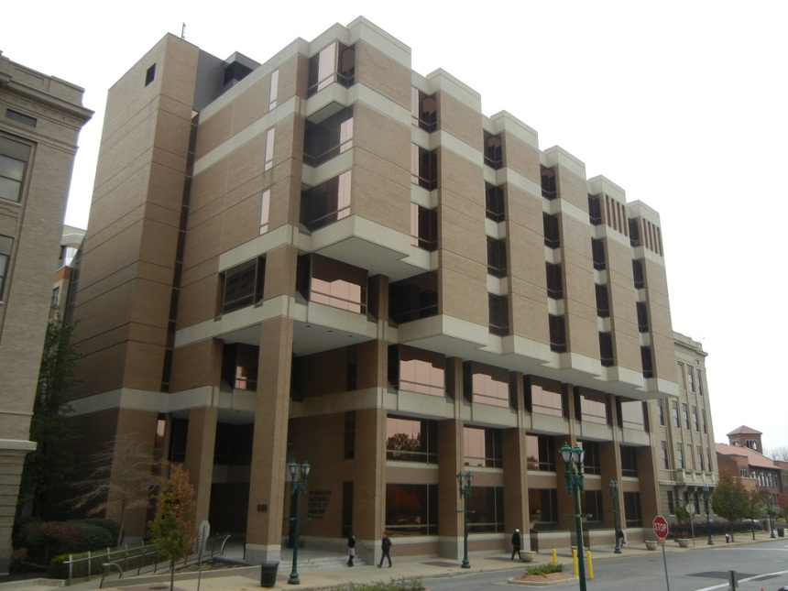
Becker Medical Library
Notes:
Dr. Bernard Becker is professor emeritus and emeritus head of the Department of Ophthalmology and Visual Sciences at Washington University School of Medicine. Passed away on August 28, 2013
The mission of the Becker Medical Library is to provide information resources and technology in support of the educational, research and patient care objectives of the School of Medicine. Also serve the Barnes-Jewish Hospital, and the St. Louis Children’s Hospital.
The Collections
The Bernard Becker Medical Library collections are available to the nearly 10,000 faculty, staff and students at the Washington University Medical Center. The collections consist of:
4,615 electronic journal titles (active and inactive)
3,723 electronic journal titles (active)
4,536 print journal titles (active and inactive)
158 print journal titles (active) – print-only or print+online
26 print-only journal titles (active)
over 3,000 electronic books
114,000 print monographic volumes
1,500 audio-visual items
33 electronic databases
811 archival collections (institutional records, manuscripts, visuals, and oral histories)
over 26,500 volumes of rare books, in 9 distinct collections
Library Staff
The library staff of 50 employees includes:
librarians
information technology specialists
library assistants

Slide 4



Translational Research Support Division
Dr. Kristi Holmes, Bioinformaticist
  Preceptor for NLM Fellow
Dr. Marcy Vana, Bioinformaticist
  Led by Bob Engeszer, Associate Director, Translational Research Support
  Other members: Mychal Voorhees, Judy Hansen, Cathy Sarli, Amy Suiter, Robert Altman

Slide 5


Goals for 2nd year
Research Support
Research Impact
Clinical Librarianship
Outreach
Systematic Reviews

Slide 6
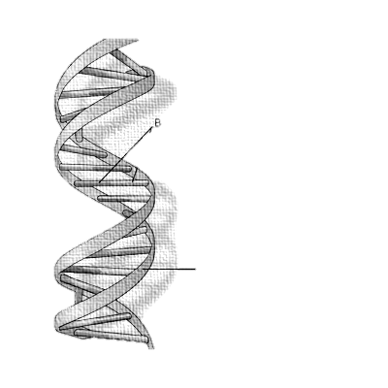
Genomic Information
Needs Project
Four specific populations
  basic science researchers
  clinical research professionals (physicians, clinical research coordinators, etc.)
  healthcare professionals (physicians, nurses, pharmacists, etc.)
  community organizations
Meet with focus groups
Partners:
  MLA’s Donald A. B. Lindberg Research Fellowship
  Institute for Clinical and Translational Sciences (ICTS)
Notes:
This work proposes to carry out a cross sectional study to understand information needs in the academic medical environment through a survey-based needs assessment and focus groups, comparison of findings across populations, development of a model for supporting the identified needs, and broad dissemination of the research findings.
A survey to investigate how specific groups search for genetic/genomic information will be developed and sent to four specific populations at WUSM: basic science researchers, clinical researchers, clinicians and healthcare workers, and the public. The survey instrument will be developed in cooperation with campus partners. The survey instruments will be disseminated via established campus email lists and in coordination with departmental administrators. The public will be engaged through the Washington University Research Participant Registry.
Four lunchtime focus groups of 6-8 attendees will be held upon completion of the survey. Respondents will be asked in the survey to indicate their interest in participating in a focus group.
The Lindberg Research Fellowship Endowment, established in 2003, provides an annual award by the Medical Library Association through a competitive grant process. The purpose of this fellowship is to fund research aimed at expanding the research knowledge base, linking the information services provided by librarians to improved health care and advances in biomedical research.

Slide 7
Timeline
Clinical Research Professional Survey
Community Organization Survey
Basic Science Survey
Healthcare Professional Survey
Research and development
IRB process
Open Surveys
Focus groups
Analyze Results
Oct. Nov. Dec. Jan. Feb. Mar. Apr. May June July
2013
2014

Slide 8
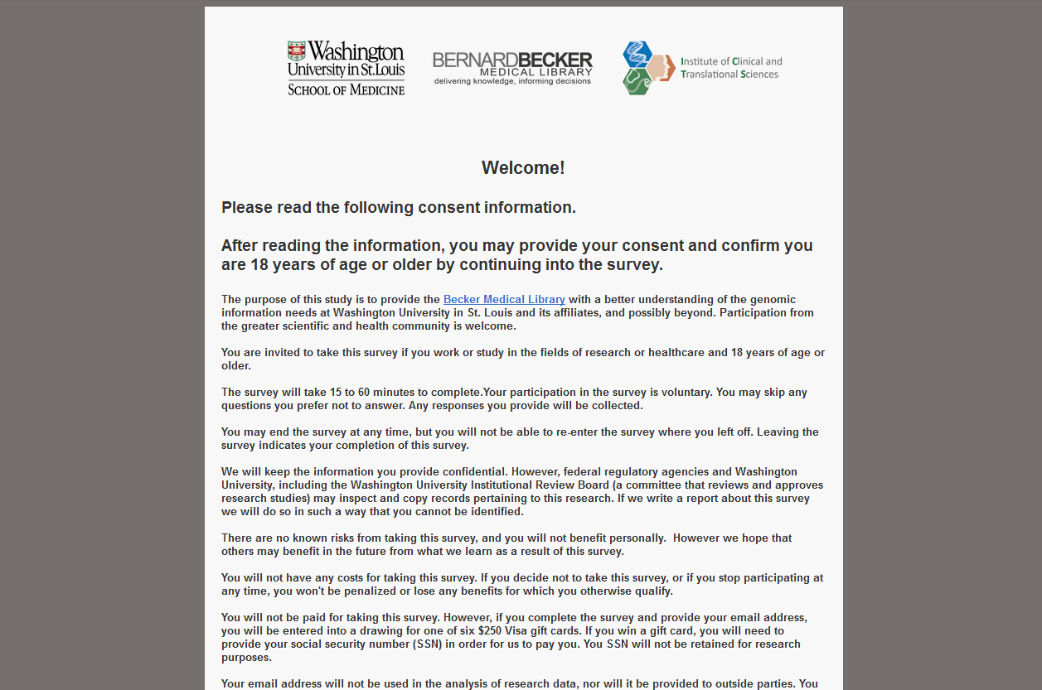
Overview
Notes:
Qualtrics is a private research software company, based in Provo, UT. The company was founded in 2002 by Scott M. Smith, Ryan Smith, Jared Smith and Stuart Orgill.^{[2]}
Qualtrics software enables users to do many kinds of online data collection^{[1]} and analysis including market research, customer satisfaction and loyalty, product and concept testing, employee evaluations and website feedback.^{[3]}
Qualtrics
Question Blocks
Genomic/Genetic Education
Genomic/Genetic Testing
Databases and Software
Staying Current
Seeking information
Question types
Multiple choice
Free text

Slide 9
Genomic Education Block
Which of the following topics related to genetics and genomics would you like to learn more about?
 | Very interested | Somewhat Interested | Not Interested
Consumer Genomics (including direct to consumer tests)
Current application of genomics in diagnosis and treatment
Delivery of complex health information to the public
Molecular Biology/Genetics Refresher
The Genetic Basis of Disease
Statistics for Genome Research
Genomes and Genome Browsers
Consent and Tissue Banking
Research Ethics
Genome Sequencing Technologies
Copy Number Variation
Analysis of the Transcriptome

Slide 10

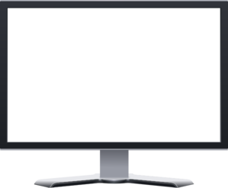






Research Outputs and
Dissemination
Notes:
Publish in
Journal of the Medical Library Association
Open Access title in field of genetics (ex. PLoS Genetics)
Present poster or abstract at
2014 American Society of Human Genetics annual meeting
2014 Medical Library Association annual meeting.
Develop workshop and other materials and deposit into the MLA’s Educational Clearinghouse
The dissemination plan for this project is unique in that both library and non-library audiences are targeted.
Write and submit manuscripts for review and subsequent publication to the Journal of the Medical Library Association and an Open Access title in the field of genetics, such as PLoS Genetics.
Submit poster and podium presentation abstracts to the 2014 American Society of Human Genetics annual meeting and the 2014 Medical Library Association annual meeting.Incorporate social media as an ongoing mode of dissemination, including blog posts on the Becker Briefs Newsletter, and tweets at @kristiholmes.

Slide 11
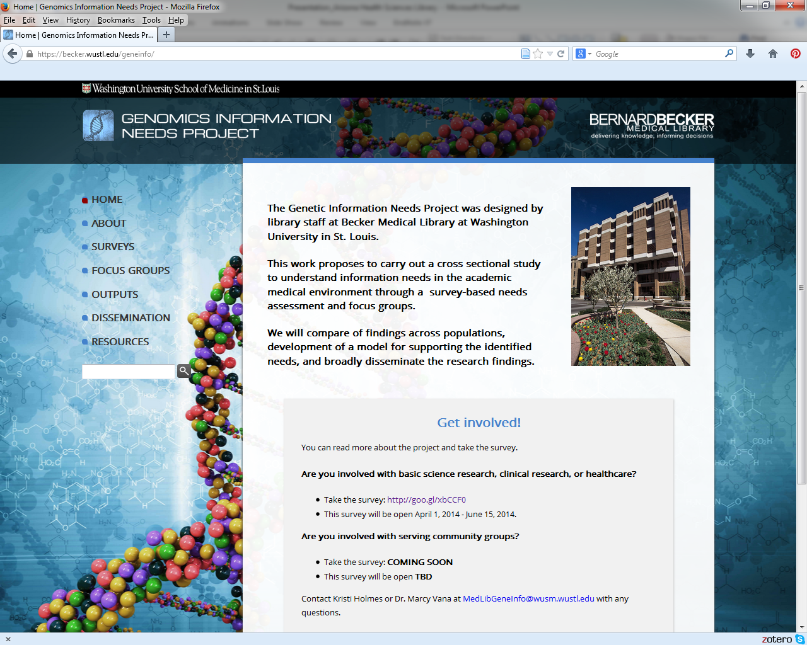
https://becker.wustl.edu/geneinfo/

Slide 12
Gain understanding of
Research Impact
Why is impact important?
  Justify requests for future funding
  Quantify return on investment
  Discover how research findings are being used
  Qualify for tenure
  Create promotion dossiers
impact

Slide 13

How do we measure impact?
Citation Analysis is…
  traditionally-used method of assessing research impact
  performed by examining an individual publication (or a group of publications)
  assessing how often it has been cited, if ever, by subsequent publications
  Limitations of citation analysis
  Inherent assumption is that significant publications will demonstrate a high cited-by count
  High cited-by publication counts do not automatically equate quality of research or greater research impact
Notes:
Citation analysis is a traditionally-used method of assessing research impact performed by examining an individual publication (or a group of publications) and assessing how often it has been cited, if ever, by subsequent publications.
Inherent assumption is that significant publications will demonstrate a high cited-by count.
Citation Analysis Limitations
Results from a particular resource reflect only those publications that are indexed by the resource; potentially a small pool of literature.
Citation analysis does not include new, non-traditional modes of dissemination.
Author self-citations and reciprocal citing often inflate cited-by publication counts.
High cited-by publication counts do not automatically equate quality of research or greater research impact.

Slide 14
Beyond citation analysis
The Becker Model for Assessing Research Impact
involves tracking
research outputs
to locate
indicators
that demonstrate
evidence of
research impact.
Research Output
Indicators
Evidence of Research Impact
https://becker.wustl.edu/impact-assessment/model
Notes:
The Becker Model involves tracking research outputs that have been disseminated/diffused to locate indicators that demonstrate evidence of research impact. The Becker Model is a tool to supplement citation analysis to provide a more meaningful narrative of research impact:
Research outputs are:
Products created/generated from basic or clinical biomedical research
Products disseminated by the research study investigators that discuss or interpret the findings of the research study
Research output examples are:
Publications resulting from the research study
Conference abstracts (papers or posters) resulting from the research study
Outreach visits by research investigators
Biological materials or application
Data
Patents
ETC.

Slide 15
Indicators
Advancement of Knowledge
  Generation of a new research study
  Development or changes to curriculum guidelines
Clinical Implementation
  Creation of Current Procedural Terminology (CPT) codes
Community Benefit
  A blood test for detection of damage to the heart muscle leads to early treatment for myocardial infarctions
Legislation and Policy Enactment
  Testimony given by researchers before a government body
Economic Benefit
  Discovery of lithium treatment for manic-depressive disorders saved the US over $145 billion in hospital costs.
Notes:
Indicators are specific, concrete examples of outcomes that demonstrate impact as a result of a research output.
Knowledge Transfer
Clinical Implementation
Community Benefit
Legislation and Policy Enactment
Knowledge Transfer: Evidence of Research Impact
New research study generated as a result of the research study
License agreement granted for use of intellectual property generated by the research study
Clinical data generated in support of marketing a medical device
Consensus Development Conference
Curriculum guidelines
Cited references
Clinical Implementation is the application or adoption of research outputs in clinical practice.
Creation of Current Procedural Terminology (CPT) codes
Medical device is registered with FDA and used in delivery of healthcare
Research study cited in private insurance benefit plan in support of coverage
Healthcare providers report that research outputs from a research study has affected the way they manage patients
Community Benefit is the enhancement of community health outcomes as a result of research outputs.
A blood test for detection of damage to the heart muscle leads to early treatment for myocardial infarctions, a leading cause of death worldwide.
A critically appraised economic evaluation reports that research outputs from a research study demonstrates an effective injury intervention strategy in reducing head injuries: “wearing a bicycle helmet reduced the risk of incurring a head injury following an accident by 70%.”
Discovery of lithium treatment for manic-depressive disorders saved the US over $145 billion in hospital costs.
Legislation and Policy Enactment represents codification of research outputs into public law, guidelines, standards or policy.
Smoke-free Air Acts
Automated External Defibrillators (AED) Acts
ANSI Standards
AIA Guidelines for Design and Construction of Health Care Facilities
Testimony given by a research investigator before a governing body supports creation of a bill and/or regulation
The Becker Model is a tool to supplement citation analysis to provide a more meaningful narrative of research impact:
What resulted from an outreach visit by a research investigator to a policy-making organization?
What new legislation was enacted as a result of a research study?
How many cases of glaucoma were prevented based on new diagnostic criteria identified by a research study?
How many new research studies resulted from a research study?
How many healthcare providers report that research outputs from a research study has affected the way they manage patients?

Slide 16
The Project
Develop common framework for using the Becker Model for Assessing Research Impact
  Tracking and Evaluation Committee of the Institute for Clinical and Translational Sciences (ICTS)
  Currently in the first year of a 2 year project
  Total of 6 researchers
Sources of information
  Publication data
  Collaboration patterns
  Survey data
  Anecdotal data
Notes:
Publication data- publication history and citations
Survey data- do respondents report on meaningful outcomes?
Collaboration patterns- based on publication data and collaboration survey
Anecdotal data- what do PIs and administrative staff learn from others and from interviews?
DATABASES
PubMed
SCOPUS
Web of Science
Google Scholar
ClinicalTrials.gov
RePORTER.gov
PUBLICATIONS/
RESOURCES
Peer-reviewed journal
articles
Trade publications
Gray literature
Clinical guidelines
Policy statements
Curriculum materials
Patents
MTAs
Licenses
ORGANIZATIONS
FDA
National Center for
Biotechnology Information
(NCBI)
Agency for Healthcare Research
and Quality (AHRQ)
Websites of professional
organizations
Websites of standard-issuing
organizations
Academic organizations

Slide 17
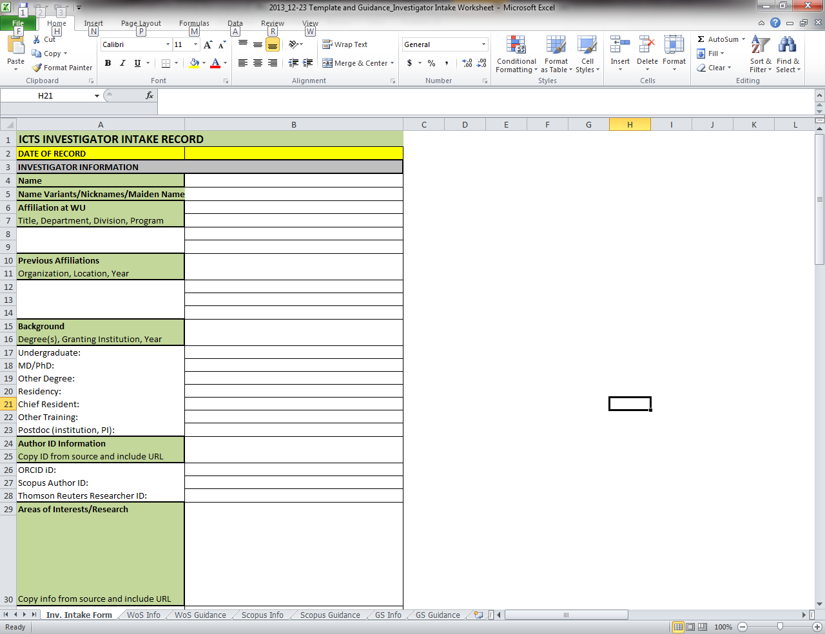
Outcomes
Intake Screening form

Slide 18
Other Outcomes
Interview Template
Visualizing Information Portfolio
  http://visualizinginformationportfolio.blogspot.com/

Slide 19
Up Next?
Continue
  working on Genomic Information Needs Project
  learning about assessing and enhancing research impact
Find gainful employment

Slide 20

Acknowledgements
Dr. Kristi Holmes
  Senior Bioinformaticist
Bob Engeszer
  Associate Director, Translational Research Support
Paul Schoening
  Associate Dean and Director
NLM Associate Fellowship Program

Slide 21
Thank you

Slide 22
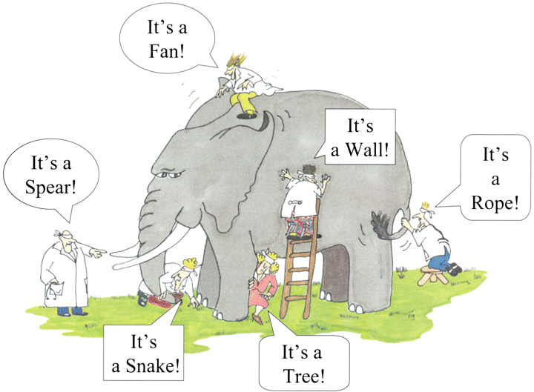
Health Sciences Librarianship and me
http://www.journeyifc.com/modx/assets/images/5GodTheElephant.gif
Notes:
Originally this picture was an allegory for God, but I think it can also represent my exploration of Health Sciences Librarianship. The elephant in this case is Health Sciences Librarianship, and this year has seen me touching on many different aspects of it, which all seem different, but only to discover it is still all one field, or elephant.

Slide 23
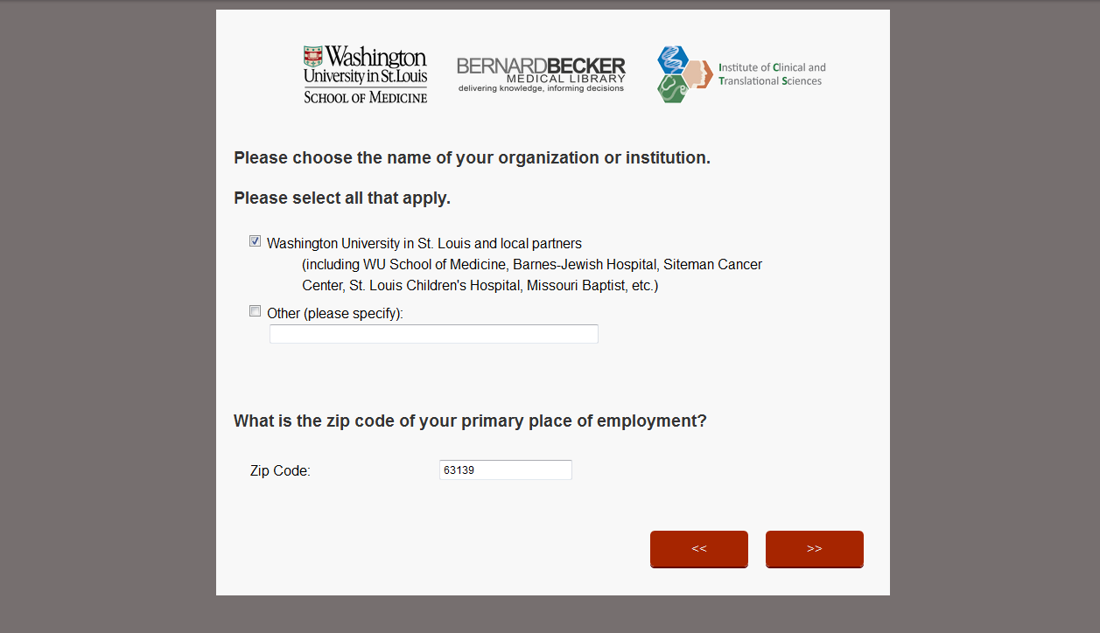
Overview
Notes:
Qualtrics is a private research software company, based in Provo, UT. The company was founded in 2002 by Scott M. Smith, Ryan Smith, Jared Smith and Stuart Orgill.^{[2]}
Qualtrics software enables users to do many kinds of online data collection^{[1]} and analysis including market research, customer satisfaction and loyalty, product and concept testing, employee evaluations and website feedback.^{[3]}
Qualtrics
Question Blocks
Genomic/Genetic Education
Genomic/Genetic Testing
Databases and Software
Staying Current
Seeking information
Question types
Multiple choice
Free text

Slide 24
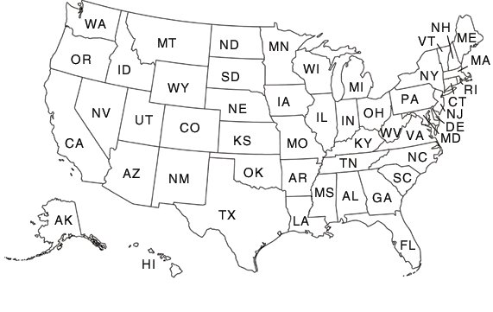
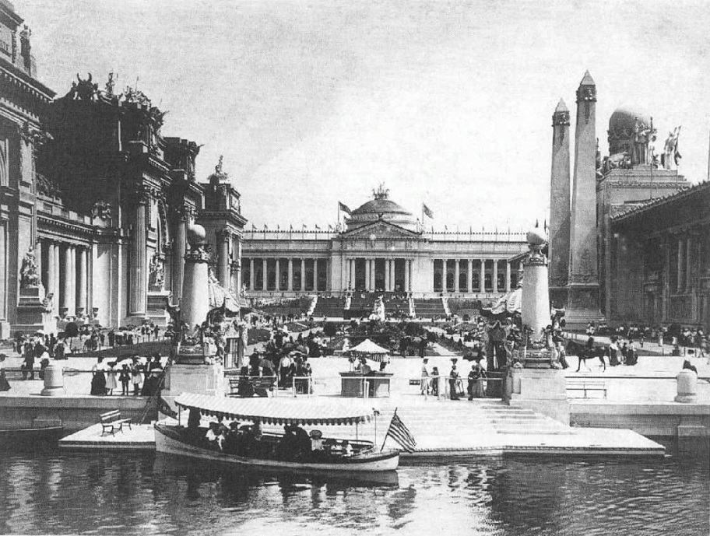

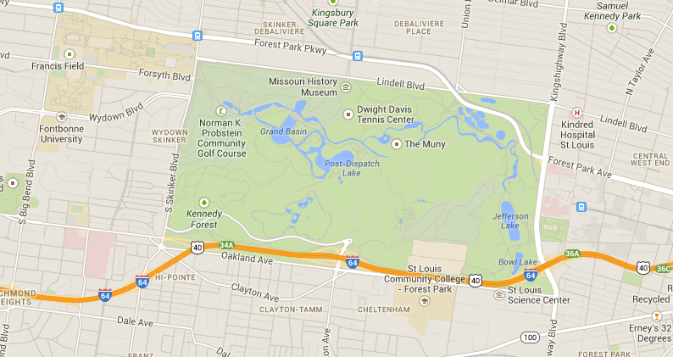
St. Louis, MO
Notes:
St. Louis is located just south of the confluence of the Missouri and Mississippi Rivers. The population was 319,294 in 2012 making it the 58th largest city. The city's population peaked in 1950, then began a long decline that continues in the 21st century.
Washington University is separated by Forest Park. Forest Park is a public park located in western part of the city of St. Louis, Missouri, in the United States. It is a prominent civic center and covers 1,371 acres (5.55 km²).^{[1]} The park, which opened in 1876, more than a decade after its proposal, has hosted several significant events, including the Louisiana Purchase Exposition of 1904 and the 1904 Summer Olympics. The park features a variety of attractions, including the St. Louis Zoo, the Saint Louis Art Museum, the Missouri History Museum, and the St. Louis Science Center.
Louisiana Purchase Exposition, informally known as the 1904 World’s Fair. The Fair opened April 30, 1904, and closed December 1, 1904. The Fair's 1,200 acre (4.9 km²) site, designed by George Kessler,^{[2]} was located at the present-day grounds of Forest Park and on the campus of Washington University, and was the largest fair to date. All but one of the Louisiana Purchase Exposition's grand, neo-Classical exhibition palaces were temporary structures, designed to last but a year or two. They were built with a material called "staff," a mixture of plaster of Paris and hemp fibers, on a wood frame. As at the Chicago world's fair, buildings and statues deteriorated during the months of the Fair, and had to be patched. Dr Pepper and Puffed Wheat cereal were first introduced to a national audience at the fair.
The Gateway Arch is a 630-foot (192 m) high monument in St. Louis. Built as a monument to the westward expansion of the United States, it is the centerpiece of the Jefferson National Expansion Memorial and has become an internationally famous symbol of St. Louis. The arch was finished on October 28, 1965; 48 years ago.

Slide 25
Why is impact important?
Justify requests for future funding
Quantify return on investment
Discover how research findings are being used
Qualify for tenure
Create promotion dossiers
from Beyond citation analysis: a model for assessment of research impact PMID: 20098647
Notes:
Researchers are required to describe the impact of their work in grant proposals, project reports, press releases, to receive tenure or promotions, or to discover how their research findings are being used.

