Slide 1
Evaluating your Goals
Evaluating your Mentee’s Goals
Presenter: Leah C. Neubauer, EdD, MA

Slide 2
Session Learning Objectives
Consider the role of including evaluation in goal setting
Discuss your approach to evaluating goals
Apply a standards-based framework to developing and evaluating goals

Slide 3
Disclosures
Nothing to disclose

Slide 4
Agenda
7:30am-7:50am
Zoom Etiquette
Check-In
Linking Goal Setting with Learning
7:50am-8:15am
Consider the role of including evaluation, reward & recognition in goal setting
  Group Activity: Considerations and Reactions
8:15am-8:40am
Apply a standards-based framework to developing, evaluating, recognizing & rewarding goals
  Individual/Breakout Activity: Apply the SMARTER framework
8:40am-9:00am
Discuss your approach to evaluating, rewarding & recognizing goals
Wrap-Up

Slide 5
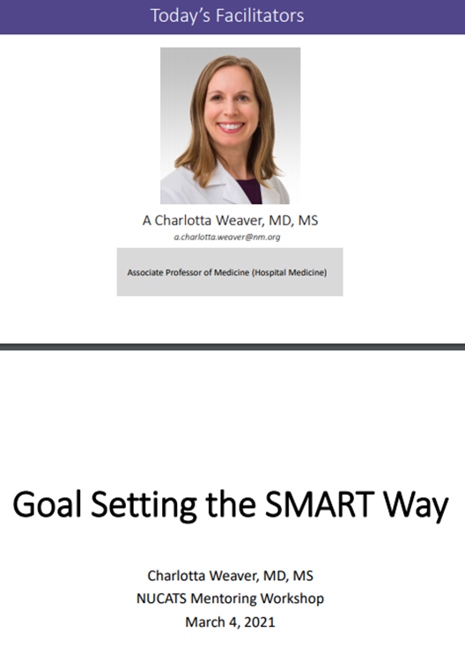
Notes:
Discuss how this session builds on the March offering

Slide 6
What are you hoping to learn today?

Slide 7
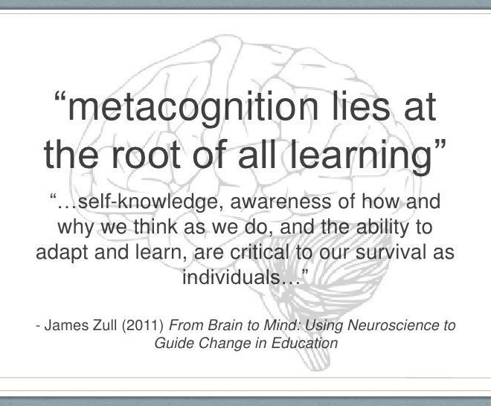
https://www.figur8.net/2015/09/30/metacognition-getting-better-at-learning-by-understanding-how-we-think/
Notes:
Link that the question “what are you hoping to learn” is an exercise in metacognition. Remind all how important metacognition is in training
Metacognition is learning in progress…
Thinking about thinking – monitoring our own thinking.
Knowing about knowing – being aware of what you know.
Cognitive self-management – planning, decision making, identifying problems and setting goals.
Emotional self-management – knowing how to control our own emotions, how to show empathy, etc.
Self evaluation – evaluating our own performance.

Slide 8
From Thinking-about-Thinking
Linking a Discussion about Evaluating Mentoring Goals to Education

Slide 9
How do adults learn across the lifespan?

Slide 10
Defining Adult and Continuing Education
Activities intentionally designed for the purpose of bringing about learning among those who age, social roles, or self-perception define them as adults
Merriam, S. B., & Brockett, R. G. (2007). Philosophical perspectives. The profession and practice of adult education, 27-50.
Notes:
Do we need to define how many Adult Education programs there are across the globe???
Kasworm, Rose & Ross-Gordon state:
Roots and history (prior to the 20th centure) saw adult education interchangeably with home education and popular education
By the 20th century, the term had come to be more associated with formal educational activities – as the field became more institutionalized and moved into the academy
The movement toward professionalism created a constant tension between the desire to narrative the field to formal educational activities and a continuing concern that such an approach deterred the most important and socially relevant aspects of adult learning

Slide 11
Critical Adult Education
Adult education is more than the design and management of effective learning
  How do our mentoring programs, policies, and practices exist in task, relational and multi-level arenas? How do they support the dynamic life of university personnel?
Activities concerned to assist adults in their quest for a sense of control in their own lives, within their interpersonal relationships, and with regard to the social forms and structures within which they live
  How do our mentoring experiences link with our lives, relationships, social forms & structures? Are these links different – why/why not?
This sense of control is realized in the creation and renegotiation of personal relationships, in the sphere of socio-political behavior, and in the realm of intellectual exploration, judgement and discrimination
  How are our mentoring experiences shaped by sociopolitical behaviors of our colleagues, units & the institution?
Brookfield, S. (1985). A critical definition of adult education. Adult Education Quarterly, 36(1), 44-49.
Notes:
Brookfield’s Critical Notes

Slide 12
Goal-Setting & Learning
Locke’s goal-setting theory argues that for goal-setting to be successful with desired outcomes, they must contain the following specific points (Lunenberg & Samaras, 2011):
Clarity: goals need to be specific;
Challenging: goals must be difficult yet attainable;
Goals must be accepted;
Feedback must be provided on goal attainment;
Goals are more effective when they are used to evaluate the performance;
Deadlines improve the effectiveness of goals;
A learning goal orientation leads to higher performance than a performance goal orientation;
Group goal-setting is as important as individual goal-setting.

Slide 13
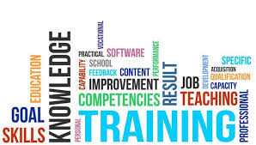
How is goal setting linked your learning agenda?
https://www.bcctc.org/adult-education/

Slide 14
Consider the role of including evaluation, recognition & reward in goal setting

Slide 15
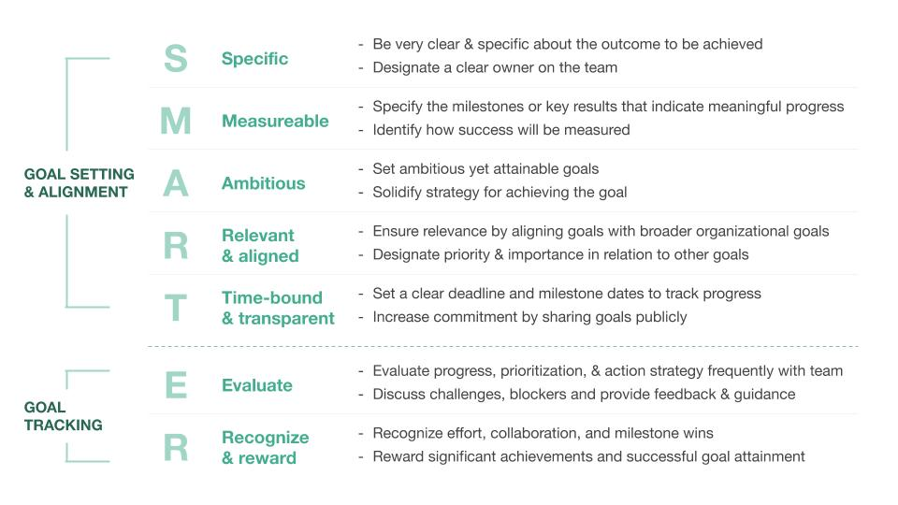
Image retrieved from: https://support.cultureamp.com/hc/en-us/articles/360010896540-Guide-to-create-and-track-goals

Slide 16
Evaluate, Recognize & Reward
Evaluate
Recognize & Reward
Evaluate Progress
Prioritization
Action Strategy Development
Discuss Challenges
Identify blockers
Provide Feedback & Guidance
Recognizes Effort
Collaboration
Milestone wins
Reward significant achievements
Reward successful goal attainment

Slide 17
Evaluation
  Systematic determination of the merit or worth of an object. (Scriven, 1967)
  What? So what? Now what? (Patton, 2008)

Slide 18

A Metaphor for Outcomes in Evaluation
Not how many worms
the bird feeds its young,
but
how well the fledgling flies
–United Way, 1999
Hatry, H. P. (1996). Measuring program outcomes: A practical approach. United Way of America.
Notes:
18

Slide 19

Why am I evaluating outcomes?
“Don’t accept your dog’s admiration as conclusive proof that you are wonderful.”
–Ann Landers
Notes:
19

Slide 20
Why Is Evaluation Important?

Slide 21

Recognition & Reward
Image retrieved from: https://www.amazon.com/Reserved-Employee-Parking-SmartSign-Plastic/dp/B0089ORAS4

Slide 22
Recognition & Reward
  Reward: serves to reward performance and motivate the individual
  Recognition: provide a psychological benefit, must occur while the performance is fresh in the mind

Slide 23
Why Are Recognition & Reward Important?

Slide 24
Group Activity #1
Notes:
This activity is in a discussion format

Slide 25
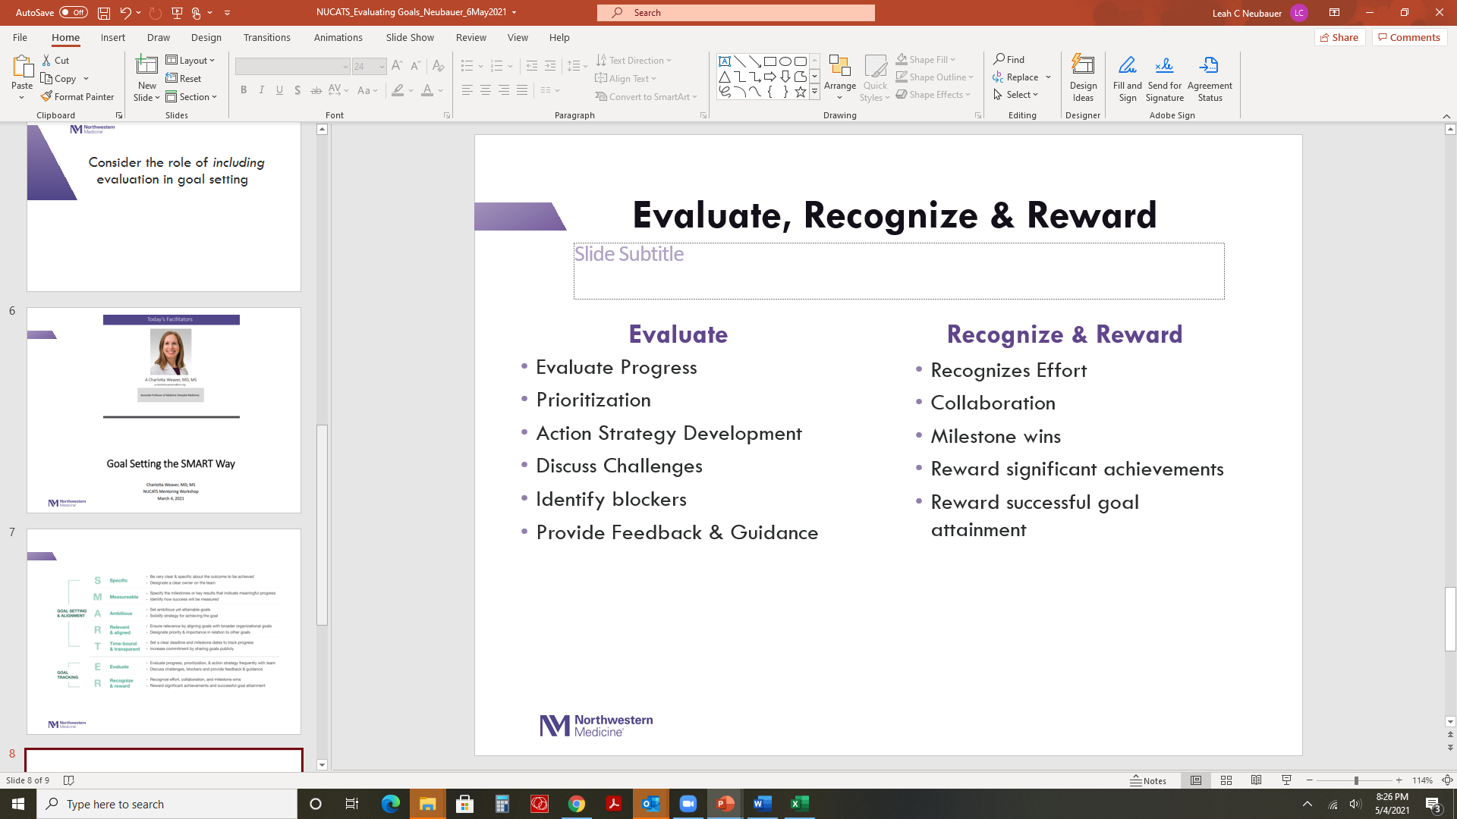
Example 1: Planning
Professor C Goal from early February: I will submit three applications for external funding (R01, R21, and ACS) by December 2021
Notes:
Ask audience to provide examples of evaluate, recognize & reward

Slide 26
Example #2: Planning
Professor D Goal from early February: I will complete the assessment of the new curriculum (n=40 courses) I developed, write and submit a manuscript by December 2021.
Notes:
Ask audience to provide examples of evaluate, recognize & reward

Slide 27
Example #3: In Practice
Professor C: I planned to submit three applications by December 2021, but there is no way I will make the July deadline now for application #1 – there is too much happening right now. SO - let me try to push to make that January 2022 deadline.
Professor D: “I told myself that I’d have a whole curriculum reviewed and a manuscript submitted by December. It’s nearly ½ way through the year and I have not begun the project. AH! Let me focus all of my energy in June/July on this project to catch up. I should be able to finish this all by December.”
Adapted from: https://www.facultydiversity.org/monday-motivator/recalibrate2020
Notes:
Now shift, ask participants to consider this.

Slide 28
Recalibration
Notes:
Discuss the role of recalibration, re-examining standards, identifying blockers, and moving forward

Slide 29
Recalibration
to make small changes to an instrument so that it measures accurately
to change the way you do or think about something
-Cambridge Dictionary, 2021

Slide 30

Why is Recalibration Important in Goal Setting and Evaluation?
https://espanol.safelite.com/resource-center/car-safety/car-safety/2020/06/04/the-importance-of-recalibration-infographic

Slide 31
Activity #2: Breakout Session
Objective: Apply the SMARTER framework to your goals
Steps
  Briefly introduce yourself
  Choose one of your goals and apply the SMARTER framework
  Describe it to the group
  Group provides feedback with emphasis on the Evaluation, Recognition & Reward elements
  Return & Report Out

Slide 32
Group Debrief
Objective: Apply the SMARTER framework to your goals
How did this process go?
Examples of evaluation, recalibration, reward, or recognition

Slide 33

Image retrieved from: https://www.fjg.co.uk/blog/2021/04/26/preliminary-considerations-when-buying-or-selling-a-business-2

Slide 34
Implementing Your Goals and Recalibration Practice
Establish a frequency to monitor your goals (weekly, monthly, quarterly)
Develop mechanisms to receive feedback
Consider the ongoing feasibility of your goals in practice; understand the role of recalibration
Identify reward and recognition systems at multiple levels (self, mentee, teams)
What else?

Slide 35
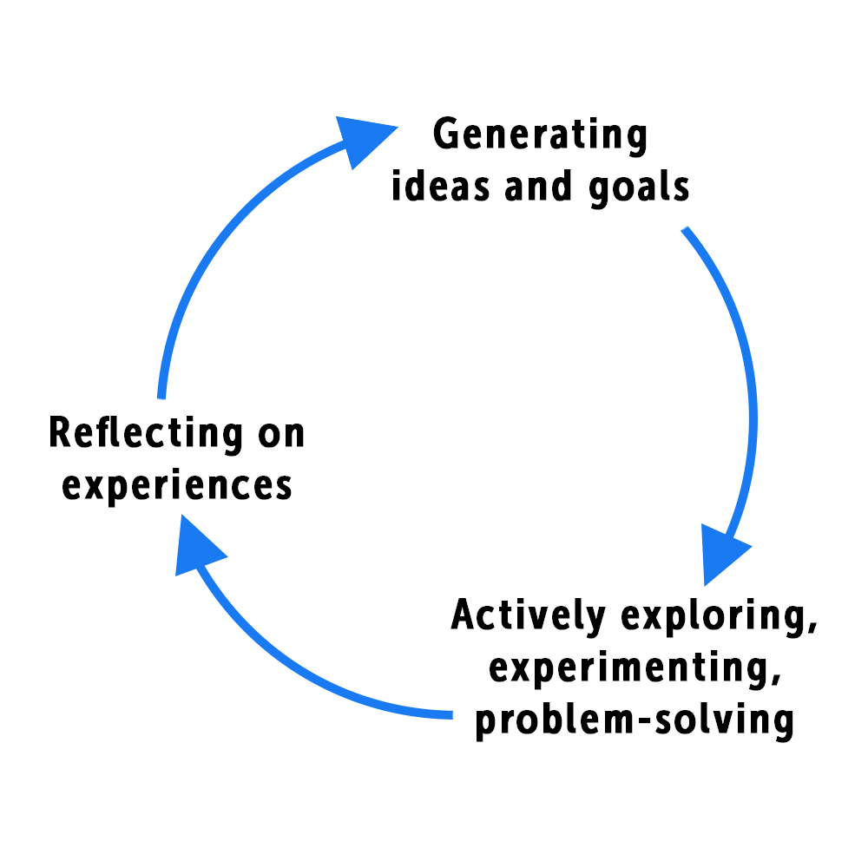
Key Learning Takeway
What is a key learning from today’s session?
The Natural Learning Cycle (2017).
Retrieved from https://www.responsiveclassroom.org/natural-learning-cycle/

Slide 36
Key Learning Reflection
Reflect on this discussion today.
Write down one thing you hope to do differently in the future when evaluating & rewarding/recognizing your goals.
Does anyone want to share what they put down?

Slide 37
Open Discussion

Slide 38

Image retrieved from: https://stock.adobe.com/search?k=thank+you+in+different+languages

Slide 39
References
Brookfield, S. (1985). A critical definition of adult education. Adult Education Quarterly, 36(1), 44-49.
Hatry, H. P. (1996). Measuring program outcomes: A practical approach. United Way of America.
Locke, E. A., & Latham, G. P. (2006). New directions in goal-setting theory. Current directions in psychological science, 15(5), 265-268.
Lunenberg, M., & Samaras, A. P. (2011). Developing a pedagogy for teaching self-study research: Lessons learned across the Atlantic. Teaching and teacher education, 27(5), 841-850.
Merriam, S. B., & Brockett, R. G. (2007). Philosophical perspectives. The profession and practice of adult education, 27-50.
Patton, M. Q. (2008). Utilization-focused evaluation. Sage publications.
Rockquemore, K. (2020). Recalibrate Those Standards. National Center for Faculty Development and Diversity. Retrieved from: https://www.facultydiversity.org/monday-motivator/recalibrate2020
Scriven, M. (1967). The methodology of evaluation (AERA Monograph series on curriculum evaluation, No. 1). New York: Rand Mc Nally.
Zull, J. E. (2011). The connecting thread: metacognition and the integrated mind. From brain to mind: Using neuroscience to guide change in education, 257-284.

