Slide 1
Relative Citation Ratio and iCite Tool
Galter Health Sciences Library
Karen Gutzman, MA, MSLS
Patty Smith, MLIS
December 15, 2016

Slide 2
Overview
Review concepts regarding research impact
Discuss appropriate indicators
Review the Relative Citation Ratio
Get comfortable with the iCite tool
Show examples of the Relative Citation Ratio
Discuss other article-level, field normalized metrics

Slide 3


Defining Research Impact
Research impact is the recorded occasion in which a research activity or output influences another actor or organization.
RESEARCH IMPACT
She
communicates
her research findings.
A researcher doing her work.
ACTIVITIES
OUTPUTS
Resources
Maximizing the Impact of Your Research from LSE Blog: http://blogs.lse.ac.uk/impactofsocialsciences/the-handbook/
Becker Library Model for Assessing the Impact of Research: https://becker.wustl.edu/impact-assessment/how-to-use
100 Metrics to Asses and Communicate the Value of Biomedical Research by Rand Europe: http://www.rand.org/pubs/research_reports/RR1606.html
A Basket of Metrics for Research Excellence: https://blog.scopus.com/get-involved

Slide 4
Defining Research Impact
Research impact is the recorded occasion in which a research activity or output influences another actor or organization.
Types of research impact
Highlight research: How has she contributed to science?
Funding: Can she support her research?
Measures of Prestige: How is she perceived in her field?
Collaboration: How good is her collaboration network?
Productivity: How productive is she?
Visibility of communication channels: What is the impact of the channels that her outputs are published in?
Research Influence: How are her outputs used in academia?
Knowledge Transfer: How are her outputs used in industry?
Social, Policy and Health Impacts: What is her wider impact?

Slide 5
Measuring Impact: Research Activity
Highlight research: How has she contributed to science?
Providing context and background of scientific problem
Description of central findings of her research
Discussion on influence her findings have had on the progress of science or the application of those findings to health or technology

Slide 6
Measuring Impact: Research Activity
Highlight research: How has she contributed to science?
Providing context and background of scientific problem
Description of central findings of her research
Discussion on influence her findings have had on the progress of science or the application of those findings to health or technology
Funding: Can she support her research?
Number of different research funders supporting research
Success rate of grant applications
Number and size of grant awards

Slide 7
Measuring Impact: Research Activity
Highlight research: How has she contributed to science?
Providing context and background of scientific problem
Description of central findings of her research
Discussion on influence her findings have had on the progress of science or the application of those findings to health or technology
Funding: Can she support her research?
Number of different research funders supporting research
Success rate of grant applications
Number and size of grant awards
Measures of Prestige: How is she perceived in her field?
Number of editorships of high-profile journals
Service on relevant boards and committees
Number and type of prizes
Number of speaker invitations/conference invitations

Slide 8
Measuring Impact: Research Activity
Highlight research: How has she contributed to science?
Providing context and background of scientific problem
Description of central findings of her research
Discussion on influence her findings have had on the progress of science or the application of those findings to health or technology
Funding: Can she support her research?
Number of different research funders supporting research
Success rate of grant applications
Number and size of grant awards
Measures of Prestige: How is she perceived in her field?
Number of editorships of high-profile journals
Service on relevant boards and committees
Number and type of prizes
Number of speaker invitations/conference invitations
Collaboration: How good is her collaboration network?
Number of different collaborators across all projects
Number of collaborators from academia, industry or community partners
Number of collaborations on grant applications

Slide 9
Measuring Impact: Research Outputs
Productivity: How productive is she?
Number and type of outputs (articles, books, research data, software, etc.)
Number of outputs per year (or other timeframe)

Slide 10
Measuring Impact: Research Outputs
Productivity: How productive is she?
Number and type of outputs (articles, books, research data, software, etc.)
Number of outputs per year (or other timeframe)
Visibility of communication channels: What is the impact of the channels that my outputs are published in?
Journal Impact Factor (Thomson Reuters), or Impact Per Publications (Elsevier)
Prestige of conferences, or Status of books publisher or visibility of data repositories

Slide 11
Measuring Impact: Research Outputs
Productivity: How productive is she?
Number and type of outputs (articles, books, research data, software, etc.)
Number of outputs per year (or other timeframe)
Visibility of communication channels: What is the impact of the channels that my outputs are published in?
Journal Impact Factor (Thomson Reuters), or Impact Per Publications (Elsevier)
Prestige of conferences, or Status of books publisher or visibility of data repositories
Research Influence: How are her outputs used in academia?
Views/downloads or usage metrics, mentions in social media
Total citation count, citations per publication, citations per year (or other timeframe)
Field normalized Citation Impact (Elsevier), Relative Citation Ratio (NIH), Hot and Highly Cited Papers (Thomson Reuters)

Slide 12
Measuring Impact: Research Outputs
Productivity: How productive is she?
Number and type of outputs (articles, books, research data, software, etc.)
Number of outputs per year (or other timeframe)
Visibility of communication channels: What is the impact of the channels that my outputs are published in?
Journal Impact Factor (Thomson Reuters), or Impact Per Publications (Elsevier)
Prestige of conferences, or Status of books publisher or visibility of data repositories
Research Influence: How are her outputs used in academia?
Views/downloads or usage metrics, mentions in social media
Total citation count, citations per publication, citations per year (or other timeframe)
Field normalized Citation Impact (Elsevier), Relative Citation Ratio (NIH), Hot and Highly Cited Papers (Thomson Reuters)
Knowledge Transfer: How are her outputs used in industry?
Number of patent applications or patents awarded
Number of patent citations
Number, size or description of consultancy work

Slide 13
Measuring Impact: Research Outputs
Productivity: How productive is she?
Number and type of outputs (articles, books, research data, software, etc.)
Number of outputs per year (or other timeframe)
Visibility of communication channels: What is the impact of the channels that my outputs are published in?
Journal Impact Factor (Thomson Reuters), or Impact Per Publications (Elsevier)
Prestige of conferences, or Status of books publisher or visibility of data repositories
Research Influence: How are her outputs used in academia?
Views/downloads or usage metrics, mentions in social media
Total citation count, citations per publication, citations per year (or other timeframe)
Field normalized Citation Impact (Elsevier), Relative Citation Ratio (NIH), Hot and Highly Cited Papers (Thomson Reuters)
Knowledge Transfer: How are her outputs used in industry?
Number of patent applications or patents awarded
Number of patent citations
Number, size or description of consultancy work
Social, Policy and Health Impacts: What is her wider impact?
Number of citations in clinical guidelines
Number of citations in policy documents
Number or description of new treatments developed
Narrowing of health/health care disparities

Slide 14
Best Practices for Metrics

Slide 15

Best Practices for Metrics or Indicators
a metric or an indicator is a proxy; it has the authority to represent something else
Metrics should be easy to understand, open and transparent.
Resources:
The Leiden Manifesto by Hicks et al.
Article: http://www.nature.com/news/bibliometrics-the-leiden-manifesto-for-research-metrics-1.17351
Video: https://vimeo.com/133683418

Slide 16

Best Practices for Metrics or Indicators
a metric or an indicator is a proxy; it has the authority to represent something else
Metrics should be easy to understand, open and transparent.
Metrics should not substitute for informed, qualitative assessment.
Resources:
The Leiden Manifesto by Hicks et al.
Article: http://www.nature.com/news/bibliometrics-the-leiden-manifesto-for-research-metrics-1.17351
Video: https://vimeo.com/133683418

Slide 17

Best Practices for Metrics or Indicators
a metric or an indicator is a proxy; it has the authority to represent something else
Metrics should be easy to understand, open and transparent.
Metrics should not substitute for informed, qualitative assessment.
Different contexts may require different sets of metrics.
Allow those evaluated to verify data and analysis.
Resources:
The Leiden Manifesto by Hicks et al.
Article: http://www.nature.com/news/bibliometrics-the-leiden-manifesto-for-research-metrics-1.17351
Video: https://vimeo.com/133683418

Slide 18

Best Practices for Metrics or Indicators
a metric or an indicator is a proxy; it has the authority to represent something else
Metrics should be easy to understand, open and transparent.
Metrics should not substitute for informed, qualitative assessment.
Different contexts may require different sets of metrics.
Allow those evaluated to verify data and analysis.
Resources:
The Leiden Manifesto by Hicks et al.
Article: http://www.nature.com/news/bibliometrics-the-leiden-manifesto-for-research-metrics-1.17351
Video: https://vimeo.com/133683418

Slide 19

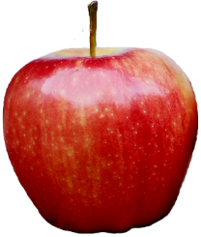

Best Practices for Metrics or Indicators continued
Account for variation in fields related to publication and citation practices.
Some fields have low output.
Some fields have high citation counts.
Basic citation metrics can have bias caused by differences in publication patterns between research fields, publication growth and speed, different document types, time frames and/or database coverage.
Basic Citation Metrics:
Number of papers
Number of citations
Journal Impact Factor
h-index

Slide 20
Normalized Citation Metrics
Normalized citation metrics try to counterbalance bias to allow for a fair comparison of universities or researchers active in different fields.
Normalized Citation Metrics:
Field Normalized Citation Impact (Scopus)
Hot and Highly Cited Publications (Web of Science)
Relative Citation Ratio (NIH)

Slide 21
Relative Citation Ratio

Slide 22

NIH develops Relative Citation Ratio (RCR)
Raw citation counts present a problem – some fields cite more than others, and citation counts rise over time.
Citation-based → uses a co-citation network
Benchmarked against all NIH-funded publications to measure influence
Freely available → use the iCite tool to analyze articles (only PubMed)
Resources
Hutchins IB, Yuan X, Anderson JM, Santangelo GM. Relative Citation Ratio (RCR): A New Metric That Uses Citation Rates to Measure Influence at the Article Level. PLoS Biol [Internet]. 2016;14(9): e1002541. doi:10.1371/journal.pbio.1002541 Available from: http://journals.plos.org/plosbiology/article?id=10.1371/journal.pbio.1002541
Lauer M. Measuring Impact of NIH-supported Publications with a New Metric: the Relative Citation Ratio. Open Mike [Blog]. September 8, 2016. Available from: https://nexus.od.nih.gov/all/2016/09/08/nih-rcr/
Notes:
In 2015, the NIH Office of Portfolio Analysis introduced this new metric, and an article detailing the methods was published in September in Plos Biology, so it’s a very new metric that researchers are getting the feel for. But, it’s important to note that the office of portfolio analysis (among other international organizations) is using the RCR to identify whether some types of grant deliver more bang for their buck.
This metric attempts to take into account the field in which an article is published and the time of publication. For example: an algebra paper with a few dozen citations, may have a greater impact in mathematics than a widely cited cancer study would have in oncology
Publications funded by R01 awards serve as a benchmark to determine how well a particular article is expected to perform, or how “influential” that publication is based on the research field.

Slide 23
How is the RCR calculated?
The RCR is calculated by dividing the article citation rate, which is the average number of citations an article receives each year, by the expected citation rate, which represents the citation rate of NIH-funded publications in the same year and disciplinary field.
RCR = Article Citation Rate
Expected Citation Rate
Abbreviations used:
  RCR: Relative Citation Ratio
  ACR: Article Citation Rate
  FCR: Field Citation Rate
  ECR: Expected Citation Rate
Notes:
Patty

Slide 24

How is the RCR calculated?
1. Calculate the Article Citation Rate
my paper
2010
Notes:
patty

Slide 25
How is the RCR calculated?
1. Calculate the Article Citation Rate
cites my paper
cites my paper
cites my paper
cites my paper
my paper
2010
Notes:
patty

Slide 26
How is the RCR calculated?
1. Calculate the Article Citation Rate
cites my paper
cites my paper
cites my paper
cites my paper
my paper
2010
Article Citation Rate = Total Citations to an Article
=
4
=
0.7
Current Year – Year of article publication
2016 - 2010
Notes:
patty

Slide 27
How is the RCR calculated?
2. Create a Co-Citation Network
cites my paper
cites my paper
cites my paper
cites my paper
my paper
Notes:
patty

Slide 28
How is the RCR calculated?
2. Create a Co-Citation Network
cites my paper
cites my paper
cites my paper
cites my paper
my paper
Notes:
patty

Slide 29
How is the RCR calculated?
2. Create a Co-Citation Network
cites my paper
cites my paper
cites my paper
cites my paper
Also on
ref list
Also on
ref list
Also on
ref list
Also on
ref list
Also on
ref list
Also on
ref list
my paper
Also on
ref list
Also on
ref list
Also on
ref list
Also on
ref list
Also on
ref list
Also on
ref list
Notes:
patty

Slide 30
How is the RCR calculated?
2. Create a Co-Citation Network
cites my paper
cites my paper
cites my paper
cites my paper
Also on
ref list
Also on
ref list
Also on
ref list
Also on
ref list
Also on
ref list
Also on
ref list
my paper
Also on
ref list
Also on
ref list
Also on
ref list
Also on
ref list
Also on
ref list
Also on
ref list
Notes:
patty

Slide 31
How is the RCR calculated?
2. Create a Co-Citation Network
cites my paper
cites my paper
cites my paper
cites my paper
Also on
ref list
Also on
ref list
Also on
ref list
Also on
ref list
Also on
ref list
Also on
ref list
my paper
Also on
ref list
Also on
ref list
Also on
ref list
Also on
ref list
Also on
ref list
Also on
ref list
Notes:
patty

Slide 32
How is the RCR calculated?
3. Calculate the Field Citation Rate
Also on
ref list
Also on
ref list
Also on
ref list
Also on
ref list
Also on
ref list
Also on
ref list
my paper
Also on
ref list
Also on
ref list
Also on
ref list
Also on
ref list
Also on
ref list
Also on
ref list
Notes:
patty

Slide 33
How is the RCR calculated?
3. Calculate the Field Citation Rate
Also on
ref list
Also on
ref list
Also on
ref list
Also on
ref list
Also on
ref list
Also on
ref list
my paper
Also on
ref list
Also on
ref list
Also on
ref list
Also on
ref list
Also on
ref list
Also on
ref list
Field Citation Rate = Sum of all Journal Impact Factors
Number of Articles
Notes:
patty

Slide 34
How is the RCR calculated?
3. Calculate the Field Citation Rate
Journal Impact Factor
Cites to items published in the past two years
Also on
ref list
Also on
ref list
Also on
ref list
Also on
ref list
Also on
ref list
Also on
ref list
Number of items published in the past two years
my paper
Also on
ref list
Also on
ref list
Also on
ref list
Also on
ref list
Also on
ref list
The highest JIF is 137.57 by the CA: A Cancer Journal for Clinicians
Also on
ref list
Field Citation Rate = Sum of all Journal Impact Factors
Number of Articles
Notes:
patty

Slide 35
How is the RCR calculated?
3. Calculate the Field Citation Rate
Journal Impact Factor
Cites to items published in the past two years
Also on
ref list
Also on
ref list
Also on
ref list
Also on
ref list
Also on
ref list
Also on
ref list
Number of items published in the past two years
Please note!
my paper
The use of Journal Impact Factor in this presentation is for demonstration purposes only…
Also on
ref list
Also on
ref list
Also on
ref list
Also on
ref list
Also on
ref list
The highest JIF is 137.57 by the CA: A Cancer Journal for Clinicians
Also on
ref list
The iCite tool calculates journal impact based on data from it’s own database of publications, and not from Web of Science.
Field Citation Rate = Sum of all Journal Impact Factors
Number of Articles
Notes:
patty

Slide 36
How is the RCR calculated?
3. Calculate the Field Citation Rate
Journal Impact Factor
Cites to items published in the past two years
Also on
ref list
Also on
ref list
Also on
ref list
Also on
ref list
Also on
ref list
Also on
ref list
Number of items published in the past two years
my paper
Also on
ref list
Also on
ref list
Also on
ref list
Also on
ref list
Also on
ref list
The highest JIF is 137.57 by the CA: A Cancer Journal for Clinicians
Also on
ref list
Field Citation Rate = Sum of all Journal Impact Factors
Number of Articles
Notes:
patty

Slide 37
How is the RCR calculated?
3. Calculate the Field Citation Rate
JIF: 2.0
JIF: 1.0
JIF: 0.25
JIF: 4.0
JIF: 2.0
JIF: 1.0
Also on
ref list
Also on
ref list
Also on
ref list
Also on
ref list
Also on
ref list
Also on
ref list
my paper
Also on
ref list
Also on
ref list
Also on
ref list
Also on
ref list
Also on
ref list
Also on
ref list
JIF: 4.0
JIF: 2.0
JIF: 0.25
JIF: 1.25
JIF: 1.50
JIF: 5.0
JIF: 10.0
Field Citation Rate = Sum of all Journal Impact Factors
Number of Articles
Notes:
patty

Slide 38
How is the RCR calculated?
3. Calculate the Field Citation Rate
JIF: 2.0
JIF: 1.0
JIF: 0.25
JIF: 4.0
JIF: 2.0
JIF: 1.0
Also on
ref list
Also on
ref list
Also on
ref list
Also on
ref list
Also on
ref list
Also on
ref list
my paper
Also on
ref list
Also on
ref list
Also on
ref list
Also on
ref list
Also on
ref list
Also on
ref list
JIF: 4.0
JIF: 2.0
JIF: 0.25
JIF: 1.25
JIF: 1.50
JIF: 5.0
JIF: 10.0
Field Citation Rate = Sum of all Journal Impact Factors
34.25
2.63
=
=
Number of Articles
13
Notes:
patty

Slide 39
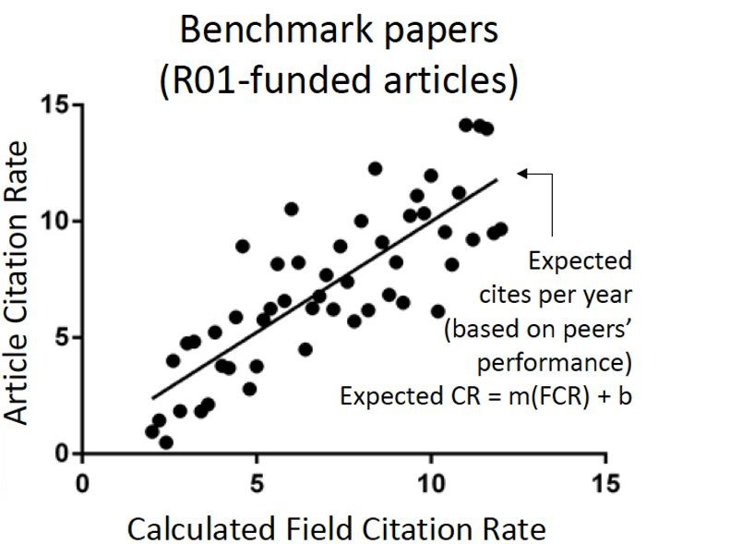
How is the RCR calculated?
4. Calculate the Expected Citation Ratio
ECR = Slope (FCR + Intercept)
ECR = 0.49 (2.63 + 0.156)
ECR = 0.49 (2.78)
ECR = 1.37
Year | Slope (OLS) | Intercept (OLS) | Slope (QR) | Intercept (QR)
2003 | 0.497 | 1.947 | 0.355 | 0.87
2004 | 0.531 | 1.877 | 0.344 | 1.09
2005 | 0.593 | 1.645 | 0.384 | 0.914
2006 | 0.608 | 1.471 | 0.385 | 0.967
2007 | 0.643 | 1.411 | 0.381 | 1.091
2008 | 0.772 | 0.711 | 0.446 | 0.681
2009 | 0.768 | 0.704 | 0.469 | 0.542
2010 | 0.739 | 0.657 | 0.49 | 0.156
2011 | 0.78 | 0.12 | 0.498 | 0
Notes:
patty

Slide 40
How is the RCR calculated?
5. Calculate the Relative Citation Ratio
RCR = Article Citation Rate
Expected Citation Rate
RCR = 0.7
1.37
RCR = 0.51
  A paper with an RCR of less than 1.0 has received fewer citations per year than the average NIH-funded paper in its field.
Notes:
Patty

Slide 41
iCite Tool

Slide 42
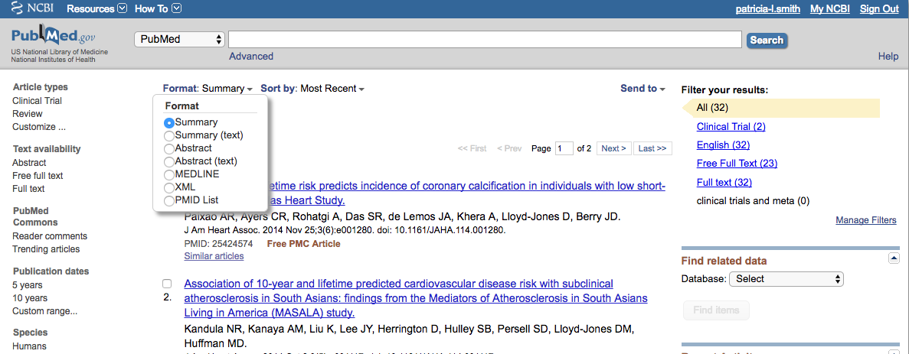
iCite Tool
For a single group of publications:
  Gather data from PubMed (PMIDs): https://www.ncbi.nlm.nih.gov/sites/myncbi/karen.gutzman.1/collections/51612073/public/
  Open the iCite Tool: https://icite.od.nih.gov/
  Copy and paste the PMIDs into iCite, OR upload a single-column spreadsheet with the PMIDs
Notes:
Patty

Slide 43
iCite Tool Definitions
Total Pubs: Total publications that could be matched in the citation database.
Pubs/Year: Publications per year, starting from the year of the earliest publication.
  Cites/Year: Citations per full calendar year after publication, through the end of our records.
  For example, a paper published in June 2012 with 30 citations by the end of 2014 would have 30 citations / 2 full calendar years (2013 and 2014) = 15 cites/year.
  The displayed values for the papers in the group are:
    MAX: the maximum value for the paper with the highest cites per year
    MEAN: also known as the average
    SEM: the standard error of the mean tells you how accurate your estimate of the mean is likely to be
    MED: the median value of the papers in the group
RCR: Relative Citation Ratio represents a citation-based measure of scientific influence of one or more articles. It is calculated as the cites/year of each paper, normalized to the citations per year received by NIH-funded papers in the same field and year.
  For example: A paper with an RCR of 1.0 has received the same number of cites/year as the average NIH-funded paper in its field, while a paper with an RCR of 2.0 has received twice as many cites/year as the average NIH-funded paper in its field.
  The displayed values for the papers in the group are:
    MAX: the maximum value for the paper with the highest RCR
    MEAN: also known as the average
    SEM: the standard error of the mean tells you how accurate your estimate of the mean is likely to be
    MED: the median value of the papers in the group
Weighted RCR: This is the sum of the RCRs in this portfolio. This weights the article count by influence relative to NIH-funded papers. A highly influential set of articles will have a higher Weighted RCR than Total Pubs, while a set of articles with below-average influence will have a lower Weighted RCR than Total Pubs.
Resources
iCite Help Documentation: https://icite.od.nih.gov/help
Notes:
Karen

Slide 44
iCite Tool Definitions continued
The iCite database was last updated on November 8, 2016 and currently contains 15,450,956 publications, of which 11,561,343 have an RCR greater than 0. iCite covers the years 1995 through 2016.
Percentiles for NIH-funded publications
NIH-funded papers are the benchmark for RCR: Any paper with RCR 1.0 has an RCR higher than 50% of NIH-funded papers. Some other RCR percentiles for NIH-funded papers are shown below.
Percentile | 99.9 | 99.0 | 95.0 | 90.0 | 80.0 | 70.0 | 60.0 | 50.0 | 40.0 | 30.0 | 20.0 | 10.0
RCR | 38.00 | 13.11 | 5.72 | 3.81 | 2.39 | 1.72 | 1.30 | 1.00 | 0.76 | 0.56 | 0.38 | 0.20
Resources
iCite Stats Documentation: https://icite.od.nih.gov/stats
Notes:
Karen

Slide 45
Using the Relative Citation Ratio

Slide 46
How do we talk about the RCR?
Ten of my peer-reviewed articles have relative citation ratios in the 99th percentile when compared to NIH-funded publications (i.e. their RCR is > 38; iCite tool).
Eight of my peer-reviewed works have higher citation impact than the average NIH-funded article published in the same field and year (i.e. their RCR is >1.0; iCite tool).
Our group’s publications are more impactful when compared against similar NIH-funded articles from the same field and year (i.e. their Weighted RCR > Total Pubs; iCite tool).
Notes:
Karen

Slide 47
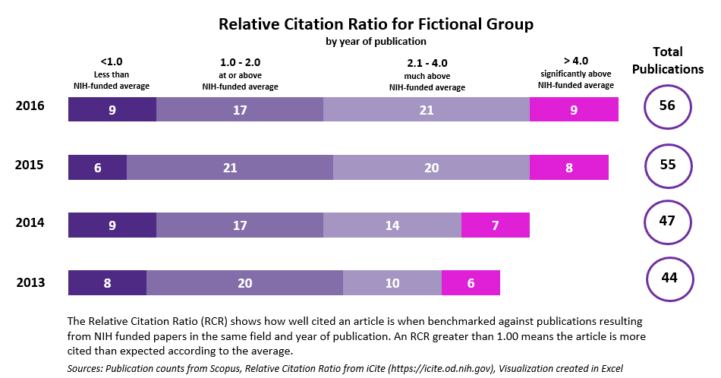
How do we talk about the RCR? continued
Notes:
Karen

Slide 48
Challenges
Calculating the RCR is highly complex, making the transparency of the metric difficult to support.
The use of co-citation networks for field-normalization can pose some technical issues.
  See blog post by Ludo Waltman at Leiden University for more information: https://www.cwts.nl/blog?article=n-q2u294
In an evaluation setting, the RCR provides a nice complement to a suite of citation-based metrics.

Slide 49
Other Metrics

Slide 50
How does the RCR differ from similar metrics?
Unlike similar ratios (such as Scopus’s Field Weighted Citation Impact), the RCR does not determine an article’s disciplinary field at the journal-level; instead it creates a field based on articles that are cited alongside it in reference lists (also known as a co-citation network).
Additionally, the expected citation rate is calculated, not from a global average of all field-related publications regardless of their funding or origin, but instead focuses on publications from NIH-funded R01 awards.
Notes:
Karen

Slide 51
Comparison with other metrics
Field Weighted Citation Impact
  Scopus
    PMID(24682252 )
Hot and Highly Cited Papers
  Web of Science
    PMID=(24682252)
    Relative Citation Ratio
  iCite Tool
    24682252
Notes:
Karen

Slide 52
Questions
Karen Gutzman, Impact and Evaluation Librarian
  Karen.gutzman@northwestern.edu
Patty Smith, Research Librarian
  Patricia.smith@northwestern.edu
Notes:
Karen

Slide 53
Thank You

