Slide 1


Scientific Writing Seminar Series
Session 1: Back to Basics
Patty Smith, MLIS
Research Librarian
Galter Health Sciences Library

Slide 2

Overview
Introduction
Appealing to your readers (and peer reviewers, and editors…)
  Simplify your writing
  Cut the jargon
  Use active voice
Becoming a more productive writer
Resources
Notes:
There was a blog post in April about readability from the AMA style inside, and the author stated: “When a paper is excruciatingly hard to edit, it’s not usually because of the science but because of the writing.” There was also an article in March from Nature titled “It’s not just you: science papers are getting harder to read”

Slide 3

Woe is me…
Why do I have to write?!
Edinburgh Napier University: http://staff.napier.ac.uk/services/information-services/research-cycle/Pages/home.aspx
Notes:
I know a lot of people feel this dread when it comes time to write. You would rather be with your patients or in the lab than writing up a manuscript. But like it or not, scientists are writers and we wouldn’t have science without writing. There wouldn’t be any progress. Evidence-based medicine wouldn’t exist. You don’t conduct research for the heck of it. You do it to improve outcomes. To change things. I like this image because it actually has “write” as a step in the process – a lot of these flows just say “publish”

Slide 4
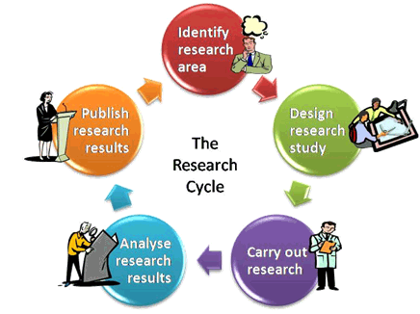
Notes:
Like this one. It just says “Publish research results.” I think this assumption that you just know how to “write up your results” is at the core of why we are all here today. Poll on how many people have taken a science writing class.

Slide 5
Writing is a skill
It can be learned!
What makes a good writer?
  Hint: NOT inborn talent, a muse, or divine intervention.
☑ You need something to say
☑ You need to be logical in your thinking
Notes:
Good writing communicates an idea clearly and effectively. This is even more important in scientific writing because it’s all about getting your idea across to other researchers, policy makers, and even the public.
Preoccupation with elegant writing and sounding like a good writer.

Slide 6
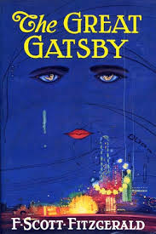
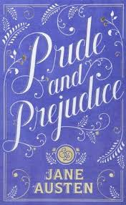
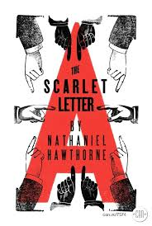

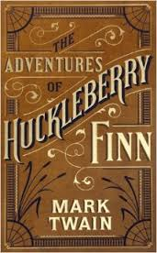
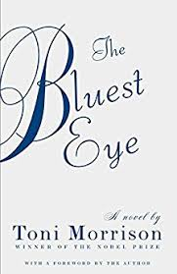
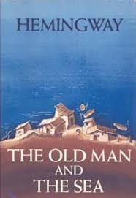
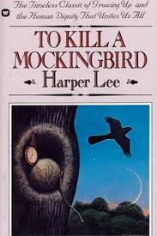
Notes:
For most of us, our only official writing instruction probably occurred in English class. And at some point in high school or college you were told “write a 5 page essay on The Great Gatsby.” And so you sat down, wrote with really flowery language, long words, long complex sentences with lots of commas, and you might have even used a thesaurus to spice up your language. Let’s be honest – you were desperately trying to meet that 5 page requirement while sounding good.
Scientific writing is the complete opposite of this. It should be clear, consistent, and to the point. Your readers shouldn’t have to analyze your manuscript to understand it. Everything should be clearly laid out.

Slide 7
Reading takes effort.
Don’t make your readers work harder than they have to.
Notes:
We’ve all had this experience – you sit down to read something, and you find yourself reading the same paragraph over and over trying to decipher its meaning. As a reader, you’re working hard. We want to make things easy for our readers. If you approach scientific writing like you’re writing an English essay, your writing will quickly become convoluted and difficult to follow.

Slide 8
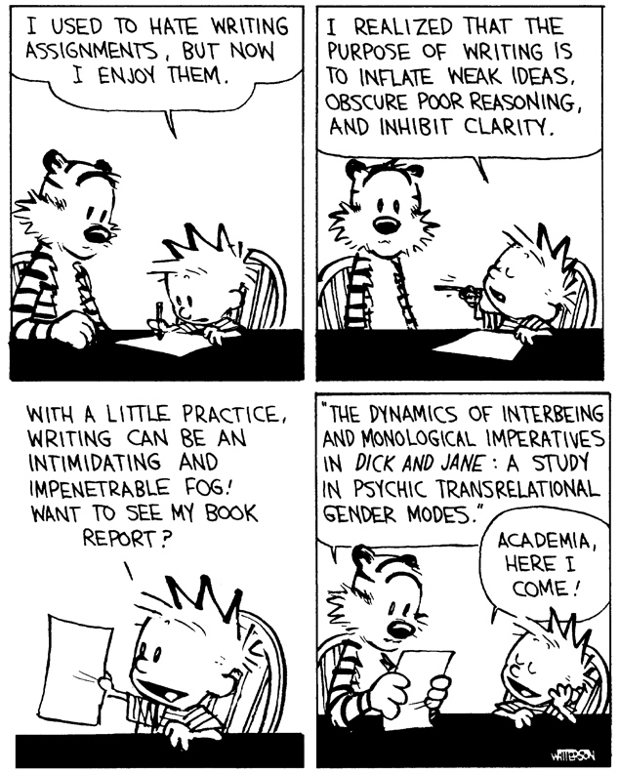
Notes:
I’m going to give you some tips to simplify your writing and make it clearer. We’re not going to get into the nitty gritty of grammar such as when to use “that” vs. “which” or “affect” vs. “effect” because those are just rules you can easily google. If I explain them today, we’ll all just forget the rules. Plus, those are things that even the most experienced writers mess up. A few grammar mistakes aren’t going to be the reason your paper gets rejected. An editor can easily fix those.
Keep in mind that some of these tips I’m going to give you might be the complete opposite of what you were taught in school. But we have to let go of some of those bad habits in order to make our writing clear and concise.

Slide 9
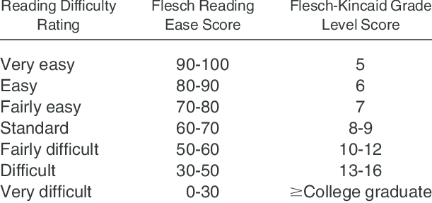
Reading Ease Score
Calderon JL, Fleming E, Gannon MR, Chen SC, Vassalotti JA, Norris KC. Applying an expanded set of cognitive design principles to formatting the Kidney Early Evaluation Program (KEEP) longitudinal survey. Am J Kidney Dis. 2008;51(4 Suppl 2):S83-92. Epub 2008/04/11. doi: 10.1053/j.ajkd.2008.01.008. PubMed PMID: 18359412.
Notes:
There are two tests I want to briefly mention. One is the Flesch Reading Ease test that measures readability, and there is also the Flesch-Kincaid Grade Level test, which assigns a US school grade level to a reading passage. Both tests were developed by the US Navy.
Writing that is considered “plain English” falls around the 60-70 range, which is an 8-9 grade level. Medical and scientific writing uses a lot terminology, so the reading ease score lowers a bit and ideally, your writing should fall somewhere in the range of 46-70, or grades 7-11. This recommendation is from a recently published book “Plain English for Doctors and Other Medical Scientists”
These scores are actually very simple to calculate and take into account average sentence length and average number of syllables per word. Microsoft Word actually has these tests built in and you can check the readability of your document – depends on your version, but within the spelling and grammar function, you should be able check a box that says “show readability statistics.”

Slide 10
Keep your sentence length under control
15 words average, 25 words maximum
Read your work out loud
  Are you taking multiple breaths?
  Are there awkward pauses?
  Do you forget what the beginning of the sentence was by the time you reach the end?
Revise your work and break longer sentences into multiple short sentences.
Use your word processor’s readability score tool to keep tabs on your average sentence length.
Notes:
What makes scientific writing hard to read? Boils down to two reasons: long sentences and long words. Using complex terminology can be unavoidable. To compensate for that, we want to keep our sentences short and simple. You don’t have control over the standard terminology in your field, but sentence length is something you have control over. Keep in mind that your writing is reaching a global audience and that English is not the first language of many of your readers. Shorter sentences will keep the attention of your readers.

Slide 11
Keep your sentence length under control
15 words average, 25 words maximum
Example:
Referral to a clinical geneticist for assistance in the diagnosis and management of Noonan syndrome, including determining the appropriateness and sequence of genetic testing, may be helpful.
Revised:
It may help to refer a patient with Noonan syndrome to a clinical geneticist. They can help diagnose and manage it and decide on genetic tests.
Examples from:
Linares O, Daly D, Daly G. Plain English for doctors and other medical scientists. New York, NY: Oxford University Press; 2017.
Excerpt from:
Bhambhani V, Muenke M. Noonan syndrome. American family physician. 2014;89(1):37-43. Epub 2014/01/22. PubMed PMID: 24444506; PMCID: PMC4099190.
Notes:
This sentence has 27 words, has a reading ease score of zero, and is at grade level 20. This sentence is complex, not due to complicated terminology, but due to wordiness, we have these awkward commas and unnecessary information.
We break it into two sentences. Average of 13.5 words, reading ease score of 61 and grade level 8.

Slide 12
Keep your sentence length under control
15 words average, 25 words maximum
Our Review will focus on advances in understanding of COPD and its risk factors, prevalence, and natural history since these Reviews were published, address some of the questions that still persist, and raise some of the issues that health-care planners will have to consider as the burden of COPD increases as the world's population ages.
Revised:
Our Review focuses on new knowledge of COPD, its risk factors, prevalence, and history since these reviews were published. It addresses some questions that still persist. It also raises some issues health-care planners must think about as the burden of COPD increases as the world’s population ages.
Examples from:
Linares O, Daly D, Daly G. Plain English for doctors and other medical scientists. New York, NY: Oxford University Press; 2017.
Excerpt from:
Mannino DM, Buist AS. Global burden of COPD: risk factors, prevalence, and future trends. Lancet. 2007;370(9589):765-73. Epub 2007/09/04. doi: 10.1016/s0140-6736(07)61380-4. PubMed PMID: 17765526.
Notes:
Writing in these complex sentences with multiple clauses is common, and I think it goes back to our English class days where short clauses sounded choppy and so we combined them into something more flowy with lots of commas. But for scientific writing, short sentences are ok and preferred because it makes your writing clearer.

Slide 13
Use short words
Impress people with your good ideas, not your big words
Essential scientific terms
  Names of diseases
  Medicines
  Chemicals
  Processes
Can you think of a shorter word that works just as well?
Can you paraphrase it in a few shorter words?
Do doctors/researchers use it consistently?
Can you easily look up the definition?
Notes:
Now, of course we can’t avoid using big words entirely. Long words come with the territory. These necessary long words are essential scientific terms.

Slide 14
Use short words
Impress people with your good ideas, not your big words
Longer term | Simplified
Cardiovascular disease | Heart disease
Ventricular hypertrophy | Heart wall thickening
Pulmonary | Lung
Hypertension | High blood pressure
Breast neoplasms | Breast cancer
Can you think of a shorter word that works just as well?
Can you paraphrase it in a few shorter words?
Do doctors/researchers use it consistently?
Can you easily look up the definition?
Notes:
But this doesn’t just apply to scientific terms – you’re going to want to choose the shorter simpler words overall too. And we’ll address that in a few slides.

Slide 15
BEWARE! Don’t use jargon
Also, write out abbreviations
Jargon | Preferred Form
Labs | Laboratory test results
Pap smear | Papanicolaou test
Prepped | Prepared
Afib | Atrial Fibrillation
Negative | Absence of abnormalities
Appendectomize | Perform an appendectomy
Gland | Lymph node
Jargon: special words or expressions that are used by a particular profession or group that are difficult for others to understand
AMA manual of style : a guide for authors and editors. 10th ed. Oxford; New York: Oxford Univ Pr; 2009. xi, 1010 p. p.
Notes:
Sometimes you might think you’re simplifying your writing by using jargon, but you’re actually making it more difficult to read because the definition of jargon is “special words or expressions that are used by a particular profession or group that are difficult for others to understand.” So unless you’re in the club, it’s tough to comprehend. Again, keep in mind that you’re not always talking to your direct peers in your field. Policy makers could read your paper, the public, someone in a totally unrelated discipline. And not everyone’s first language is English. So if you’re using slang or jargon, those words might not translate well. And even if it does translate well, it might just sound too informal. You’re not writing up notes.

Slide 16
BEWARE! Don’t use jargon
“The patient was status post cholecystectomy.”
“If the patient refluxed, they were treated with…”
“Two hundred patients were imaged, and 98 had positive cancer.”
Medical jargon. As medical students, interns, and residents,
we pick it up from our peers and from attending physicians
who should know better. We hear it at lectures and
conferences. We read it in journals and textbooks. Eventually,
we become inured to it, and we no longer recognize
how ugly it is and how often it impairs effective communication.
Ronai PM. A bad case of medical jargon. AJR Am J Roentgenol. 1993;161(3):592. Epub 1993/09/01. doi: 10.2214/ajr.161.3.8352113. PubMed PMID: 8352113.
Notes:
It would make more sense to say The patient had a cholecystectomy in 2010. Or, even better, the patient had their gallbladder removed in 2010.
Patients don’t reflux. Fluids reflux.
What was imaged? How was it done? What is positive cancer?

Slide 17
Use short words
...and avoid redundant phrases
Instead of | Consider
Utilize | Use
Elucidate | Show
Etiology | Cause
A large majority of | Most
Are in agreement | Agree
Prior to | Before
Subsequent to | After
Brown in color | Brown
Fewer in number | Fewer
Past history | History
AMA manual of style : a guide for authors and editors. 10th ed. Oxford; New York: Oxford Univ Pr; 2009. xi, 1010 p. p.
Notes:
So we already talked about trying to use shorter words when it comes to essential scientific medical terminology, but this rule applies to other words and phrases too.
Utilize – and I’m not making these up! I’ve seen the “utilize” example in many places, including in a short video by a Nature editor where she says that the word use is infinitely preferable to utilize.
So I could go on and on with these examples. It’s very common in writing to have unnecessarily long words and redundant phrases. A good thing to keep in mind when writing and revising – a lot of little things you can slash out to shorten your word count and make your work more readable.

Slide 18
The power of verbs
What are verbs?
A physical action: to write, to walk, to measure, to treat
A mental action: to estimate, to think, to consider
A state of being: to be, to exist, to appear
Variants of “to be”
  Is, are, were, was, be, been, am
    It is
    We are
    They were
    I was
Notes:
There many different types of verbs. A physical action, A mental action, A state of being. We use “a state of being” verbs a lot in scientific writing, specifically ‘”to be.” And there are a lot of variants of to be.

Slide 19
The power of verbs
Don’t turn verbs into nouns!
We performed an analysis of the data.
We conducted a review of the literature.
We analyzed the data.
We reviewed the literature.
Nominalizations are sometimes useful:
We analyzed the data. Our analysis shows the need for more research.
Notes:
Verbs make a sentence engaging and exciting, and they usually simplify the sentence. We do this weird thing in scientific writing where we turn verbs into nouns. The fancy word for this is nominalization.
Readers expect the main action of a sentence to be found in the verb.

Slide 20
The power of verbs
Don’t turn verbs into nouns!
Nominalization | Action
Regulation | To regulate
Analysis | To analyze
Occurrence | To occur
Understanding | To understand
Investigation | To investigate
Delineation | To delineate
Performance | To perform
https://cgi.duke.edu/web/sciwriting/index.php?action=lesson1
Notes:
It’s preferable to say “we investigated the outbreak of measles” instead of “we conducted an investigation of the outbreak of measles”

Slide 21
Active voice
What is active vs. passive voice?
We speak in the active voice:
Subject – Verb – Object
  He threw the football.
  She drove the car.
  We ate the pizza.
Passive voice flips this around:
Object – Verb – Subject
  The football was thrown by him.
  The car was driven by her.
  The pizza was eaten by us.
Notes:
So now we come to the hotly debated topic of active vs. passive voice. But before we dive into the controversy, let’s make sure we’re all on the same page. We speak in the active voice naturally. The sentence structure is subject, verb, object. Sometimes only Subject verb. The term “voice” describes whether the subject of the sentence is doing the action or receiving the action. When the subject does the action, the verb is active voice. When the subject receives the action, the verb is in passive voice. Not all sentences are active or passive. You can usually spot passive voice by looking for the verb “to be.”
You can see even with these simple examples, the passive voice makes our sentences longer and more complicated. So let’s look at some examples of passive voice in scientific writing.

Slide 22
Active voice
Passive voice:
The medication was administered by the nurse.
Data were collected from 5000 patients by physicians.
In this paper, a structure is suggested for the salt of deoxyribose nucleic acid (D.N.A.).
Active voice:
The nurse administered the medication.
Physicians collected data from 5000 patients.
We wish to suggest a structure for the salt of deoxyribose nucleic acid (D.N.A).
Watson JD, Crick FH. Molecular structure of nucleic acids; a structure for deoxyribose nucleic acid. Nature. 1953;171(4356):737-8. Epub 1953/04/25. PubMed PMID: 13054692.
Notes:
This last example is the opening line from the famous 1953 nature paper by watson and crick and is a common example used to demonstrate the power of the active voice. They used the active voice in their original paper. This paper shows how you can used simple, active language to communicate a complex topic. We’ll look at some longer, more complex examples in a minute.

Slide 23
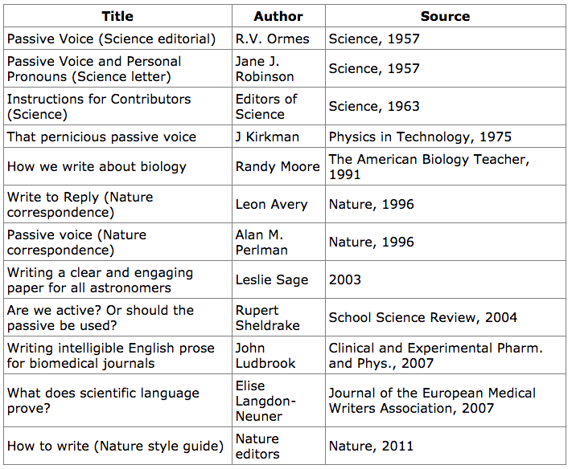
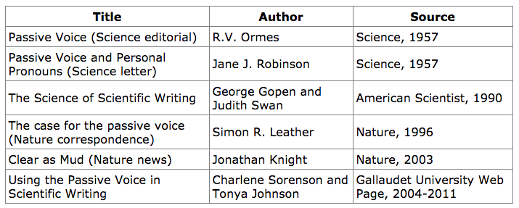
In favor of active voice
https://cgi.duke.edu/web/sciwriting/index.php?action=passive_voice
In favor of passive voice
Notes:
There is a lot of debate surrounding this topic and it goes back 60 years. There are all these opinions floating around about whether to use active voice or passive voice. So which one is correct?

Slide 24
Short answer?
Both are correct.
Notes:
We think back to examples of the passive voice “the pizza was eaten by us” and it sounds funny, right? Because that’s not how we speak. but it’s not grammatically incorrect. Passive voice is not wrong.

Slide 25
Long answer?
Active voice is preferred because…

Slide 26
Prefer the active voice
Length¹
Sounds more natural
Avoids the “whodunit” guessing game.
  Classic example: Mistakes were made.
  After all, human agents are responsible for designing experiments...writing awkward phrases to avoid admitting their responsibility and their presence is an odd way of being objective.
  -Jane J. Robinson
Passive voice can sound pompous or impersonal
Passive voice encourages nominalization
  An analysis of the data was performed. vs. We analyzed the data.
1. Greene AE. Writing science in plain English. Chicago ; London: The University of Chicago Press; 2013. xii, 124 pages p.
Notes:
Length – active sentences are shorter. A document that uses just passive sentences can be 30% longer than one that just uses active sentences. So eliminating all those little words really impacts the length and clarity of your paper.
Active voice sounds direct and vigorous and the reader will understand a sentence written in active voice more quickly and easily because that is how our minds naturally think and process information.
Active sentences force you to name the actor or causal agent of your narrative. With passive voice, the actor tends to go unnamed. You don’t have to admit who made the mistakes and it seemingly absolves that person of responsibility. But in science, we want to know who did what. We want to know cause and effect relationships. Sometimes the actor is obvious, but sometimes it’s not so obvious and your reader will have to guess and they might get it wrong. People tend to be in two different camps. One camps argues that removing the actor increases objectivity of the research.

Slide 27
Journals prefer the active voice!
“Nature journals like authors to write in the active voice ("we performed the experiment..." ) as experience has shown that readers find concepts and results to be conveyed more clearly if written directly.” Nature author guidelines
“Choose the active voice more often than you choose the passive, for the passive voice usually requires more words and often obscures the agent of action. Use first person, not third; do not use first person plural when singular is appropriate.” Science author guidelines
Notes:
It hasn’t always been this way, but more and more journals are clearly stating in their author guidelines that they prefer active voice. In addition to these two sources, the American Medical Association Manual of Style indicates that active voice is preferred – so that’s all the JAMA journals.

Slide 28
Journals prefer the active voice!
Behavioral Ecology: "The first-person active voice is preferable to the impersonal passive voice.”
British Medical Journal: "Please write in a clear, direct, and active style....Write in the active [voice] and use the first person where necessary.”
The Journal of Neuroscience: "Overuse of the passive voice is a common problem in writing. Although the passive has its place—for example, in the Methods section—in many instances it makes the manuscript dull by failing to identify the author's role in the research....Use direct, active-voice sentences.”
The Journal of Trauma and Dissociation: "Use the active voice whenever possible: We will ask authors that rely heavily on use of the passive voice to re-write manuscripts in the active voice.”
Ophthalmology: "Active voice is much preferred to passive voice, which should be used sparingly....Passive voice...does not relieve the author of direct responsibility for observations, opinions, or conclusions (e.g., 'The problem of blood flow was investigated...' vs. 'We investigated the problem of blood flow...').”
Notes:
I just want to point out that passive voice does have its place – like I said, it’s not grammatically incorrect – and the most common place to see acceptable use of the passive voice is in the Methods section, however, its encouraged that you try and write in the active voice if you can.
If you do write in the passive voice, be prepared for outright rejection or massive re-writes! It’s a pain in the butt for editors to do a mass overhaul of your passive manuscript. If a few passive sentences sneak in there, that’s easy to fix, but they might not re-write the entire thing for you.

Slide 29
More examples:
Examples from:
Linares O, Daly D, Daly G. Plain English for doctors and other medical scientists. New York, NY: Oxford University Press; 2017.
COPD can be classified with respect to both phenotype and disease severity.
Once a drug is administered, it is absorbed and distributed to its site of action, where it interacts with targets (such as receptors and enzymes), undergoes metabolism, and is then excreted.
The exact pathophysiologic mechanism for scoliosis is unknown.
A linear regression was used to assess trends over time.
We can classify a case of COPD by type and severity.
When a patient takes a drug, their body absorbs it and distributes it to the site of action. There, it interacts with targets such as receptors and enzymes, is metabolized, and then excreted.
We don’t know exactly what causes scoliosis.
We used a linear regression to assess trends over time.

Slide 30

Personal pronouns
Yes! You can use personal pronouns!
I, we, our, us, etc.
Notes:
In case you haven’t caught on, yes it’s ok to use personal pronouns!

Slide 31
Use terms consistently
Avoid the temptation to use “elegant variation”
Don’t pull out your thesaurus!
Examples:
Senior citizen, elderly, aged
Patient, participant, subject
Statutes, standards, laws, guidelines
Pick one and stick with it!
Notes:
One final tip to improve clarity and readability. Use terms consistently. If you’re writing up a blog post about your recent trip to new york, you’ll probably spice up your language and say “the big apple” or “the city that never sleeps” this is called elegant variation – so you don’t use the same words over and over. We typically don’t want to do this in scientific writing because it muddies the waters. So resist the temptation to pull out your thesaurus!

Slide 32
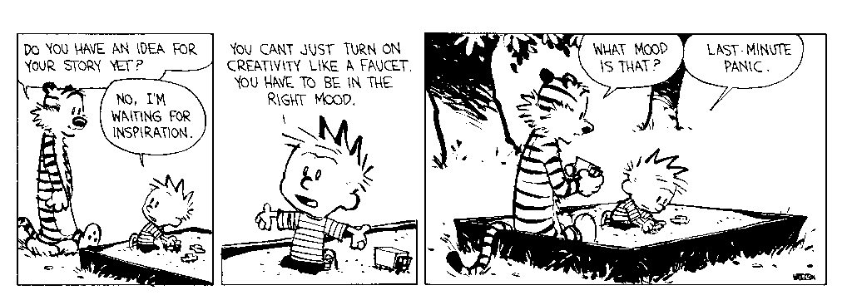
Becoming a more productive writer
Notes:
So now we’re going to switch gears a bit and talk about how we can become more productive writers. So how do you become a better, more productive writer? Remember that writing is a skill that can be learned. How does a resident become a better doctor? By treating patients. How do you improve your Spanish skills? You talk with Spanish speakers. How do you become a better writer? You write.

Slide 33
Notes:
Which brings us back to this research cycle diagram that skips over the writing process. The first step to becoming a better, more productive writer is changing our mentality about the writing process. We must factor it in to our schedules. Factor it in to our research plans. It’s not realistic to collect data for three years and then expect to write it all up in 3 days or even three week.

Slide 34
What can you do to become a better writer?
Set aside designated writing time.
Read! Not just science literature.
Write in a journal. Practice. Let go of “academic writing” habits.
Talk about your research. Chat with someone who isn’t in your field.
Stop waiting for inspiration. This is different than being prepared.
  Start with the methods section
Revise and read out loud!
Find an editor and have others read your paper.
Writing is hard for everyone.
Notes:
So that’s the first thing you can do. Set aside designated writing time in your schedule. You block off time in your calendar for meetings and events like this one. Why not schedule your writing time? I was in a meeting with someone who told me she had “Manuscript Mondays” when she would dedicated a large chunk of time on Mondays to work on her writing and research projects. Stop trying to FIND time to write, and allot time in your schedule specifically for writing. And you have to defend that time.
Two – Read! Not just science literature. Because as we’ve seen, science writing is pretty convoluted sometimes, so it can be good to get away from that and branch out a bit.
3 & 4. These practices will help you when writing because remember, we want to write in a way that people can understand. In the active voice. In clear, concise language. We tend to be better at talking in clear language than writing in clear language. You could even try recording yourself.
5. Writers block is often an excuse that people use. Writers block doesn’t exist in science writing, it is something that happens to fiction writers when they don’t know where their story is going. You have the data. You know your methods. You have are prepared with this clear and logical structure to follow. If you don’t know where to start, consider starting with the methods section. You really should be able to writer your methods before you even start your project. Then maybe you can move on to the results. Many people find the introduction and discussion difficult to write.
6. No one gets it perfect on the first draft. Try not to get too attached to your words and phrases because they might get cut later. And remember to read your paper out loud! We skim over words when we read and you’re so familiar with the text by the time your first draft is done that we skim even more. Reading out loud forces you to actually pay attention to sentence and word length and comma usage.
7. Ask someone to read your paper – NOT someone who is on your team. Of course co-authors should read the paper, but co-authors are not editors. Have a friend or a spouse look it over. A person who is not in your field should be able to understand your paper. They won’t necessarily understand all the concepts, but they will be able to point out confusing or complex sentences, jargon, and other issues the writing. Remember, they’re editing your writing, they’re not editing your science.
8. And always remember that writing is hard for everyone. You’re not alone if you find it difficult

Slide 35
Form a writing group
Find a small group of likeminded individuals
Brainstorm the purpose and goals
Find a time and place to meet
Choose a moderator (but all members agree to facilitate discussion)
The only way writing groups work is if people actually write.
Notes:
One thing that could help you be more productive is forming a writing group. A writing group can help you stay on track and stick to your writing goals because it relies on social contracts between members.
First, you’ll obviously need to find people to participate. A smaller group works best. No more than 8-10 people. 5 or 6 is probably more realistic.
The group will be whatever you want and need it to be, but your group will need to identify your purpose and your goals.
Finding a time and place to meet is tricky, maybe start with meeting once a month or whatever works best. It’s actually nice to have an interdisciplinary group because then it’s easier to help each other weed out jargon and confusing sentences, but sticking with your department usually the easiest way to coordinate schedules. But I encourage you to meet with people outside your department if you can.
And it is helpful to have a coordinator or moderator, but the work doesn’t fall to them – everyone must participate in the group.
BUT the only way writing groups work is if people actually write. If people don’t actually write and bring their work to meetings, the group will quickly fizzle out.

Slide 36
Resources
Writing and Terminology GalterList
https://galter.northwestern.edu/lists/Writing-and-Terminology
AMA Manual of Style
Duke Graduate School Scientific Writing Resource
https://cgi.duke.edu/web/sciwriting/index.php
Plain English for Doctors and Other Medical Scientists by Oscar Linares et al. ISBN: 9780190654849
The Writing Place
http://www.writing.northwestern.edu/
Stanford Medicine’s Writing in Science online class
https://cme.class.stanford.edu/courses/CME/002/2014/about
View videos at USF Writing Commons YouTube channel:
https://www.youtube.com/channel/UC2ZP9DctU6636VFKoHJ1k7w

Slide 37
References
1. AMA manual of style : a guide for authors and editors. 10th ed. Oxford; New York: Oxford Univ Pr; 2009. xi, 1010 p. p.
2. Bhambhani V, Muenke M. Noonan syndrome. American family physician. 2014;89(1):37-43. Epub 2014/01/22. PubMed PMID: 24444506; PMCID: PMC4099190.
3 .Calderon JL, Fleming E, Gannon MR, Chen SC, Vassalotti JA, Norris KC. Applying an expanded set of cognitive design principles to formatting the Kidney Early Evaluation Program (KEEP) longitudinal survey. Am J Kidney Dis. 2008;51(4 Suppl 2):S83-92. Epub 2008/04/11. doi: 10.1053/j.ajkd.2008.01.008. PubMed PMID: 18359412.
4. Greene AE. Writing science in plain English. Chicago ; London: The University of Chicago Press; 2013. xii, 124 pages p.
5.Linares O, Daly D, Daly G. Plain English for doctors and other medical scientists. New York, NY: Oxford University Press; 2017. p. p.
6. Mallett S, Deeks JJ, Halligan S, Hopewell S, Cornelius V, Altman DG. Systematic reviews of diagnostic tests in cancer: review of methods and reporting. BMJ. 2006;333(7565):413. Epub 2006/07/20. doi: 10.1136/bmj.38895.467130.55. PubMed PMID: 16849365; PMCID: PMC1553548.
7. Mannino DM, Buist AS. Global burden of COPD: risk factors, prevalence, and future trends. Lancet. 2007;370(9589):765-73. Epub 2007/09/04. doi: 10.1016/s0140-6736(07)61380-4. PubMed PMID: 17765526.
8. Ronai PM. A bad case of medical jargon. AJR Am J Roentgenol. 1993;161(3):592. Epub 1993/09/01. doi: 10.2214/ajr.161.3.8352113. PubMed PMID: 8352113.
Websites:
Duke Graduate School Scientific Writing Resource: https://cgi.duke.edu/web/sciwriting/index.php
USF Writing Commons Channel: https://www.youtube.com/channel/UC2ZP9DctU6636VFKoHJ1k7w

Slide 38
Questions?

Slide 39
Thank You

