Slide 1
Internet Archive:
Ideas for Proactive and Patron-Friendly Use
Susan Wishnetsky
Assistant Collections Librarian
Galter Health Sciences Library
Feinberg School of Medicine
Northwestern University
CMERIG, ALA 2017, Chicago, Illinois
Notes:
I’m Susan Wishnetsky, and I’m going to talk about the wonders of Internet Archive and its Wayback Machine, which takes on the daunting task of trying to preserve the entire internet.

Slide 2
Galter Health Sciences Library
Northwestern University
Feinberg School of Medicine
Chicago, Illinois
Notes:
I work at the Chicago campus of Northwestern University, the medical campus, very close to the Water Tower high rise shopping mall. You may see this building if you wander east from the Gold Coast shopping district, heading toward the lake.
I’ve been working at the Galter Library of the Feinberg School of Medicine since 1987, before the medical school or its library got the names they have now. My title has changed several times, too, but I’m primarily a serials cataloger, with other duties.
But this presentation isn’t about me or my library. Any library with an online catalog which provides links to online resources can utilize Internet Archive’s links. It’s possible some of you have already thought of this, and are already doing it. But my counterpart on the Evanston campus said it was a new idea to him. He thought it was clever, so I figured it would be worth sharing with you all.

Slide 3
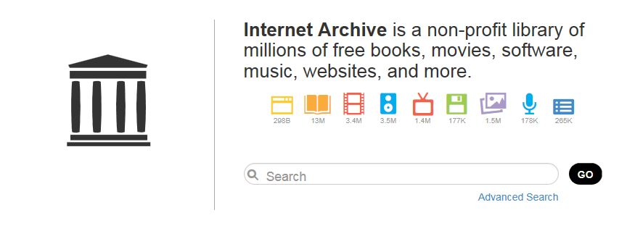
http://archive.org
Notes:
We all know about Internet Archive, I think, and recognize its logo, a Greek style building, which looks very much like their headquarters in San Francisco. It’s a 501(c)(3) non-profit library founded in 1996. Its mission, according to its “about” page, is to “provide universal access to all knowledge.”

Slide 4
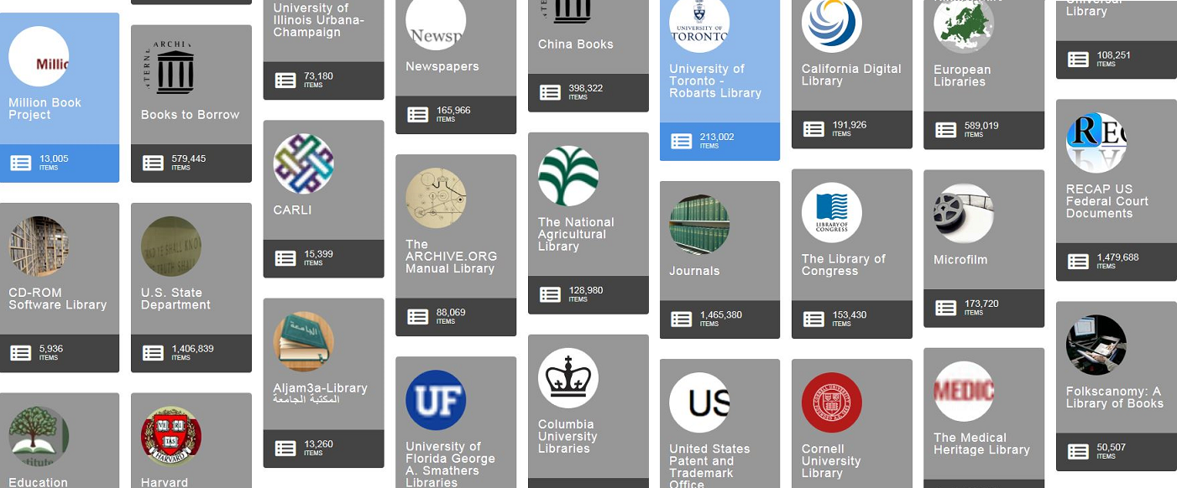
Notes:
With the help of its partner institutions – just a few of which are shown here -- it collects digitized versions of books and newspapers and pamphlets and other materials dating back practically to the invention of the printing press – maybe even earlier! Now it’s also collecting historical broadcasts from radio and television, requiring truly massive amounts of storage space.

Slide 5
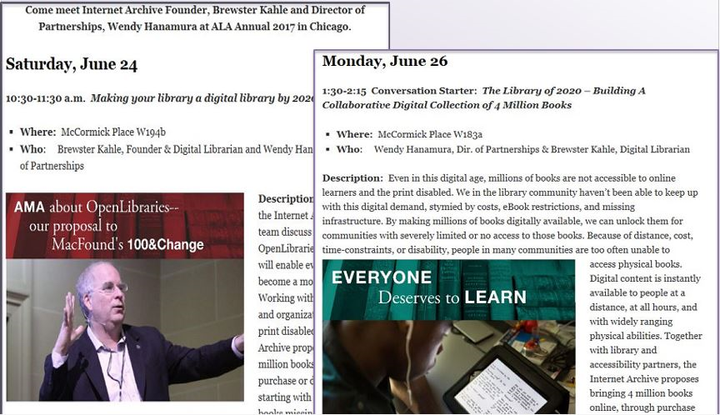
Notes:
You may have seen Brewster Kahle, the founder of Internet Archive, here at ALA yesterday, talking about how libraries can utilize the massive collections of books he has already preserved, or partner with Internet Archive to expand those collections. And he’ll be here tomorrow, too, describing his plans to increase access to materials to people with disabilities or other obstacles to access. But today I want to talk about one of his earlier initiatives called …

Slide 6
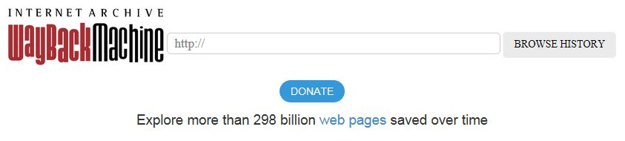
b
Notes:
… the Wayback Machine.
The Wayback Machine is there to preserve a digital history of the World Wide Web. When some agency changes its mind about its official policy, or some politician deletes an unwise blog post and hopes everyone will forget about it, the Wayback Machine remembers.
The Wayback Machine, as you may know, sends out web crawlers – little programs – to take snapshots of every web page it comes across and store them on Internet Archive’s servers. And many of these web sites host publications – journals, newsletters, reports, etc. – that we may have cataloged. The Wayback Machine’s crawlers try to preserve those, too.

Slide 7
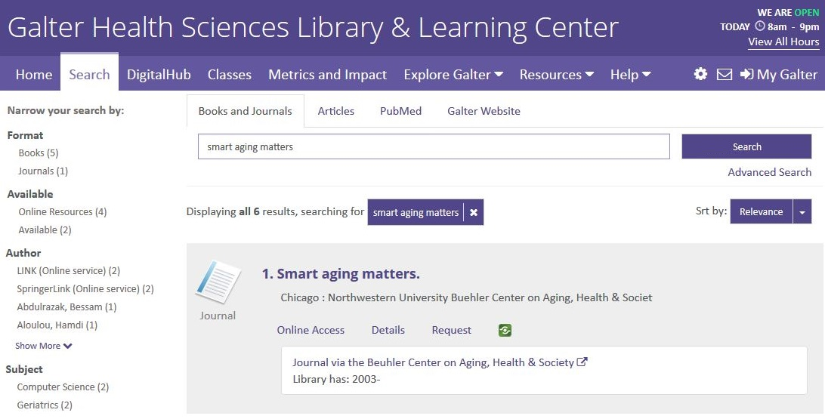
b
Notes:
My own university’s Center on Aging had one of those publications. At one time, our Buehler Center on Aging published this periodical, Smart Aging Matters, and posted the issues on their web site. Here is our public display of our catalog record. Ideally, you should be able to click the link for online access and be able to view the journal page immediately, right?

Slide 8
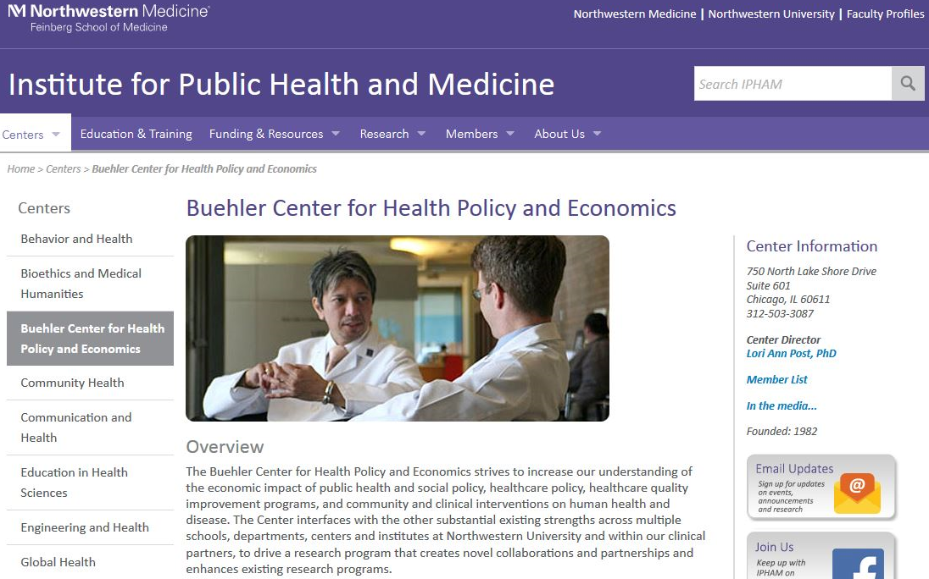
Notes:
Well, that’s not what happens. I wanted the Center on Aging, and instead, I got this. Apparently, the Center on Aging doesn’t even exist anymore. There must’ve been a reorganization, and I’ve been redirected to a new home page of some new Institute, since the URL I’ve reached here is entirely different from the one in our catalog record link. I searched for Smart Aging Matters anyway, on this site and with a Google search, but it really seems to have vanished.
Ordinarily, if a publication has disappeared from the web page of one of our own university departments, I might try to call them up and find out if the publication is still posted somewhere … and if not, ask them if they’d please put it back. But in this case, I’ve got no one to phone. I searched a few more ways, to make sure, to confirm that the department really has been eliminated. I found nothing.

Slide 9
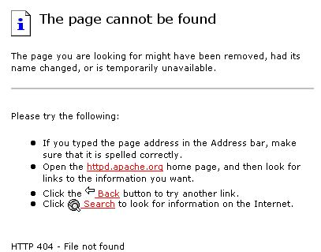
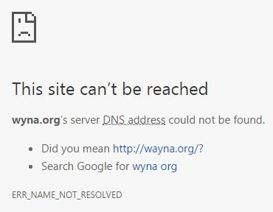
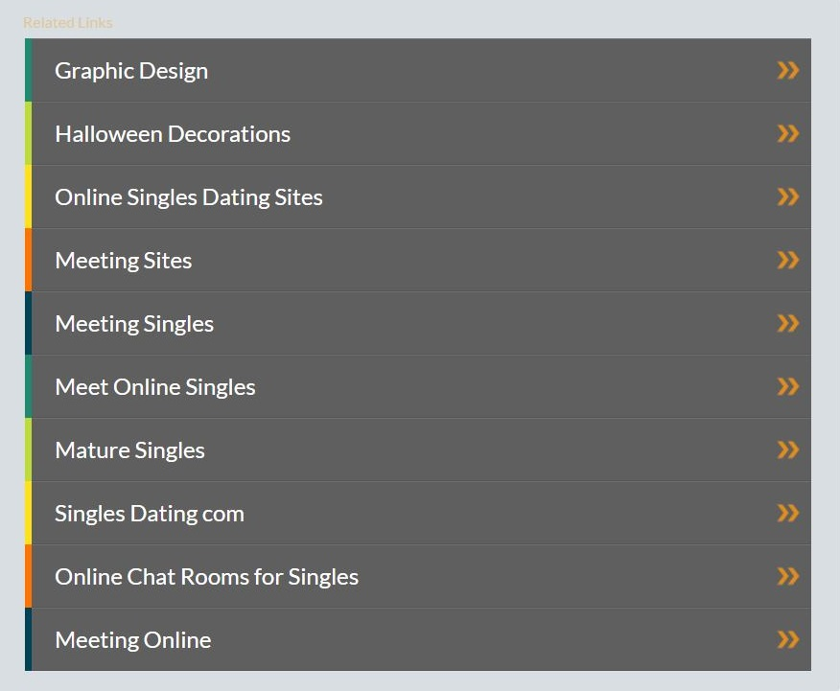
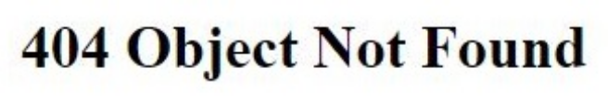
https://archive.org/web/
Notes:
This is just one variety of the things you might see when web pages disappear. Here are a few others you may have encountered. The saddest, to me, is the one in which the whole domain is taken over by advertising.
In the past, when we tested a link and saw any of these things, we’d do a little searching, and if we still couldn’t find the missing content, we’d have had to give up and suppress our record. Now that we can go back in time on the web with the Wayback Machine, many of these missing materials can be found. Reference librarians, in cases like this, may suggest that patrons try Internet Archive to find missing content. So why not make the process seamless for patrons and put Internet Archive’s link right into your ILS?
You start by putting this URL into your browser. That’s the link to the Wayback Machine.

Slide 10
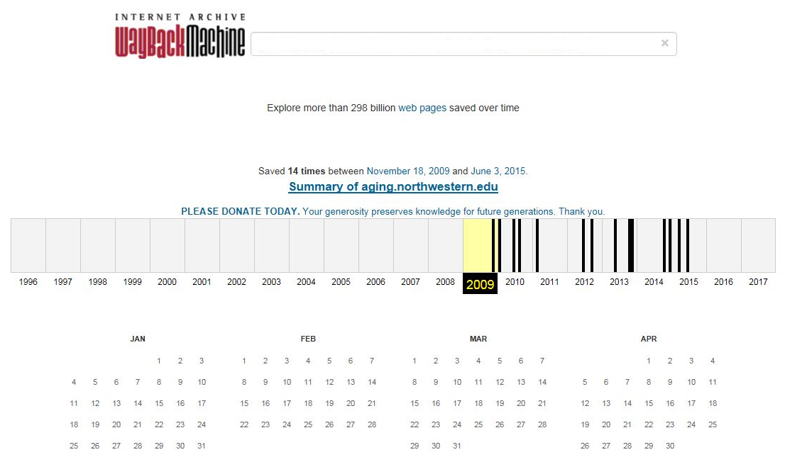
http://www.aging.northwestern.edu/publications_productions.php
Notes:
Once you type your broken URL into the Wayback Machine’s search box, like this, you get a calendar display with all the times the web page was saved. This particular page was saved 14 times between November 2009 and June 2015. I generally click on the most recent capture, in mid 2015, and see if the journal was still there on that date, just to try to get the maximum number of issues. If the latest date is no good, I work backward in time until I find the latest captured version of the journal.

Slide 11
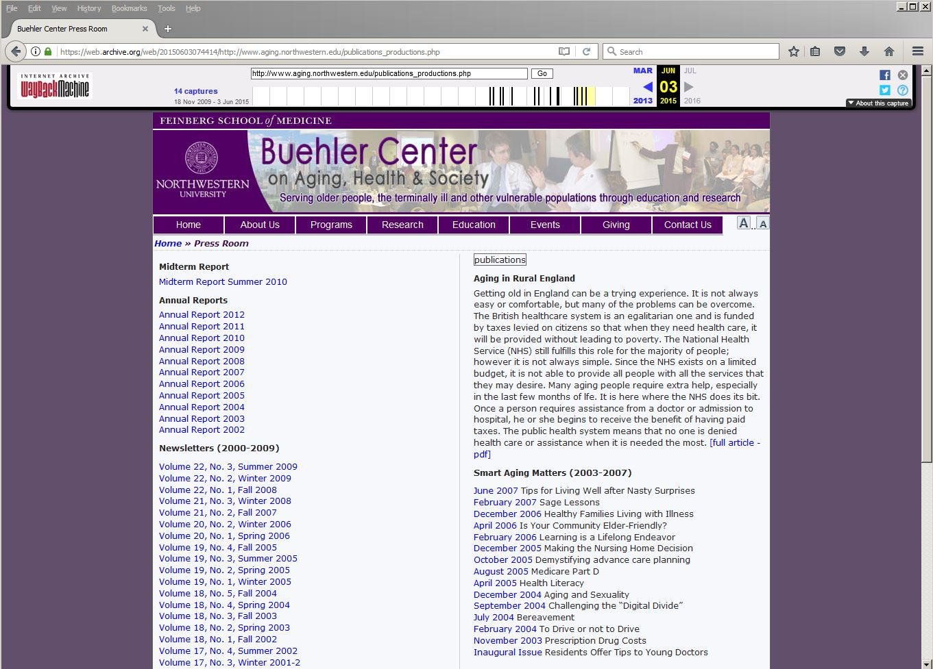

Notes:
In this case, the latest capture date worked. It took me to this page with several of the Center for Aging’s publications on it … and here’s the entire run of Smart Aging Matters. Looks like it ceased back in 2007.
You can see at the top that the Wayback Machine header bar is still there, so we know we’re looking at an archived snapshot, rather than the old, living web page of the Buehler Center on Aging.
Before rushing in and replacing your URL, you should check – or at least spot check – the links to the actual content of each issue, to make sure that all the content is actually there, properly formatted. In this case, all the issues, in PDF format, are perfect. Sometimes, however, the content is incomplete or unreadable, occasionally to the extent where you might not want to use it. If that happens, you might want to go back to the Wayback Machine’s calendar and see if a different capture on a different date works better. Or you may decide not to use it at all.

Slide 12
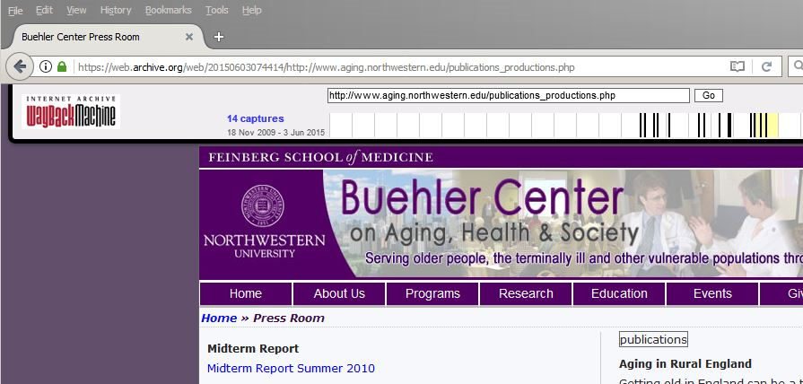
https://web.archive.org/web/20150603074414/http://www.aging.northwestern.edu/publications_productions.php
Notes:
Now just copy the URL that you see in your browser’s address bar. You can see that, after the prefix for Internet Archive and the date and time of the snapshot, the original URL is included.
Once I replace our old URL with this one from Internet Archive (and update the catalog record with the cessation date and a few other edits), one click takes the patron directly to the full run of the title, just as it is supposed to!

Slide 13
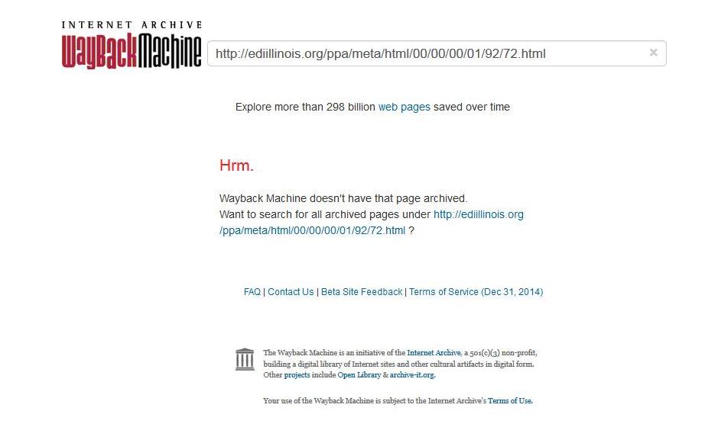
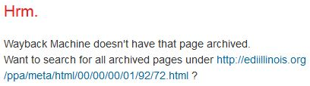
Notes:
Occasionally you’ll find a web page that the Wayback Machine hasn’t archived. (This one is an State Government series of annual reports.) If the reports have already disappeared, it’s too late! but in this case, they’re still there. This is when you can be proactive and help Internet Archive preserve content that hasn’t yet disappeared … but might in the future!

Slide 14
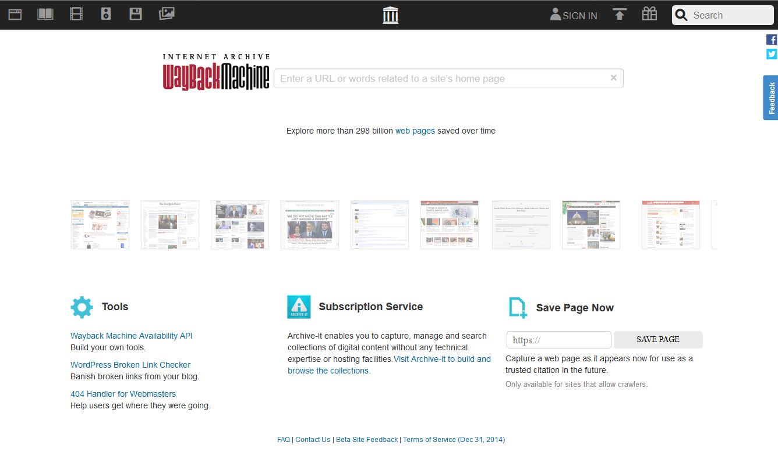
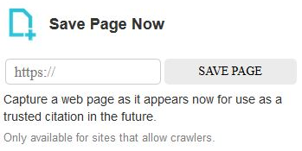
Notes:
On the Wayback Machine page, enter the URL of the content you want to preserve in the “Save Page Now” box, and submit your request for the page to be preserved. If the content is still live, you don’t have to use the Wayback Machine’s link, but you can be reassured that the content will be there if you ever need it.

Slide 15
Caveats.
Not for subscription products. Good for government publications – state and local, as well as federal – and society or organization newsletters.
Formerly open-access material may now be membership or subscription-based, raising the question of whether access through Internet Archive is legal (or ethical).
Newsletters and other free serial publications may have always offered rolling archives, so that no single archive link contains a complete run.
Notes:
Internet Archive does not make content available that is proprietary and only available for a charge. Sometimes small publishers change their open-access policies and start charging or requiring memberships … as they are within their rights to do. If they haven’t actually contacted Internet Archive and asked them to remove the open archive, the content may still be available … and not being a legal expert, I can’t comment on whether it would be legal or ethical to take advantage of archives left open by mistake.
I had a lovely example of this last caveat – a publication called Reported Tuberculosis in the United States – but there is just not enough time to show it to you. It’s a case in which the web site is still actually live, with the three latest reports posted, but with the Wayback Machine, you can find captures of many earlier reports … only three at a time! It’d be up to individual libraries to decide whether to these include multiple links with different ranges of coverage in their ILS.

Slide 16
Questions?
Susan Wishnetsky
pasiphae@northwestern.edu

Slide 17
References
“About the Internet Archive.” Internet Archive [web site], < https://archive.org/about/>.
“Connect with Internet Archive at ALA 2017 Chicago.” < https://blog.archive.org/2017/06/18/connect-with-internet-archive-at-ala-2017-chicago/>
Magistad, Mary Kay."Where to find what's disappeared online, and a whole lot more: the Internet Archive." PRI Public Radio International, Feb. 23, 2017, <https://www.pri.org/stories/2017-02-23/where-find-whats-disappeared-online-and-whole-lot-more-internet-archive>.

