Slide 1
Data Sharing for Open Access
Cunera Buys, MLIS
Data Management Librarian
Mudd Library
c-buys@northwestern.edu
Sara Gonzales, MLIS
Data Librarian
Galter Health Sciences Library & Learning Center
sara.gonzales2@northwestern.edu

Slide 2
Topics
Data Sharing for Open Access: Definitions and Requirements
Benefits of Data Sharing
Resources to Help with Data Sharing
Preparing Data to be Shared
Open Data repositories

Slide 3
Data Sharing for Open Access: Definitions and Requirements

Slide 4
Data Definitions
Office of Management and Budget: “Research data means the recorded factual material commonly accepted in the scientific community as necessary to validate research findings” (OMB Circular A110)
The Oxford English Dictionary (OED)defines “data” as:
Related items of (chiefly numerical) information considered collectively, typically obtained by scientific work and used for reference, analysis, or calculation.
Data can be both analog and digital materials.

Slide 5
Research Data Management
Research Data Management is the care and maintenance of data and helps to ensure data is properly organized, described, preserved, and shared. It includes practices for collecting, organizing, backing up, and storing data.

Slide 6
The Office of Science and Technology Policy (OSTP) 2013 memo defining a requirement to share research data from studies funded by federal agencies with >$100 million in research and development expenditures
…the direct results of federally funded scientific research [must be] made available to and useful for the public, industry, and the scientific community. Such results include peer-reviewed publications and digital data.
Agency plans for sharing digital scientific data must include the following elements:
A strategy to leverage existing archives, where appropriate
A strategy to improve the public’s ability to locate and access digital data
An approach for optimizing search, archival, and dissemination features that encourages innovation in accessibility and interoperability, while ensuring long-term stewardship of the results of federally funded research.
White House Office of Science and Technology Policy (OSTP). Memo: Expanding Public Access to the Results of Federally Funded Research, 2013. https://obamawhitehouse.archives.gov/blog/2013/02/22/expanding-public-access-results-federally-funded-research
Notes:
In February 2013 the White House Office of Science and Technology Policy (OSTP) released a memorandum requiring federal agencies supporting research to create plans for increased public access to research data. While the memo is a directive to federal funding agencies, it provides clues about procedures for researchers sharing data. For instance, it refers to using existing archives to deposit or catalog data, as well as maximizing search and dissemination and encouraging interoperability for deposited data. Managing and preparing data for sharing will be needed to achieve these objectives, and we will cover details on this in a moment.
Regarding the existing archives, in recent years data catalogs and institutional repositories have been developed to help researchers comply with their agreements to post publications or archive data publicly. Next let’s consider the archives that can be used to meet Federal Open Access requirements.

Slide 7
Funder Public Access Requirements: Articles
(Most require article archiving after a 12 month embargo)
Federal Funder | Required Repository
CDC, FDA, NIH, NIST, ASPR, AHRQ, VA | PubMed Central
DoD | DoD’s Defense Technical Information Center database
DoE | PAGES (Public Access Gateway for Energy and Science)
NASA | PubSpace (NASA’s publication repository)
Smithsonian | Smithsonian-managed or Smithsonian-approved repositories
USAID | DEC (USAID’s document storage system)
USDA | PubAg (USDA’s repository)
DoT, FDA, NOAA, NSF | Any publicly accessible repository
Notes:
To deposit your articles to meet Open Access requirements, the road is fairly easy. PubMed Central is the archive of choice in most cases, and where it is not, the agency typically outlines the preferred repository for research articles. But what about depositing datasets?

Slide 8
Funder Public Access Requirements: Data (Data Management Plans required in all grant applications; deposit to the repository noted in DMP)
Federal Funder | Data sharing: required or encouraged? | When must data be shared?
CDC | Required | Within 30 months of end of data collection
DoD, DoE, DoT, NSF | Required, except where data legally/ethically can’t be shared | Within a reasonable time
FDA, NASA, NIST, NOAA, ASPR, AHRQ, USAID | Required (FDA: except 2-year embargo for investigational new drug studies) | Upon publication (if appropriate; some allow up to 24 or 36 months after data collection)
NIH | Since 2003, for grants over $500,000, a data sharing statement is required with grant applications | New! Proposed key revisions to data policy: https://osp.od.nih.gov/provisions-data-managment-sharing/
Smithsonian | Required (submit data to Smithsonian -managed or –approved repository) | Within 12 months of paper publication
USDA, VA | No policy yet (VA: Encouraged)
Notes:
As we can see, when it comes to the sharing of research data, federal funders have less clear outlines for exactly how to do this. Generally more time is allotted for sharing data than for sharing articles, and the specific repository one must use is rarely specified. Increasingly a data management plan, or, an outline of how you will manage data throughout the life of your research project, is required as part of the grant application process. Researchers can deposit their datasets to any repository that they outline in the data management plan. How much of the collected data to deposit should also be specified by your funder.

Slide 9
Journal Data Sharing Requirements: The Spectrum
Associated Data
Data Available Upon Request
Minimum Dataset
Full Data Deposit and Sharing
Minimum sharing
Maximum sharing
Notes:
Each journal has different requirements when it comes to data sharing, so you will need to pay close attention to your particular journal. Their requirements can range from:
An associated data file is required with your manuscript submission. This often takes the form of a file of figures used in the paper, sometimes with the backing data required.
Data available upon request: If your journal allows this method of sharing, your only requirement is to supply contact information and answer the requests for data as they come in.
Minimum dataset: From your stockpile of project data, only the minimum set necessary to support the claims made in the current paper must be deposited.
Full Data Deposit and Sharing: In these cases, the journal will require a full deposit of your research data in an appropriate repository. This can include, in the case of Nature, data, code, and associated protocols.
Things to keep in mind:
Publisher agreement: your level of sharing can be negotiable! Before signing your publication agreement, get confirmation on the terms of sharing and ask for any amendments that you would like.
Data Availability Statement: Many journals require a data availability statement, or a clear outline of exactly how you will make the data available, early in the manuscript submission process. Keeping in mind your agreement and the realities of what you are able to share, write your Data Availability Statement accordingly.

Slide 10
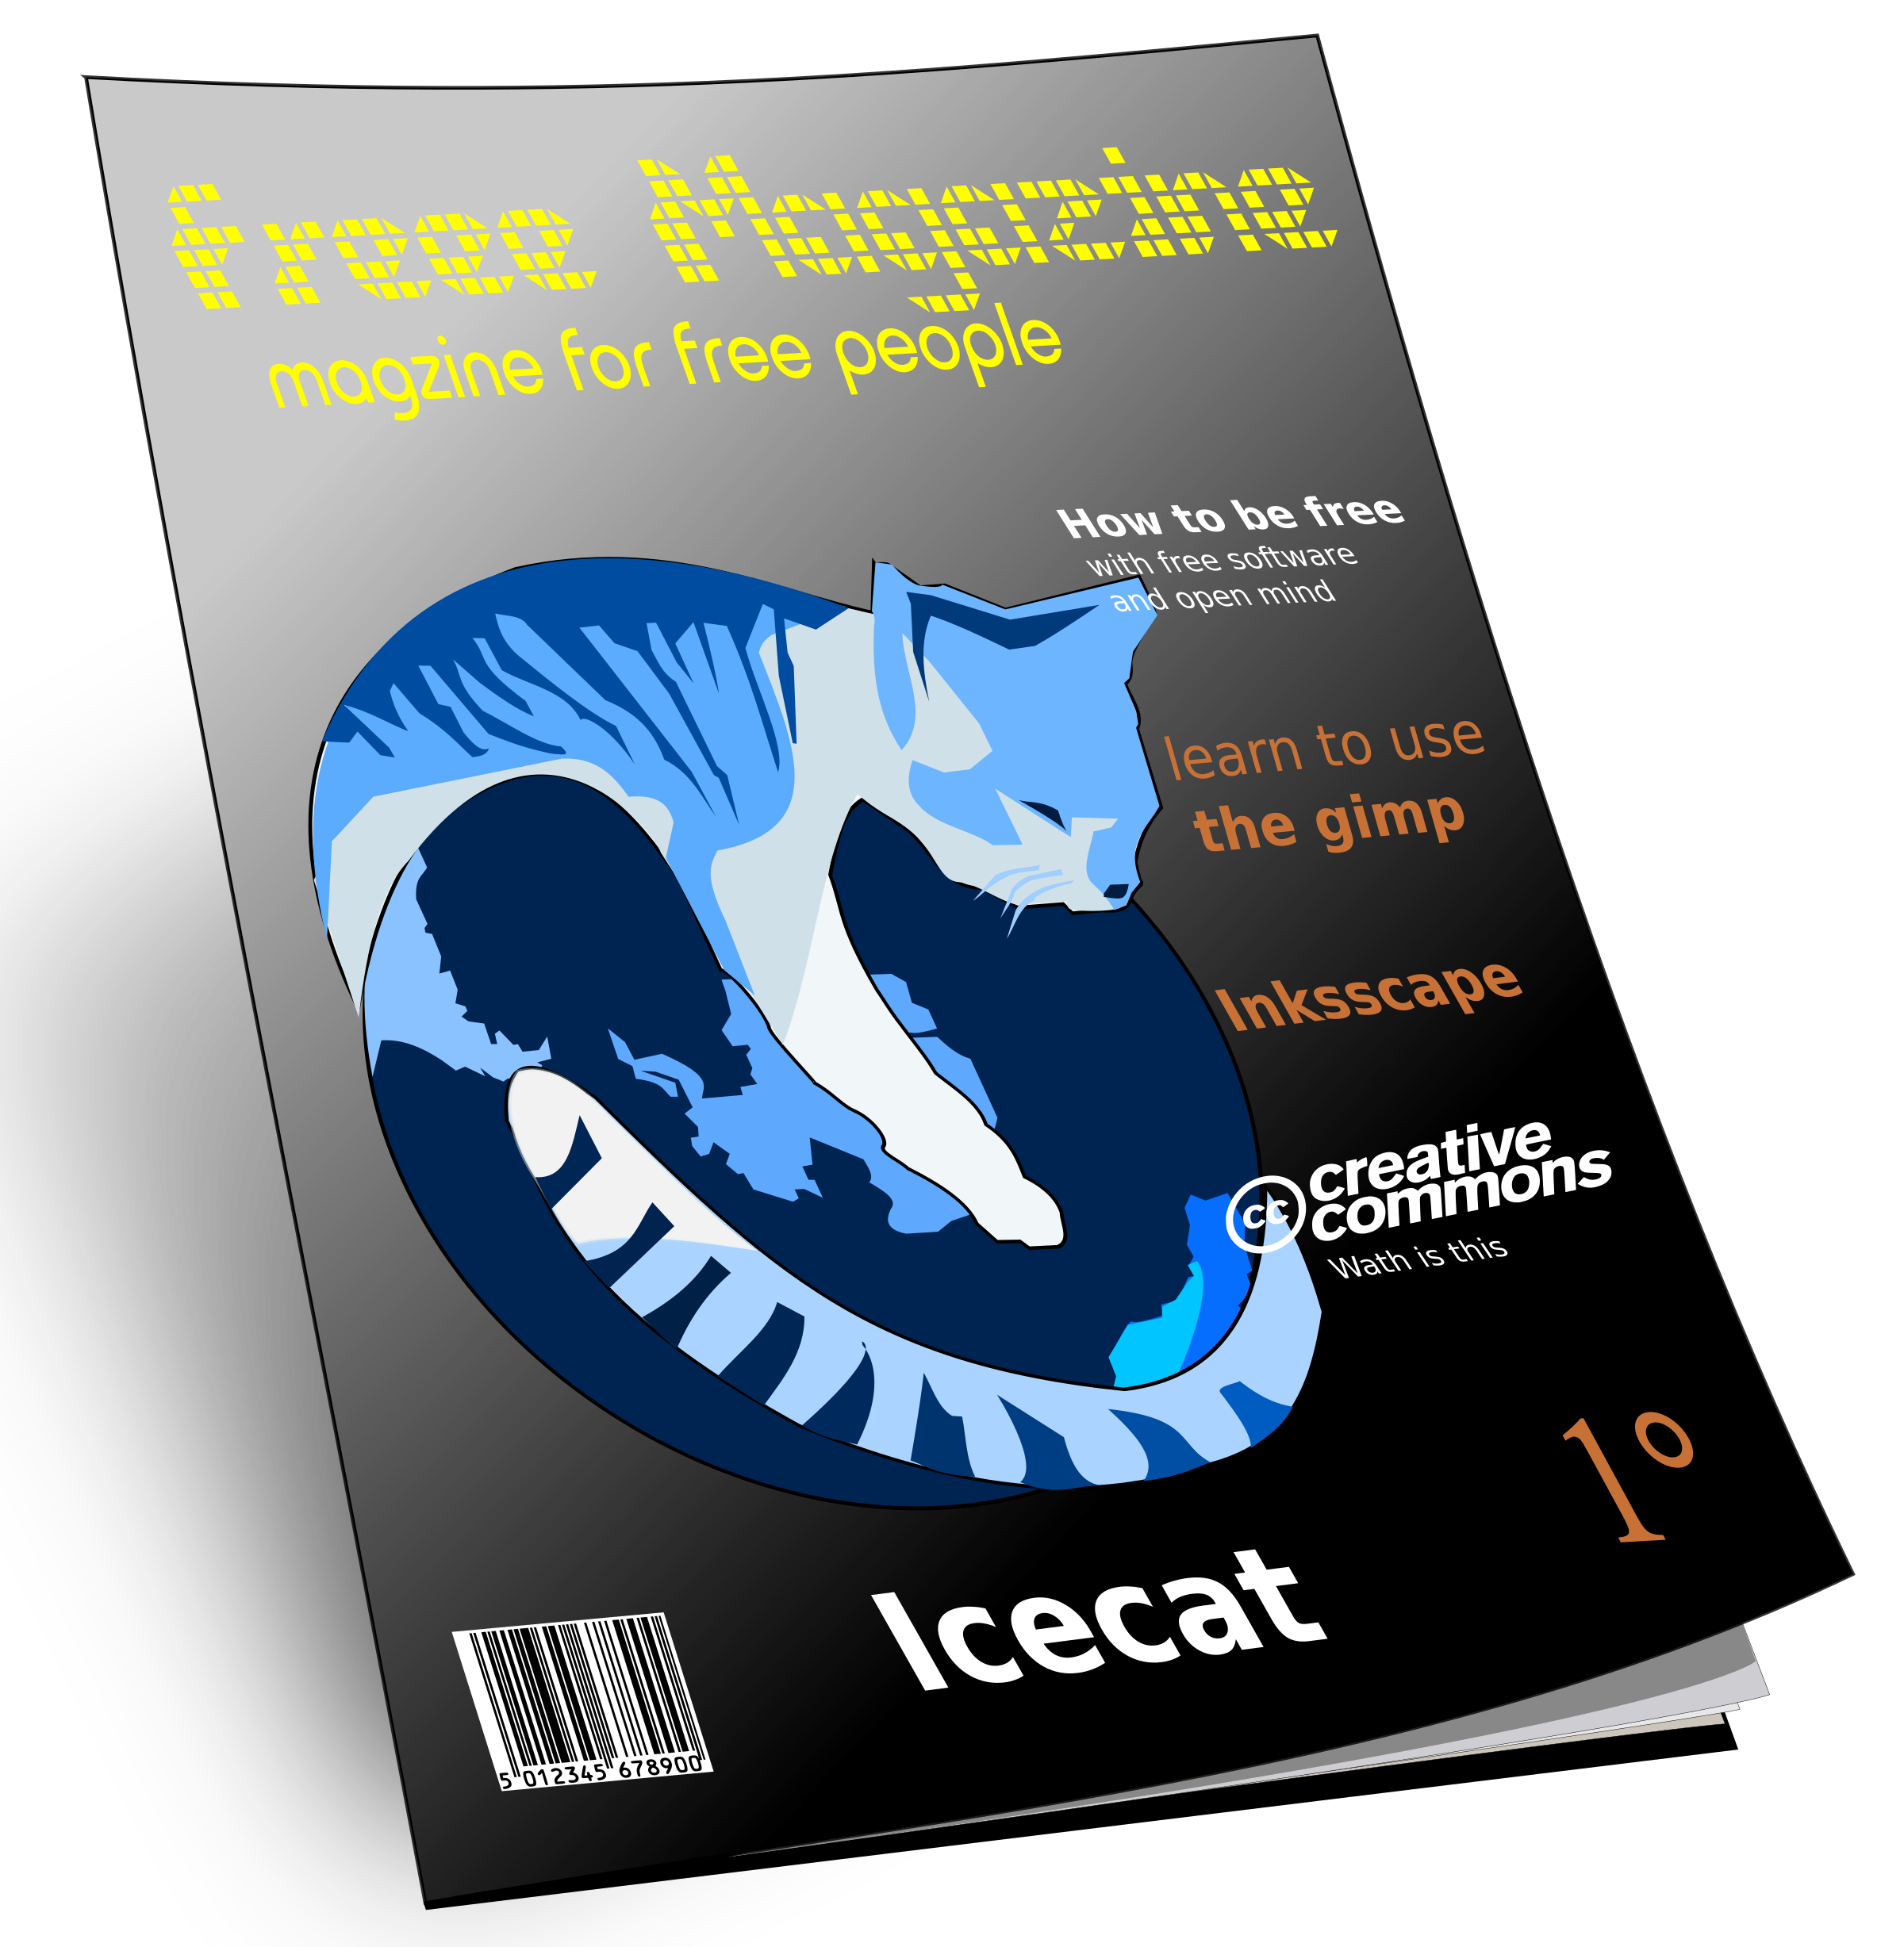
Resources for Journal Data Sharing Requirements
Which journals require sharing of which data?
No one-stop shop for all journals’ data sharing requirements
Check data sharing requirements with your individual publishers
See Sherpa Romeo (sherpa.ac.uk/romeo/index.php) to look up journals’ policies on open access publications and pre- and post-print archiving
PLOS: Criteria for acceptable data repositories
Allows open access to the data for all
Assigns a DOI or other permanent digital identifier
Allows for the data to be made available under CC0 or CC BY licenses
No cost to access the data and no registration requirement
Repository must have a long-term data management plan
Repository should demonstrate acceptance and use within the relevant research community
The repository has an entry in FAIRsharing.org
Adapted from PLOS One: Data Availability, https://journals.plos.org/plosone
Image by asrafil, https://openclipart.org/detail/81877/free-magazine-3d
Notes:
Unfortunately there is no single place to look up all journals’ data sharing requirements. You can get a lot of information about open access practices of journals through Sherpa Romeo, though this resource largely focuses on journals’ policies for pre-and post-print archiving. Check with individual journals about their data-sharing requirements.
If your journal recommends depositing data to any reputable repository, you may still wonder how to find such a repository, and what qualities the repository should have to be the best possible steward of your data. PLOS clearly outlines on their website the criteria for acceptable data repositories, and these recommendations are useful for anyone searching for a viable repository for their materials. Minting a DOI upon deposit is an important preservation technique for digital objects. It ensures that they will always be locate-able online, even if the hosting repository folds, and it allows the dataset to be cited, and to be linked to its corresponding publication through a URI.
It is best practice, when depositing research products online, to ensure that the repository you use has a plan for long-term preservation of its deposits, and that it is accepted in your research community. For full open access sharing, the data should be made available through the repository to anyone who might encounter it, free of charge, and without a requirement to create an account.

Slide 11
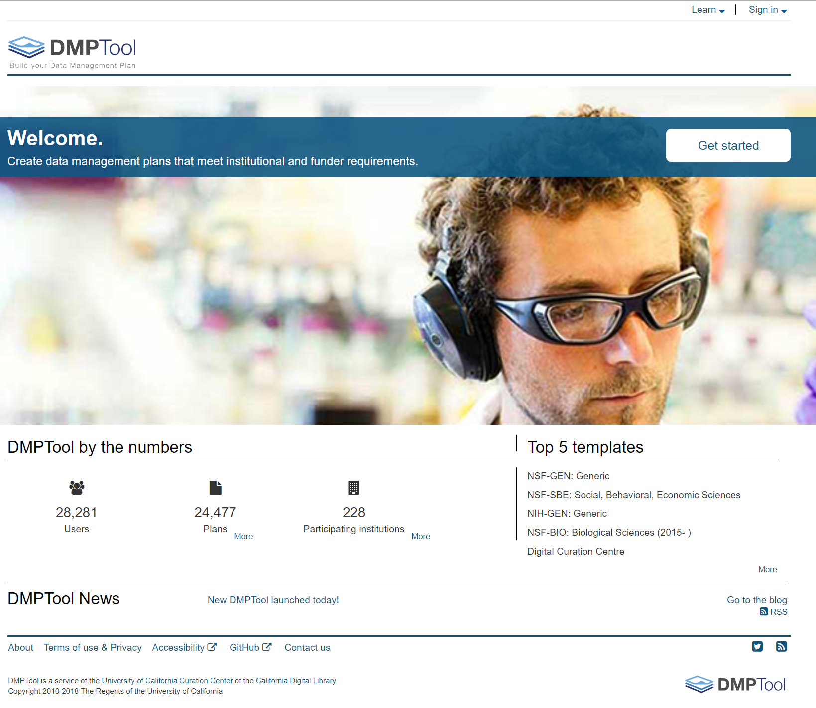
DMP Tool
Login with NetID
Generates Data Management Plans
Templates from federal agencies and private foundations
Saves your plans for reuse and adaption
Export as PDF, DOCX
dmptool.org

Slide 12
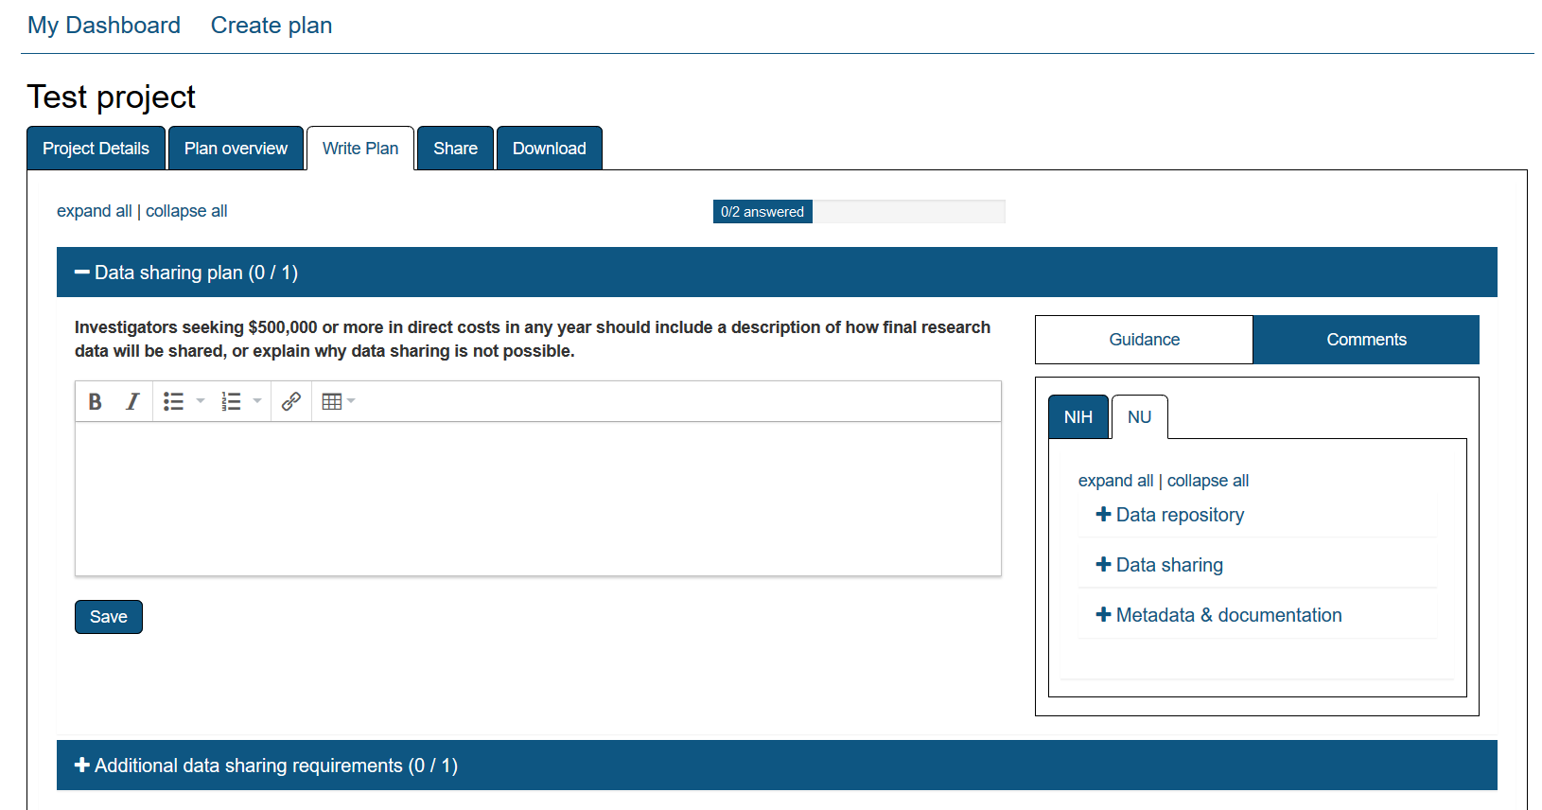
Data Management Plans
See: dmptool.org and libguides.northwestern.edu/datamanagement/datamanagementplans
Notes:
We mentioned that Data Management Plans (DMP’s) are required for most federal funding submissions. Establishing and following a data management plan can help enormously when it comes time to deposit data. In a good data management you should outline how data will be collected and with which tools, how it will be processed, who is responsible for data collection and processing, and the standards and procedures for data management and preservation that will be used throughout the life of the project. If the elements of your plan are carried out in carefully implemented procedures, then at the end of the process you should have a lot less trouble in tasks like identifying minimum datasets, describing them with appropriate metadata in a repository, and even de-identifying the data.
In this example you can see that in the DMP tool, once logging in as a Northwestern user with your netID, you can tailor your plan to your funder’s specifications, while using the guidance on the right to also incorporate Northwestern’s recommendations for repositories, data sharing and metadata and documentation.

Slide 13
Proposed Elements for Data Management Plans (NIH)
Data Types and Storage:
-What type of data will be produced?
-How much data will be produced?
-What tools and software are you using to create and process data?
-What storage and backup solutions will you use?
Data Organization, Documentation, and Metadata:
-How are you documenting data collection methods?
-Do you have a convention for naming files?
-What identifiers are you using (standard names, code numbers, etc.)?
-What standard vocabularies do you apply to data?
Data Access and Intellectual Property:
-Are you collecting and storing sensitive data?
-What security measures are in place to protect sensitive data?
-Who can access data, and at what stages in the research process? Who is in charge of access?
-Who owns the research data? What licenses can you assign to the data?
Data Sharing:
-Does your funder require some level of data sharing? Your publisher?
-How are you preparing data for sharing? How are you de-identifying sensitive data?
-Through what repositories do you plan to share data?
-What tools or software will you use to prepare data for sharing?
Data Preservation and Archiving:
-Does your institution or funder require data retention for a certain period?
-How will you ensure that the data will be accessible and usable in the long term?
-Where will you store data securely for the long term?

Slide 14
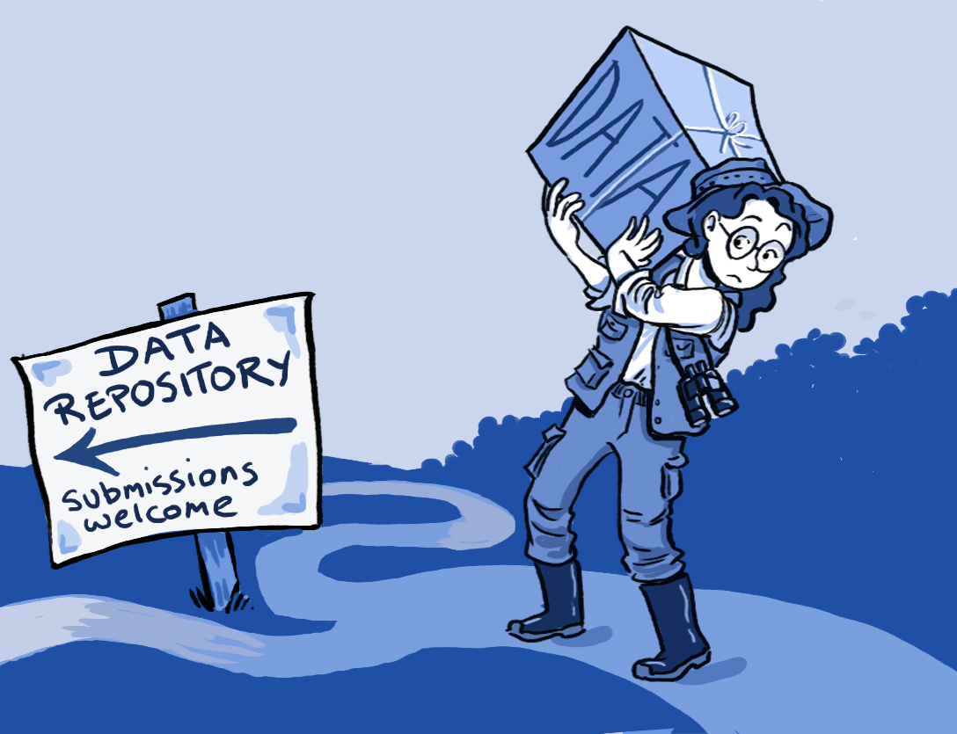
Why share data?
https://upload.wikimedia.org/wikipedia/commons/6/65/To_deposit_or_not_to_deposit%2C_that_is_the_question_-_journal.pbio.1001779.g001.png

Slide 15
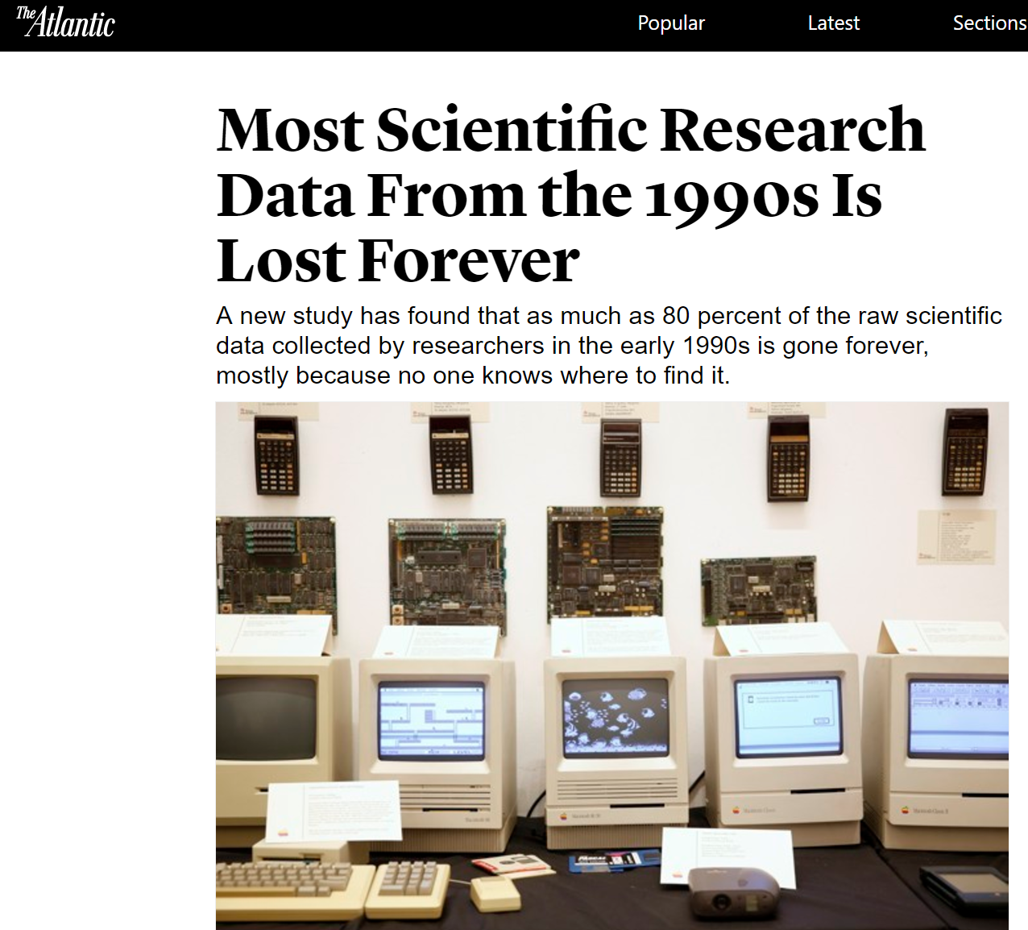
https://www.theatlantic.com/national/archive/2013/12/scientific-data-lost-forever/356422/
Notes:
An article from the Atlantic about the Current Biology study
Prevention of data loss. As this study published in Current Biology in January 2014 shows:
1. the availability of data decreased by 17% each year after publication
2. most raw data from scientific papers published twenty years ago is unobtainable
3. the most common obstacles to data sharing were because authors have since changed their contact information and can't be reached or because the data was stored using outdated technology, like floppy disks.

Slide 16
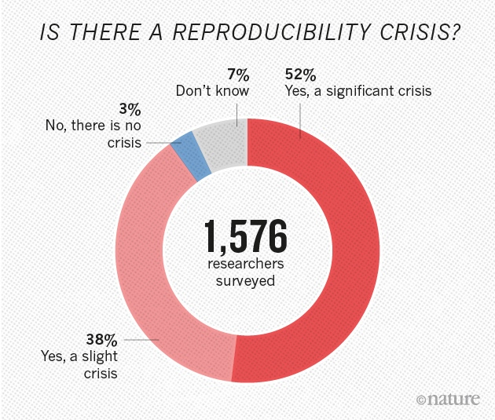
Source: Baker, M. (2016). 1,500 scientists life the lid on reproducibility, Nature, https://www.nature.com/news/1-500-scientists-lift-the-lid-on-reproducibility-1.19970
Notes:
Sharing data may assist in the reproducibility of your work.
1576 researchers
70% tried and failed to reproduce others work
More than ½ failed to reproduce their own work
Researchers still confident most research can be trusted
Pressure to publish and selective reporting contribute.

Slide 17

Data Management & Data Sharing
Makes your data easily accessible by you and others
Can save you time and perhaps money
Data sharing increases recognition of your work
May help you find collaborators more easily
Helps with reproducibility of your published results
Helps further new discoveries and research
Preserves data for long-term access and prevents loss of data
Federal and other funding agencies require data management plans and data sharing
Journals require deposit of data underlying the articles in public repositories
https://www.flickr.com/photos/mbiddulph/3240818979/ (CC BY-SA 2.0)

Slide 18
FAIR Principles for scientific data management
Data that is stored, curated, and shared according to the FAIR principles (a set of guiding principles) to make data
Findable: described richly with metadata and have a unique identifier (often a URI)
Accessible: retrievable by their identifier through free and open Internet protocols that allow authentication and authorization where necessary
Interoperable: described with commonly used metadata standards and controlled vocabularies
Re-usable: have been assigned a license assuring their re-use and have a clear provenance
Notes:
The FAIR principles were published in 2016. They serve as a guide to all researchers who manage research data and who may have a desire or responsibility to deposit it in a repository or otherwise share it freely in the future. Increasingly adopted by institutions, including some in the US.
Approximately only 15% if researchers are familiar with FAIR principles. (State of open data report- Digital Science).
Open data and FAIR are 2 separate concepts. Open data means data that can be used freely from the internet. Fair means thinking about the people who might use your data. This is done by adding persistent identifies ( DOI) so data doesn't disappear, adding metadata that describes the data and a license stating the conditions under which data can be reused (creative commons). Present data in a standardize way so it is machine readable. (develop community standards.)
Data can be FAIR but not open.( eg medical data). How describe the data (metadata) is crucial in helping users discover the data.
In practice, for researchers it can be very simple to achieve the findable and accessible parts. If depositing to a data repository, try to always choose one that will mint a DOI for your deposit. This makes the dataset an identifiable object on the Web, and allows it to be cited. This identified object should then be retrievable through free and open internet protocols (which any well-designed data repository will allow for).
To cover the R first, to be optimally re-useable a dataset should be assigned a license. We will talk about licenses later, and now we will see how having a license is an important part of depositing data. Re-use is made easier if the second user of a dataset knows what they may and may not do with re-used data.
Finally, interoperability it achieved mainly through the use of common metadata standards to describe a dataset in a repository.

Slide 19
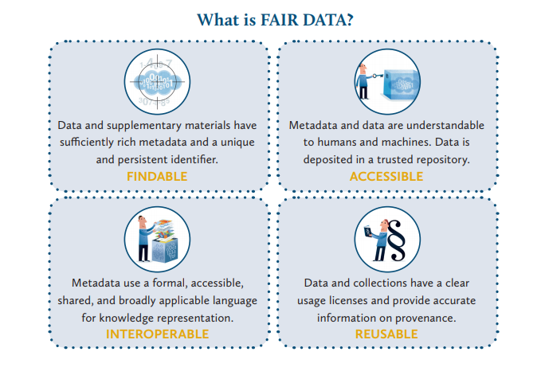
Ligue des Bibliothèques Européennes de Recherche/ Association of European Research Libraries (LIBER)
https://libereurope.eu/wp-content/uploads/2017/12/LIBER-FAIR-Data.pdf
Notes:
Just because I like graphics.

Slide 20
Data Citation
Important to cite data used
Increases recognition of your work
Currently no standard way to cite to data
Notes:
Another new principle involving data. Joint declaration of data citation principles. Adopted by many journal publishers. Allows that data citations will be treated the same as article citations

Slide 21
JOINT DECLARATION OF DATA CITATION PRINCIPLES
1. Importance
Data should be considered legitimate, citable products of research. Data citations should be accorded the same importance in the scholarly record as citations of other research objects, such as publications.
2. Credit and Attribution
Data citations should facilitate giving scholarly credit and normative and legal attribution to all contributors to the data, recognizing that a single style or mechanism of attribution may not be applicable to all data.
3. Evidence
In scholarly literature, whenever and wherever a claim relies upon data, the corresponding data should be cited.
4. Unique Identification
A data citation should include a persistent method for identification that is machine actionable, globally unique, and widely used by a community.
5. Access
Data citations should facilitate access to the data themselves and to such associated metadata, documentation, code, and other materials, as are necessary for both humans and machines to make informed use of the referenced data.
6. Persistence
Unique identifiers, and metadata describing the data, and its disposition, should persist -- even beyond the lifespan of the data they describe.
7. Specificity and Verifiability
Data citations should facilitate identification of, access to, and verification of the specific data that support a claim. Citations or citation metadata should include information about provenance and fixity sufficient to facilitate verfiying that the specific timeslice, version and/or granular portion of data retrieved subsequently is the same as was originally cited.
8. Interoperability and Flexibility
Data citation methods should be sufficiently flexible to accommodate the variant practices among communities, but should not differ so much that they compromise interoperability of data citation practices across communities.
Data Citation Synthesis Group: Joint Declaration of Data Citation Principles. Martone M. (ed.) San Diego CA: FORCE11; 2014 [https://www.force11.org/group/joint-declaration-data-citation-principles-final].
Notes:
set of guiding principles for data citation

Slide 22
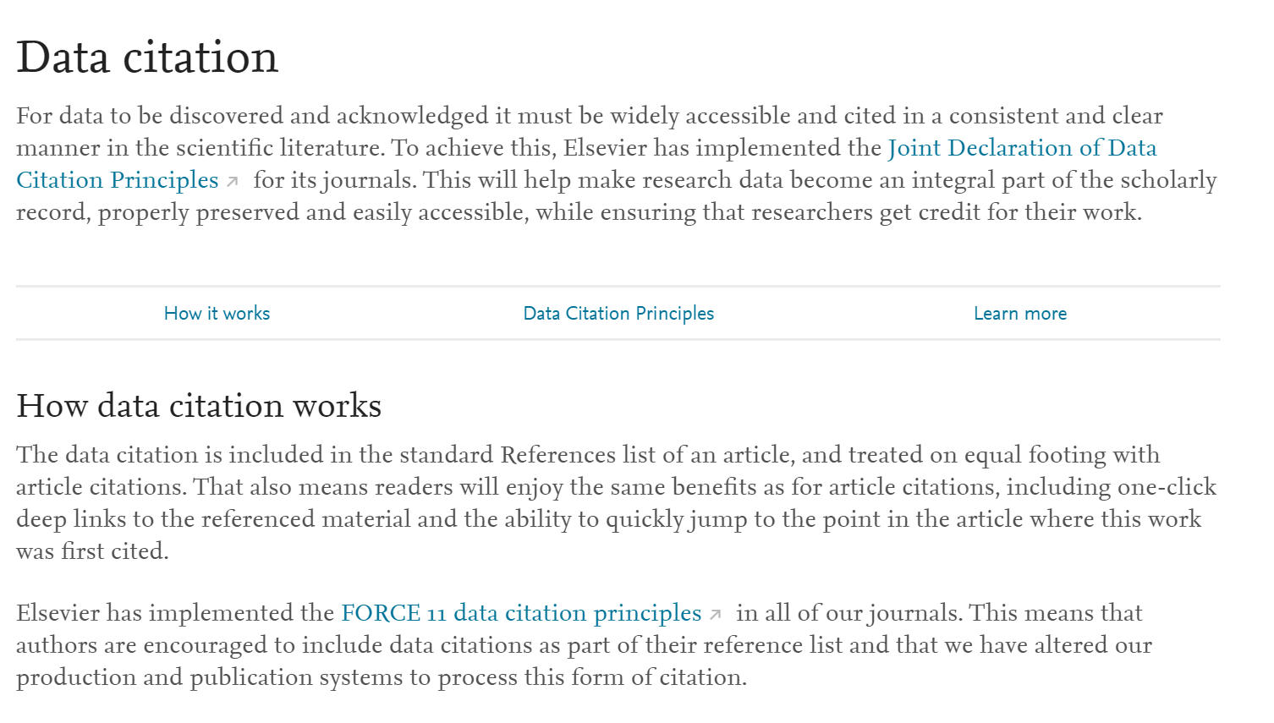
https://www.elsevier.com/about/open-science/research-data/data-citation
Notes:
Adopted by many journal publishers. Example of publisher (Elsevier) adopting standards.

Slide 23
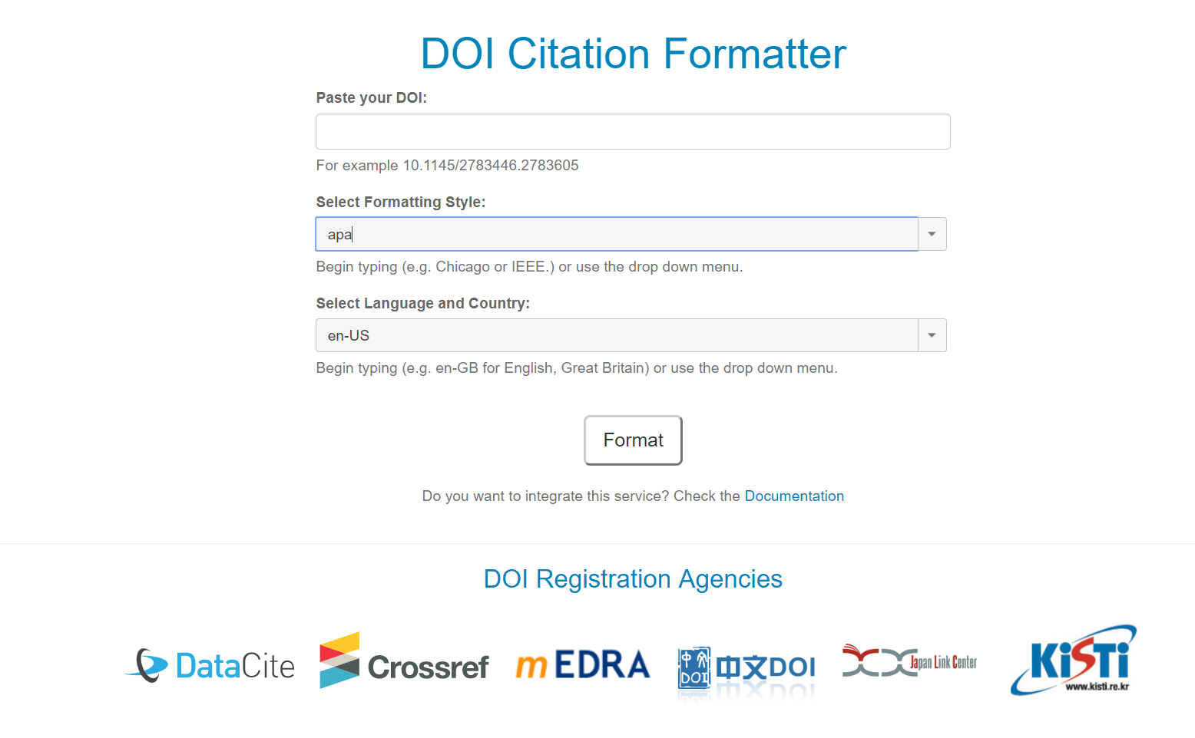
Notes:
The DOI Citation Formatter is a service created in collaboration with Crossref, mEDRA, ISTIC, and JaLC. It provides a simple interface to extract metadata automatically from a DOI and build a full citation. It supports more than 5,000 different citation styles in 45 different languages, using the Citation Style Language.

Slide 24

Community resources
people group by Oksana Latysheva from the Noun Project

Slide 25
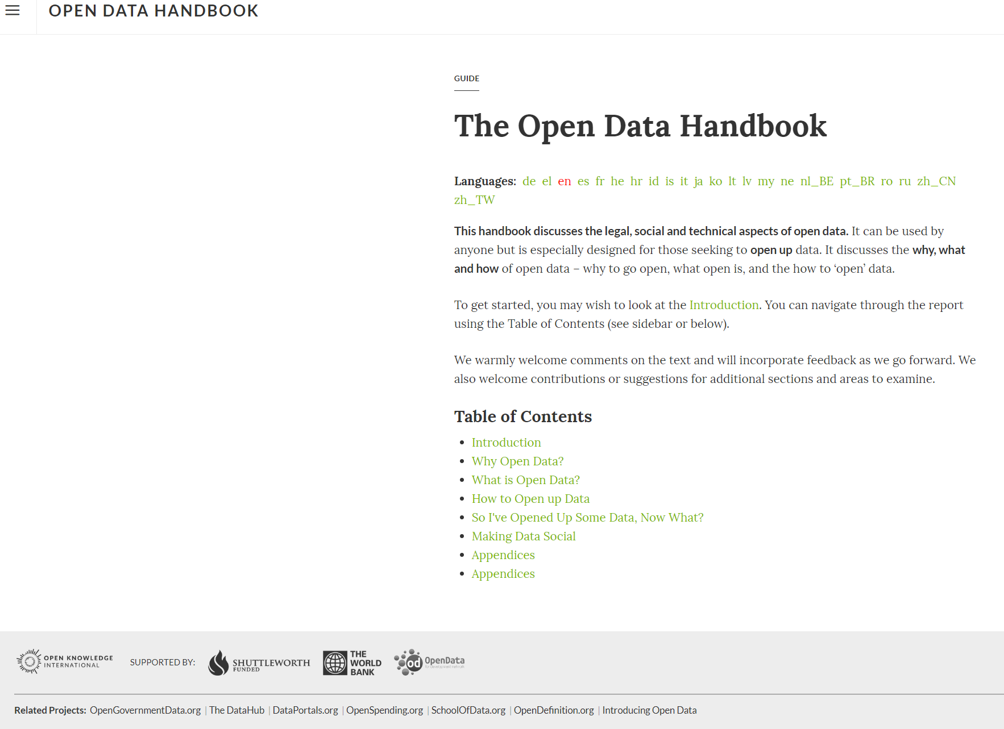
http://opendatahandbook.org/
Notes:
Open Data Guide
This guide discusses the legal, social and technical aspects of open data. It can be used by anyone but is especially designed for those seeking to open up data. It discusses why to go open, what open is, and the how to 'open' data.
Web site also has links to:
Use cases, stories and case studies highlighting the social and economic value, the impact and the varied applications of open data from cities and countries across the globe.
Resource Library
A curated collection of open data resources, including articles, longer publications, how to guides, presentations and videos, produced by the global open data community.

Slide 26
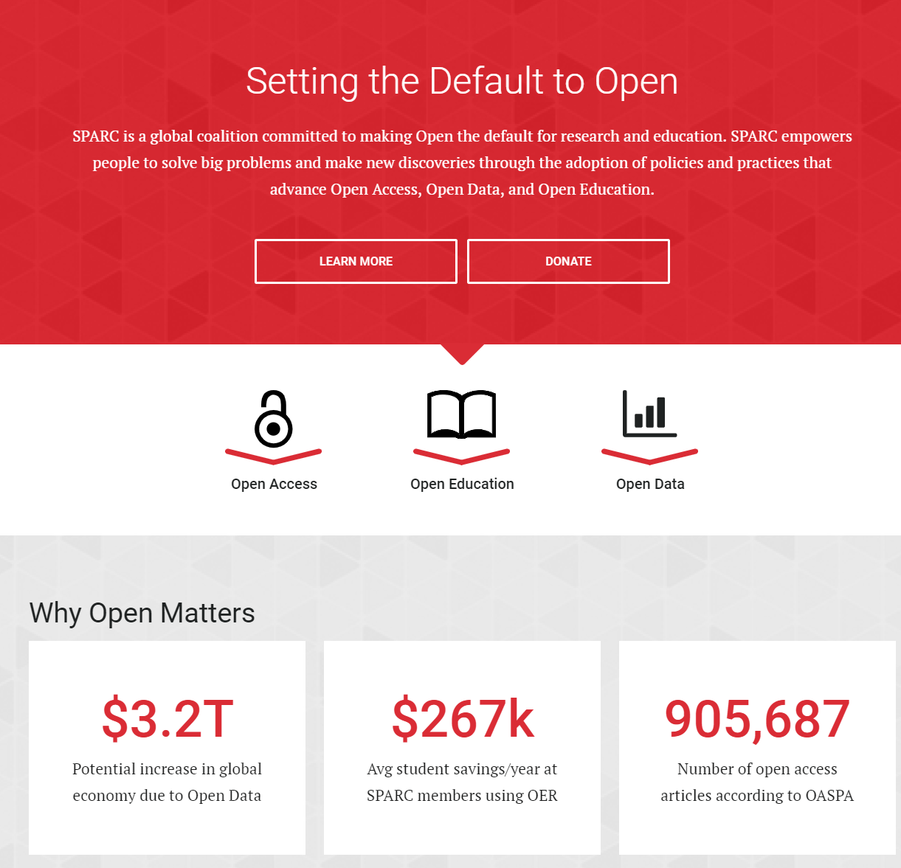

https://sparcopen.org/
Notes:
SPARC is a global coalition committed to making Open the default for research and education.
SPARC (the Scholarly Publishing and Academic Resources Coalition) works to enable the open sharing of research outputs and educational materials in order to democratize access to knowledge, accelerate discovery, and increase the return on our investment in research and education
Click on the open data tab:
Defines and discussed open data. Also has a link that allows one to Browse Article and Data Sharing Requirements by Federal Agency

Slide 27
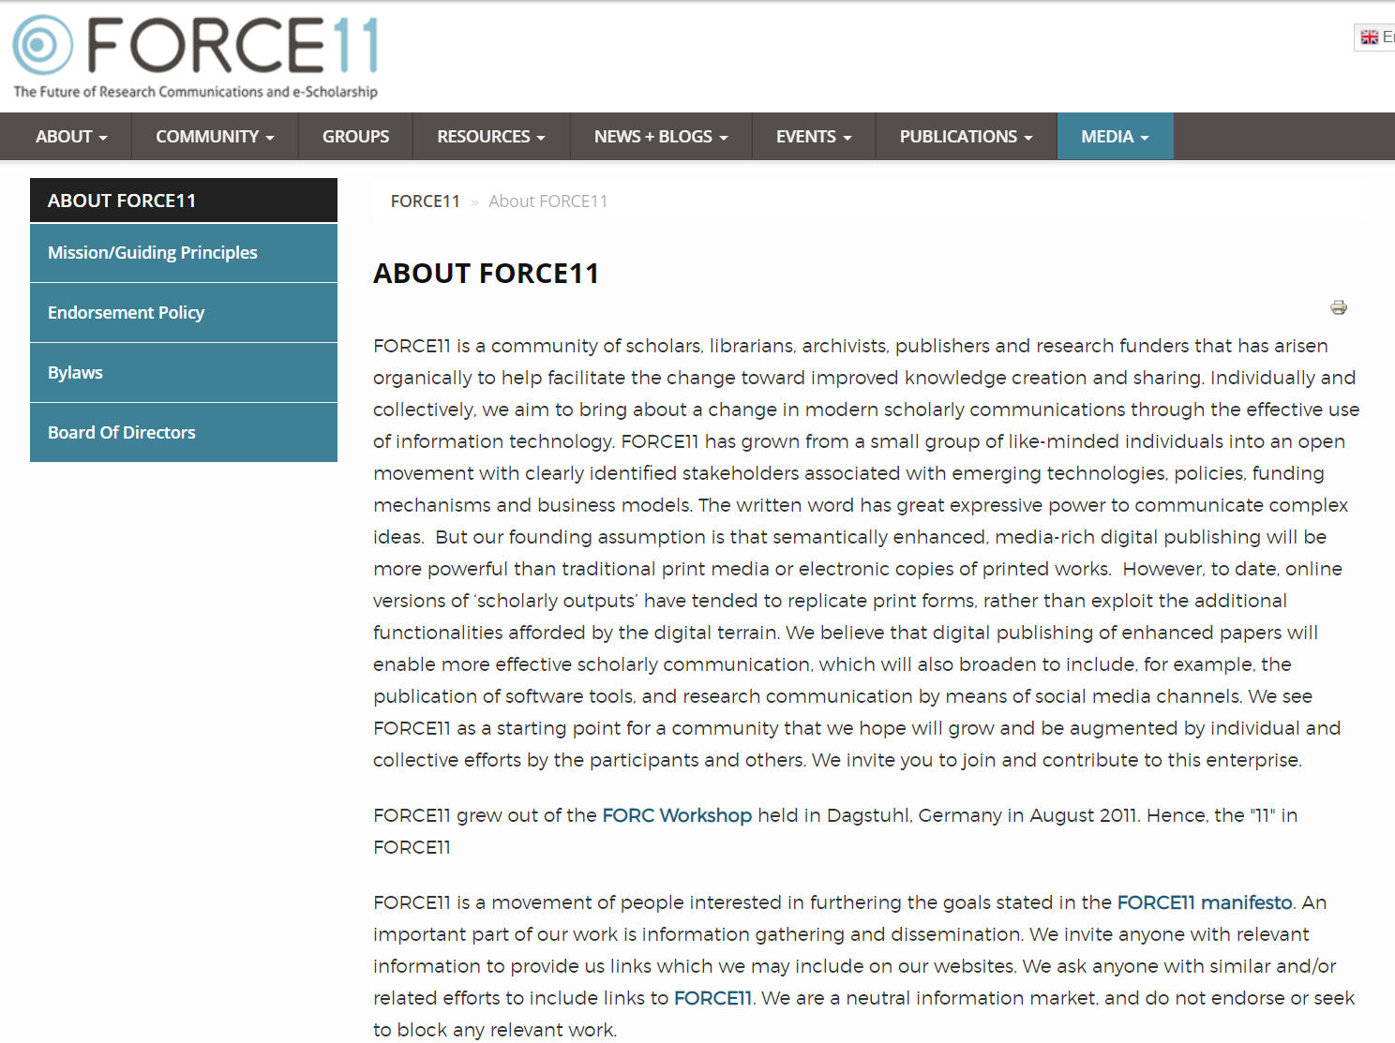
https://www.force11.org/
Notes:
Holds meetings and workshops to educate in open data and other aspects of open science. Was instrumental in developing the data citation principles discussed earlier.

Slide 28

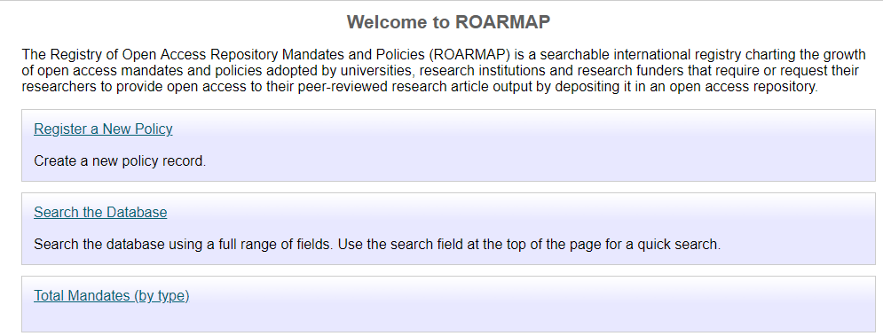
Notes:
Can search to find OA mandates and policies, including at the University and governmental levels.

Slide 29
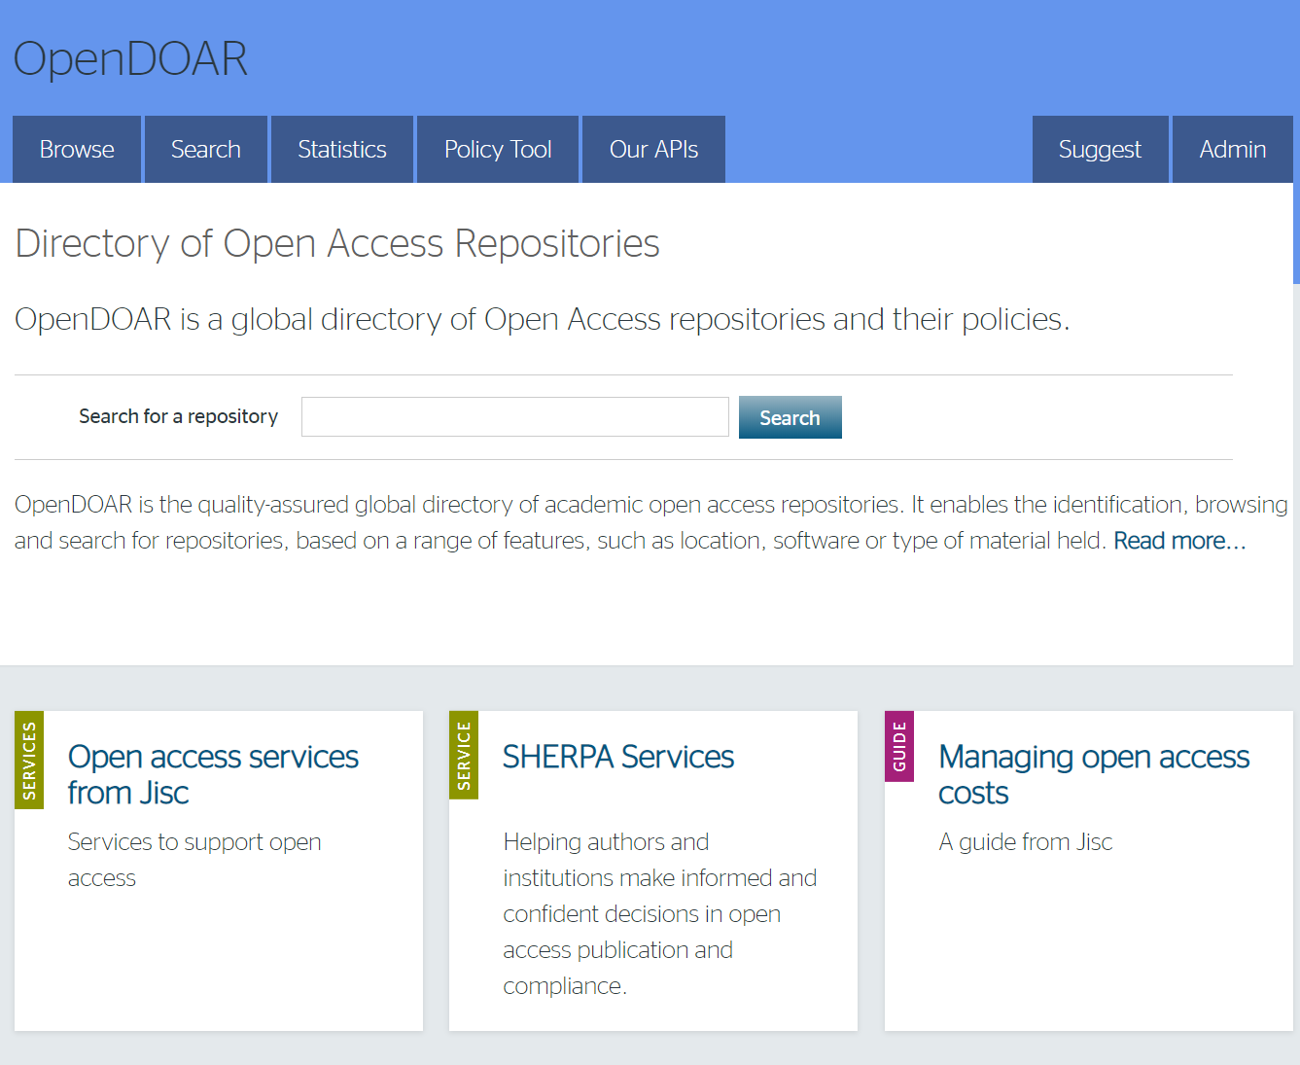
Notes:
OpenDOAR is the quality-assured global directory of academic open access repositories. It enables the identification, browsing and search for repositories, based on a range of features, such as location, software or type of material held.
Tools and support enable both repository administrators and service providers to share best practice and improve the quality of the repository infrastructure.
Criteria for Inclusion & Exclusion
OpenDOAR has opted to collect and provide information solely on sites that wholly embrace the concept of open access to full text resources that are of use to academic researchers. Thus sites where any form of access control prevents immediate access are not included: likewise sites that consist of metadata records only are also declined.
Typically OpenDOAR lists publication repositories, as this is the basis for most repositories. However, OpenDOAR also lists other types, for example of images or data-sets, particularly where these have metadata or documentation sufficient to make the material re-usable.

Slide 30

https://fairsharing.org/
Notes:
Can use to find resources in your area of interest. Can also help with data management planning.
Researchers can use FAIRsharing as a lookup resource to identify and cite the standards, databases or repositories that exist for their data and discipline, for example, when creating a data management plan for a grant proposal or funded project; or when submitting a manuscript to a journal, to identify the recommended databases and repositories, as well as the standards they implement to ensure all relevant information about the data is collected at the source.

Slide 31

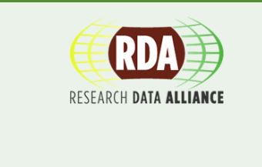
Notes:
2 international groups working on creating standards and aids around data sharing and management.
RDA- 7700 members from 137 countries, RDA provides a neutral space where its members can come together to develop and adopt infrastructure that promotes data-sharing and data-driven research.
CODATA- committee of the international council for science. CODATA exists to promote global collaboration to advance Open Science and to improve the availability and usability of data for all areas of research. CODATA supports the principle that data produced by research and susceptible to be used for research should be as open as possible and as closed as necessary. CODATA works also to advance the interoperability and the usability of such data: research data should be FAIR (Findable, Accessible, Interoperable and Reusable).

Slide 32
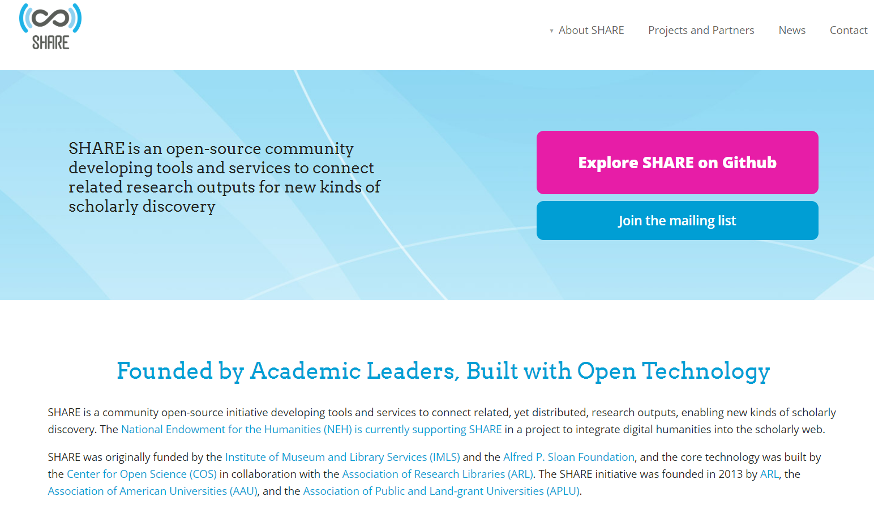
http://www.share-research.org/

Slide 33
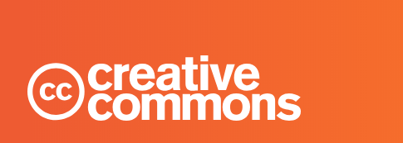
Creative commons licenses
Free copyright licenses to help you give your permission to share and use your creative work with conditions of your choice.
Has a tool to help you chose a license: https://creativecommons.org/share-your-work/
Use CC0 for open data if possible
https://creativecommons.org/
Notes:
Why use an open license?
Facilitate data sharing and discovery
Increase visibility of your data
Advance knowledge

Slide 34





The Creative Commons license options:
CC-BY: Requires re-users to credit your original work
CC-SA: “ShareAlike,” users can copy, distribute, display, modify, etc., as long as they distribute the modified work under the same terms as yours
CC-NC: “NonCommercial,” users can copy, distribute, display, modify, etc., but not for commercial purposes
CC-ND: “NoDerivaties,” users can copy, distribute, display, etc. your original work, but cannot modify it without your permission
Resource: creativecommons.org.au/content/licensing-flowchart.pdf
Notes:
Creative Commons is a US-based non-profit organization which has been a leader in developing legal tools for sharing creative works over the internet since the 2000s.
Creative Commons (CC) licenses are popular on the internet because they provide robust legal code combined with a human-readable summary that is understandable at a glance, and also a machine-to-machine layer of code that will help make information resources interoperable across systems.
In the suite of 4.0 licenses released in 2013, CC has worked with legal experts in a wide range of countries to produce a set of licences that work well for both research data and expressive works because they
conform to both copyright law and database rights where applicable
do not need to be ported for use in particular countries, as they are applicable in all jurisdictions
You can select an appropriate license and generate text for your web page or document by using this online tool: http://creativecommons.org/choose/
Several open data advocacy groups, including DataCite, recommend CC0 (CC Zero) for datasets to allow maximum freedom to end-users who may be combining and 'mashing up' several sources. However, for academic data creators, whose careers depend on their publication record, CC-BY may be more palatable - in which the user is expected to provide a citation to the original source.
CC-BY is used most frequently by authors assigning their own licenses, since an attribution/citation is generally desired when someone references your work. CC-BY can be combined with any of the other licenses you see here, as well. You can also assign CC0, which is a way to release copyright in all jurisdictions on a work that, for example, is only currently in the public domain in one jurisdiction. Works can also be set to Public Doman for anything you wish to make completely public, and to the copyright symbol ( a c inside a circle), if you would like all rights reserved to yourself.
Even knowing these definitions, it still can be hard to select the proper license. Assigning a Creative Commons license is all about letting the user know what they can and can’t do with your resource. The PDF link above will take you to a handy flowchart from Creative Commons Australia, walking you through the steps for selecting the proper license.
For additional advice on licenses, contact Northwestern’s copyright Librarian, Liz Hamilton, at emhamilton@northwestern.edu

Slide 35
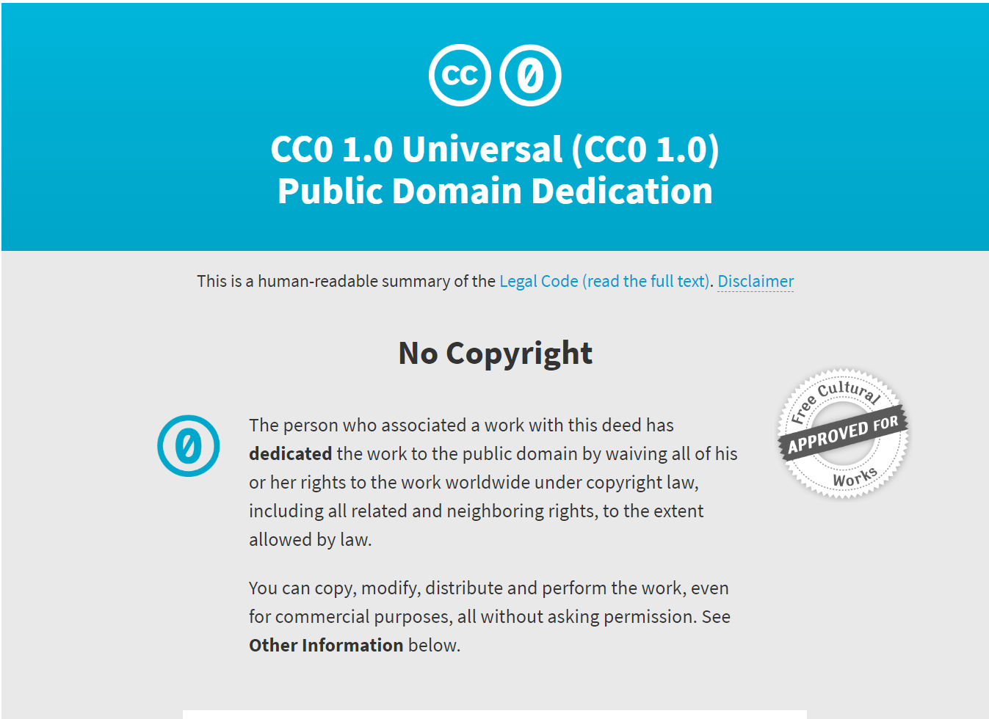
Notes:
Recommended for data sets. Can also use CC-BY.

Slide 36
Creative Commons: Benefits and Caveats
Applies throughout the world
Helps to speed the dissemination and re-use of your work
Enhances the social aspect of publishing by sharing and encouraging others to share alike
Remember to check with all authors of a resource to ensure that you agree on the license assigned
CC licenses are not revocable once granted
Works can be assigned CC dual- or multi-licenses, but again, check with all authors if multiple licenses are to be assigned.
Notes:
With Open Access, it is then up to you to assign licenses to any services that you allow to distribute your article or dataset.

Slide 37
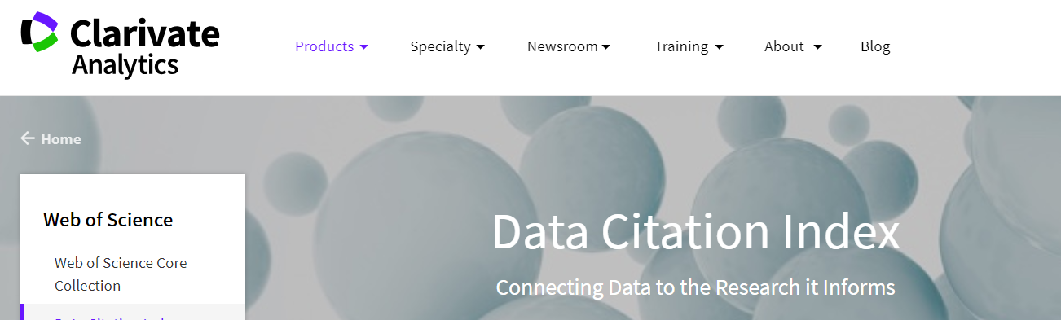
Notes:
Can locate data sets through the data citation index of web of science

Slide 38
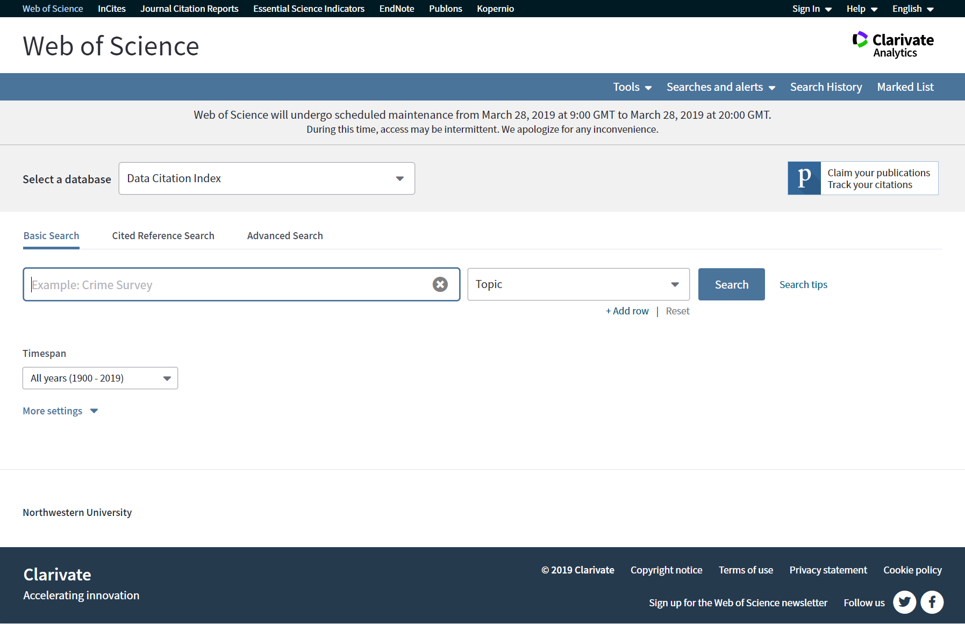

Slide 39
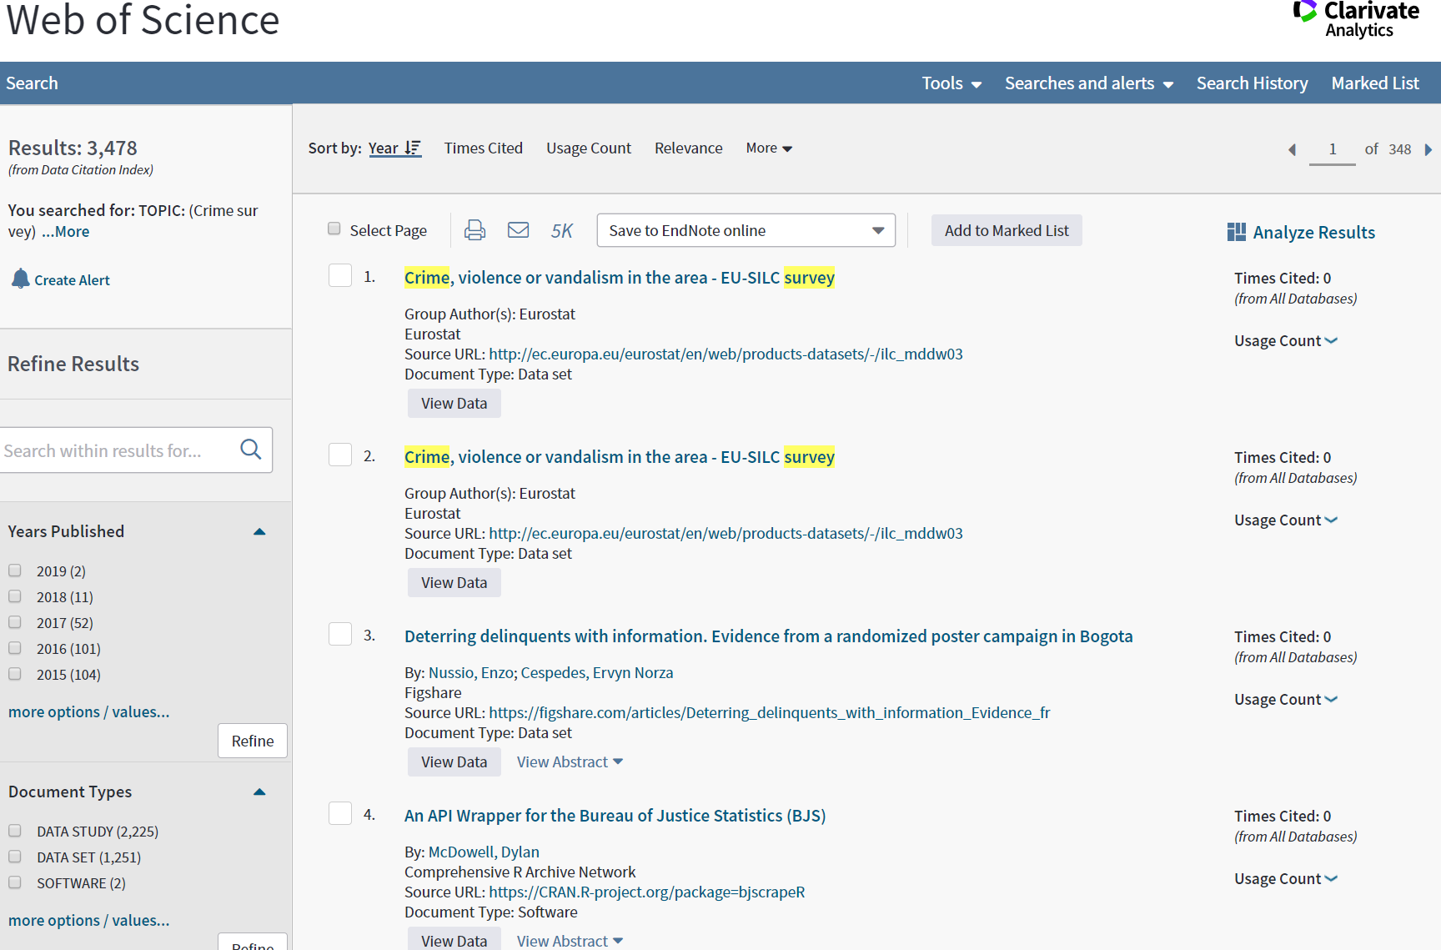

Slide 40
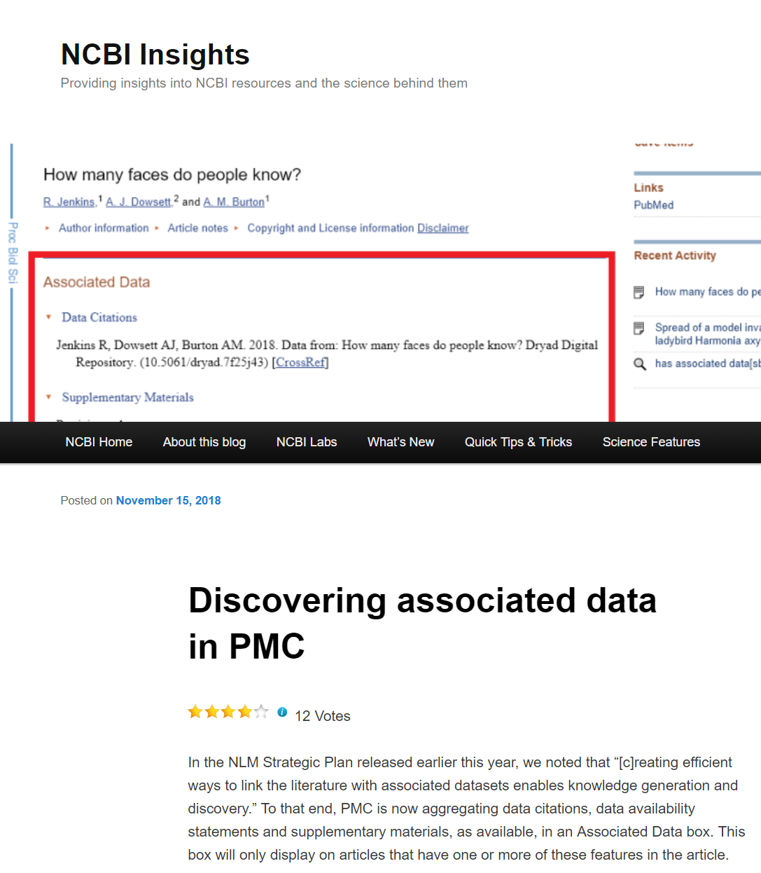
Notes:
PubMedCentral- now will also display associated data, supplemental materials, where applicable.

Slide 41
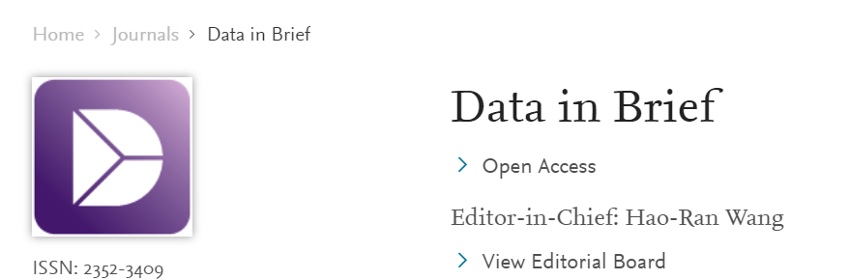


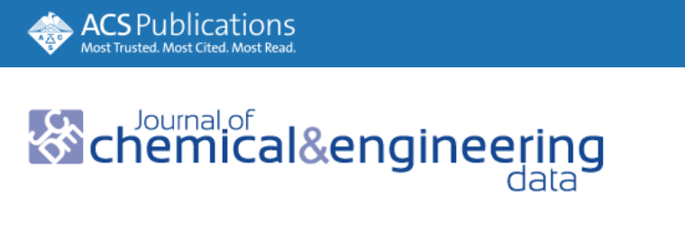
Data Journals
Primarily publishes Data Descriptors
Detailed descriptions of research datasets, including the methods used to collect the data and technical analyses supporting the quality of the measurements.
Focus on helping others reuse data
Helps with reproducibility
Make your data, which is often buried in supplementary material, easier to find.
Increase citations.
Potential for new collaborations.
Notes:
Another way to find/ share data.

Slide 42
Preparing Data to be Shared

Slide 43

Data Sharing: Consents and IRB
Q: Should I leave my project open with IRB if I share data?
A: No, but follow the caveats below for de-identified vs. identifiable data!
Scenario 1: Data is de-identified
Close project with IRB. Free to share data at will.
Scenario 2: Data is identifiable
Project can be closed with IRB. However sharing this identifiable data will require a Data Use Agreement/Data Transfer Agreement (DUA or DTA)
DUA is processed by NU’s Office for Sponsored Research and requires IRB approval.
Random sharing will not be permitted! The requesting project must have a logical connection to the original project to receive approval to share.
The original consent forms must have clarified that data might be shared.
Contact NU IRB with questions at: irb@northwestern.edu
Notes:
If you have older data from previous projects that you are thinking of sharing, if it is identifiable, then re-consenting would be required (sending out new consent forms to the participants, asking them to consent to the data sharing). This is often impractical. If the data can be successfully de-identified, it is share-able. But keep in mind that effective de-identification can be a challenging process. Contact your local office of IT security for guidance.

Slide 44



Tools to clean and organize data before upload to a repository
OpenRefine: openrefine.org
Clean and normalize the data in spreadsheets
Create a new file with cleaned data without altering the original
Free, open source. Runs on a browser but data is not online
R: r-project.org
Useful for statistical computing and visualizations
Learning curve
Python: python.org
Learning curve
Math and plotting libraries
Notes:
Preparing different types of data for cataloging or upload will be a different process for all the different types of data that exist. For general recommendations on file types that are best for long-term archiving, see Maynooth University’s “Preparing your data for archiving” at: https://www.maynoothuniversity.ie/iqda/deposit-data/preparing-your-data-depositing
If you need to organize spreadsheet or statistical data for the purpose of data cataloging, the tools listed here can be helpful.
Galter DataLab (https://galter.northwestern.edu/about/datalab) will soon offer classes and trainings in all three tools.

Slide 45
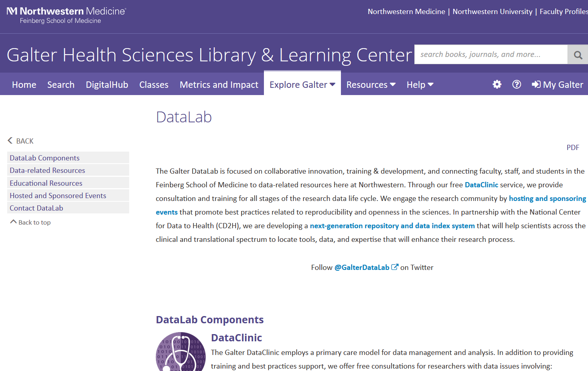
Help for prepping data for upload to a repository (galter.northwestern.edu/about-us/datalab)
Notes:
For assistance with managing or packaging large files, or more sophisticated data cleaning, see Galter Library’s Datalab page at: https://galter.northwestern.edu/about-us/datalab

Slide 46
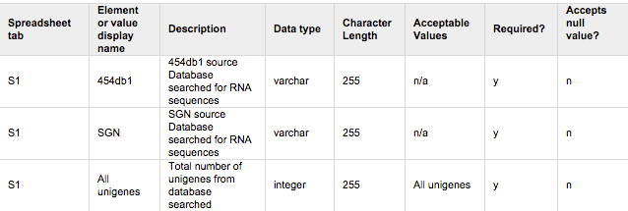
Help Others Interpret your Data
Data Dictionaries:
OSF’s “How to Make a Data Dictionary”: help.osf.io/m/bestpractices/l/618767-how-to-make-a-data-dictionary
DataONE’s “Create a data dictionary”: dataone.org/best-practices/create-data-dictionary
USGS Data Management, Data Dictionaries (Making a Data Dictionary for tools and templates): usgs.gov/products/data-and-tools/data-management/data-dictionaries
README files:
Georgia Tech Library’s README Template: d7.library.gatech.edu/research-data/readme
Cornell University Research Data Management Service Group’s “Guide to writing ‘readme’ style metadata”: data.research.cornell.edu/content/readme
Harvard Biomedical Data Management’s “ReadMe Files”: datamanagement.hms.harvard.edu/readme-files
Image: ata.nal.usda.gov/data-dictionary-examples
Notes:
The purpose of a data dictionary is to list and define all the variables in your study. At the most basic level a dictionary should include the variable name in its most commonly used form. Next should be a human-readable version of the name, if the common form is not human readable. Define what the variable means, the units of measurement, and the allowed values (if a controlled list) or type of values. The dictionary can take any format you like, although it should be human readable.
README files: Goes one step further than a data dictionary to accompany data deposits, in that it explains how all the data files of the deposit relate to each other, all definitions and abbreviations related to the study, apart from variable names, software specifications, methodology, any uncertainty or nuances in the measurements, and names of related resources, be they other data, articles, or software. This file fills in the gaps of knowledge that would keep someone who was not on the original team from understanding the dataset. Tips for writing a good README file can be found at the following links.

Slide 47


Dataset Metadata
How to add robust metadata to make your resource Interoperable:
Author Disambiguation with ORCiD: orcid.it.northwestern.edu
Subject/Keywords: Controlled vocabularies
MeSH Browser: meshb.nlm.nih.gov/search
Library of Congress Subject Headings Search: id.loc.gov/authorities/subjects.html
Look up the keyword browse feature in your repository of choice
ISO 639-2 and 639-1 language codes: loc.gov/standards/iso639-2/php/code_list.php
Licenses
Notes:
Interoperable metadata is all about tapping into the metadata standards that already exist and using them to describe your study and data so that it is more useable both by you, your team, and anyone who finds it in a data repository in the future. Title and description will always vary, but things like your name as Creator/PI, keywords or subjects, places, and languages are often expressed in controlled ways.
Librarians or repository managers can often help you to prepare your metadata whenever creating a record, but is may help to know about these resources if you prefer to create your own records.
LCSH subject headings can be helpful for subject keywords, People’s names (from the Name Authority file), and Geographic location. If your repository follows a convention for names or Geo Locations, just make sure for format yours the same way.
Licenses are usually expressed in a controlled way as well. Check with your repository.

Slide 48
Open Access and Open Data Repositories

Slide 49
Options for Data Archiving
Funder repositories (very few)
Publisher
Elsevier- Mendeley data https://data.mendeley.com/
ACS- partnered with Figshare https://acs.figshare.com/
IEEE DataPort https://ieee-dataport.org/about-ieee-dataport
Springer-Nature https://www.springernature.com/gp/authors/research-data-policy
Disciplinary repositories (e.g.Genbank, World Protein Bank etc.)
Registry of Research Data Repositories http://www.re3data.org/
General repositories
Figshare
Harvard Dataverse
Dryad
Institutional repositories

Slide 50
Publishing Data to Repositories
Re3data.org:
Browse by subject
At a glance: whether the data is licensed, whether it is open or closed access
Easy to find resources for APIs, metadata standards, and any data access restrictions
Connects researchers to data repositories that follow the FAIR standards
FAIRsharing.org: Provides a database search for open data repositories
Sort by domain
At a glance: associated data standards and policies, countries and organizations, and whether the database is Ready, In Development or Deprecated
Notes:
We’ve mentioned the fact that both funders and publishers may require you to post data upon which a publication is based to a repository. One of the first questions you may have is “how do I find a vetted and respected repository in which to deposit my data?”
Here are two key places you can search: re3data.org and FAIRsharing.org.
Re3data is partially sponsored by DataCite, a non-profit organization that mints DOIs and works to maintain a dataset metadata standard. FAIRsharing.org, based at the University of Oxford e-Research Centre, curates Open Data repositories, policies, and standards.

Slide 51
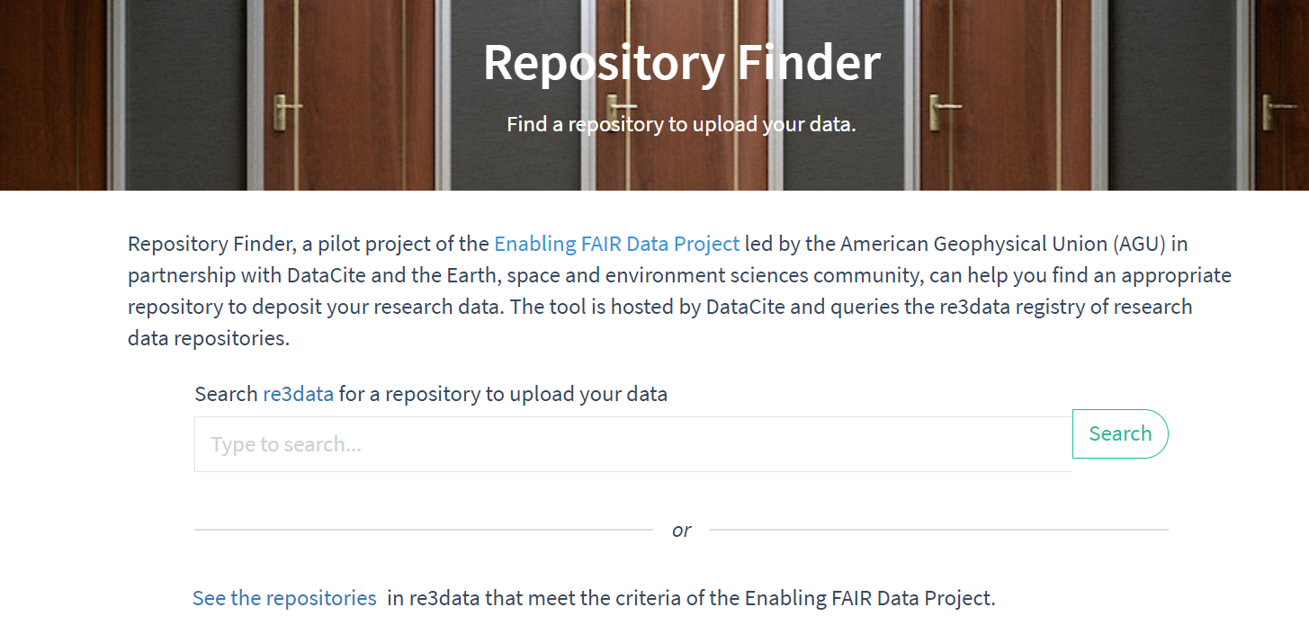
Notes:
Repository Finder (https://repositoryfinder.datacite.org/ )
Built on top of the Re3data registry
Pilot project of the space and environment sciences community
Allows you to easily find a repository to deposit data and to find FAIR repositories.

Slide 52

Open Access and Open Data Repositories
Generalist databases:
Dryad (datadryad.org)
Figshare (figshare.com)
Harvard Dataverse (dataverse.Harvard.edu)
Open Science Framework (osf.io)
Zenodo (zenodo.org)
Notes:
Dryad, Figshare, Dataverse, Open Science Framework and Zenodo all also accept data uploads, which is helpful in the event that your funder has a data sharing requirement. The features of these systems all differ slightly, so examine them all (or ask for a librarian’s help!) if you’d like to hone in on which one is the best for you.
Dryad, Figshare, Dataverse and Zenodo all mint DOI’s for their deposits (and OSF mints them for public projects).

Slide 53
Open Access and Open Data Repositories
Northwestern-based repositories:
Arch: arch.library.northwestern.edu
DigitalHub: digitalhub.northwestern.edu
Features:
Institutionally supported, free to use by all NU faculty, students or staff
Meets funders’ requirements for openly archiving both articles and data
Metadata: create your own or request librarian support
Proxy upload supported
All works receive a Digital Object Identifier (DOI) for citation and persistent linking.
Copyright is retained by the author. The author grants Northwestern University a non-exclusive license to preserve and provide online access to the content
Visibility options include Public Access, Northwestern University (end-users need to login with NetID), or Embargo (i.e. set a future release date)
Deposited content becomes part of the library’s digital preservation program

Slide 54
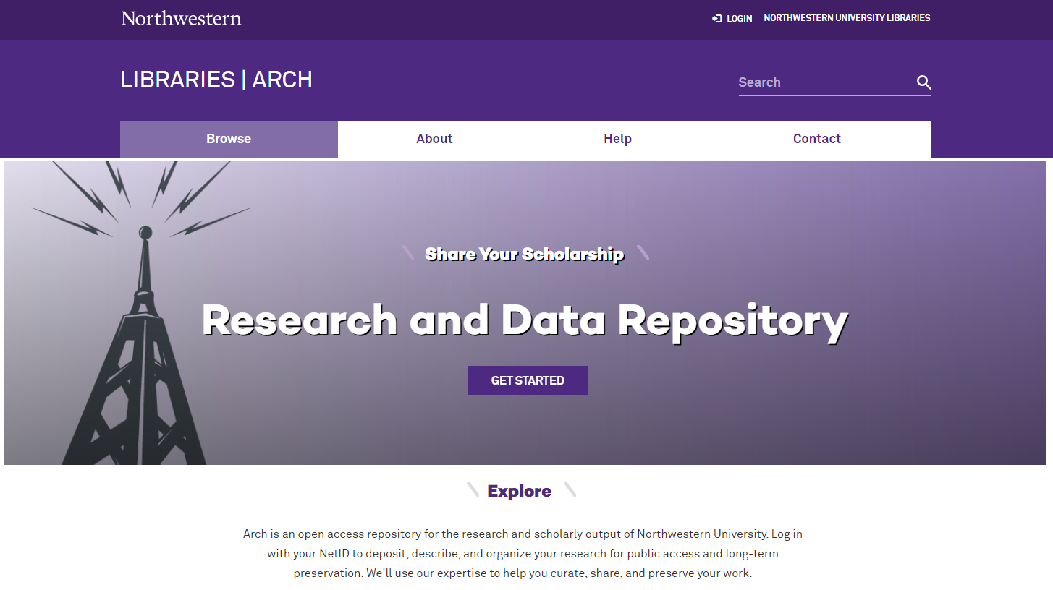
Arch
All Northwestern University
Research papers
Technical reports
Documentation
Presentations
Case studies
Datasets
Posters
Managed by the Main Library
digitalscholarship@northwestern.edu
arch.library.northwestern.edu

Slide 55
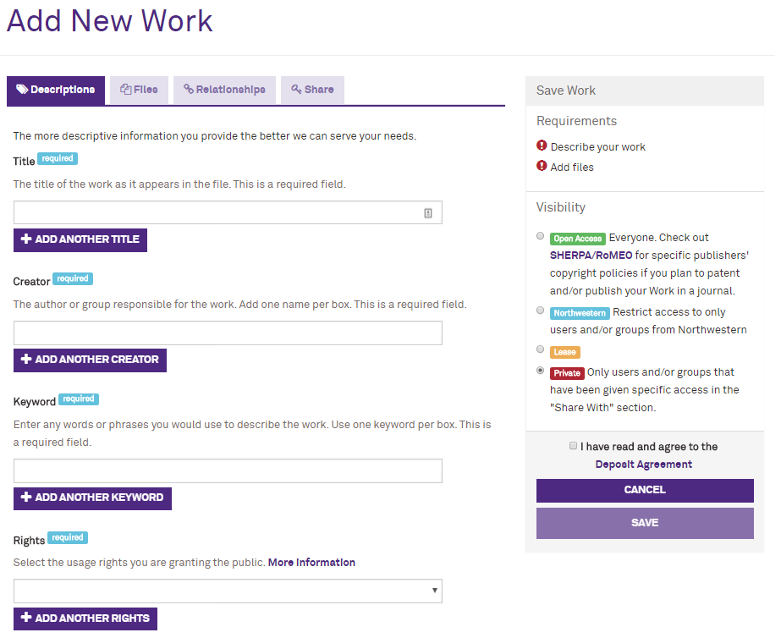
Self-deposit Process
Go to arch.library.northwestern.edu
Log in with your NetID
Describe your work
Upload files
Select visibility setting
Agree to Deposit Agreement
Save to the repository

Slide 56
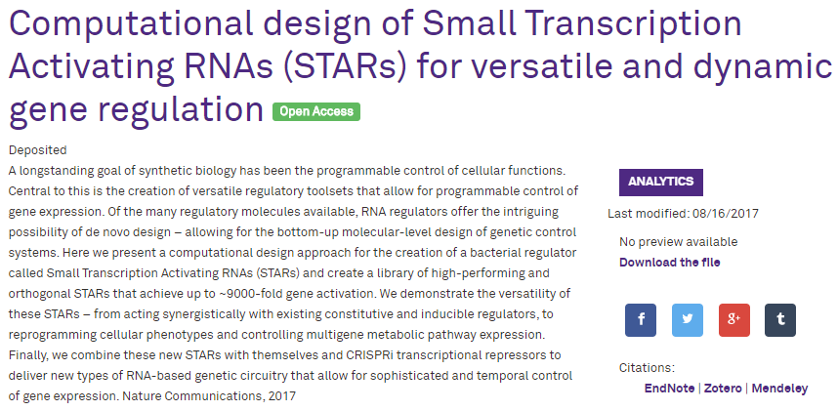
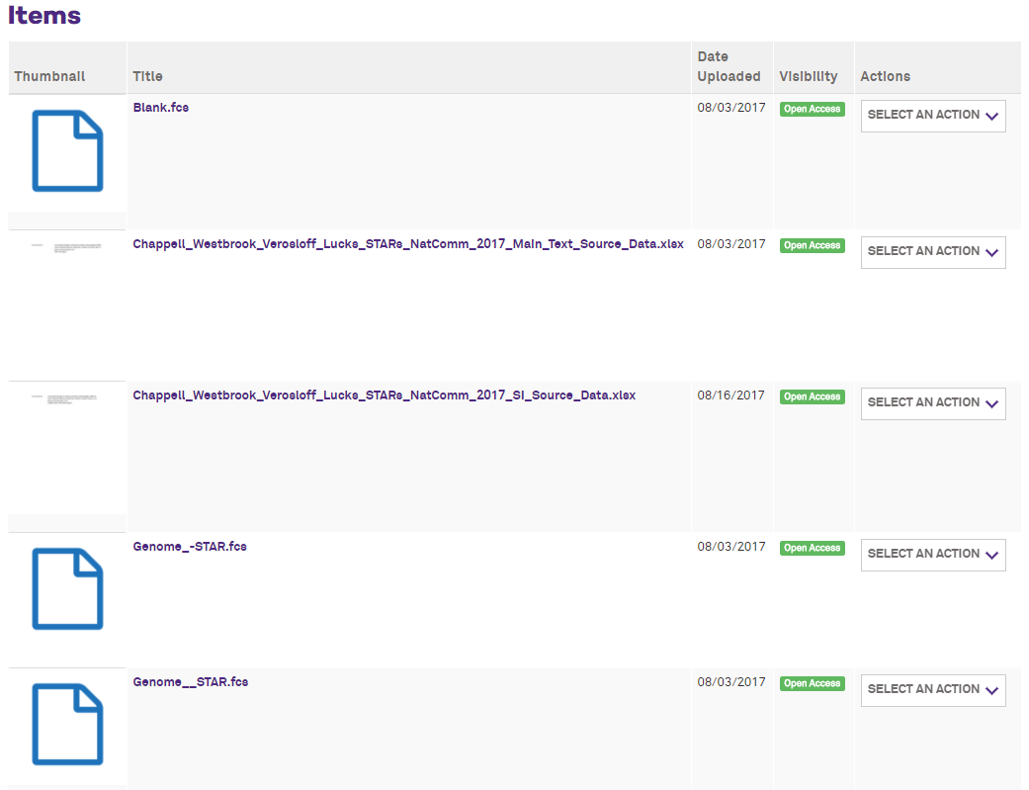
Example: Dataset
Faculty member in Chemical and Biological Engineering wants to provide access to the underlying data in support of his publication:
Digital Object Identifier (DOI)
Cited in journal article
Publicly available
Contact Chris Diaz for assistance with any deposit: chris-diaz@northwestern.edu

Slide 57
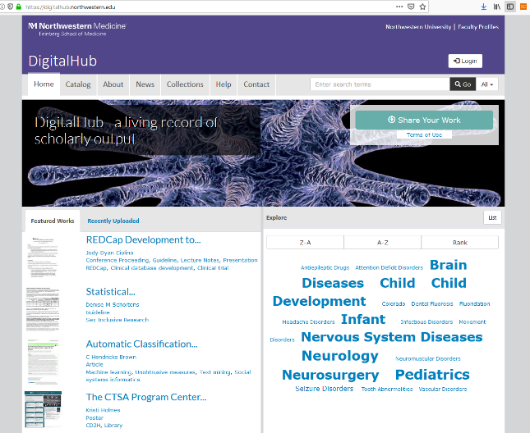
Login with your netID
Discover local collaborators
Share your department’s output with a Collection
Get a DOI with each upload for citations

Slide 58


New repository being developed at Galter Health Sciences Library & Learning Center
GHSL is involved in a new initiative to create a next-generation data catalog and repository to assist researchers in sharing and re-using data and identifying potential collaborators on interdisciplinary projects.
An improvement on FSM’s existing repository, DigitalHub, the data catalog will make records about datasets findable, accessible, interoperable, and re-useable by minting DOI’s for each deposit, encouraging the use of robust metadata to describe records, and providing the latest in use and re-use analytics.
The project is being funded through the National Institutes of Health’s Clinical and Translational Science Award (CTSA) Program to create the CTSA Program National Center for Data to Health (CD2H) Grant # U24TR002306.

Slide 59
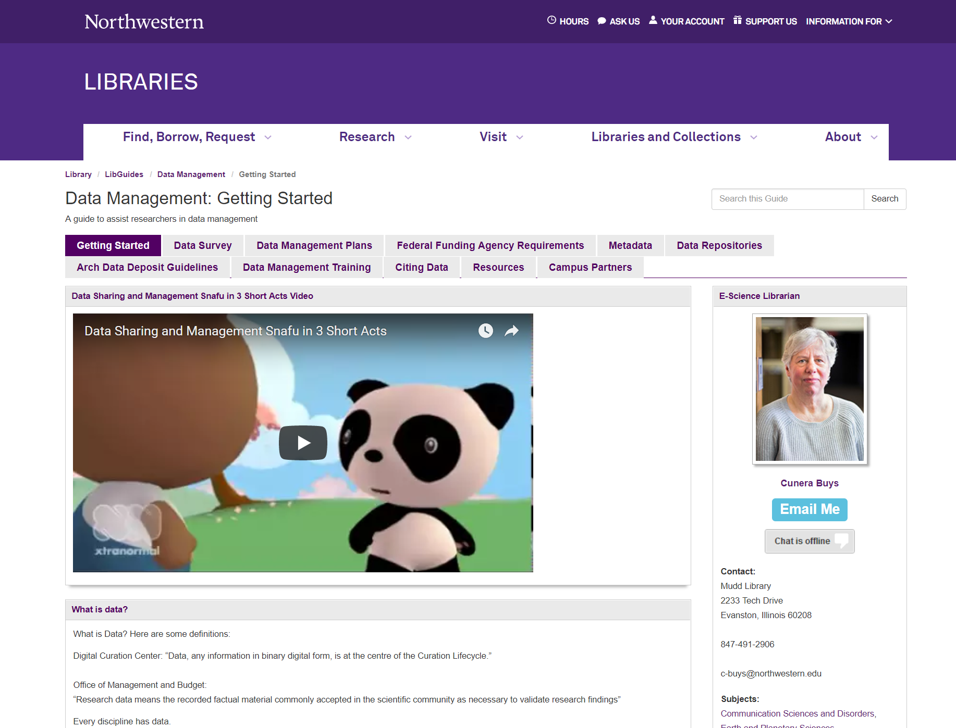
Help Guide
Resources for…
Data Management Plans
Funding Agency Policies
Data repositories
Data Citation
Metadata
Contact Cunera Buys for assistance: c-buys@northwestern.edu
libguides.northwestern.edu/datamanagement

Slide 60
Northwestern University: Resources
Arch (Northwestern institutional repository): arch.library.northwestern.edu
DigitalHub (FSM institutional repository): digitalhub.northwestern.edu
Northwestern University Library Data Management LibGuide: http://libguides.northwestern.edu/datamanagement
Northwestern Research Data: Ownership, Retention and Access Policy: www.research.northwestern.edu/policies/documents/research_data.pdf
Data Librarian, Sara Gonzales, sara.gonzales2@northwestern.edu
Data management Librarian, Cunera Buys: c-buys@northwestern.edu
Copyright Librarian, Liz Hamilton: emhamilton@northwestern.edu

Slide 61
Data Sharing for Open Access: Resources
PLOS One, Data Availability: journals.plos.org/plosone
SpringerNature’s Research Data Policy Templates: springernature.com/gp/authors/research-data-policy/data-policy-types/12327096
Data Management Plan tool: dmptool.org
Registry of Research Data Repositories: re3data.org
FAIRsharing: FAIRsharing.org/policies
Creative Commons: creativecommons.org/
Open Data Handbook: http://opendatahandbook.org/guide/en/

Slide 62
Metadata and Data Cleaning Resources
OpenRefine: openrefine.org
R: r-project.org
Python: python.org
OSF’s “How to Make a Data Dictionary”: help.osf.io/m/bestpractices/l/618767-how-to-make-a-data-dictionary
DataONE’s “Create a data dictionary”: dataone.org/best-practices/create-data-dictionary
USGS Data Management, Data Dictionaries (Making a Data Dictionary for tools and templates): usgs.gov/products/data-and-tools/data-management/data-dictionaries
Georgia Tech Library’s README Template: d7.library.gatech.edu/research-data/readme
Cornell University Research Data Management Service Group’s “Guide to writing ‘readme’ style metadata”: data.research.cornell.edu/content/readme
Harvard Biomedical Data Management’s “ReadMe Files”: datamanagement.hms.harvard.edu/readme-files
ORCiD: orcid.it.northwestern.edu
MeSH Browser: meshb.nlm.nih.gov/search
Library of Congress Subject Headings Search: id.loc.gov/authorities/subjects.html

Slide 63
Thank You

Slide 64
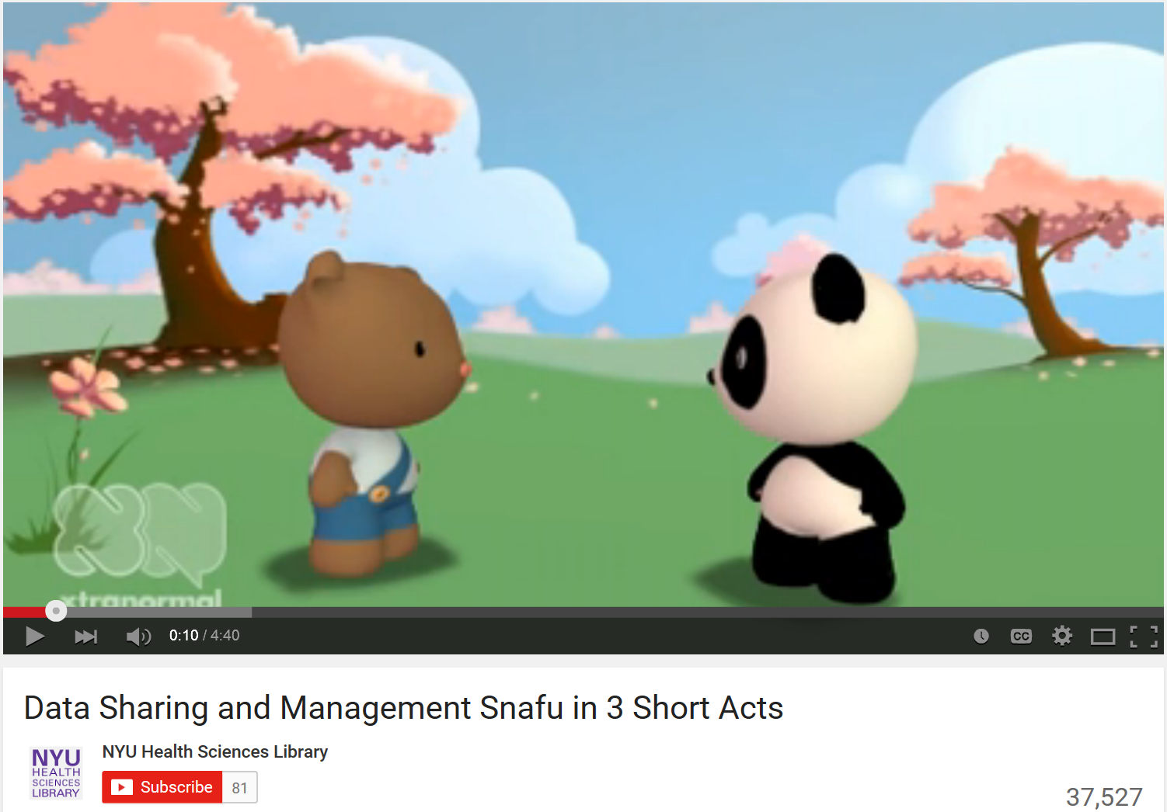
Data Snafu
Data Sharing and Management Snafu in 3 Short Acts
https://www.youtube.com/watch?v=N2zK3sAtr-4

