Slide 1
Impactful Partnerships: Working with Faculty to Enhance Visibility and Dissemination of Research
Karen Gutzman
Impact and Evaluation Librarian
Northwestern University, Feinberg School of Medicine
South Central Region, NNLM
Wednesday, August 9, 2017, 10:00 am – 11:00 am CT
Slides available at:
Presentation originally given for the American Library Association 2017 Annual Conference, Sunday, June 25, 2017, 8:30 am - 10:00 am. Panel discussion on Impactful Partnerships: Navigating the Evolving Scholarly Communication Landscape with Faculty. Slides available at: doi:10.18131/G3M91W
Notes:
Description: Faculty are under pressure to "publish or perish" and they may need support to enhance the visibility and dissemination of their research. This presentation will discuss library services to assist faculty, provide examples of good visibility and dissemination practices, and review traditional and alternative metrics for evaluating research outputs. Attendees will gain insight that will inform and reinvigorate their partnerships with faculty.
Speaker Bio: Karen Gutzman is the Impact and Evaluation Librarian at Galter Health Sciences Library at Northwestern University. Karen works within the library's Metrics and Impact Core<https://galter.northwestern.edu/request-services-and-materials/metrics-and-impact-core-mic> to support individuals and groups in their understanding, assessment, visualization, and reporting of impactful outcomes of research and clinical care efforts.
This webinar will be eligible for one hour of Medical Library Association (MLA) Continuing Education credit and will be archived for future viewing.
For more information about this webinar, please visit https://nnlm.gov/scr/professional-development/connections.

Slide 2
Overview
Today’s presentation will cover:
  Overview of Metrics and Impact Core Services
  Review of “Enhancing the Impact of Your Research” class
  Review of “Research Impact Assessment” consultation
Learning Outcomes
  Gain a better understanding of how libraries can provide assistance to faculty with visibility and dissemination of their research
  Gather inspiration and ideas for working with faculty on visibility and dissemination

Slide 3




Feinberg School of Medicine
facts and figures
Received $443.1M in research awards in 2016 (up 72% from 2012)
Team Scientists
Research Faculty
Received $76.1M in clinical trials funding in 2016
2,059
Full-time faculty
30 + Core Research facilities
Clinician-Educators
4,000 medical school faculty overall,
including Health System Clinicians
Notes:
Phrases such as "core," "shared facility" and "shared instrumentation" do not have precise definitions. At Northwestern, any investigator has the option to share instruments or services in a formal or informal manner, with or without charge. However, there are specific requirements related to funding and rates.
http://www.feinberg.northwestern.edu/research/cores/about/definition.html
Promotion and Tenure Guideline at Northwestern Feinberg School of Medicine. The Information Guide for Appointments, Promotion and Tenure provides an overview of faculty appointments and outlines the criteria for appointment and promotion in each career track. It is intended to provide transparency and assist faculty members with planning for and successfully achieving promotion and/or tenure. The guide was first issued in 2011 in response to faculty feedback desiring greater transparency in the promotion and tenure process.
http://www.feinberg.northwestern.edu/fao/faculty/promo-tenure/index.html

Slide 4
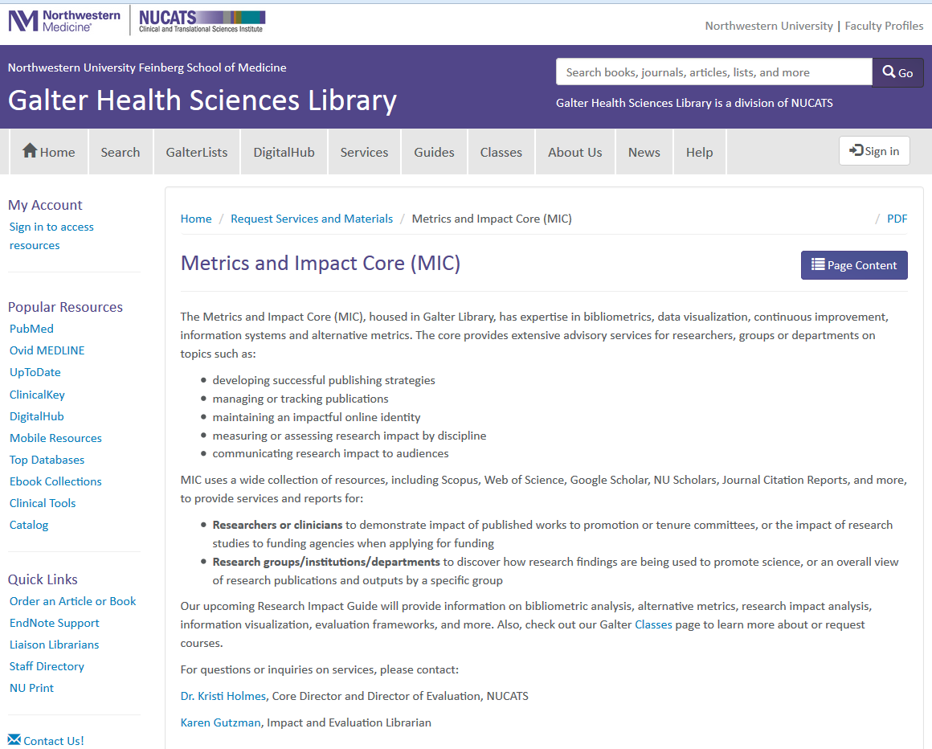
Metrics and Impact Core
resources and services for our faculty, staff, and students
The core provides extensive advisory services for researchers, groups or departments on topics such as:
  developing successful publishing strategies
  managing or tracking publications
  maintaining an impactful online identity
  measuring or assessing research impact by discipline
  communicating research impact to audiences
(above) Screenshot of Metrics and Impact Core homepage
http://galter.northwestern.edu/Request-Services-and-Materials/metrics-and-impact-core-mic

Slide 5
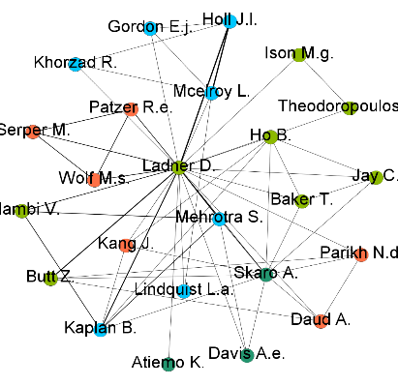
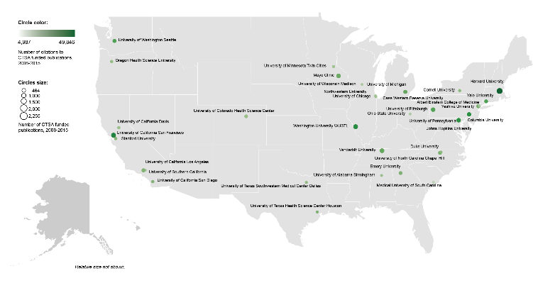
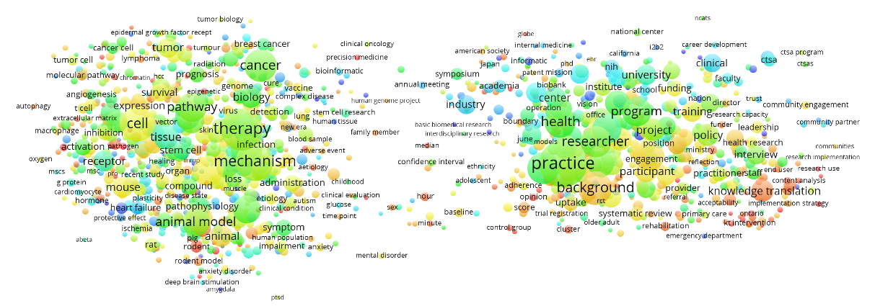

Data Sources and Tools
Bibliographic databases:
  Scopus (Elsevier)
  PubMed (NLM)
  Web of Science (Clarivate Analytics)
  NU Scholars (Elsevier)
  Google Scholar
  Sympletic Elements
Other databases:
  iCite Tool
  NIH RePORTER
  Essential Science Indicators (Clarivate Analytics)
  InCites (Clarivate Analytics)
Visualization Tools
  Sci2 Tool
  Gephi
  Pajek
  VOSviewer
  CitNetExplorer
  Tableau
  Microsoft Excel
Gephi
Tableau
VOSviewer

Slide 6
Metrics and Impact Core Services for Individuals
services are tailored for individuals (i.e. not for groups)
Classes on demand:
  Enhancing the Impact of Your Research
  How to Prepare an NIH Biosketch
  The NIH Relative Citation Ratio and iCite Tool
  Upcoming: Dissemination and Outreach Overview
  Upcoming: Journal Selection
  Upcoming: Tenure and Promotion
Consultations
  Research Impact Assessment Consultation
  Review of NIH Biosketch
  Tenure and Promotion Consultation
Standardized Reports
  Individual Publication Summary
  Journal Selection Review

Slide 7
Metrics and Impact Core Services for Individuals
services are tailored for individuals (i.e. not for groups)
Classes on demand:
  Enhancing the Impact of Your Research
  How to Prepare an NIH Biosketch
  The NIH Relative Citation Ratio and iCite Tool
  Upcoming: Dissemination and Outreach Overview
  Upcoming: Journal Selection
  Upcoming: Tenure and Promotion
Consultations
  Research Impact Assessment Consultation
  Review of NIH Biosketch
  Tenure and Promotion Consultation
Standardized Reports
  Individual Publication Summary
  Journal Selection Review

Slide 8

Class: Enhancing the Impact of Your Research
class available on demand with customizable options
  Want to make your research more discoverable? Wonder how to discuss your research impact? Join us for this practical class in learning how to enhance your research impact. The class briefly covers the concept of research impact, including definitions and a discussion on why thinking about research impact is important, and is offered to faculty, students or staff.
(above) screenshot of Enhancing the Impact of Your Research opening slide
  Participants will learn practical strategies on:
      establishing an online presence
      enhancing the discovery of scholarly outputs
      increasing the dissemination of scholarly outputs
      communicating the impact of your research
Notes:
developing successful publishing strategies
managing or tracking publications
maintaining an impactful online identity
measuring or assessing research impact by discipline
communicating research impact to audiences

Slide 9


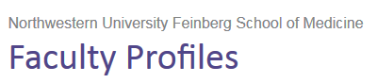


Establishing an Online Identity
putting your best foot forward
Use the same author name and affiliation name consistently
Consider registering for an ORCiD
Consider corporate authorship or using study name in title or abstract
  The Ocular Hypertension Treatment Study Group
  CARDIA study
Keep author profiles up to date
Notes:
We encourage researchers to be proactive in how they are represented online. Also, name consistency enhances retrieval.
ORCiD
http://orcid.org/
Major ORCiD sponsors include:
American Chemical Society
CrossRef *
Elsevier *
IEEE *
Nature Publishing Group *
PLOS *
Sage *
Springer *
Taylor and Francis Group *
Wiley*

Slide 10
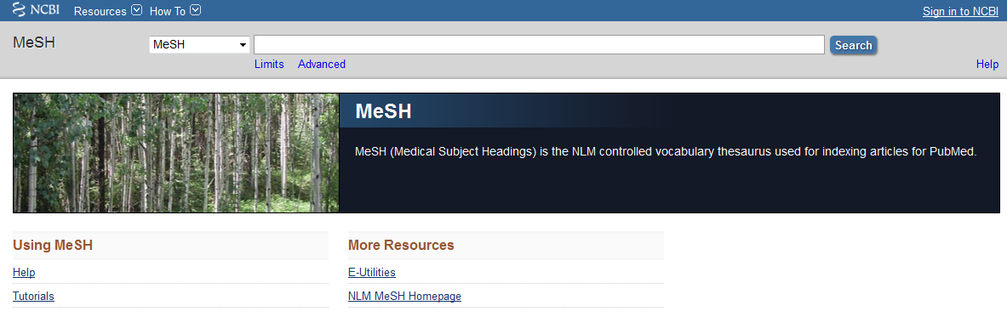
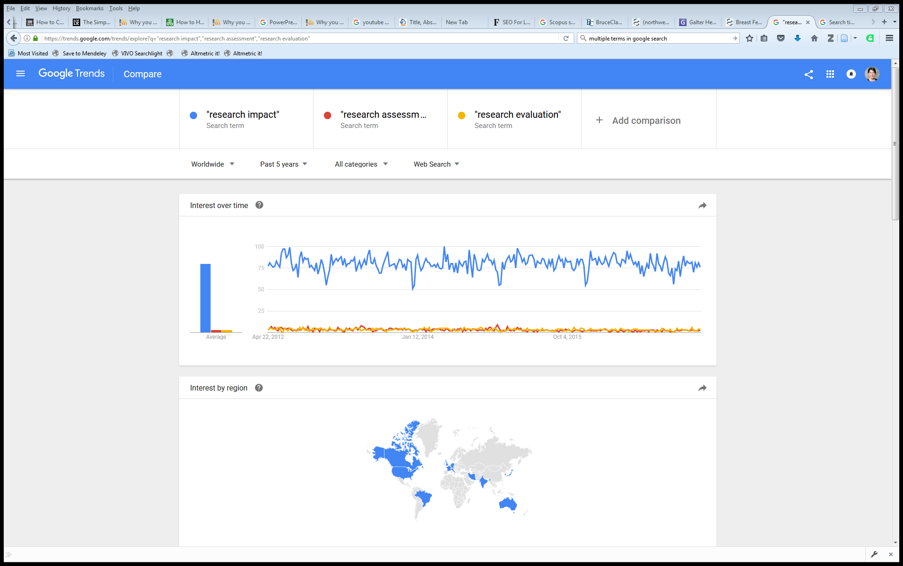
Enhancing Discovery of Your Work
Academic Search Engine Optimization: how to optimize title, abstract, and keywords
  Consider words from “controlled vocabularies” such as PubMed’s Medical Subject Headings (MeSH)
  Check Google Trends “related searches” to learn how people query a topic
Publishing Strategies: consider publishing in journals indexed in literature databases
  PubMed/Medline is crawled by Google and Google Scholar
  Indexing with MeSH increases discoverability.
  (above) Screenshot of MeSH homepage: http://www.ncbi.nlm.nih.gov/mesh/
    (right) Screenshot of Google
    Trends comparison:
    https://trends.google.com/trends/
Notes:
Academic Search Engine Optimization (ASEO): Optimizing Scholarly Literature for Google Scholar and CO.
http://www.sciplore.org/publications/2010-ASEO--preprint.pdf
In Google Scholar, the most important factors are relevance, citation count, author name(s), and name of publication.
Once the keywords are chosen, they need to be mentioned in the right places: in the title, and as often as possible in the abstract and the body of the text (but, of course, not so often as to annoy readers). Although in general titles should be fairly short, we suggest choosing a longer title if there are many relevant keywords.
[ASEO] is about helping academic search engines to understand the content of research papers and, thus, about how to make this content more widely and easily available.
Search Engine Optimization and Your Journal Article: Do you want the bad news first?
So what do you need to do? We’ve created an SEO for Authors tips sheet to give authors an at-a-glance guide to optimizing their papers. Here are some highlights:
Carefully select relevant keywords
Lead with keywords in the article title
Repeat keywords 3-4 times throughout the abstract
Use headings throughout the article
Include at least 5 keywords and synonyms in the keyword field
Link to the published article on social media, blogs and academic websites
from : http://exchanges.wiley.com/blog/2013/07/23/search-engine-optimization-and-your-journal-article-do-you-want-the-bad-news-first/
PubMed Relevance Ranking
The relevance sort order for search results is based on an algorithm that analyzes each PubMed citation that includes the search terms. For each search query, "weight" is calculated for citations depending on how many search terms are found and in which fields they are found. In addition, recently-published articles are given a somewhat higher weight for sorting.
From: https://www.nlm.nih.gov/pubs/techbull/so13/so13_pm_relevance.html

Slide 11


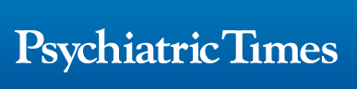

Increasing Dissemination of Your Work
How does dissemination happen?
  Publishing Strategies
    Online journal matching tools
    Journal Impact Factor or Cite Score
    Finding “time to publication” timelines
    Finding editorial boards and refereed status
    Indexing in Literature Databases
    Review journal author guidelines
    Discuss open access avenues
    …and so much more!
  In-person Strategies (participate, present, and share)
    Join professional organizations
    Teach CE courses
    Serve as a reviewer for a journal
    Present at journal clubs
    Work with a large network of colleagues
    Consider interdisciplinary work
  Dissemination Tip: Consider writing about your research in a trade journal or magazine to reach members of profession or industry.
Notes:
Take every opportunity to present your work at meetings, department seminars, journal clubs and events for the general public.

Slide 12
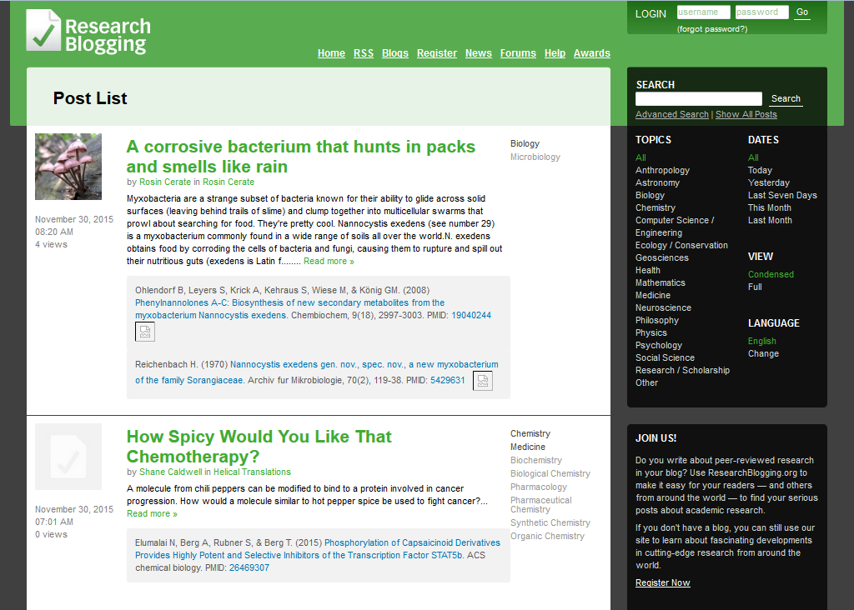
Increasing Dissemination of Your Work
How does dissemination happen?
  Online Strategies
    Start a blog or podcast, or publish videos
    Utilize social media (Twitter, Facebook, YouTube)
    Use list servs to promote your work
    Ask to write guest posts on popular blogs or for national organizations
  Write plain language summaries of research
    Quick tips: https://blog.growkudos.com/2015/12/04/explain-your-work-the-kudos-way/
    PRISM Toolkit and Workshop: https://www.kpwashingtonresearch.org/about-us/capabilities/research-communications/prism
  Content for social media can include topics such as:
    Discussion of research findings
    Questions about your area of research
    Comments on publications by other authors
(above) Screenshot of Research Blogging News page: www.researchblogging.org
Notes:
Take every opportunity to present your work at meetings, department seminars, journal clubs and events for the general public.
Blogging:
Research Blogging:
http://researchblogging.org/static/index/page/about
NU FSM Blogging:
http://www.feinberg.northwestern.edu/communications/brand/social-media/blogs.html
Videos:
Journal of Visualized Experiments:
http://www.jove.com/
Northwestern Feinberg School of Medicine YouTube:
https://www.youtube.com/user/NUFeinbergMed
Northwestern FSM Office of Communications:
http://www.feinberg.northwestern.edu/communications/brand/social-media/you-tube.html
Add your own channel (department, center or institute), sent email to Nicole Mladic with the link to your video.
http://www.feinberg.northwestern.edu/communications/brand/social-media/you-tube.html
Podcasts Steps:
Who can host your Podcast files online?
Blubrry Media
https://create.blubrry.com/resources/podcast-media-hosting/?code=noodle
Hosts podcast files for as little as $12/mo for 100MB of storage
Amazon S3
https://aws.amazon.com/free/
There is a monthly charge for the storage of your files and for when people download your files.
Soundcloud
https://soundcloud.com/
Will host 3 hours of podcasting for free
Who can create a podcast-only RSS feed?
Blubrry Media
https://create.blubrry.com/resources/podcast-media-hosting/?code=noodle
Creates an i-Tunes compliant RSS feed from files you’ve uploaded to your Blubrry account
Soundcloud
https://soundcloud.com/
Will create an RSS feed of podcasts files that you’ve uploaded to your Soundcloud profile
Who can make your podcast-only RSS feed available to wide audiences?
iTunes
http://itunespartner.apple.com/en/podcasts/faq
Does not host podcasts. Instead you must connect iTunes with the RSS feed of your podcast (which is hosted somewhere else).
GooglePlay
https://play.google.com/music/podcasts/publish
Does not host podcasts. Instead you must connect iTunes with the RSS feed of your podcast (which is hosted somewhere else).
Soundcloud
https://soundcloud.com/
Will host 3 hours of podcasting for free
WordPress’s PowerPress Podcasting Plugin
https://wordpress.org/plugins/powerpress/
Publish your podcasts directly on your wordpress blog using the PowerPress plugin. This plugin makes your files being hosted by Blubrry available on your blog.
Podcast Help
iTunes Podcast help:
https://itunespartner.apple.com/en/podcasts/overview
LSE Impact Blog: The Simple Guide to Academic Podcasting
(http://blogs.lse.ac.uk/lsereviewofbooks/2014/04/09/the-simple-guide-to-academic-podcasting/)
Examples of Podcasts
List of Podcasts from Georgia Tech Library
http://libguides.gatech.edu/BME/podcasts
Dr. Whitaker's Instant Anatomy
(http://www.instantanatomy.net/podcasts.html)
Podcasts to help the learning of human anatomy for doctors, medical students, nurses and anyone else who has an interest in human anatomy by Dr Robert Whitaker, Cambridge, UK. The six most recent podcasts are always available for free.
Sound Medicine
(http://podcast.iu.edu/Portal/PodcastPage.aspx?podid=f12936bb-ff68-4a34-970b-7919d9dc163e)
University of Virginia Health & Medicine Podcasts (http://newsroom.uvahealth.com/about/news-room/radiomd-podcasts/radiomd-medical-podcasts-from-uva)
Health and medical discussions
University of Michigan Health & Medicine Podcasts (http://www.med.umich.edu/podcast/)
Updates on basic science and research

Slide 13




Consider Open Access
  Directory of Open Access Journals (DOAJ): http://www.joaj.org/
  Check with your publisher or SHERPA/RoMEO for which version you can submit: http://www.sherpa.ac.uk/romeo/
  Options for sharing include:
    DigitalHub: https://digitalhub.northwestern.edu/
    Slideshare: http://www.slideshare.net
    Figshare: http://www.figshare.com
    Dryad: http://datadryad.org
  For more information, see Galter News Item: http://galter.northwestern.edu/News/sharing-publishing-and-archiving-your-work
  Dissemination Tip: Include a discussion of how your research could translate to clinical outcomes or technologies. This could enhance the probability that the article will affect public policy and thus increase its impact.

Slide 14

Metrics and Impact Core Services for Individuals
services are tailored for individuals (i.e. not for groups)
Classes on demand:
  Enhancing the Impact of Your Research
  How to Prepare an NIH Biosketch
  The NIH Relative Citation Ratio and iCite Tool
  Upcoming: Dissemination and Outreach Overview
  Upcoming: Journal Selection
  Upcoming: Tenure and Promotion
Consultations
  Research Impact Assessment Consultation
  Review of NIH Biosketch
  Tenure and Promotion Consultation
Standardized Reports
  Individual Publication Summary
  Journal Selection Review

Slide 15
Research Impact Assessment Consultation
faculty have different motivations for seeking assistance
Career Motivations
  Tenure Process
  Promotion dossiers
  Identify similar research projects
  Identify possible collaborators
Community of Research Motivations
  Discover how research findings are being used
  Determine if research findings were
  Confirm that research findings were properly attributed/credited
  Demonstrate that research findings are resulting in meaningful health outcomes
  Discover community benefit as a result of research findings
    Duplicated
    Confirmed
    Corrected
    Improved
    Repudiated
    Extended
Funding Motivations
  Quantify and document research impact
  Justify future requests for funding
  Quantify return on research investment
Notes:
Promotion and Tenure Guideline at Northwestern Feinberg School of Medicine. The Information Guide for Appointments, Promotion and Tenure provides an overview of faculty appointments and outlines the criteria for appointment and promotion in each career track. It is intended to provide transparency and assist faculty members with planning for and successfully achieving promotion and/or tenure. The guide was first issued in 2011 in response to faculty feedback desiring greater transparency in the promotion and tenure process.
http://www.feinberg.northwestern.edu/fao/faculty/promo-tenure/index.html

Slide 16
Research Impact Assessment Consultation
faculty have different motivations for seeking assistance
Career Motivations
  Tenure Process
  Promotion dossiers
  Identify similar research projects
  Identify possible collaborators
Community of Research Motivations
  Discover how research findings are being used
  Determine if research findings were
  Confirm that research findings were properly attributed/credited
  Demonstrate that research findings are resulting in meaningful health outcomes
  Discover community benefit as a result of research findings
    Duplicated
    Confirmed
    Corrected
    Improved
    Repudiated
    Extended
Funding Motivations
  Quantify and document research impact
  Justify future requests for funding
  Quantify return on research investment
Today’s Scenario: “I’m early in my career in a narrow research field.
How do I describe my impact?”

Slide 17


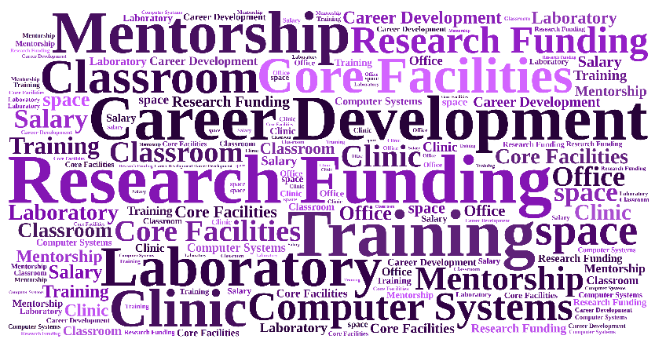
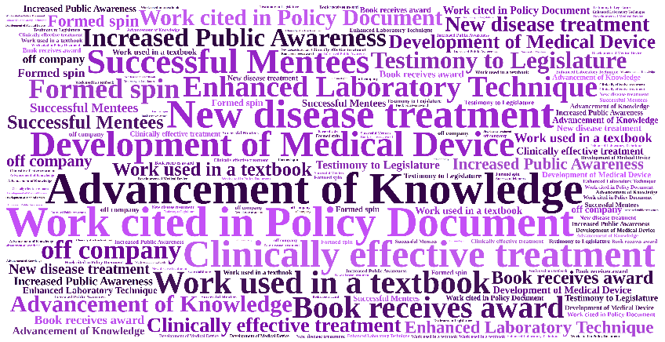
Research Career Lifecycle
also called a “Logic Model” for those versed in evaluation-speak
Career Activities
Career Outputs
Career Support and Resources
Career Outcomes
Use Process Indicators
Use Impact Indicators
Notes:
Shows an example of a traditional “cause and effect” logic model which describes how the available resources (also known as inputs) and program activities will lead to desired outputs and outcomes (both of which can be measured in the short , intermediate, or long term), given a specific environmental context.

Slide 18
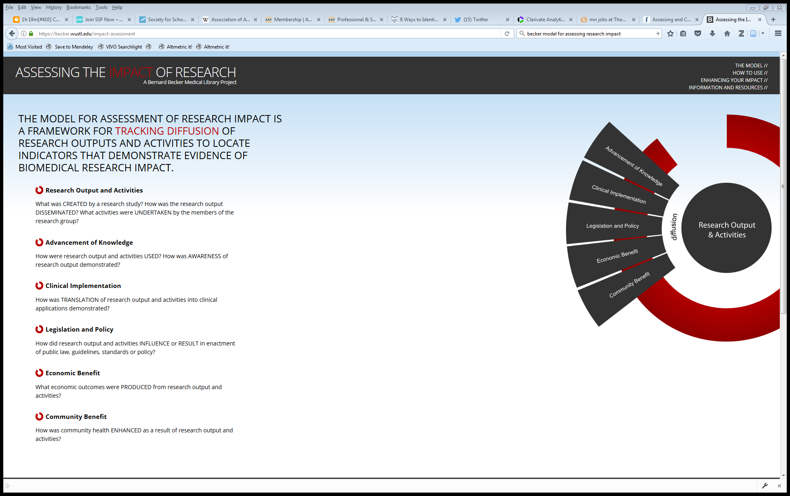
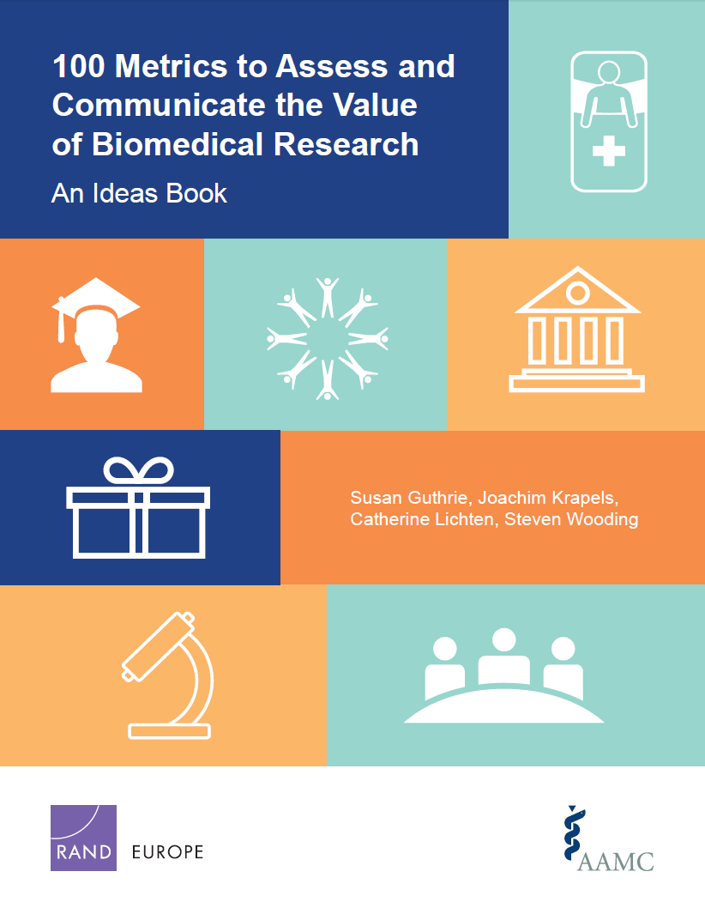
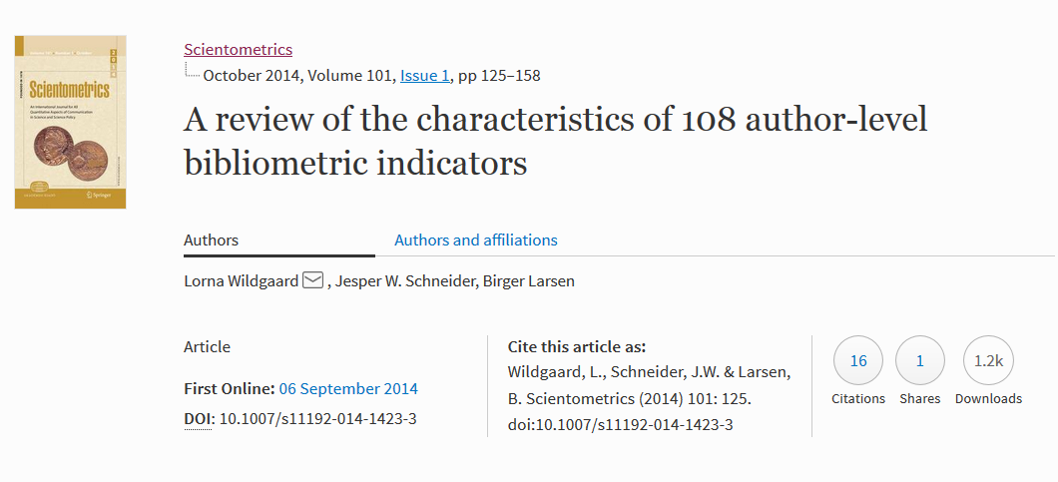
Libraries of Indicators
often called “evaluation frameworks”
(above) Homepage of Becker Model: https://becker.wustl.edu/impact-assessment
(above) Screenshot of 100 Metrics paper by AAMC and RAND Europe: http://www.rand.org/pubs/research_reports/RR1606.html
(left) Screenshot of Wildgaard L, et. al.: https://arxiv.org/abs/1408.5700
Notes:
100 Metrics by AAMC and RAND Europe
Guthrie, Susan, Joachim Krapels, Catherine Lichten and Steven Wooding. 100 Metrics to Assess and Communicate the Value of Biomedical Research: An Ideas Book. Santa Monica, CA: RAND Corporation, 2016. http://www.rand.org/pubs/research_reports/RR1606.html
ACUMEN Project
Wildgaard L, Schneider JW, Larsen B. A review of the characteristics of 108 author-level bibliometric indicators. Scientometrics. 2014 Oct;101(1):125–158. https://arxiv.org/abs/1408.5700
Becker Medical Library Model for Assessment of Research Impact
The Becker Medical Library Model for assessment of research impact – an Interview with Cathy C. Sarli and Kristi L. Holmes [Internet]. Research Trends. [cited 2015 Jun 8]. Available from: http://www.researchtrends.com/issue-34-september-2013/the-becker-medical-library-model/
Elsevier Usage Guidebook
Colledgre L, Elsevier Research Intelligence. Usage Guidebook. https://www.elsevier.com/research-intelligence/resource-library/usage-guidebook
InCites Indicators Handbook
Thomson Reuters (Clarivate Analytics). Insites Indicators Handbook. http://ipscience-help.thomsonreuters.com/inCites2Live/indicatorsGroup/aboutHandbook.html
CDC Science Impact Framework
https://www.cdc.gov/od/science/impact/framework.html
Institute of Medicine: Degrees of Impact
http://www.nationalacademies.org/hmd/~/media/Files/About%20the%20IOM/PresidentsAddress2013.pdf

Slide 19

Libraries of Indicators (continued)
100 Metrics to Assess and Communicate the Value of Biomedical Research
Research Impacts
Number of journal articles published | The number of peer-reviewed journal articles published over a particular timeframe is a quantitative metric of the volume of research produced by an individual or institution.
Number of citations | Measures of citations to published articles are used as a proxy for article quality. Can include Highly Cited Papers, Normalized Citation Score, etc.
Number of research output downloads | The number of times a research output has been downloaded gives an indication of how much it is being of use and the level of interest in it.
Mentions in Social Media | Information on who is citing the institution in social media can help identify where the influence of the medical school or teaching hospital is being felt across the sector, noting that this may be within academia.
http://www.rand.org/pubs/research_reports/RR1606.html

Slide 20


Libraries of Indicators (continued)
Becker Medical Library Model for Assessment of Research Impact
https://becker.wustl.edu/impact-assessment
Advancement of Knowledge
Books or Book Chapters | Book or book chapters generated by the research study is noted in a bibliography. Book is used as a textbook for higher education. Translations of the book. Book or book chapter cited in subsequent publications.
Change in Understanding and Awareness | Research study findings represent a paradigm shift in a field. Research study findings lead to change in understanding a problem.
Citations to Publications | Number of first generation citations. Number of second generation citations. Countries represented by citations. Institutions represented by citations. Languages represented by citations.

Slide 21
Libraries of Indicators (continued)
A review of the characteristics of 108 author-level bibliometric indicators
https://arxiv.org/abs/1408.5700
Indicators of publication count
P (total publications) | Count of production used in formal communications
FA (first author counting) | Credit given to first author only
Co-authors | Indicates cooperation and growth of cooperation at inter- and national level
Noblesse Oblige (last author counting) | Indicates importance of the last author for the project behind the paper

Slide 22
Alternative Metrics Resources
  Konkiel S, Sugimoto C, William S. The Use of Altmetrics in Promotion and Tenure. Retrieved from: http://er.educause.edu/articles/2016/3/the-use-of-altmetrics-in-promotion-and-tenure
What are Altmetrics? Retrieved from: http://www.whatarealtmetrics.com/resources/workshops/
Sarli C., Suiter A, Research Impact LibGuide. Becker Medical Library. Retrieved from http://beckerguides.wustl.edu/impact

Slide 23
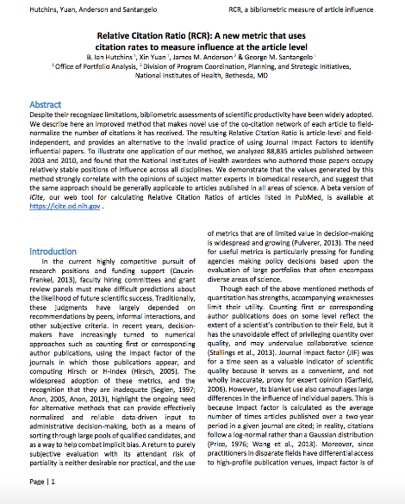

Relative Citation Ratio (using the iCite tool)
iCite: tool dashboard of bibliometrics for papers associated with a portfolio. https://icite.od.nih.gov/
Relative Citation Ratio (RCR): a field-normalized metric that shows the citation impact of one or more articles relative to the average NIH-funded paper.
Users upload the PubMed IDs of articles of interest (from SPIRES or PubMed), optionally grouping them for comparison.
iCite then displays the number of articles, articles per year, citations per year, and RCR. A range of years can be selected, as well as article type, and individual articles can be toggled on and off.
Users can download a report table with the article-level detail for later use or further visualization.
(above) screenshot of Relative Citation Ratio paper at http://biorxiv.org/content/early/2015/10/22/029629

Slide 24
Scenario: Early career researcher describing impact
Today’s Scenario: “I’m early in my career in a narrow research field.
How do I describe my impact?”
A few things to consider
    Early career – may not find many citations, though normalized citation metrics can be helpful
    Narrow field – hopefully easy to identify important researchers, and determine how people are using her work
    Describing impact – does she have any particular metrics she’s been asked to provide? If not, there is a lot to work with
Notes:
“…scholarship that is not only created on the web (e.g., by using Dropbox to store and manage research data or Google Docs to collaboratively author a paper) but also discussed, shared, reviewed, saved, and recommended on the web, moving the informal scholarship conversations that happen in faculty lounges or around the family dinner table into the digital realm.”
http://er.educause.edu/articles/2016/3/the-use-of-altmetrics-in-promotion-and-tenure

Slide 25
Scenario: Early career researcher describing impact
areas for consideration or discussion (if no particular metrics are required)
Advancement of Knowledge
  Give a short description of why people have cited her work
  Look for citations in other sources, such as books, presentations, etc.
Measures of Prestige
  Count of first author publications, presentations, etc.
  Review number of speaker invitations or conference invitations
Health Impacts and Clinical Implementation
  Search for citations in clinical sources, guidelines, etc.
Research Productivity and Knowledge Production
  Write about her work with conference presentations, papers, or posters
  Ask her about presentations to department or relevant groups
Research Engagement
  Review her co-authors and the strength of the collaborations
  Examine social media attention for interest by researchers or public
  Look for views or downloads as dissemination and interest in research

Slide 26
Scenario: Early career researcher describing impact
review visibility and dissemination concepts
  Discuss her online footprint
  Register for ORCiD
  Review her online profiles for completeness
  Review her biographical statement
  Review her dissemination options
  Outline a basic dissemination plan
      What does she want to achieve?
      What are her target audiences?
      What modes of communication, tools, or resources should she use?
  Draft a plain language description of one of her papers for use on Facebook, Twitter, or a popular list-serv
  Find examples of online dissemination in her field (blogs from national organizations, tweets from important conferences) to discuss how work is disseminated
  Explain how an institutional repository can benefit her work
  Discussion sharing options such as Slide Share, Figshare, etc.
  Discuss her publishing strategies or schedule journal selection training

Slide 27
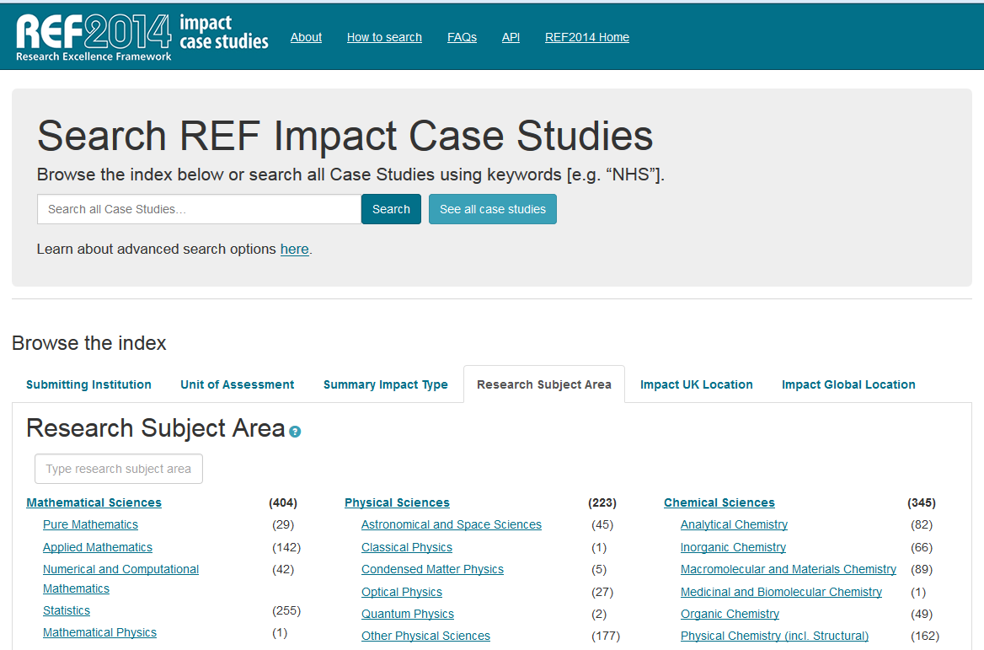
Examples of Impact Descriptions
  Research Excellence Framework Impact Case Studies (from UK institutions)
(above) Screenshot of REF2014 Impact Case Studies: http://impact.ref.ac.uk/CaseStudies/Search1.aspx
Notes:
The REF is a system for assessing the quality of research in UK higher education institutions implemented for the first time in 2014. REF impact case studies were written by Higher Education Institutions (HEIs), following a four-page template provided for REF submissions.
All impact case studies published within this database have been agreed for publication by the HEI who submitted the impact case study to the REF2014. Where the institution holds the rights to materials contained in the REF submission, the Institution declared it has authority to grant the UK HE funding bodies individual, non-exclusive, perpetual and irrevocable licences to make use of, release and publish the materials.
For more information: http://impact.ref.ac.uk/CaseStudies/About.aspx

Slide 28
Measure What Matters
go beyond the numbers and find the story
  What is the real story?
    Change in understanding of disease, disorder or condition
    Change in clinical practice
    Change in community health
    Change in public law or policy
  Why should we go beyond the numbers?
    Reporting of tangible and meaningful outcomes
    Demonstration of judicious use of taxpayer monies
    Allows funding bodies to reallocate resources for directions that are showing progress
    Inform the community of potential new health interventions

Slide 29
Metrics and Impact Core Services for Individuals
services are tailored for individuals (i.e. not for groups)
Classes on demand:
  Enhancing the Impact of Your Research
  How to Prepare an NIH Biosketch
  The NIH Relative Citation Ratio and iCite Tool
  Upcoming: Dissemination and Outreach Overview
  Upcoming: Journal Selection
  Upcoming: Tenure and Promotion
Consultations
  Research Impact Assessment Consultation
  Review of NIH Biosketch
  Tenure and Promotion Consultation
Standardized Reports
  Individual Publication Summary
  Journal Selection Review

Slide 30
Thank you!
Today’s presentation will cover:
  Overview of Metrics and Impact Core Services
  Review of “Enhancing the Impact of Your Research” class
  Review of “Research Impact Assessment” consultation
Learning Outcomes
  Gain a better understanding of how libraries can provide assistance to faculty with visibility and dissemination of their research
  Gather inspiration and ideas for working with faculty on visibility and dissemination

Slide 31
Questions
Slides available at:

