Slide 1
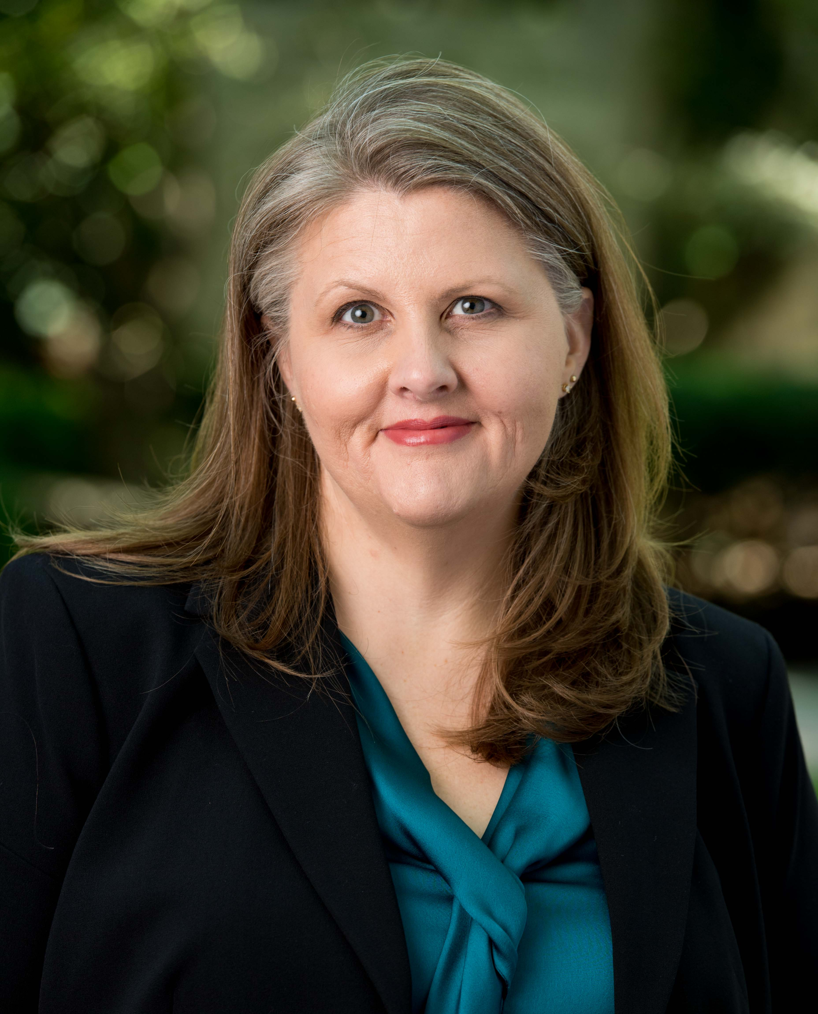

Sage Assembly Lightning Talks
Better algorithms for optimizing impact
KRISTI HOLMES
Northwestern University

Slide 2


Issues: we count/track only a few outputs, more interesting/ appropriate indicators are hidden, attribution can be improved!
Research impact: what we typically count …and what opportunities do we miss with all of the other stuff we create (below the line!)
Defining *meaningful* impact and going beyond the counts to find evidence (blooming!)
  Examples: new clinical studies, improved translation or improved health of our communities
  Systems to study: CARDIA & other longitudinal efforts
How do we get there? Culture & technology
  Data use, reuse, & repurposing + smarter systems
  Cultural interventions & algorithms
  Better representation of contributor roles (CRediT & CD2H)
  Recognition of a range of outputs (Becker Model, NISO, CD2H)
Join us! Collaborate on attribution through the CTSA Program National Center for Data to Health (CD2H). More at https://ctsa.ncats.nih.gov/cd2h/ or contact @kristiholmes or @ontowonka for more details
PATHWAYS TO IMPACT: Advancement of Knowledge, Clinical Implementation, Community/Society Benefit, Legislation and Policy, Economic Benefit, Advancement of Innovation (Becker Model)
NCATS GRANTS U24TR002306 (CD2H) & UL1TR001422 (NUCATS); NHLBI PROJECT 268201300027C-6-0-1 (CARDIA)
GALTER LIBRARY; BECKER MODEL https://becker.wustl.edu/impact-assessment/model; NISO RECOMMENDED PRACTICE RP-25-2016 http://bit.ly/NISOaltmetrics
Notes:
Image credit: Johannes Plenio
https://pixabay.com/en/tree-nature-landscape-alone-fog-3224754/
How can you get involved? Join us! Collaborating CD2H Working Groups include Ontologies & Standards; People, Expertise & Attribution; & Evaluation & Analytics.
More at https://ctsa.ncats.nih.gov/cd2h/
@kristiholmes / kristi.holmes@northwestern.edu
@ontowonka / meliss@tislab.org

