Slide 1
Enhancing the Visibility and Dissemination of Research
Karen Gutzman
Impact and Evaluation Librarian
Northwestern University, Feinberg School of Medicine
American Library Association
2017 Annual Conference
Sunday, June 25, 2017
8:30 am - 10:00 am
Panel discussion on Impactful Partnerships: Navigating the Evolving Scholarly Communication Landscape with Faculty

Slide 2




Feinberg School of Medicine
Facts and Figures
Received $443.1M in research awards in 2016 (up 72% from 2012)
Team Scientists
Research Faculty
Received $76.1M in clinical trials funding in 2016
2,059
Full-time faculty
30 + Core Research facilities
Clinician-Educators
4,000 medical school faculty overall,
including Health System Clinicians
Notes:
Phrases such as "core," "shared facility" and "shared instrumentation" do not have precise definitions. At Northwestern, any investigator has the option to share instruments or services in a formal or informal manner, with or without charge. However, there are specific requirements related to funding and rates.
http://www.feinberg.northwestern.edu/research/cores/about/definition.html
Promotion and Tenure Guideline at Northwestern Feinberg School of Medicine. The Information Guide for Appointments, Promotion and Tenure provides an overview of faculty appointments and outlines the criteria for appointment and promotion in each career track. It is intended to provide transparency and assist faculty members with planning for and successfully achieving promotion and/or tenure. The guide was first issued in 2011 in response to faculty feedback desiring greater transparency in the promotion and tenure process.
http://www.feinberg.northwestern.edu/fao/faculty/promo-tenure/index.html

Slide 3
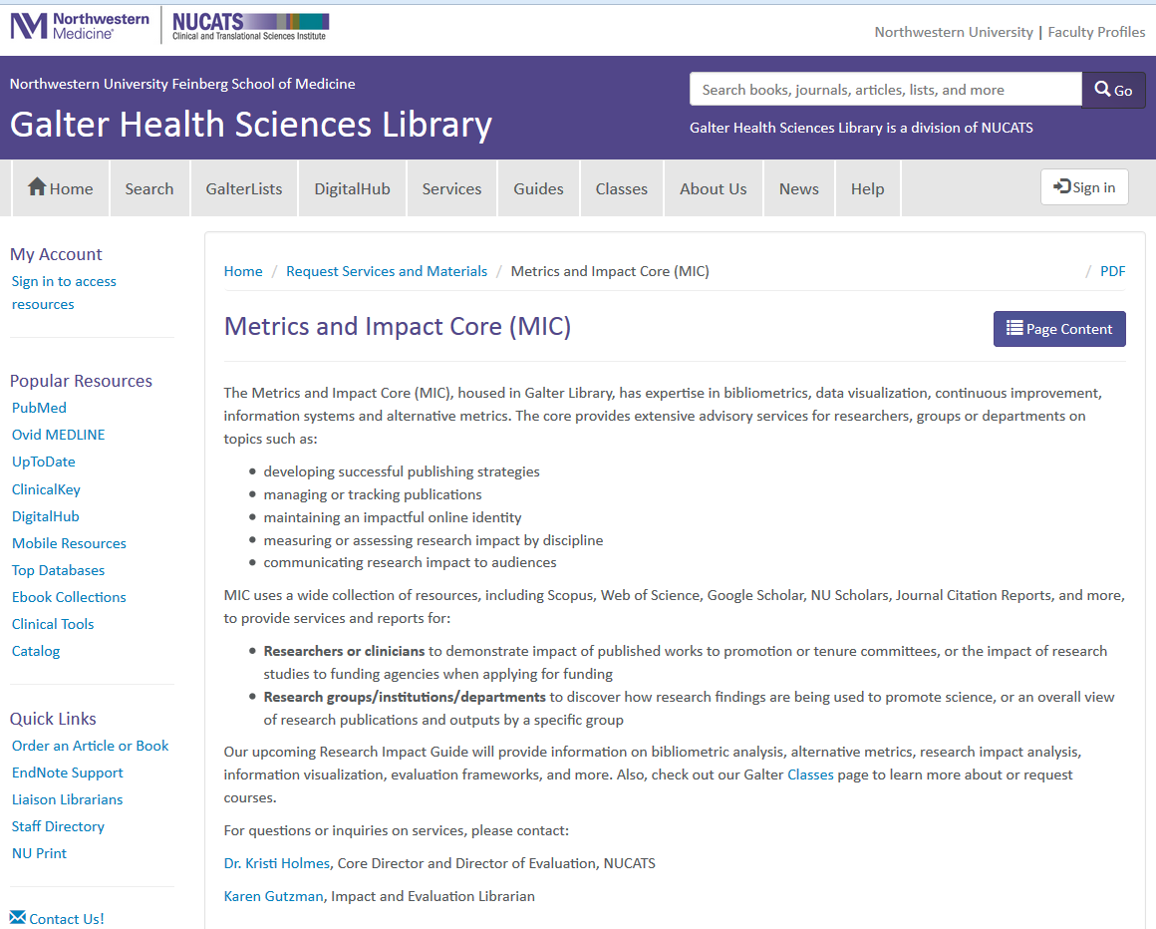
Metrics and Impact Core
Resources and Services for our Faculty, Staff, and Students
The core provides extensive advisory services for researchers, groups or departments on topics such as:
  developing successful publishing strategies
  managing or tracking publications
  maintaining an impactful online identity
  measuring or assessing research impact by discipline
  communicating research impact to audiences
(above) Screenshot of Metrics and Impact Core homepage
http://galter.northwestern.edu/Request-Services-and-Materials/metrics-and-impact-core-mic

Slide 4
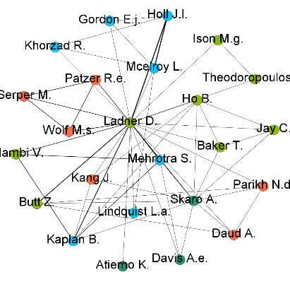
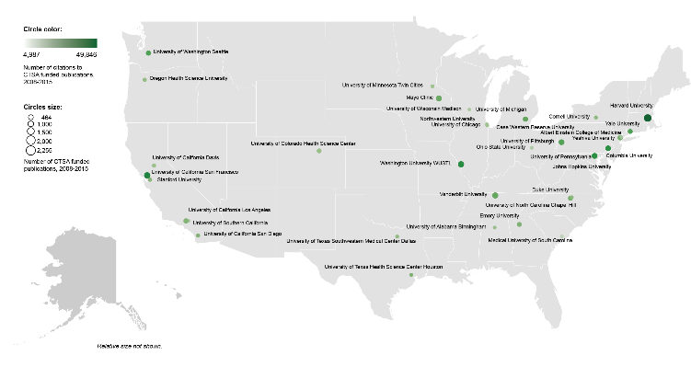
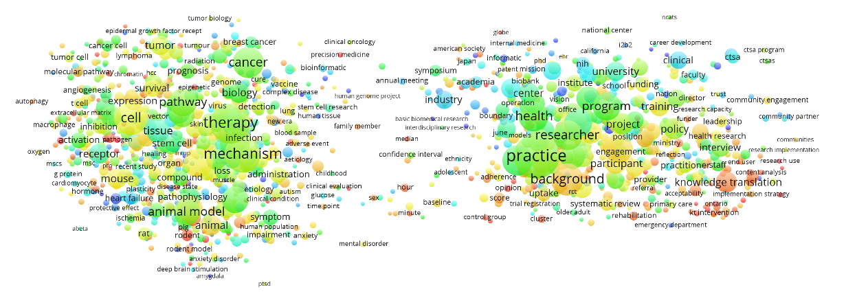

Data Sources and Tools
Bibliographic databases:
  Scopus (Elsevier)
  PubMed (NLM)
  Web of Science (Clarivate Analytics)
  NU Scholars (Elsevier)
  Google Scholar
  Sympletic Elements
Other databases:
  iCite Tool
  NIH RePORTER
  Essential Science Indicators (Clarivate Analytics)
  InCites (Clarivate Analytics)
Visualization Tools
  Sci2 Tool
  Gephi
  Pajek
  VOSviewer
  CitNetExplorer
  Tableau
  Microsoft Excel
Gephi
Tableau
VOSviewer

Slide 5

Outreach and Engagement
Classes on demand
Enhancing the Impact of Your Research
  Want to make your research more discoverable? Wonder how to discuss your research impact? Join us for this practical class in learning how to enhance your research impact. The class briefly covers the concept of research impact, including definitions and a discussion on why thinking about research impact is important, and is offered to faculty, students or staff.
  Participants will learn practical strategies on:
    establishing an online presence
    enhancing the discovery of scholarly outputs
    increasing the dissemination of scholarly outputs
    communicating the impact of your research
(above) screenshot of Enhancing the Impact of Your Research opening slide
Notes:
developing successful publishing strategies
managing or tracking publications
maintaining an impactful online identity
measuring or assessing research impact by discipline
communicating research impact to audiences
Karen Gutzman is our Impact and Evaluation Librarian. You can contact her directly or through your liaison librarian.

Slide 6


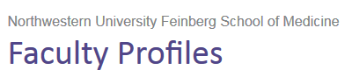


Establishing an Online Identity
Putting your best foot forward
Use the same author name and affiliation name consistently
Consider registering for an ORCiD
Consider corporate authorship or using study name in title or abstract
  The Ocular Hypertension Treatment Study Group
  CARDIA study
Keep author profiles up to date
Notes:
We encourage researchers to be proactive in how they are represented online. Also, name consistency enhances retrieval.
ORCiD
http://orcid.org/
Major ORCiD sponsors include:
American Chemical Society
CrossRef *
Elsevier *
IEEE *
Nature Publishing Group *
PLOS *
Sage *
Springer *
Taylor and Francis Group *
Wiley*

Slide 7
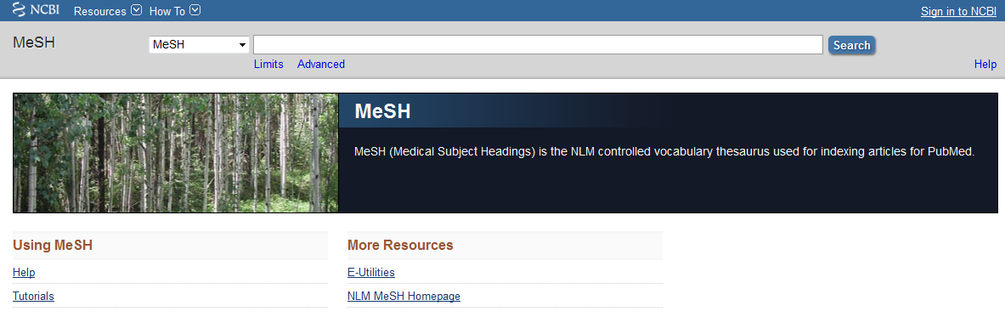
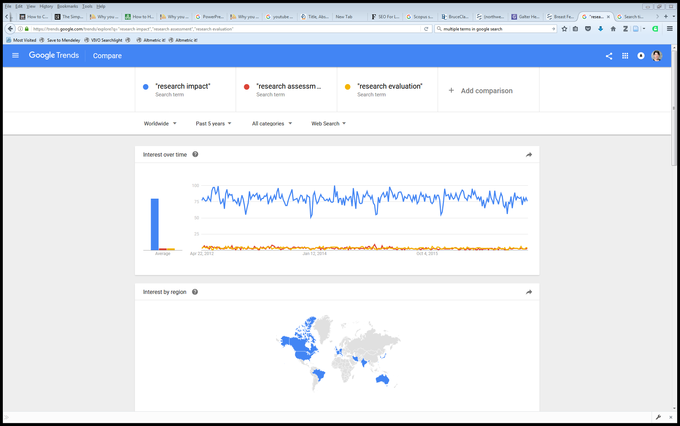
Enhancing Discovery of Your Work
Optimize title, abstract, and keywords for academic search engines
  Consider words from “controlled vocabularies” such as PubMed’s Medical Subject Headings (MeSH)
  Check Google Trends “related searches” to learn how people query a topic
Publish works in journals indexed by PubMed/Medline. PubMed is crawled by Google and Google Scholar. Indexing with MeSH increases discoverability.
  Repeat significant keywords or descriptive phrases several times
  (above) Screenshot of MeSH homepage: http://www.ncbi.nlm.nih.gov/mesh/
    (right) Screenshot of Google
    Trends comparison:
    https://trends.google.com/trends/
Notes:
Academic Search Engine Optimization (ASEO): Optimizing Scholarly Literature for Google Scholar and CO.
http://www.sciplore.org/publications/2010-ASEO--preprint.pdf
In Google Scholar, the most important factors are relevance, citation count, author name(s), and name of publication.
Once the keywords are chosen, they need to be mentioned in the right places: in the title, and as often as possible in the abstract and the body of the text (but, of course, not so often as to annoy readers). Although in general titles should be fairly short, we suggest choosing a longer title if there are many relevant keywords.
[ASEO] is about helping academic search engines to understand the content of research papers and, thus, about how to make this content more widely and easily available.
Search Engine Optimization and Your Journal Article: Do you want the bad news first?
So what do you need to do? We’ve created an SEO for Authors tips sheet to give authors an at-a-glance guide to optimizing their papers. Here are some highlights:
Carefully select relevant keywords
Lead with keywords in the article title
Repeat keywords 3-4 times throughout the abstract
Use headings throughout the article
Include at least 5 keywords and synonyms in the keyword field
Link to the published article on social media, blogs and academic websites
from : http://exchanges.wiley.com/blog/2013/07/23/search-engine-optimization-and-your-journal-article-do-you-want-the-bad-news-first/
PubMed Relevance Ranking
The relevance sort order for search results is based on an algorithm that analyzes each PubMed citation that includes the search terms. For each search query, "weight" is calculated for citations depending on how many search terms are found and in which fields they are found. In addition, recently-published articles are given a somewhat higher weight for sorting.
From: https://www.nlm.nih.gov/pubs/techbull/so13/so13_pm_relevance.html

Slide 8
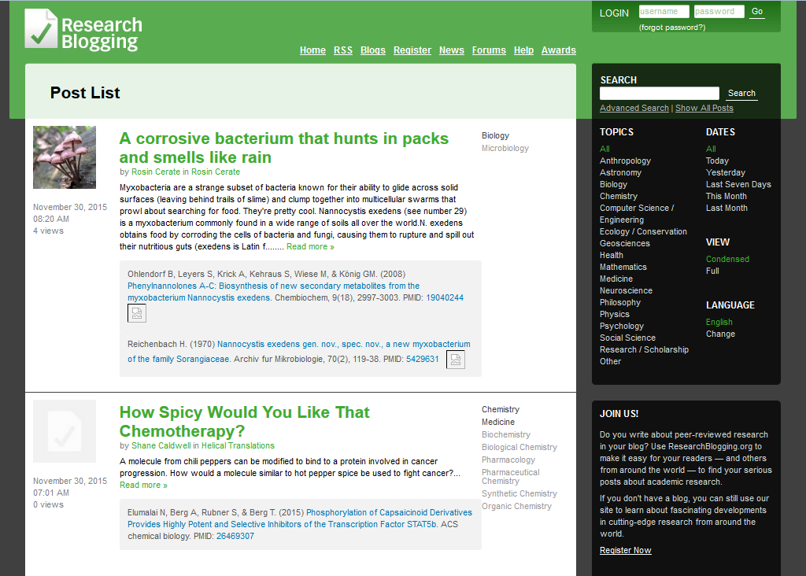


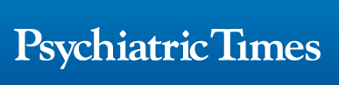

Increasing Dissemination of Your Work
Be active: participate, present, and share
  Join professional organizations
  Teach CE courses
  Serve as a reviewer for a journal
  Present at journal clubs
Start a blog or podcast, or publish videos. Cover topics such as:
  Research findings
  Questions about your area of research
  Comments on publications by other authors
(above) Screenshot of Research Blogging News page: www.researchblogging.org
  Consider writing about your research in a trade journal or magazine to reach members of profession or industry.
Notes:
Take every opportunity to present your work at meetings, department seminars, journal clubs and events for the general public.
Blogging:
Research Blogging:
http://researchblogging.org/static/index/page/about
NU FSM Blogging:
http://www.feinberg.northwestern.edu/communications/brand/social-media/blogs.html
Videos:
Journal of Visualized Experiments:
http://www.jove.com/
Northwestern Feinberg School of Medicine YouTube:
https://www.youtube.com/user/NUFeinbergMed
Northwestern FSM Office of Communications:
http://www.feinberg.northwestern.edu/communications/brand/social-media/you-tube.html
Add your own channel (department, center or institute), sent email to Nicole Mladic with the link to your video.
http://www.feinberg.northwestern.edu/communications/brand/social-media/you-tube.html
Podcasts Steps:
Who can host your Podcast files online?
Blubrry Media
https://create.blubrry.com/resources/podcast-media-hosting/?code=noodle
Hosts podcast files for as little as $12/mo for 100MB of storage
Amazon S3
https://aws.amazon.com/free/
There is a monthly charge for the storage of your files and for when people download your files.
Soundcloud
https://soundcloud.com/
Will host 3 hours of podcasting for free
Who can create a podcast-only RSS feed?
Blubrry Media
https://create.blubrry.com/resources/podcast-media-hosting/?code=noodle
Creates an i-Tunes compliant RSS feed from files you’ve uploaded to your Blubrry account
Soundcloud
https://soundcloud.com/
Will create an RSS feed of podcasts files that you’ve uploaded to your Soundcloud profile
Who can make your podcast-only RSS feed available to wide audiences?
iTunes
http://itunespartner.apple.com/en/podcasts/faq
Does not host podcasts. Instead you must connect iTunes with the RSS feed of your podcast (which is hosted somewhere else).
GooglePlay
https://play.google.com/music/podcasts/publish
Does not host podcasts. Instead you must connect iTunes with the RSS feed of your podcast (which is hosted somewhere else).
Soundcloud
https://soundcloud.com/
Will host 3 hours of podcasting for free
WordPress’s PowerPress Podcasting Plugin
https://wordpress.org/plugins/powerpress/
Publish your podcasts directly on your wordpress blog using the PowerPress plugin. This plugin makes your files being hosted by Blubrry available on your blog.
Podcast Help
iTunes Podcast help:
https://itunespartner.apple.com/en/podcasts/overview
LSE Impact Blog: The Simple Guide to Academic Podcasting
(http://blogs.lse.ac.uk/lsereviewofbooks/2014/04/09/the-simple-guide-to-academic-podcasting/)
Examples of Podcasts
List of Podcasts from Georgia Tech Library
http://libguides.gatech.edu/BME/podcasts
Dr. Whitaker's Instant Anatomy
(http://www.instantanatomy.net/podcasts.html)
Podcasts to help the learning of human anatomy for doctors, medical students, nurses and anyone else who has an interest in human anatomy by Dr Robert Whitaker, Cambridge, UK. The six most recent podcasts are always available for free.
Sound Medicine
(http://podcast.iu.edu/Portal/PodcastPage.aspx?podid=f12936bb-ff68-4a34-970b-7919d9dc163e)
University of Virginia Health & Medicine Podcasts (http://newsroom.uvahealth.com/about/news-room/radiomd-podcasts/radiomd-medical-podcasts-from-uva)
Health and medical discussions
University of Michigan Health & Medicine Podcasts (http://www.med.umich.edu/podcast/)
Updates on basic science and research

Slide 9




Consider Open Access
  Options for sharing include:
  DigitalHub: https://digitalhub.northwestern.edu/
  Slideshare: http://www.slideshare.net
  Figshare: http://www.figshare.com
  Dryad: http://datadryad.org
  For more information, see Galter News Item:
  http://galter.northwestern.edu/News/sharing-publishing-and-archiving-your-work
  Directory of Open Access Journals (DOAJ)
  http://www.joaj.org/
  Check with your publisher or SHERPA/RoMEO for which version you can submit: http://www.sherpa.ac.uk/romeo/
  Include a discussion of how your research could translate to clinical outcomes or technologies
  Could enhance the probability that the article will affect public policy and thus increase its impact

Slide 10
Motivations for Assessing Research Impact
Career Motivations
  Tenure Process
  Promotion dossiers
  Identify similar research projects
  Identify possible collaborators
Community of Research Motivations
  Discover how research findings are being used
  Determine if research findings were
  Confirm that research findings were properly attributed/credited
  Demonstrate that research findings are resulting in meaningful health outcomes
  Discover community benefit as a result of research findings
    Duplicated
    Confirmed
    Corrected
    Improved
    Repudiated
    Extended
Funding Motivations
  Quantify and document research impact
  Justify future requests for funding
  Quantify return on research investment
Notes:
Phrases such as "core," "shared facility" and "shared instrumentation" do not have precise definitions. At Northwestern, any investigator has the option to share instruments or services in a formal or informal manner, with or without charge. However, there are specific requirements related to funding and rates.
http://www.feinberg.northwestern.edu/research/cores/about/definition.html
Promotion and Tenure Guideline at Northwestern Feinberg School of Medicine. The Information Guide for Appointments, Promotion and Tenure provides an overview of faculty appointments and outlines the criteria for appointment and promotion in each career track. It is intended to provide transparency and assist faculty members with planning for and successfully achieving promotion and/or tenure. The guide was first issued in 2011 in response to faculty feedback desiring greater transparency in the promotion and tenure process.
http://www.feinberg.northwestern.edu/fao/faculty/promo-tenure/index.html

Slide 11



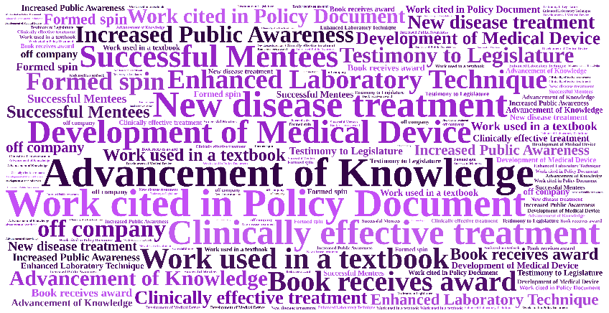
Research Career Lifecycle
Also called a “Logic Model” for those versed in evaluation-speak
Career Activities
Career Outputs
Career Support and Resources
Career Outcomes
Use Process Indicators
Use Impact Indicators
Notes:
Shows an example of a traditional “cause and effect” logic model which describes how the available resources (also known as inputs) and program activities will lead to desired outputs and outcomes (both of which can be measured in the short , intermediate, or long term), given a specific environmental context.

Slide 12
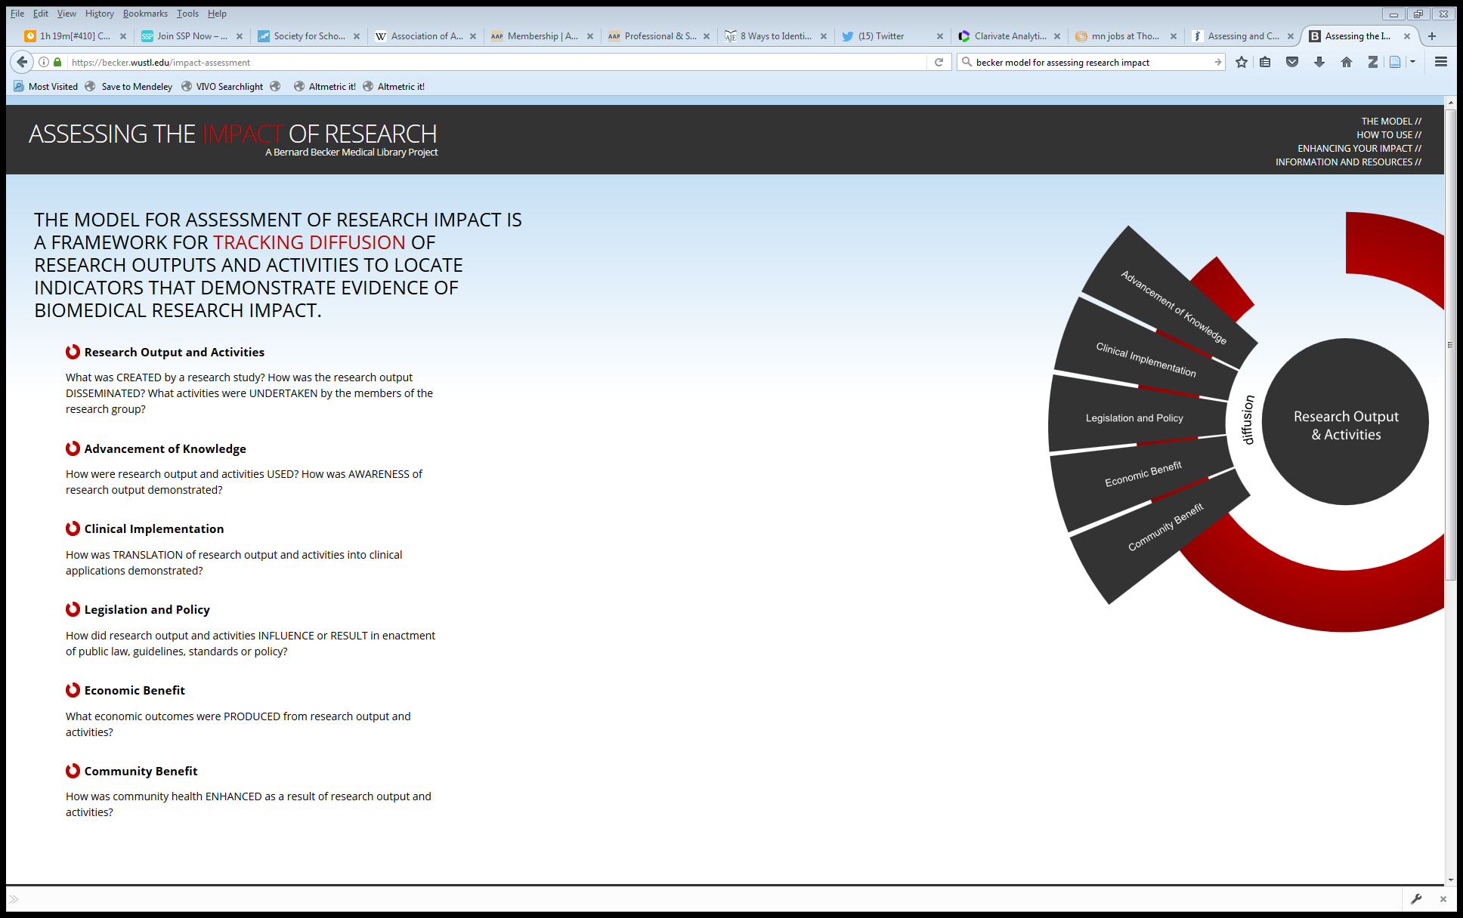
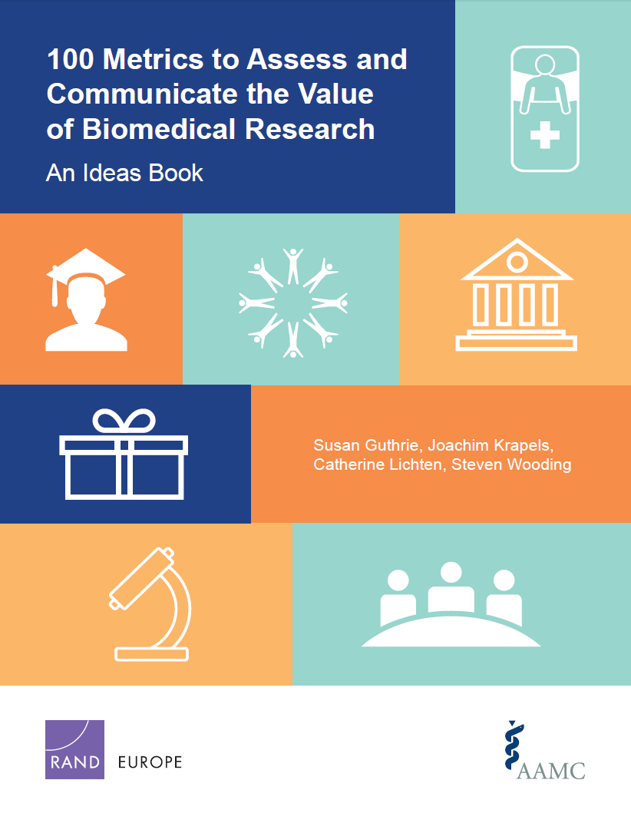
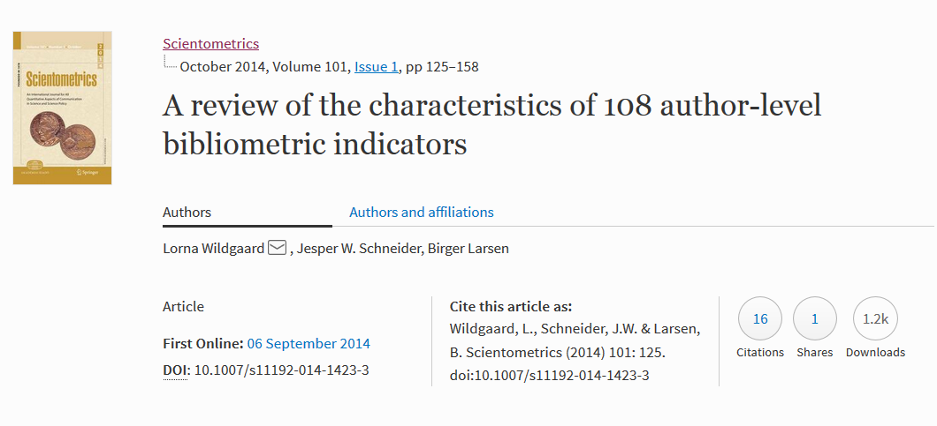
Libraries of Indicators
Often called “evaluation frameworks”
(above) Homepage of Becker Model: https://becker.wustl.edu/impact-assessment
(above) Screenshot of 100 Metrics paper by AAMC and RAND Europe: http://www.rand.org/pubs/research_reports/RR1606.html
(left) Screenshot of Wildgaard L, et. al.: https://arxiv.org/abs/1408.5700
Notes:
100 Metrics by AAMC and RAND Europe
Guthrie, Susan, Joachim Krapels, Catherine Lichten and Steven Wooding. 100 Metrics to Assess and Communicate the Value of Biomedical Research: An Ideas Book. Santa Monica, CA: RAND Corporation, 2016. http://www.rand.org/pubs/research_reports/RR1606.html
ACUMEN Project
Wildgaard L, Schneider JW, Larsen B. A review of the characteristics of 108 author-level bibliometric indicators. Scientometrics. 2014 Oct;101(1):125–158. https://arxiv.org/abs/1408.5700
Becker Medical Library Model for Assessment of Research Impact
The Becker Medical Library Model for assessment of research impact – an Interview with Cathy C. Sarli and Kristi L. Holmes [Internet]. Research Trends. [cited 2015 Jun 8]. Available from: http://www.researchtrends.com/issue-34-september-2013/the-becker-medical-library-model/
Elsevier Usage Guidebook
Colledgre L, Elsevier Research Intelligence. Usage Guidebook. https://www.elsevier.com/research-intelligence/resource-library/usage-guidebook
InCites Indicators Handbook
Thomson Reuters (Clarivate Analytics). Insites Indicators Handbook. http://ipscience-help.thomsonreuters.com/inCites2Live/indicatorsGroup/aboutHandbook.html
CDC Science Impact Framework
https://www.cdc.gov/od/science/impact/framework.html
Institute of Medicine: Degrees of Impact
http://www.nationalacademies.org/hmd/~/media/Files/About%20the%20IOM/PresidentsAddress2013.pdf

Slide 13
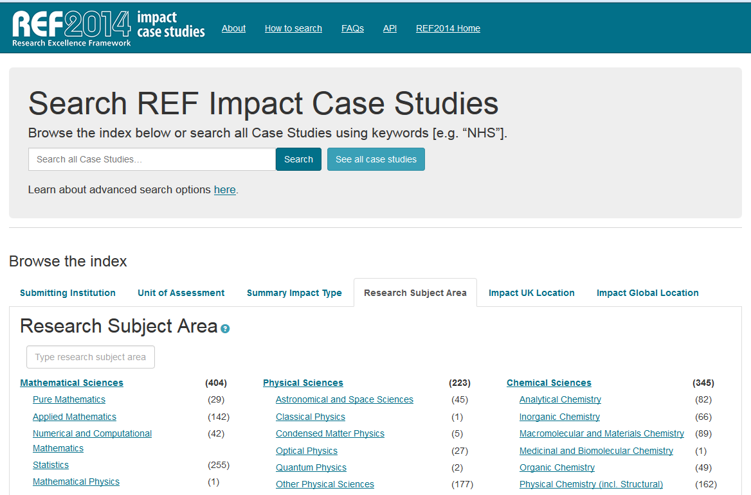
Examples of Impact Descriptions
  Research Excellence Framework Impact Case Studies (from UK institutions)
(above) Screenshot of REF2014 Impact Case Studies: http://impact.ref.ac.uk/CaseStudies/Search1.aspx
Notes:
The REF is a system for assessing the quality of research in UK higher education institutions implemented for the first time in 2014. REF impact case studies were written by Higher Education Institutions (HEIs), following a four-page template provided for REF submissions.
All impact case studies published within this database have been agreed for publication by the HEI who submitted the impact case study to the REF2014. Where the institution holds the rights to materials contained in the REF submission, the Institution declared it has authority to grant the UK HE funding bodies individual, non-exclusive, perpetual and irrevocable licences to make use of, release and publish the materials.
For more information: http://impact.ref.ac.uk/CaseStudies/About.aspx

Slide 14
Alternative metrics: scenario for thought
“I’m early in my career in a narrow research field.
How do I describe my impact?”
Consider these areas:
  Advancement of Knowledge
    Give a short description of why people have cited her work
    Look for citations in other sources, like books, etc.
  Measures of Prestige
    Count of first author publications, presentations, etc.
    Review number of speaker invitations or conference invitations
  Health Impacts and Clinical Implementation
    Search for citations in clinical sources, guidelines, etc.
  Research Productivity and Knowledge Production
    Write about her work with conference presentations, papers, or posters
    Ask her about presentations to department or relevant groups
  Research Engagement
    Review her co-authors and the strength of the collaborations
    Examine social media attention for interest by researchers or public
    Look for views or downloads as dissemination and interest in research
  Provide her with ideas:
  Look at her online footprint
    Register for ORCiD
    Review her online profiles
  Schedule journal selection training with her
  Review her dissemination options
    Explain the institutional repository, Slide Share, Figshare, etc.
    Consider blogging about her work

Slide 15
Alternative metrics: scenario for thought
“I’ve been a successful researcher for 20 years, and I publish in high impact journals. Why should I care about anything other than high citation counts?”
Citations are a proxy for research quality and scholarly/academic impact. They can be normalized by discipline, year, and document type (i.e. field-weighted citation impact) and can be a great jumping off point to tell a large piece of your research story.
Two basic considerations:
What is the impact of your non-traditional outputs? Datasets, software, presentations, white papers, etc.
What is the societal or educational impact, or public engagement of your career and research?
Notes:
“…scholarship that is not only created on the web (e.g., by using Dropbox to store and manage research data or Google Docs to collaboratively author a paper) but also discussed, shared, reviewed, saved, and recommended on the web, moving the informal scholarship conversations that happen in faculty lounges or around the family dinner table into the digital realm.”
http://er.educause.edu/articles/2016/3/the-use-of-altmetrics-in-promotion-and-tenure

Slide 16
Measure What Matters
Go beyond the numbers and find the story
  What is the real story?
    Change in understanding of disease, disorder or condition
    Change in clinical practice
    Change in community health
    Change in public law or policy
  Why should we go beyond the numbers?
    Reporting of tangible and meaningful outcomes
    Demonstration of judicious use of taxpayer monies
    Allows funding bodies to reallocate resources for directions that are showing progress
    Inform the community of potential new health interventions

Slide 17
Alternative Metrics Resources
  Konkiel S, Sugimoto C, William S. The Use of Altmetrics in Promotion and Tenure. Retrieved from: http://er.educause.edu/articles/2016/3/the-use-of-altmetrics-in-promotion-and-tenure
What are Altmetrics? Retrieved from: http://www.whatarealtmetrics.com/resources/workshops/
Sarli C., Suiter A, Research Impact LibGuide. Becker Medical Library. Retrieved from http://beckerguides.wustl.edu/impact

Slide 18
Thank You

