Slide 1
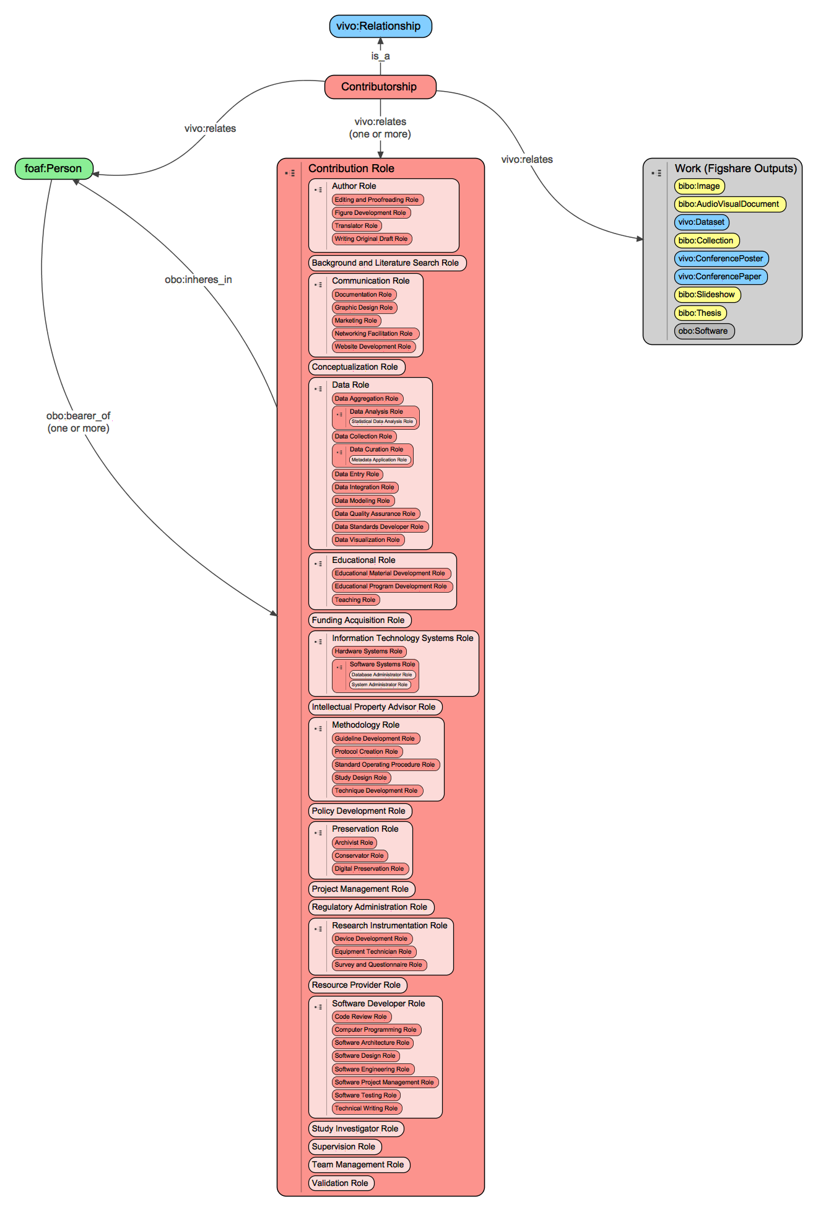
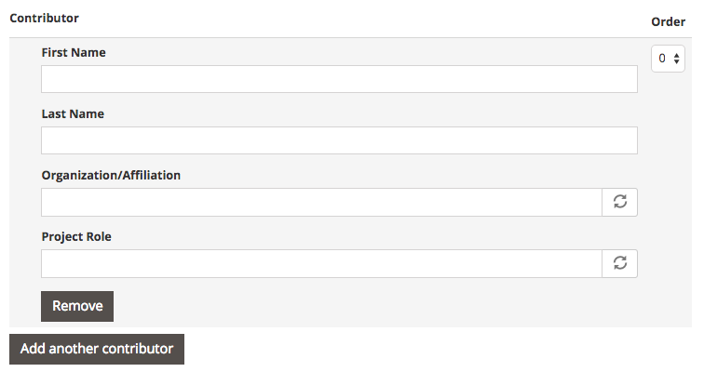
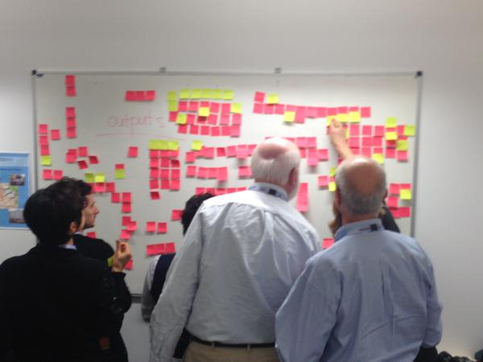
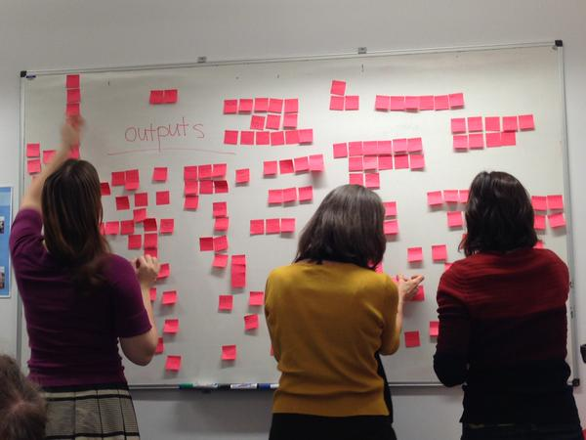



Attribution of Work in the Scholarly Ecosystem
Karen E. Gutzman¹, Stacy Konkiel², Marijane White³, Matthew Brush³, Violeta Ilik¹, Mike Conlon⁴, Melissa Haendel³, Kristi L. Holmes¹, FORCE11 Attribution Working Group, OpenVIVO Working Group
¹Galter Health Sciences Library, Northwestern University ²Altmetric, ³Oregon Health Sciences University, ⁴VIVO
Introduction
Contribution Ontology
Results
As research is driven forward by technological advances, the composition and structure of the research team is also evolving. Professionals from a wide array of backgrounds contribute to scientific breakthroughs and discoveries, often in ways that are not easily recognizable using traditional measures of scholarly impact. Metrics and indicators that are limited to grants and publications often cause these diverse contributions to be overlooked and undervalued. The lack of adequate representation can affect large swaths of the current scholarly ecosystem, such as career advancement, financial incentives, funding acquisition, and scholarly recognition.
We found there to be a diverse landscape of projects and groups working in this area, though each with its own perspective. A brief outline of the coverage, goals and relevant factors of these projects or groups is provided. Several projects were identified as being relevant to this inquiry, including Contributor Roles Taxonomy Project (CRediT), VIVO-ISF ontology, Provenance (PROV), the Becker Model and other impact frameworks, Transitive Credit, Academic Careers Understood through Measurement and Norms (ACUMEN Project), and the Scholarly Contributions and Roles Ontology (SCoRO). Additionally, several working groups were identified: Global Alliance for Genomics and Health (GA4GH), National Information Standards Organization (NISO), and the Force 11 Attribution Working Group.
Through the in-depth study of different contribution roles in the scholarly process, we were able to better understand how these contributions might be structures – in terms of a particular output (manuscript, dataset, etc.) and also contributions to the project as a whole. Moreover, we developed a 2-level hierarchy to enable more complete representation of these roles through major classes such as author, communication, data, IP, project and team management, regulatory administration, software development, and so on.
Methods
In this project we have outlined a list of contributor roles identified by the Force 11 Attribution Working Group. Contributor roles from existing taxonomies were leveraged (CRediT) and further enhanced with finer resolution contributor roles based on an in-depth investigation of activities and outputs. We have also collated and reviewed existing efforts on scholarly contribution taxonomies to determine their unique aspects, and how they complement each other. We review the landscape of taxonomies or systems in order to compare and contrast key types of contributions. We speculate on the objectives needed to create a contributorship model that is robust enough to cover various fields of research, and specific enough to adequately describe contribution in a meaningful way.
Working with FORCE11
FORCE16 submission form that contains “Project Role” field.
Brainstorming session on output types at the Contribution and Attribution in the Context of the Scholar workshop at Force2015, Oxford.
Discussion
While there are projects and ongoing efforts to better understand the diverse roles that professionals take on when contributing to the scholarly ecosystem, it is clear that more work is needed to fully explore the area of contributorship roles. Several leaders in this area have proposed projects to define an informatics infrastructure that enables the collection and dissemination on contributor attribution data to various stakeholder audiences. Projects of that nature bring excitement and expectation, as we wait to see where they will take us and how greatly they will impact the scholarly ecosystem. Perhaps most important is the need to accomplish this work in an open, collaborative manner, leveraging data standards along the way to enable interoperability and integration with existing architectures.
Relevant Projects and Groups
Projects:
Project CRediT
OpenRIF (VIVO-ISF ontology)
PROV
Becker Model for Assessing Research Impact
Transitive Credit
Academic Careers Understood through Measurements and Norms (ACUMEN Project)
Scholarly Contributions and Roles Ontology (SCoRO)
Groups:
Global Alliance for Genomics and Health (GA4GH)
National Information Standards Organization (NISO)
Goals
Review and summarize the objectives of the projects listed above to determine how much they overlap - can a core set of objectives, perhaps with extensions, be defined?
Review and summarize key types of scholarly products and the roles that people have in relation to them, resulting from the Force15 workshop
Landscape review, comparing and contrasting key types of contributions across the different taxonomies/systems
Recommendations for publishers, IRs, research profiling systems to implement.
Ontology available on Github:
https://github.com/openrif/contribution-ontology
References
SCoRO: http://www.essepuntato.it/lode/http://purl.org/spar/scoro
PROV (W3C): https://www.w3.org/TR/prov-overview/
Becker Model: https://becker.wustl.edu/impact-assessment/model
CRediT: http://casrai.org/w/images/casrai.org/5/50/CRediT-Fact_Sheet-Jan_2016.pdf

