Slide 1
Cultural Awareness to Enhance Mentoring Across Differences
NUCATS Series on Developing and Enhancing Mentoring Relationships
Welcome! We will start on time at 7:30.
Presenters: Rick McGee, PhD and Namratha R. Kandula, MD, MPH

Slide 2
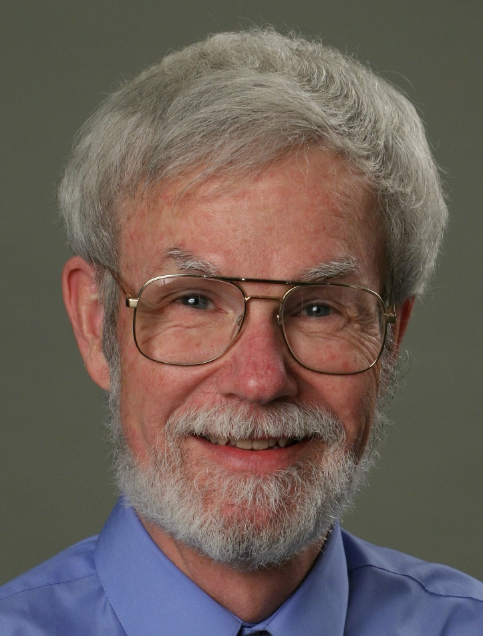
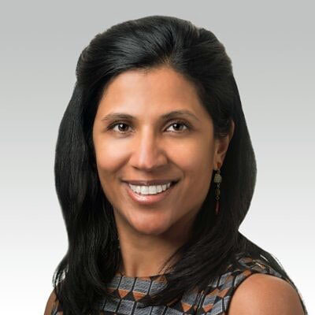
Today’s Facilitators
Rick McGee, PhD
Namratha R. Kandula, MD, MPH
r-mcgee@northwestern.edu
n-kandula@northwestern.edu
Associate Dean for Faculty Recruitment and Professional Development
Professor of Medical Education
Co-director, Institute for Public Health and Medicine (IPHAM) - Center for Community Health
Professor of Medicine (General Internal Medicine and Geriatrics) and Preventive Medicine (Epidemiology)

Slide 3
Introductions
NUCATS Staff
Christine Charles
Jaime Ziegler

Slide 4


Center for the Improvement of Mentored Experiences in Research (CIMER)
CIMER Mission
Improve the research mentoring relationships for mentees and mentors at all career stages and disciplines through the development, implementation, and study of evidence-based and culturally-responsive interventions.
CIMER History
A UW-Madison team led by Dr. Christine Pfund established CIMER in 2015 with support from the Wisconsin Center for Education Research to begin the work of expanding efforts to investigate and implement ways to improve research mentoring relationships in higher education settings.

Slide 5
Agenda
Time | Activity
7:30-7:45 (15 mins) | Introductory Activities – Equality, Equity, Justice
7:45-8:00 (15 mins) | Reflecting on Diversity
8:00-8:10 (10 mins) | Unconscious Biases and Assumptions
8:10-8:30 (20 mins) | Sharing of Culture Boxes – Breakouts
8:30-8:50 (20 mins) | Case Study – Breakouts followed by group debrief
8:50-9:00 (10 mins) | Closing & Next Steps – What will you do next?

Slide 6
Session Materials and Zoom Tools
You were all sent the Culture Box instructions previously. You will want it handy by the time we get to that activity about 40 minutes into the session.
Most of the session will be devoted to dialogue either within the full group or in the breakout groups. Please have your video on if at all possible, and don’t be shy about sharing your thoughts either verbally or in the Chat!

Slide 7
Addressing Equity and Inclusion
Learning Objectives
Mentors and mentees will have the knowledge and skills to:
Increase understanding of equity and inclusion and their influence on mentor-mentee interactions
Recognize the impact of conscious and unconscious assumptions, preconceptions, biases, and prejudices on the mentor-mentee relationship and acquire skills to manage them
Identify concrete strategies for learning about and addressing issues of equity and inclusion

Slide 8
Addressing Equity and Inclusion

Slide 9
Welcome
In the chat box, indicate if you are here thinking mostly about your role as mentor, a mentee or both

Slide 10
Reflecting on Diversity

Slide 11
What Do These Terms Mean?
Equity

Slide 12
What Do These Terms Mean?
Equity
Diversity

Slide 13
What Do These Terms Mean?
Equity
Diversity
Inclusion

Slide 14
What Do These Terms Mean?
Equity
Diversity
Equality
Inclusion

Slide 15
What Do These Terms Mean?
Equity
Diversity
Equality
Inclusion
Justice

Slide 16
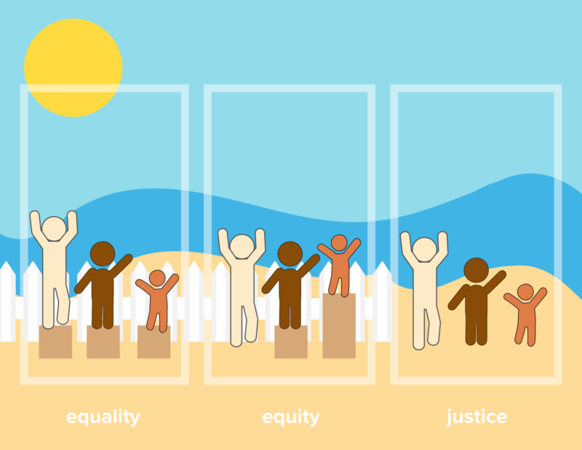
Equality, Equity and Justice
Assumption that everyone
benefits from the same,
resources and supports
Everyone gets the
support they need.
Removing the systemic
and structural barriers
that create inequities
What is the end goal?
The illustration above was inspired by an illustration in “Seo, Jeong-Wook & Chung, Hosik & Seo, Tae-Sul & Jung, Youngim & Hwang, Eun & Yun, Cheol-Heui & Kim, Hyungsun. (2017). Equality, equity, and reality of open access on scholarly information.” and was created for Heal the Bay’s use by Alex Choy and Danielle Furuichi

Slide 17
Activity:
Reflecting on Diversity in the Mentoring Relationship

Slide 18
Activity Overview & Instructions
Think of a specific mentee or mentor with whom you are currently working
Write down their initials.
For 1 minute, list on paper or in your head as many ways that you are or perceive to be different from your mentee or mentor.
Then please share in the chat window two of the differences between you and your mentee or mentor across any aspect of identity, background, etc.

Slide 19
Activity Reflection Questions
Reflect on the following questions for 2 minutes
  How do these differences impact your relationship with your mentee or mentor?
  Which differences from your list enhance your mentoring relationship?
  Which differences sometimes seem difficult or get in the way of the relationship?
  How can (or do) you capitalize on these differences to create a high quality research experience for mentee(s)?

Slide 20
Reflect on Unconscious Biases
& Assumptions

Slide 21
Much Recent Attention being Given to Unconscious Bias and Assumptions
Unconscious beliefs and attitudes that influence our behaviors and decision-making, and eventually determine the climate of relative opportunity and challenge for mentees, in particular those who are underrepresented.
Many new workshops and trainings developed
New requirements for training for search committees and other settings
Won’t spend a lot of time here, but want to briefly introduce and remind people what it is, what it occurs, and how critical it is in our own self-awareness journeys
A short video to watch
https://www.ted.com/talks/verna_myers_how_to_overcome_our_biases_walk_boldly_toward_them?language=en#t-334121

Slide 22
What did you take away from the video?
Did you learn anything new about unconscious biases and assumptions?
How do you see unconscious biases or assumptions as having impacts in your mentoring relationships?
Reflecting on them now, are you thinking about any new ways you might consider unconscious biases in your mentoring relationships?

Slide 23
Your Culture Boxes

Slide 24
Purpose of the Culture Box Activity
We don’t leave our culture or social identity behind us when we enter a research group, or a mentoring relationship
Often hard to know how and if to get to know each other’s cultures
Many of us have not reflected deeply about our cultures that we bring with us
An opportunity to reflect on our cultures, which ones are most important and meaningful, and share those with colleagues

Slide 25
Here is what we will do…
We will share our own ‘culture boxes’ briefly
You will be sent to breakout rooms to share yours – 4 people each
Assign a time keeper to make sure everyone gets a chance
Take turns (1 person does both items before going to the next)
  What did you bring?
  Why is it important to you, and what part of you does it represent?
  Others are able to ask about it as time allows
You will get warnings with 10, 5 and 1 minute left!!
Return to full group for short debrief

Slide 26
Culture Box Debrief (hidden slide – all on screen)
What was it like creating your culture box? Did you learn anything new about yourself in doing so?
What was it like sharing your culture box with others? Was it hard or easy?
Were there any ah ha’s?
Are you taking away any new thoughts about potential roles of differences in culture/social identity for you mentoring relationships?
From this, is there anything you might do differently in the future?

Slide 27
Case Study:
IS IT OK TO ASK?

Slide 28
Case Study: Is it ok to Ask?
Several years ago, I had a first-year graduate student do a rotation in my lab. She seemed really smart and generated a lot of data. I think that she had a positive experience working with our research team, but there are a few questions that still linger in my mind. This particular student was an African American woman from a small town. I always wondered how she felt on a big urban campus. I also wondered how she felt about being the only African-American woman in my lab. In fact, she was the only African-American woman in our entire department. I wanted to ask her how she felt, but I worried that it might be insensitive or politically incorrect to do so. I never asked. I still wonder how she felt, and how those feelings may have affected her experience.

Slide 29
Case Study Instructions
We will move you into breakout rooms (4-5 per room)
Once in the breakout rooms…
  You can access the case study via the link provided in the chat box
  Assign roles:
    A FACILITATOR to help ensure everyone has a chance to share
    A TIMEKEEPER who will keep track of time. We will be sending you a 5 minute and 1 minute warning in the chat.
    Share your initial reactions to the case and discuss the questions
You will receive reminders with 5 and 1 minutes remaining before returning you to the main room to share with the larger group
If you need help in the breakout room, send a chat to the facilitators

Slide 30
Discussion Questions
Should the mentor have asked? Why or why not?
What might the mentor’s intent have been in asking the question, and what might the impact be on the mentee?
How might you react differently to this case if the student was the only openly gay student in the department?
How do you engage in such conversations based on interest without feeling or expressing a sense of judgment about differences?
How do you ask without raising issues of tokenism?

Slide 31
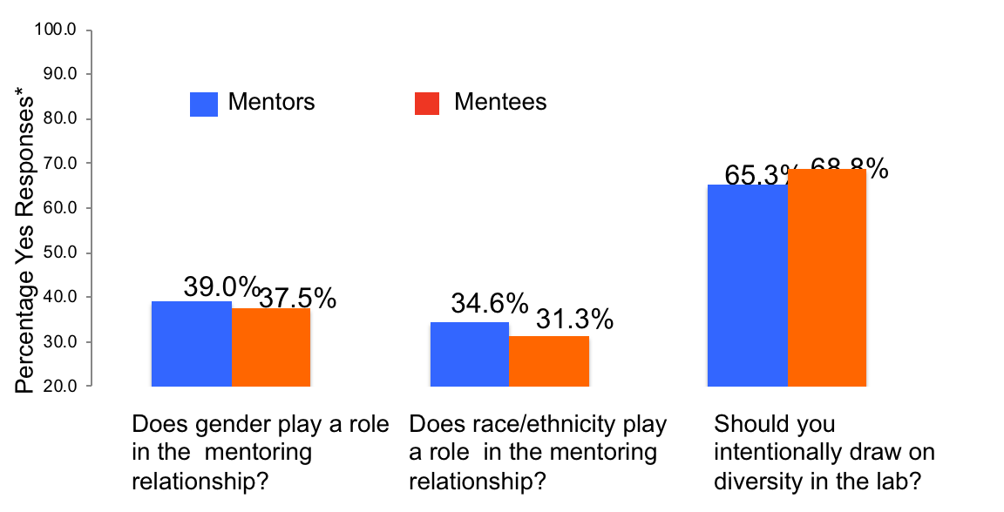
Cultural Diversity in Mentoring:
Quantitative Results
*Results compare Yes responses with those responding No or not indicating an opinion
Byars-Winston, Leveritt, Pfund, Branchaw and Benbow, 2019. J. Div Higher Ed.

Slide 32
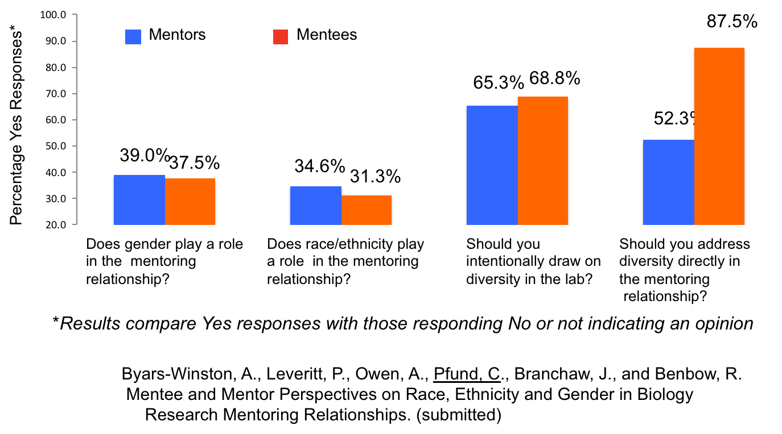
Cultural Diversity in Mentoring:
Quantitative Results
*Results compare Yes responses with those responding No or not indicating an opinion
Byars-Winston, Leveritt, Pfund, Branchaw and Benbow, 2019. J. Div Higher Ed.

Slide 33
Reflection and Next Steps
  Reflect on the morning, and write down one or two things you hope to do differently in the future to promote greater equity and inclusion in your mentoring relationships.
  Does anyone want to share what they put down?

Slide 34
Resources to learn more
YWCA Evanston Equity Institute workshops
https://www.ywca-ens.org/equity-institute/
To identify your own implicit biases, you can take the IAT online at implicit.harvard.edu
NU Office of Equity Trainings for your unit https://www.northwestern.edu/equity/resources/training/campus-training.html
Searle Center has diversity, equity, inclusion events and workshops
https://www.northwestern.edu/searle/initiatives/calendar.html

Slide 35














Acknowledgements

Slide 36
Thank you for Attending
Please Complete Brief Evaluation via REDCap (will be emailed to you)
We use this information to refine our offerings and meet the needs of our institutional community ​
Questions:
Rick McGee r-mcgee@northwestern.edu
Namratha R. Kandula n-kandula@northwestern.edu
Resources will be posted on Website:
https://www.nucats.northwestern.edu/education-and-career-development/investigator-development/mentoring/workshops.html

Slide 37
Mentoring Workshops
All scheduled for 7:30 – 9:00 AM on Thursdays via Zoom until further notice Beginning Jan, is always 1st Thurs of the month
10/29/2020 | Articulating your Mentoring Needs
12/10/2020 | Establishing and Aligning Expectations in Mentoring
01/07/2021 | Maintaining Effective Communication/Difficult Conversations
02/04/2021 | Cultural Awareness to Enhance Mentoring Across Differences
03/04/2021 | Creating SMART Goals for your Feinberg Faculty Portal and your Career Development Plan
04/08/2021 | Mentor Mapping and Mentoring Networks
05/06/2021 | Evaluating your Goals/Evaluating your Mentee’s Goals
06/03/2021 | Articulating your Mentoring Philosophy and Plan

