Slide 1
Complying with the NIH Public Access Policy
Q & A Poll
Presented to: Insert relevant presenter information Calibri 16pt
Presented on: Month day, Year
Presented by: Insert relevant presenter information here
Dissemination, Impact, and Access Workshop
July 20, 2017
Pamela Shaw, NIH Public Access Compliance Reporter

Slide 2
PollEverywhere info:
From your phone:
Text PAMELASHAW701
to Recipient: 37607
Text LEAVE when you’re done with all of the polls in the session.
From your computer:
Go to PollEv.com/pamelashaw701

Slide 3
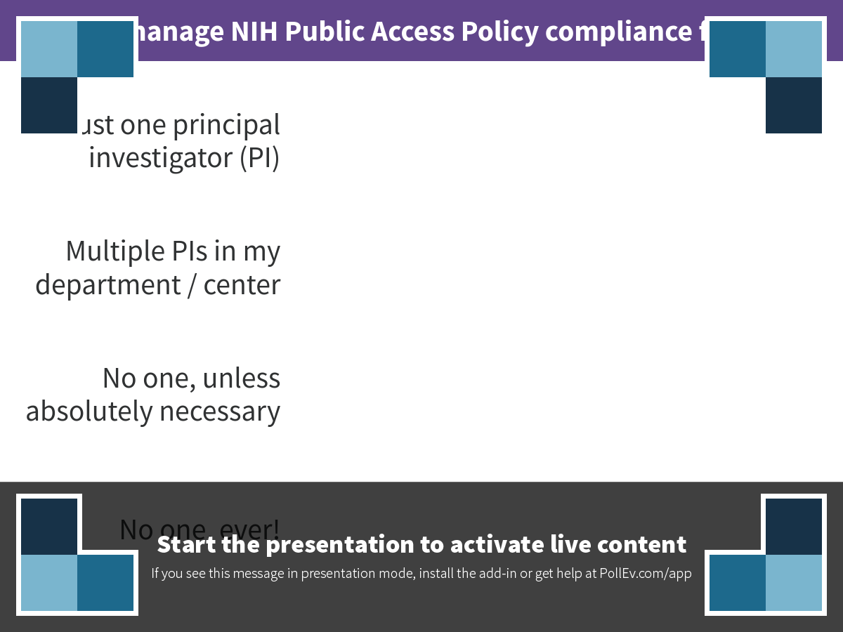
Notes:
I manage NIH Public Access Policy compliance for
https://www.polleverywhere.com/multiple_choice_polls/oOixiPdWvqYxHoC

Slide 4
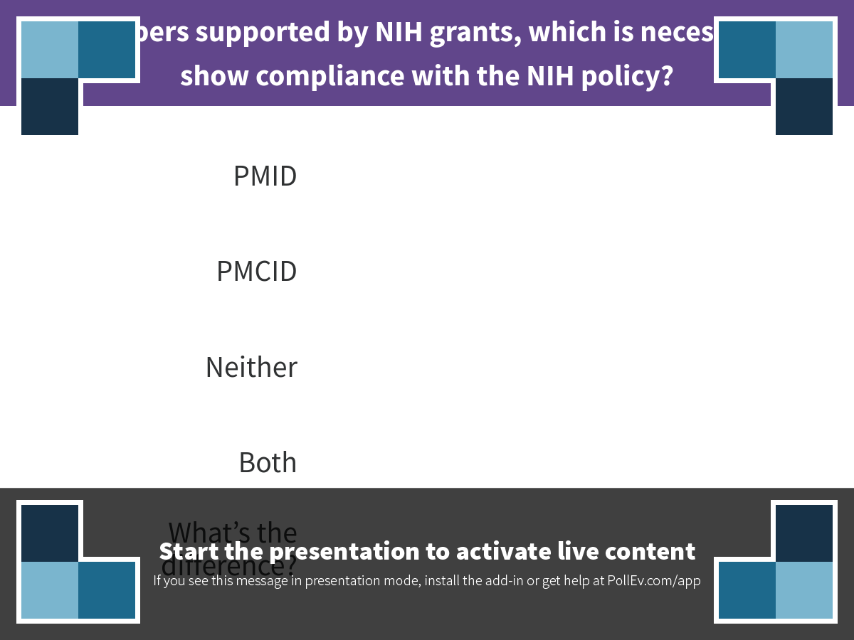
Notes:
For papers supported by NIH grants, which is necessary to show compliance with the NIH policy?
https://www.polleverywhere.com/multiple_choice_polls/CXqUg6Sskjm5NP9

Slide 5
Answer: PMCID
PMID vs. PMCID
The difference
PMID is the PubMed ID
  A PMID is given to each paper listed in the PubMed database
PMCID is the PubMed Central ID
  This identifier is given to a paper when its full text version is deposited to PubMed Central (PMC), the NIH’s database of full text manuscripts
  PMCIDs are required for all peer-reviewed journal articles that are funded by NIH grants that are active from April 2008 to present
  https://publicaccess.nih.gov/policy.htm
  Difference between PubMed and PubMed Central from the NIH PA FAQ

Slide 6
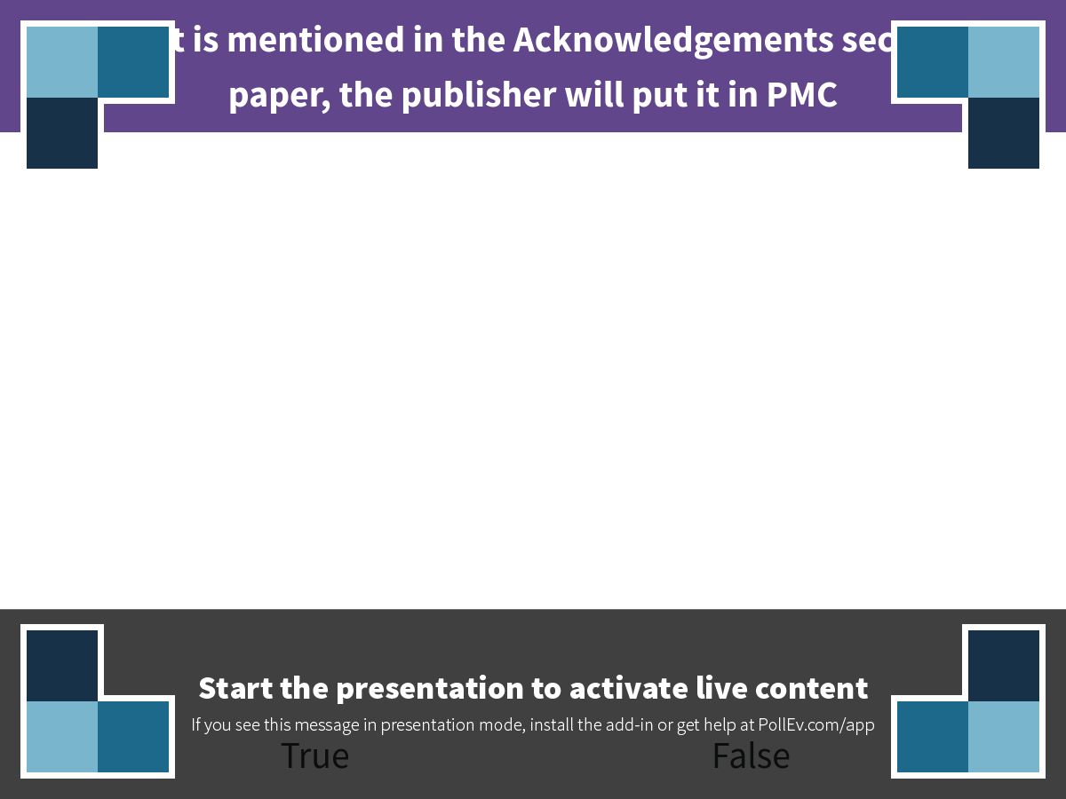
Notes:
If a grant is mentioned in the Acknowledgements section of a paper, the publisher will put it in PMC
https://www.polleverywhere.com/multiple_choice_polls/r3AbGxzQ8X3gQiR

Slide 7
Answer: False
When journals deposit to PMC
And when they don’t
Publishers are not required to add your papers to PMC.
Publishers will not take the information from the acknowledgements and automatically deposit the manuscript for you.
Some journals do deposit all of their content automatically to PMC, regardless of funding. If you publish in one of these journals (called “PMC journals ”), your manuscript will be deposited and will receive a PMCID automatically.
Most journals do not deposit to PMC, so you will need to take responsibility for having the manuscript deposited to PMC through the NIH Manuscript Submission system (NIHMS).
Some other publishers will start this process for you by depositing the manuscript to NIHMS, but they will only do this if you tell them at the time you sign the author agreement for publication.
  You must tell them of your NIH funding and provide them with the appropriate grant numbers on your author agreement letter.
  Check the journal’s author instructions for details on whether they will assist you or not.
https://publicaccess.nih.gov/submit_process.htm

Slide 8
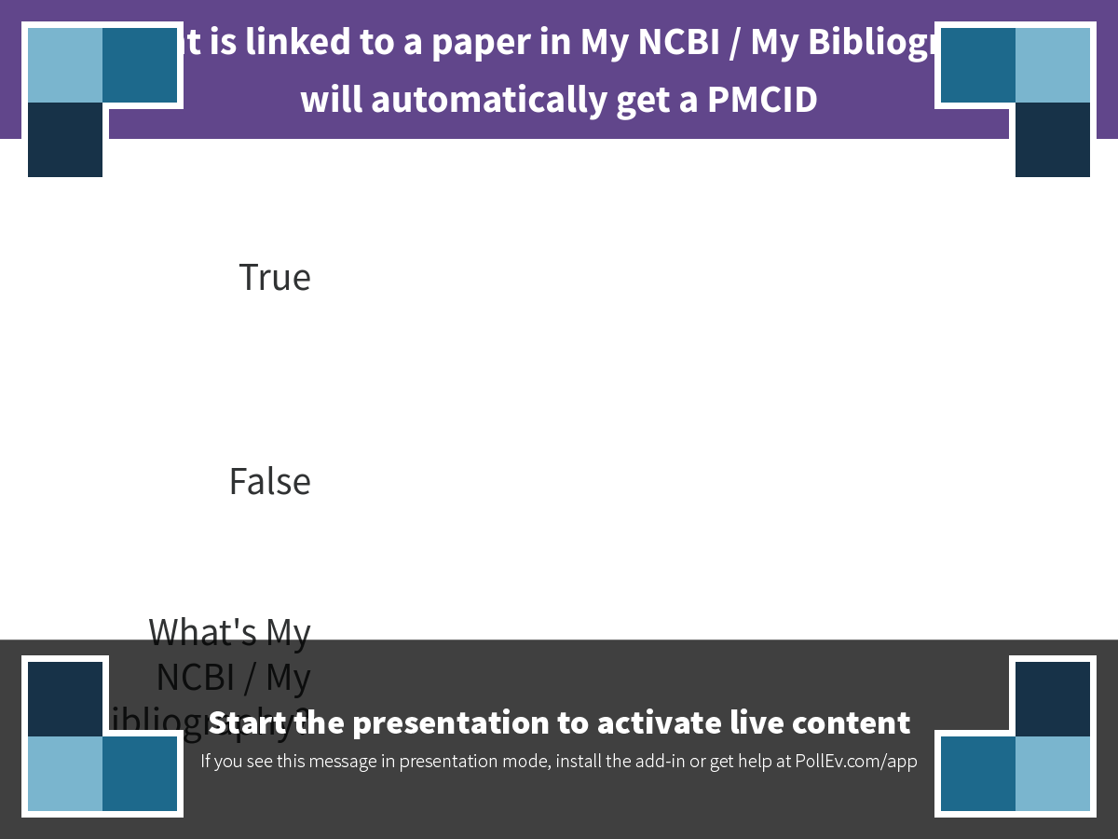
Notes:
If a grant is linked to a paper in My NCBI / My Bibliography, it will automatically get a PMCID
https://www.polleverywhere.com/multiple_choice_polls/w1WyEcndvbMZo8L

Slide 9
Answer: No
How papers get PMCIDs
A paper gets a PMCID once it’s been deposited to PubMed Central (PMC)
A paper only gets a PMCID “automatically” if it’s published in a PMC Journal
Otherwise, the author, PI, a delegate, or the journal’s publisher (by arrangement) must deposit the paper to NIHMS for eventual deposit to PMC – then it gets a PMCID
  See the NIH’s submission process page for the ways papers get deposited to PMC
Simply linking a paper to a grant won’t generate a PMCID

Slide 10
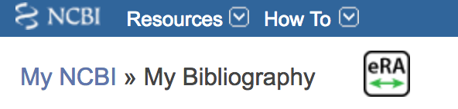
My NCBI’s My Bibliography
NIH-funded investigators are required to use My Bibliography to link manuscripts to grants for reporting purposes
  From Guide Notice NOT-OD-12-160:
    “The RPPR requires grantees to report publications using a Commons linked My NCBI account. “
For instructions on using My Bibliography, see the NIH’s My NCBI Help manual available at:
  https://www.ncbi.nlm.nih.gov/books/NBK53595/

Slide 11
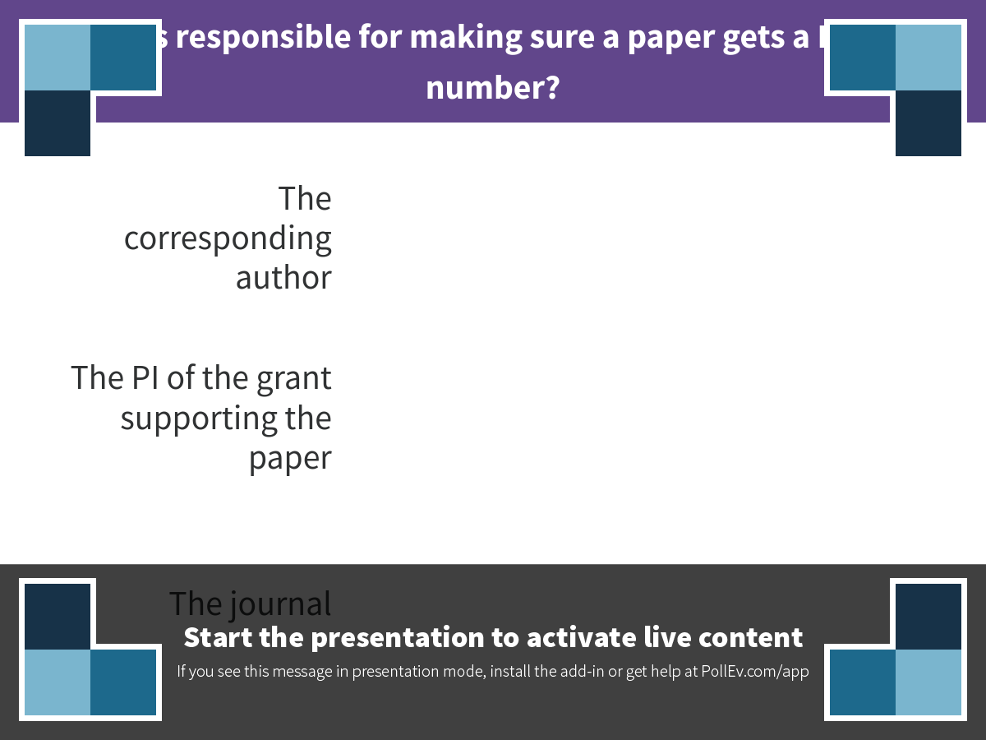
Notes:
Who is responsible for making sure a paper gets a PMCID number?
https://www.polleverywhere.com/multiple_choice_polls/wDdTHNuZNh6uPLp

Slide 12
Answer: the PI
When papers are linked to a grant, it is ultimately the PI’s responsibility to ensure that they are compliant
  From the NIH PI FAQ page:
  Principal Investigators and their Institutions are responsible for ensuring all terms and conditions of awards are met. This includes the submission of final peer-reviewed manuscripts that arise directly from their awards, even if they are not an author or co-author of the paper. Principal Investigators and their Institutions should ensure that authors are aware of and comply with the NIH Public Access Policy.
Often the PI is not the corresponding author for the journal, so communication between the PI and authors is crucial

Slide 13
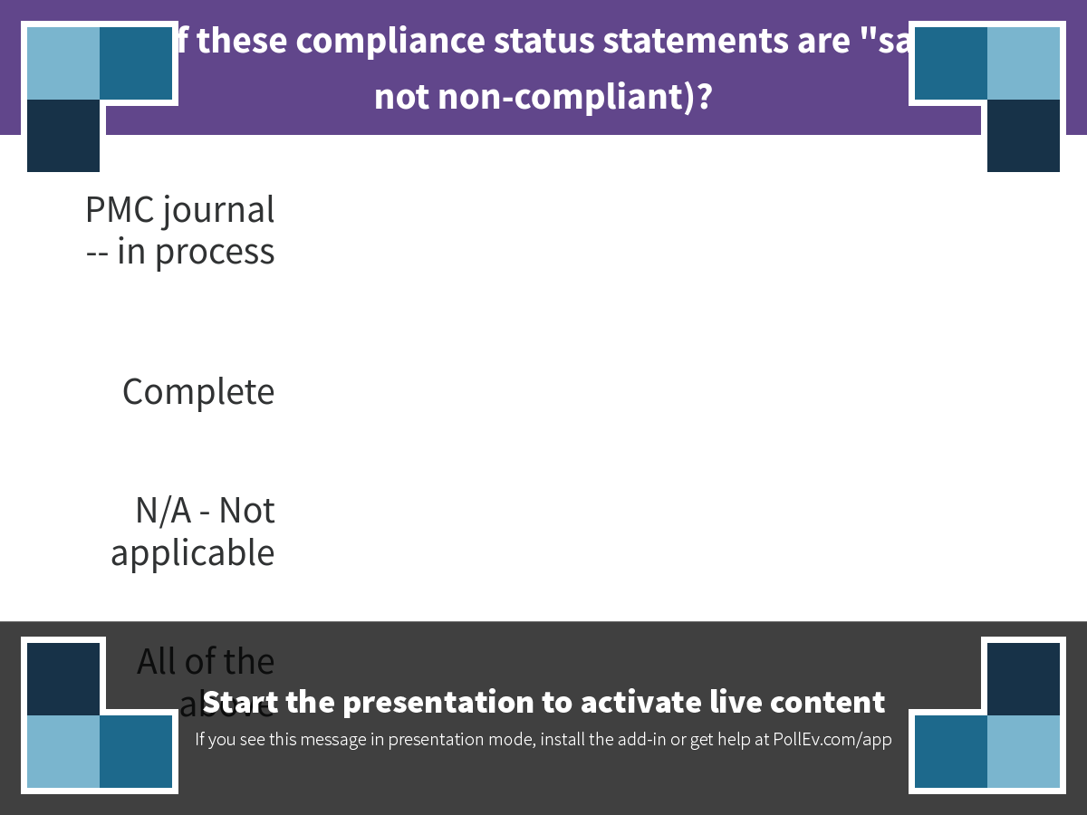
Notes:
Which of these compliance status statements are "safe" (are not non-compliant)?
https://www.polleverywhere.com/multiple_choice_polls/uqW8FxqT7ZKlsX3

Slide 14




Compliant | Not Compliant
Complete N/A (not applicable) PMC Journal in Process In process at NIHMS** | Non-compliant
** This status is only valid (compliant) up to 3 months past the official publication date of the paper
Please see the NIH “How to cite” page for details

Slide 15
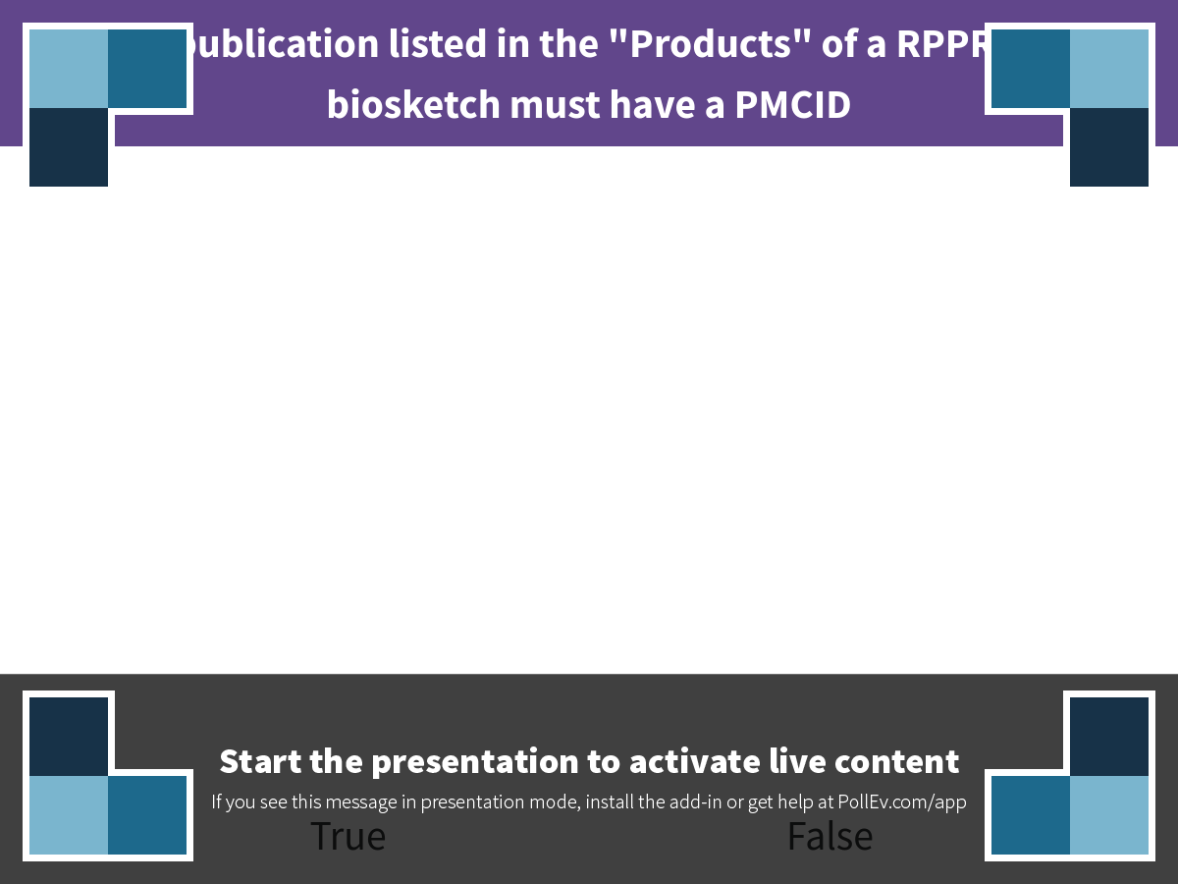
Notes:
Every publication listed in the "Products" of a RPPR or in a biosketch must have a PMCID
https://www.polleverywhere.com/multiple_choice_polls/AXQbcbg9neGppd2

Slide 16
Answer: False
When you don’t need PMCIDs
Although NIH PI FAQs state:
  Do I have to include a PMCID for every paper that I cite in an NIH application, proposal or progress report?
    Yes, include the PMCID if the paper is:
    Authored by you or arose from your NIH funds (even if you are not an author); and
    Is covered by the Public Access Policy (see http://publicaccess.nih.gov/determine_applicability.htm.)
Some research products are exempt from the NIH PA policy, such as:
  Book chapters
  Theses & dissertations
  Conference posters/abstracts
If a publication is not a peer reviewed journal article, it does not require a PMCID. You can still link it to grants, but just indicate that it is not peer reviewed in the [Edit status] pop-up in My Bibliography
The NIH also allows “Interim research products” such as preprints to be listed in My Bibliography and to be included in RPPRs.
  See NIH Notice NOT-OD-17-050 for details

Slide 17
Resources
NIH’s Public Access Policy Page
  https://publicaccess.nih.gov/
My NCBI Help
  https://www.ncbi.nlm.nih.gov/books/NBK3843/
My Bibliography Help
  https://www.ncbi.nlm.nih.gov/books/NBK53595/
Galter Library’s NIH policies and guides page (with links to individual guides)
  http://tinyurl.com/ybzcmner
Contact me:
  p-shaw2@northwestern.edu
  312-503-8689

Slide 18
Questions?

Slide 19
Thank You

