Slide 1
Charting a new course
practical data visualization for librarians
Notes:
Welcome to Charting a new course: practical data visualization for librarians.

Slide 2
What you will learn
Principles and practices of effective data visualization and visual communication.
Best practices for creating and formatting basic Excel charts to make them both informative and visually appealing.
Advanced data visualization in Excel to create charts such as heat maps, stacked bar charts, and scatter plots.
The usefulness of chart features such as legends, sidebars, colors, and benchmarks.
Notes:
Data visualization is used to communicate complex information and explore trends in large sources of data. Compelling data visualization requires thoughtful planning and execution; from understanding the data, choosing the right chart, balancing visual cues, and providing narratives to tell interesting stories. This course will give you a strong foundation in the principles of data visualization. In addition we will use Microsoft Excel, a common but incredibly powerful tool, to visualize library-relevant data through a series of hands-on activities. You will gain practical and immediately useful skills for visualizing both qualitative and quantitative data.

Slide 3




Who we are
Chris Belter
bibliometrics informationist
NIH Library
Candace Norton
Instruction Librarian
James A. Zimble Learning Resource Center at the Uniformed Services University of the Health Sciences
Karen Gutzman
Head, Research Assessment and Communications
Galter Health Sciences Library & Learning Center at Northwestern University
Annette Mendoza
Research Impact Librarian
Galter Health Sciences Library & Learning Center at Northwestern University
Notes:
In this course you’ll meet our four instructors:
Chris Belter: Chris Belter is a bibliometrics informationist at the NIH Library, where he specializes in publication and portfolio analysis. Chris regularly creates infographics related to his bibliometrics work and teaches courses on data visualization for NIH staff.
Candace Norton: Candace Norton, MLS, is the Instruction Librarian at the James A. Zimble Learning Resource Center at the Uniformed Services University of the Health Sciences. Her interest in data visualization grew out of her work in bibliometrics and is centered on how to credibly use, and teach others to use, data visualization to communicate complex information in a more concise way.
Karen Gutzman: Karen Gutzman is Head of the Research Assessment and Communications at Galter Health Sciences Library & Learning Center at Northwestern University where supports programs to increase awareness about digital scholarship and issues in the digital environment. Karen focuses on using information visualization to facilitate stronger comprehension of data in the assessment process.
Annette Mendoza: Annette Mendoza is the Research Impact Librarian at Galter Health Sciences Library & Learning Center at Northwestern University. Visual explanations of data are a valuable part of telling a story and Annette is dedicated to helping others master the utilization of tools they have access to, like Excel, for creating interesting graphics.

Slide 4
Schedule
Meeting 1
  Thursday, June 17
  1:00 pm – 3:30 pm CT // 12:00 pm – 2:30 pm ET
Office Hour (optional)
  Friday, June 18
  1:00 pm – 2:00 pm CT // 12:00 pm – 1:00 pm ET
Meeting 2
  Tuesday, June 22
  1:00 pm – 3:30 pm CT // 12:00 pm – 2:30 pm ET
Notes:
This course is organized around 3 meetings. The first meeting is today (Thursday, June 17) and will take 2.5 hours. After today’s course you will be given a “hands-on” exercise to complete before Meeting 2 on Tuesday, June 22. Just in case you have questions or need a little extra help, we are holding an optional 1-hour office hour on Friday, June 18.

Slide 5
Schedule
Meeting 1 (2.5 hours)
  15 min: Welcome, review objectives, warm-up activity
  1 hour, 5 min: Principles of Effective Data Visualization
  10 min: Break
  1 hour: Data Visualization in Excel
    Section 1: Get to know Excel
    Section 5: Create Basic Charts
    Section 6: Formatting Charts
  Homework: Hands On Creating Basic Charts
Notes:
In today’s meeting we will focus on data visualization. Chris Belter will present “Principles of Effective Data Visualization” to get us off on the right foot. After a short break, we will come back and open our course workbook. In the workbook, we will cover Section 1: Get to know Excel, Section 5: Create Basic Charts, and Section 6: Formatting Charts. After today’s session you’ll be given the “Hands On Creating Basic Charts” workbook to complete before Meeting 2.

Slide 6
Schedule
Office Hour (1 hour)
  Optional
  Review Homework: Hands On Creating Basic Charts
Notes:
As mentioned, we’ll offer an optional 1-hour Office hour to review the “Hands On Creating Basic Charts”.

Slide 7
Schedule
Meeting 2 (2.5 hours)
  15 min: Review “Hands On Creating Basic Charts”
  45 min: Data Cleaning and Manipulation in Excel
    Section 2: Basics of Data Cleaning
    Section 3: Basics of Functions
    Section 4: Basics of Data Manipulation
  10 min: Break
  20 min: Section 7: Advanced Data Visualization
  30 min: Small group work on Hands On Scenarios
  10 min: Break
  15 min: Present work to large group (or post progress to slack)
Notes:
In Meeting 2 we will review the “Hands on Creating Basic Charts” workbook. Then we will jump back into the course workbook to cover Section 2: Basics of Data Cleaning, Section 3: Basics of Functions, and Section 4: Basics of Data Manipulation. After a short break we will cover Section 7: Advanced Data Visualization. Next we will break into small groups and work on the “Hands On Data Visualization Scenarios”. There will be five small groups to correspond with the 5 different scenarios – you’ll get to choose which small group you want to join. These scenarios focus on visualization tasks related to four types of library-based data, such as data related to Institutional Repositories, Library Assessment, Collection Development, Literature Searching, and Research Impact. In the small groups, we will work on cleaning, manipulating, and visualizing data for our scenarios. After a short break, we will come back together as a large group and share our small group work. If time gets away from us, we can share our progress on Slack.

Slide 8
Course Materials and Communication
Course materials available here:
  Principles of Effective Data Visualization:
  Charting a New Course:
  Charting a New Course materials are available using the Attribution-NonCommercial-ShareAlike 4.0 License. This means you are free to share, copy, redistribute the material in any medium or format, AND you can adapt, remix, transform or build upon the material. However, you must provide appropriate credit, you may not use the material for commercial uses, and you must distribute your material under this same license.
Where do I ask questions or chat with course instructors or attendees?
  Zoom chat: Use the Zoom chat function to ask questions or chat with attendees. Note, any public AND private conversations on chat are recorded
  Join us on the Slack channel:
Notes:
Course materials are available for download at the following locations:

Slide 9
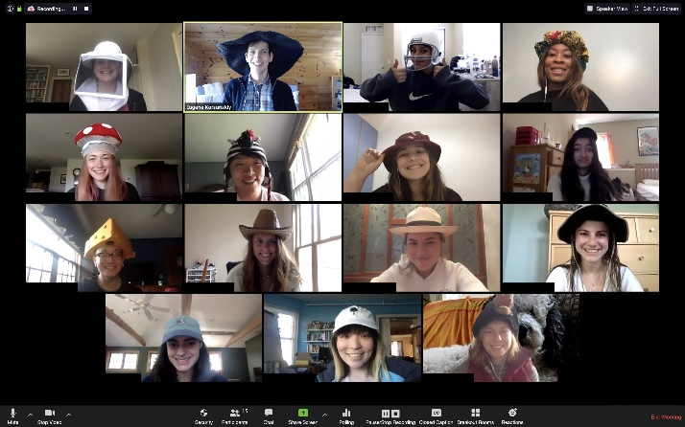
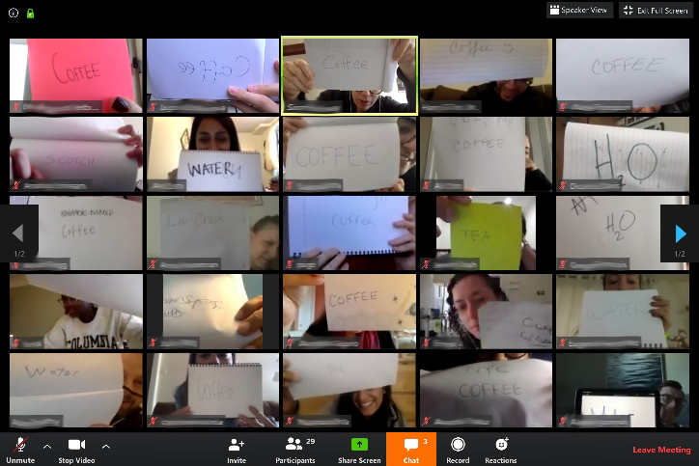
Warm up: Zoom Bingo
Set your Zoom screen to the “Gallery view” setting which allows you to see everyone as a set of tiled video screens.
Using a pen and a piece of paper, write in large print a one-word answer to this question:
  What was the last thing you had to drink?
Hold your response up to your camera. Check if you see a column or row (or any diagonal) that contains all the same responses! If yes, type BINGO! in the chat box.
Other questions we could try:
  What type of animal was your first pet?
  What city are you in now?
Gallery view in Zoom
Holding up responses
Notes:
Let’s do a quick warm-up activity called Zoom Bingo.
Set your Zoom screen to the “Gallery view” setting which allows you to see everyone as a set of tiled video screens.
Using a pen and a piece of paper, write in large print a one-word answer to this question:
What was the last thing you had to drink?
Hold your response up to your camera. Check if you see a column or row (or any diagonal) that contains all the same responses! If yes, type BINGO! in the chat box.
Idea from: https://medium.com/future-of-design-in-higher-education/zoom-friendly-warmups-and-icebreakers-3400c8b7263

Slide 10
Get your coffee and tea ready…
because we are heading into “Principles of Effective Data Visualization”
Notes:
Get your coffee and tea ready…because we are heading into “Principles of Effective Data Visualization”

