Slide 1

Identifying Predatory Journals and Questionable Conferences
A Presentation for Psychiatry Grand Rounds by Annie Wescott and Annette Mendoza
Galter Health Sciences Library & Learning Center
1

Slide 2
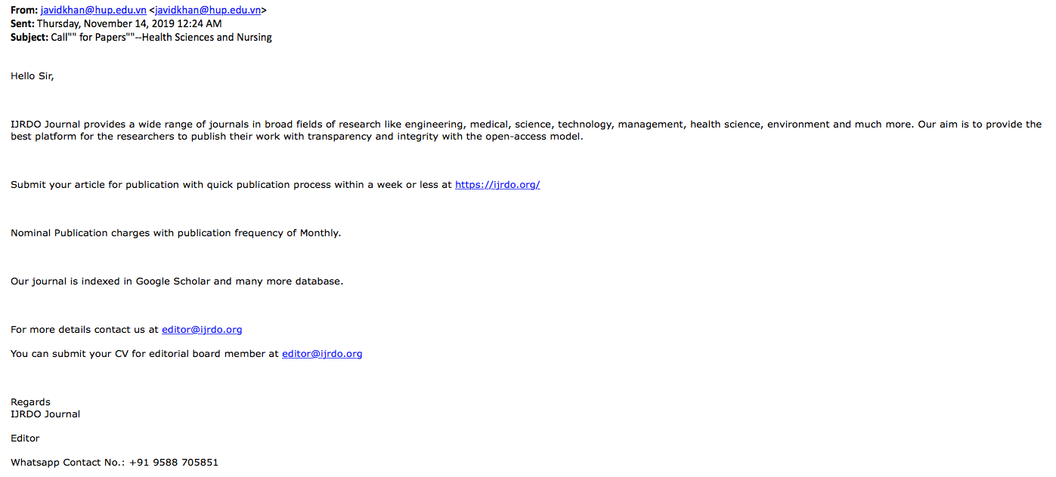

Notes:
https://www.sciencemag.org/careers/2019/05/how-i-became-easy-prey-predatory-publisher

Slide 3
Questions to be Answered
What is predatory publishing?
Why should we worry about it?
How can I tell if a journal is predatory?
What are some tools I can use?
What are predatory conferences?
How do I find a trustworthy journal?

Slide 4
Predatory Publishing
“
”
Predatory journals and their associated publishers uphold few ethical standards, often charging fees, known as author processing fees, prior to acceptance for publication without providing thorough editorial and publishing services.
Notes:
Quote is from Academic Nightmares: Predatory Publishing by Sonya E. Van Nuland and Kem A. Rogers.

Slide 5
Predatory Publishing
Motive: $$$
Mode of outreach: Email
Targets: New authors and those who feel pressure to publish quickly
Pervasiveness: potentially 1400+ predatory publishers, many of which take advantage of the open access model

Slide 6
Open Access ≠ Predatory
Purpose: Quality Open Access journals strive to make research available to the end-user free of charge
Fees: Open Access journals may charge a fee to the author, which should cover the costs of maintaining the quality standards of the journal
Benefits: Open Access benefits the authors and readers by eliminating barriers to viewership
Rights: You should be able to retain your copyright with most Open Access journals

Slide 7
Consequences of Predatory Publishing
Potential loss of an author’s ownership of their ideas and copyright
Inability to disseminate high quality research as it becomes undiscoverable
Poor quality publications that can decrease confidence in scholarly research output

Slide 8
Check for Red Flags
There are a number of red flags you can check (e.g. emails, contact information, editorial board, etc.)
Do your due diligence to check multiple source before accepting something as trustworthy
Don’t be afraid to ask your colleagues or reach out others about their experiences

Slide 9
Red Flag: Flattery & Errors
Did you receive an email solicitation with oddly stilted language or flattery?
Do the emails come at odd hours?
Does the the sender have a generic email address (e.g. gmail, yahoo, etc.)?
Do you notice frequent grammatical errors in the journal or on the journal’s website?

Slide 10
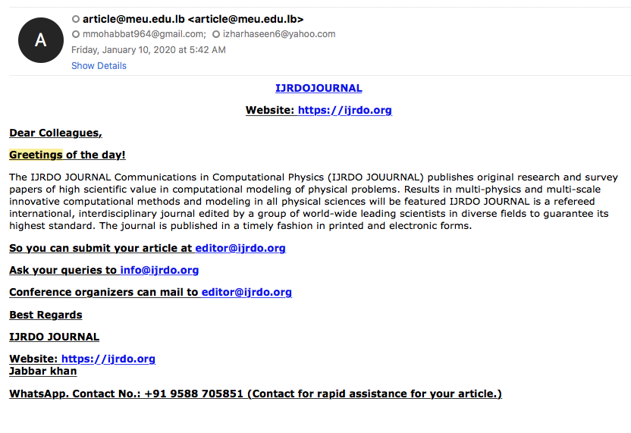
Notes:
Flowery greeting.
Generic Email.
Complicated contact.

Slide 11

Red Flag: Contact Information
Can you verify the contact information that is listed on the website?
Do they list a business address?
Can you verify the identity of the individual sending the email?
Quick Check: Look up the journal address in Google Maps.

Slide 12
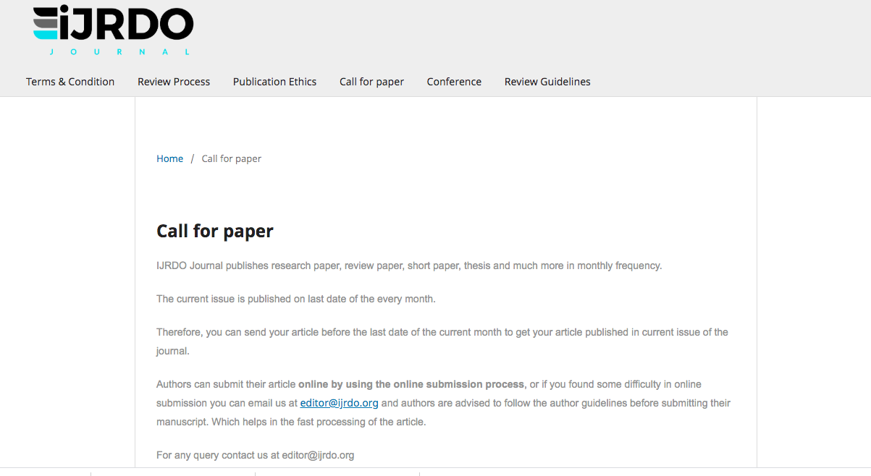
Notes:
Only one way to contact (no address, phone number, etc.)
Grammatical errors on the website.

Slide 13
Red Flag: Journal Description
Is the name of the journal nearly indistinguishable from a highly-respected journal in your field?
Is the journal scope of interest broad or unclear?
Does the journal have a ISSN number that can be verified?

Slide 14
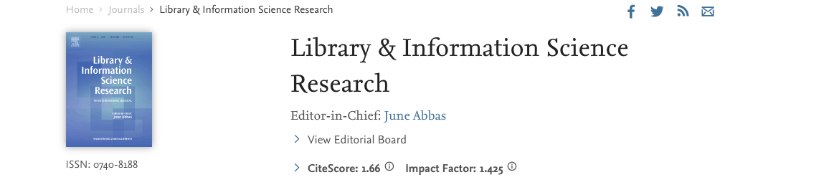
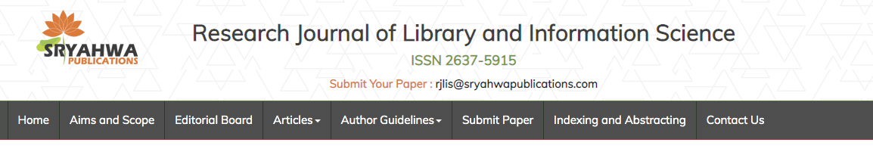
Notes:
Note how similar the two journals are in title

Slide 15
Red Flag: Editorial Board
Do you recognize the editorial board?
Do the members mention their work on the board on personal websites or online profile systems?
Are the academic affiliations of those listed on the editorial board confirmed to be genuine?
Quick Check: Look up members on LinkedIn or VIVO and check if they list their board work on their profile. When in doubt, reach out!
Notes:
You can also reach out by email to members listed on the editorial board to ask about their experience with the journal. It can be a challenge for individuals to get themselves off the editorial list of predatory journals.
https://www.chronicle.com/article/These-Professors-Don-t-Work/244120

Slide 16
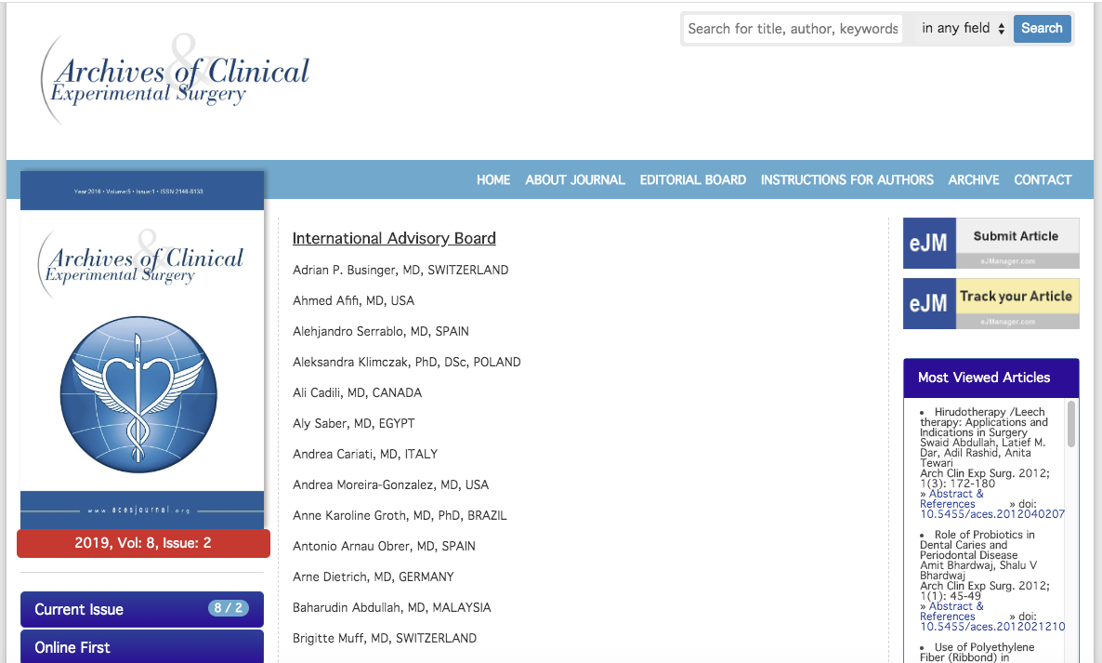


Slide 17
Red Flag: Peer Review
Does the journal undergo peer-review?
Check the “About this Journal” section
  Look for keywords like, “peer-reviewed,” or ”refereed”
Be aware: just because a journal is peer-reviewed does not mean every output is peer-reviewed
  Editorials, brief news, and short communications may not be peer-reviewed
Quick Check: Check Ulrich's Periodicals Directory for detailed journal information.

Slide 18
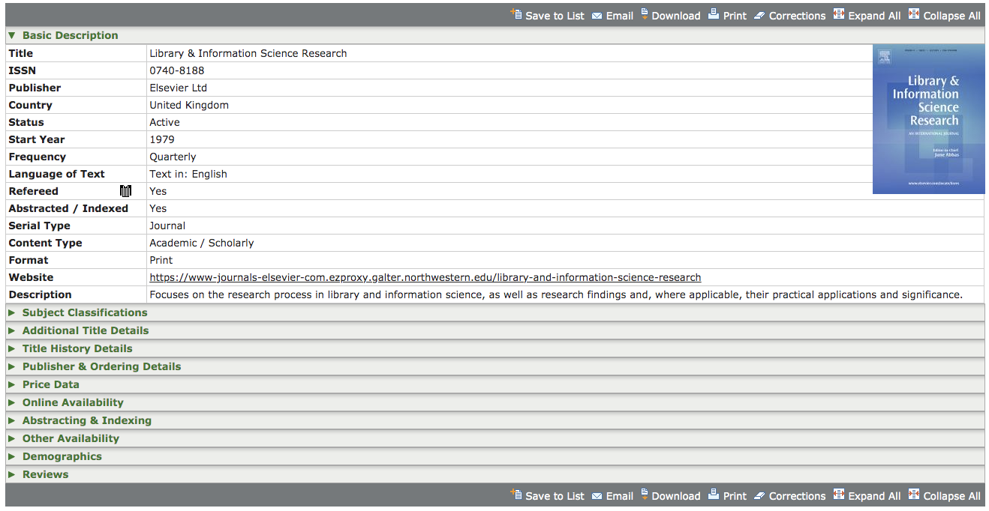
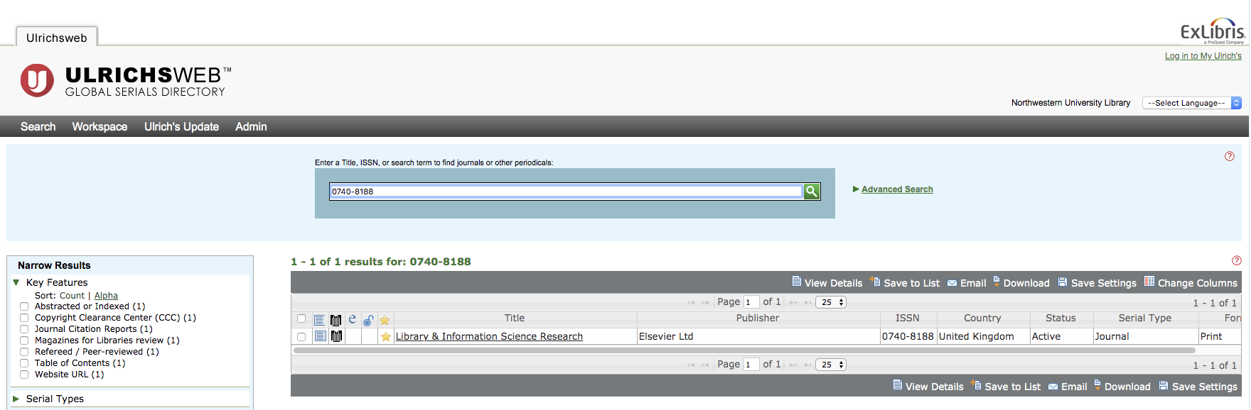

Slide 19
Red Flag: Industry Membership
Is the journal listed on the Directory of Open Access Journals (DOAJ)?
Is the publisher a member of the Committee on Publication Ethics (COPE), or the Open Access Scholarly Publishers Association (OASPA)?
Keep in mind: There may be a bias against newer journals.
Notes:
https://doaj.org/
https://publicationethics.org/
https://oaspa.org/

Slide 20
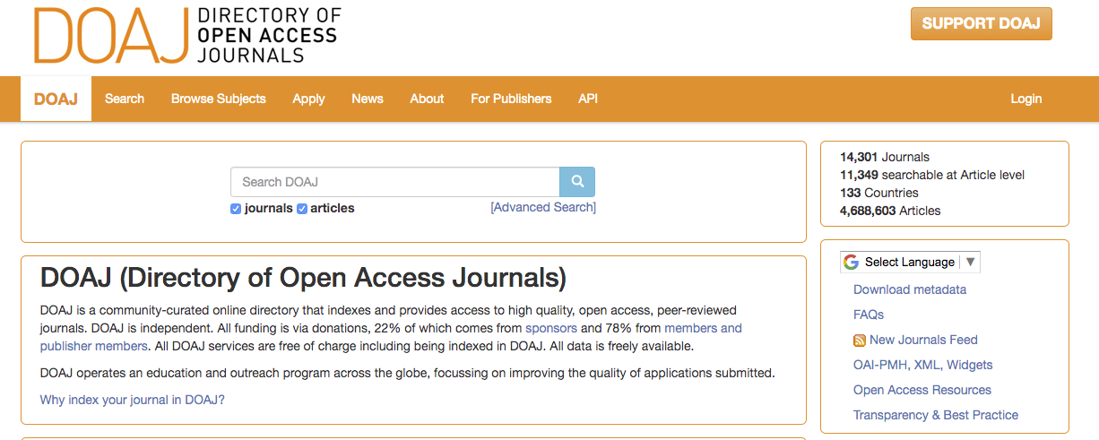

Slide 21
Red Flag: Database Lists
Can you find the journal and/or publisher in a database you have confidence in, i.e. Scopus® or PubMed®?
Do they claim to be indexed in a database, but you cannot locate them?
Can the verify the impact factor of the publication?

Slide 22
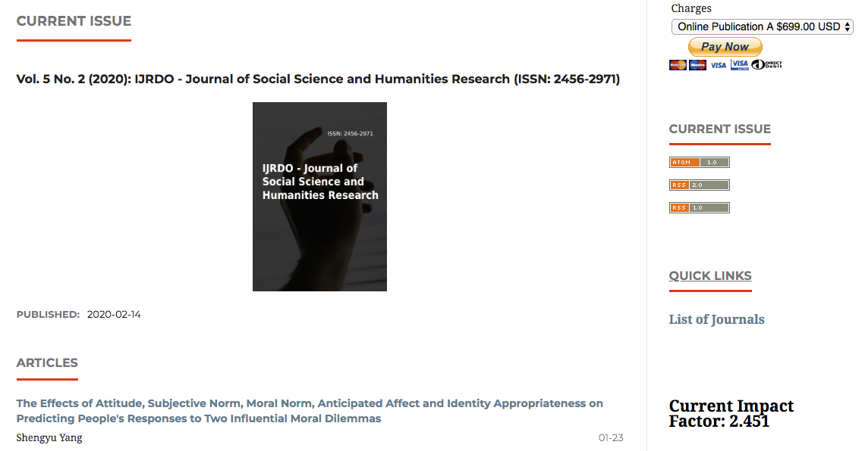
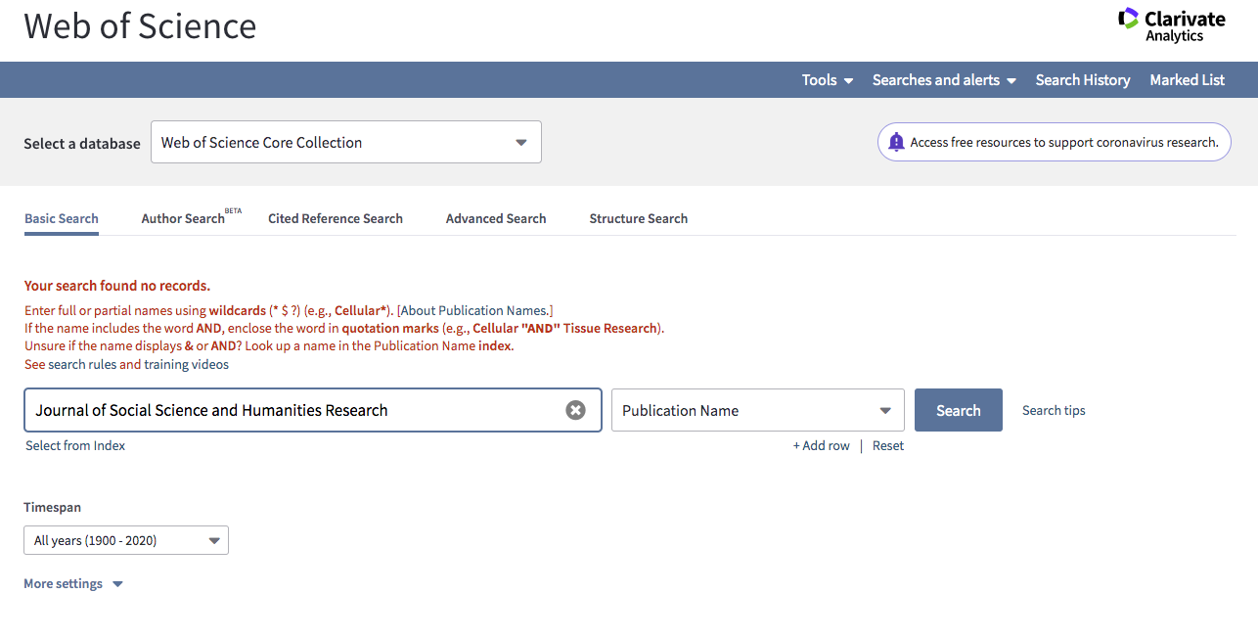
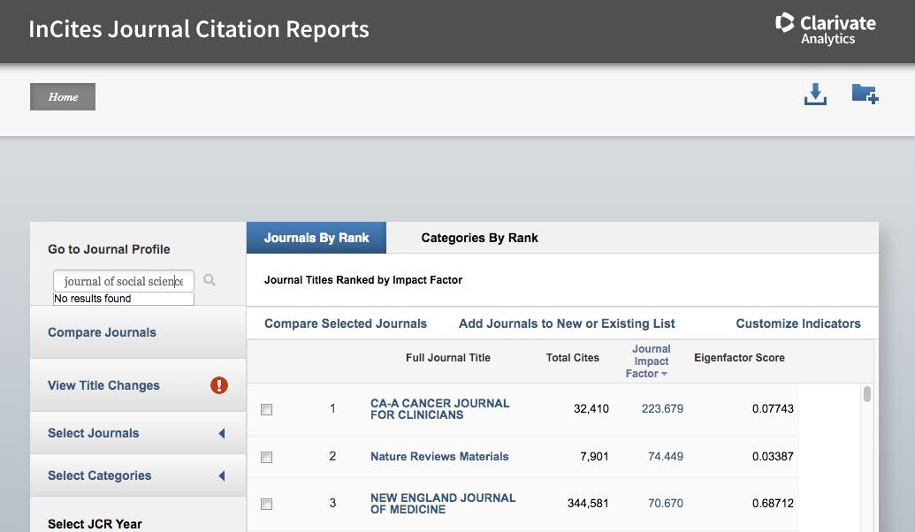

Slide 23
Red Flag: Fees
Note: Fees are not an automatic indicator of a predatory publisher.
Is there a lack of clarity about fees?
Are they charging for odd services?
Notes:
Do they list the fee schedule on the website or is it difficult to find information about the fees? That’s a red flag. These journals will express these fees after the article is submitted.

Slide 24
Red Flag: Publication Timeline
How long does the journal estimate for publication?
Does the journal boast a short submission-to-publication process?
  The peer-review process is a time consuming process
  Less than one month should be a red flag
Notes:
https://library.cuanschutz.edu/predpub

Slide 25
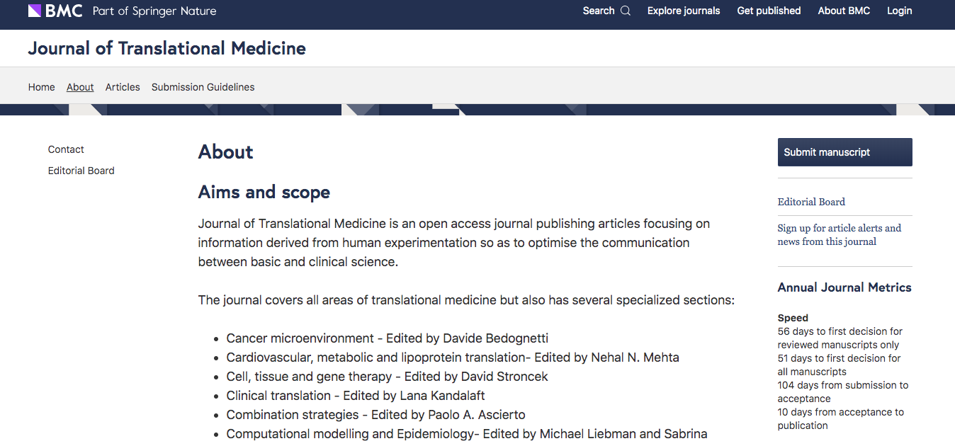
Timeline: Positive Example

Slide 26
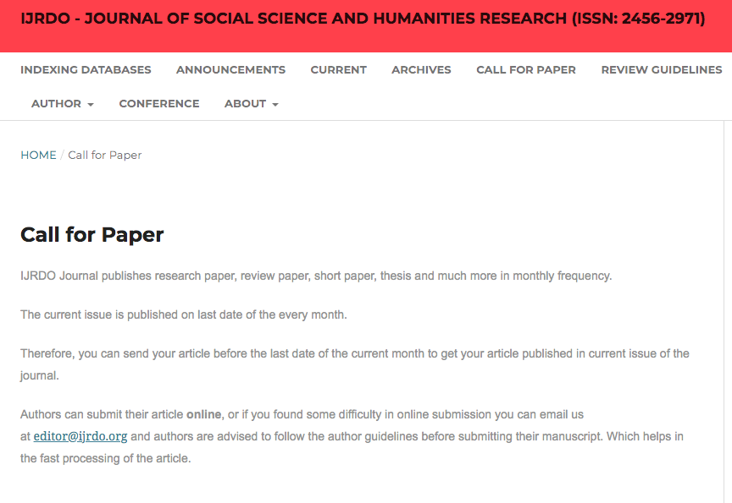
Timeline: Concerning Example

Slide 27
Progress Check!

Slide 28
Lack of focus area.
Overly-formal greeting.
Short publication timeline.
Odd phrasing.
Google Scholar does not index journals.
No name given.

Slide 29
Other Lines of Defense
Learn about the ethics of publishing
Consult Beall’s List or other predatory journal lists
Use Think, Check, Submit
Block emails from journals you have deemed predatory
Stay abreast of new journals in your field
Ask a librarian
Notes:
Note: Beall’s list is no longer updated

Slide 30
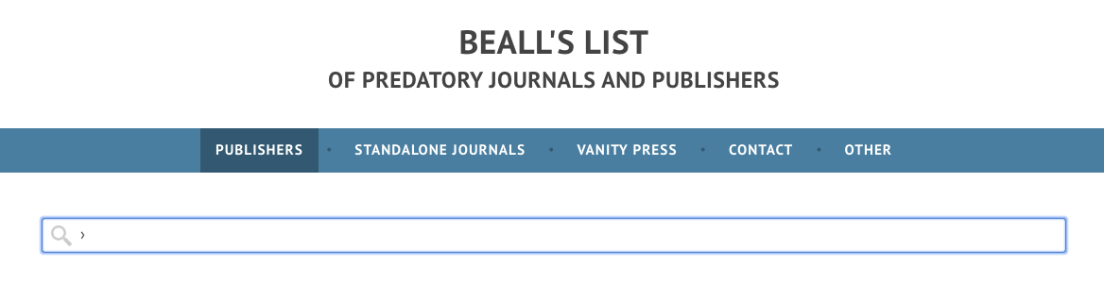
Predatory Journal Lists
Look up the standalone journal AND the parent company
Trust your gut and your process – just because it is not on the list, does not mean it is not predatory.

Slide 31
Think, Check, Submit
Utilize Think, Check, Submit guide to help determine whether a journal is right for you.
Use the check list to walk through the process:
  http://thinkchecksubmit.org/check/

Slide 32
Actions if you suspect you are a victim
Send an email calling for withdrawal of the article and in that email:
  Clarify your retention of copyright
  Point out fraudulent practices
  Suggest pending legal action
  Set up a Google Alert
  Contact the Federal Trade Commission

Slide 33
Questionable Conferences
Similar to predatory publishing, questionable conferences are situations where researchers, scientists and other professionals are enticed to attend and/or participate in fraudulent conferences in an effort to extort money.

Slide 34
Conference Checks
Check the name
  Conference promotors will alter the name of a well known conference secure registration fees (i.e., Entomology 2020 will be renamed Entomology-2020)
Keep an eye on fees
  Speakers are recruited and then requested to pay a fee
  Attendance fees may be higher than typical
Be aware of broad topic areas
  Consider the agenda’s range of focus

Slide 35
Conference Checks
Locate listed speakers and committee members
  Well known scientists will be listed as speakers without their knowledge to legitimize an event
  Reach out to speakers and committee members
Research the conference venue
  Is it clear this is a reputable venue?
  Is the conference offered in many cities?
Check with your peers
  Is the conference known in your field or by your colleagues?

Slide 36
Finding Journals
Locating the right fit for your research
Plan your process
Check for topic journals in databases
Utilize available tools
Keep an open mind

Slide 37
Think Ahead
Identify a journal before you start
If possible, identify a target journal before you begin writing your manuscript.
  Allows you to tailor to journal specifications
  Ensures you follow author guidelines

Slide 38
Check Databases
Explore journals in various databases
Search your topic and related keywords in various databases to identify journals that publish on the topic
  Looking at the search results, analyze the journals that have published articles on similar topics
  Look at the journal's website to see the mission, aim, & scope of the journal, information for authors, and to see other articles they have recently published
Notes:
https://galter.northwestern.edu/galterguides?url=https%3A%2F%2Flibguides.galter.northwestern.edu%2Fc.php%3Fg%3D474404%26p%3D3246274

Slide 39
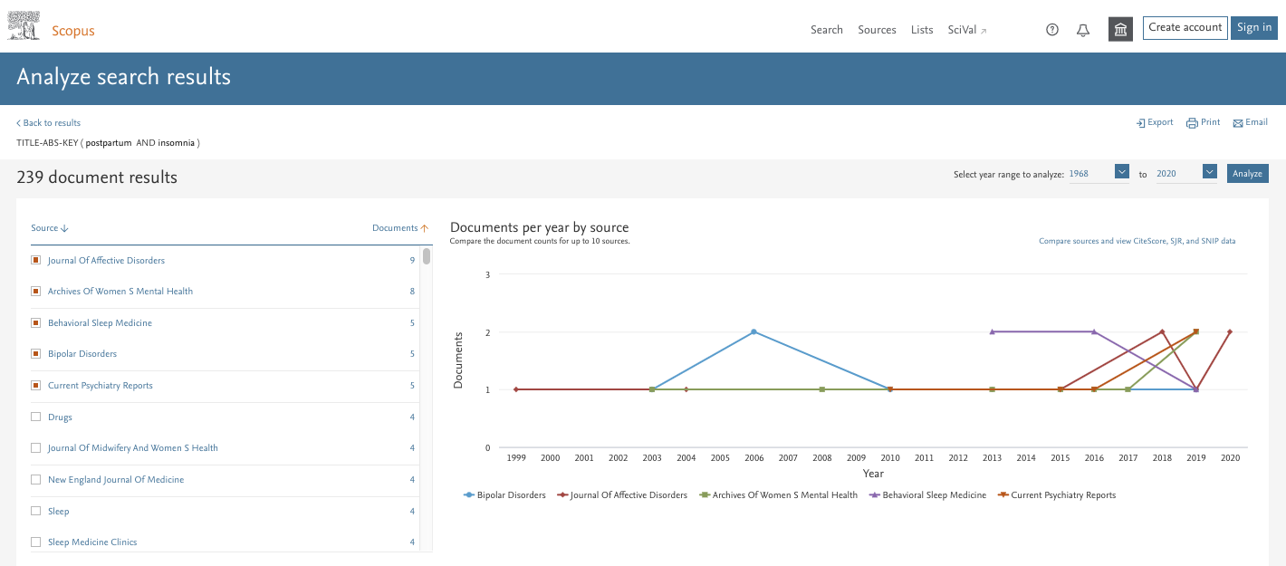

Slide 40
Utilize Tools
There are various tools that can help you identify the right journals
JANE (Journal Author Name Estimator): Enter the title, abstract, or keywords for your paper, and find a suitable journal to submit it to for publication
EndNote Web: Login to EndNote Web, click on the "Match" tab. Enter the title of your article and the abstract, and EndNote will return a list of suggested journals for your topic
Elsevier Journal Finder: Enter the title and abstract of your paper and find a journal that might be suitable to submit it to for publication

Slide 41
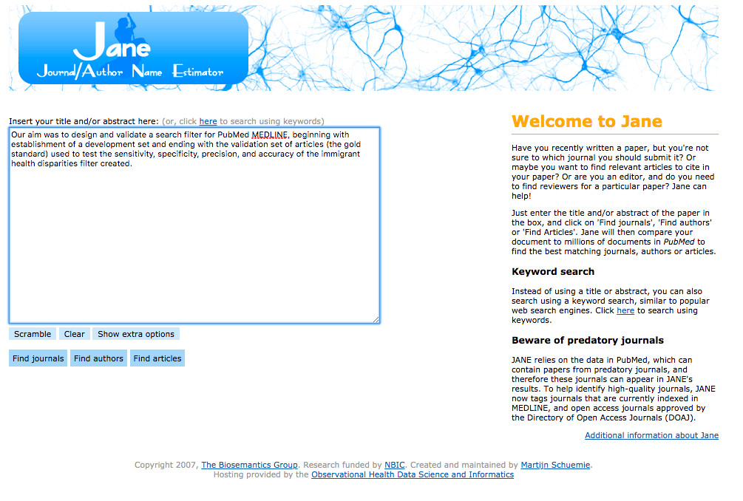
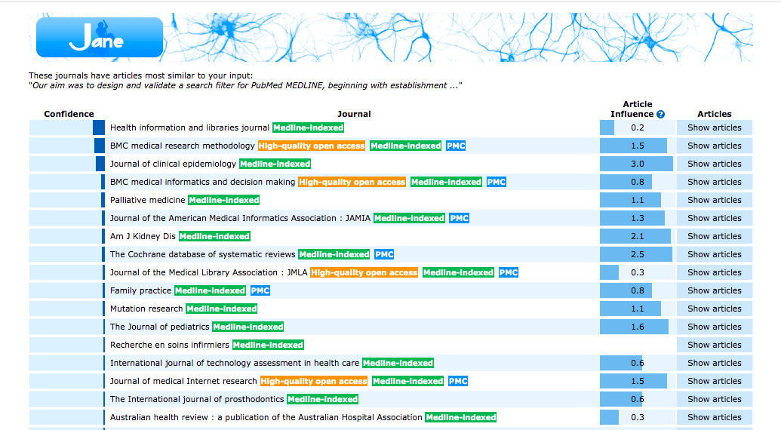

Slide 42
Be Realistic
Choose a journal that is realistically within reach
Impact factor is not the only measure of reputation
  Consider the readership numbers
  Think about whether the journal publishes on your topic
  Be objective and consider the importance of your research

Slide 43
Consider Your Topic Area
Choose a journal that specializes in your sub-area
Consider a journal that is especially geared toward your niche area
  Better publishing opportunities
  More likely to reach your target audience

Slide 44
Check Permissions
Choose a journal that permits self-archiving
When you choose a journal that allows self-archiving, you have the option of uploading your work to your author’s website and/or institutional repository such as DigitalHub
Check the Sherpa/Romeo website to see if a journal permits self-archiving
https://galter.northwestern.edu/galterguides?url=https%3A%2F%2Flibguides.galter.northwestern.edu%2Fc.php%3Fg%3D474404%26p%3D3246274

Slide 45
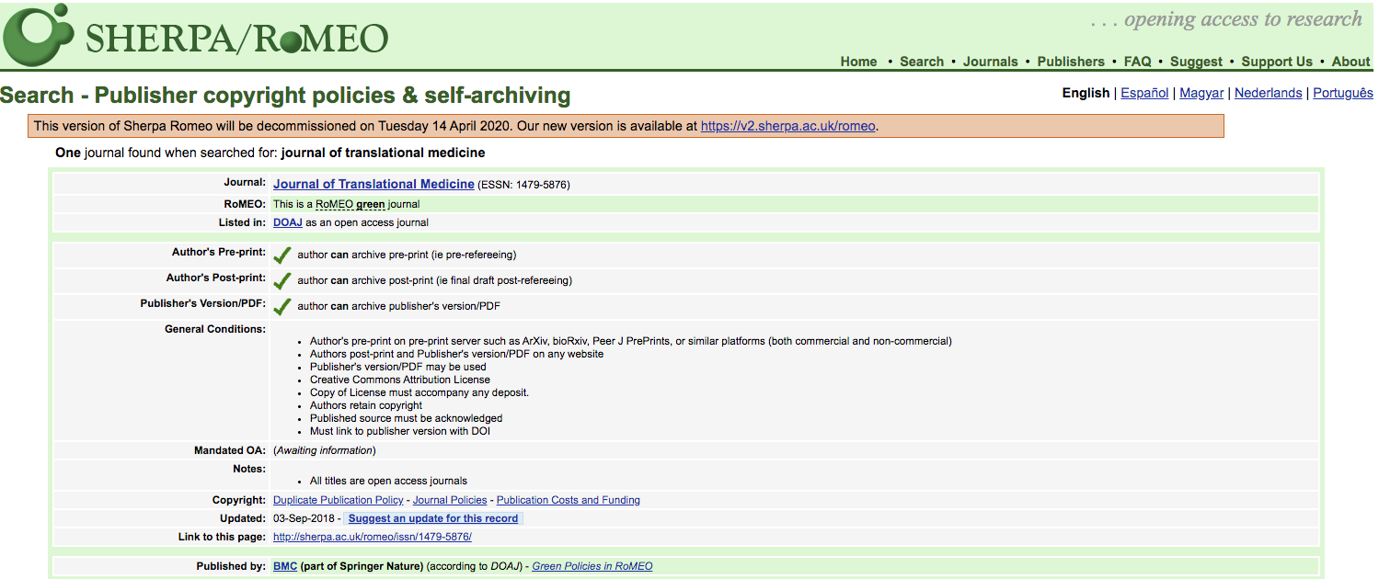

Slide 46

Predatory or Not?
Notes:
How about this open access journal - Psychiatric Research and Clinical Practice, do you think it is a predatory journal?
Do you recognize the title?

Slide 47
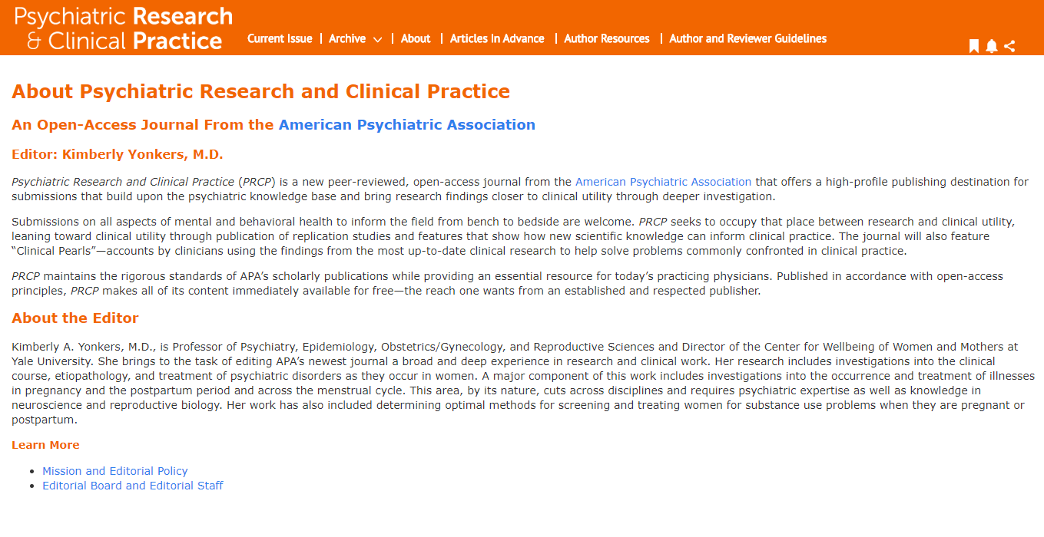
Notes:
The information states it is peer-reviewed, which is a good sign. Further, there are outlined guidelines for the review process, so we are able to verify what the peer review process looks like.
Does the editor information check out?

Slide 48
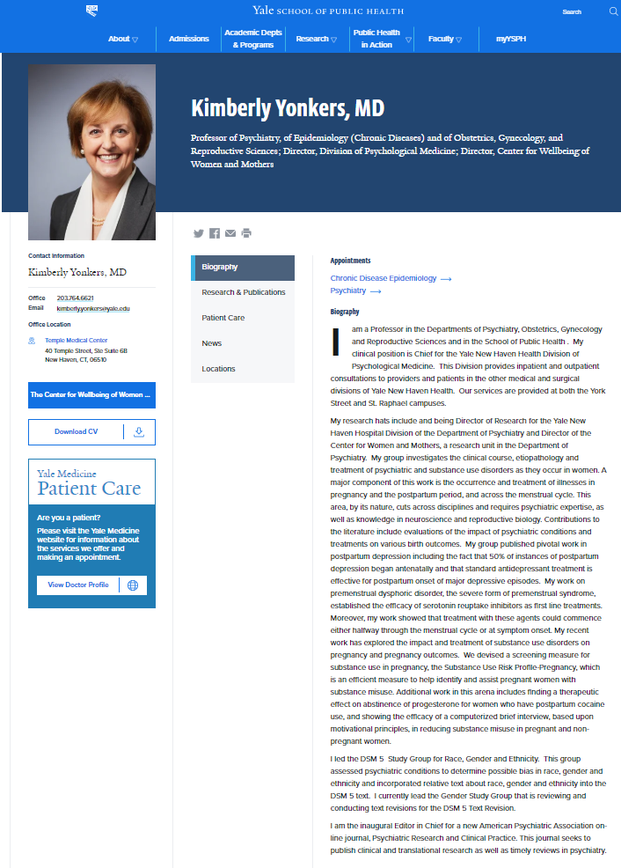

Notes:
When we visit Kim Yonkers webpage on Yale’s website, she mentions the publication.

Slide 49

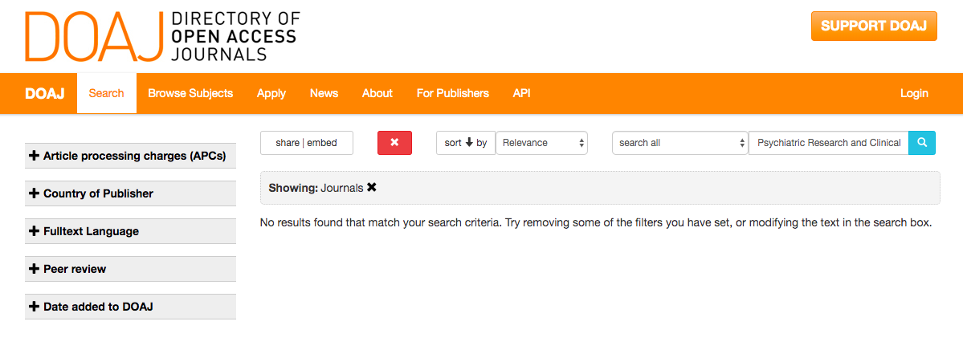
Notes:
This journal was just launched in April of 2019. It is good to keep in mind that newer journals are going to be more challenging to verify, but that does not mean they are predatory.

Slide 50
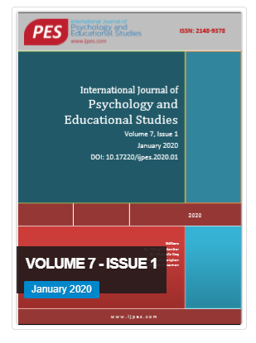
Predatory or not?
Notes:
How about this open access journal – International Journal of Psychology and Educational Studies, do you think it is a predatory journal?
Do you recognize the title?

Slide 51
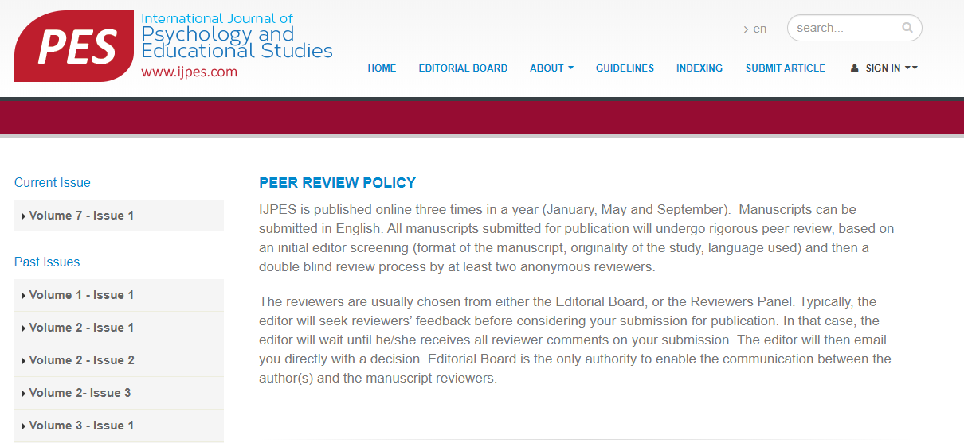
Notes:
The information states it is peer-reviewed, which is a good sign. Does the editor information check out?

Slide 52
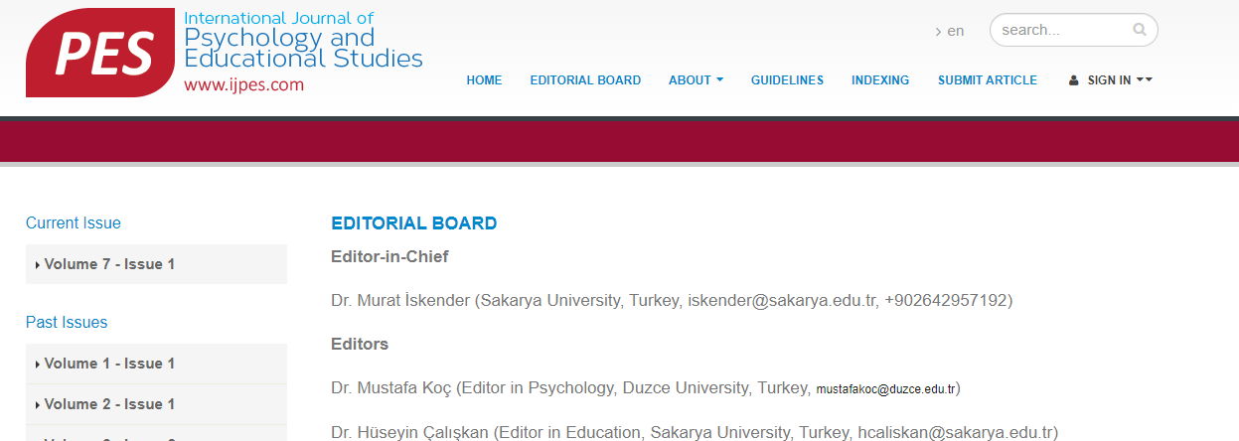
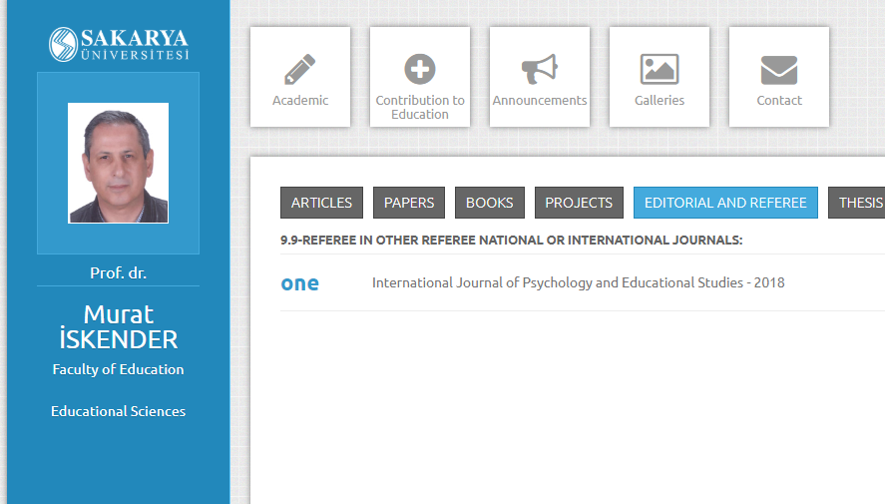
Notes:
When we visit Murat Iskender’s webpage on Sakarya University’s website, he mentions the publication.

Slide 53
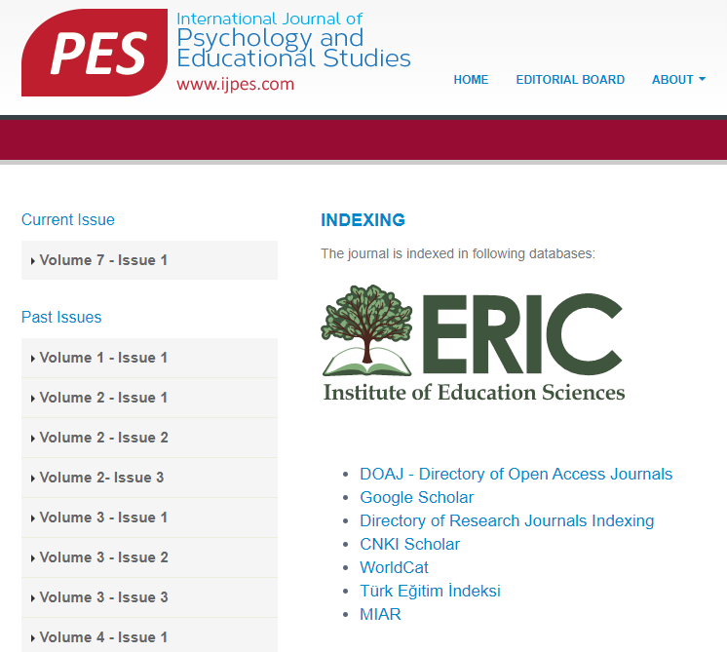
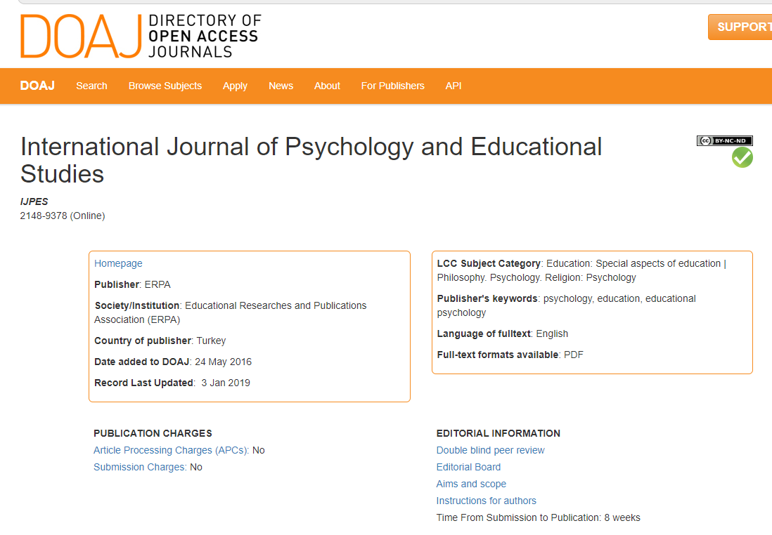
Notes:
The website provides evidence of databases it is indexed in and there is an ISSN number. I use this journal as an example because it is on a list of predatory journals – this just goes to show that you have to investigate yourself. Journals that may have had a rocky start may have been saddled with a “predatory journal” tag.

Slide 54

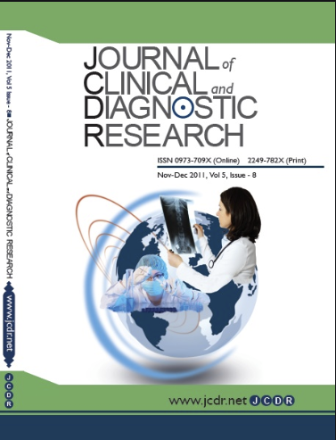
Predatory or not?
Notes:
How about this open access journal – International Journal of Clinical and Diagnostic Research.
Do you recognize the title? There is another journal that is quite similar in title, which appears on the DOAJ list.

Slide 55
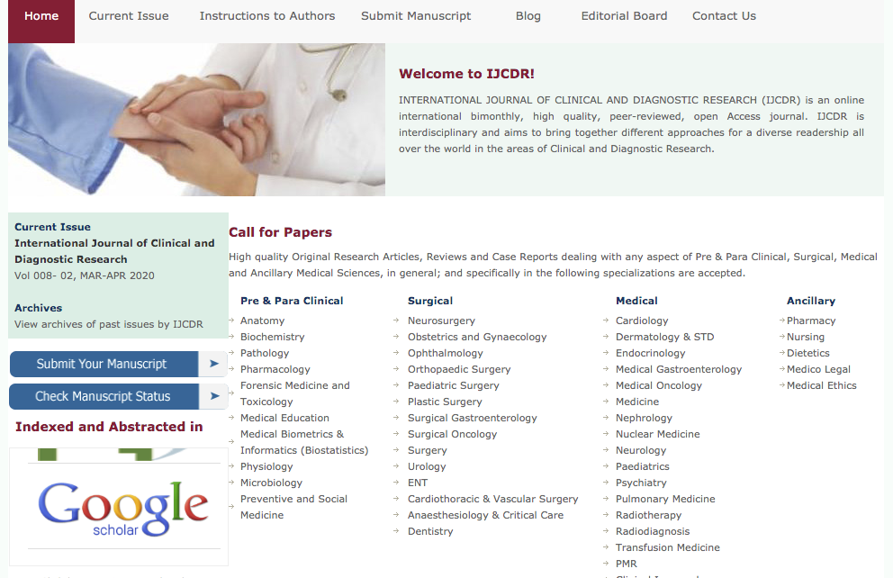
Notes:
On the home page, the journal says it is peer-reviewed, but one cannot find any information about the process on the website.
The journal claims to be indexed in Google Scholar, but we know that Google Scholar does not index journals.

Slide 56

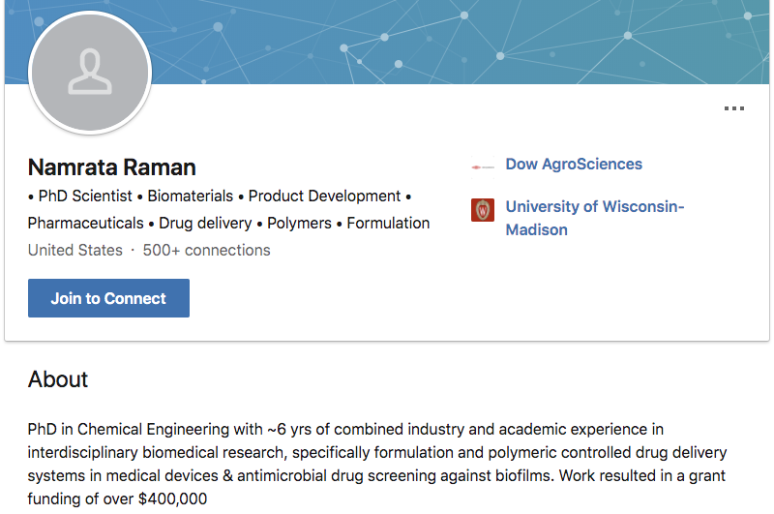
Notes:
When we visit Namrata Raman’s LinkedIn, there is no mention of work on the journal’s editorial board.

Slide 57
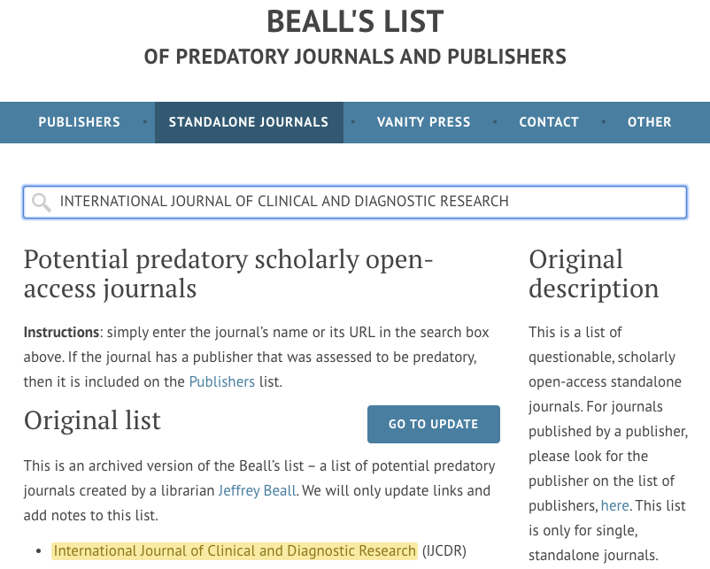
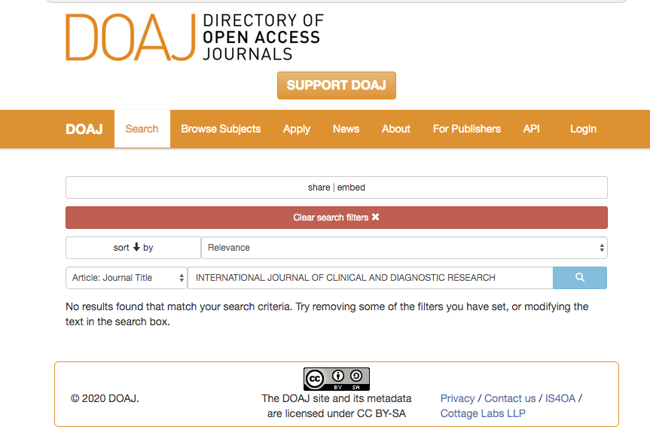
Notes:
This final example appears on Beall’s List as a predatory journal, and does not appear in the DOAJ or other trusted directories. Be sure to use the full title as searching for “Journal of Clinical and Diagnostic Research” would give you a false result.

Slide 58
Takeaways
Remember the consequences!
  Predatory journals cost time, money, and copyrights
Do the work!
  Do your due diligence when checking for red flags in journal or conference invitations
Get ahead of the game!
  Use the tools available to you to find journals for yourself – utilize Journal Impact Reports or look up journals in your topic area on Scopus or Web of Science to find a good match

Slide 59
Cautionary Tales
Stories from the media about predatory publishing
How I became easy prey to a predatory publisher By Alan H. Chambers
These Professors Don’t Work for a Predatory Publisher. It Keeps Claiming They Do By Emma Pettit
When Authors Get Caught in the Predatory (Illegitimate Publishing) Net By Phaedra Cress
Medical Journals Have a Fake News Problem By Esme E. Deprez and Caroline Chen

Slide 60
References
Bowman JD. (2014). Predatory Publishing, Questionable Peer Review, and Fraudulent Conferences. American Journal of Pharmaceutical Education, 78(10):1-6. https://doi:10.5688/ajpe7810176
Gutzman, K. Writing, Citing, & Publishing: Publishing Your Work. Galter Health Sciences Library: GalterGuides. https://libguides.galter.northwestern.edu/c.php?g=474404
Mercier, E., Tardif, P., Émond, M. & Le Sage, N. (2017). Predatory publishers and fraudulent conferences: Perspectives and implications for novice researchers. Perspect Med Educ, 6, 433–434. https://doi-org.ezproxy.galter.northwestern.edu/10.1007/s40037-017-0381-x
Moher, D. & Moher, E. (2016). Stop predatory publishers now: Act collaboratively. Annals of Internal Medicine,164(9): 616-617. https://www.scopus.com/inward/record.uri?eid=2-s2.0-84982135046&doi=10.7326%2fM15-3015&partnerID=40&md5=34778f44726e4643fe09f6bc47042f0c
Van Nuland, S.E. & Rogers, K.A. (2017). Academic nightmares: Predatory publishing. American Association of Anatomists, 10(4): 392-394. https://doi:10.1002/ase.1671

Slide 61
Conflicts of Interest
Annie Wescott and Annette Mendoza have no conflicts of interest to disclose.

Slide 62
Questions?
62

Slide 63
Thank You
http://galter.northwestern.edu

