Slide 1
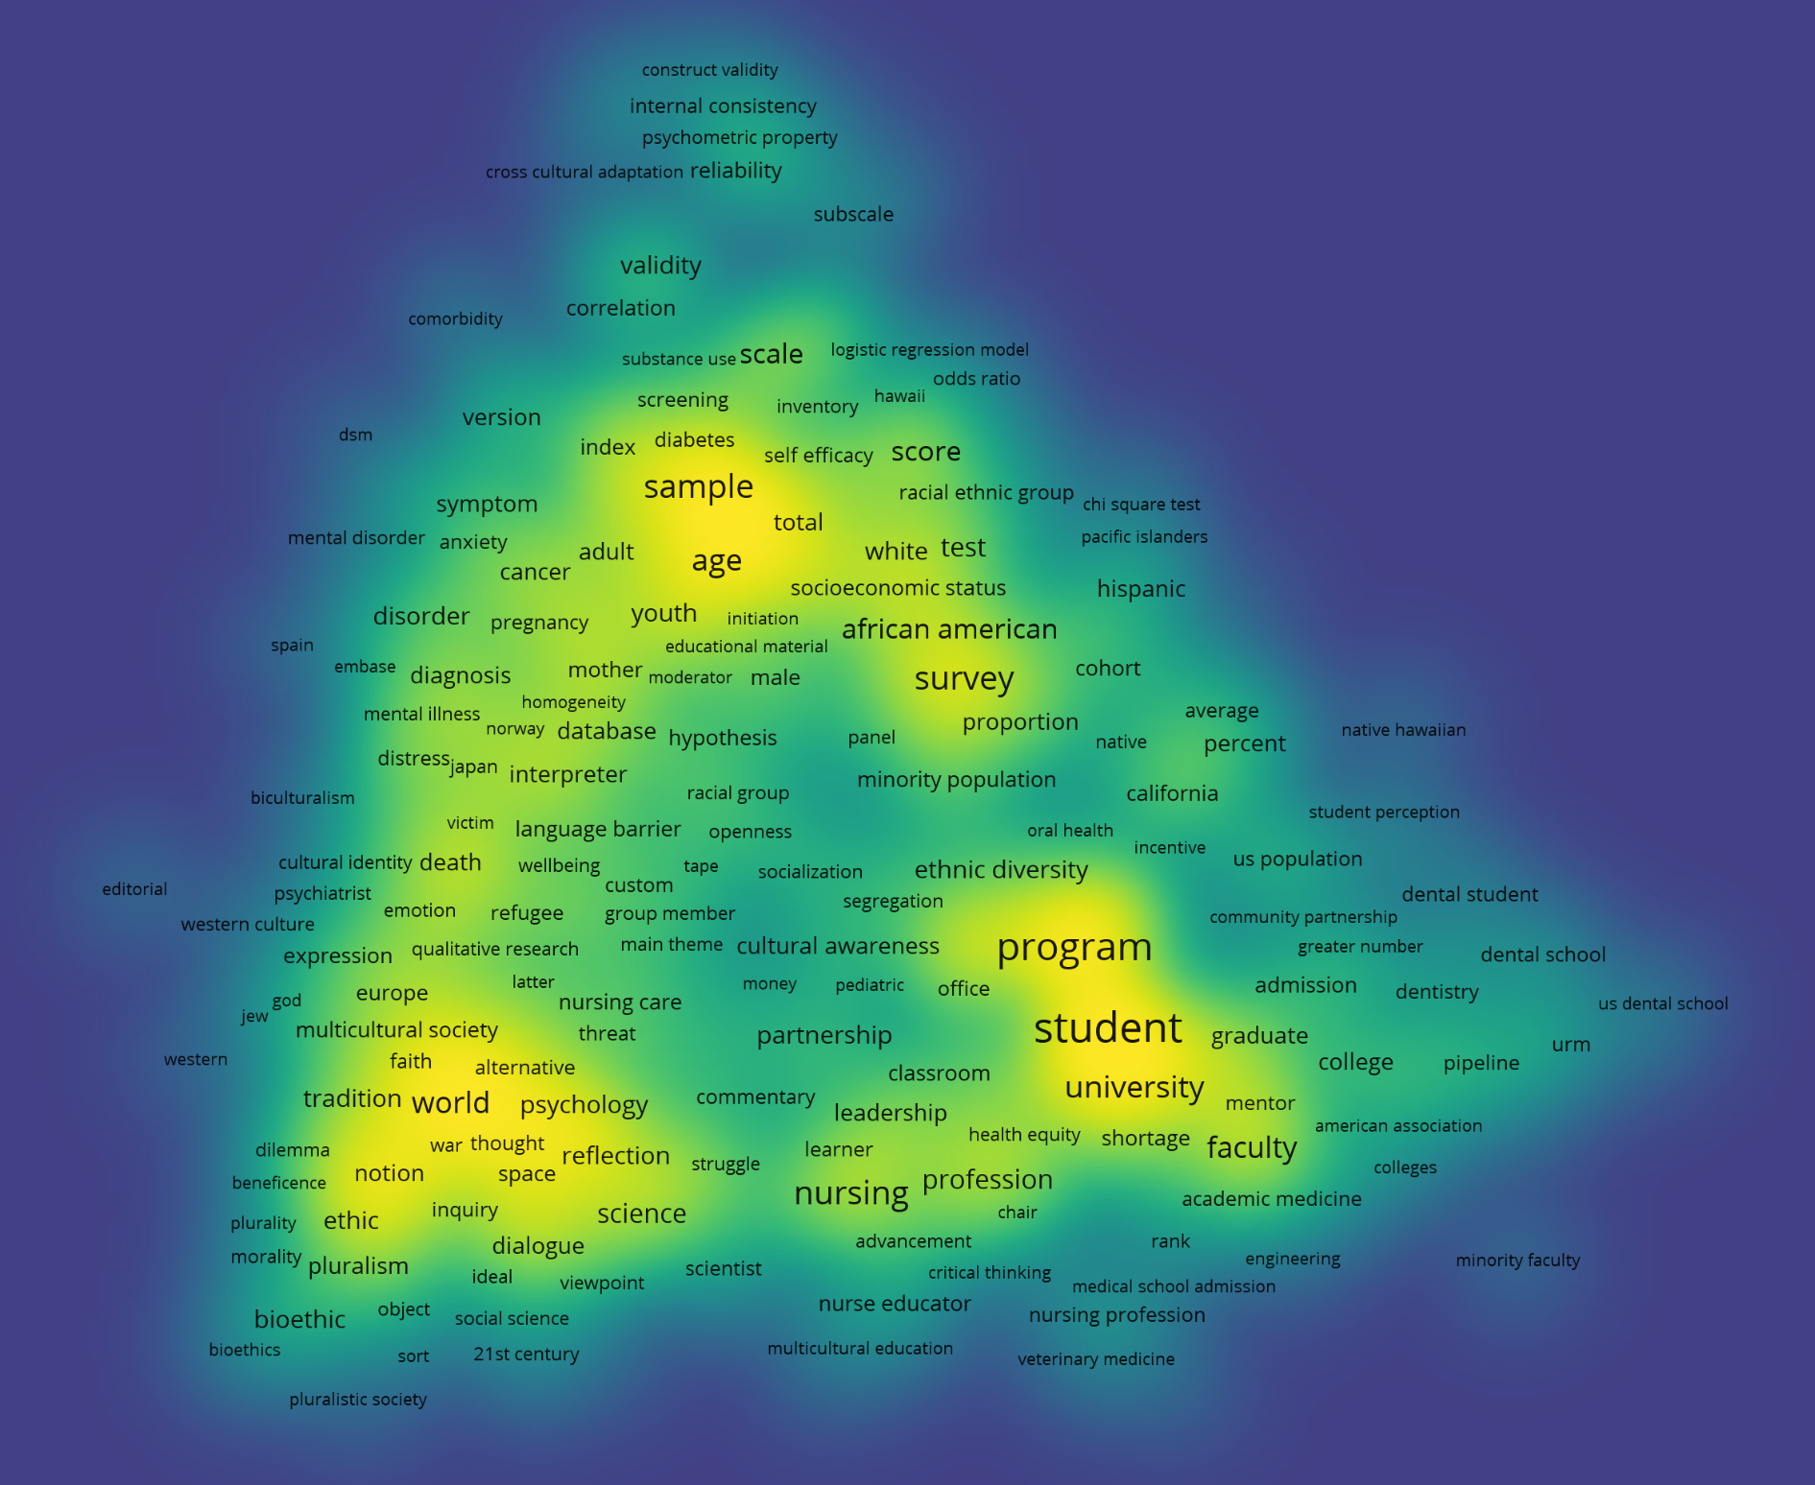
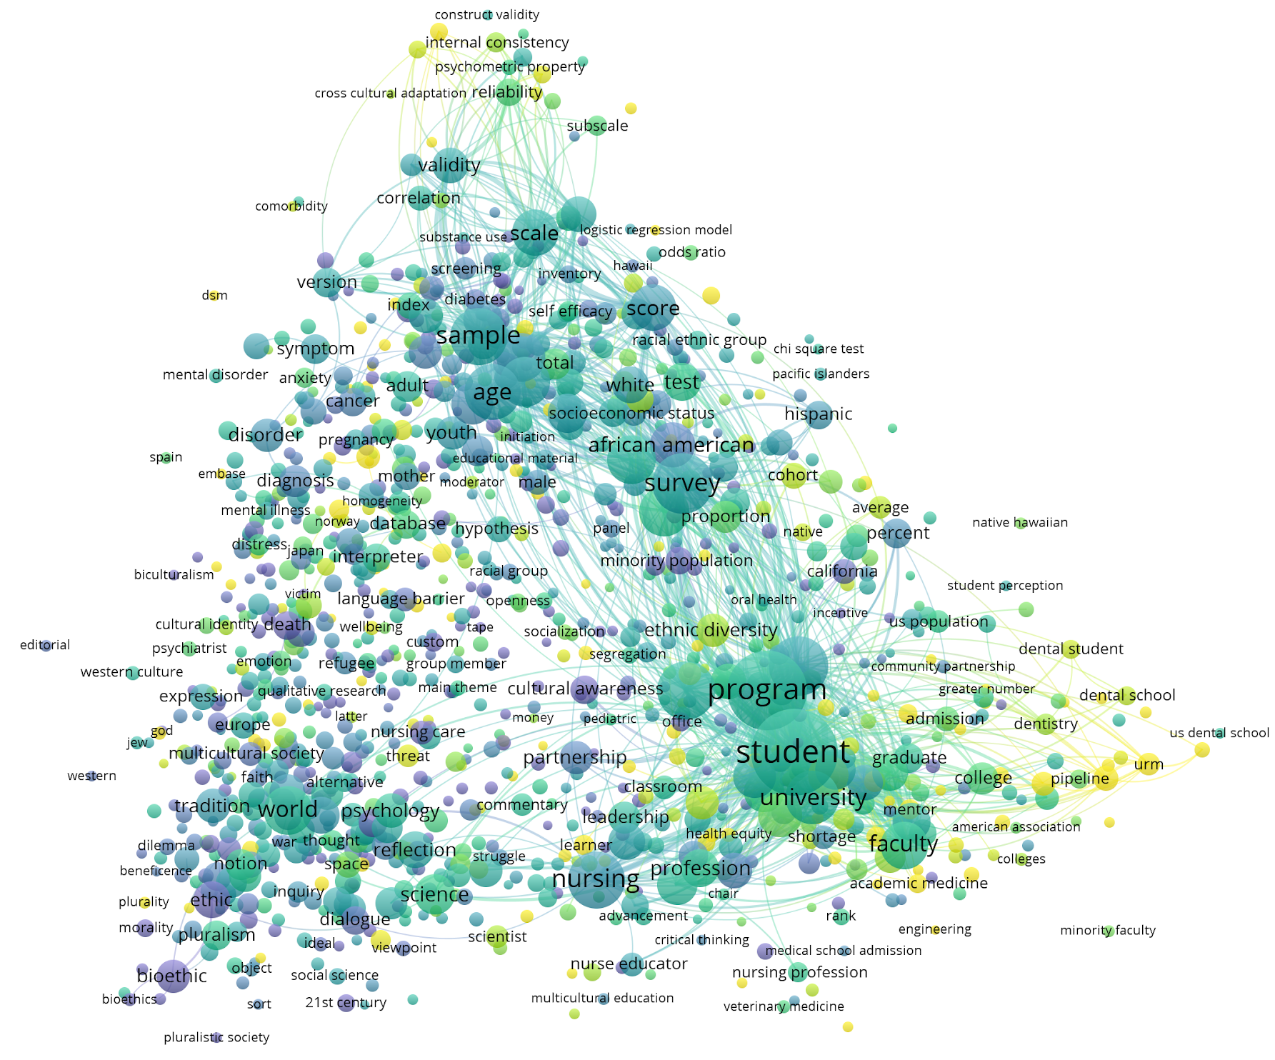
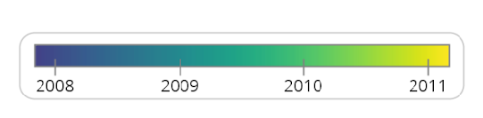
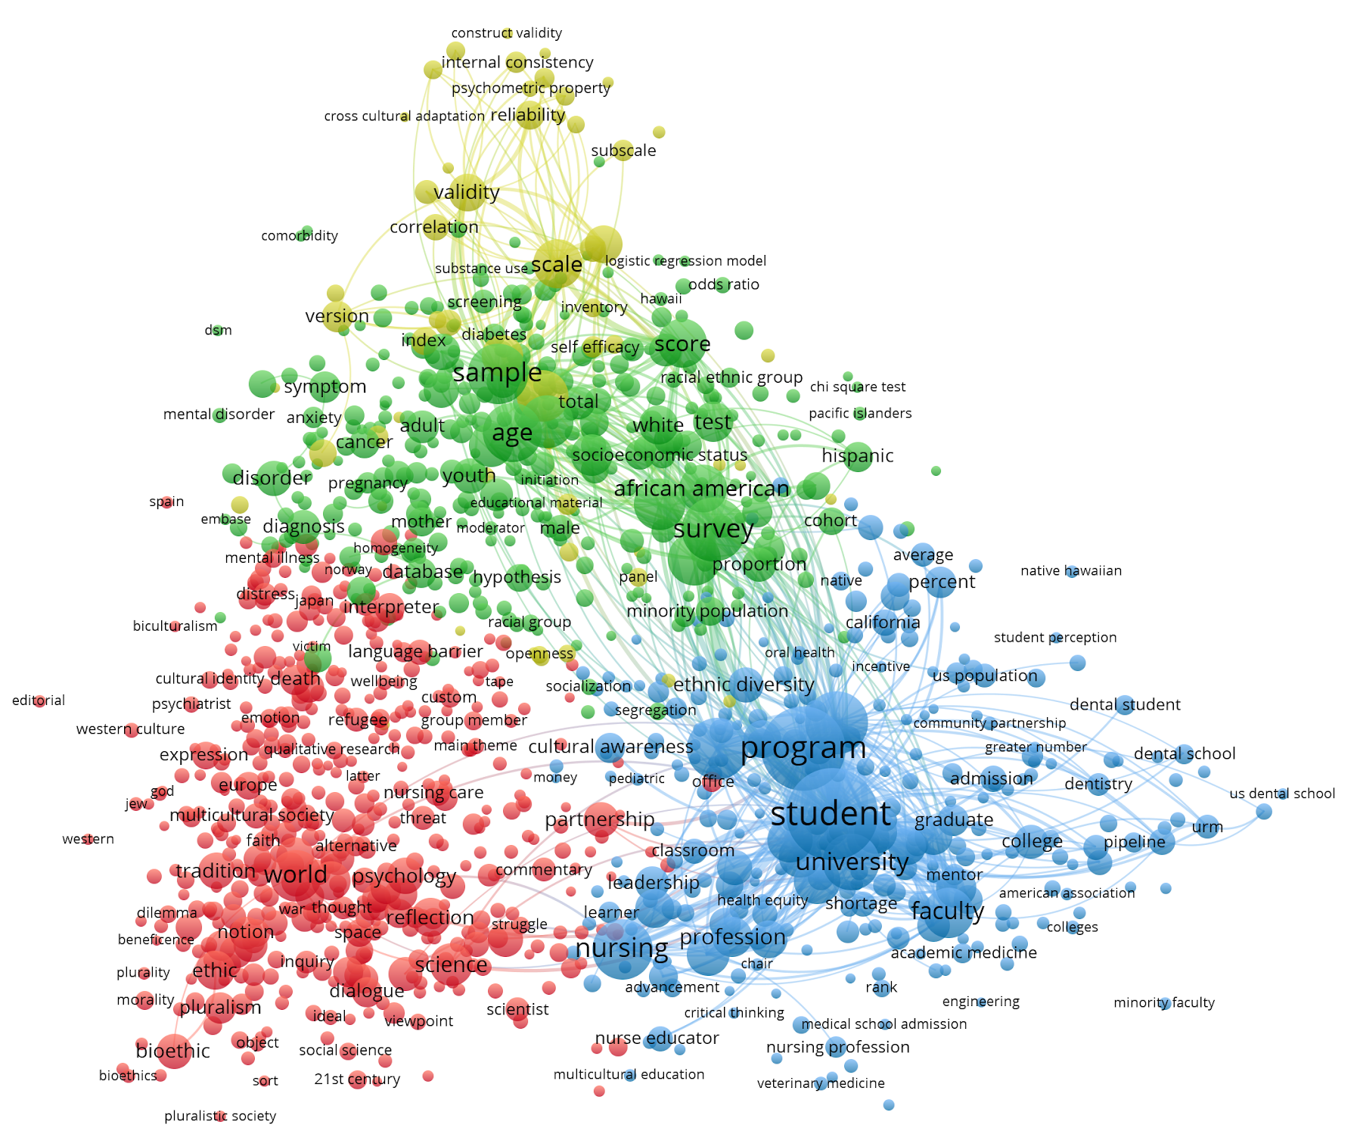
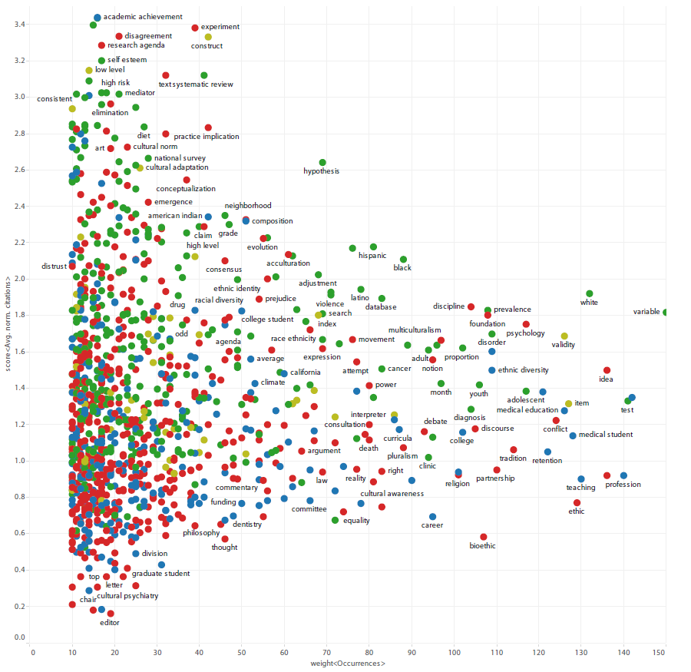
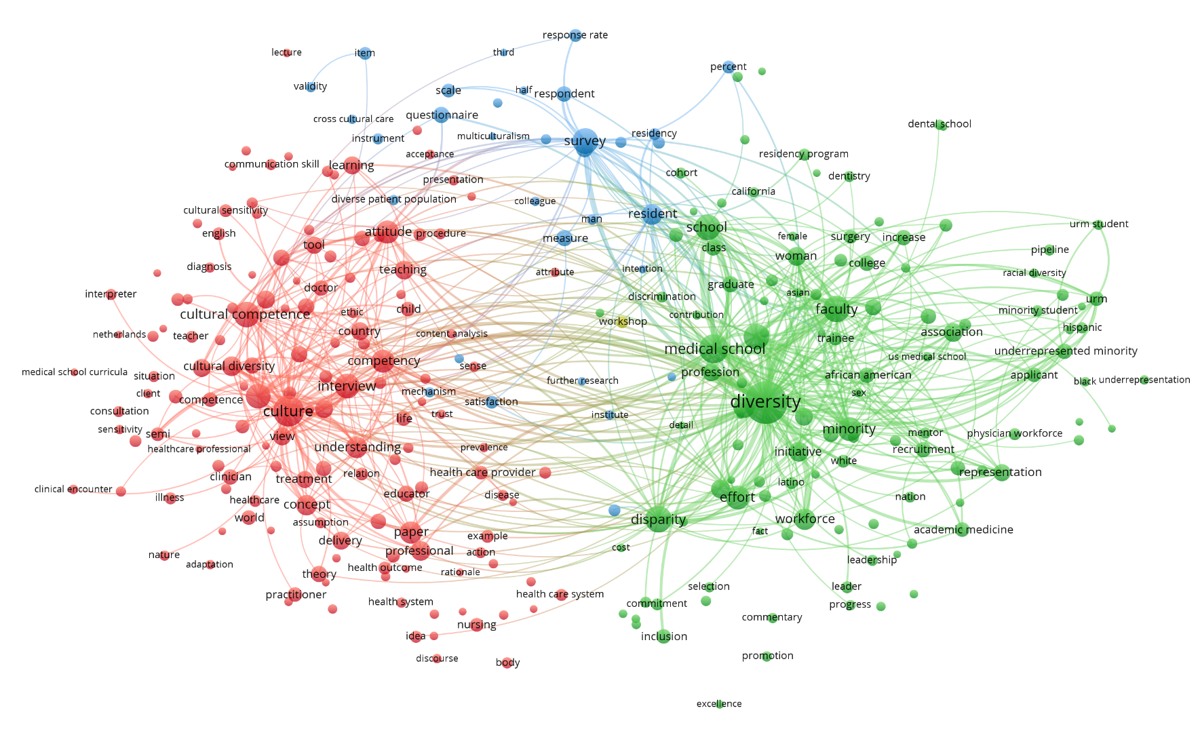
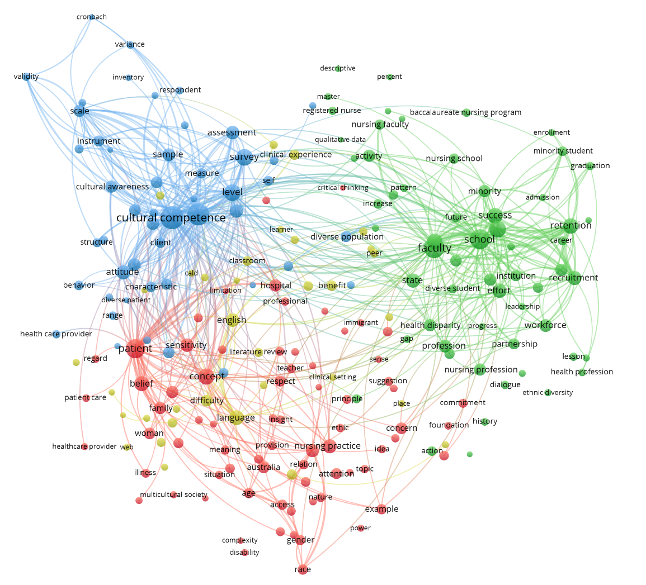
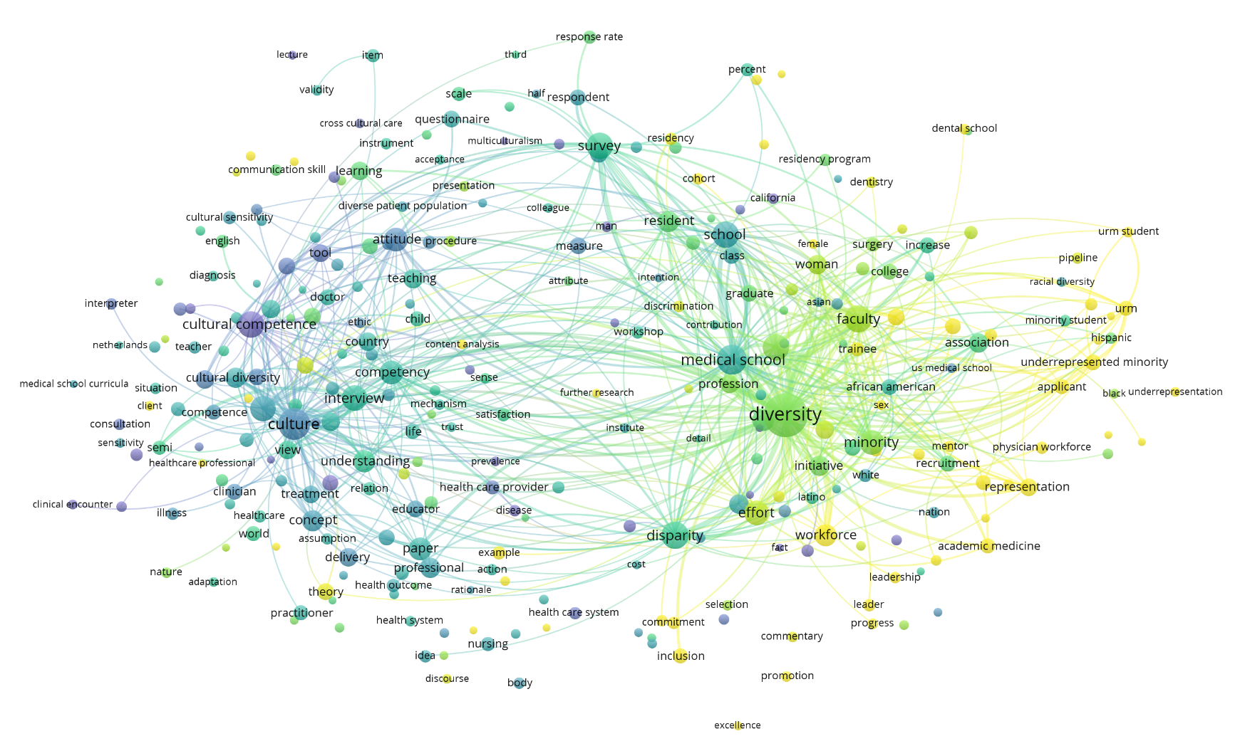
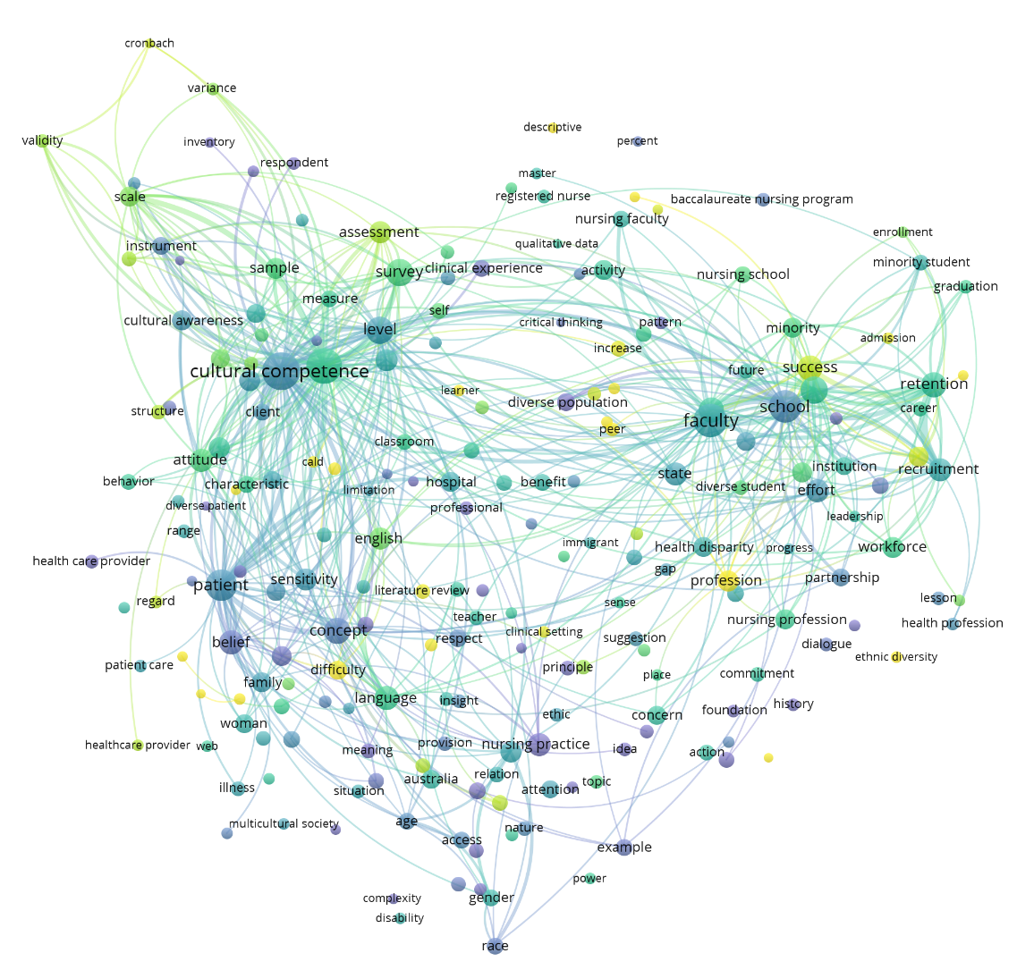


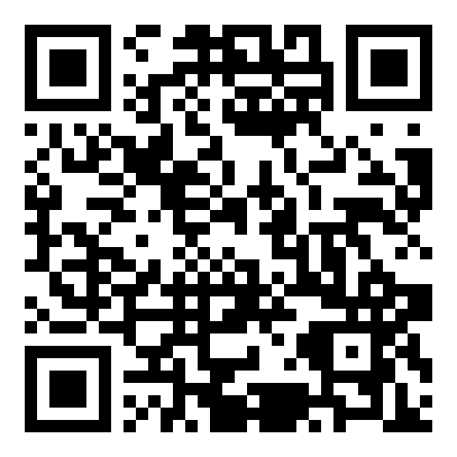
The Transforming Landscape of Cultural Diversity in the Biomedical Literature
Karen E. Gutzman¹, Diana Almader-Douglas², Brenda Linares³, Annabelle V Nunez⁴, Bredny Rodriguez⁵, Medical Library Association Latino Special Interest Group
¹Galter Health Sciences Library & Learning Center, Northwestern University, Chicago, IL; ² Mayo Clinic Library, Phoenix, AZ; ³ A.R. Dykes Library, University of Kansas Medical Center, Kansas City, KS; ⁴ University of Arizona Health Sciences Library, Tucson, AZ; ⁵ University of Nevada, Las Vegas, Health Sciences Library, Las Vegas, NV
Objective:
Analyzing topical trends in the biomedical literature can help us identify influential research, characterize changes in research direction, or discover research areas that have been overlooked. This project analyzes the metadata from papers indexed with the “cultural diversity” MeSH term from 2003-2017, so that we can better understand and discuss the landscape of cultural diversity in the biomedical literature.
Methods:
Metadata from papers indexed with the MeSH term “cultural diversity” published between 2003-2017 were extracted from the Scopus database. The title and abstract fields of each paper were analyzed using natural language process to identify terms that occur more than ten times in the entire corpus. These terms were visualized in a term co-occurrence map using VOSViewer (http://www.vosviewer.com/). The analysis involved identifying topical trends over time, topical density, and topical usage and citations based on average year of publication. Microsoft excel was also used to identify collaborative authors, productive institutions, and journal impact for these papers.
The circles sizes show the number of times words occur in the title or abstract of the publication. The distance between two terms indicates how often the terms co-occur in a title or abstract; the smaller the distance, the larger the number of co-occurrences and the stronger the terms are related to each other. The lines between each term indicate that the terms were used together in a title or abstract.
Results:
The term most often found in current literature is “health equity”, in papers highlighting the problems of health disparities and the need to better understand social determinants of health. The second most found term is “clinical placement”, in papers reflecting the physical location of students in healthcare related fields and its effect on their learning.
The term occurring often in earlier papers is “affirmative action”, used when discussing the need for diversification of education and training programs. The second most occurring term in earlier papers is “clinical encounter”, used when discussing cultural competence of clinicians and other healthcare providers when working with diverse patients.
Conclusions:
Cultural diversity literature has evolved over time with language that demonstrates a trend towards increased efforts in diversity and inclusion and cultural responsiveness in health care. These efforts build a health workforce better equipped to improve health disparities.
Using natural language processing to explore topical areas of literature helps identify the change of research over time and allows us to recognize the new interesting in this areas of study. It is important for librarians to stay current with this topic to guide conversations of inclusivity in research and medical education.
Areas of research intensity
Evolution of research over time
Cultural diversity literature focuses on areas such as programs and universities, students and faculty, surveys, sample sizes and questionnaires. Other highly occurring terms include discussion on minority and ethnic groups, and specific areas of education such as nursing and medical education. In this map, yellow topics occur very often in cultural diversity literature and blue topics occur less often.
Cultural diversity literature has evolved over time. Terms used earlier in the literature include affirmative action, clinical encounter, communication problems. Terms used more recently in the literature include culturally and linguistically diverse backgrounds (CALD), clinical placement, and health equity. All terms are colored according to their average publication year of usage; yellow indicates newer topics.
Challenge: Can you identify shifts in terms or themes over time? Do you notice any terms that are not part of this dataset that should be?
Challenge: Can you identify the top five (5) topics? Can you identify less common topics?
Clusters of research topics
Occurrence and Impact
Cluster 1: Global Health Disparities
These terms reflect the differences in health and health care between population groups on an international level.
Cluster 2: Research Populations
These terms describe diverse populations and topics that are often the subject of a research study.
Cluster 3: Workforce Development in Healthcare
These terms describe education and training for the current and upcoming workforce.
Cluster 4: Research Measures
These terms describe the type of measurement used or course of action taken in a research study.
“Medical Students”
“Nursing Students”
Research Measures
Faculty and student diversity in nursing school
Assessment for cultural awareness
Cultural competence in medical education or training
Faculty and student diversity in medical school
Cultural safety in
nursing practice
Cultural awareness in clinical practice and classroom settings
Average Normalized Citations
Number of Occurrences
Cultural diversity literature can be divided into four topical clusters: Workforce Development in Healthcare, Research Measures...In this map, all terms are assigned (and colored accordingly) to a cluster by a computer clustering algorithm. We have reviewed terms in each cluster and identified a title for each.
Challenge: Can you identify the four clusters? Do the cluster titles fit the terms they describe? If not, what titles would you suggest?
We selected “medical student” related terms from the cultural diversity term co-occurrence map to create a sub-map of those topics. More recently published documents on this topic include terms such as “inclusion”, “workforce diversity”, “underrepresented group”.
We selected “nursing student” related terms from the cultural diversity term co-occurrence map to create a sub-map of those topics. More recently published documents on this topic include terms such as “inclusion criterium”, “clinical placement”, “mentor”, and “culturally and linguistically diverse backgrounds (CALD)”.
In this map, terms are charted based on their number of occurrences and their average normalized citations. Any citation rate above 1.0 means the term is more highly cited than expected.
Challenge: Can you identify highly cited and highly occurring terms? Can you identify highly cited but not often used terms?

