Slide 1
Mentor Mapping and Developmental Networks
NUCATS Series on Developing and Enhancing Mentoring Relationships
Welcome! We will start on time at 7:30.
Presenters: Farzaneh A. Sorond, MD, PhD; Jeanne M. Horowitz, MD
Kenzie A. Cameron, PhD, MPH

Slide 2
Mentor Mapping and Developmental Networks
Farzaneh Sorond, MD, PhD
Jeanne M. Horowitz, MD
Kenzie A. Cameron, PhD, MPH
Adapted from the work by
Kathy E. Kram and Monica C. Higgins
and the National Center for Faculty Development & Diversity

Slide 3

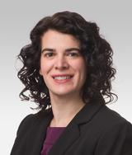

Introductions
Workshop Facilitators
Farzaneh A. Sorond, MD, PhD
Associate Dean for Faculty Development
Vice Chair for Faculty Development and Education, Department of Neurology
Chief of Stroke and Neurocritical Care in the Department of Neurology
Dean Richard H. Young and Ellen Stearns Young Professor
Jeanne M. Horowitz, MD
Vice Chair for Academic and Faculty Affairs, Department of Radiology
Associate Professor of Radiology (Body Imaging)
Kenzie A. Cameron, PhD, MPH
Director, NUCATS Mentoring Programs
Research Professor of Medicine (General Internal Medicine and Geriatrics), Medical Education, Medical Social Sciences and Preventive Medicine

Slide 4
Introductions
NUCATS Staff
Christine Charles
Jaime Zeigler
Emily Traw
Notes:
KENZIE

Slide 5
Agenda
Learning Objectives
Mentoring and Career Development Needs
Defining Developmental Networks for Career Development
Mapping Your Developmental Network: Identifying your Developers
  Individual Activity/Breakout #1: Identifying your Developers
Mapping your Developmental Network: Identifying Career and Personal Goal Areas, a.k.a. your “Buckets”
Evaluating Your Developmental Network
Action Planning
Take Aways

Slide 6
Learning Objectives
By the end of this workshop, participants will…
Compare and contrast the roles of mentors and/or developers in your academic career
Begin identifying their own developmental network (“developers”) who:
  Help get work done
  Help in career advancement
  Provide personal support
  Serve as role models
Identify Career and Personal Goal Areas
  Begin to identify relevant developers in each area
Appraise and Evaluate their initial Developmental Networks
Recognize the Need for Action Planning and Next Steps

Slide 7
Mentoring and Career Development Needs

Slide 8

Click on “Annotate”
A bar will appear that allows for annotation
Use:
TEXT
  (Format: if need to increase font)
STAMP
ERASER if needed

Slide 9
What I most need from my mentor is….

Slide 10
What I most need to advance my career is….

Slide 11
Make a note of your responses in terms of your greatest perceived mentoring need and career advancement need
Consider time frame of 3 – 6 months

Slide 12
Defining Developmental Networks for Career Development

Slide 13
Mentoring Myths
You have to find one perfect mentor
Mentoring is a formal, long-term relationship
Mentoring Matches need to be perfect
The closer a mentor is to my specific area of research or life experience, the better
You only need one mentor at a time
The mentor must be older or more senior to mentee

Slide 14

Career Development & Mentoring
Identify
Career
Goals
Build Your Career
Find the “Right” Mentor
A single senior colleague who introduces you to the dimensions of academic medicine and advocates for and helps guide your career.

Slide 15




4 Mentoring Archetypes-Chopra, Arora, Saint (2018)
Traditional Mentor
Formal
Career-focused
Long-term
Reciprocal
Coach
Issue-focused
Short-term
Sponsor
Influential
Visibility-focused
Connector
Link mentees with others
Create networks
Focused on their field
Chopra V, Arora VM, Saint S. Will You Be My Mentor?—Four Archetypes to Help Mentees Succeed in Academic Medicine. JAMA Intern Med. 2018;178(2):175–176. doi:10.1001/jamainternmed.2017.6537
Slide: Heather Heiman, MD, Director of Faculty Development and Mentoring (Clinician Educators) , Division of General Internal Medicine and Geriatrics, Northwestern University Feinberg School of Medicine

Slide 16
The Strength of Weak Ties
Acquaintances (weak ties) less likely to be socially involved with one another than close friends (strong ties)
Weak ties form a “low density network” but provide “crucial bridges” to others
  Weak ties may become strong over time and vice versa
When considering your developers, realize they will fall along a continuum of how close they may be to you
Granovetter M. (1973). Am J Sociol.; Granovetter M. (1983). Sociol Theory

Slide 17
Developmental Networks for Career Development
You
Mentor
Peer(s)
Professional Associates
Family & Friends
Junior Colleagues
Leader(s)

Slide 18
Developmental Networks for Career Development
You
Mentor
Peer(s)
Professional Associates
Family & Friends
Junior Colleagues
Leader(s)
Your Personal Board of Directors

Slide 19
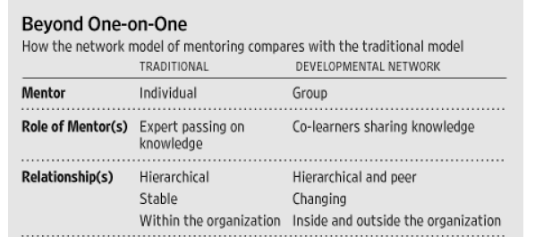
Traditional Mentor and Developmental Network Models
Kram KE, Higgins MC. A new approach to mentoring. Wall Street Journal. 2008 September 22. Available online: https://online.wsj.com/article/SB122160063875344843.html

Slide 20
Life Cycle of Career Development
Identify Career Goals
Assess Strengths and Weaknesses to Achieve Goals
Map Developmental Network
Analyze Developmental Network
Reassess Career Goals and Network
“Survival Mode”

Slide 21
Mapping your Developmental Network:
Identifying your Developers

Slide 22
The Pieces
Your Developers: Who are your developers?
Type of support: What do your developers do for you?
  Get your work done
  Advance your career
  Provide personal support
  Are role models
Extent of assistance provided (How much: Never – Always)

Slide 23
Identifying Your Developers
1
Developer Name | Type of Support Provided
 | Helps me get the job done | Helps advance my career | Provides personal support | Is a role model for me
Never
2
Rarely
3
Sometimes
4
Often
5
Always

Slide 24
Mapping Your Developmental Network
Get the Job Done
Advance Your Career
Personal Support

Slide 25
Mapping Your Developmental Network
Get the Job Done
Advance Your Career
Personal Support
Are helpful and useful in doing your work;
May work directly with you; and/or,
Have provided leads to others who helped you with important information, scientific or technical advice, professional expertise, or other resources to do your work.

Slide 26
Mapping Your Developmental Network
Get the Job Done
Advance Your Career
Personal Support
Contribute to your professional development/career advancement;
Give you career guidance/direction;
Arrange exposure to critical people;
Provide political advice;
Help you get important opportunities and assignments (such as appointments on hospital or national committees, journal editorships, or grant panels);
Advise you on promotion;
Provide advice on funding opportunities; and/or,
Advocate for you.

Slide 27
Mapping Your Developmental Network
Get the Job Done
Advance Your Career
Personal Support
People you go to for your emotional well being and psychosocial support;
Ones with whom you share experiences – positive and negative;
Consult about decisions or concerns that are important to you;
Vent/commiserate with;
Debrief critical experiences with;
People with whom you can be yourself.

Slide 28
Types of Support: What Developers May Provide
Career Support | Psychosocial Support | Role Modeling
Sponsorship | Encouragement and emotional support | Behavior to emulate
Coaching | Acceptance and confirmation | Work ethic and values
Substantive Feedback | Accountability for what REALLY matters | Inspiration and motivation
Exposure and visibility | Counseling | Productivity
Challenging assignments | Friendship | Skill set
Protection and preservation | Personal Feedback
 | Safe Space

Slide 29
Social Roles of Developers
Organization | Family | Community | Other
Superior | Spouse/partner | Personal friend | Former work colleague
Manager/supervisor | Parent/guardian | Romantic partner | Teacher/instructor
CEO/president | Sibling | Counselor/therapist | Business associate
Coworkers | Aunt/Uncle | Neighbor | Recruiter
Formal mentor | Grandparent | Spiritual guide | Unmet hero
Subordinate | Child | Acquaintance
HR representative | Relative/other

Slide 30
INDIVIDUAL ACTIVITY
Identifying Your Developers
Individually: 2 minutes
Start to jot down a list of your developers (see chat box for link to fillable form)
      Note – you do NOT need to fill out the numbers for frequency yet – focus on getting names of your developers down
You will then be sent to Breakout groups

Slide 31
Identifying Your Developers: Individual Activity
1
Developer Name | Type of Support Provided
 | Helps me get the job done | Helps advance my career | Provides personal support | Is a role model for me
Never
2
Rarely
3
Sometimes
4
Often
5
Always

Slide 32
INDIVIDUAL ACTIVITY BREAKOUT GROUPS
Identifying Your Developers
Individually: 2 minutes
Start to jot down a list of your developers (see chat box for link to fillable form)
      Note – you do NOT need to fill out the numbers for frequency yet – focus on getting names of your developers down
You will then be sent to Breakout groups
    In Group: (8 minutes total)
    Introduce yourself (BRIEFLY: Name, Division, Primary Role – e.g., research, teaching, clinical, administrative)
    Share the types of people (or names, as comfortable) you listed
    Compare and contrast types of people listed among your group members
    Assist each other in thinking outside the box of traditional mentors – remember you are identifying DEVELOPERS

Slide 33
REPORT BACK FROM BREAKOUT GROUPS
General Reactions to task?
How similar or different were each of you in terms of who (types of people) you listed?
Were there any surprises from what others’ listed that you had not considered?

Slide 34
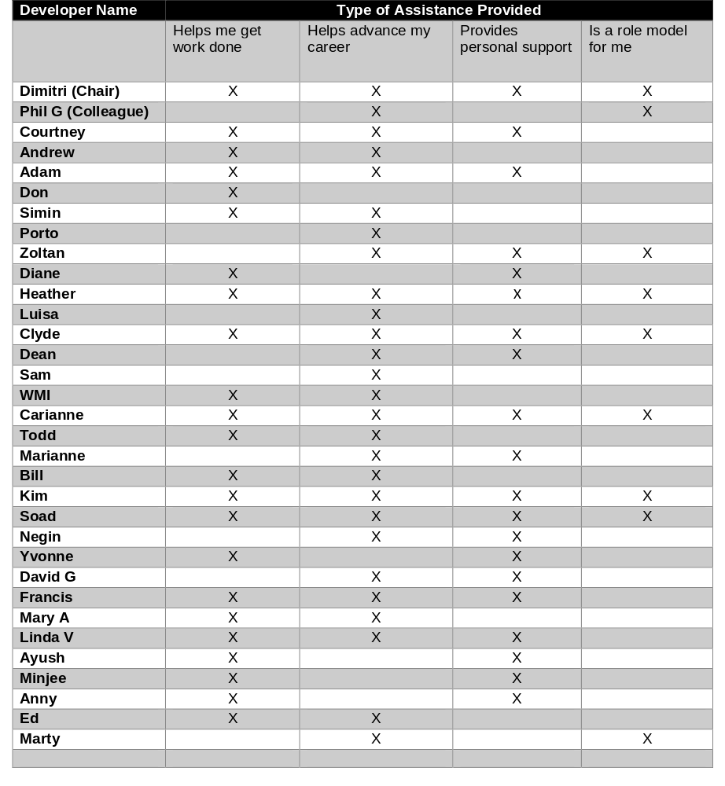
Example List

Slide 35
Notes on Assigning Frequency
“Always” may refer to:
  Your clinical staff who work with you each clinic for clinical related career goals
  Your study coordinator for projects for which you serve as the PI
“Sometimes” may refer to:
  The director of a program in which you teach
  Colleagues with whom you consult for difficult cases
“Rarely” may refer to:
  Colleague at outside institution (weak tie)

Slide 36
Mapping your Developmental Network:
Identifying Career and Personal Goal Areas
a.k.a. your “Buckets”

Slide 37
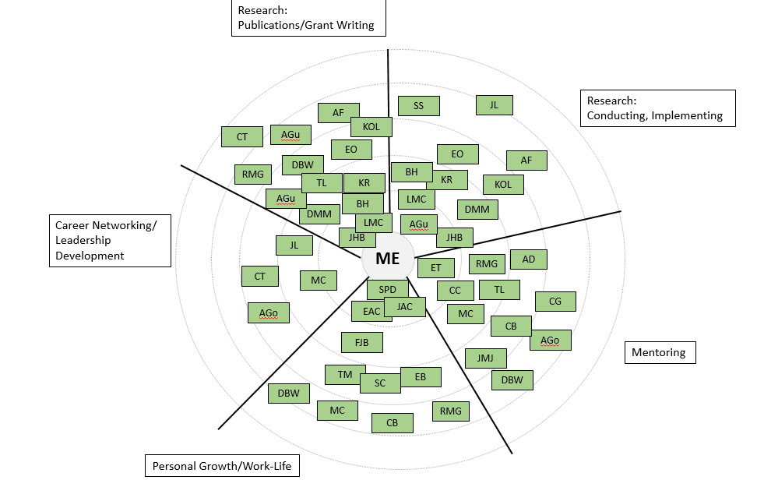
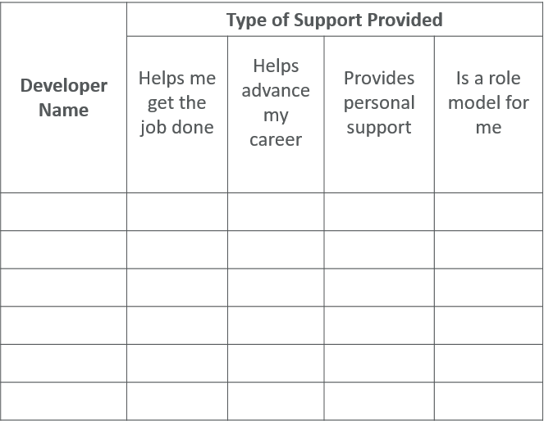
Preview of Process
Developers
Career and Personal Goal Areas
Developer Map

Slide 38
Preview: Developers to Network Map
Developer Name | Type of Support Provided
 | Helps me get the job done | Helps advance my career | Provides personal support | Is a role model for me
ME

Slide 39
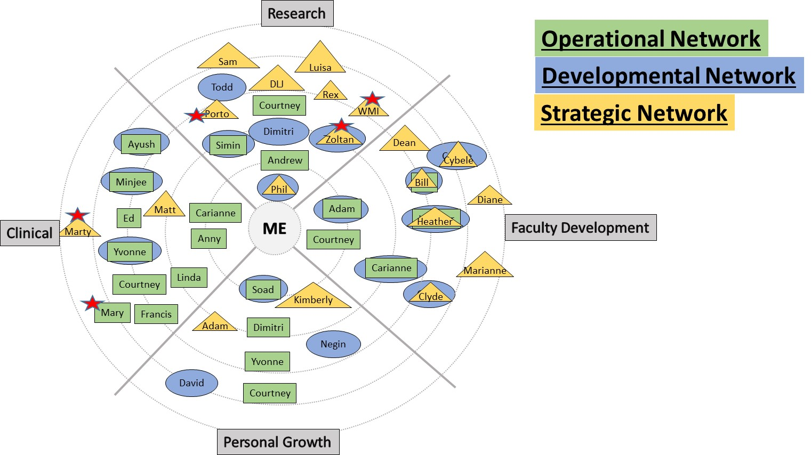

Slide 40
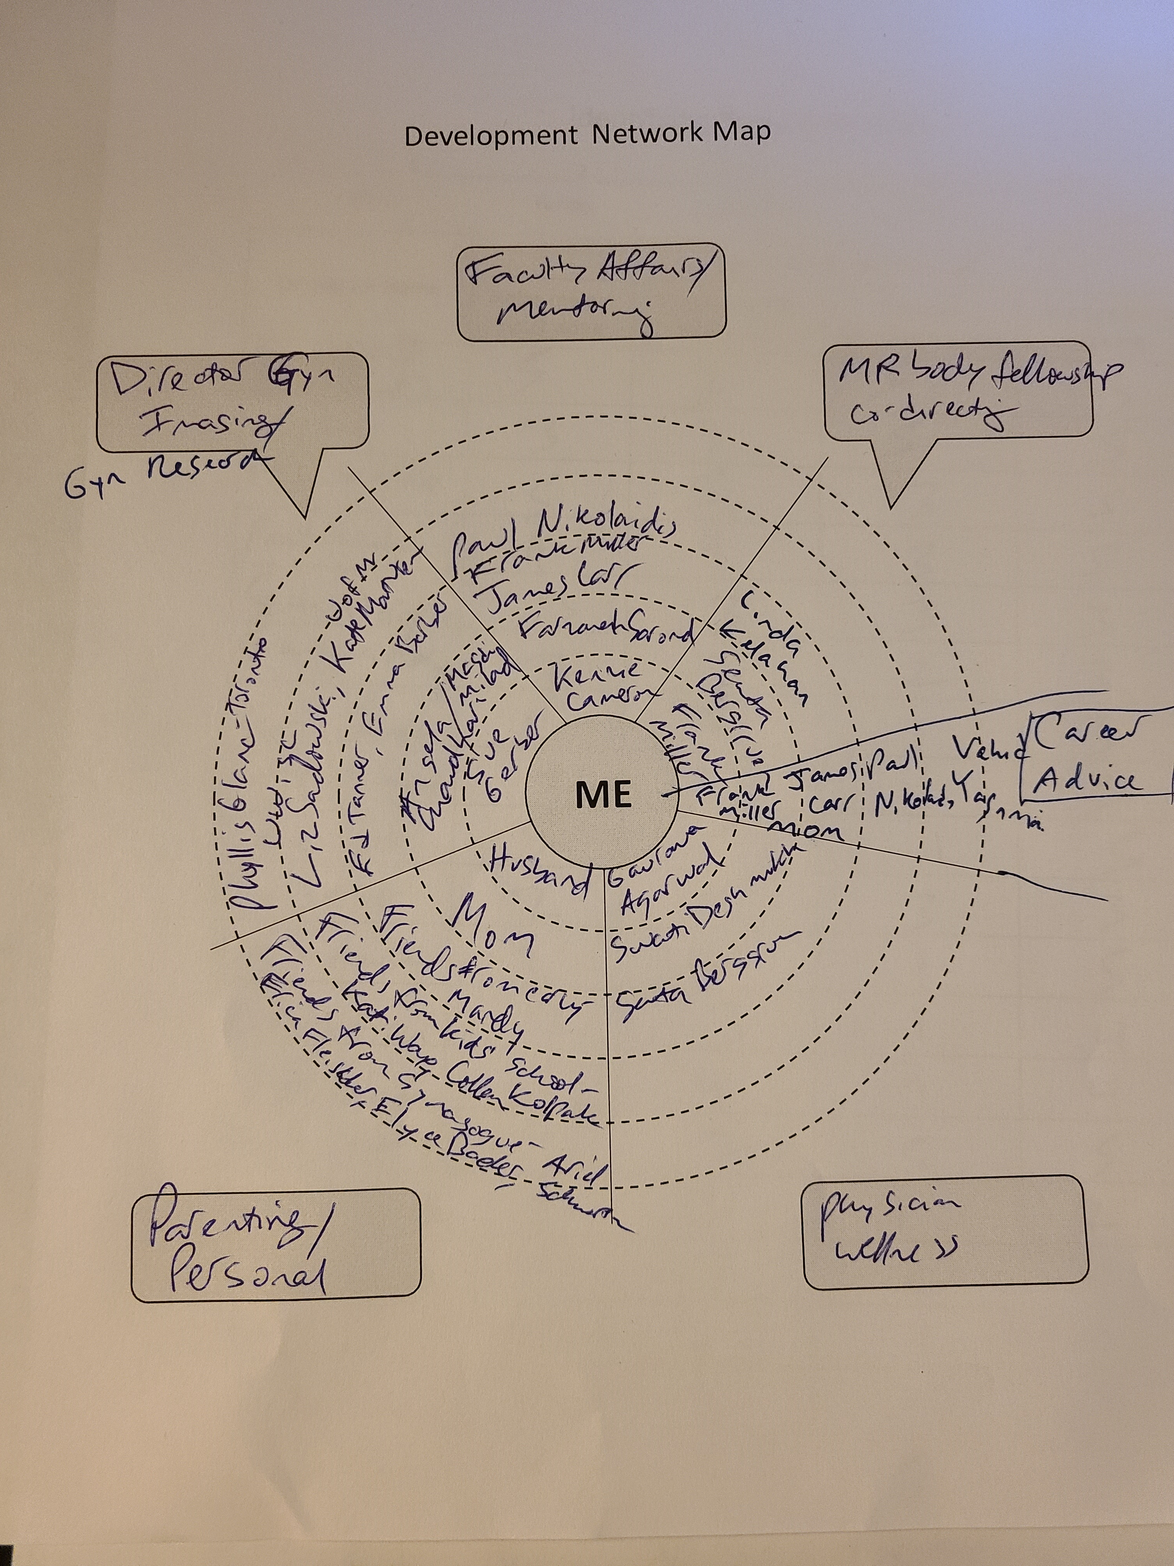
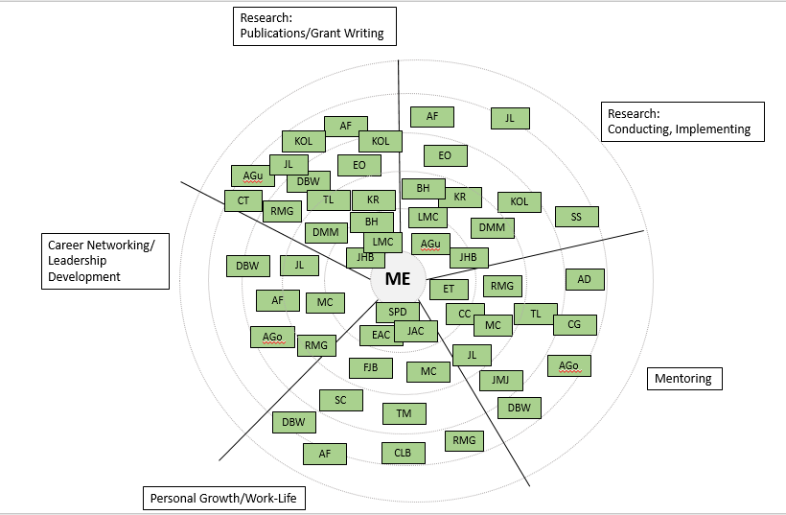

Slide 41
Developmental Network Map: What are your buckets?
ME

Slide 42
2 PART INDIVIDUAL ACTIVITY (5 MIN)
Identifying Your Career and Personal Goal Areas
PART I:
Think of what you want your buckets/areas to be (see chat box for link to fillable form) [2 – 3 minutes]
PART II:
Start to put your identified developers into the areas [2 – 3 MIN]

Slide 43
REPORT BACK
What are your thoughts as you are filling out this network map?
In what areas do you see your greatest concentration of developers? What are your thoughts about that?
  What patterns do you see?
Did anything surprise you as you worked to fill out this map?

Slide 44
Evaluating your Developmental Network

Slide 45
Evaluating Your Developmental Network
Size: Do you have the right number of developers to help you reach your goals? Should you enlist more people? Or, do you have too many and need to manage those relationships more effectively?
Diversity: How similar or different are these individuals (in terms of gender, race, function, geography, organizations) to each other and to me?
Redundancy: How much overlap is there?
Interconnectivity: How closed is the network in the sense that most of the people know each other?
Strength of Connection: What is the spread of people in terms of closeness and distance?
Balance: Is your network balanced or in danger of tipping?
Connections to Power and Influence: How many would you characterize as influential in the department or hospital or field?

Slide 46
The Next Steps:
Action Planning

Slide 47
Think back to your responses in terms of your greatest perceived mentoring need and career advancement need in next 3 – 6 months

Slide 48
Action Planning
Identify an opportunity that you would like to pursue going forward:
How will your current network help you achieve your goal?
What type of help is missing in your current developmental network?
How can you leverage your current network to meet people that can be helpful to you?
What specific actions will you take to get things started?
Who is your accountability partner?

Slide 49
Action Planning
Why is this important?
Help you enhance (extend and/or strengthen) your network relative to major challenges/opportunities you will face in the next 1-3 years.
Help you develop a relationship building strategy that will work for you.
Help you develop a specific plan to pursue over the next 3-6 months.
Help you create an accountability mechanism.

Slide 50
To Remember
Don’t restrict your developers to your own context/area
Think creatively as to who could be your developers (whose doors could you knock on?)
Consider what you need/what you are asking for from each of your developers
Don’t stop here – identify your next steps
  Action Plans
  Accountability partner/check in
Identifying Developers and Mapping your Network takes time
  Not a static map – will change over your career

Slide 51
Zoom Poll
Defining Developmental Networks for Career Development
Mapping your Developmental Networks: Identifying your Developers
Individual activity/Breakout Group: Identifying your developers
Mapping your Developmental Networks: Identifying Career and Personal Goal Areas (“buckets”)
Individual Activity: Identifying your Career and Personal Goal Areas
Evaluating your Developmental Network

Slide 52
What is your own Take Away?
What aspect of how you have approached identifying your own Mentors/Developers do you plan to change moving forward?
  i.e., what individual behavior change(s) could you enact to increase or strengthen your developer network?
    Share in chat or verbally if willing

Slide 53
Thank You for Attending
Please Complete Brief Evaluation via REDCap (will be emailed to you)
Questions:
Farzaneh Sorond farzaneh.sorond@nm.org
Jeanne Horowitz jeanne.horowitz@nm.org
Kenzie A. Cameron k-cameron@northwestern.edu
Resources and Opportunities on Website:
https://www.nucats.northwestern.edu/education-and-career-development/investigator-development/index.html

