Slide 1
ILS Data Analytics and Visualizations
Using APIs, SQL, Tableau and JavaScript
Code4Lib Chicago
16 May 2018
Jonathan Shank

Slide 2
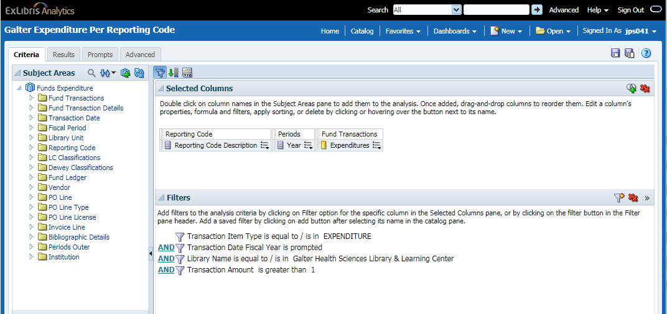
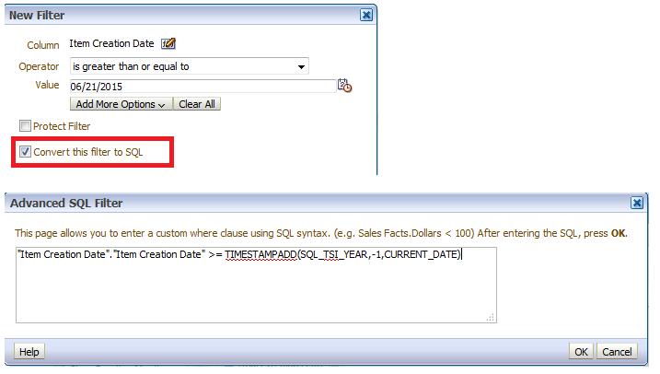
Alma Analytics
Runs on Oracle Business Intelligence (OBI)
Refreshes local ILS data nightly
Canned, community and fully customizable reporting and analysis
Reports can be written and retrieved via SQL
Easily shared among staff
Patron data anonymized
Can also be exported as csv, tsv & xml
*Bonus* Allows use of the back button

Slide 3
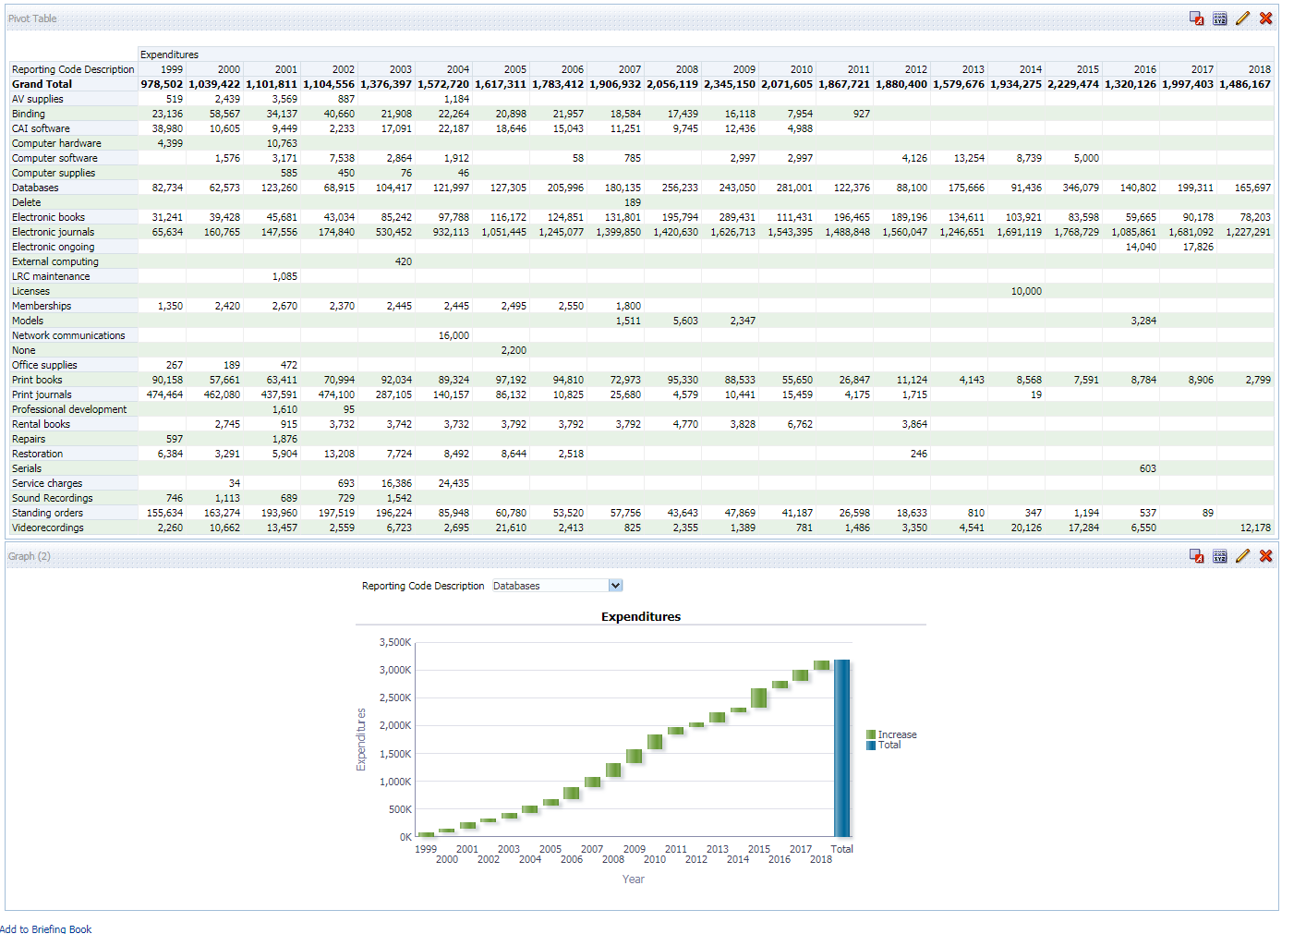
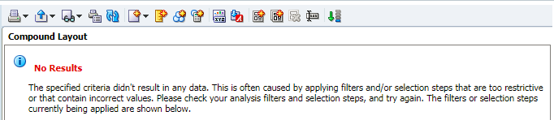
Alma Analytics
What doesn’t work so well
No OTB way to share/export live data
Built in visualizations can be wonky and hard to work with
Not every library has it

Slide 4
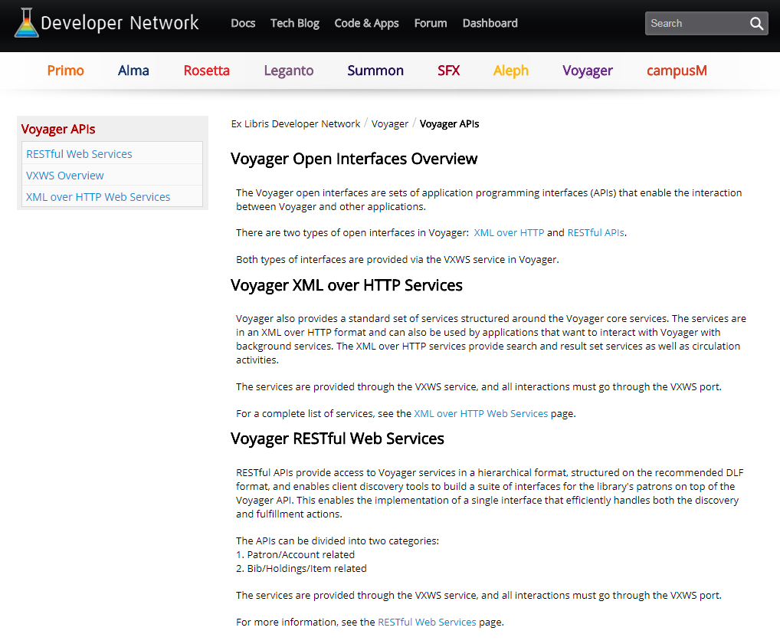
For the non-Alma libraries
Bear with me, but keep in mind…
Voyager
  Ex Libris Open Interface Web Services: RESTful API and XML over HTTP
  MS Access reports, canned from Ex Libris and SQL queries
Others
  WMS Adobe Analytics
  Summon Analytics
  ???
Notes:
Any else that spits out data in a readable format could be inserted somewhere into this process

Slide 5
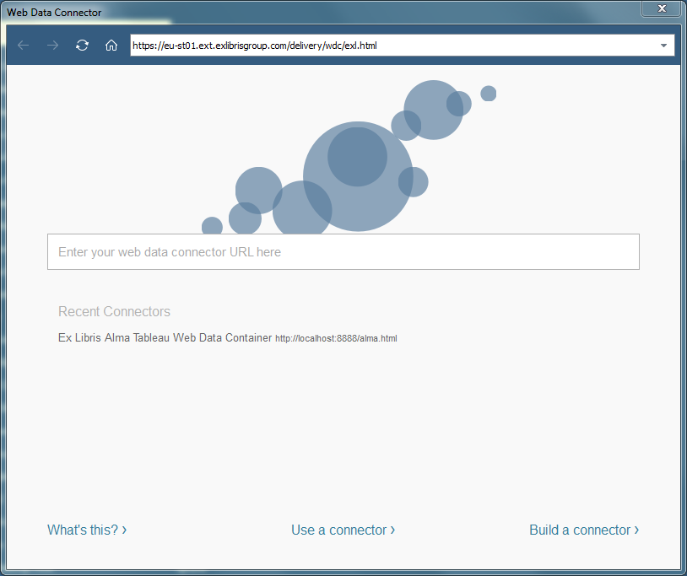
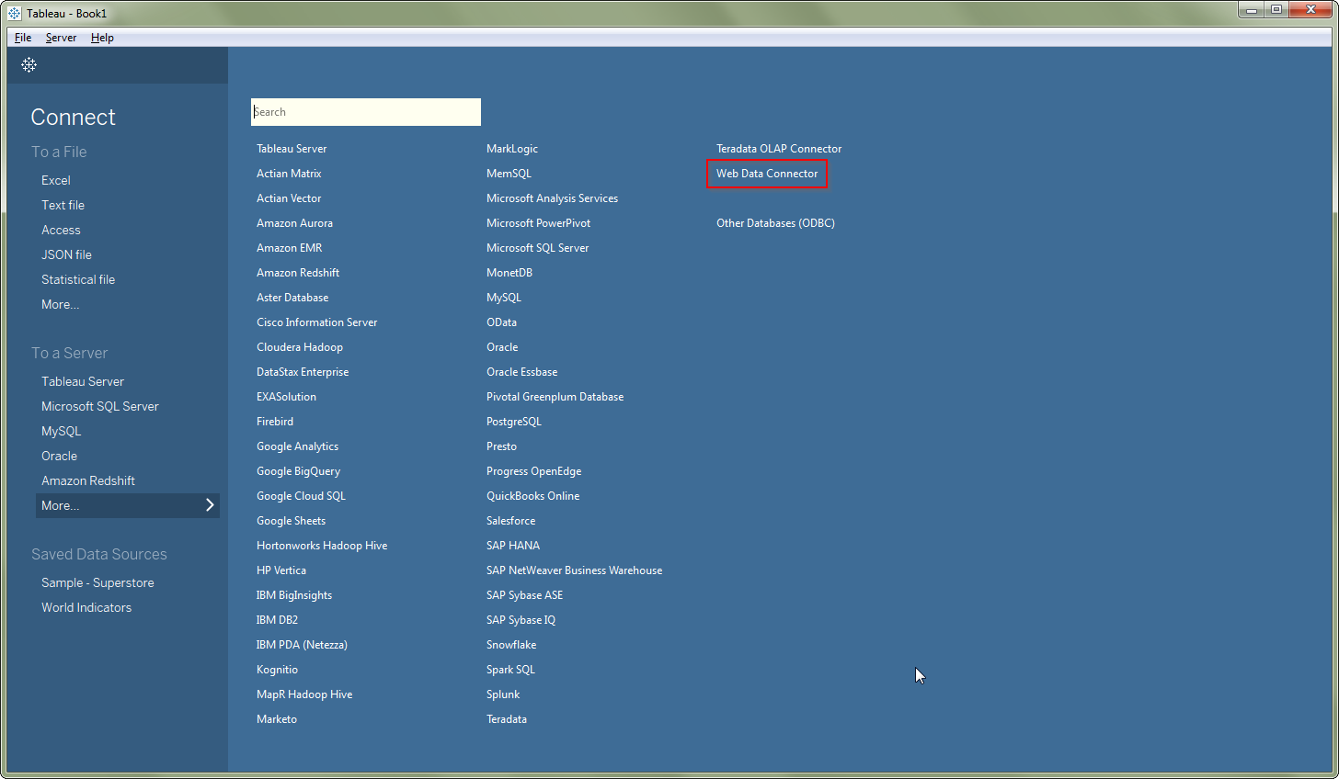
Enter the Alma API and Tableau Web-Data Connector
Easy as 1, 2, 3!

Slide 6
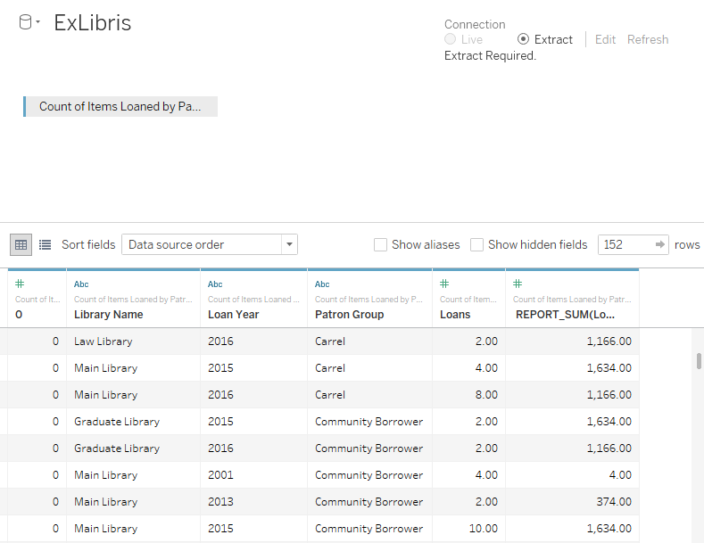
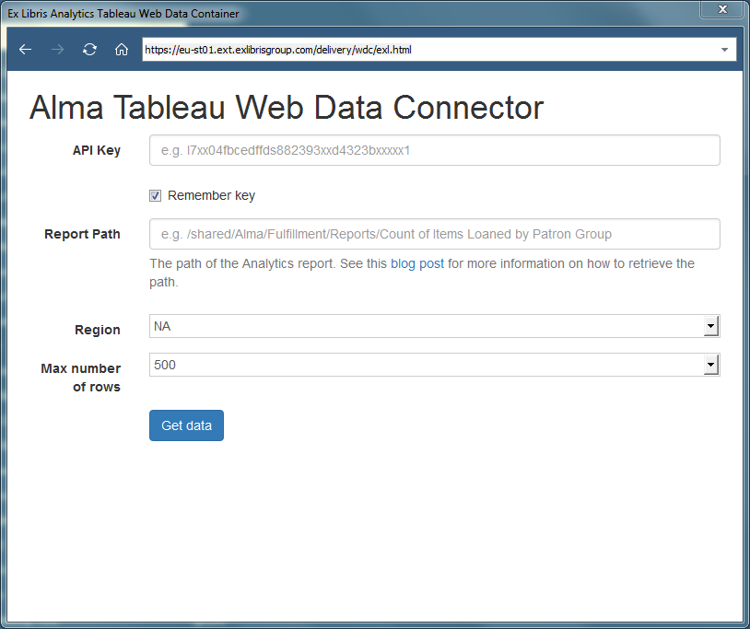
Enter the Alma API and Tableau Web Data Connector
Easy as 1, 2, 3!

Slide 7
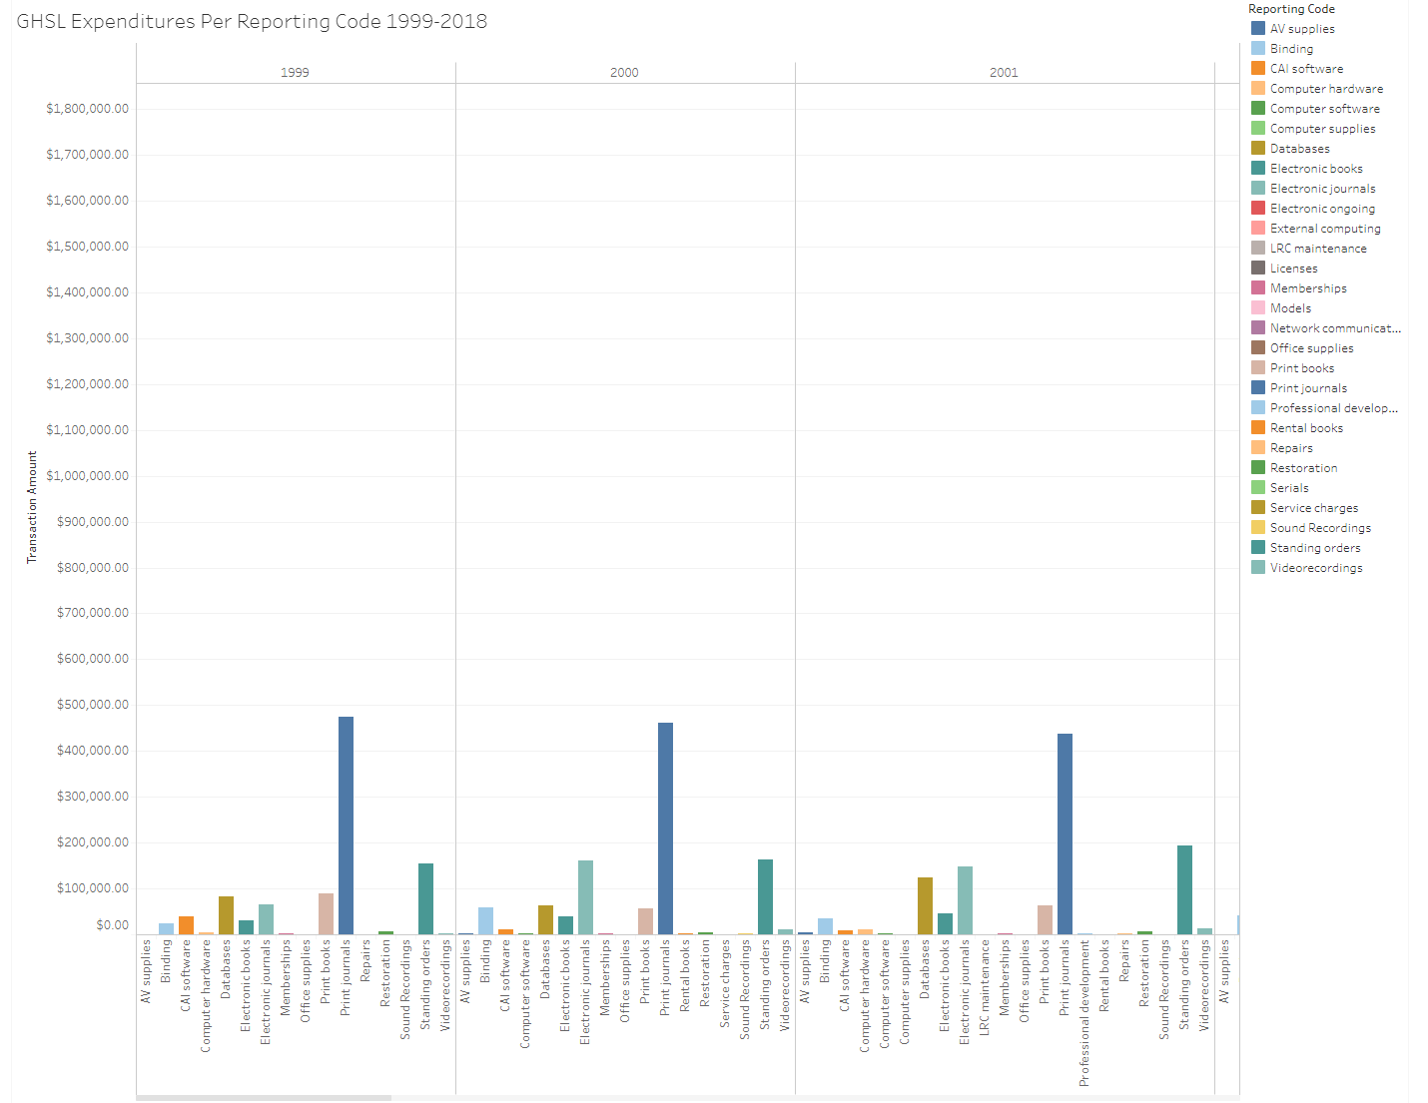
Example 1
Library expenditures per reporting code 1999-2018

Slide 8
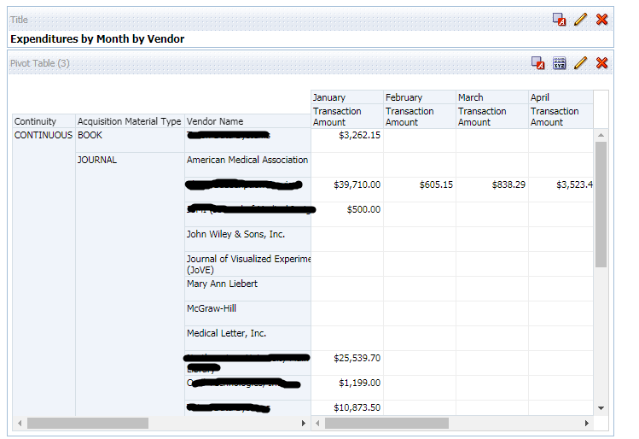
Example 2
Expenditures per month per vendor

Slide 9
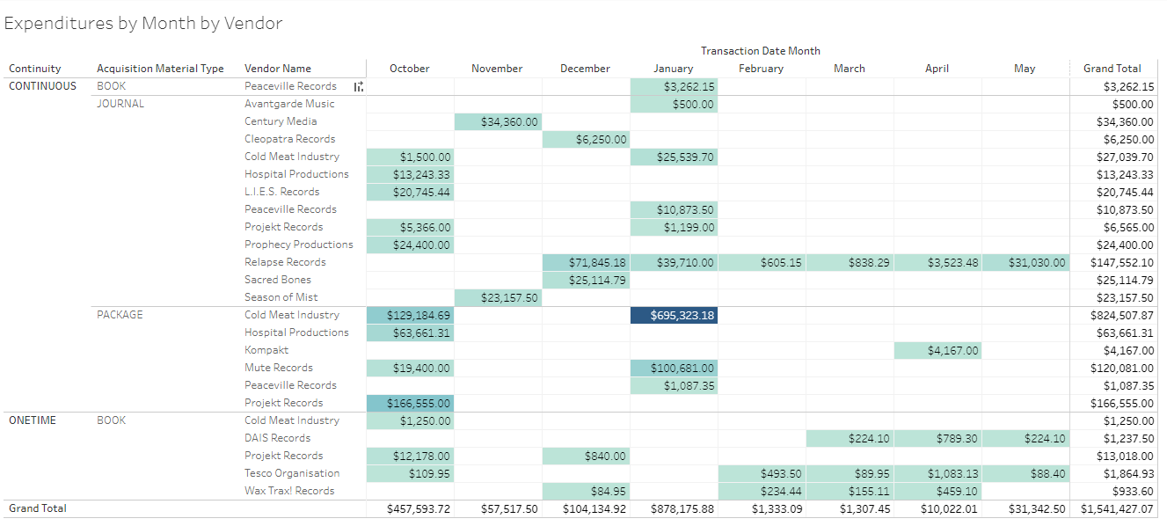
Example 2
Expenditures per month per vendor*
*vendor names have been anonymized

Slide 10
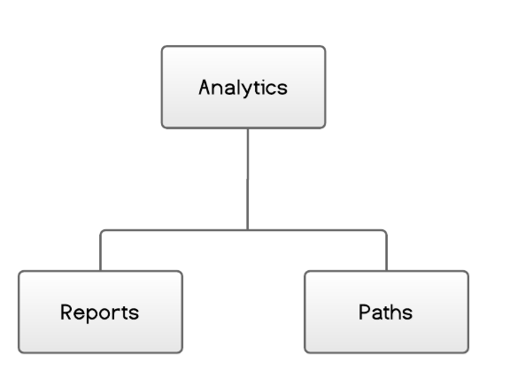
Looking forward…
Limitations of Tableau
Possible alternatives / next steps
Two licensing options:
  Expensive, or
  All data is public
WDC must be refreshed manually
Learning curve for more advanced functionality
Static images, Excel vizzes ☹
Loading static data and using JavaScript chart library (chart.js or d3.js) for some interactive features
Making API calls to create dynamic JS charts ☺
  xml via AJAX ?
  Analytics API “Retrieve Analytics report”
Doing actual analytics in OBI

Slide 11
Thank You
j-shank@northwestern.edu | @ShankLib

