Slide 1
Using Alternative Metrics in the NIH Biosketch
Presenters:
Karen Gutzman, Impact and Evaluation Librarian
Patricia Smith, Impact and Dissemination Librarian
Pamela Shaw, Biosciences and Bioinformatics Librarian
Galter Health Sciences Library
Feinberg School of Medicine
Northwestern University

Slide 2
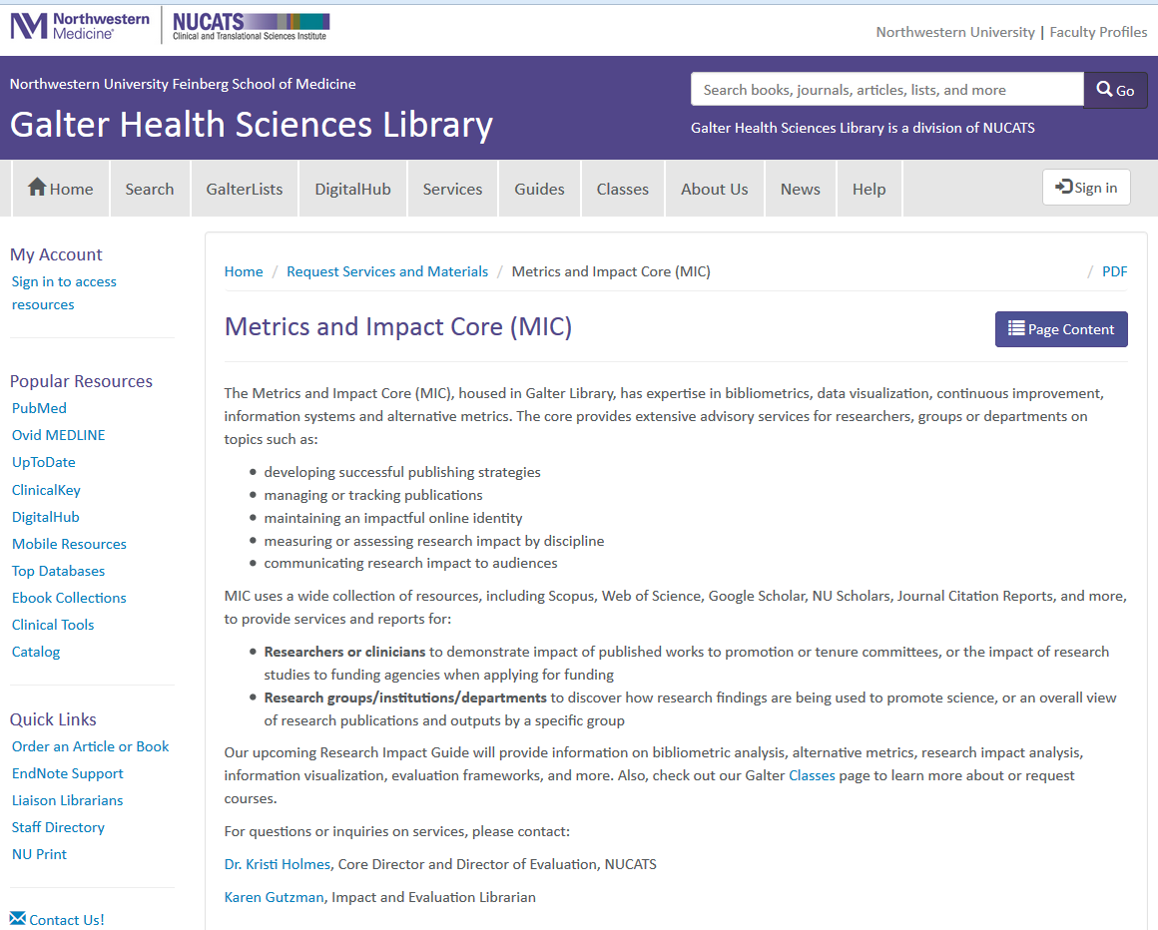
Metrics and Impact Core
resources and services for our faculty, staff, and students
The core provides extensive advisory services for researchers, groups or departments on topics such as:
  developing successful publishing strategies
  managing or tracking publications
  maintaining an impactful online identity
  measuring or assessing research impact by discipline
  communicating research impact to audiences
(above) Screenshot of Metrics and Impact Core homepage
http://galter.northwestern.edu/Request-Services-and-Materials/metrics-and-impact-core-mic

Slide 3
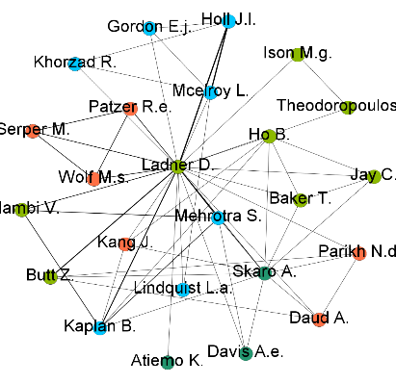
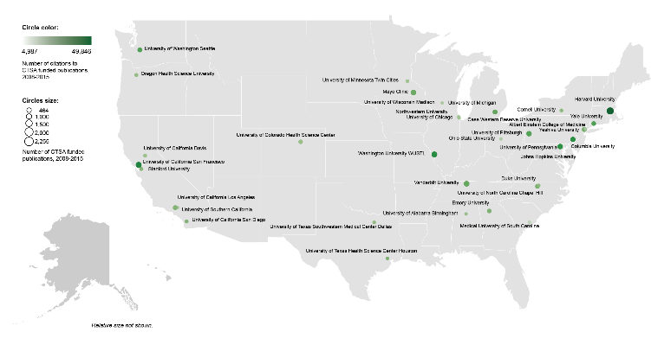
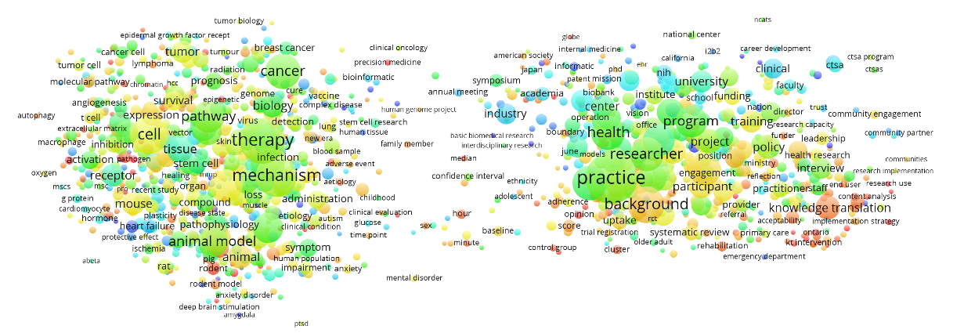

Data sources and tools
within the Metrics and Impact Core
Bibliographic databases:
  Scopus (Elsevier)
  PubMed (NLM)
  Web of Science (Clarivate Analytics)
  NU Scholars (Elsevier)
  Google Scholar
  Sympletic Elements
Other databases:
  iCite Tool
  NIH RePORTER
  Altmetric Bookmarklet
  InCites (Clarivate Analytics)
Visualization tools
  Sci2 Tool
  Gephi
  Pajek
  VOSviewer
  CitNetExplorer
  Tableau
  Microsoft Excel
Gephi
Tableau
VOSviewer
Notes:
When we first started our services we mostly used Scopus, PubMed, Web of Science for our services and for reviewing biosketches. As time went on we discovered resources such as the Almetric Bookmarklet, and we added a subscription to InCites.

Slide 4
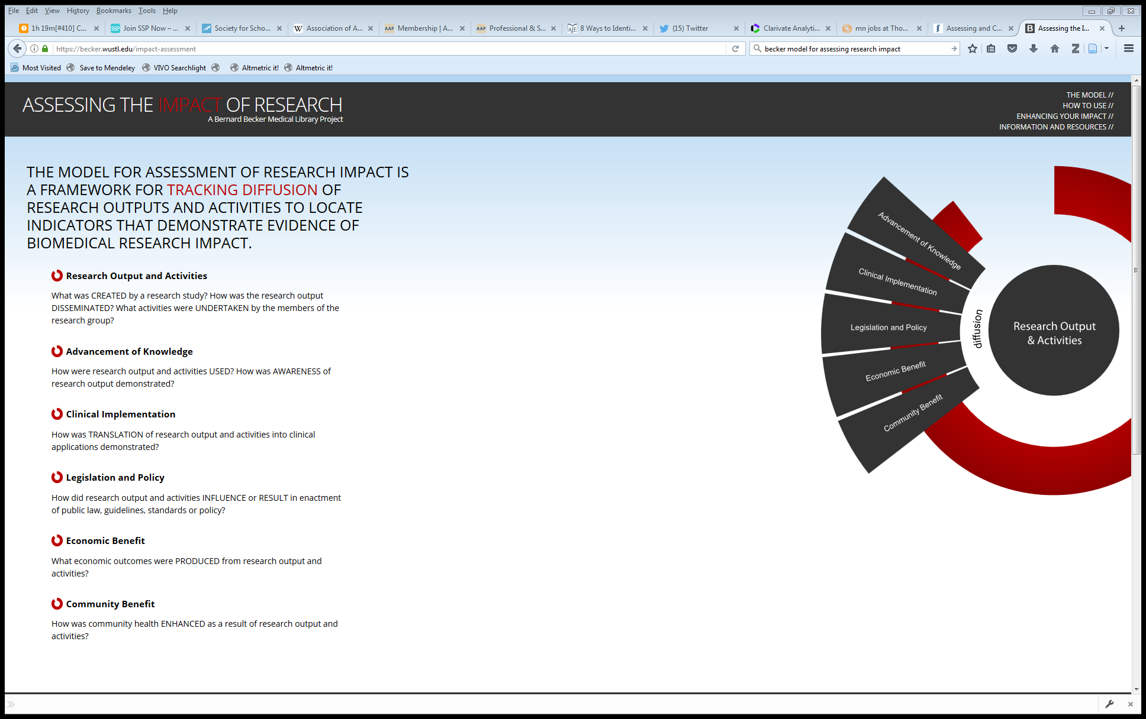

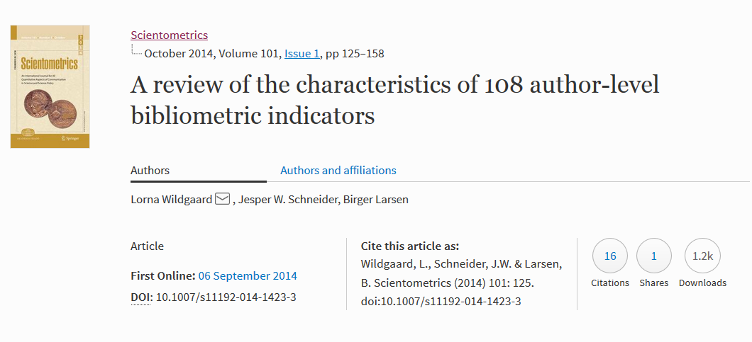
Evaluation frameworks we use often
within the Metrics and Impact Core
(above) Homepage of Becker Model: https://becker.wustl.edu/impact-assessment
(above) Screenshot of 100 Metrics paper by AAMC and RAND Europe: http://www.rand.org/pubs/research_reports/RR1606.html
(left) Screenshot of Wildgaard L, et. al.: https://arxiv.org/abs/1408.5700
Notes:
100 Metrics by AAMC and RAND Europe
Guthrie, Susan, Joachim Krapels, Catherine Lichten and Steven Wooding. 100 Metrics to Assess and Communicate the Value of Biomedical Research: An Ideas Book. Santa Monica, CA: RAND Corporation, 2016. http://www.rand.org/pubs/research_reports/RR1606.html
ACUMEN Project
Wildgaard L, Schneider JW, Larsen B. A review of the characteristics of 108 author-level bibliometric indicators. Scientometrics. 2014 Oct;101(1):125–158. https://arxiv.org/abs/1408.5700
Becker Medical Library Model for Assessment of Research Impact
The Becker Medical Library Model for assessment of research impact – an Interview with Cathy C. Sarli and Kristi L. Holmes [Internet]. Research Trends. [cited 2015 Jun 8]. Available from: http://www.researchtrends.com/issue-34-september-2013/the-becker-medical-library-model/
Elsevier Usage Guidebook
Colledgre L, Elsevier Research Intelligence. Usage Guidebook. https://www.elsevier.com/research-intelligence/resource-library/usage-guidebook
InCites Indicators Handbook
Thomson Reuters (Clarivate Analytics). Insites Indicators Handbook. http://ipscience-help.thomsonreuters.com/inCites2Live/indicatorsGroup/aboutHandbook.html
CDC Science Impact Framework
https://www.cdc.gov/od/science/impact/framework.html
Institute of Medicine: Degrees of Impact
http://www.nationalacademies.org/hmd/~/media/Files/About%20the%20IOM/PresidentsAddress2013.pdf

Slide 5

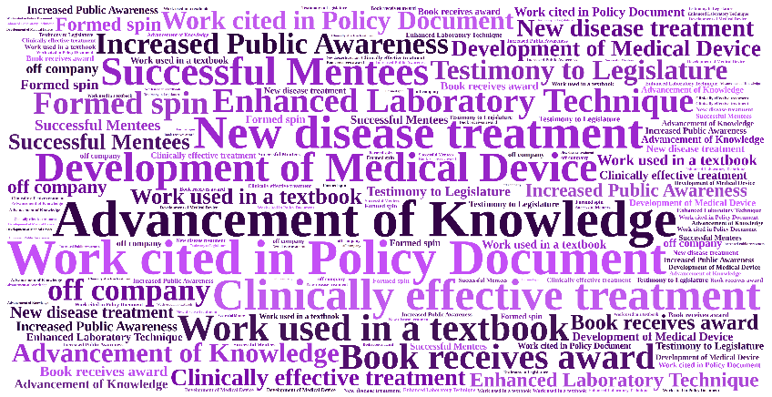
Evaluation frameworks contain indicators (or metrics)
Use Impact Indicators for measuring:
Research Outputs
Research Outcomes
Notes:
Shows an example of a traditional “cause and effect” logic model which describes how the available resources (also known as inputs) and program activities will lead to desired outputs and outcomes (both of which can be measured in the short , intermediate, or long term), given a specific environmental context.

Slide 6

Example of an evaluation framework
100 Metrics to Assess and Communicate the Value of Biomedical Research
Outcome: Research Impacts
Indicator: | Description:
Number of journal articles published | The number of peer-reviewed journal articles published over a particular timeframe is a quantitative metric of the volume of research produced by an individual or institution.
Number of citations | Measures of citations to published articles are used as a proxy for article quality. Can include Highly Cited Papers, Normalized Citation Score, etc.
Number of research output downloads | The number of times a research output has been downloaded gives an indication of how much it is being of use and the level of interest in it.
Mentions in Social Media | Information on who is citing the institution in social media can help identify where the influence of the medical school or teaching hospital is being felt across the sector, noting that this may be within academia.
http://www.rand.org/pubs/research_reports/RR1606.html

Slide 7


Example of an Evaluation Framework
Becker Medical Library Model for Assessment of Research Impact
Outcome: Advancement of Knowledge
Indicator: | Description:
Books or Book Chapters | Book or book chapters generated by the research study is noted in a bibliography. Book is used as a textbook for higher education. Translations of the book. Book or book chapter cited in subsequent publications.
Change in Understanding and Awareness | Research study findings represent a paradigm shift in a field. Research study findings lead to change in understanding a problem.
Citations to Publications | Number of first generation citations. Number of second generation citations. Countries represented by citations. Institutions represented by citations. Languages represented by citations.
Conferences | Conference panel is created around the topic related to the research study.
https://becker.wustl.edu/impact-assessment

Slide 8
Bibliometrics and alternative metrics
Bibliometrics
Alternative Metrics
Statistical analysis of publications such as articles and books, usually focused on citation analysis
An attempt to measure the impact or influence of a particular work
Many different metrics:
  Journal level: impact factor
  Individual level: h-index
  Article level: citations
Data gathered online that examines the volume and nature of attention that a work receives online
Complementary to bibliometrics
Gathers data on diverse outputs, i.e. data sets, reports, software, web projects, etc.
Examples:
  Twitter mentions
  Citations in policy documents
  Wikipedia citations
  Mass media mentions
Notes:
Karen or Patty

Slide 9
Overview of NIH Biosketch
Basic features and requirements
Total sketch length is 5 pages
Template is available from the NIH, or investigators can use the SciENcv tool at My NCBI
Up to 5 contributions to science can be written in section C (but 5 is not required)
You can list publications or scholarly output after both the personal statement and after each contribution
Up to 4 works may be listed after each contribution and the personal statement
Works listed after the personal statement or each contribution can include:
  journal manuscripts
  books and book chapters
  software
  databases
  data and research materials
  conference presentations
  patents
  audio or visual products
  teaching materials,
  instruments or equipment
  models
  protocols
Notes:
Pamela

Slide 10
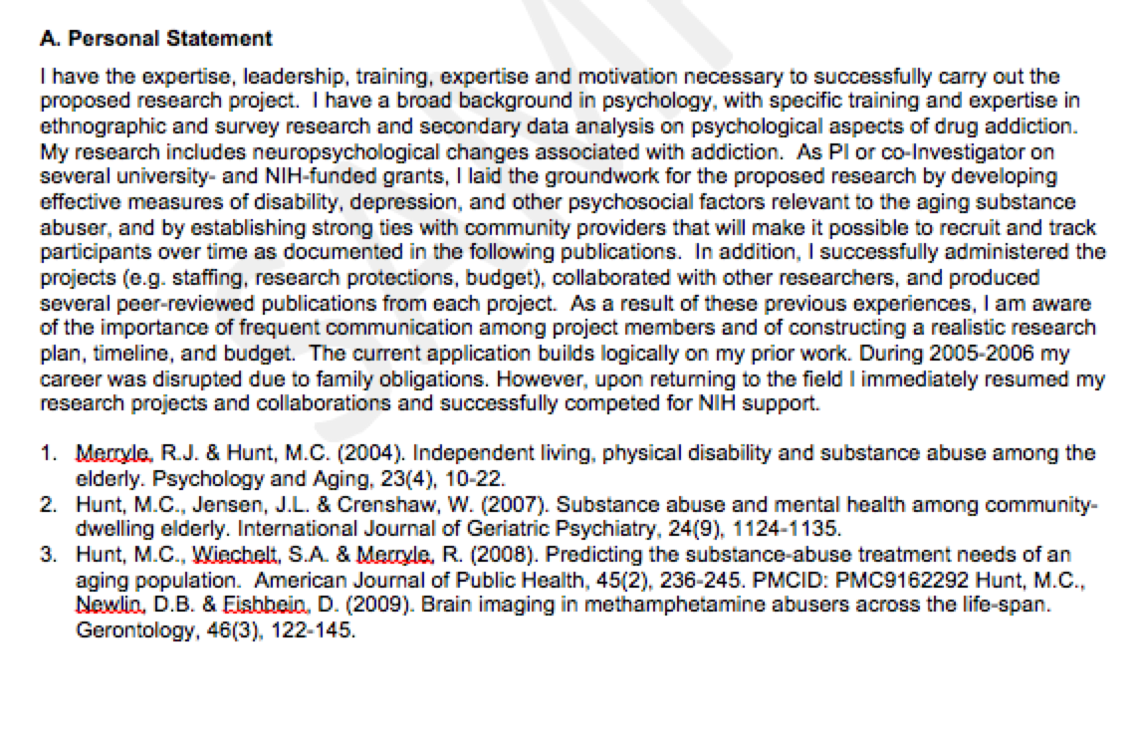
Personal Statement
Describe why you are well-suited for your role in the project described in this application.
Relevant factors may include:
aspects of your training;
previous experimental work on this or related topics;
technical expertise;
collaborators or scientific environment;
past performance in this or related fields
(you may mention specific
contributions to science that are not included in Section C).
If you wish to explain impediments to your past productivity, you may include a description of factors such as family care responsibilities, illness, disability, and active duty military service.
You may identify up to four peer reviewed publications that specifically highlight your experience and qualifications for this project.
Notes:
Pamela

Slide 11
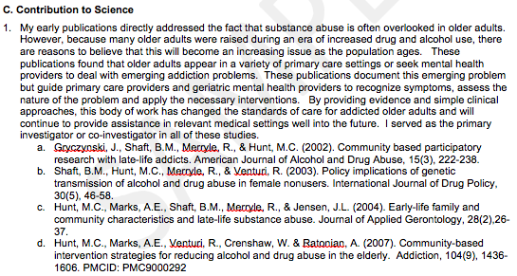
Contribution to Science
Text should consist of 4 parts:
Background of the medical or biological concept
Your results
Relevance or impact of your work on medical care or technology
Your role in the work
Briefly describe up to five of your most significant contributions to science.
For each of these contributions, reference up to 4 relevant peer-reviewed publications or non-publication research products.
The description of each contribution should be no longer than ½ page including citations.
This is a perfect opportunity to incorporate citation metrics or social media metrics (from altmetric.com, a citation index like Scopus, or the publisher’s page) to indicate dissemination and reach, especially if your work influences the public.
Notes:
Pamela

Slide 12
NIH Biosketch review checklist
Overall: Completes template as specified in NIH Biosketch instructions
Personal Statement
  Clear and concise description of career background and training
  Strong description of professional expertise
  Mentions role to be performed in grant and provides context on fitness
Contributions to Science
  Consider number of contributions
      Early career generally have 2-3 contributions
      Later career generally have 3-5 contributions
      No more than 5 contributions total
      Review author’s Scopus profile if you feel you’d like to suggest another contribution
  Provides clear narrative with appropriate emphasis and level of description
  Consider Leading Statement in bold at beginning of contribution
  Consider bibliometric or alternative metrics for one or more of the four citations, or for a body of work described in contribution
  See examples
    “Writing About Your Impact in the New NIH Biosketch”: https://galter.northwestern.edu/News/writing-about-your-impact-in-the-new-nih-biosketch
    “Using Alternative Metrics to Tell your Science Story” : https://galter.northwestern.edu/news/using-alternative-metrics-to-tell-your-science-story
Notes:
Karen

Slide 13
Alternative metrics on the NIH Biosketch
It can take 2+ years for citations to accrue. Alternative metrics offer real-time information.
Alternative metrics can help show how you’ve reached various audiences, i.e. the public, policy makers, peers in your field.
Alternative metrics can track more than journal articles and books.
http://www.whatarealtmetrics.com/what/advantages/
Notes:
Patty – why it is useful to use altmetrics in your biosketch

Slide 14
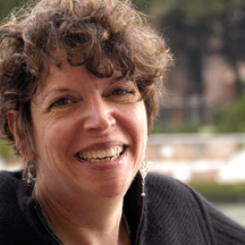

Sample case for experienced researcher
for Linda A. Teplin, PhD, Professor of Psychiatry and Behavioral Sciences
Dr. Teplin works with a multidisciplinary group on researching the bi-directional effects of mental health and incarceration
Researchers from psychiatry, psychology and statistics at Northwestern University Feinberg School of Medicine
Working together over many grants
Principal Investigator for each grant shifts among team members
Work has received widespread news attention in Chicago and the USA
Notes:
Pamela

Slide 15
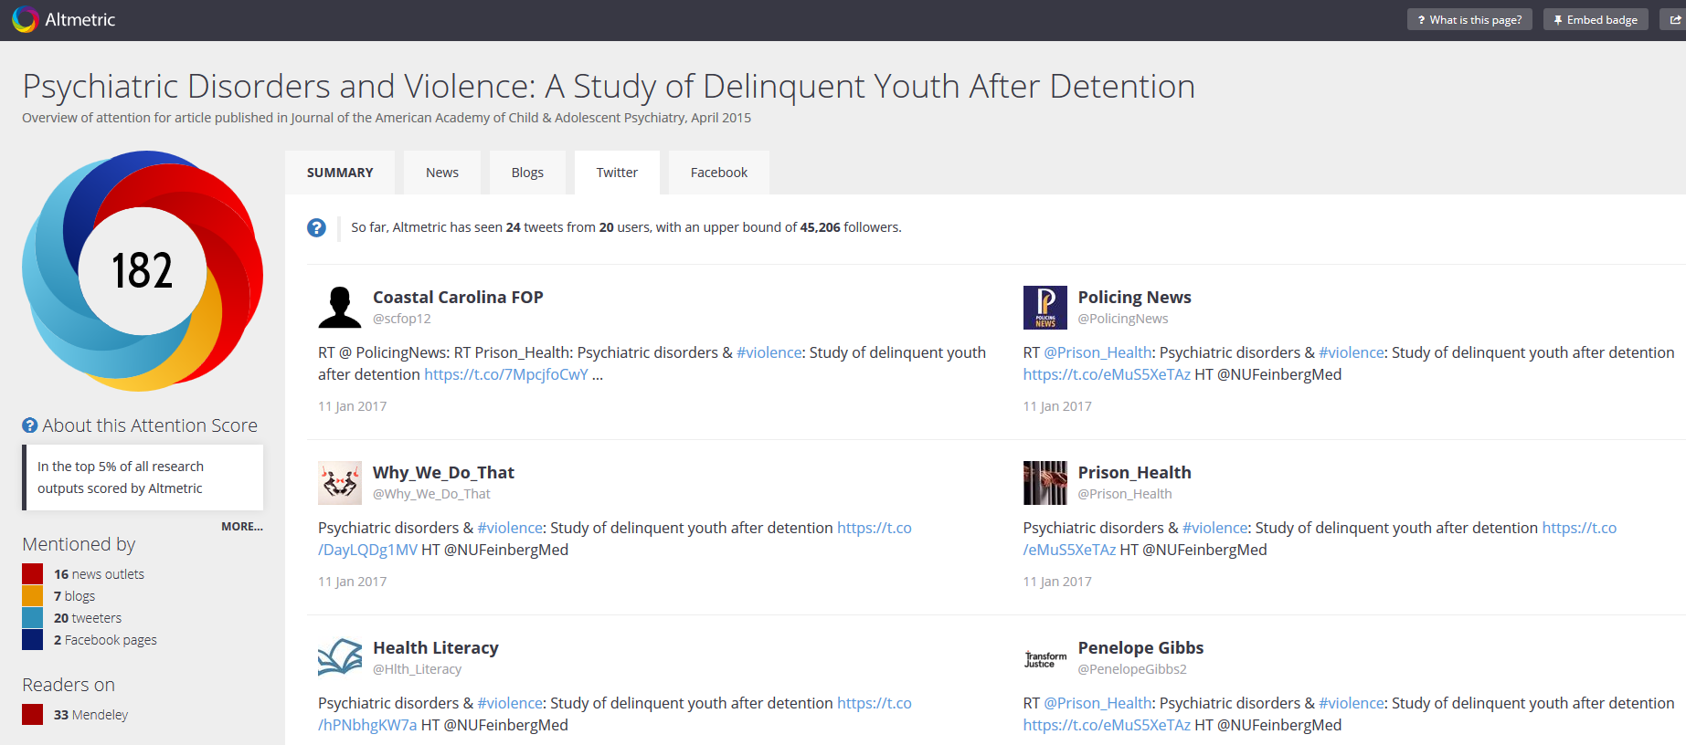
Seeking alternative metrics for one document
Using the freely available Altmetric Bookmarklet
Please note, the Altmetric bookmarklet allows you to review one document’s metrics at a time.
Notes:
Pamela

Slide 16
Sample text using Altmetric data for one document
for Linda A. Teplin, PhD, Professor of Psychiatry and Behavioral Sciences
Sentences are suggested at the end of the individual contribution, after the investigator’s description of their research and after any mention of “conventional” (citation) metrics.
“Publications from this study also are gaining significant mass media and social media attention. This attention is exemplified by 3c below, which has an Altmetric score of 182, has been featured in numerous news media stories and has received social media attention from the prison system, law enforcement, the medical community, and the public at large. This activity indicates our successful dissemination of the study results and public interest in our work.”
Notes:
Pamela

Slide 17
Seeking Altmetric data for a group of documents
Using Altmetric for Institutions or Altmetric Explorer
Use a list of PMID, PMCID, or DOIs to view groups of documents in Altmetric for Institutions (or Altmetric Explorer)
Abram, K.A., Azores-Gococo, N.M., Emanuel, K.M., Aaby, D.A., Welty, L.J., Hershfield, J.A., Rosenbaum, M.S., Teplin, L.A. (2017). Sex and racial/ethnic differences in positive outcomes in delinquent youth after detention a 12-year longitudinal study. JAMA Pediatr. 171(2); 123-132. PMID: 27992626. Accompanied by editorial feature.
Welty, L. J., Harrison, A. J., Abram, K. M., Olson, N. D., Washburn, J. J., McCoy, K. P., Teplin L. A. (2016). Health disparities in drug and alcohol use disorder: a 12 year longitudinal study of use after detention. Am J Public Health. 106(5):872-80. doi: 10.2105/AJPH.2015.303032. PMID: 26985602. Accompanied by editorial feature.
Abram, K. M., Zwecker, N. A., Welty, L. J., Hershfield, J. A., Dulcan, M. K., & Teplin, L. A. (2015). Comorbidity and continuity of psychiatric disorders in youth after detention: a prospective longitudinal study. JAMA Psychiatry.72 (1), 84-93. PMID: 25426584; PMC4562696
Teplin, L. A., Welty, L. J., Abram, K. M., Dulcan, M. K., & Washburn, J. J. (2012). Prevalence and persistence of psychiatric disorders in youth after detention: a prospective longitudinal study. JAMA Psychiatry, 69(10), 1031-1043. PMID: 23026953; PMC3737771

Slide 18
Sample text using Altmetric data for a group of documents
for Linda A. Teplin, PhD, Professor of Psychiatry and Behavioral Sciences
For a contribution whose total citation activity is only in the 200s (newer work) but whose social media interest is on the rise (list of publications on previous slide):
“This work has also been reported in numerous news outlets and has generated social media activity among law enforcement, health care providers and the public at large (source: Altmetric), suggesting community engagement and reach beyond academia.”

Slide 19
Alternative metrics and the early career researcher
Tradition and time
  The traditional mode of disseminating scholarly research in the biomedical sciences is through journal publishing
  Citations to journal articles can take years to accumulate
  Citations are often used as a proxy to assess research contribution, influence, or quality
Enhancing dissemination
  Online platforms such as blog posts, twitter, list servs, (etc.) enhance dissemination of research
  Lay summaries of research often used in online platforms can increase uptake of research by various audiences
Finding an alternative
  Alternative metrics capture attention, discussion, and other non-traditional interactions with research
Please note, our Altmetric example of an Early Career Researcher has been anonymized.

Slide 20
Seeking Altmetric data for a group of documents
Using Altmetric for Institutions or Altmetric Explorer
Bancks MP, Pletcher MJ, Kertesz SG, Sidney S, Rana JS, Schreiner PJ. Marijuana use and risk of prediabetes and diabetes by middle adulthood: the Coronary Artery Risk Development in Young Adults (CARDIA) study. Diabetologia 2015; Dec;58(12):2736-44. PMID: 26364621; PMCID: PMC4631659.
Reis JP, Auer R, Bancks MP, Goff DC Jr, Lewis CE, Pletcher MJ, Rana JS, Shikany JM, Sidney S. Cumulative Lifetime Marijuana Use and Incident Cardiovascular Disease in Middle Age: The Coronary Artery Risk Development in Young Adults (CARDIA) Study. Am J Public Health. 2017 Apr;107(4):601-606. PMID: 28207342; PMCID: PMC5343712.

Slide 21
Sample text using Altmetric data for a group of documents
for Early Career Researcher
For publications listed on the previous slide:
  “With growing media and public attention on the debate over legalization of marijuana for medicinal or recreational use, it is not surprising that my work in this field has received interest in news outlets and in the public in general. Manuscripts a and b below have Altmetric scores of 71 and 72, respectively, and have been mentioned in 11 news outlets and numerous social media accounts belonging to clinicians and the public. Additionally, 2a below has been cited by a policy document from the National Academy of Sciences on the health effects of cannabis. This attention suggests that my work in this field is expanding beyond academia to enter public awareness, and can contribute evidence to the discussion on the health effects of marijuana among clinicians, policy makers, and patients. ”

Slide 22
Questions?

Slide 23
Thank you

