Slide 1
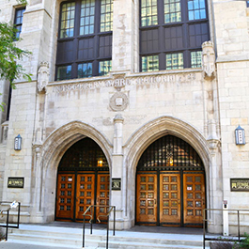

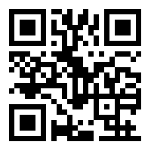
Searching for the
“Best Available Evidence”
Taking the Quest Beyond the Medical School Community
Presented by: Q. Eileen Wafford, MSt, MLIS, q-wafford@northwestern.edu
Research Librarian, Galter Health Sciences Library & Learning Center
Northwestern University Feinberg School of Medicine
https://bit.ly/3fGpbTo
Notes:
Chicago skyline image: https://www.jeffreymurrayphotography.com/photos/chicago-skyline

Slide 2
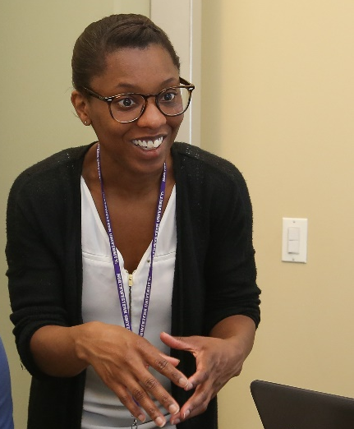

My Role at Feinberg School of Medicine
Working with faculty, staff, students, and affiliated researchers to provide reference and specialized research services at Galter Health Sciences Library and Learning Center.
Serve on various committees and teams
Conduct research on topics of interest
Provide training and assistance with systematic and scoping reviews for publication
Research Librarian
Galter Health Sciences Library & Learning Center
Participate in collaborative partnerships
Create and deliver training on the evidence-based medicine process

Slide 3
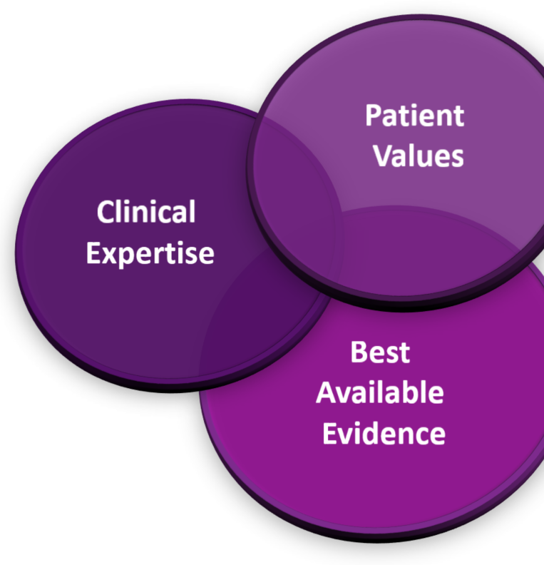
DEFINING
EVIDENCE-BASED
MEDICINE (EBM)
EBM is the conscientious, explicit, judicious and reasonable use of modern, best evidence in making decisions about the care of individual patients.
EBM integrates clinical experience and patient values with the best available research information.
Notes:
Source: https://www.ncbi.nlm.nih.gov/pmc/articles/PMC3789163/

Slide 4
TEACHING
EVIDENCE-BASED
MEDICINE (EBM)
The 5 Essential Steps of EBM
Convert information needs into answerable questions
Find the best evidence to answer the question
Critically appraise the evidence for its validity and usefulness
Apply the results
Evaluate performance
ACQUIRE evidence
APPRAISE evidence
APPLY evidence
ASSESS EBM process
ASK a question
https://adc.bmj.com/content/archdischild/90/8/837.full.pdf
Notes:
https://www.library.ucdavis.edu/guide/ebp-resources/

Slide 5
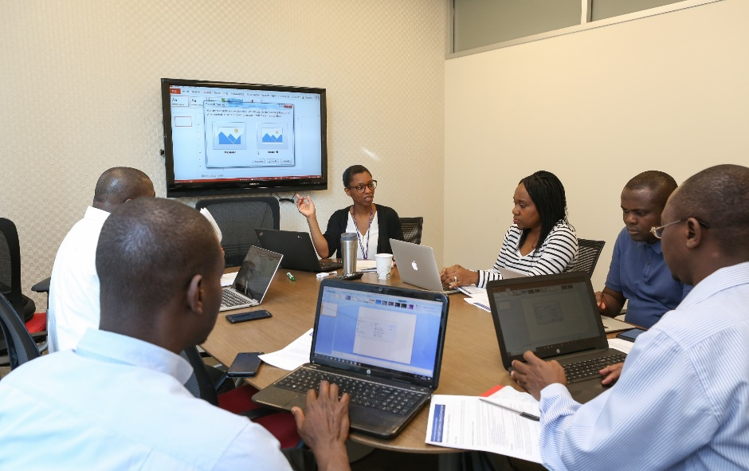
Liaison Areas
Galter Library’s Liaison Librarian Service creates partnerships by pairing librarians with departments, centers, institutes, and programs at Feinberg School of Medicine.
Orthopaedic Surgery
Center for Community Health
Otolaryngology-Head and Neck Surgery
Center for Population Health Sciences
Physical Medicine and Rehabilitation
Osher Center for Integrative Medicine
Physical Therapy and Human Movement Sciences
Institute for Global Health
Preventive Medicine
Radiology
Radiation Oncology
Surgery
Comprehensive Transplant Center
Center for Health Equity Transformation

Slide 6
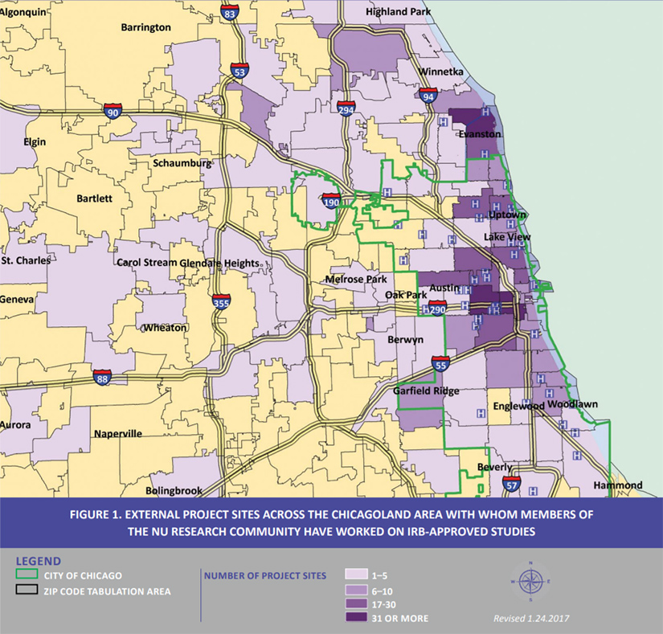
Community Engagement
at Feinberg
“We live our mission to improve human health beyond the individual patient. This means making a genuine commitment to meeting the needs of the diverse neighborhoods and populations we serve.”
In 2017, Feinberg investigations involved 737 community performance sites in Illinois, 473 in other U.S. locations and 398 internationally.
Notes:
Map: https://www.feinberg.northwestern.edu/sites/community-engagement/research/index.html

Slide 7
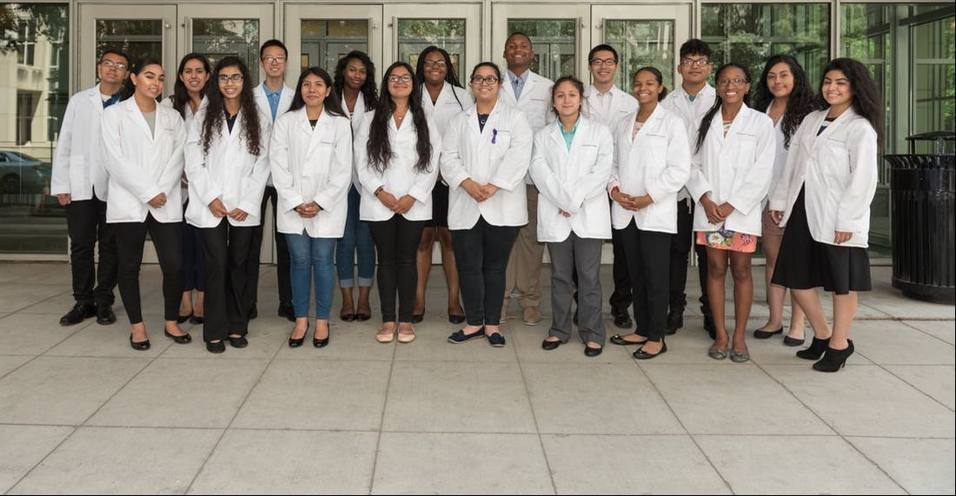
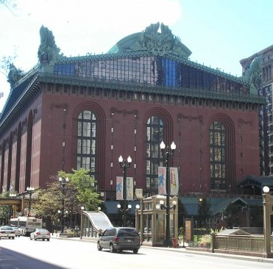
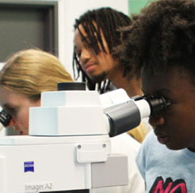
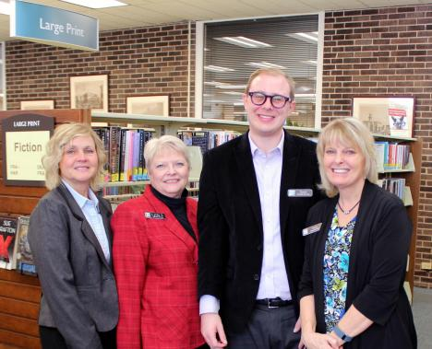
Community Partnerships
Taking EBM Training to the Community
NM Scholars
“Health for All”
St. Charles Public Library
ChicagoCHEC

Slide 8
NM Scholars
Northwestern Medicine Scholars Program
The Northwestern Medicine Scholars Program at Westinghouse College Prep high school is a unique partnership that joins the Northwestern University Feinberg School of Medicine and Northwestern Memorial Hospital in an effort to inspire talented high school students to consider careers in Medicine and Science.
Audience: High school students
Time: 1-hour hands-on training at the library (annual program)
Quest: Locate, access, and appraise sources of health information using basic and advanced searching technics
Treasure: Quality health information from various websites and databases to support research projects
Notes:
https://scholars.nm.org/who-are-we.html

Slide 9
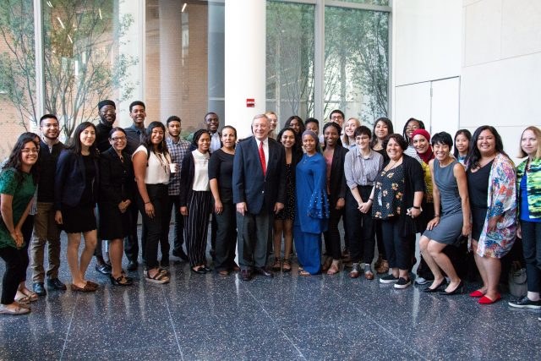
ChicagoCHEC Fellows
ChicagoCHEC Summer Research Fellows Program
The ChicagoCHEC Research Fellows Program is a comprehensive learning experience for undergraduate and post-baccalaureate students at Northeastern Illinois University, University of Illinois at Chicago, Northwestern University, City Colleges of Chicago, and other community colleges in the Chicago metropolitan area.
Audience: Undergraduate and post-baccalaureate students
Time: Two 1-hour hands-on training sessions at Galter (annual program)
Quest: Define the research question/ Locate, access, and appraise sources using advanced searching technics
Treasure: Quality health information on a narrow topic from advanced databases searches
Notes:
Source: https://www.cancer.northwestern.edu/research/education-training/summer-research/index.html

Slide 10
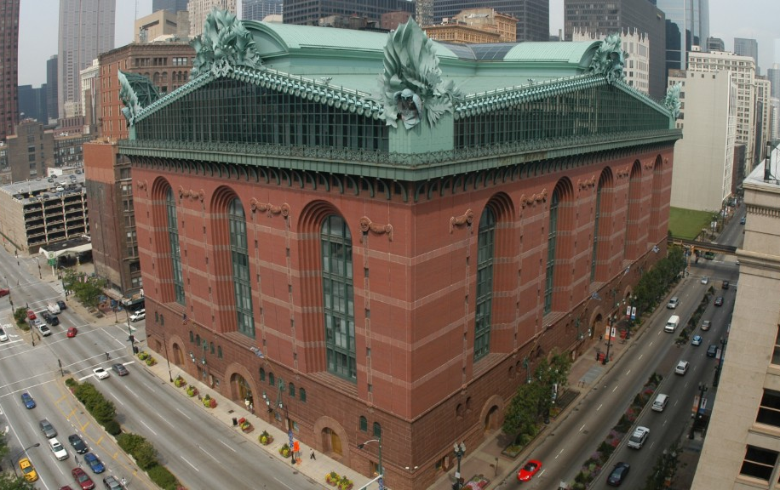
“Health for All”
Health for All – Real Talk: Clinical Trials Project
The Health for All – Real Talk: Clinical Trials (“Health for All”) tool was developed in partnership with Northwestern researchers, members of the community, and the Chicago Public Library. The tool provides information about clinical trials and help people find clinical trials that they might want to join. The project is supported by a grant from the NIH.
Audience: Adults 18 and older
Time: 1-hour training at various Chicago public libraries (ongoing)
Quest: Visit healthforallproject.org
and learn about clinical trials
Treasure: Information about clinical trial participation and access to local and national clinical trials
Notes:
https://healthforallproject.org/

Slide 11
Online Training for Seniors
Outreach Services Department, St. Charles Public Library
The Outreach Services Department of the St. Charles Public Library spearheaded training at two local senior facilities in partnership with the National Network of Libraries of Medicine and the Galter Library. The goal was to “equip seniors with the skills and knowledge to find and access quality health information on the web, becoming better informed about current healthcare trends and health information resources to lead longer and healthier lives.”
Audience: Senior citizens, librarians
Time: 1-hour hands-on training at two senior residential living facilities (January and March 2018)
Quest: Navigate MedlinePlus and Google / Appraise online information
Treasure: Relevant information on senior health from MedlinePlus and Google

Slide 12
Challenges and Solutions
Expectations
Time
Resources
Continue communication
Target program objectives
Reuse content

Slide 13

Thank you!

Slide 14
References
& Sources of Interest
Akobeng, A. K. (2005). Principles of evidence based medicine. Archives of disease in childhood, 90(8), 837-840. https://adc.bmj.com/content/archdischild/90/8/837.full.pdf [Opens to a PDF]
Studer, K., Abbot, B., (2020) Subject Guide: Evidence-Based Practice Resources. https://www.library.ucdavis.edu/guide/ebp-resources/
Community Engagement at Feinberg https://www.feinberg.northwestern.edu/sites/community-engagement/index.html
Northwestern Medicine Scholars Program at Westinghouse College Prep https://scholars.nm.org/
ChicagoCHEC Research Fellows Program - https://chicagochec.org/opportunities/education-training-programs/research-fellows/
Health for All – Real Talk: Clinical Trials - https://healthforallproject.org/
Newman, B. (2017) Funding Awarded for an Outreach Award: Senior Health Outreach. Funding, Public Libraries. https://news.nnlm.gov/gmr/2017/10/funding-awarded-for-an-outreach-award-senior-health-outreach/

