Slide 1


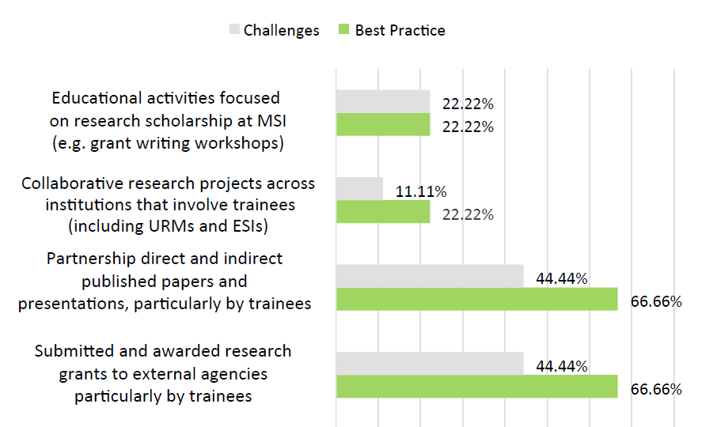
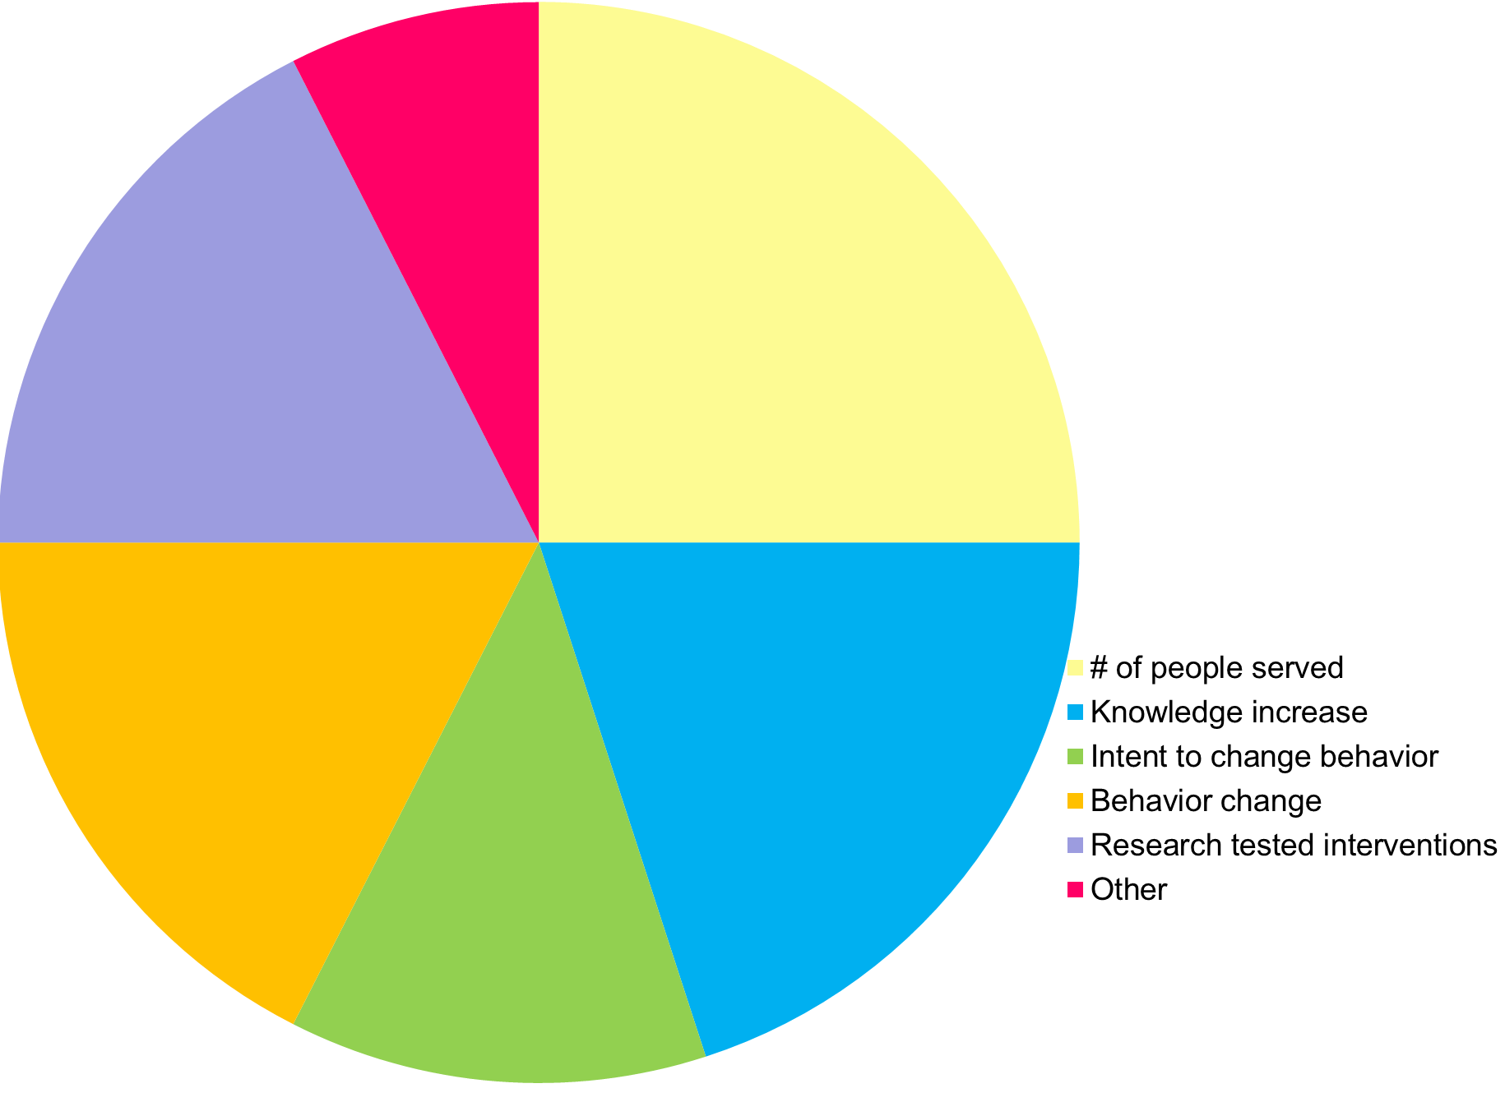
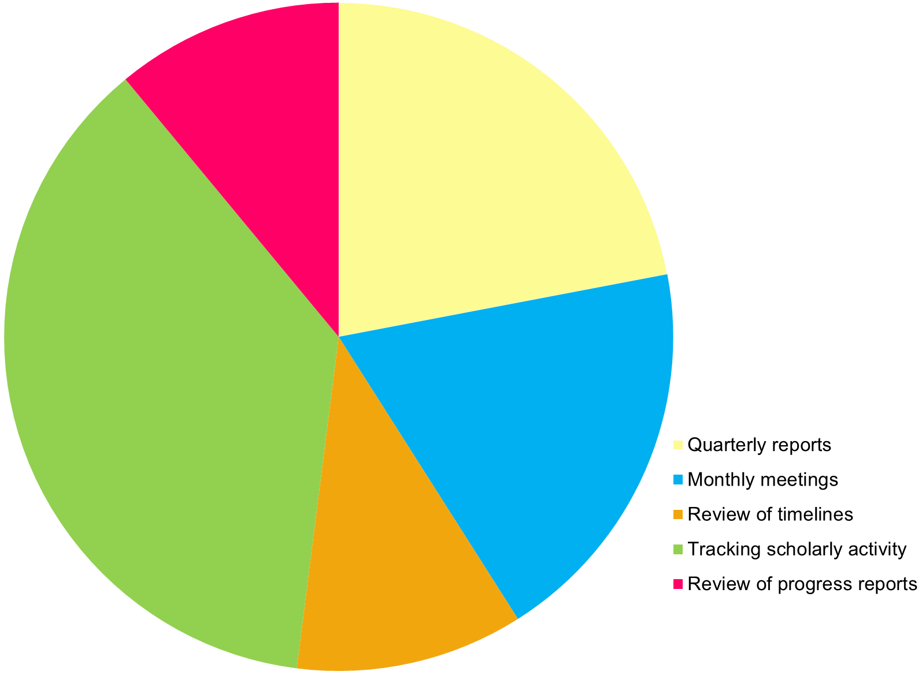
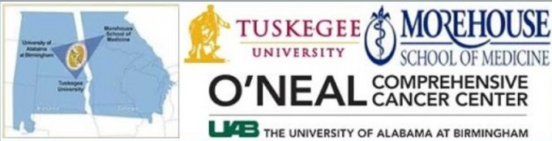
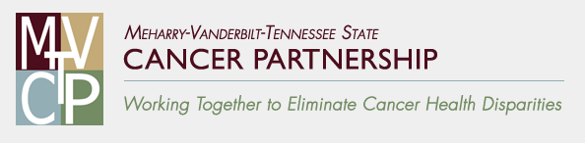
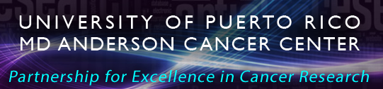
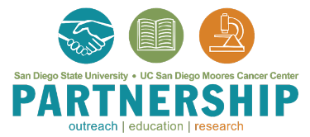
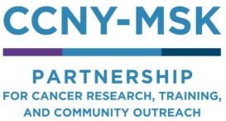
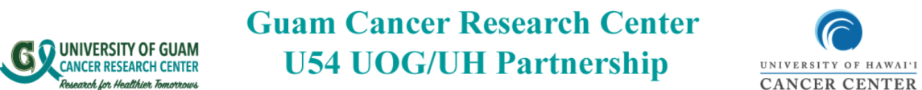
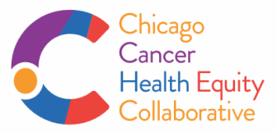
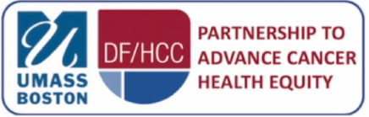
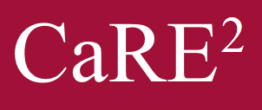
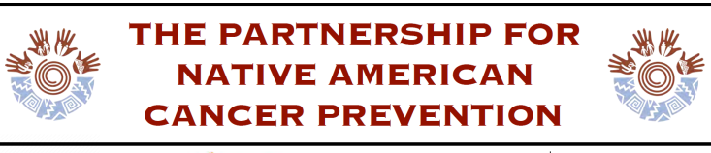



Efforts to implement a participatory evaluation plan for Comprehensive Partnerships to Advance Cancer Health Equity
McIntyre, J.¹; Peral, S.L.²; Dodd, S.J.³; Behar-Horenstein, L.S.⁴; Madanat, H.⁵; Shain, A.A.⁶; De Jesús, S.⁷; Laurila, K.⁸; Robinett, H.R.⁹ ;Holmes, K.L.¹⁰; Aguila, N.H.¹¹;
Marzan, M.¹; Spychala, L.¹²; Barrios, A.⁵; Rivers, D.²; Loest, H.B.¹³; Drennan, M.¹³; Suiter, S.V.¹⁴; Richey, J.M.⁴; Brown, T.⁴; Webb, L.²; Hubbard, K.¹²; Scarinci, I.C. ²
¹Ponce Health Sciences University-Moffitt Cancer Center Partnership; ²Morehouse School of Medicine-Tuskegee University-O’Neal Comprehensive Cancer Center at the University of Alabama at Birmingham Partnership; ³Temple University-Fox Chase Cancer Center, Hunter College Partnership; ⁴University of Florida-Florida A&M University-University of Southern California-Norris Comprehensive Cancer Center CaRE2 Health Equity Center; ⁵San Diego State University-University of California San Diego Moores Cancer Center Partnership; ⁶University of Massachusetts Boston and Dana-Farber/Harvard Cancer Center Partnership; ⁷University of Puerto Rico-MD Anderson Cancer Center Partnership; ⁸Partnership for Native American Cancer Prevention; ⁹University of Guam-University of Hawaii Cancer Center Partnership; ¹⁰Chicago Cancer Health Equity Collaborative; ¹¹Center to Reduce Cancer Health Disparities, National Cancer Institute; ¹²City College of New York and Memorial Sloan Kettering Cancer Center Partnership; ¹³New Mexico State University-Fred Hutchinson Cancer Research Center Partnership; ¹⁴Meharry Medical College-Vanderbilt-lngram Cancer Center-Tennessee State University Cancer Partnership
Background
Results
Comprehensive Partnerships to Advance Cancer Health Equity (CPACHE) aim to create stable and long-term partnerships between minority serving institutions (MSI) and NCI designated Cancer Centers.
All CPACHEs are expected to achieve the six objectives listed on table 1 below.
Evaluation is a key component to successful and sustainable partnerships.
In recent years, funding agencies have called for a collaborative approach among partnerships.
This abstract describes collaborative efforts undertaken to implement a participatory evaluation plan for CPACHEs.
During a six month period, the CPACHE taskforce made significant progress toward achieving its goals by:
Establishing communication channels, including a mailing list and monthly conference calls
Mobilizing each Partnership to develop a program specific evaluation matrix
Developing an integrated evaluation matrix utilizing common metrics, and vetting the matrix with leadership at NCI and individual program PIs
Using an NIH-supported online platform to exchange tools used for tracking and measuring outcomes
Utilizing surveys to facilitate discussion, inform best practices & identify commonalities
Establishing a model of shared participation by allowing taskforce members to facilitate meetings
Survey Results: Challenges & Best Practice
Survey Results: Current Measures for Outreach Outcomes
Survey Results: Strategies Used to Monitor Research Projects
7.5%
11%
17.5%
25%
22%
Table 1: CPACHE General Objectives
1 | Increase participation of MSI and underrepresented minority (URM) students in the nation’s cancer research and training enterprise
2 | Produce more competitive grant applications from URM scientists
3 | Increase competitive research capacity at the MSIs
4 | Increase involvement and effectiveness of cancer centers in research and training related to underserved populations
5 | Develop more effective research, outreach, and education programs that will have an impact on health disparity populations
6 | Enhance research in cancer health disparities (CHD) at cancer centers (CC)
37%
17.5%
20%
19%
12.5%
11%
Results: PACHE U54 Evaluation Matrix (summarized)
Objective | Process Evaluation | Impact Evaluation
1 | Comprehensive monitoring, tracking, and evaluation of educational activities, guidance and mentorship of trainees | ↑ # trainees who complete their degrees; ↑ # faculty who mentor trainees; ↑ # trainees who pursue careers in cancer and/or CHD research; ↑ # of cancer-related research projects at the MSI; ↑ #/range of research training experiences available to URMs/ESIs at the MSI; ↑ # of cancer-related courses at the MSI
2 | Same as #1 Monitoring and tracking of collaborations across institutions with a particular focus on engagement of trainees | ↑ # submitted and awarded grants in cancer and CHD to external agencies, specifically by trainees; ↑ # partnership direct and indirect published papers and presentations, specifically by trainees; ↑ # collaborative research projects across institutions that involve trainees; ↑ # of educational activities focused on research scholarship at MSI and underrepresented students.
3 | Monitor progress of full and pilot projects and how they generate submitted and awarded grants, publications & presentations Monitor additional institutional support to grow cancer research at MSI | ↑ # submitted and awarded research grants to external agencies by partnership investigators, specifically by full and pilot project recipients; ↑ # partnership direct and indirect published papers and presentations by partnership investigators, specifically by full and pilot project recipients;↑ # faculty engaged in cancer and CHD research at the MSI as well as provision of resources to these faculty members; ↑ # collaborative research projects across institutions; ↑ institutional support at the MSI
4 | Same as #3 Monitoring of additional training activities, such as submissions/awards of T32s, R25s, etc. focusing on CHD | Same as #3 ↑ # capacity building grants (researchers, trainees, community partners) ↑ CHD research at the cancer center side
5 | Monitor the development, implementation, evaluation, and dissemination of evidence-based strategies aiming at decreasing CHD Monitor strategies to increase participation of underserved health disparity populations in cancer-related studies, including clinical trials | Effectiveness of the cancer outreach program at the community level and disseminate findings to the partnership and community members, which can range from number of people served to specific behavior change outcomes ↑ knowledge/awareness of cancer, cancer risks, cancer prevention and cancer screening ↑ uptake of primary and secondary cancer prevention behaviors/strategies
6 | Same as #3 | ↑ # faculty engaged in cancer and CHD research and the number of recruitment/retention faculty addressing CHD at the CC
Methods
During a grantee workshop in July, 2018 Principal Investigators determined it was imperative to develop common metrics to support individual partnership evaluation and enable a better understanding of the CPACHE program nationally.
A taskforce comprised of 22 evaluators from CPACHE partnerships and one NCI Program representative was established.
The goals of the taskforce were: 1) To develop an integrated evaluation matrix with process and impact outcomes for each of the six objectives 2) To share best practices and resources for tracking, measuring and reporting progress toward each objective.
Conclusion
The collaborative development of CPACHE performance standards will help each partnership conduct more relevant and effective cancer research, training, outreach, and education aimed at advancing cancer health equity.
Although each partnership can collect additional information based on their needs, focus and structure, the evaluation matrix reflects a collaborative evaluation plan. Significant engagement, participation, and commitment from all stakeholders is critical for success
Implementation of the evaluation matrix will inform NCI evaluation focused on the impact of the CPACHE program
For correspondence email: jessica.mcintyre@moffitt.org

