Slide 1

Altmetrics:
Real-Time Measurement of Your Scholarly Impact
Patty Smith, MLIS
Impact and Dissemination Librarian
Northwestern University
Feinberg School of Medicine
Galter Health Sciences Library & Learning Center
Nutrition 2018
June 9-12, 2018
Boston, MA

Slide 2
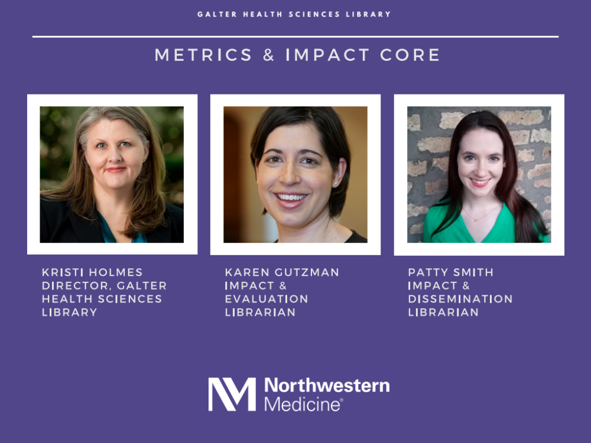
Notes:
MIC services: advanced bibliometric analysis, data visualizations, nih biosketches, group publication summaries, promotion and tenure materials, grant proposals, alternative metrics.
Enhancing Your Online Presence for Networking, Visibility and Traffic

Slide 3
Alternative metrics = Altmetrics

Slide 4
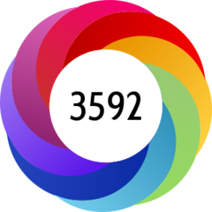
= Altmetric.com

Slide 5

Today’s Objectives
Define altmetrics
Discover altmetrics
Leverage altmetrics

Slide 6
Altmetrics & Bibliometrics
Altmetrics are intended to complement, not replace, bibliometrics.
Notes:
Altmetrics go hand in hand with bibliometrics – these new metrics were not conceived to replace the more traditional ways of measuring scholarly impact, rather they are meant to complement bibliometrics. Therefore, the first step to defining and understand altmetrics is defining and understanding biblometrics. This will help us see how useful altmetrics can be and see what gaps they fill.

Slide 7

Bibliometrics
Traditional measures of impact
“The measurement of all aspects related to the publication and reading of books and documents.”
– Paul Otlet, 1934
“The application of mathematics and statistical methods to books and other media of communication.”
– Alan Pritchard, 1969
Notes:
Biblio = book
Metric = measure
trace relationships amongst academic journal citations. Citation analysis, which involves examining an item's referring documents, is used in searching for materials and analyzing their merit.

Slide 8
Bibliometrics
Traditional measures of impact
Usually citation-based
Proxy for expert evaluation
Levels of metrics
    Author-level (h-index)
    Article-level (number of citations)
    Journal-level (Journal Impact Factor)
Notes:
trace relationships amongst academic journal citations. Citation analysis, which involves examining an item's referring documents, is used in searching for materials and analyzing their merit.
Proxy: if we’re evaluating a researcher’s body of work, we don’t always have time to read their entire portfolio. Bibliometrics, h-index, are used as proxies for this expert evaluation.

Slide 9
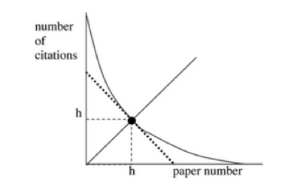
Bibliometrics
h-index: the number of papers (h) that have received at least h citations
Combines publication and citation counts into a single metric.
Can be used for individuals or groups of papers.
23
                Example: Dr. Jones has an h-index of 23. This means that 23 of her papers have received at least 23 citations.
Notes:
So let’s start at the level of the individual. The author. The h-index is the go-to metric for individuals.

Slide 10
Bibliometrics
h-index: the number of papers (h) that have received at least h citations
Things to consider:
  Useful metric for established authors, but not for early career authors
  Does not factor in the context or source of citations
  Does not account for author order
  Can be manipulated through self-citations
  Review articles are more highly cited than research articles
  Differs between databases due to database coverage
  An author’s h-index can never go down
Notes:
So let’s start at the level of the individual. The author. The h-index is the go-to metric for individuals.

Slide 11



Bibliometrics
Number of Citations
Check:
Scopus
Web of Science
Google Scholar
Notes:
Show Scopus if possible.
Explain why numbers are different from different sources.

Slide 12
Bibliometrics
Journal Impact Factor (JIF)
Attempts to measure the prestige of a journal by averaging the number of citations each article in the journal receives.
You can only compare JIFs between journals in the same field, i.e. you cannot compare a cardiology journal to a radiology journal.
Reflects a journal’s overall performance, not necessarily a particular paper or individual’s performance.
Sensitive to a few highly cited papers.

Slide 13
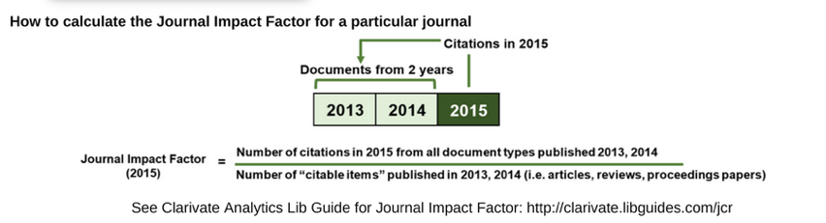
Bibliometrics
Journal Impact Factor (JIF)
Example: an Impact Factor of 2.5 means that on average, the articles published in a journal 1 or 2 years ago have been cited 2.5 times. (show in WOS)

Slide 14
Bibliometrics: Limitations
“Any metric can be gamed, especially singular metrics such as citation counts.” — Christine L. Borgman
“Quantitative metrics are poor choices for assessing the research output of an individual scholar. Summing impact factors, counting citations, tallying an h-index, or looking at Eigenfactor™ Scores (described below)—none of these methods are adequate compared with what should be the gold standard: reading the scholar’s publications and talking to experts about her work.” Bergstrom, C. T., West, J. D., & Wiseman, M. A. (2008). The EigenfactorTM Metrics. The Journal of Neuroscience, 28(45), 11433–11434.
Notes:
Biblio = book
Metric = measure
trace relationships amongst academic journal citations. Citation analysis, which involves examining an item's referring documents, is used in searching for materials and analyzing their merit.

Slide 15
Bibliometrics: Limitations
Authors cite other papers for all kinds of reasons: to refer to a particular methodology, to point out examples of other work done on the same topic, to reinforce a point they make in the text, to give credit to their mentors or experts in the field, or even to discuss examples of flawed methods or misleading results.
Time: it takes time for a paper to accumulate citations
Largely limited to tracking articles, even though there are many other types of research outputs.
Bibliometrics are often used incorrectly
Notes:
Biblio = book
Metric = measure
trace relationships amongst academic journal citations. Citation analysis, which involves examining an item's referring documents, is used in searching for materials and analyzing their merit.

Slide 16
Alternative metrics or Altmetrics
New way to measure engagement with research outputs.
Data that explain both the volume and nature of attention research has received online.
Can measure how many people have shared or engaged with a scholarly output online, e.g.
  Twitter, news outlets, Wikipedia citations, post-publication peer review, citations in policy documents
Provides evidence of engagement with diverse audiences and potential impact
Complementary to bibliometrics (citation-based)
Notes:
https://www.nature.com/articles/nmat3485
Alternative metrics or ‘altmetrics’ represent new ways to measure engagement with research outputs. Specific tools have been built to aggregate altmetrics across a wide variety of content. Altmetric.com for example, reveals the impact of anything with a digital object identifier (DOI) or other standard identifier. It can find mentions of a data set in blog posts, tweets and mainstream media. Another example – the non-profit organization ImpactStory – tracks the impact of articles, datasets, software, blog posts, posters and lab websites by monitoring citations, blogs, tweets, download statistics and attributions in research articles, such as mentions within the methods and acknowledgements sections.

Slide 17
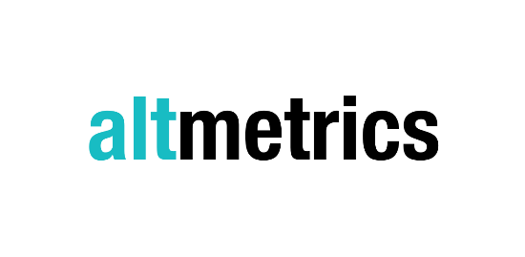








Altmetrics Manifesto is published
Kudos is launched
Elsevier acquires Plum Analytics, integrates metrics in Scopus.
1st HuMetrics workshop held
2010
2012
2013
2014
2017
2018
Almetric, Impact Story, Plum Analytics, are launched
1st Altmetrics conference held; Ebsco integrates PlumX metrics in databases; Springer Nature integrates Altmetric in journals
Metrics Toolkit launched
Notes:
Presenter: Patty
2010 Altmetrics manifesto
A call for more tools and research based on altmetrics
2012 altmetric,impact story launched, plum analytics
2013 Kudos launched
2014 plum incorporated into Ebsco, 1st Altmetric conference held in london, Springer Nature incorporates altmetric
2017 Scopus integrates PlumX metrics

Slide 18
Advantages of Using Altmetrics
It can take 2+ years for citations to accrue. Alternative metrics offer real-time information.
Alternative metrics can help show how you’ve reached various audiences, i.e. the public, policy makers, peers in your field.
Alternative metrics can track more than journal articles and books.
http://www.whatarealtmetrics.com/what/advantages/

Slide 19
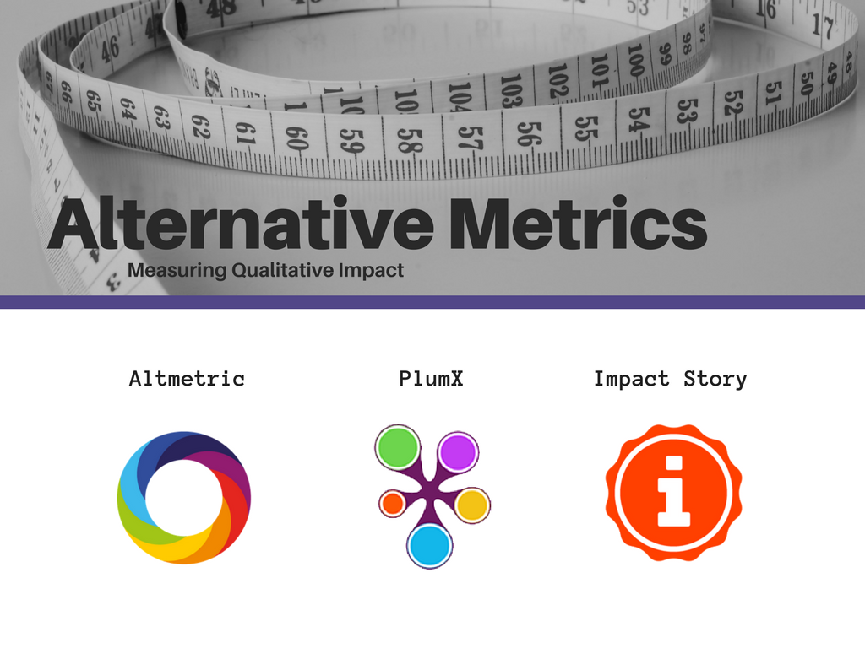

Slide 20
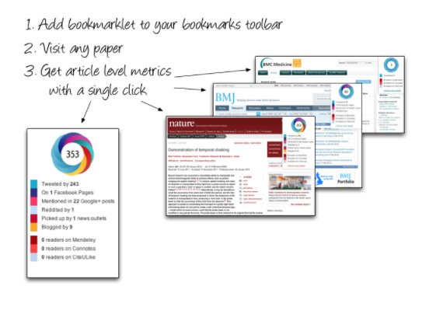

https://www.altmetric.com/products/free-tools/
Notes:
Altmetric = digital science, free tools and subscription. Altmetric donut – each color indicates a different type of attention, red = news outlets, light blue = twitter. Number in the middle = a weighted score.

Slide 21
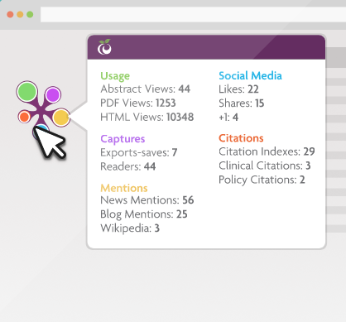

How PlumX Metrics on Scopus help tell the story of your research:
https://www.elsevier.com/solutions/scopus/support/webinars
Plum Goes Orange: Elsevier Acquires Plum Analytics
https://scholarlykitchen.sspnet.org/2017/02/02/plum-goes-orange-elsevier-acquires-plum-analytics/
Spotlight on Captures: Early indicators of citation counts:
https://plumanalytics.com/captures-early-indicators-citation-counts/
Notes:
PlumX = Elsevier, integrated into Scopus and various Elsevier journals. Plum Print, The colors again indicate a different type of attention, they change size based on how much attention. No single score.
Clinical citations – Dynamed

Slide 22
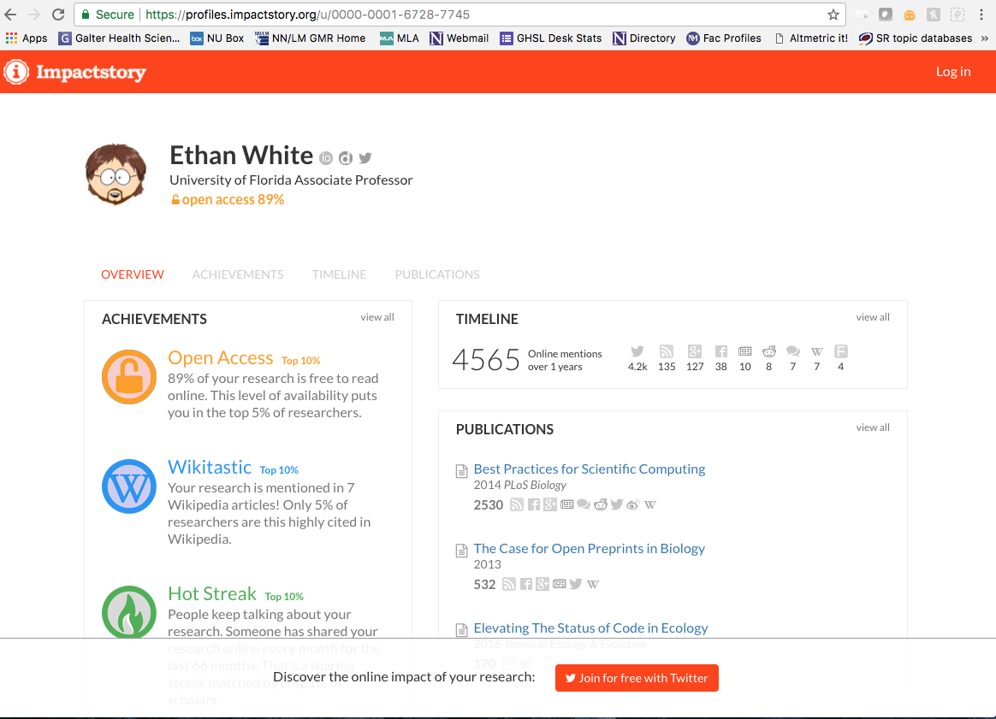
Notes:
Impact Story = nonprofit funded by the Alfred P. Sloan foundation and the National Science Foundation, free. Marks different ”achievements” a researcher has.

Slide 23
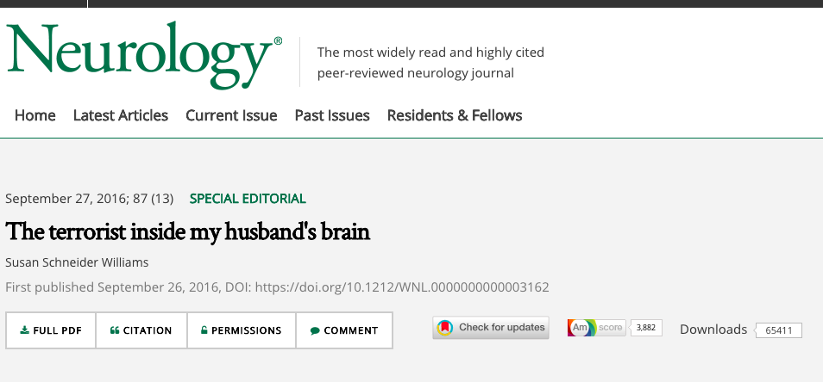
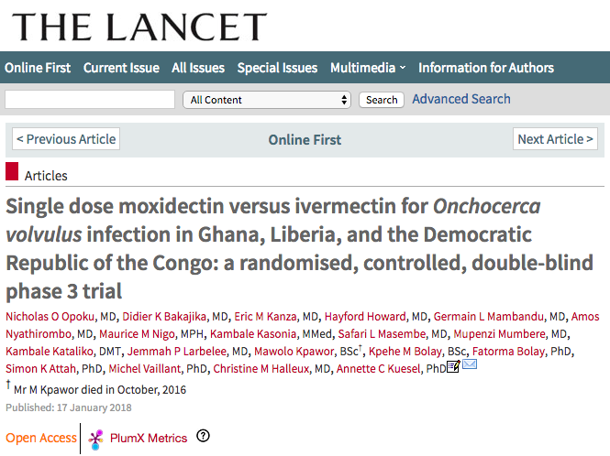
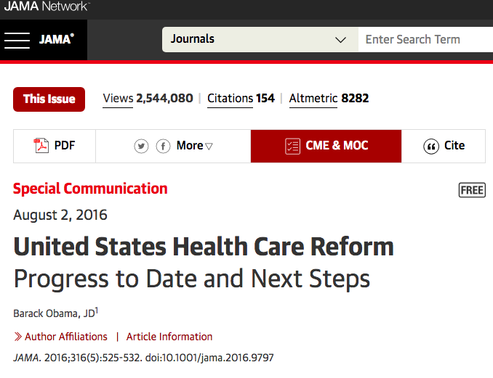

Slide 24
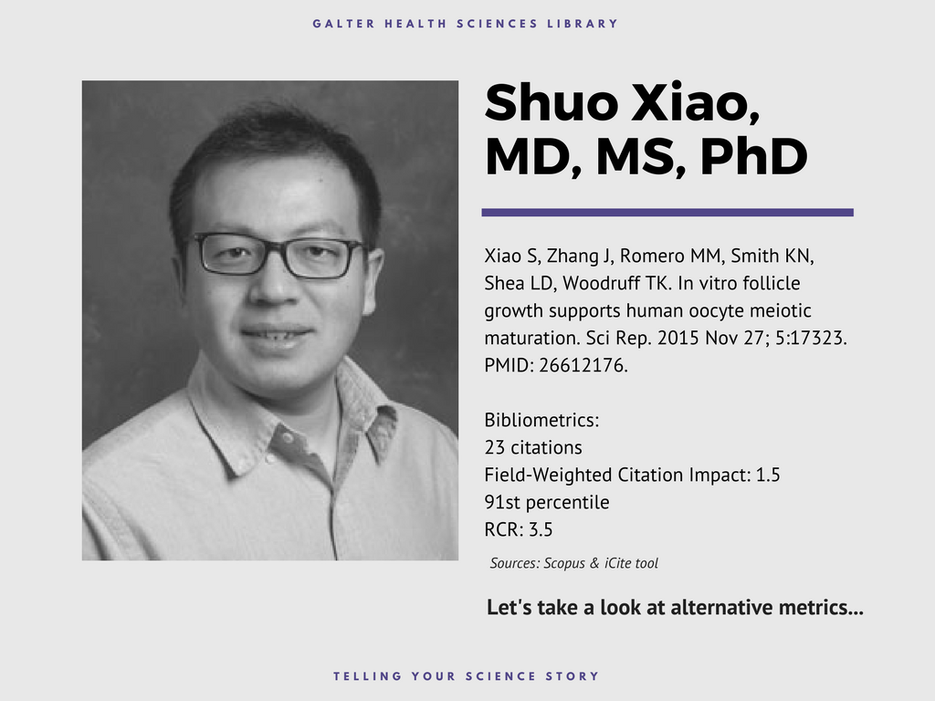

Slide 25


Slide 26
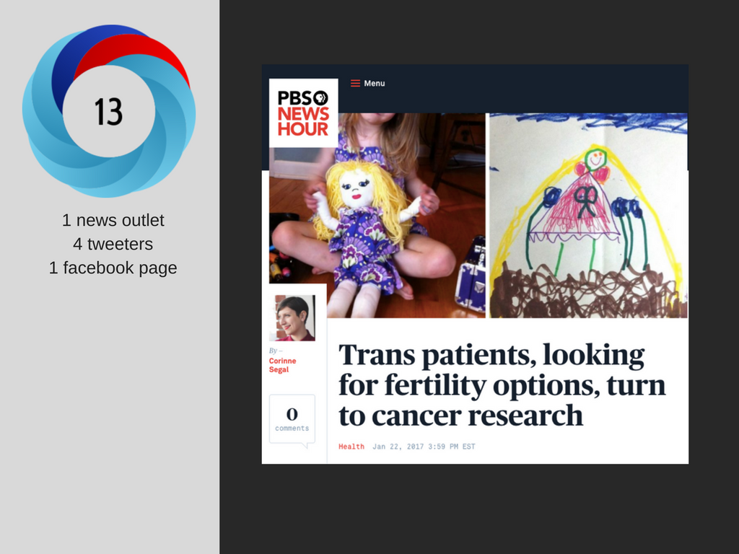

Slide 27
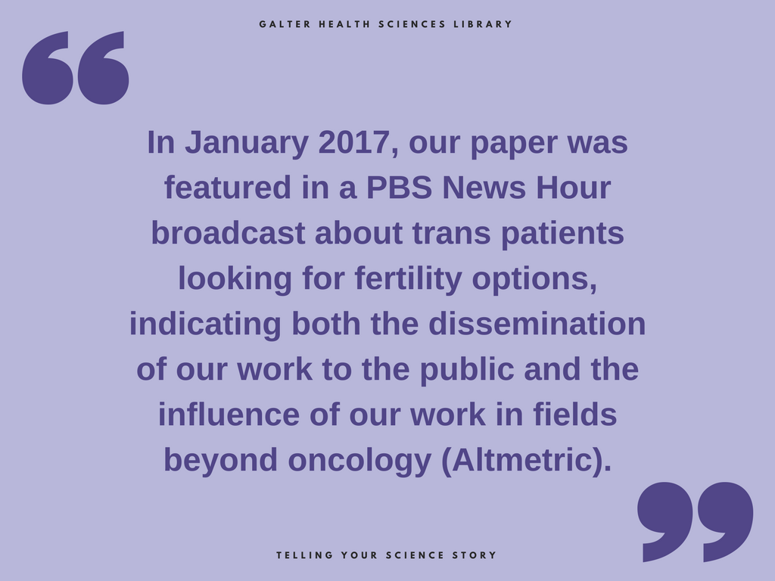

Slide 28
Hands-on demo
Christine Tangney, PhD, FACN, CNS, Associate Dean for Research, Rush University
News attention
https://www.ncbi.nlm.nih.gov/pubmed/?term=25681666
Link to Altmetric page: https://www.altmetric.com/details/3541679?src=bookmarklet
Policy citation
https://www.ncbi.nlm.nih.gov/pubmed/?term=26086182
Link to Altmetric page: https://www.altmetric.com/details/4163922?src=bookmarklet
Impact story
https://profiles.impactstory.org/u/0000-0002-2431-9687
Metrics Toolkit
http://www.metrics-toolkit.org/

Slide 29


Slide 30
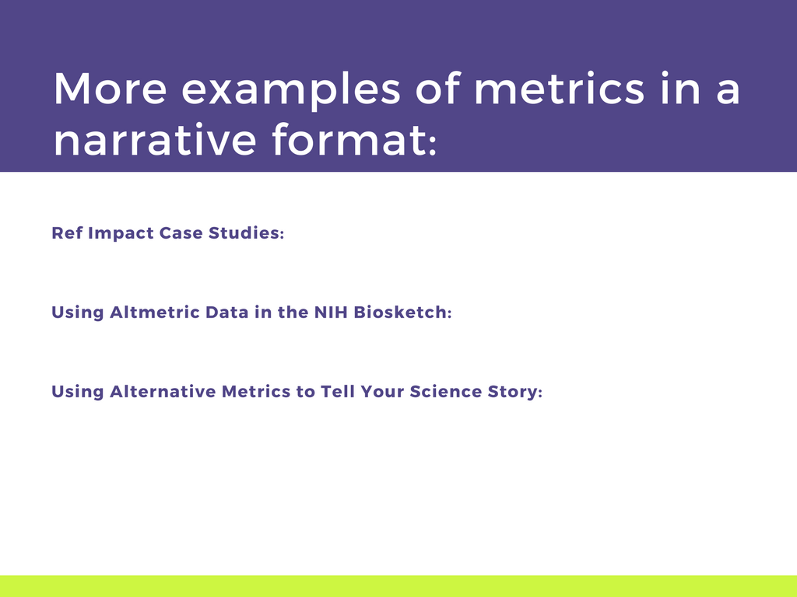
http://impact.ref.ac.uk/CaseStudies/
https://staticaltmetric.s3.amazonaws.com/uploads/2016/05/NIH-guide.pdf
https://galter.northwestern.edu/news/using-alternative-metrics-to-tell-your-science-story

Slide 31
Why concern ourselves with Altmetrics?
Articles with positive altmetrics scores also have higher citations when compared to similar articles. (Thelwall M, et al. 2013)
Social Media. Tweets, Facebook wall posts, blog mentions, mainstream media mentions, and forum posts are associated with citation counts, though the magnitude of this association is not known. (Thelwall M, et al. 2013)
Online Reference Managers. Articles saved in CiteULike and Mendeley are also likely to have citation counts in Web of Science. (Li X, et al. 2012)
Blogs. Articles receiving blog citations close to their publication time receive more journal citations later than the articles in the same journal published in the same year that did not receive such blog citations. (Shema H, et al. 2014)
Notes:
Sources:
1) Do Altmetrics Work? Twitter and Ten Other Social Web Services. Statistically significant associations were found between higher metric scores and higher citations for articles with positive altmetric scores in all cases with sufficient evidence (Twitter, Facebook wall posts, research highlights, blogs, mainstream media and forums) except perhaps for Google+ posts. Evidence was insufficient for LinkedIn, Pinterest, question and answer sites, and Reddit,…
Thelwall M, Haustein S, Larivière V, Sugimoto CR (2013) Do Altmetrics Work? Twitter and Ten Other Social Web Services. PLOS ONE 8(5): e64841. https://doi.org/10.1371/journal.pone.0064841
2) Validating online reference managers for scholarly impact measurement. Statistically significant correlations were found between the user counts [CiteULike and Mendeley] and the corresponding WoS citation counts, suggesting that this type of influence is related in some way to traditional citation-based scholarly impact but the number of users of these systems seems to be still too small for them to challenge traditional citation indexes.
Li, X., Thelwall, M. & Giustini, D. Scientometrics (2012) 91: 461. https://doi.org/10.1007/s11192-011-0580-x
3). Do blog citations correlate with a higher number of future citations? Research blogs as a potential source for alternative metrics. Articles reviewed in these blogs therefore receive “blog citations.” We hypothesized that articles receiving blog citations close to their publication time receive more journal citations later than the articles in the same journal published in the same year that did not receive such blog citations. Statistically significant evidence for articles published in 2009 and 2010 support this hypothesis for seven of 12 journals (58%) in 2009 and 13 of 19 journals (68%) in 2010. We suggest, based on these results, that blog citations can be used as an alternative metric source.
Shema, H. , Bar‐Ilan, J. and Thelwall, M. (2014), Do Blog Citations Correlate With a Higher Number of Future Citations?. J Assn Inf Sci Tec, 65: 1018-1027. doi:10.1002/asi.23037

Slide 32
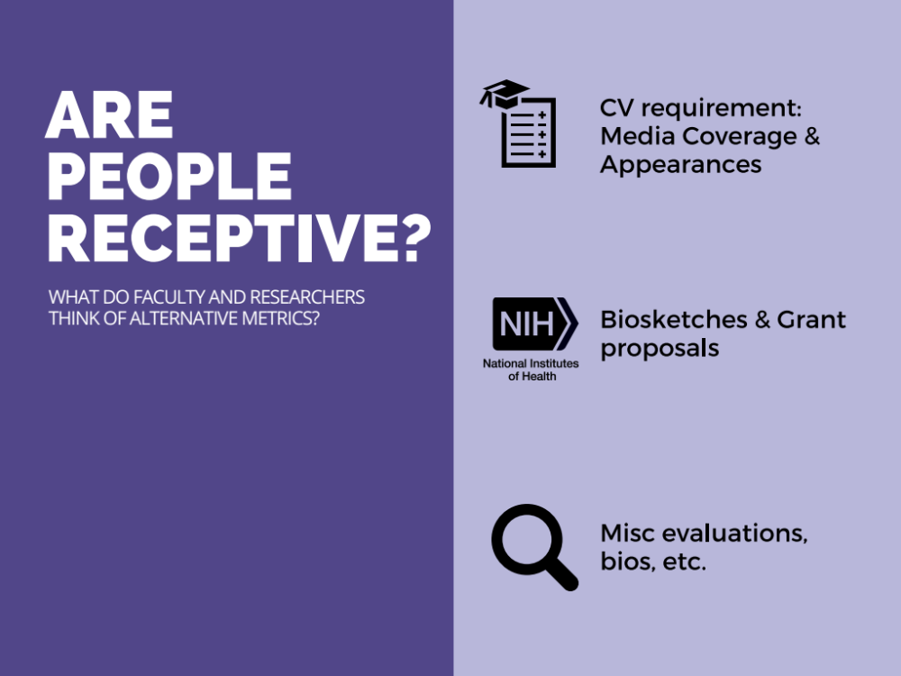

Slide 33
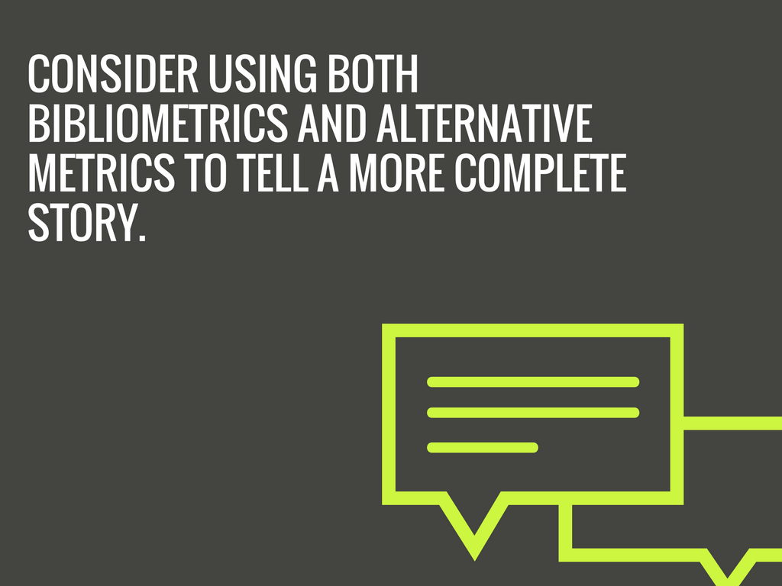

Slide 34
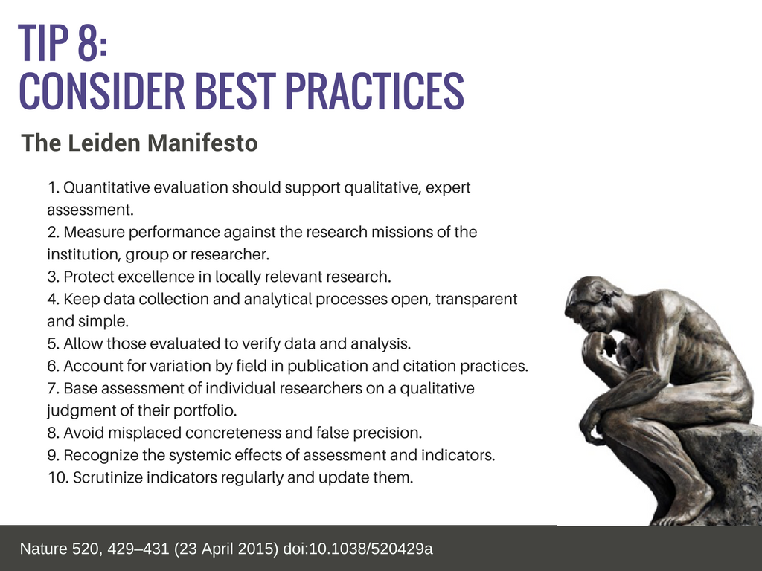
Link to video: https://vimeo.com/133683418
Notes:
Link to video.
#1, 5, 7, 10
CWTS blog,
Nature blog
Scholarly kitchen

Slide 35
Relevant Literature From the NNLM Data Thesaurus https://nnlm.gov/data/thesaurus/altmetrics:
Chamberlain S. (2013). Consuming Article-Level Metrics Information Standards Quarterly, 25(2):5-13.
Haustein S. (2016). Grand challenges in altmetrics: heterogeneity, data quality and dependencies. Scientometrics, 108(1):413-423. doi.org/10.1007/s11192-016-1910-9.
Konkiel S, Scherer D. (2013). New Opportunities for Repositories in the Age of Altmetrics. Bulletin of the Association for Information Science and Technology, April/May.
Lapinski S, Piowowar H, Priem J. (2013). Riding the crest of the altmetrics wave: How librarians can help prepare faculty for the next generation of research impact metrics. College and Research Libraries News, 74(6):292-300.
Liu J, Adie E. (2014). Realising the potential of altmetrics within institutions. Ariadne, 72.
Piwowar H. (2013). Altmetrics: Value all research products. Nature, 493(159).
Priem J. (2013). Scholarship: Beyond the paper. Nature, 495(7442):437-440. doi:10.1038/495437a
Priem J, Parra C, Piwowar H, Groth P, Waagmeester A. (2012). Uncovering impacts: a case study in using altmetrics tools. Proceedings of the Workshop on Semantic Publishing (SePublica 2012) 9th Extended Semantic Web Conference. Crete, Greece. p. 42–4.
Priem J, Piwowar HA, Hemminger B. (2012). Altmetrics in the wild: Using social media to explore scholarly impact.
Priem J, Taraborelli D, Groth P, Neylon C. (2010). Altmetrics: a manifesto

Slide 36
Acknowledgements
The following people are instrumental in developing research impact materials and training, and from whose ideas and guidance I have greatly benefited:
  Kristi Holmes, Karen Gutzman, & Pamela Shaw
  Galter Health Sciences Library & Learning Center, Northwestern University
  Cathy Sarli & Amy Suiter
  Becker Medical Library, Washington University in St. Louis

Slide 37


