Slide 1
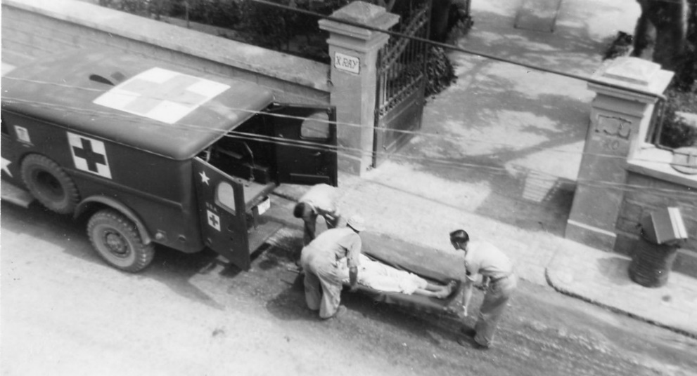
Getting People into History Means
Going Out of the Box
Gabrielle Barr, MSI
LAMPHHS
Notes:
Good afternoon and thank you for attending my presentation “Getting People into History Means Going Out of the Box” that discusses the outreach conducted to promote the 12th General Hospital Collection as a second-year National Library of Medicine Fellow at Northwestern’s Galter Health Sciences Library & Learning Center.

Slide 2
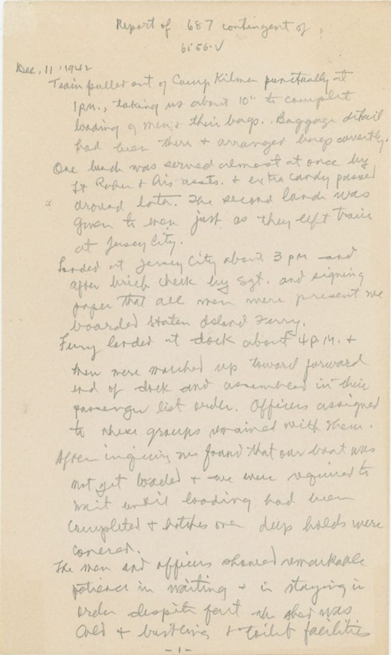
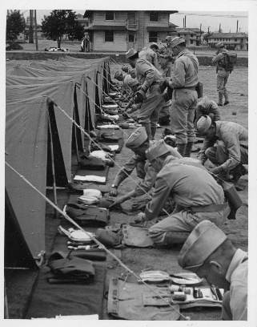
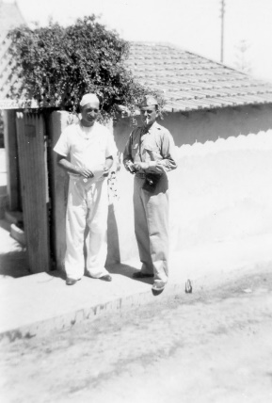
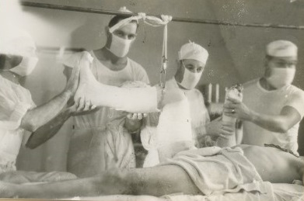
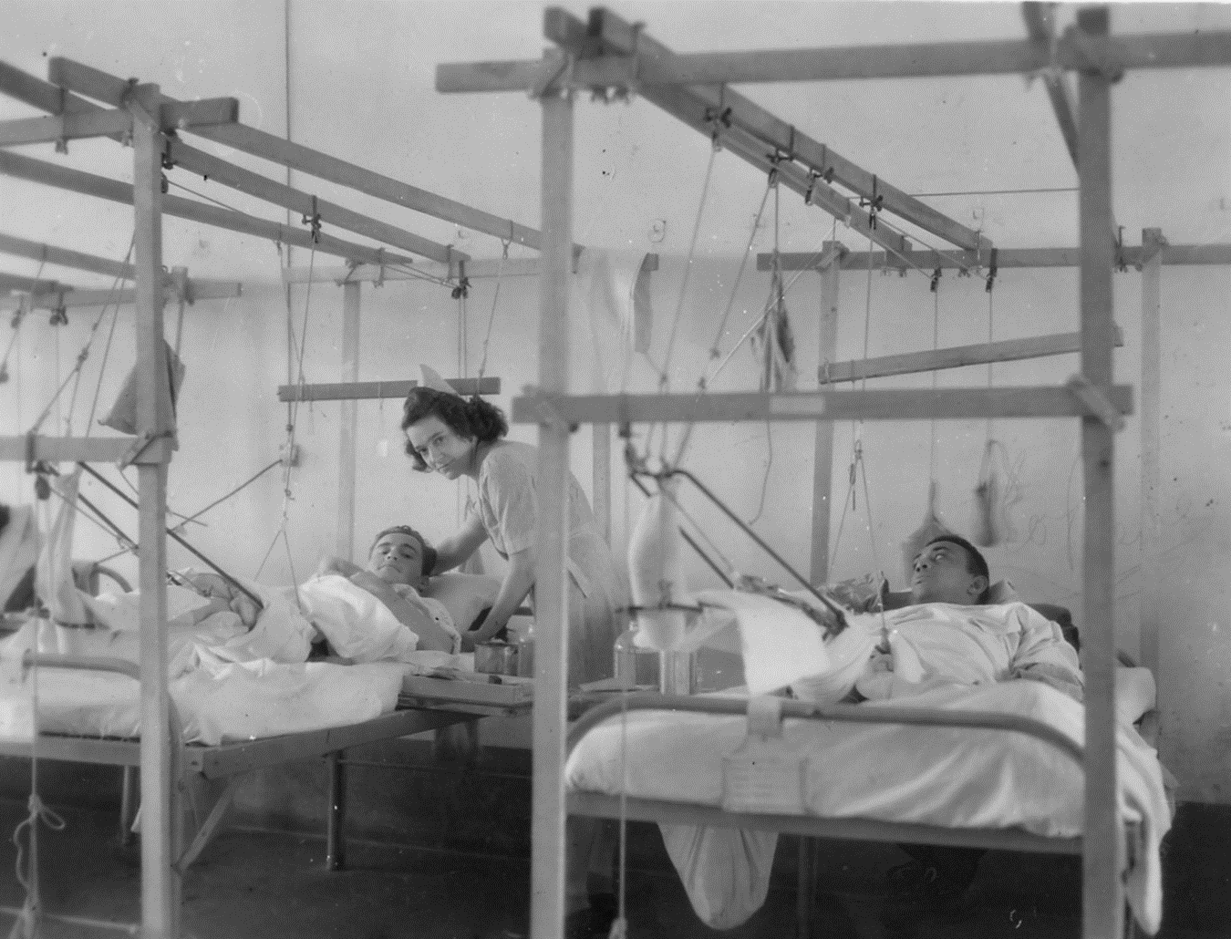
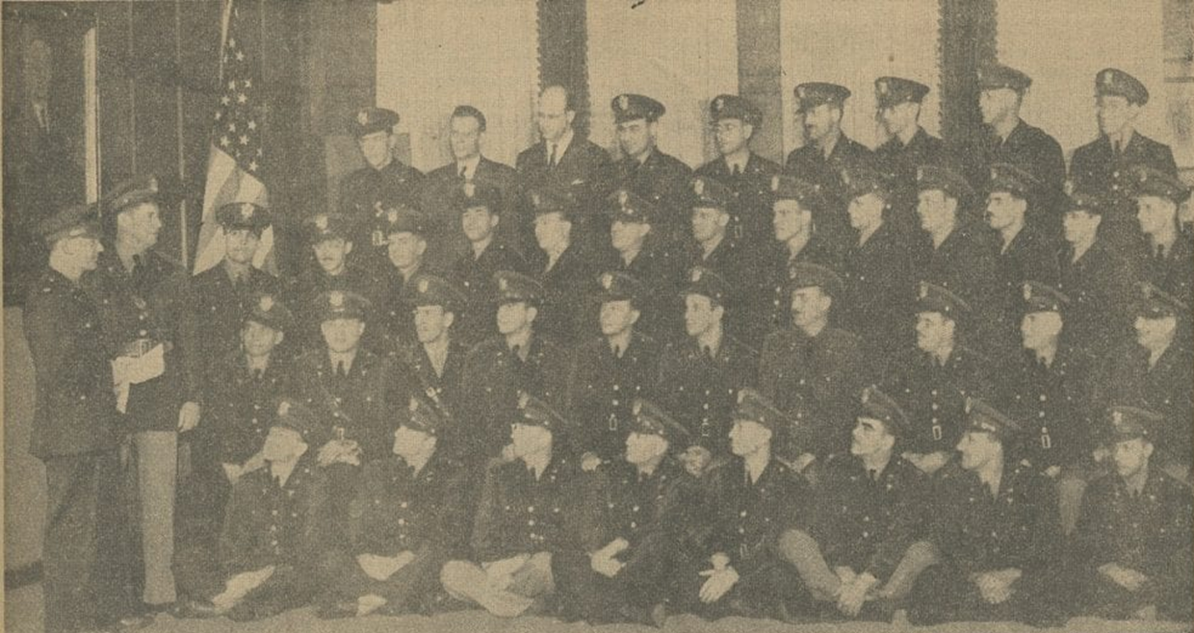
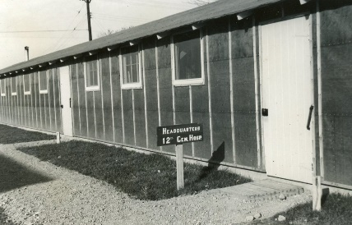
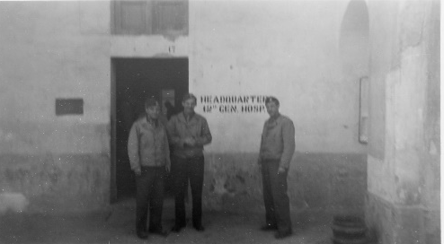
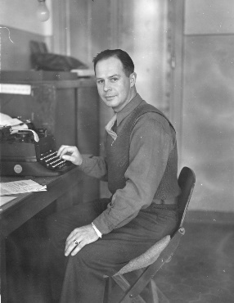
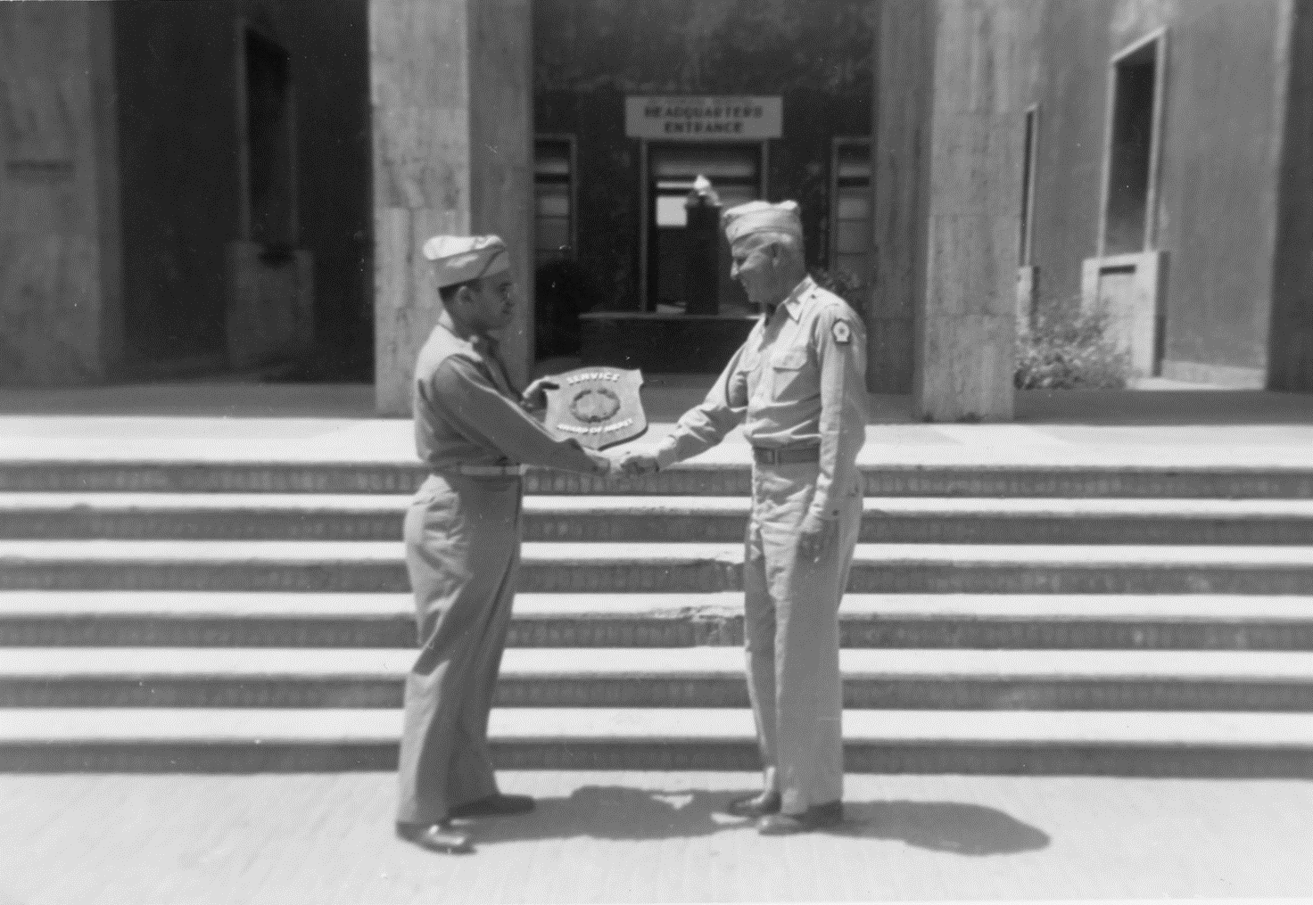
Legacy of the 12th General Hospital Unit
Fort Custer (Michigan)
Camp Kilmer (New Jersey)
Ain-El-Turck (Algeria)
1941
Chicago
1942
1943
1944
Rome
1945
Statistics
Roughly 1,510 individuals served between 1940 and 1945
Treated nearly 30, 000 patients
16,229 surgical cases 11,382 medical cases 2,188 venereal cases
53 deaths due to surgical complications
Fort Benjamin Harrison (Indiana)
Naples
Livorno (Leghorn)
Notes:
During WWII, Northwestern University physcians and dentists, Chicago-area nurses, and enlisted men from all over the country treated their ill and injured comrades in Algeria and Italy as the 12th General Hospital Unit.

Slide 3
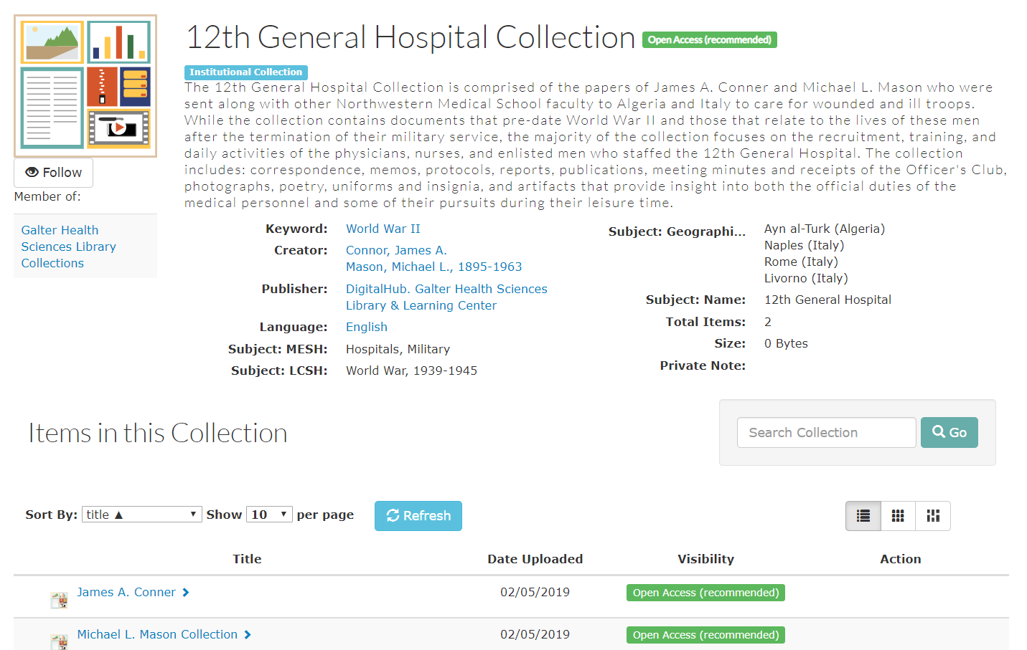
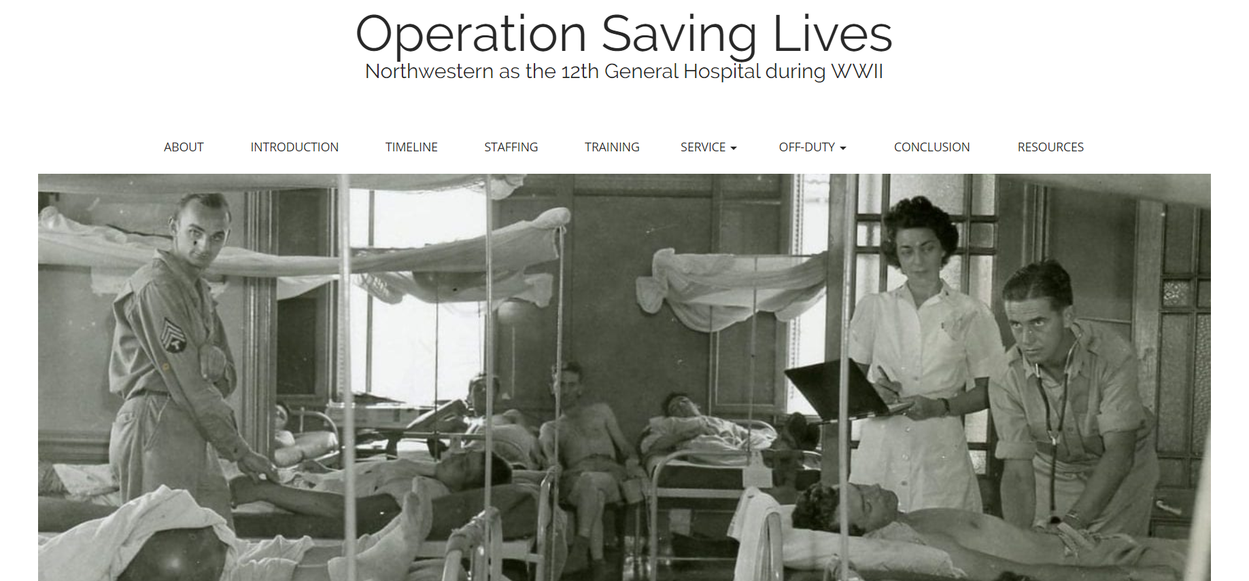
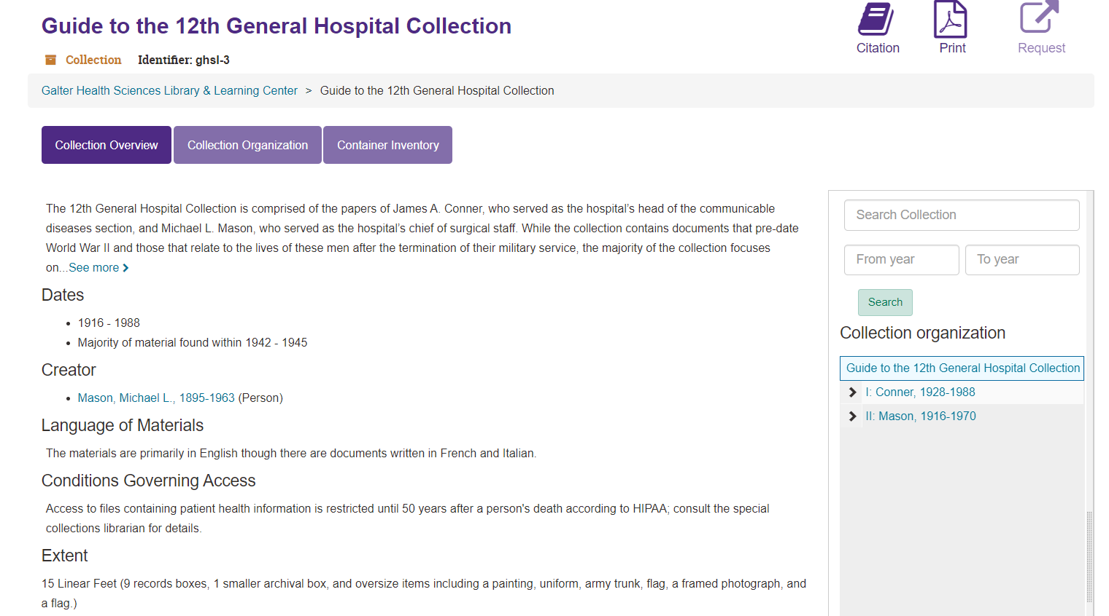
12th General
Hospital Resources
DigitalHub
Digital Exhibit
Finding Aid
Notes:
As part of my fellowship, I processed the collection of James A. Conner and Michael L. Mason, who served in the Unit, producing the finding aid, uploading images and documents into Galter’s digital repository, DigitalHub, and creating an interactive digital exhibit. To draw attention to these resources and cultivate an interest in the collection, the director of the Library, Kristi Holmes, requested embarking on some sort of outreach initiative.

Slide 4
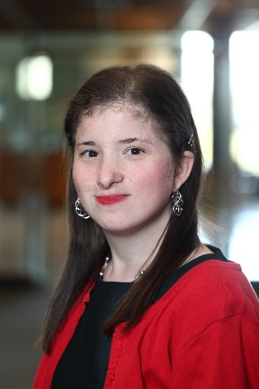



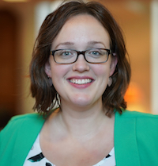


Team
Karen Gutzman
Head of Research Assessment and Communications
Ramune Kubilius
Collection Development/Special Projects Librarian
Gabrielle Barr
NLM Fellow
Abebi Espinoza Special Collections Assistant
Corinne Miller
Clinical Informationist
Annie Wescott
Research Librarian
Mary Anne Zmaczynski
Head of User Services
Notes:
It was the job of those in the Special Collections Working Group as well as Karen Gutzman, who was my Fellowship preceptor and Mary Anne Zymaczynski, who has design experience, to decide how we wanted to highlight the exhibit.

Slide 5
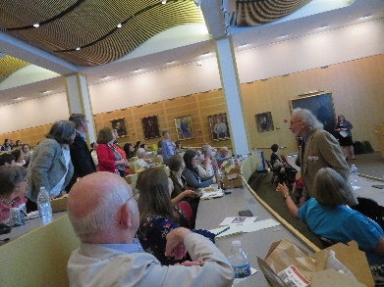
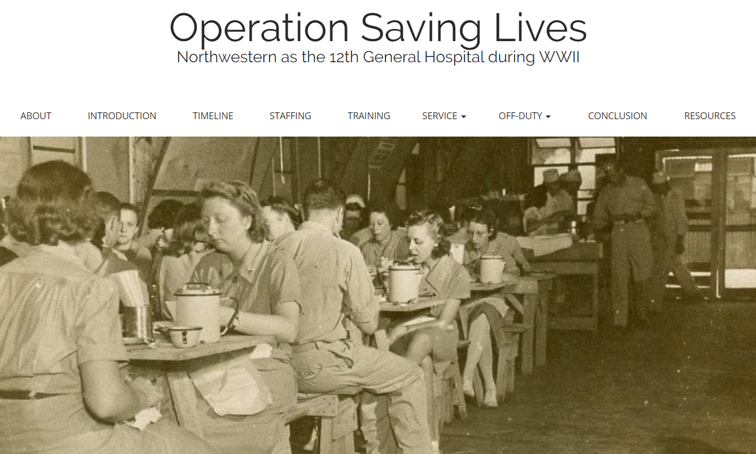
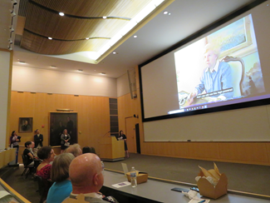
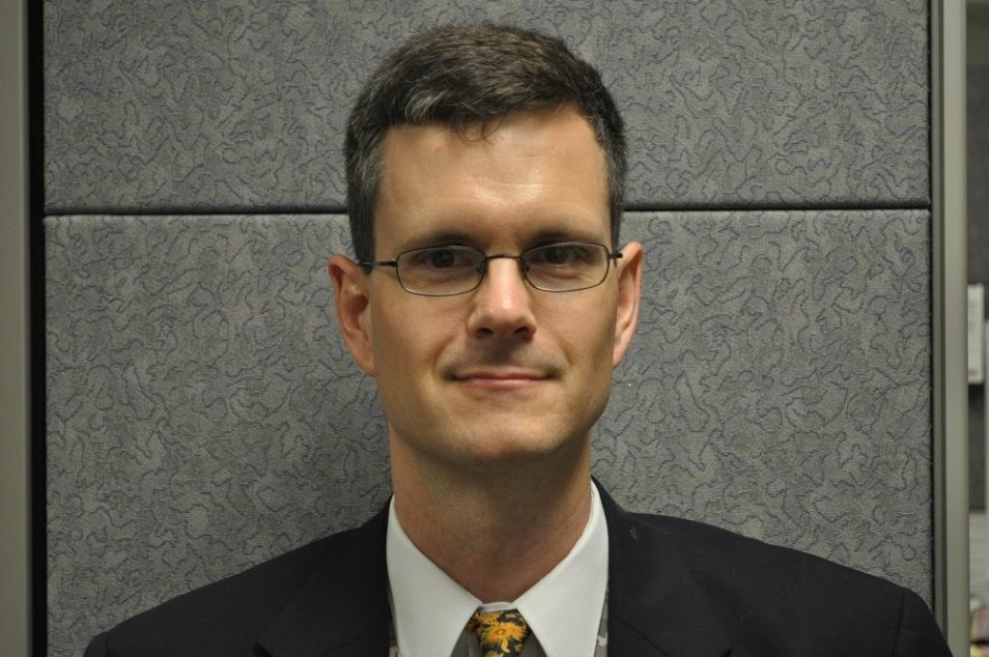

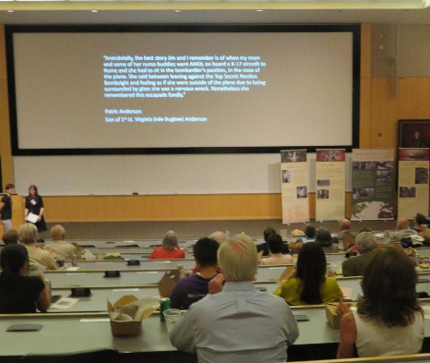

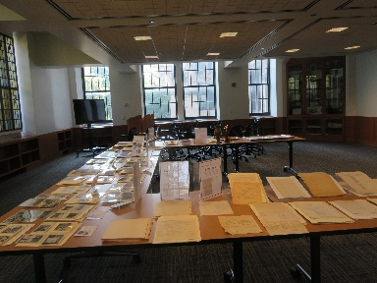
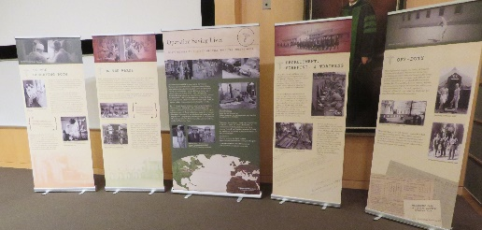
Proposed Elements of the Event
Acknowledgement of Families of
12th General Hospital Unit Members
Launching Digital Exhibit
Presentation of Selected Clips of Interview with Chief Nurse
Speaker
Honoring Veterans
Tribute Video
Tour of Campus
Banner Exhibit
Open House
Notes:
The scale of our publicity efforts evolved from being a simple presentation to library staff to a multi-dimensional lunch-time speaker event to launch the exhibit. We put forth an ambitious schedule that was amended according to our allotted time frame, staffing capabilities, and funds.

Slide 6
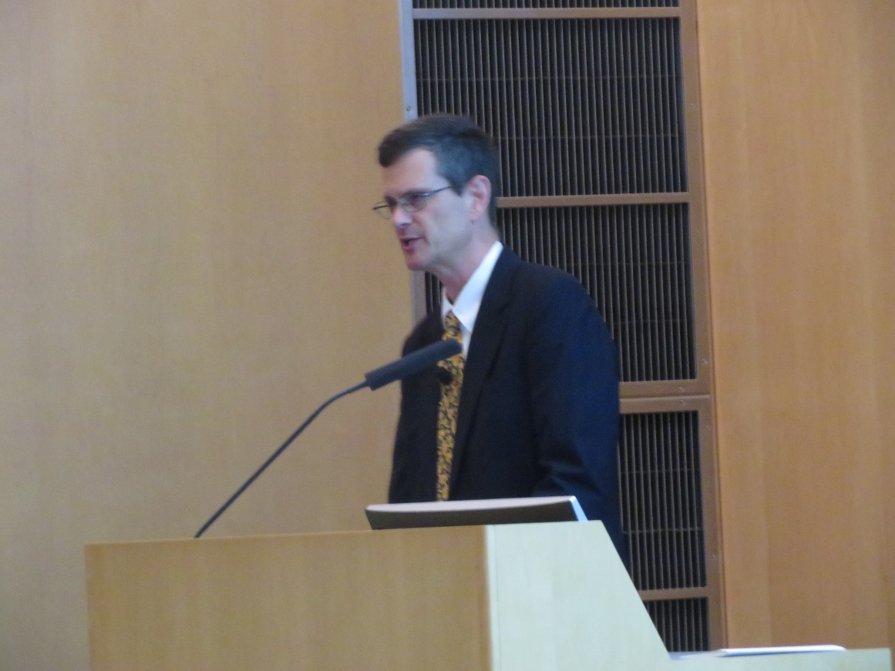
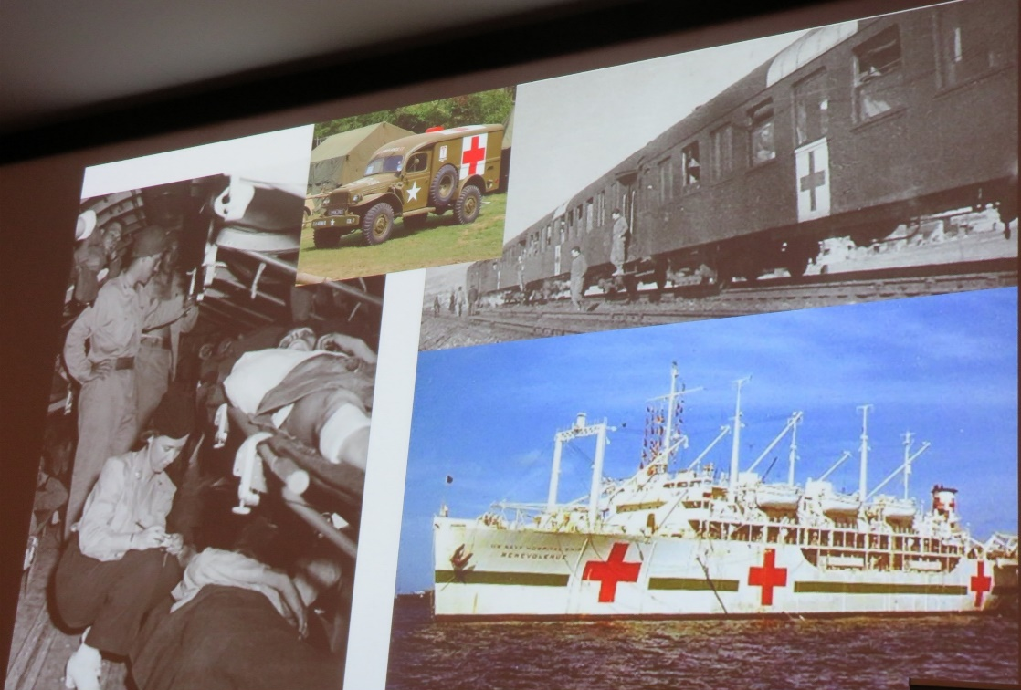
Selecting a Speaker
“Forward Surgery and Rearward Recovery: Aspects of Military Medicine during WWII”
Dr. W. Sanders Marble
Notes:
Early in the process, I put forth recommendations for potential speakers as well as assembled a budget. Dr. Sanders Marble, who is a Senior Historian for the US Army Medical Department agreed to speak about surgery during WWII.

Slide 7
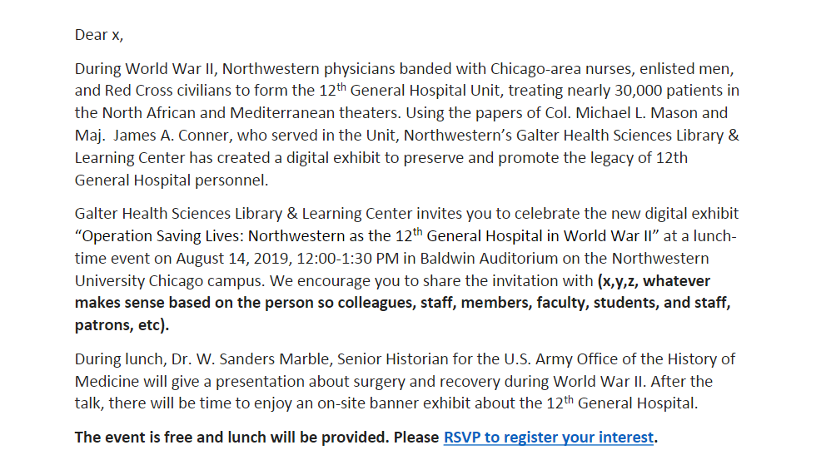
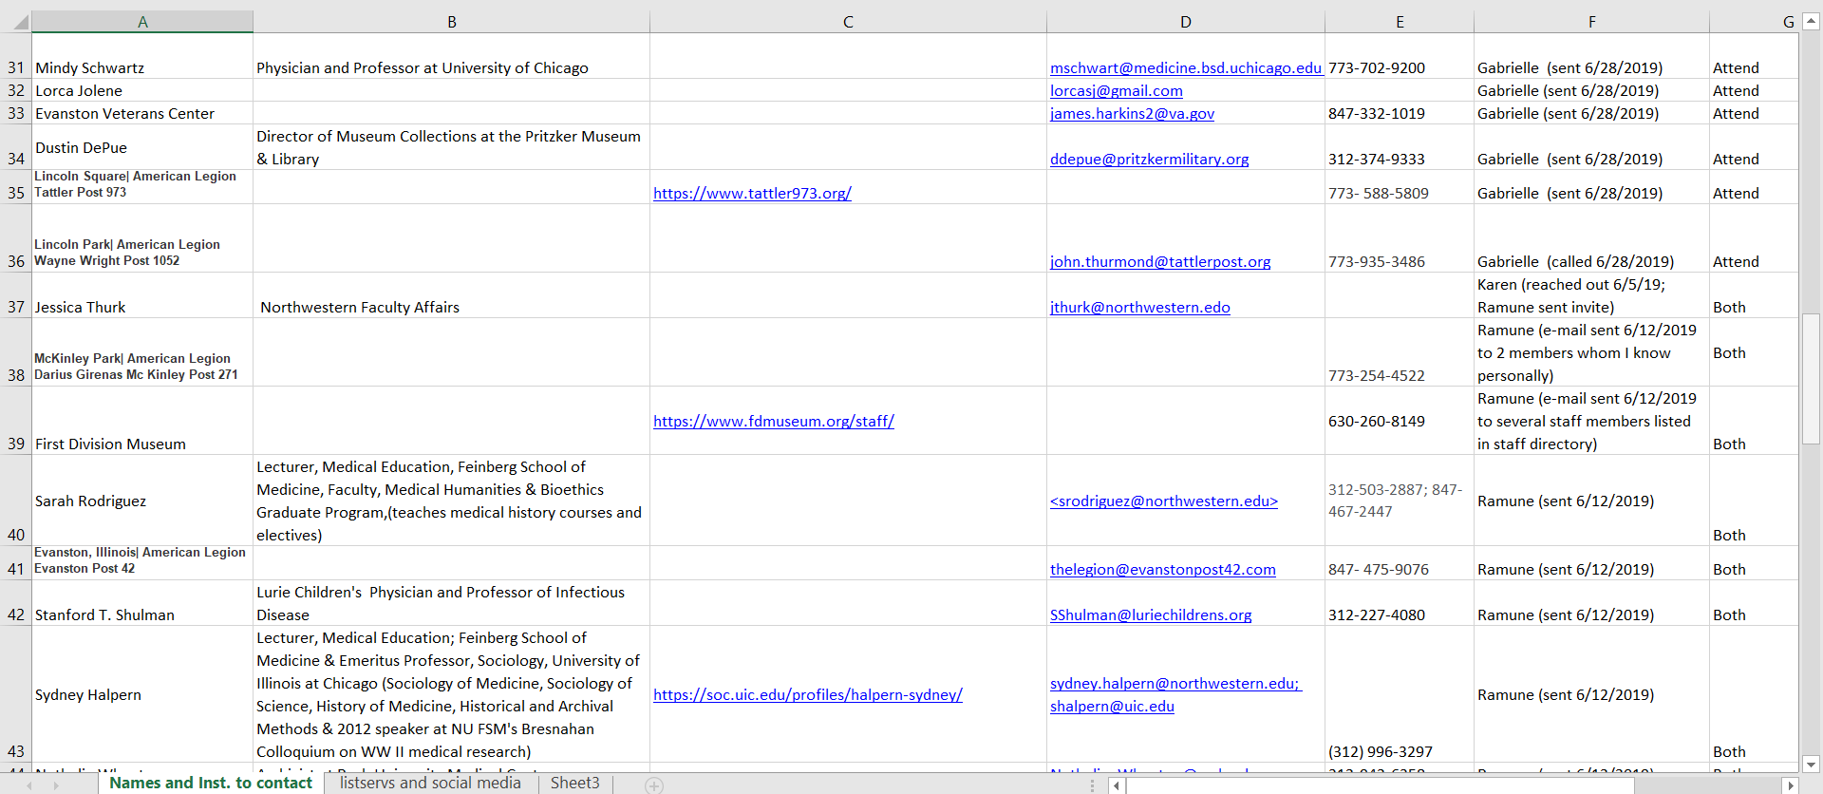
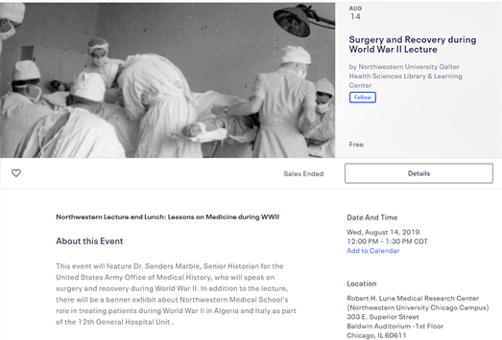
Email and Phone
Model Email
Section of “Who to Contact” Spreadsheet”
Eventbrite Page
Notes:
To begin reaching out to potential attendees, I collated a list of individuals, veteran organizations, academic departments, and cultural institutions. I created model emails specific to particular groups as well as a corresponding guide for how to communicate with these entities, but ultimately, the team used one email template that could be altered accordingly. The link to the Eventbrite page to RSVP was incorporated into the email. Phone calls were made to those who did not have email or social media accounts.

Slide 8
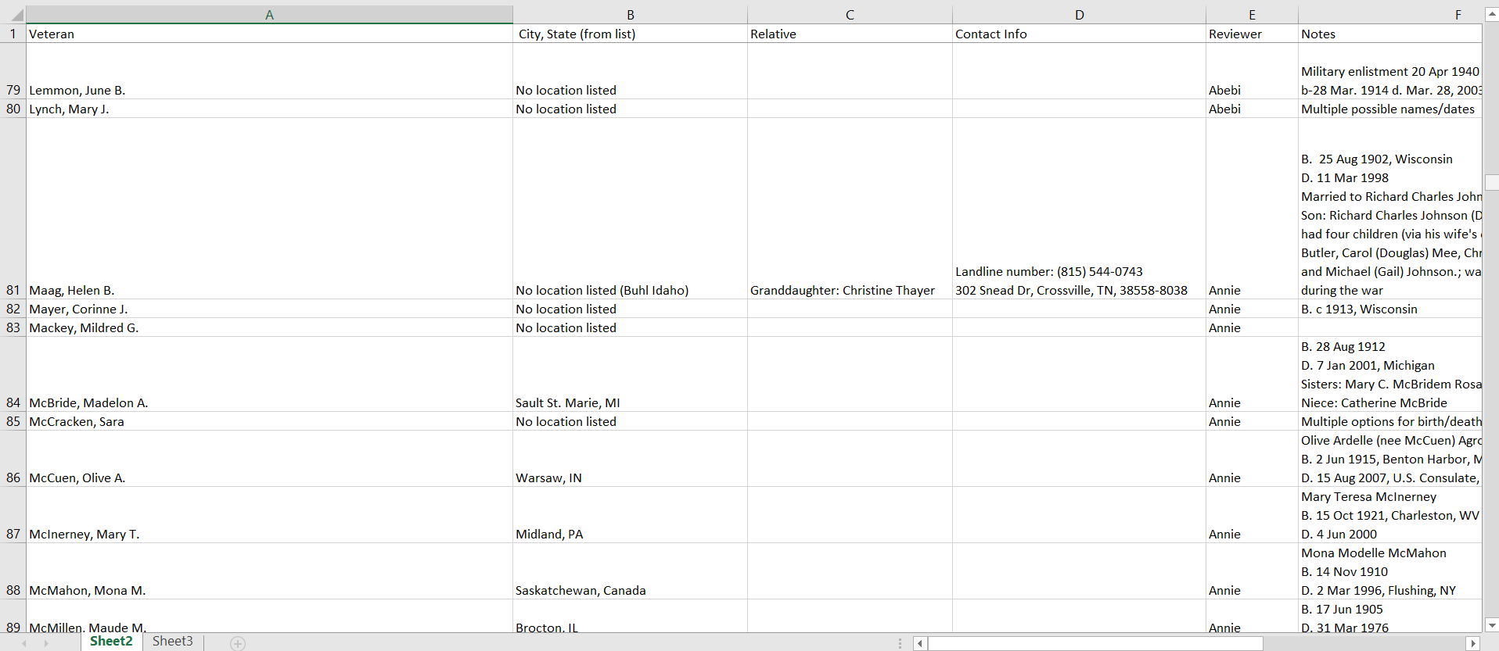
Genealogical Research
Section of Spreadsheet
Notes:
The team also performed genealogical research to notify any living veterans and their families about the event using sites such as Ancestry, Findagrave, Whitepages.com as well newspaper databases and Northwestern publications. Conducting genealogical research was a very interesting but time-consuming endeavor. We got through about 300 names. We were not able to locate any living member of the Unit, but we were able to track down some of their descendants.

Slide 9
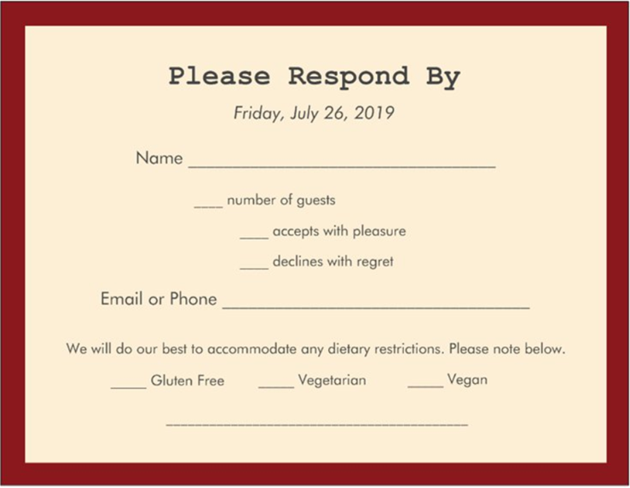
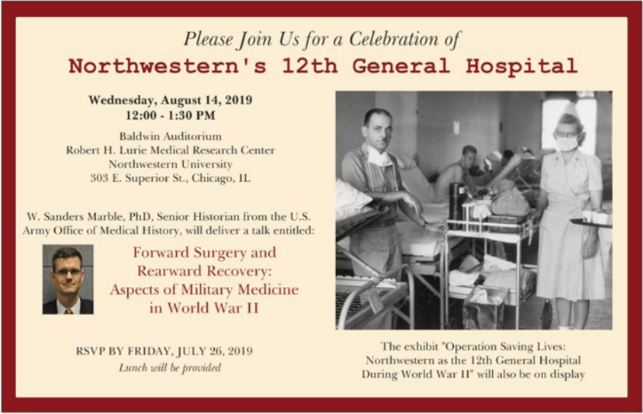
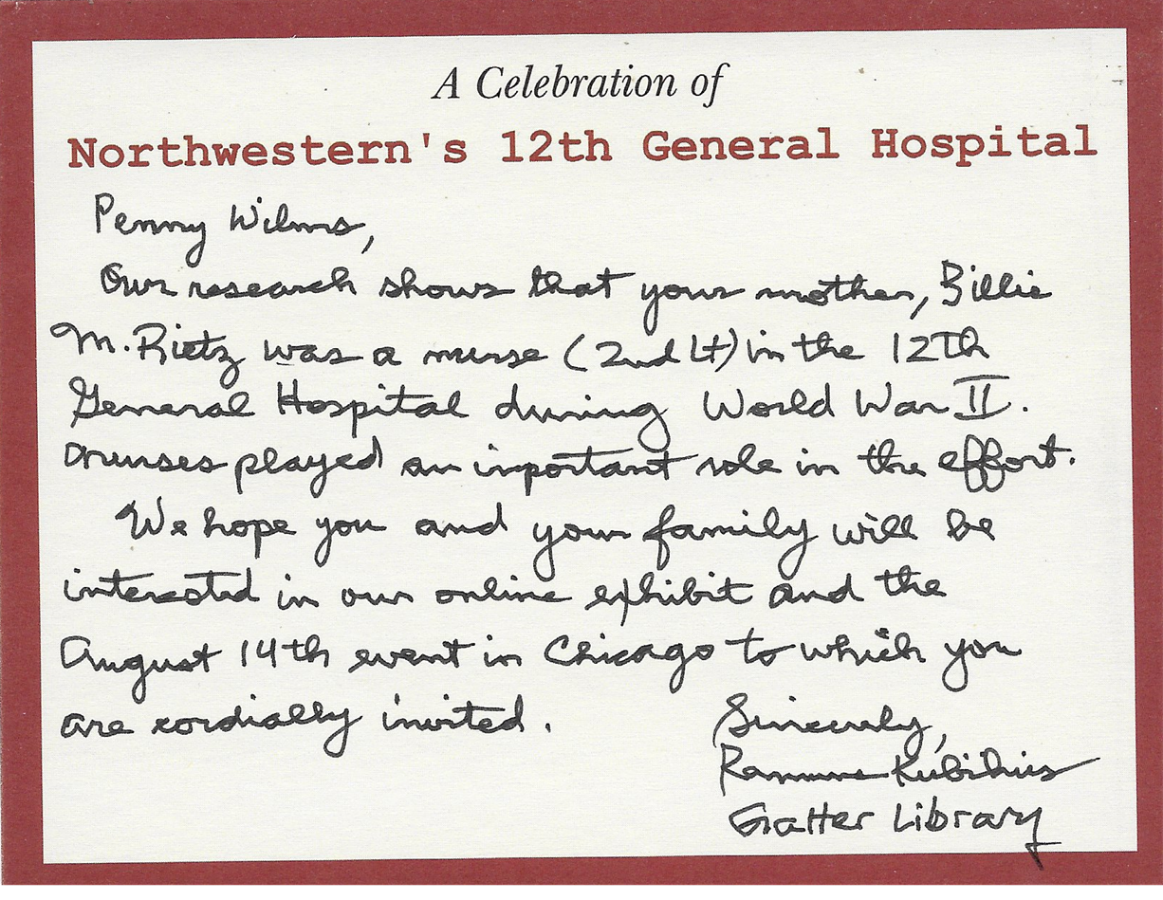
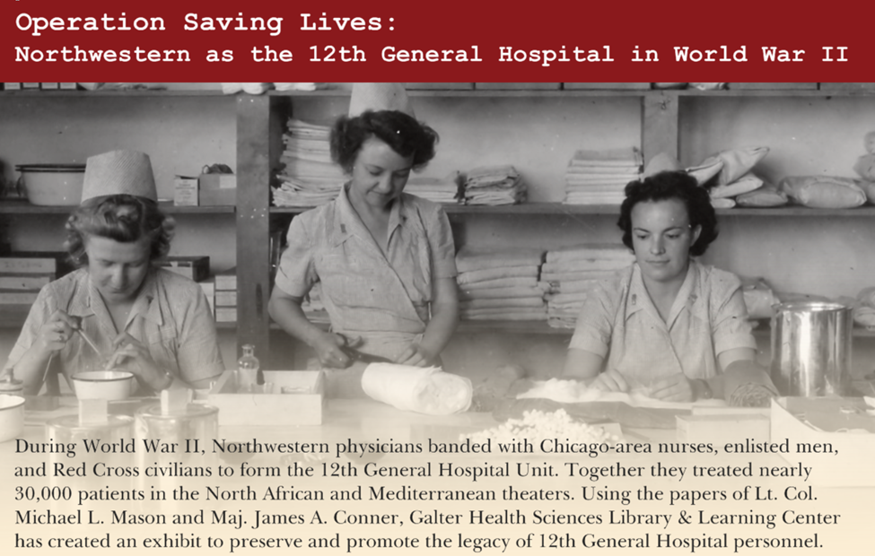
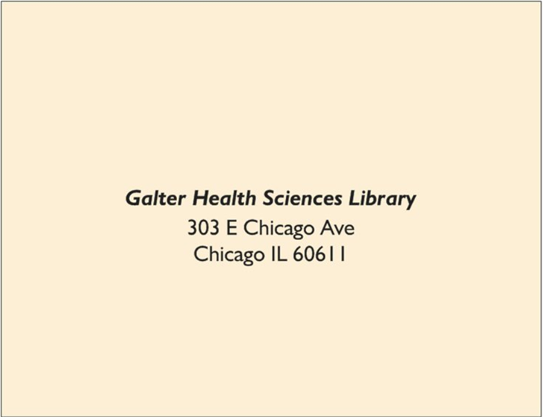
Invitation
Front of RSVP Card
Front of Invitation
Notecard
Back of RSVP Card
Back of Invitation
Notes:
The Medical School’s Office of Alumni Affairs suggested composing hand-written notes as way of connecting to an older population, which prompted the creation of this invitation suite designed by our team and printed with VistaPrint. The invitation contained information about the event and the collection, and we mailed nearly 200 personal letters to family members that included as many specifics about their loved one’s tour of duty as we knew. To expediate getting a response for logistical purposes and forming a relationship with these honored guests, I followed-up with phone calls. Because many of the children of the veterans could not attend in person on such short notice, the team decided to set up remote streaming.

Slide 10
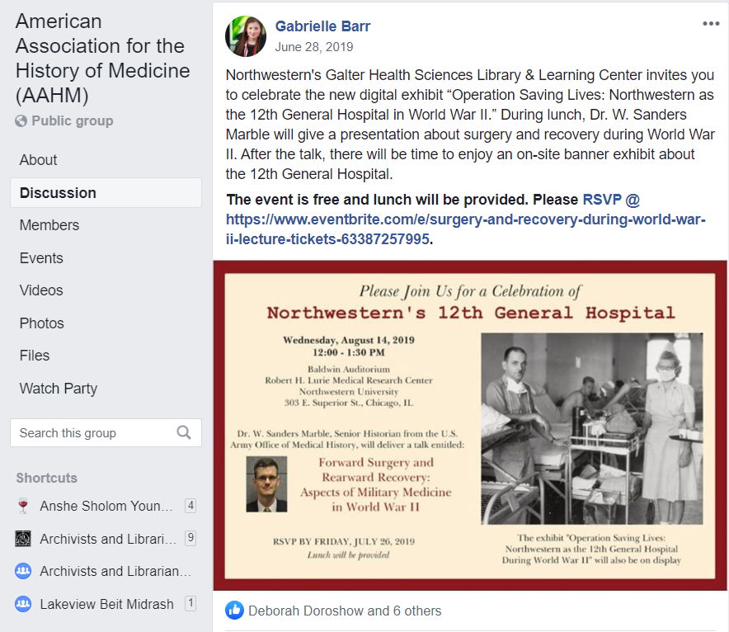
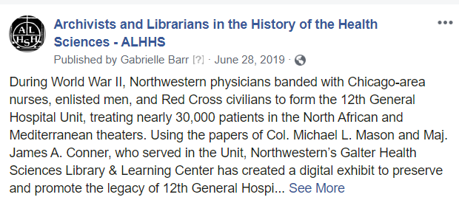
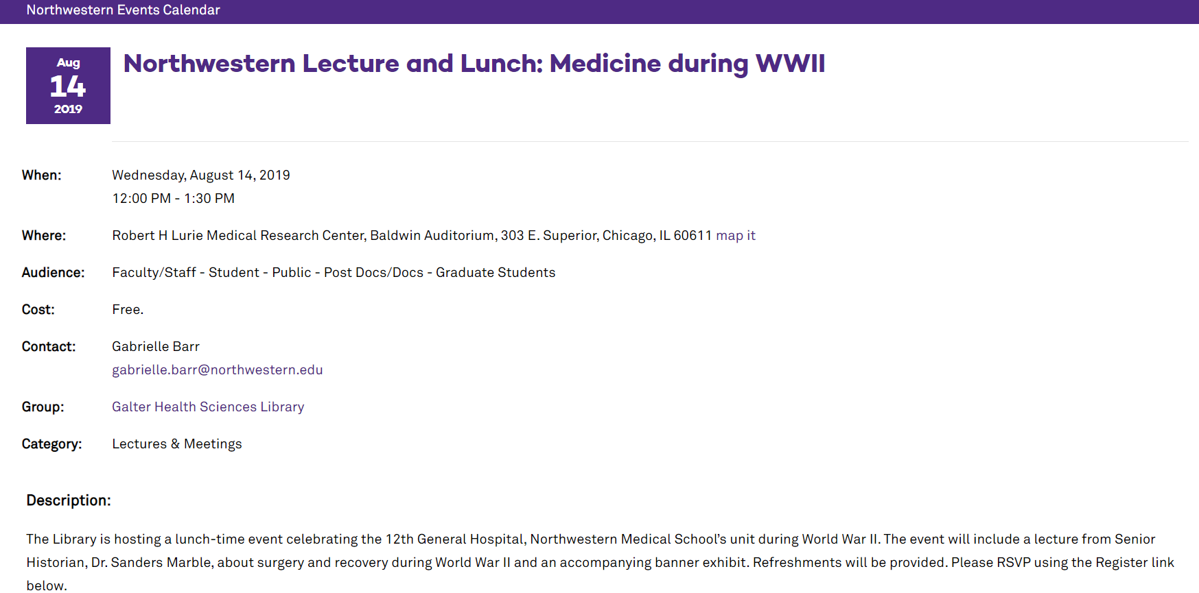
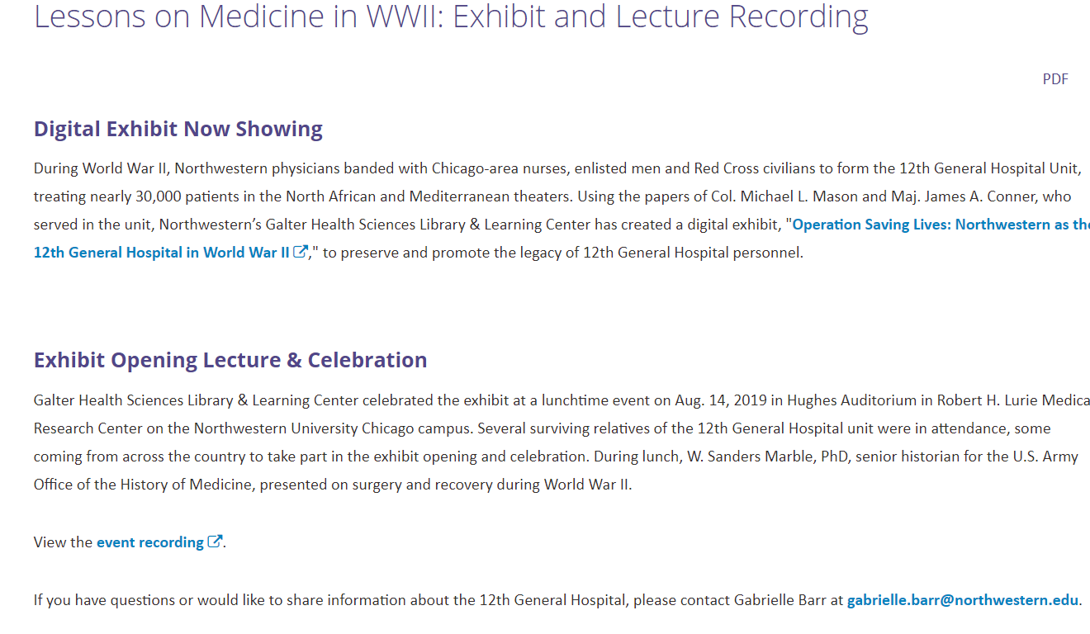
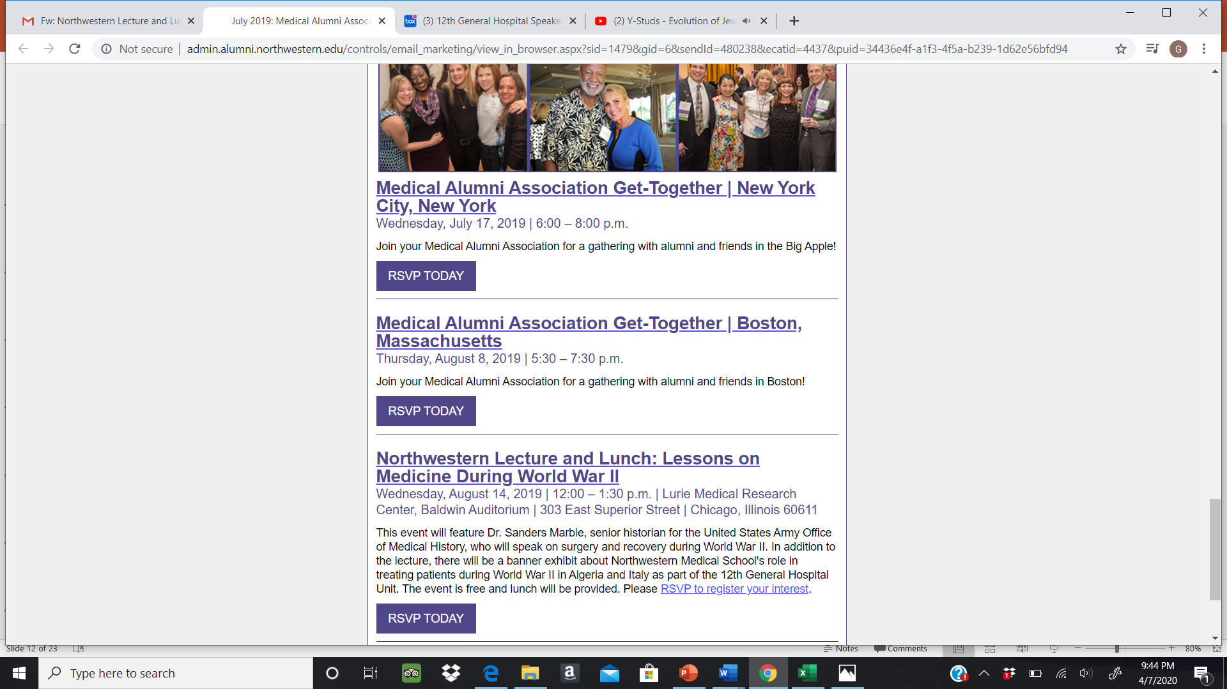
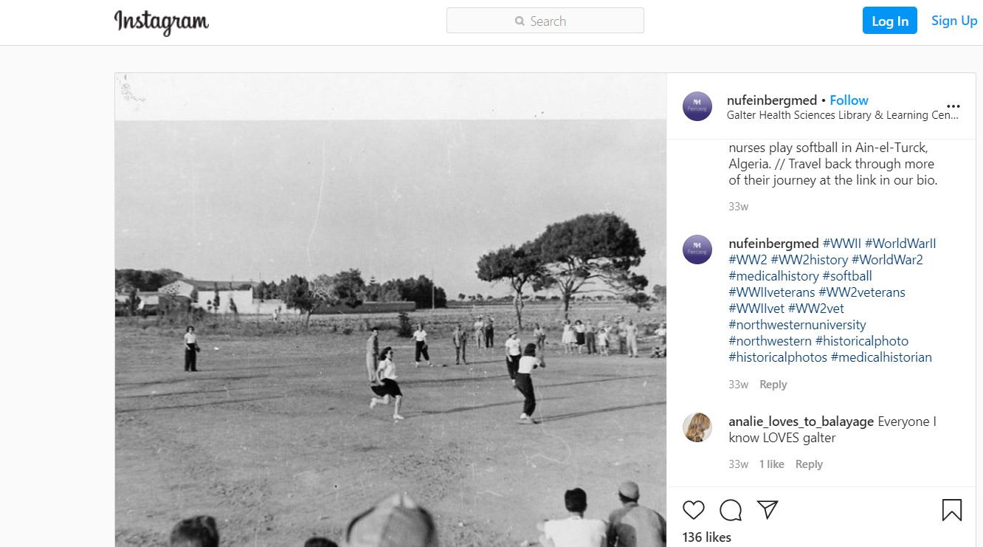
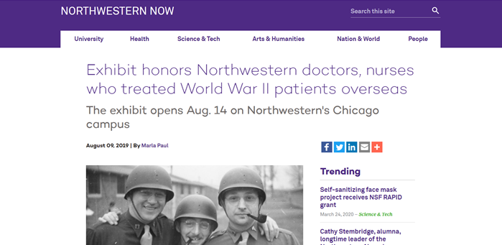
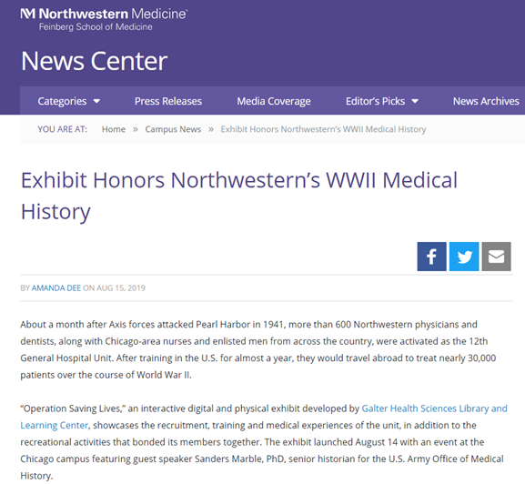
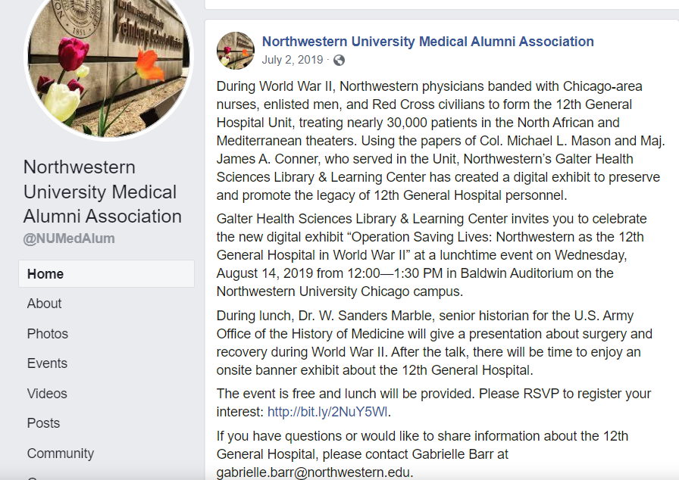
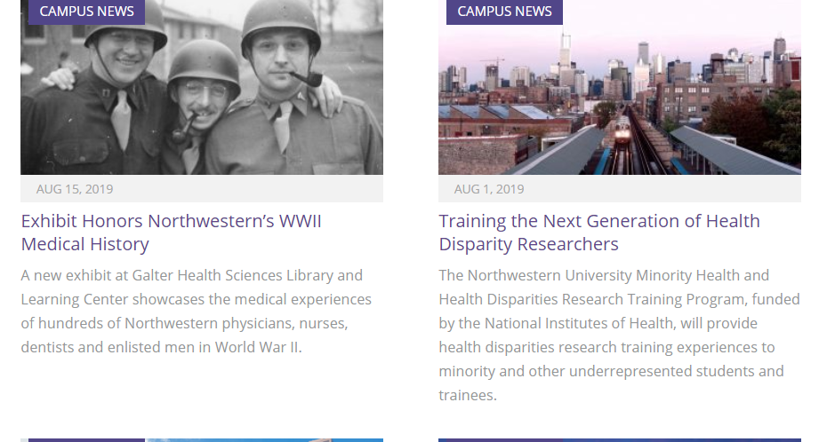

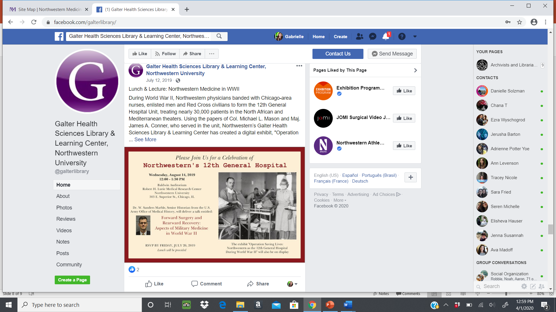
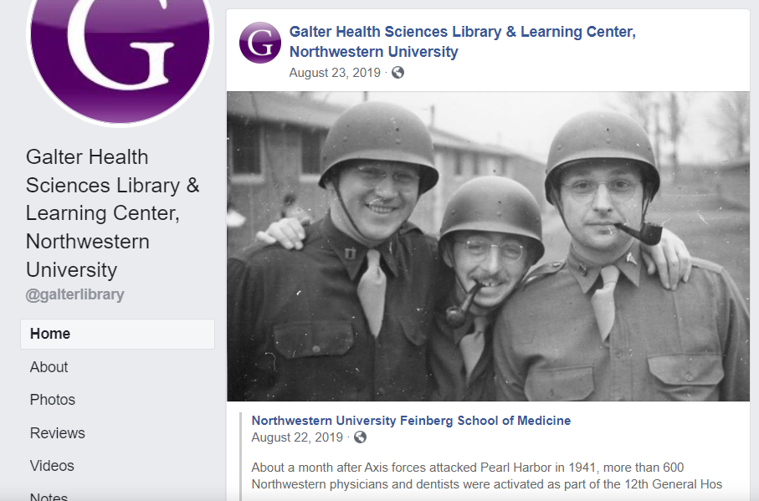
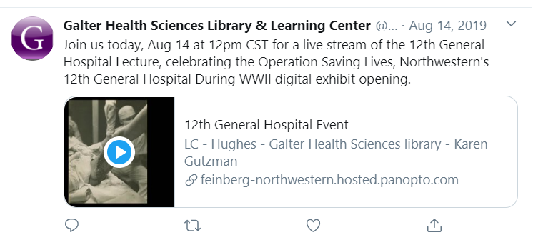
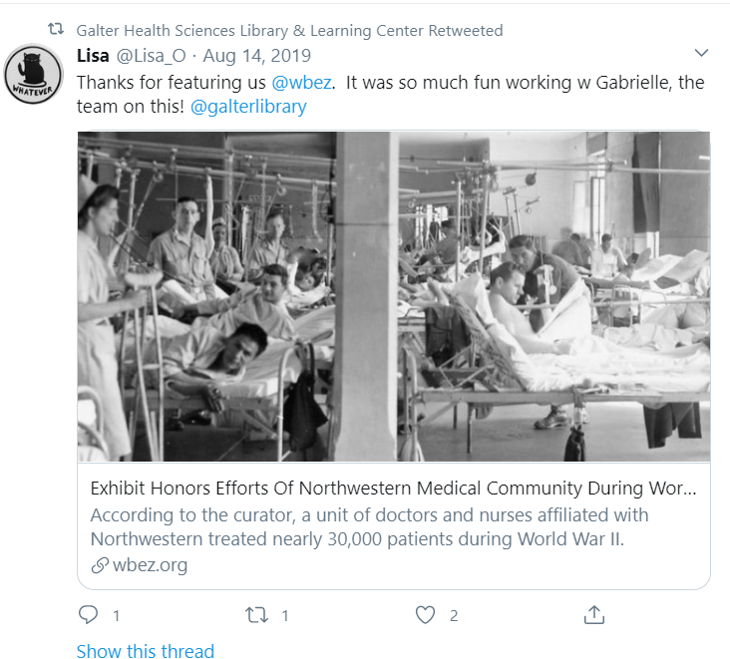
Digital Media Blitz
Health History & Library Associations’ Social Media and Listservs
Plan It Purple
Galter Webpage
Instagram
Northwestern University Medical Alumni Association
Facebook
Twitter
Notes:
Our team employed a variety of virtual platforms to draw attention to the event from social media to the digital signage on monitors at Galter Library. Other Northwestern departments and some of the veteran’s associations contributed to spreading the word.

Slide 11
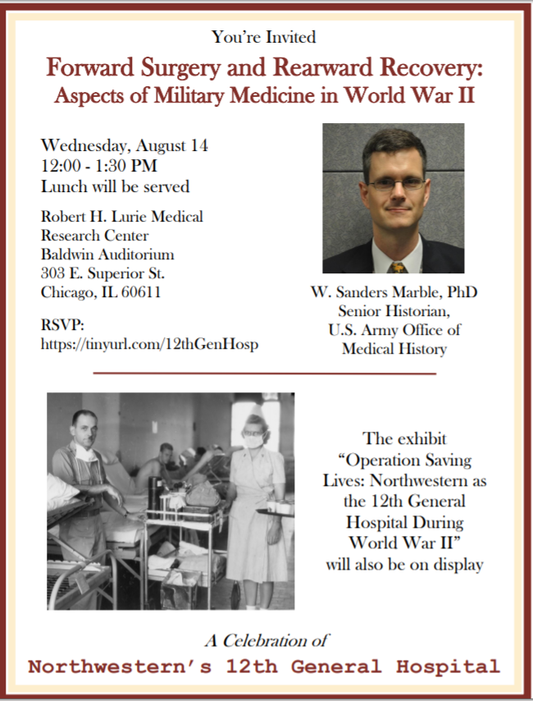
Flyers
Notes:
We also posted paper flyers around the Library and emailed them to groups that shared them with their members physically and electronically.

Slide 12
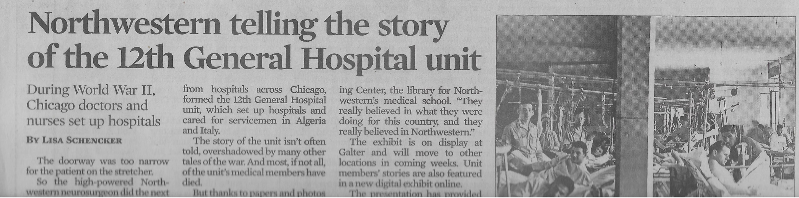

External Publicity
Chicago Tribune
WBEZ (NPR)
Notes:
Finally, we collaborated with the Feinberg School of Medicine’s Office of Communication to garner outside publicity. A promotion for the event was aired on WBEZ the morning of the event and then a write up was posted on the website a few days later. It was also covered by the Chicago Tribune.

Slide 13





Banner Exhibit
Notes:
Because Galter Library was undergoing renovations, we could not install a physical exhibit. Inspired by the traveling exhibits of the National Library of Medicine, we designed our own banner display to be shown at the event that could be brought out for other occasions. Corinne generated the panels in PowerPoint using text and images that I had written and selected and then Mary Anne and Karen converted them into PDFS and transferred them over to VistaPrint. This experience taught us the importance of establishing the color scheme and design elements early in the process, getting a better sense of the word count before jumping into creation, and leaving enough time for revision given the number of details.

Slide 14

Interview with Katherine Baltz Hayes, Chief Nurse
Notes:
During the course of the project, we had the opportunity to meet the great-nephew of Katherine Baltz Hayes, who acted as the Unit’s chief nurse, and he allowed us to show parts of a 2005 interview she did with the Army Nursing Corps. I selected four clips, and Karen, using Adobe Premier Pro, edited and combined these segments into a presentation. We also added closed captions to be 508 compliant.

Slide 15

Tribute Video
Notes:
Another component of the event was a tribute video set to the World II Army song “Over Hill, over Dale” that we believed would instill the audience with the spirit we wanted the ceremony to have while also providing something aesthetically pleasing to those who arrived early.

Slide 16




Featuring the Families of
12th General Hospital Unit Members
Notes:
Around 20 family members of 12th General Hospital Unit attended, traveling from all over the United States. Not wanting to put anyone on the spot or emphasize a particular type of experience over another, we had each person during the event stand and briefly discuss who they were attending for. This was by far the most heartfelt and memorable aspect of the entire program. The families, reminiscing, were very knowledgeable about their relative’s role in the War, and the audience really enjoyed hearing their stories.

Slide 17


Honoring Veterans
Applauding Veterans
Veteran Charities Listed
On Back of the Program
Notes:
The team debated how to incorporate living veterans into the schedule. We ultimately chose to applaud those who are currently serving or have served, mention some of the hardships veterans today face in the director’s closing remarks, and list some Chicago associations that aide veterans on the back of the program.

Slide 18



Open House at the Library
Featuring Related Items from Northwestern University Memorial Medical Archives
Showcasing Materials
Chatting with Family Members of the Veterans
Notes:
Lastly, we partnered with Susan Sacharski, who is the archivist at Northwestern University Memorial Medical Archives, in showcasing the papers and memorabilia physically in the Library and had a large monitor in the corner for guests to explore the digital exhibit.

Slide 19









Details of the Day
Guest Book
Program
Tour
AV
Speaker Gift
Lunch
Signage
Name Tags
Organizing Volunteers
Notes:
There were countless other aspects of planning the event. One of the best actions the team took was recruiting our Library colleagues to assist that day carrying out tasks like directing guests, distributing programs, and setting-up and breaking down the room.

Slide 20








Evaluating the Event
Unveiling the Digital Exhibit
Family Member Sharing Personal Picture
Audience
Kristi Holmes, Director,
Making Remarks
Dr. Marble Addressing an Attentive Audience
Guests Looking at Banners
Honoring Families
Open House
Notes:
Between 150 and 160 individuals physically attended the event with more than 10 people watching remotely. We received positive reviews at the time of event and in the weeks following. Of course, there were mishaps ranging from issues with remote access due to having to change our room to underwhelming participation in the tours. Nevertheless, there is no question that the event and initiatives we carried out to market it, raised awareness about the 12th General Hospital Collection and the fact that the Library, houses other historical materials that tell the story not only of Northwestern but also Chicago, which is why it was so nice to have a broader community present.

Slide 21




Long-term Impact
Banner Exhibit Travels
Chicago Area Medical Archivists Meeting
Model for Subsequent Exhibits
Notes:
In the immediate aftermath of the event, the Library received a few in-person and remote reference requests about the collection, primarily from relatives but also from those who had read the Chicago Tribune article who wanted to see the banners. There presently are no concrete metrics for how many individuals outside of the Library have looked at the digital exhibit, finding aid, or content on DigitalHub. The banner display, which served as a model for a subsequent exhibit about women in Northwestern Medical School, has been featured at the First Division Museum at Cantigny Park, Illinois and may in the future travel other locations in the Chicago area. We have also highlighted the collection and our efforts to champion it at conferences like the Chicago Area Medical Archivists meeting last fall.

Slide 22


Lessons Learned
Remain focused but flexible
Allot enough time for preparation for each action item
Scale back and prioritize when appropriate
Organization is vital
Decide on design elements as quickly as possible
Contact AV early in the process and practice
Communicate frequently in a variety of ways
Debrief and assess
Form a team with varied expertise and capabilities
Notes:
By engaging in this project, we learned several lessons that will guide us in future special collection ventures. Among the most important include: ensuring that the event remains focused on a central theme, dialing back on some proposed ideas and prioritize amongst the ones selected, the value of debriefing about experiences and hard numerical figures as evidenced in the graph about how we utilized our budget to make more informed decisions, and finally how essential it is to assemble a team with assorted talents and capabilities, especially when operating with a limited budget.

Slide 23


Acknowledgements
Kristi Holmes-Director
Molly Beestrum-Education and Curriculum Coordinator
Mark Berendensen-Deputy Director
Josh Elder-Library Assistant
Abebi Espinoza-Special Collections Assistant
Karen Gutzman-Head of Research Assessment and Communication
Rodney Jackson-Library Assistant
Ira Hardin-Library Assistant
Dave Heckler-Library Assistant
Ramune Kubilius-Collection Development/Special Projects Librarian
Katie Lattal-Special Collections Librarian
Corinne Miller-Clinical Informationist
Linda O’Dwyer-Head of Research and Information Services
Lisa O’Keefe-Senior Program Administrator
Joelen Pastva-Head of Collection Management and Metadata Services
Jonna Peterson-Senior Clinical Informationist
Liping Song-Metadata Librarian
Stephanie Thor-Associate Department Administrator
Q. Eileen Wafford-Research Librarian
Annie Wescott-Research Librarian
Mary Anne Zmaczynski-Head of User Services
Notes:
I would like to acknowledge those on my team and others at Galter who contributed to making the event a success.

Slide 24

Questions

Slide 25




Communicating as a Team
Box
Weekly Meetings
Track Changes
Notes:
The team met weekly from late May through Mid-August to discuss our ideas and progress. Documents were shared in Box for both organizational and transparency purposes, and we also communicated via email. Over the course of the project, we discovered that some forms of communication were better suited for certain activities than others.

Slide 26




