Slide 1
A Journal Article Tag Suite (JATS) extension to support NISO’s Recommended Practices for Online Supplemental Journal Article Materials
Karen Gutzman, Washington University in St. Louis
Kimberly A. Tryka, NCBI/NLM/NIH
April 2, 2014
JATS CON

Slide 2
Road Map
NISO’s Recommended Practices for Online Supplemental Journal Article Materials
  Referred to as NISO RP
An Extension to JATS
  Constraints used during modeling process
  Schematic of Extension
Discussion on Extension
  What does this solve?

Slide 3
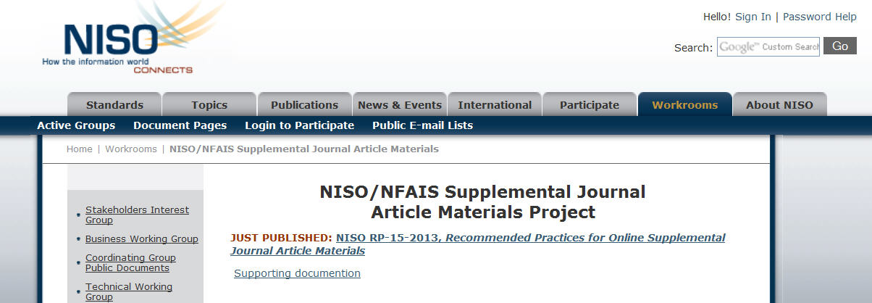
NISO/NFAIS
“Recommended Practices”
“Recommendations on metadata needed to manage the Supplemental Materials throughout their lifecycle.”
  Required and Optional metadata
  Non-normative DTD

Slide 4
Required metadata
Article Metadata
Information about the article in which supplementary material resides
Article Identifier
An identifier, likely a DOI, but could contain any other identifier for the article
Supplemental Material Descriptive Metadata
An identifier, possibly a DOI or something domain specific
Descriptive data of all or some of the supplemental material
Supplemental Material Identifier

Slide 5
Required metadata, cont.
Supplemental Material Object Metadata
Metadata related to a particular piece of supplementary material
Supplemental Material Physical Metadata
Format
File format, preferably from a public format registry
Information about the file such as format, mime-type, size, fixity, etc.
Supplemental Material Type
Additional or Integral

Slide 6
Optional elements and attributes
As part of Supplemental Material Object Metadata
  Supplemental Material Label
  Supplemental Material Title
  Supplemental Material Caption
  Supplemental Material Contributors
  Supplemental Material History
  Supplemental Material Subject Descriptor
  Supplemental Material Summary
  Supplemental Material Publisher
  Supplemental Material License
  Supplemental Material Provenance
  Relationship between Supplemental Material Objects
  Supplemental Material Version Number
  Original
  Article Component Metadata
As part of Supplemental Material Physical Metadata
  Supplemental Material Preservation
  Supplemental Material File Validity
  Supplemental Material Data Fixity
  Creating Application
  Rendering Application

Slide 7
Schematic of NISO RP
sup-mat-metadata (root)
article-metadata
sup-mat-descriptive
sup-mat-object-metadata @sup-mat-type=“additional” (PDF file)
sup-mat-descriptive
sup-mat-physical
format
sup-mat-object-metadata (object in PDF file - figure)
article-component-metadata
sup-mat-descriptive
sup-mat-object-metadata - (object in PDF file - figure)
article-component-metadata
sup-mat-descriptive

Slide 8
Constraint 1: Part of JATS
Supplementary material information is part of a JATS article instance
NISO RP
JATS EXT
<article-metadata>
<article-identifier>
<front>
<sup-mat-metadata>
<sec>

Slide 9
Constraint 2: JATS preferred
Descriptors preferred from JATS when conceptually similar
NISO RP
JATS EXT
<contrib-group>
<history>
<mime-type>
<contrib-group>
<history>
@mime-type
Take from NISO RP when there are no corresponding JATS concepts
NISO elements brought in with a namespace (ext:)

Slide 10
Constraint 3: Changes to names
Name changes for difficult to understand descriptors, mesh with JATS
NISO RP
JATS EXT
<provenance>
<preservation>
<ext:original-sources>
<ext:preservation-level>

Slide 11
Re-thinking structure
<sup-mat-metadata> changes to <sec>
<sup-mat-object-metadata> changes to <supplementary-material>
Recursion of <sup-mat-object-metadata> changes to two new elements:
  <ext:resource> objects addressable in file system
  <ext:item> logical object inside a physical object

Slide 12
Levels within the structure
NISO RP
Extension
1
2
p
<sec> Supplementary Material</sec>
<sup-mat-metadata>
<sup-mat-object-metadata>
<sup-mat-descriptive>
<sup-mat-physical>
<sup-mat-object-metadata>
<sup-mat-descriptive>
<sup-mat-physical>
<sup-mat-object-metadata>
<sup-mat-descriptive>
<sup-mat-physical>
<supplementary-material>
<label>
<caption>
<ext:resource>
<ext:resource-meta>
<ext:resource>
<ext:resource-meta>
<ext:item>
<caption>
4

Slide 13
Other considerations
Reconfiguration of <fig>
  include <ext:resource> and <ext:item>
  No longer using <graphic> or <media>
NISO’s @sup-mat-type
  Additional = objects that provide additional expansion but do not form part of core intellectual work
  Integral = objects that are necessary part of intellectual work
In JATS EXT
  Use <fig> for integral
  Use <supplementary-material> for additional

Slide 14
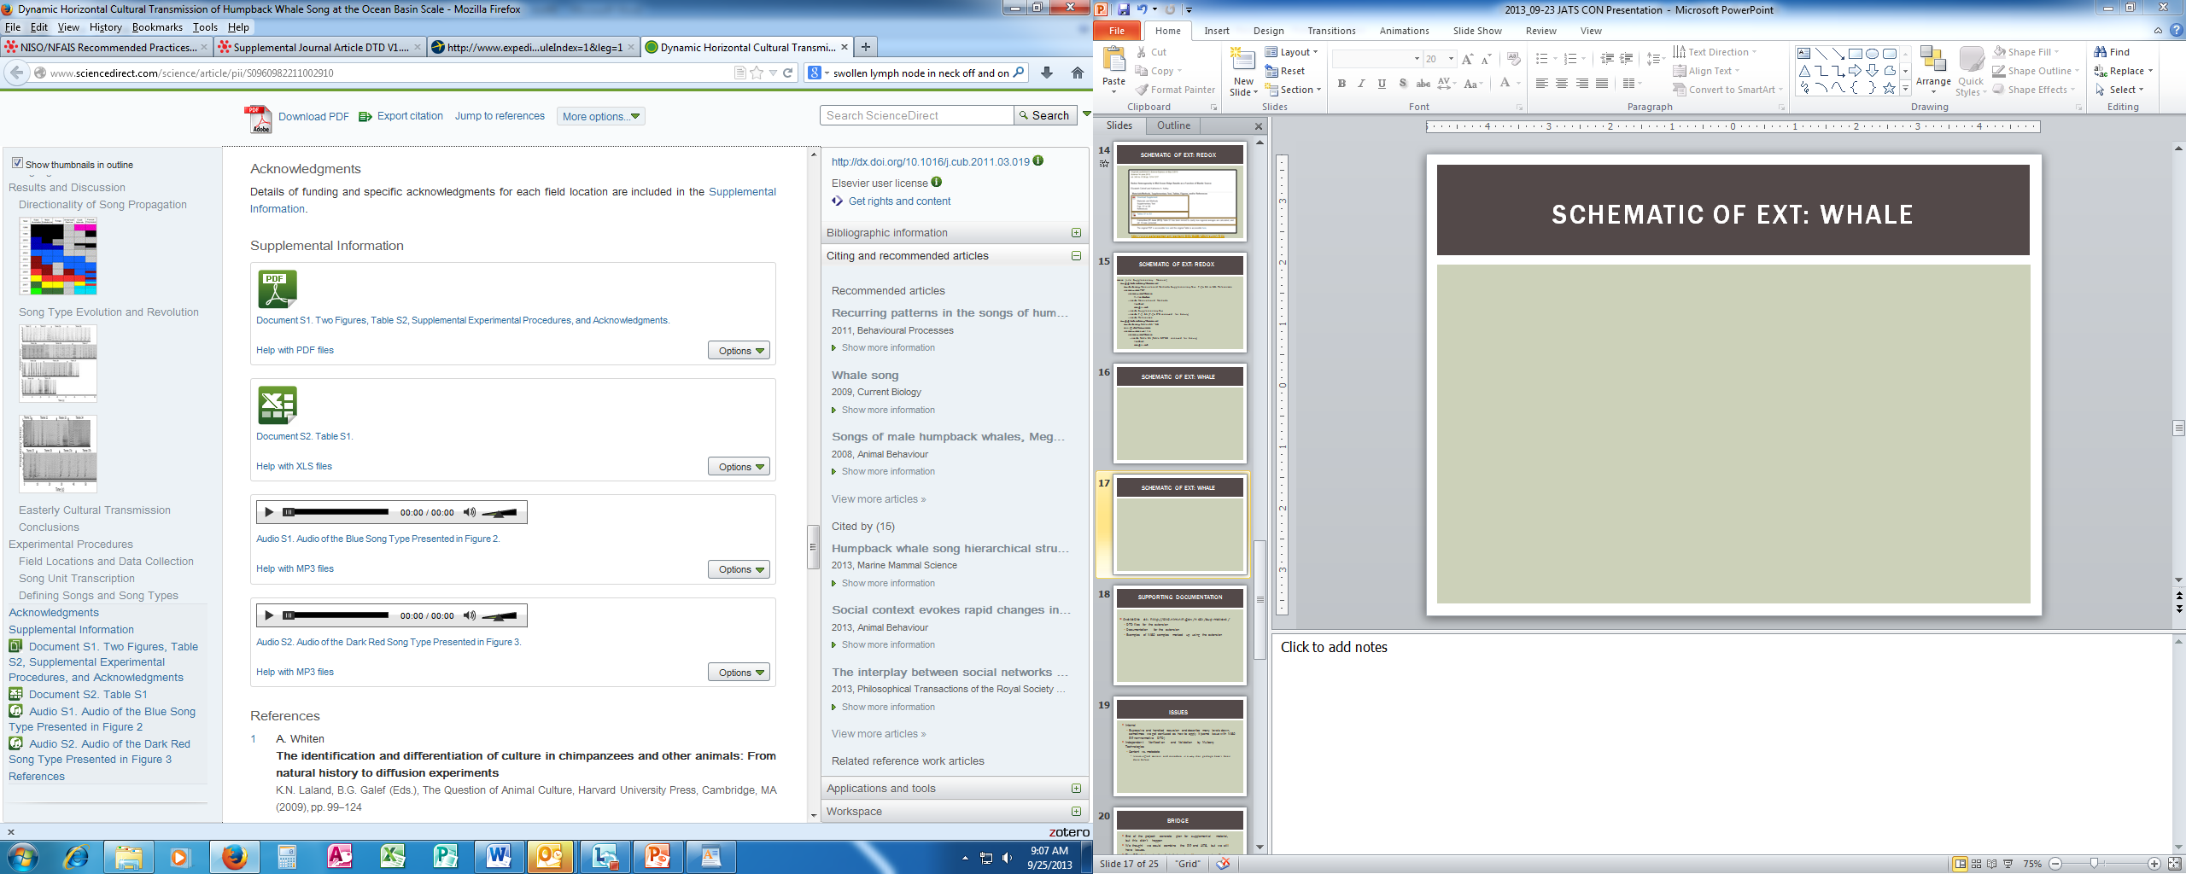
Schematic of EXT: Whale
http://www.sciencedirect.com/science/article/pii/S0960982211002910

Slide 15
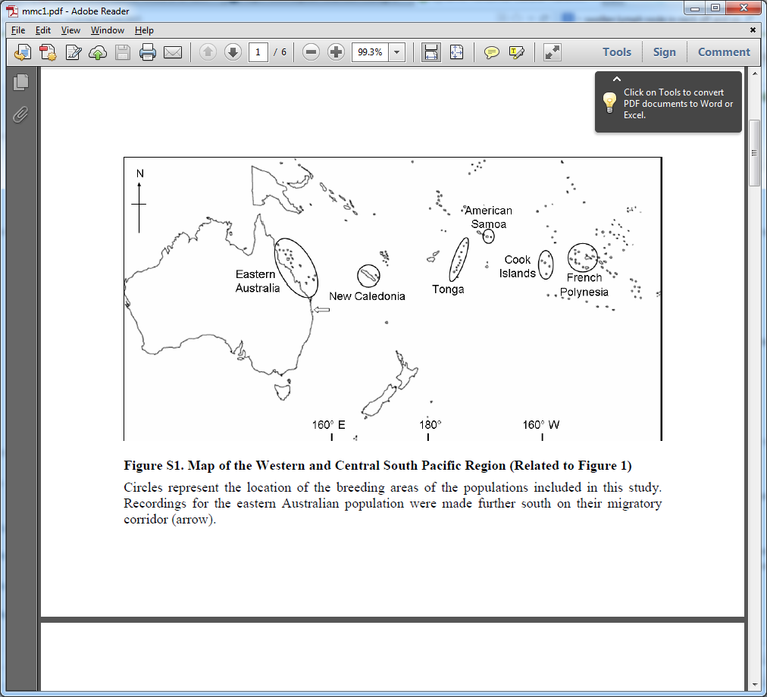
Schematic of EXT: Whale
sec title: Supplementary Material
supplementary-material
label Document S1
caption
title Two Figures, Table S2,
Supplemental Experimental
Procedures, and Acknowledgments
resource [PDF]
resource-meta
filename PII….mmc1.pdf
  item [Figure S1]
  label Figure S1
  caption
  title Map of the Western and Central South Pacific Region (Related to Figure 1)
  p Circles represent the location of the breeding areas of the …
  item [other items removed for brevity]

Slide 16

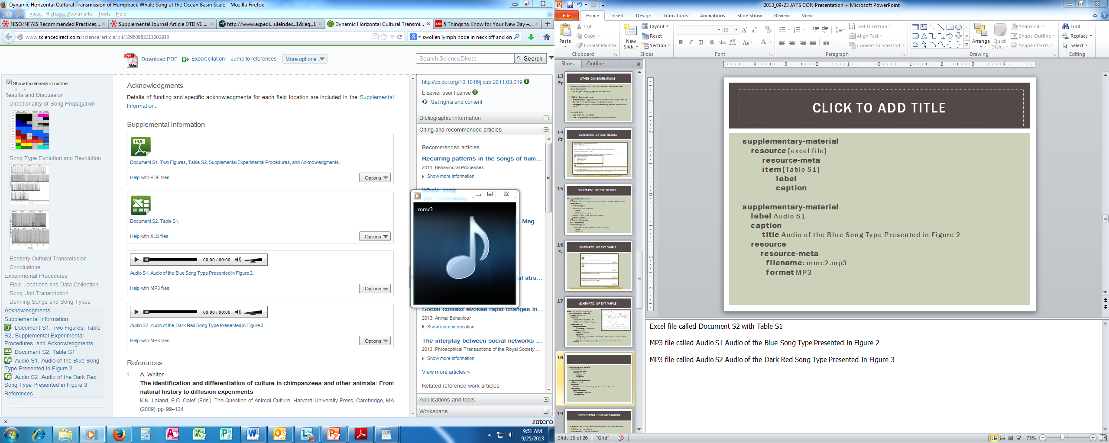
Schematic of EXT: Whale
supplementary-material [excel file with Table S1, removed for brevity]
supplementary-material
label Audio S1
caption
title Audio of the Blue Song Type Presented in Figure 2
resource
resource-meta
filename: mmc2.mp3
format MP3
supplementary-material [Audio S2, removed for brevity]

Slide 17
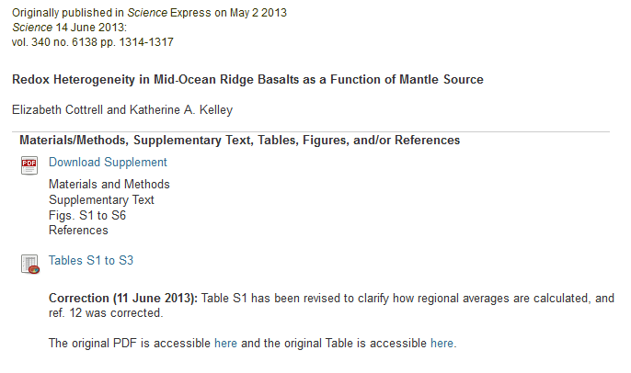
Schematic of EXT: Redox
http://www.sciencemag.org/content/340/6138/1314/suppl/DC1

Slide 18
Schematic of EXT: Redox
sec title: Supplementary Material
supplementary-material
summary Materials and Methods, Supplementary Text, Figs. S1 to S6, References
resource [PDF]
resource-meta
filename
  item [Materials and Methods]
  label
  caption
  item [Supplementary Text]
  item [Fig. S1 [Figs. 2-6 removed for brevity]]
  item [References]
supplementary-material
summary Tables S1 - S3
original-sources
resource [excel file]
resource-meta
item [Table S1 [Table S2-S3 removed for brevity]]
label
caption

Slide 19
Supporting Documentation
Available at: http://dtd.nlm.nih.gov/ncbi/supmatext/
  DTD files for the extension
  Documentation for the extension
  Examples of NISO samples marked up using the extension

Slide 20
It’s just not quite right
Restructuring the <sup-mat-object-meta> element into <ext:resource> and <ext:item> didn’t solve our problem of clarifying the hierarchy.
A review of the extension by Mulberry Technologies expressed concern about our mingling of content and metadata at different levels within our hierarchy.

Slide 21

For fun, A literary Analogy
“Childlike in his innocence but grotesque in form, Frankenstein’s bewildered creature is cast out into a hostile universe by his horror-struck maker.” - promotional materials, National Theatre (London)

Slide 22


Slide 23
Simple approach – Generics
Create :
a generic element that holds (block-level elements that are allowed to float, but that don’t reference external files…?)
    Examples : <fig>, <table-wrap>, <supplementary-material>, etc
    (This purposefully excludes <graphic> and <media>)
    Would you want to include <list> and <app>?
a generic element that holds references to external files
    This would take the place of JATS <graphic> and <media>
an attribute that would note “level of importance”
    Start with integral and additional from NISO for time being – but this could be expanded

Slide 24
Wrap up
Extended JATS to include recommendations from the NISO working group on online supplemental materials
  We don’t much like the result
  But, we’re happy to put it out as a strawman
  “An experiment that points out this many problems is, by definition, a success”
Proposed that what caused this exercise to be as problematic as it was is the idea of “Supplementary Material Exceptionalism”

Slide 25
Thank you
NLM Associate Fellows Program
Jeff Beck (proposed project, deep knowledge)
Sasha Schwartzman (discussion)

Slide 26
What does this solve?
Technically this is “easy”
Does it solve our earlier issues?
  Confusion issue, not necessarily
    Modeling and recursion are still problems
  Content vs. metadata
    Still an issue
  No longer a class of objects that look the same, but are treated differently

Slide 27
So why are we talking about it?
Because who wants to deal with little issues, when there is a bigger problem at large
NISO RP solved an immediate problem
End to supplemental material exceptionalism is more of a long term look at a wider issue.
Points the way to a more integrated solution

