Slide 1
Strategies for re-establishing legacy license agreements
Jonathan Shank, MLIS
Northwestern University Galter Health Sciences Library
ER&L Conference
Austin, TX
4 April 2017

Slide 2
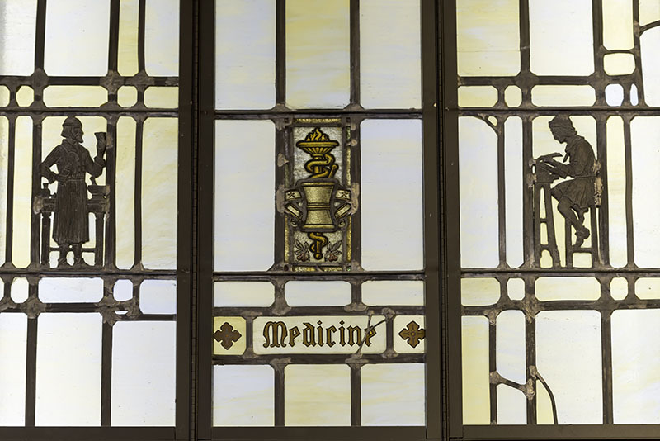
Current licensing issues at Galter
Major systems migrations
  Voyager to Alma
  360 Resource Manager cancelled
Changes in staffing and responsibilities
Complex licensing environment
  Grandfathered hospital sites
  Several licensing entities
Northwestern University

Slide 3
NU’s Elsevier landscape
GHSL
Licenses
NUL
Accesses
EMBASE
ClinicalKey
Licenses
Accesses
NMH
Accesses
LCH
Accesses
ScienceDirect
Scopus
Cell Press
Licenses
ClinicalKey Nursing

Slide 4

The nightmare scenario…
New Line Cinema

Slide 5
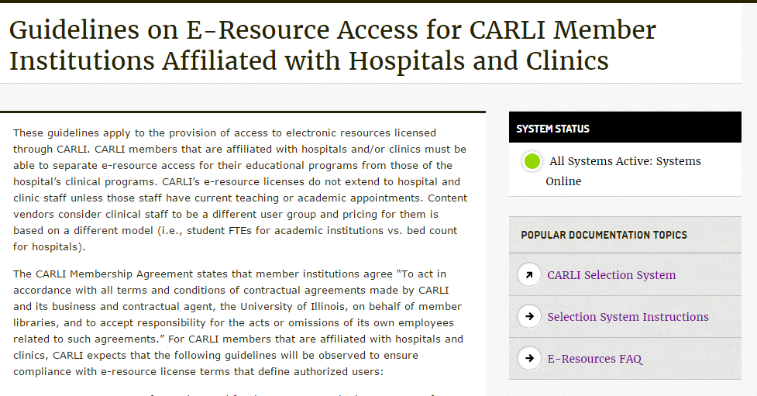

Slide 6
Ideas so far…
Get access to email archives for previous licensing librarians (is possible) and search for any relevant language
Scan paper files, run OCR, save time (hopefully)
  An old license is better than no license
  Use free tools to analyze text
Use notes from ILS, holdings, access entitlements to build your case
Enter licensing information into Alma following code mapping table
What are yours?

Slide 7
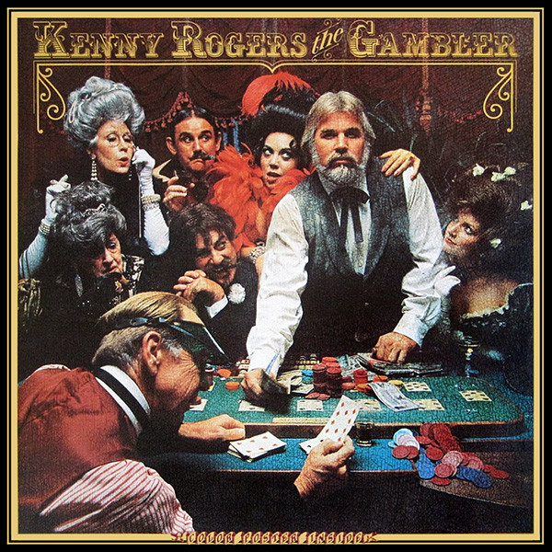
Main question
How to deal with vendors, publishers & content providers?
United Artists Group

Slide 8
Questions and discussion?

Slide 9
Thank You!
Email: j-shank@northwestern.edu
Twitter: @ShankLib

