Slide 1






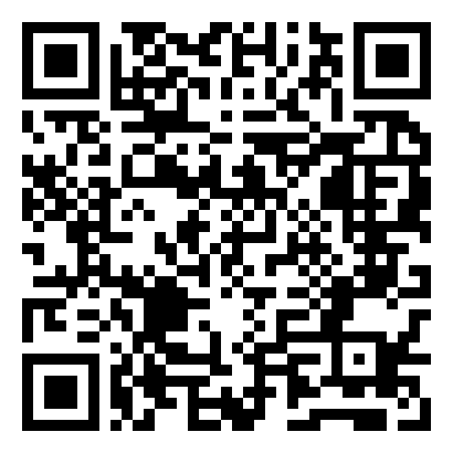
Disciplinary Perceptions of Data and Data Management Practices
Pamela L Shaw¹ MSLIS, MS and Cunera M Buys² JD, MS, MSLIS
Galter Health Sciences Library¹, Northwestern University Clinical and Translational Sciences Institute (NUCATS)¹,
Seeley G. Mudd Library², Feinberg School of Medicine¹, Northwestern University^{1 & 2}
Brief Background Highlights
Results - Demographics
Results – Data Retention
Disciplinary Perceptions of Data & Data Services
NSF requires data management plans since 2011 [1]
NIH has a data sharing policy since 2003 [2]
White House OSTP released memoranda calling for data sharing plan requirements for awards from federal agencies with more than $100 million R & D expenditures [3,4]
Published study shows differences in data sharing or reuse among different academic disciplines [5]
Academic researcher dissatisfaction with long-term data storage, funding, infrastructure and instruction in data management [5]
Libraries becoming involved in research data management [6]
831 responses; 788 completed the survey (response rate of 6.4%)
Many researchers prefer to retain raw data and published data indefinitely, citing the value of raw data for new analyses, longitudinal studies or replication of results
The time span of 5-10 years was also commonly selected, often cited as required by NIH funding mandates
Responses from humanities were low and many humanities researchers did not perceive their output as “data”, despite the fact that text files compose the largest category of data collected among all researchers.
Respondents from the schools of education and management requested information on accessing sources of data more than any other schools.
Representatives from 159 different departments responded to the survey, with the department of chemistry the largest respondent
Results – Sharing
Schools most likely to have data management plans were schools of education (69%), journalism (60%) and medicine (59%). Schools least likely to have DMPs were law (0%) and management (23%)
Methods
54.6% of responders indicated that they share data by personal choice, others share because of funder requirements or recommendations
Those who do not plan to share their data cite protection of human subject privacy, protection of their intellectual property rights and beliefs that others would not be interested in their data.
Survey conducted by the Northwestern University E-Science Working Group (ESWG), a collection of representatives from Northwestern libraries, research computing, information technologies and the Office of Sponsored Research
Survey questions adapted from survey materials shared by other academic institutions
Survey constructed in Qualtrics, consisting of 21 questions in the following categories:
  Researcher demographics
  Types and size of data
  Data storage
  Data retention
  Data sharing
  Data management planning
  Training or assistance needed
Survey was distributed via email link to over 12,000 Northwestern faculty, staff and students across all academic schools and disciplines
Survey results analyzed with Atlas.ti text analysis package and with Qualtrics built-in cross-reference functionality
Link to the completed report with appendices: https://www.library.northwestern.edu/sites/www.library.northwestern.edu/files/images/5-27-14%20final%20report%20ver%202_psEdit.pdf
Barriers to Good Data Practices
Results – Data Types & Storage Size
  Poor storage choices
    Users are storing data on potentially unstable computer hard drives
    Lack of choice in long-term storage options at the university level, and user misunderstanding of current university storage options for long term use
    NUIT is investigating options for long-term storage
  Lack of organization
    Text analysis indicated that “frustration” and “disorganization” were a common theme in text responses from all user communities
    This is an opportunity for libraries and IT to provide training and consultation in file naming, metadata and file version control practices
  Lack of knowledge
    Respondents at all levels indicated interest in library and NUIT guidance on all levels of data management, from federal requirements to local storage and analysis services.
Results – Data Storage Location by School
Limitations of Survey Design
The numbers in the “Don’t know” category of this chart suggest that the individuals who may spend the most time generating and working with data (research staff and graduate students) may not have as clear a concept of the cumulative data storage needs for projects
  Department designation
    Respondents were given a text box to supply department name, instead of a list of options to select from. This made coding the responses for correlation statistics by department virtually impossible with our limited staff resources. As a result, our plan of “disciplinary” analysis was not easily implemented.
  Contact follow up
    Several respondents indicated that they would be willing to be contacted for a follow up interview, but only 2 provided contact email addresses.
References
National Science Foundation. NSF Data Management Plan Requirements. Available from: http://www.nsf.gov/eng/general/dmp.jsp
National Institutes of Health. NIH Data Sharing Policy. Available from: http://grants.nih.gov/grants/policy/data_sharing/
White House Office of Science and Technology Policy. Increasing Access to the Results of Federally Funded Scientific Research . Available from: http://www.whitehouse.gov/sites/default/files/microsites/ostp/ostp_public_access_memo_2013.pdf
White House OSTP. Memorandum update. Available from: http://www.whitehouse.gov/sites/default/files/microsites/ostp/OpenAccess_March-2014.pdf
Tenopir, C., et al., Data sharing by scientists: Practices and perceptions. PLoS One, 2011. 6(6): p. e21101.
Soehner, C., C. Steeves, and J. Ward, e-Science and data support services: a survey of ARL members, in International Association of Scientific and Technological University Libraries, 31st Annual Conference 2010: Purdue University, West Lafayette, Indiana.
  Term usage
    The survey asked about data needs for each new “grant”. Not all respondents had grants, so the word “project” would have been a better choice.
  Missing questions
    Questions about sensitive data were left out of the survey, but would have provided valuable information on practices in managing data privacy.

